Slide 1
CSE 127: Computer Security
WI24
Lecture 7- Side Channels
Slide Credit: Kirill Levchenko, Stefan Savage, Stephen Checkoway, Hovav Shacham, David Wagner, Deian Stefan, Dan Boneh, and Zakir Durumeric , Nadia Heninger, George Obiado, Earlence Fernandes, Imani Munyaka

Slide 2
Assignment 2 Due Saturday Midnight
Discussion - Midterm
AFA - email from me about midterm

Slide 3
Today
•
•
Overview and history of side channels
Countermeasures (brief)

Slide 4
Last Time: Isolation is key to building secure systems
Basic idea: protect secrets so that they can’t be
•
•
•
accessed across a trust boundary
Mechanisms: privilege separation, least privilege,
complete mediation
Assumption: We know what the trust boundaries are
and can control access

Slide 5
How can attackers access protected data?
•
•
Find a bug in an unprotected program
Find a bug in the kernel, VMM, or runtime system
providing protection
•
Find a hardware bug that lets you bypass isolation

Slide 6
The power of abstraction in computer science
“All problems in computer science can be solved by another
level of indirection.” – David Wheeler
•
Computer systems are often built on layers of
abstraction
•
•
Physics → hardware → operating system → applications
An ideal abstraction allows each layer to treat the layer
below as a black box with well-deﬁned behavior

Slide 7
Side channels
Implementations have artifacts and side eﬀects
How long, how fast, how loud, how hot
•
•
A side channel is a source of information beyond the
output speciﬁed by an abstraction

Slide 8
What is a side channel attack?
Attack is based on information gained from the physical implementation of a system (process), rather than theoretical weaknesses in the algorithms
  Focused on gathering information from unintentional leaks
Not to be confused with Covert Channels
Covert Channels : intentional communication between a sender and a receiver via a medium not designed to be a communication channel.

Slide 9
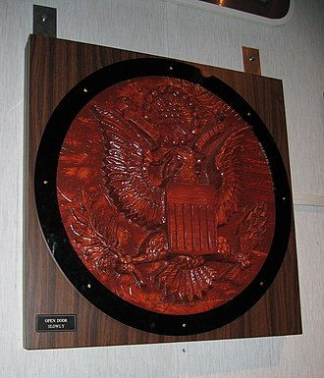
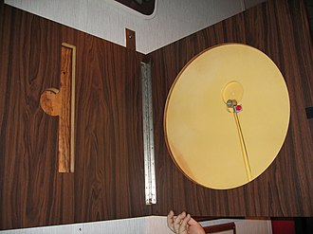
Soviet Great Seal Bug
•
•
1945 Soviet gift to ambassador
Contained passive listening device
•
Would transmit when illuminated at a particular radio frequency
•
•
Designed by Theremin
Discovered in 1952
https://en.wikipedia.org/wiki/The_Thing_(listening_device)

Slide 10
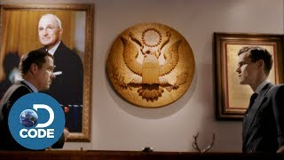

Slide 11
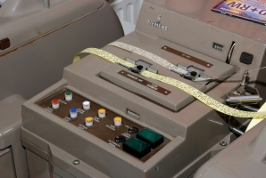
TEMPEST: US/NATO side channel codename
TEMPEST is a U.S. National Security Agency specification and a NATO certification referring to spying on information systems through leaking emanations, including unintentional radio or electrical signals, sounds, and vibrations. (wikipedia.org)
•
WWII: Bell Telephone discovers electromagnetic leakage
in one-time pad teleprinters: 100-ft radius
•
•
1951: CIA rediscovers teleprinter leakage; 200-ft radius
1964: TEMPEST shielding rules established

Slide 12
TEMPEST: US/NATO side channel codename
TEMPEST -Transient Electromagnetic Pulse Emanation Standard.
https://www.nsa.gov/portals/75/documents/news-features/declassified-documents/cryptologic-spectrum/tempest.pdf

Slide 13
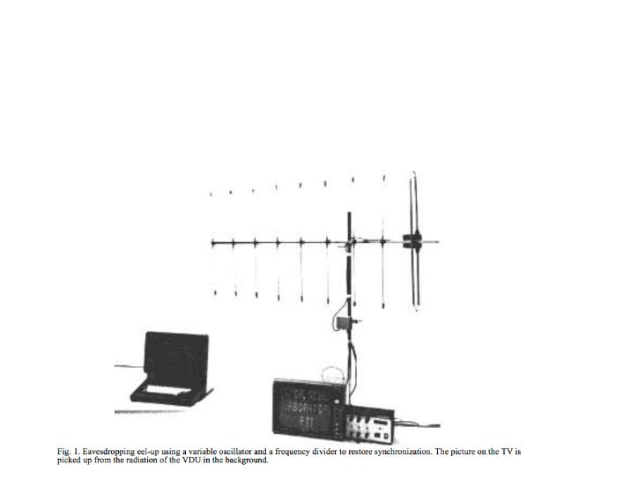
van Eck Phreaking
“Electromagnetic Radiation from Video Display Units: An Eavesdropping Risk?”
Wim van Eck 1985
• 1985: Wim van Eck demonstrates side channel image
recovery from CRT monitors with oﬀ-the-shelf equipment

Slide 14
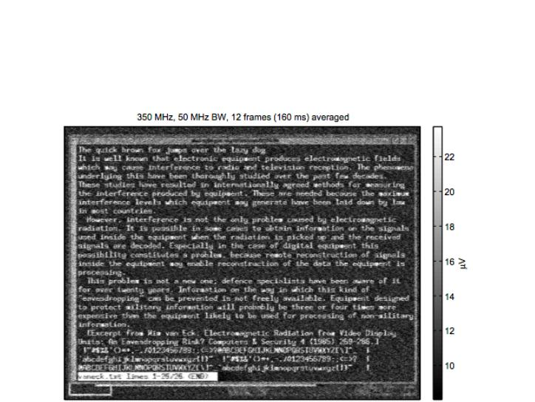
“Electromagnetic Eavesdropping Risks of Flat-Panel
Displays” Kuhn 2004
•
Image displays simultaneously along line
Pick up radiation from screen connection cable
•

Slide 15
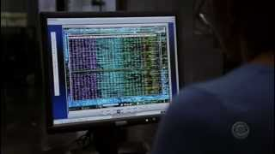

Slide 16
Consumption side channels
How long does this password check take?
char pwd[] = “z2n34uzbnqhw4i”;
//...
int check_password(char *buf) {
return strcmp(buf, pwd);
}

Slide 17
Examples of side channels
C
o
n
s
u
m
p
t
i
o
n
:
H
o
w
m
u
c
h
o
f
a
r
e
s
o
u
r
c
e
i
s
b
e
i
n
g
u
s
e
d
t
o
perform an operation?
Timing
•
• Diﬀerent execution time due to program branches
• Cache timing attacks
•
•
Power consumption
Network traﬃc
Emission: What out-of-band signal is generated in the
course of performing the operation?
Electromagnetic radiation
•
• Voltage running through a wire produces a magnetic field
•
•
Sound (acoustic attacks)
• Capacitors discharging can make noises
Error messages

Slide 18
Tenex password veriﬁcation bug
Alan Bell 1974
•
•
Early virtual memory implementation in Tenex computer
system.
Character-at-a-time comparison + interrupt on memory
page
•
Linear-time password recovery

Slide 19
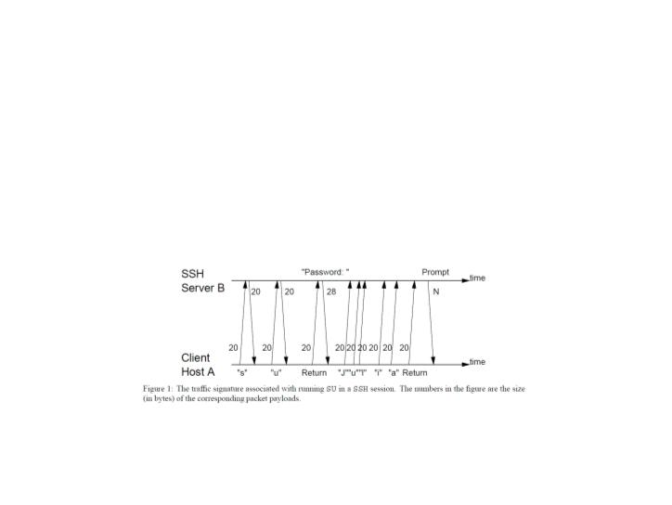
“Timing Analysis of Keystrokes and Timing Attacks
on SSH”
Song Wagner Tian 2001
• In interactive SSH, keystrokes sent in individual packets
• Build model of inter-keystroke delays by ﬁnger, key pair
• Measure packet timing oﬀ network, do Viterbi decoding

Slide 20
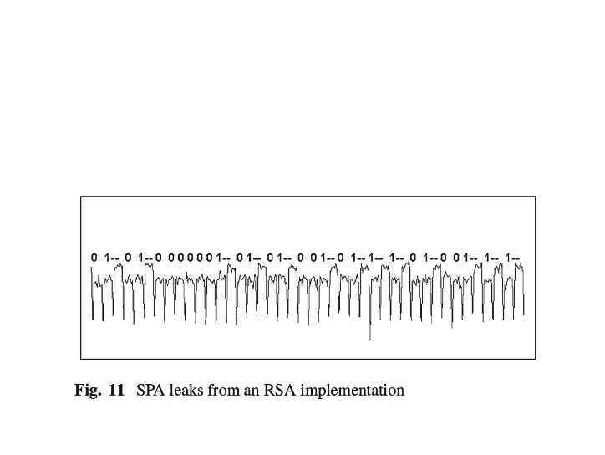
Power Analysis Attacks
Kocher Jaﬀe Jun 98
Side-channel attacks can also leak cryptographic secrets.
Simple power analysis and diﬀerential power analysis
exploit secret-dependent power consumption.

Slide 21
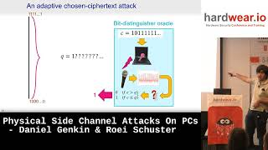
Acoustic Attacks
Genkin Shamir Tromer 2014
“We describe a new acoustic cryptanalysis attack which can extract full 4096-bit RSA keys from the popular GnuPG software, within an hour, using the sound generated by the computer during the decryption of some chosen ciphertexts.”

Slide 22
Acoustic Attacks
Genkin Shamir Tromer 2014
“We describe a new acoustic cryptanalysis attack which can extract full 4096-bit RSA keys from the popular GnuPG software, within an hour, using the sound generated by the computer during the decryption of some chosen ciphertexts.”

Slide 23
Browser History Sniﬃng
Jang, Jhala, Lerner, Shacham 2010
Default web browser behavior: unvisited links are blue and
visited links are purple.
Text display attributes available to scripts via DOM.
Victim browser visits malicious website. Malicious website
enumerates URLs in invisible portion of site to sniﬀ browser
history.
Exploited in the wild.
Fixed in browsers, but surprisingly hard to eliminate all the
information leaks.

