Slide 1
Project Part 4 Details
Jug Venkatesh

Slide 2
Project 4 Overview
Continue log collection and analysis
Extend log collection from our scripts to your own, using performance counters
Implement your own DVFS module
Compare and quantify your algorithm to the “state of the art”

Slide 3
1. Continue Log Collection
Latest scripts are stable. Use them, make sure to understand:
  How we collect data
  What we collect
  Where this data comes from – look up the source files in Linux/Android documentation
  This will help you collect your own data!
Continue collecting and analyzing short- and long-term logs

Slide 4
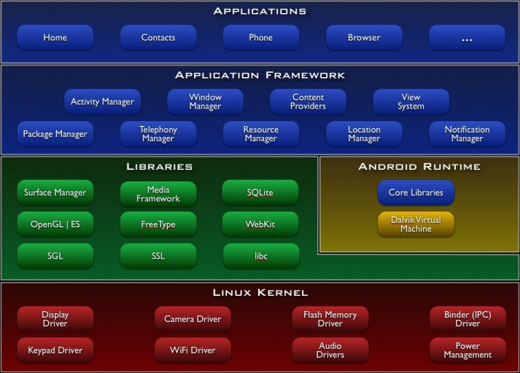
Kernel Modules
Written to extend kernel functionality
Modular self-contained binaries that can be installed/uninstalled at boot-time or runtime
Compiled from C code using the ARM toolchain into a *.ko file (kernel object)

Slide 5
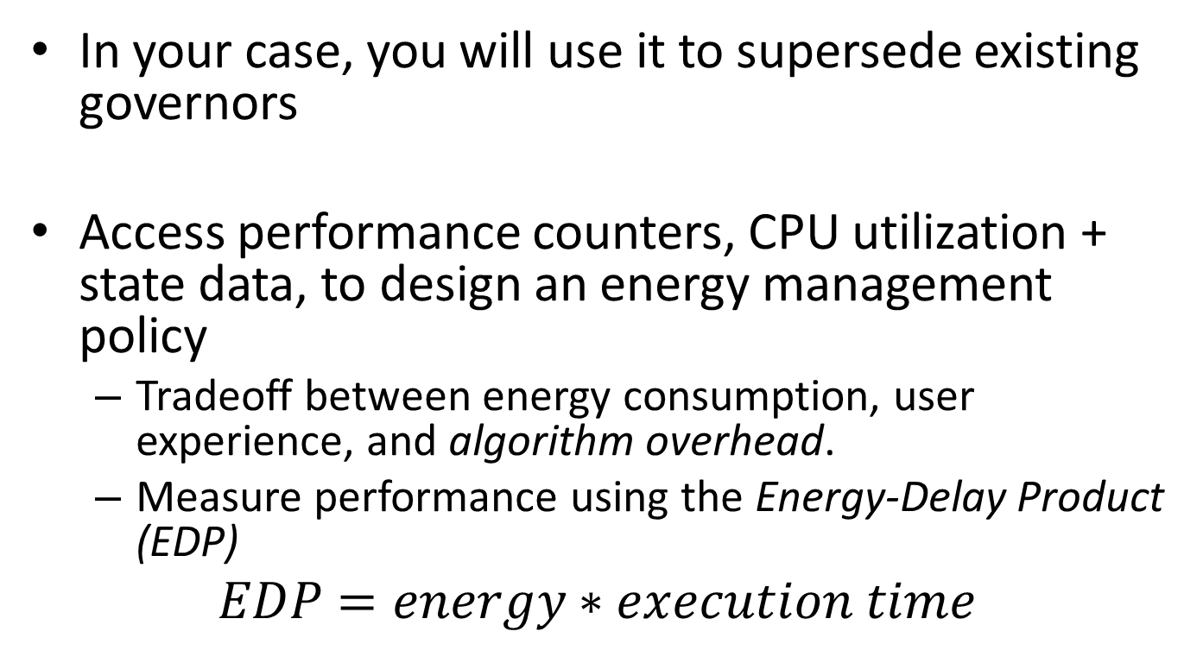
Kernel Modules (cont’d)
In your case, you will use it to supersede existing governors
Access performance counters, CPU utilization + state data, to design an energy management policy
  Tradeoff between energy consumption, user experience, and algorithm overhead.
  Measure performance using the Energy-Delay Product (EDP)
$$EDP=energy∗execution time$$

Slide 6
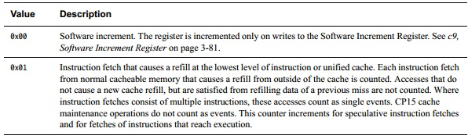
2. Gathering Useful Data
Using kernel module, automate gathering and extracting useful data:
  File access: time_in_state, cpuusage, cpufreq, gpufreq
  Hardware performance counters
    Provided with the Cortex A8 manual, with register codes for different performance counters.
Your job to decide which ones are useful, and justify in your report using actual numbers.

Slide 7
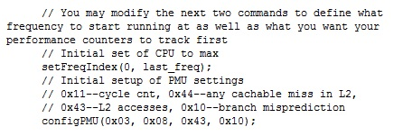
Data Collection via Kernel Module
Read from log files:
  C-standard file reads – read access only to avoid performance hit
  Access to last few lines of a log via “inspect” method of file command
Performance counters:
  Opening in code to set performance counters
  Limit of 4 perf counters at a time

Slide 8
Data Collection Demo

Slide 9
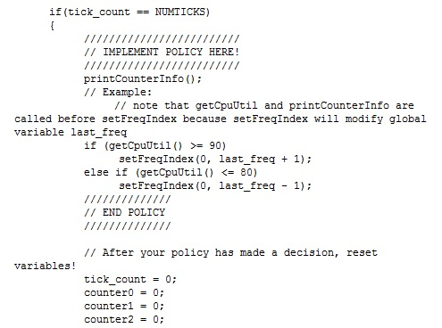
3. Implementing your policy
Kernel module has an open area for your algorithm (or just the initial data collection)

Slide 10
Kernel Implementation Demo

Slide 11
4. Compare your algorithm
Looking for details – quantify your results!
  What does your algorithm do?
  How does your algorithm affect specific scenarios:
    Show specific results – graphs or tables
    How do these cases apply in terms of general usage – justify based on your usage pattern
  How effective is your algorithm?
    It doesn’t help to improve the 1% use case by 100x
    Amdahl’s Law

