Slide 1

Algorithms for de Novo Sequencing of Cyclic Peptides:
Hosein Mohimani and Pavel Pevzner
Department of Computer Science and Engineering, UC San Diego
Notes:
1

Slide 2

genomics
transcriptomics
proteomics
METABOLOMICS!
SECONDARY metabolites are compounds that are NOT directly involved in the normal growth and development. Unlike PRIMARY metabolites, absence of secondary metabolities does not result in immediate death. Secondary metabolites (e.g, antibiotics) represent arguably the most successful type of drugs ever developed by humans.

Slide 3
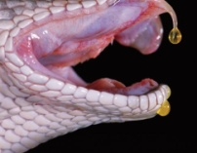

Protein Sequencing of NOVEL peptides/proteins by MS
Some proteins are still sequenced by laborious Edman degradation.
  Integrilin (Millennium Pharma), a blood clot prevention drug derived from snake venom.
  Ziconotide (Elan), 20x more potent than morphine and has no addiction side effects, derived from snail venom
Many important proteins are not inscribed in genomes
  Fusion proteins in tumors
  Antibodies
Notes:
3
3

Slide 4
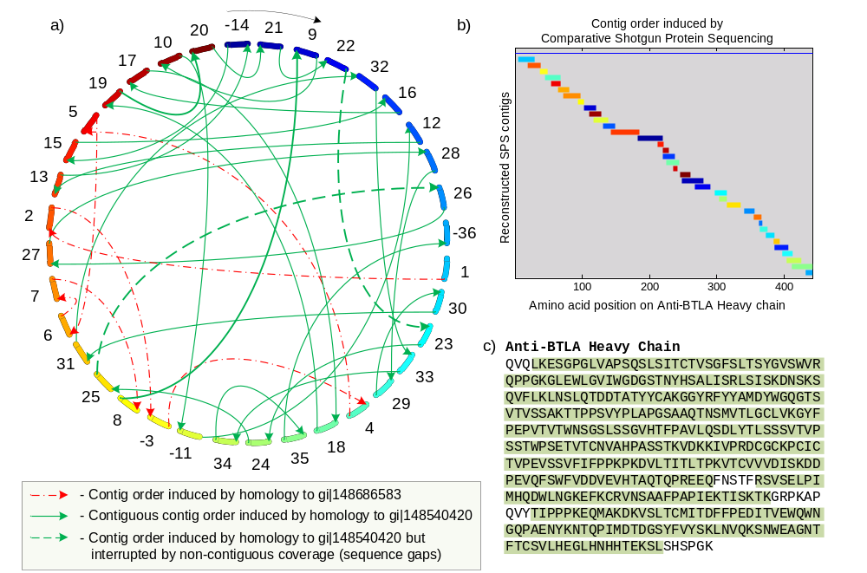
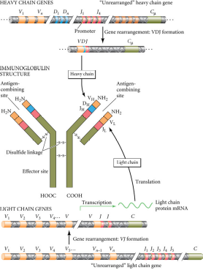
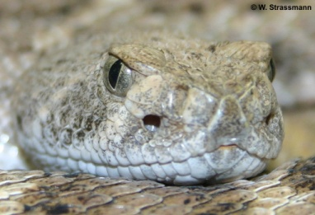
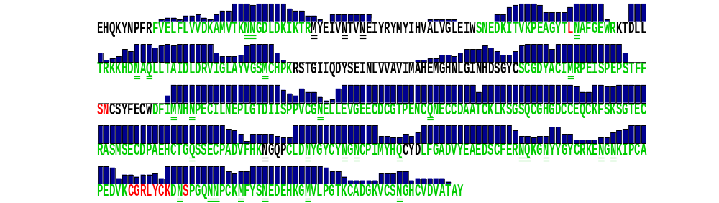

Sequencing Antibodies (collaboration with Genentech) and Snake Venoms (collaboration with Broad Institute)
Bandeira et al., Proc. Natl. Academy of Sciences 2007, Nature. Biotech, 2008

Slide 5
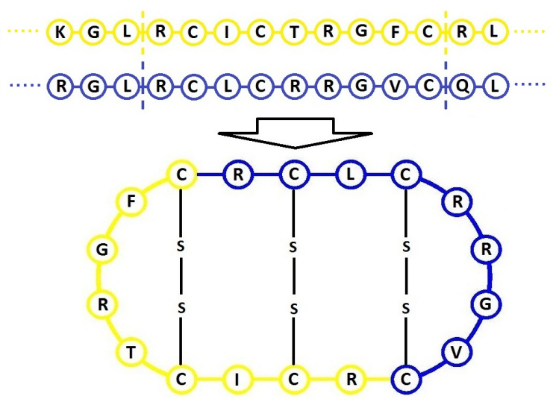
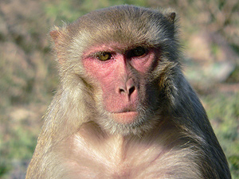
Theta defensins
Theta defensin is a 18aa cyclic peptide, a concatenate of 9aa segments from two DIFFERENT proteins.
Theta-defensins act primarily by preventing viruses from entering cells.
Extremely strong anti-HIV activity as compared to alpha- and beta-defensins.
Macaques (as well as baboons) have theta-defensins while human (as well as chimpanzees) don’t.
Loss of theta-defensin might have contributed to human susceptability to HIV

Slide 6
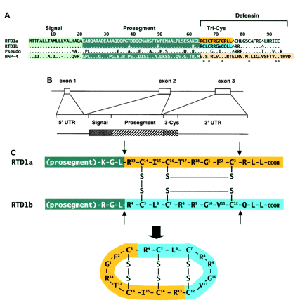
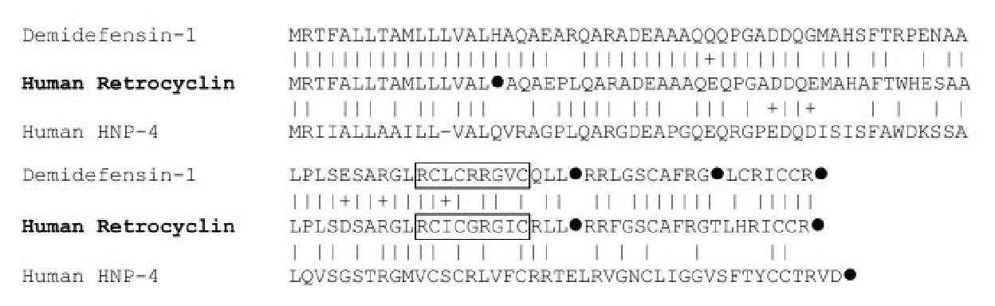
If Theta Defensins Are So Important Why They Disappeared in Human?
RTD1a and RTD1b are theta defensin genes in macaque
Genes very similar to RTD1a and RTD1b are expressed in human bone marrow
However, 7 millions years ago, a premature stop codon mutation turned one of these genes into a silent pseudogene.
Is it a reason for human susceptibility to HIV? Can human get theta-defensins back???

Slide 7

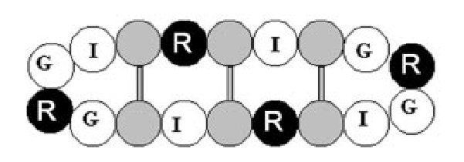
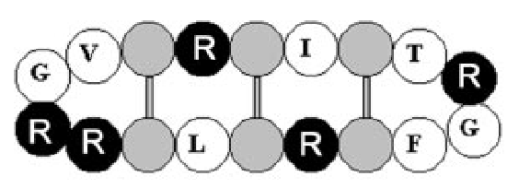
Reawakening Retrocyclins from 7 Million Years of Slumber: Ancestral Human Defensins Active Against HIV
Retrocyclin is an artificial theta-defensin, created by reading through stop-codon in human pseudogene (Venkataraman et al., PLOS Biology 2009)
Effective against HIV
Mohimani et al., JPR 2011: Cycloquest algorithm for identification of defensin-like chimeric peptides
    Human artificial Retrocyclin
    Macaque thera-defensin

Slide 8
De Novo Sequencing of Some Important Peptides is the Only Option Even When Genome is KNOWN
DNA makes RNA makes PROTEIN (central dogma)
transcription translation
Notes:
8
8
Elevator pitch: We are going to form a mass spec software company that will revolutionize the application of mass spectrometry to proteomics and life sciences. It will enable new applications that will significantly advance the research … in industry..

Slide 9

De Novo Sequencing of Some Important Peptides is the Only Option Even When Genome is KNOWN
Without any RNA!
DNA makes RNA makes PROTEIN makes … PEPTIDE
transcription translation non-ribosomal peptide synthesis
Non-Ribosomal Peptides (NRPs) are excellent compounds for the development of pharmaceutical agents (NRP and other natural products represent 9 out of top 20 bestselling drugs):
Antibiotics (penicillin, vancomicine, etc.),
Immunosuppressors (cyclosporin),
Antiviral agents (luzopeptin A),
Antitumor agents (bleomycin),
Notes:
9
Elevator pitch: We are going to form a mass spec software company that will revolutionize the application of mass spectrometry to proteomics and life sciences. It will enable new applications that will significantly advance the research … in industry..

Slide 10
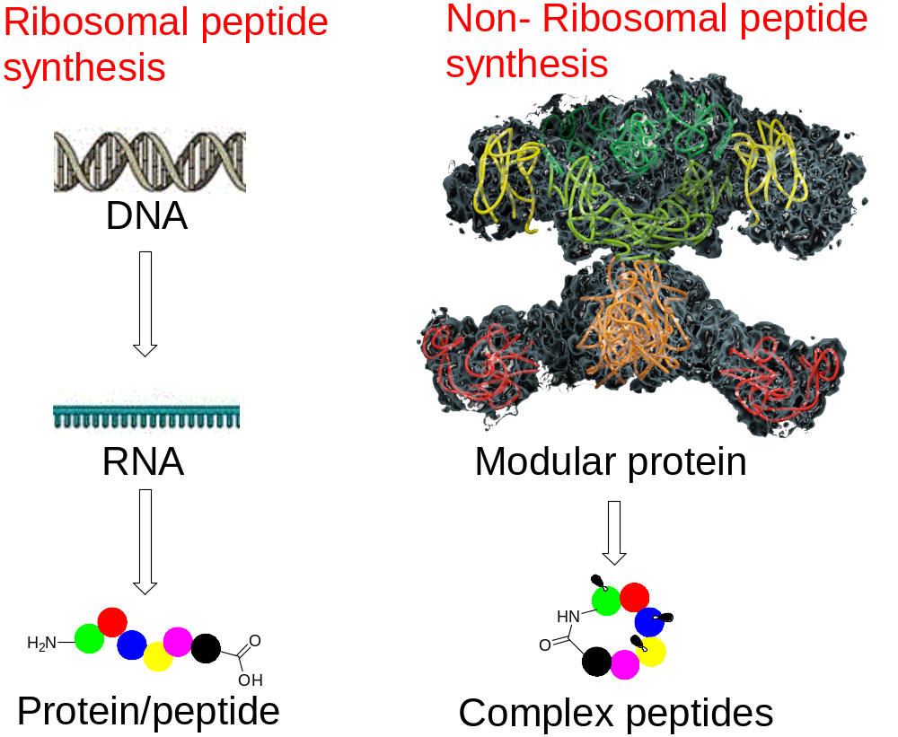

Slide 11
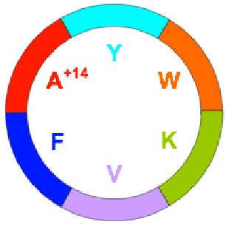
De Novo Sequencing of Peptidic Antibiotics Remains a Heroic Effort
NRPs differ from ribosomal peptides in many respects:
non-linear structures, e.g., most NRPs are cyclic
they often contain non-standard amino acids increasing the number of possible building blocks from 20 to 300+
they are extensively modified
There are no codons coding for these peptides!
Seglitide
used experimentally to treat Alzheimer’s disease
Notes:
11
Elevator pitch: We are going to form a mass spec software company that will revolutionize the application of mass spectrometry to proteomics and life sciences. It will enable new applications that will significantly advance the research … in industry..

Slide 12

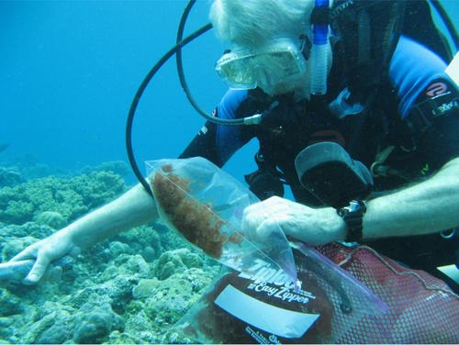
From Seaside to Bedside
Our colleagues at the Scripps Institute of Oceanography at UCSD found a cyclic NRP that has a 2500 fold therapeutic anti-malarial window (isolated from cyanobacteria off the coast of Panama)
How can we sequence this NRP?
No room for errors since only small amount of material is available and it may not be possible to collect this compound again.
Professor Bill Gerwick at work hunting for new NRPs
Notes:
12

Slide 13
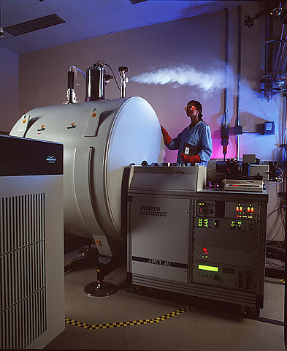
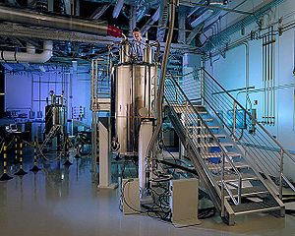
Cyclic Peptide Sequencing:
MS vs NMR
NMR requires large amount of material that is often unavailable. MS requires very small amounts
NMR is extremely time consuming. MS is very fast
NMR is difficult to interpret – many NMR-based projects fail. MS of cyclic peptides is also difficult to interpret:
No protein database
Non-standard amino acids
Cyclic structure
Notes:
13

Slide 14
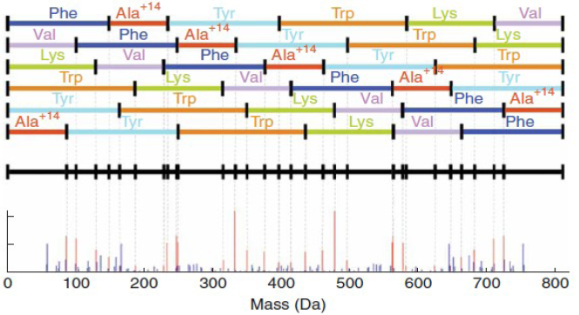
Sequencing NRPs by Mass Spectromety
Bandeira et al., RECOMB 2008, Ng et al., Nature Methods 2009
Spectra of a cyclic peptides (of length n) are very complex since they represent a superposition of n spectra of linear peptides
Notes:
14

Slide 15
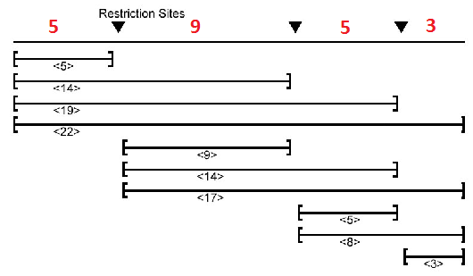
Déjà vu from 1990s: Partial Digest Mapping
X:
ΔX:
X:
unknown
distances between consecutive cuts: (5, 9, 5, 3)
ΔX:
mapping data
pairwise distances between all cuts: (3, 5, 5, 8, 9, 14, 14, 17, 19, 22)
Notes:
15
15

Slide 16
Partial Digest Problem
(aka Turnpike Problem)
Goal: Given the set of all pairwise distances between points on a line (eg., integers), reconstruct the positions of these points
Input: The set Distances of pairwise distances
(3, 5, 5, 8, 9, 14, 14, 17, 19, 22)
Output: A set X, such that ΔX = Distances
(5, 9, 5, 3)
Notes:
16
16

Slide 17
Partial Digest Problem
(accounting for errors in experimental data)
Goal: Given the set of all pairwise distances between points on a line, reconstruct the positions of these points
Input: The set of pairwise distances Distances
Output: A set X, such that ΔX and Distances are as similar as possible
Notes:
17
17

Slide 18
Beltway Problem
Goal: Given the set of all pairwise distances between points on a CIRCLE, reconstruct the positions of these points
Input: The set Distances of pairwise distances on the circle
Output: An set X, such that ΔX = Distances
Notes:
18
18

Slide 19
From Turnpike to Beltway Problem
Complexity of the Turnpike Problem remains unknown
There exists a pseudo-polynomial algorithm (Rosenblatt and Seymour, SIAM J. Disc. Math, 1982)
Cyclic Peptide Sequencing Problem corresponds to the circular version of the Turnpike Problem known as the (more difficult) Beltway Problem
The Turnpike Problem (let alone the Beltway Problem) is NP-Hard for data with errors (Cielebak et al., 2005)
Notes:
19
19

Slide 20
From Beltway Problem to Cyclic Peptide Sequencing
the sequence of n integers representing masses of consecutive amino acids in a cyclic peptide: (Y,W,K,V,F,A⁺¹⁴)=(163,186,128,99,147,85)
Peptide:
unknown
the set of masses of all sub-fragments of Peptide (theoretical spectrum): (163,186,128,99,147,85, 163+186,186+128,128+99,99+147,147+85,85+163,163+186+128,186+128+99,128+99+147,…)
ΔPeptide:
Approximated by the spectrum
Notes:
20
20

Slide 21
Cyclic Peptide Sequencing Problem
Goal: Given an experimental spectrum, reconstruct the cyclic peptide that generated this spectrum
Input: A Spectrum (set of integer masses)
Output: A cyclic Peptide such that:
ΔPeptide = Spectrum
Notes:
21
21

Slide 22
A More Realistic Cyclic Peptide Sequencing Problem
Goal: Given an experimental spectrum, reconstruct the cyclic peptide that generated this spectrum
Input: A Spectrum (set of masses)
Output: A cyclic Peptide such that
ΔPeptide and Spectrum are as similar as possible
Notes:
22
22

Slide 23
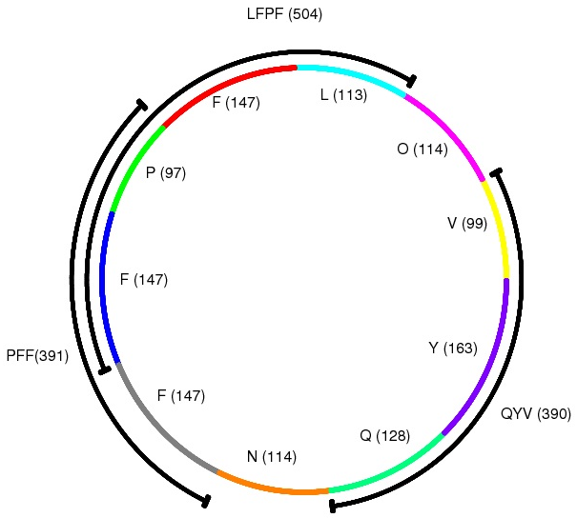
Similarity Between Peptide and Spectrum
Theoretical Spectrum: Δ(Peptide) is the set of all masses of sub-peptides of the cyclic peptide.
LFPF: 113+147+97+147=504
Similarity(Peptide, Spectrum) = | Δ(Peptide) ∩ Spectrum|
(number of shared masses between theoretical and experimental spectra)
Notes:
23

Slide 24
Cyclic Peptide Sequencing Problem
Goal: Given an experimental spectrum, reconstruct the cyclic peptide that generated this spectrum
Input: A Spectrum (set of integer masses)
Output: A cyclic Peptide maximizing:
Similarity(Peptide,Spectrum)
Notes:
24
24

Slide 25
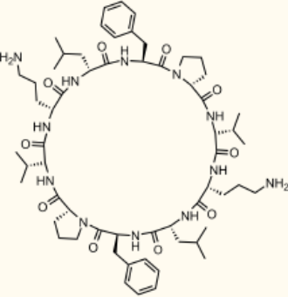
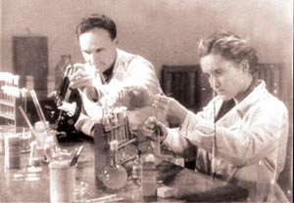

Historical Detour:
First Mass Produced Antibiotic
Gramicidin S discovered in 1942 (Georgyi Gause and Maria Brazhnikova)
Used in Soviet hospitals in 1943, first Mass Produced Antibiotics
Sent from USSR to Great Britain via Red Cross in 1944
Stalin Prize for Gause, saved him from prosecution during Lysenkoism
Nobel Prize for Richard Synge who proved the compound is a peptide
Notes:
25

Slide 26
First Mass Produced Antibiotic
Gramicidin S discovered in 1942 (Georgyi Gause and Maria Brazhnikova)
Used in Soviet hospitals in 1943, first Mass Produced Antibiotics
Sent from USSR to Great Britain via Red Cross in 1944
Stalin Prize for Gause, saved him from prosecution during Lysenkoism
Nobel Prize for Richard Synge who proved the compound is a peptide
Bacterium producing Gramicidin S produces dozens of other antibiotics that Gause, Brazhnikova, and Synge missed
Notes:
26

Slide 27


Cyclic Peptide Sequencing Problem:
Previous Studies
First algorithms for de novo sequencing of cyclic peptides:
Bandeira et al., RECOMB 2008
Ng et al., Nature Methods 2009
Applications of de novo cyclopeptide sequencing:
Liu et al., PNAS 2010 (bacterial cannibalism)
Leao et al., PNAS 2010 (interactions between cyclic peptides)
Notes:
27
27

Slide 28
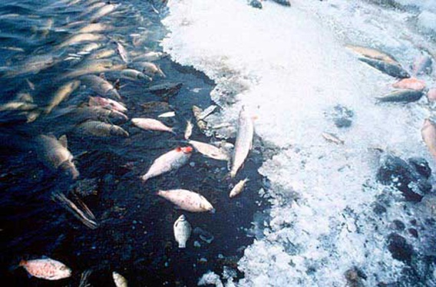
Interactions Between Cyclic Peptides: Allelopathy
In a joint project with Scripps we studied peptides produced by cyanobacterium that that inhibit green algae
We demonstrated that they are allelopathic, i.e., different variants of these peptides are needed to inhibit the green algae
This observation emphasizes the importance of studying various peptide variants and calls for the development of a technology able to sequence ALL peptides in complex mixtures at once (multiplex NRP sequencing).
Leao et al. PNAS 2010
Notes:
28

Slide 29
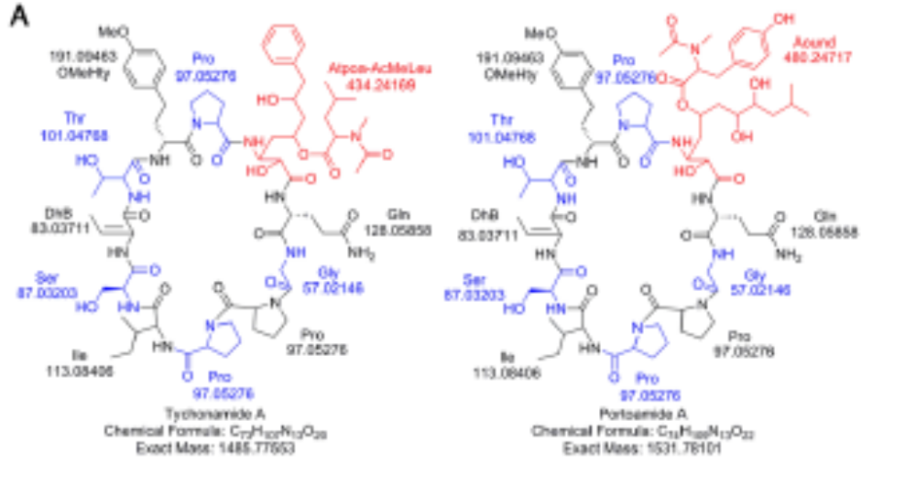
From sequencing the most abundant peptides to multiplex sequencing
Since our first attempt to sequence NRPs from Oscillatoria sp. via MS was inconclusive, Leao et. al. 2010 resorted to purification of the most abundant peptide and sequencing it via NMR.
This large effort involved applications of various NMR technologies (including HSQC, HMBC, COSY, and NOESY) but still failed to identify some inter-residue dependencies
Applications of both NMR and mass spectrometry to finally sequence this compound represented a time-consuming effort of a multidisciplinary team.
A better approach would be to generate spectra of all variant NRPs (without the need to purify individual peptides) and to multiplex sequence them.

Slide 30
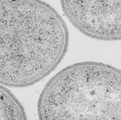
Bacillus brevis: Tyrocidines and Gramicidins
Gramicidin S was isolated from soil bacteria Bacillus brevis
Over the course of decades, 28 (!) different peptides produced by Bacillus brevis were sequenced (forming two families: Tyrocidines and Gramicidins)
Some Tyrocidines have been isolated but have not been sequenced yet

Slide 31
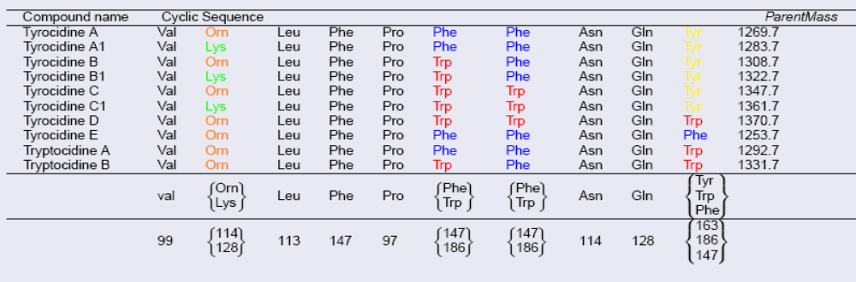
Bacillus brevis: Tyrocidines and Gramicidins
Gramicidin S was isolated from soil bacteria Bacillus brevis
Over the course of decades, 28 (!) different peptides produced by Bacillus brevis were sequenced (forming two families: tyrocidines and gramicidins)
Some Tyrocidines have been isolated but have not been sequenced yet
Open Problem: How many different NRPs Bacillus brevis produces and what are their roles? Why so many?
Rule, not an exception: NRPs are found as collections of Related Peptides

Slide 32
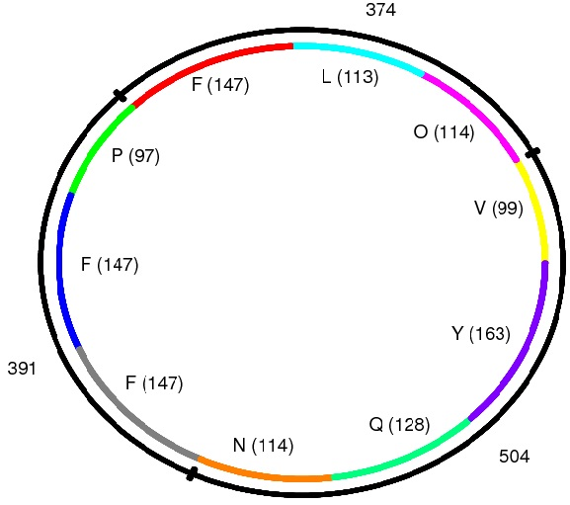
Tags
k-tag: partitioning of the parent mass into k integers larger or equal than 57 (the mass of the lightest amino acid Gly):
(100, 1000, 169)
A correct k-tag corresponds
to masses of a sub-partition of
the correct peptide:
147+147+97,
147+113+114,
99+163++128+114=
(391, 374, 504)
Tyrocidine A: VOLFPFFNQY. Parent Mass: 1269 Da
Notes:
32

Slide 33
Scoring Tags
Tag can be viewed as a peptide:
(391, 374, 504)
Δ(Tag): theoretical spectrum of
Tag:
391, 374, 504, 391+374, 374+504, 504+391, 391+374+504
Similarity(Tag, Spectrum) = | Δ(Tag) ∩ Spectrum|
(number of shared masses between theoretical spectrum of the tag and the experimental spectrum)
Notes:
33

Slide 34
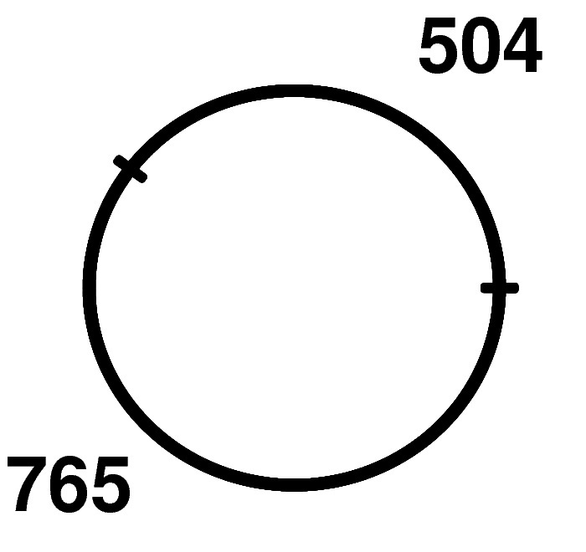
Tag Extension:
Starting from 2-tags
Notes:
34

Slide 35
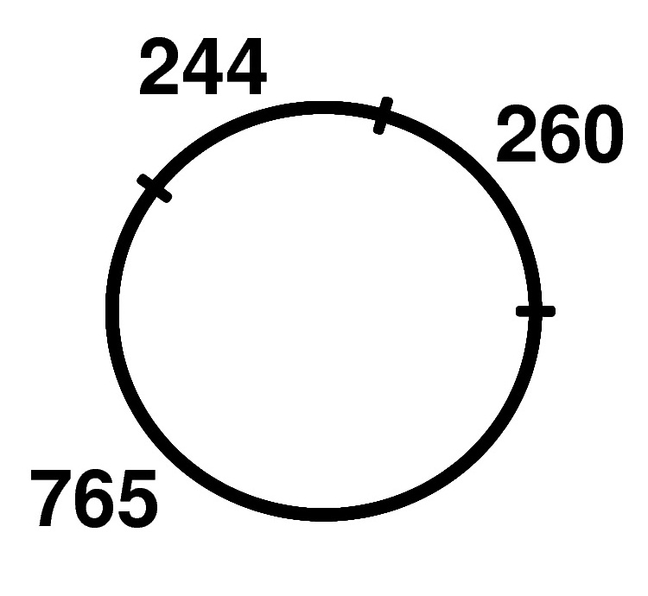
Tag Extension: from k-tags to (k+1)-tags
Breaking one of the masses into two
(604, 765) => (244, 260, 765)
Notes:
35

Slide 36
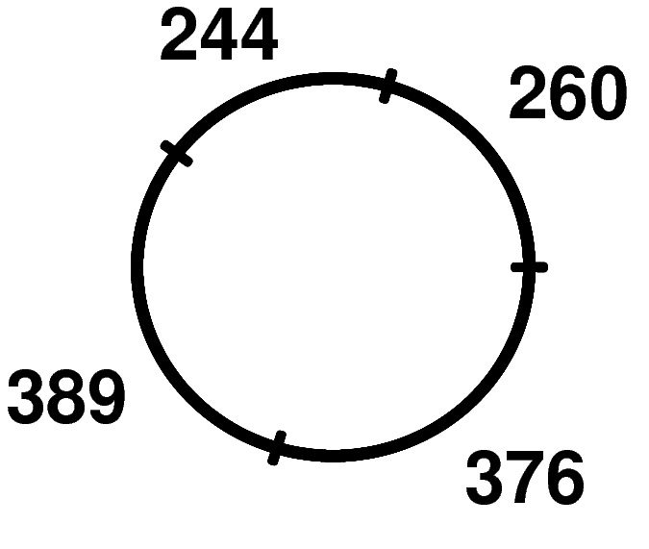
Tag Extension: from k-tags to (k+1)-tags
Breaking one of the masses into two
(244, 260, 765) => (244, 260, 376, 389)
Notes:
36

Slide 37
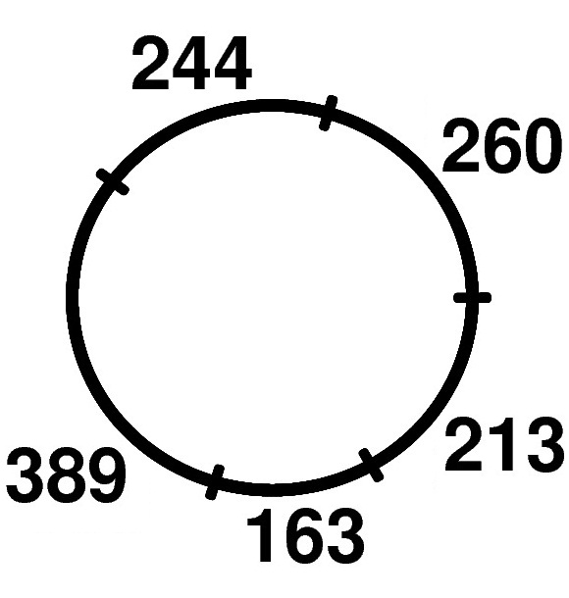
Tag Extension: from k-tags to (k+1)-tags
Breaking one of the masses into two
(244, 260, 376, 389) => (244, 260, 213, 163, 389)
Notes:
37

Slide 38
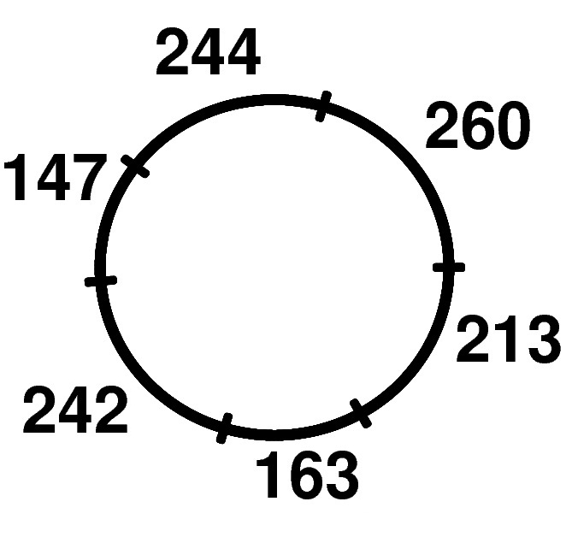
Tag Extension: from k-tags to (k+1)-tags
Breaking one of the masses into two
(244, 260, 213, 163, 389) => (244, 260, 213, 163, 242, 147)
Notes:
38

Slide 39
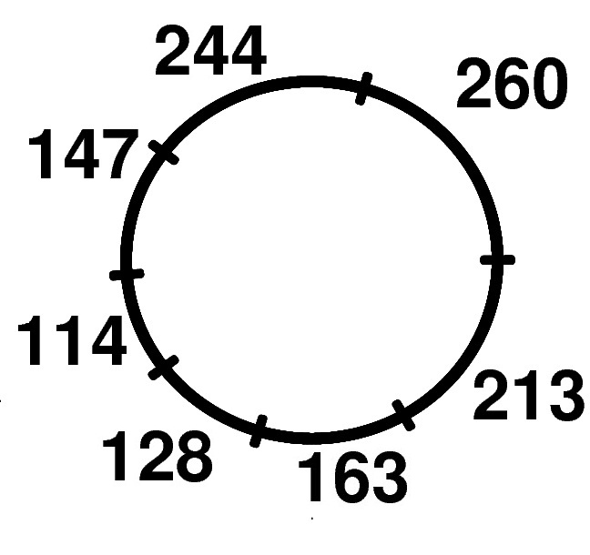
Tag Extension: from k-tags to (k+1)-tags
Breaking one of the masses into two
(244, 260, 213, 163, 242, 147) => (244, 260, 213, 163, 128, 114, 147)
Notes:
39

Slide 40
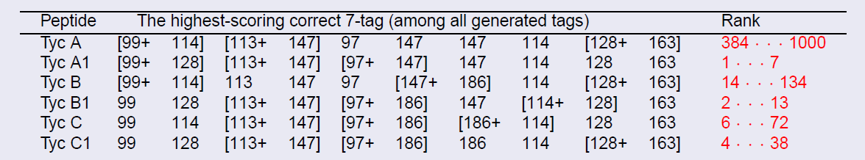
Simple Peptide Sequencing Algorithm
(for a single spectrum)
Find t top-scoring 3-tags (exhaustive search)
For k=3 to peptide length-1
  Extend all top-scoring k-tags to (k+1)-tags
  Select t top-scoring (k+1)-tags from the resulting list
Correct Peptide is not on top (t=1000)
Notes:
40

Slide 41
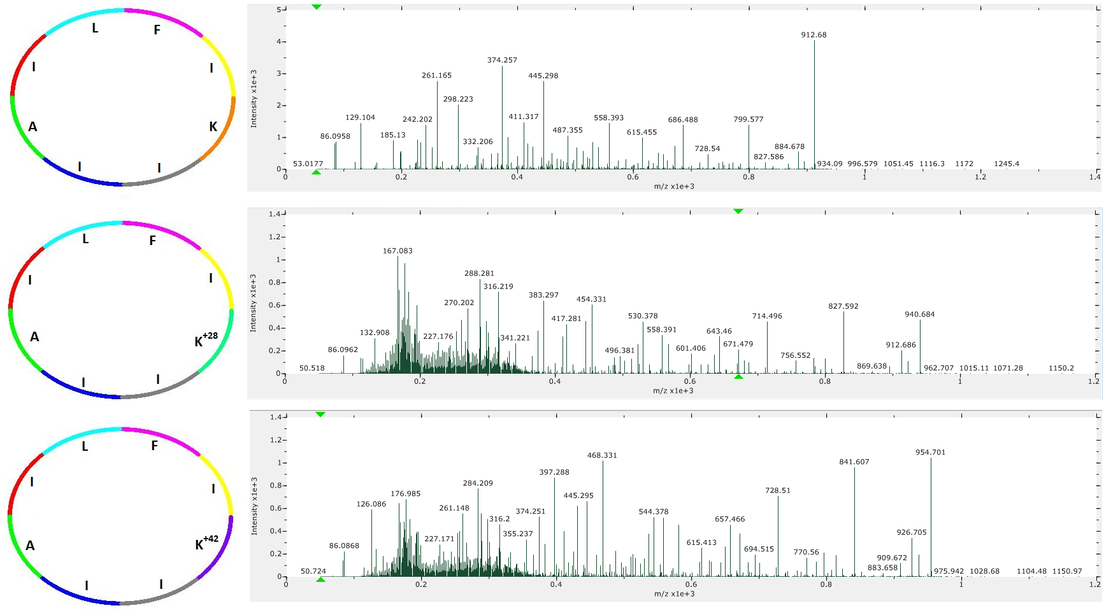
Multiplex Peptide Sequencing
Acquire spectra of many related peptides and sequence all of them at once.
Notes:
41

Slide 42
Multiplex Peptide Sequencing
Acquire spectra of many related peptides and sequence all of them at once.
K
K⁺²⁸
K⁺⁴²
Notes:
42

Slide 43
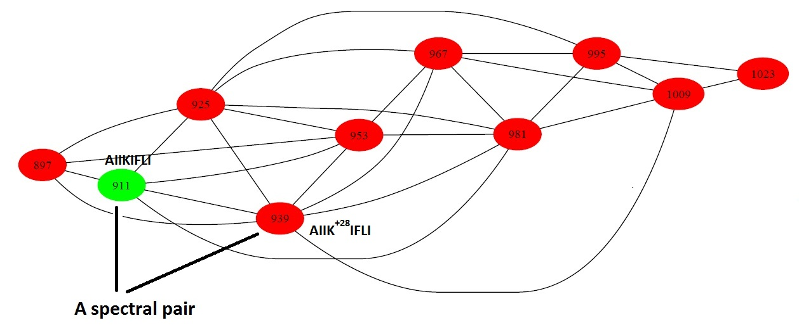
Spectral Network
Spectral pair: A pair of spectra whose peptides differ by a single amino acid substitution.
Spectral Network: A graph on the set of spectra where two spectra are connected if they form a spectral pair.
Spectral network can be approximated without knowing which peptide corresponds to which spectra
Bandeira et al., RECOMB 2006, PNAS 2007
Notes:
43

Slide 44
Spectral Network as an Oracle for de novo Peptide Sequencing
If one correctly reconstructs a peptide in a single vertex, peptide annotations can be propagated to all other vertices
If one incorrectly reconstructs a peptide in a single vertex: peptide annotations cannot be propagated to all other vertices without conflicts
Bandeira et al., RECOMB 2006, PNAS 2007
Notes:
44

Slide 45
G-consistent Multitags
Let G be a spectral network on spectra S₁, … , S_{m} with tags Tag₁, … , Tag_{m}
Tags of individual spectra form: MultiTag=(Tag₁, … , Tag_{m})
MultiTag is G-consistent if tags of spectra forming a spectral pair differ in a single mass.
Notes:
45

Slide 46
Multiplex Cyclic Peptide Sequencing Problem
Input: Spectra S₁, … , S_{m}, and a spectral network G
Output: A G-consistent multitag P₁ , … , P_{m} maximizing multitag score:
Similarity(S₁,P₁) + … + Similarity(S_{m},P_{m})
Notes:
46

Slide 47
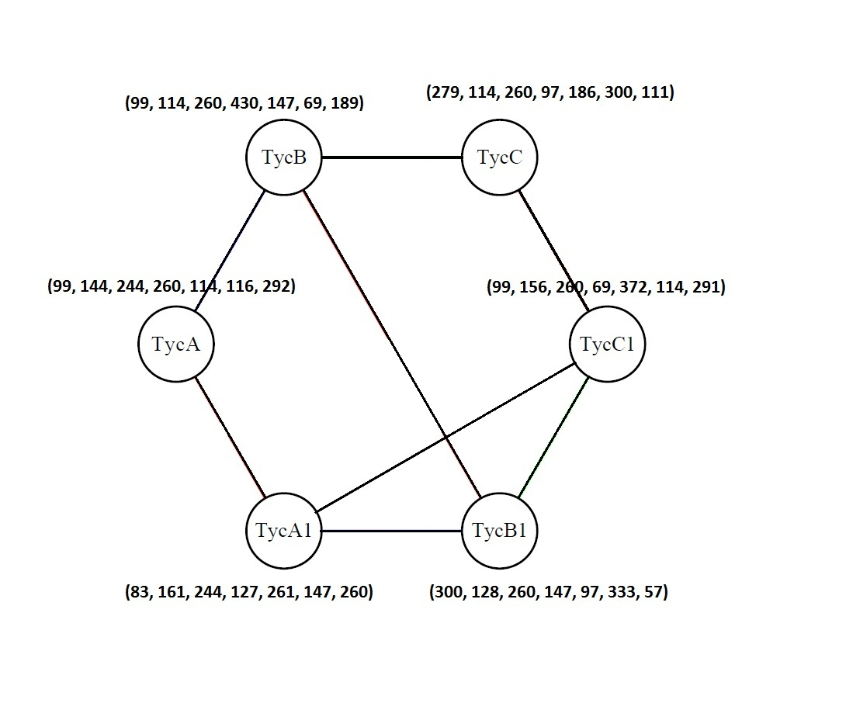
Top-scoring Tags of Individual Spectra Are Usually Inconsistent

Slide 48
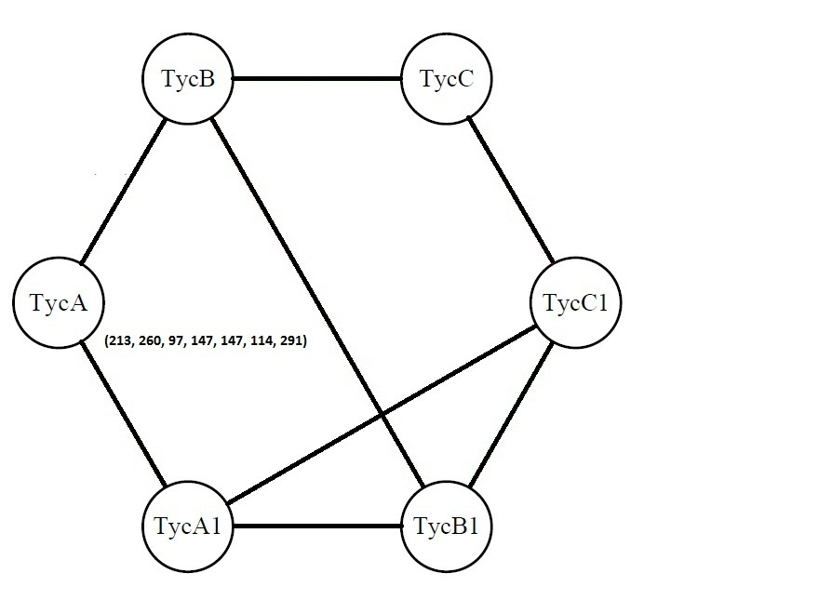
Multitag Algorithm:
Starting from a Single Tag

Slide 49
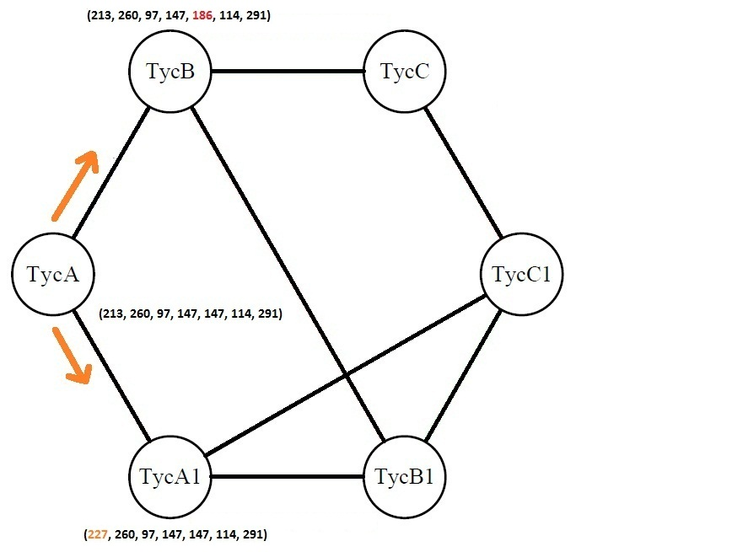
Multitag Algorithm

Slide 50
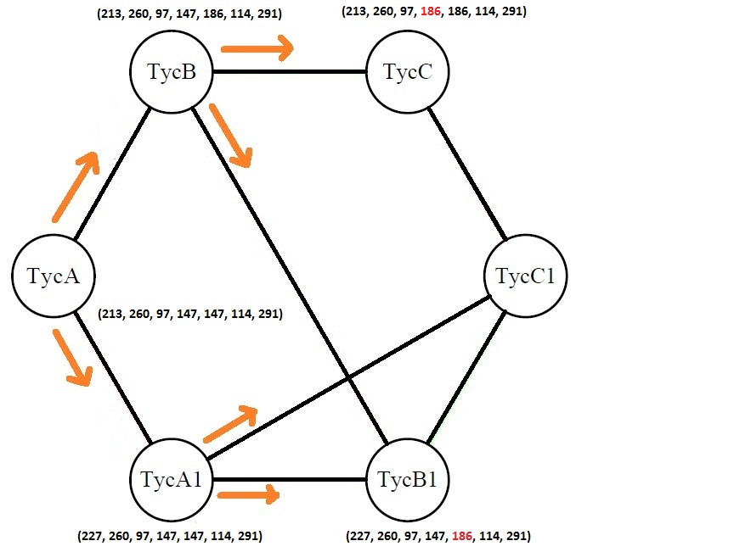
Multitag Algorithm

Slide 51
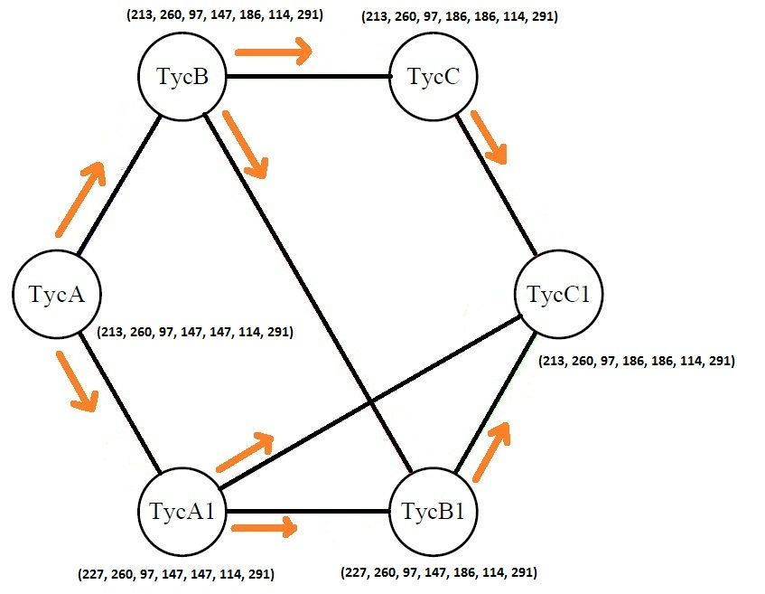
Multitag Algorithm

Slide 52
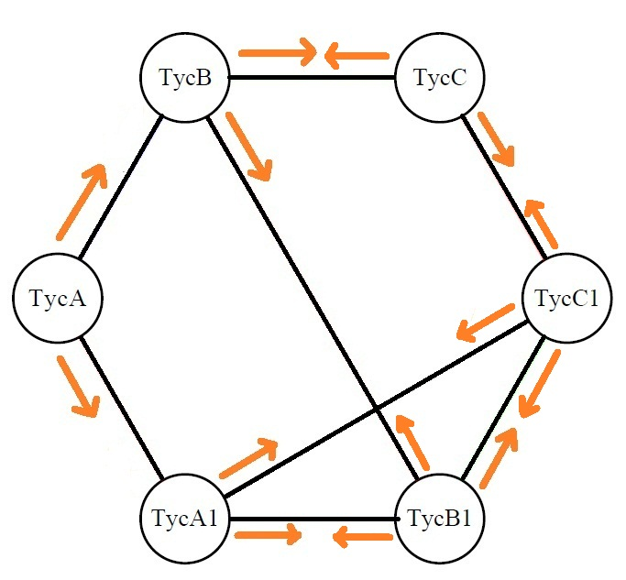
Multitag Algorithm

Slide 53
Exploring High-Scoring G-consistent Multitags
Given a MultiTag=(Tag₁, … ,Tag_{i} ,…Tag_{m}), define MultiTag(i)=Tag_{i}
We can generate high-scoring tags Tag_{i} for each spectrum S_{i}
Goal: Given a high-scoring Tag_{i} for a spectrum S_{i}, generate all high scoring G-consistent MultiTags such that:
MultiTag(i)=Tag_{i}
Notes:
53

Slide 54
Constrained Multiplex Cyclic Peptide Sequencing Problem
Input: Spectra S = (S₁, …S_{i} ,…,S_{m}) , spectral network G, and a tag Tag_{i} of spectrum S_{i}
Output: A G-consistent multitag:
MultiTag(Tag_{i},S,G) = (Tag₁ , … Tag_{i},…,Tag_{m})
maximizing
Sim(Tag₁,S₁) + …Sim(Tag_{i},S_{i}) + Sim(Tag_{m},S_{m})
Notes:
54

Slide 55
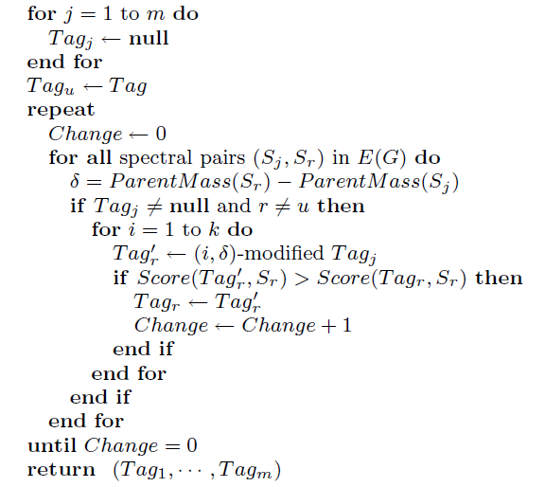
Multitag algorithm
Notes:
55

Slide 56
Spectral Datasets
  Tyrocidines
  Reginamides: a new family of cyclic peptides isolated from a marine Streptomyces strain that produces peptides with anti-asthma activities.
    Multiple variants of Reginamides were sequenced using MS.
    Due to limited quantities of Reginamides, it was only possible to purify one of the variants (named Reginamide A)
    Multi-dimensional NMR confirmed the sequence of Reginamide A, derived by MS-based algorithm.
  Cyclomarins: peptides with anti-inflammatory activity isolated from a marine Streptomyces strain.
Notes:
56

Slide 57
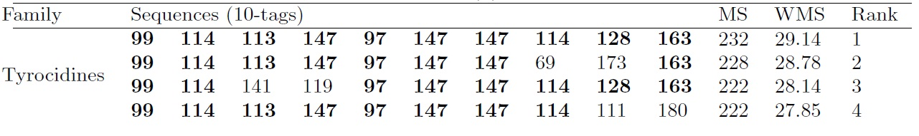
Results
For tyrocidines, the correct tag is on the top:
Notes:
57

Slide 58
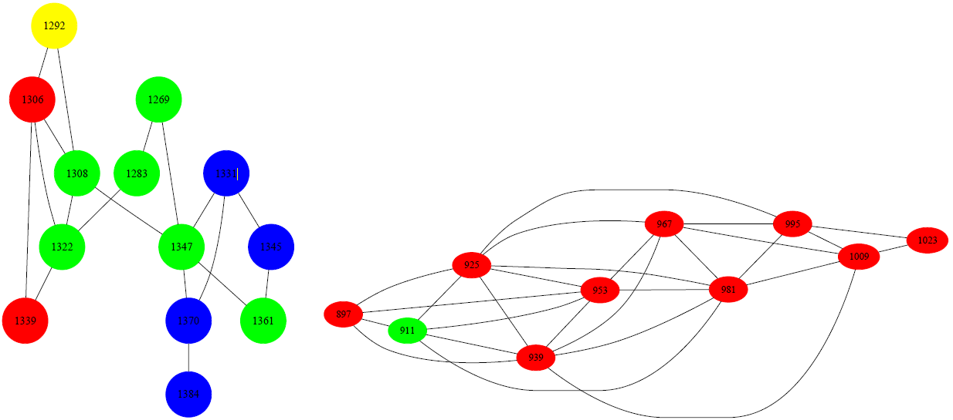
Spectral Networks Reveal new NRPs
Tyrocidine
Reginamide
Notes:
58

Slide 59
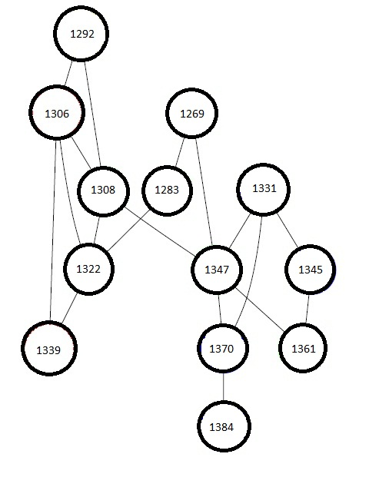
Spectral Network of Tyrocidines
Notes:
59

Slide 60
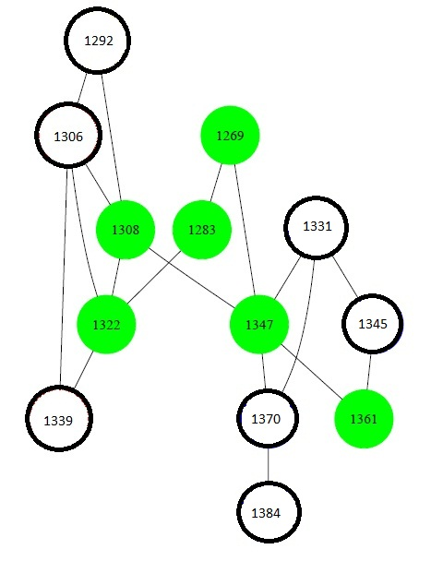
Spectral Network of Tyrocidines
  Green Tyrocidines: well studied in the last 40 years. We knew about their presence from previous studies.
Notes:
60

Slide 61
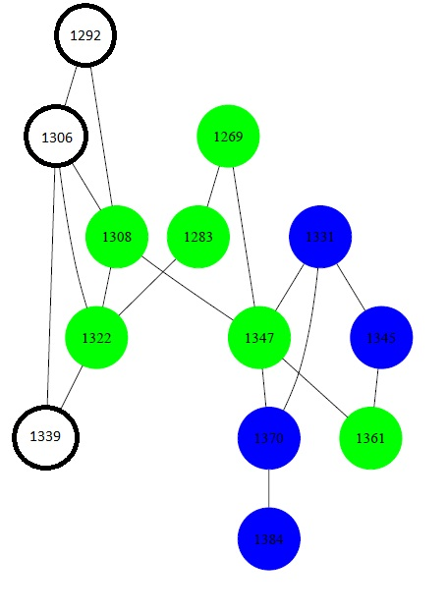
Spectral Network of Tyrocidines
  Blue Tyrocidines are also known albeit rare peptides. However, we were not sure about their presence in the mixture before this study.
Notes:
61

Slide 62
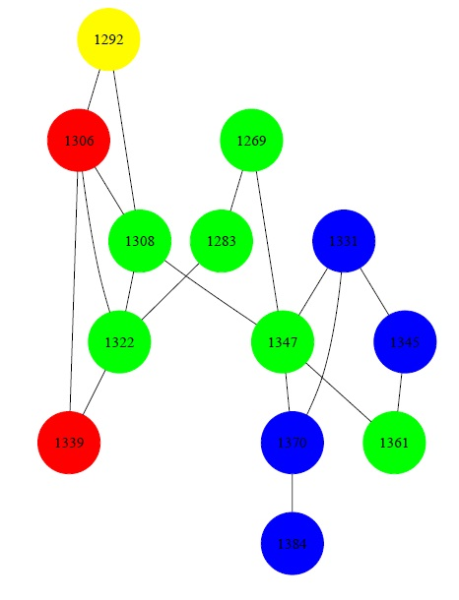
Spectral Network of Tyrocidines
  Red and Yellow: novel tyrocidines. Red are completely new. Yellow: parent mass was reported in a previous study but the sequence remained unknown.
Notes:
62

Slide 63
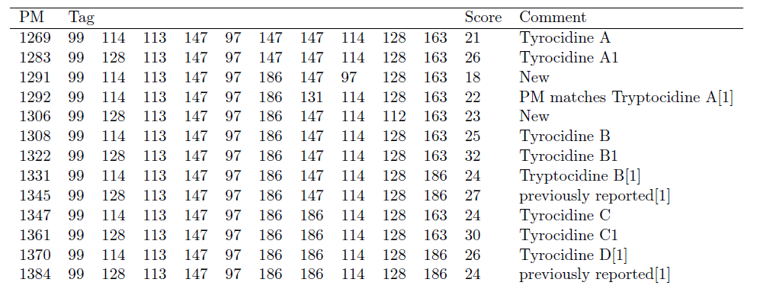
Results : Sequence of Tyrocidines
Notes:
63

Slide 64
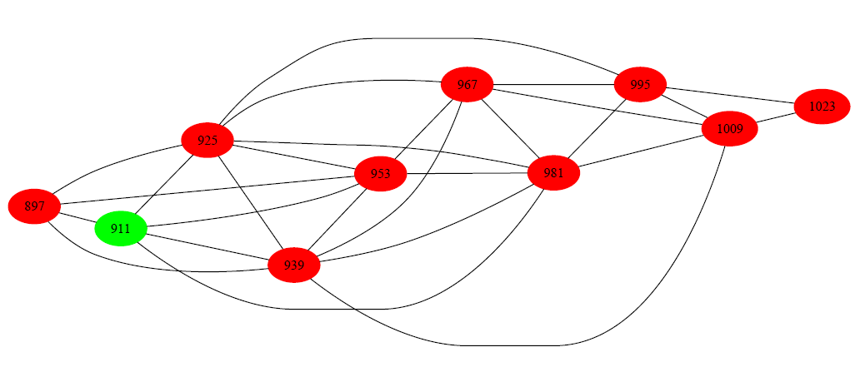
Spectral Network of Reginamides

Slide 65
Spectral Network of Reginamides
(reconstruction confirmed by NMR)

Slide 66

Results : Sequence of Reginamides
Notes:
66

Slide 67


Conclusions
vancomycin
At the age of drug-resistant diseases, can we make antibiotics sequencing as routine as genome sequencing is today?
Notes:
67

Slide 68


…Unexpectedly, the cecum in germ-free mice swelled up to several times its normal size and the mice died. Mice without germs don’t develop normal intestines. ..
How bacteria interact with other organisms and cooperate/kill them?
Neighboring environment (host or microbial) affects the growth of pathogens.
What are the molecules responsible for these interactions?

Slide 69
Bacterial Cannibalism
Bacterial spore formation (e.g., in Bacilus subtilis) is triggered by nutrient limitation.
Losick et al, Science 2003 discovered that when cells enter the sporulation pathway, they export an (unknown) agent that kills sister cells
The sporulating cells feed on the released nutrients and keep growing rather than complete morphogenesis.
Sporulation is a stress-response: bacteria delay spore formation by cannibalizing their sister cells
Open problem: What is the killing agent?

Slide 70






It is straightforward to find bacteria that inhibit or promote growth of pathogens. But it is difficult to find out what molecules are responsible for such actions.
Inhibition of
Methicillin
Resistant
Staphylococcus
Aureus
(MRSA)
Increased growth of MRSA

Slide 71


Using MS-Imaging to Probe Bacterial Interactions
Dorrestein. Nature Chem. Biol. 2009.

Slide 72
Probing Interactions Between Different Bacteria via MS
Killing zone
Candidate killing bacterium
Bacterium we want to kill, e.g., MRSA
Inhibition of MRSA:
done for 100s bacteria in Dorrestein lab

Slide 73

MS Imaging of Killer and Victim Cells
Killer
colony
Victim
colony
Surfactin
SKF
mass=4313

Slide 74

Bacterial Cannibalism
Losick et al, Science 2003 discovered that when cells enter the sporulation pathway, they export an (unknown) agent that kills sister cells
Open problem: What is the killing agent?
Liu et al., PNAS 2010

Slide 75

Where we want to go and what it will take?
Revealing bacterial peptidome using MS imaging
Sequencing bacterial peptidome
Single cell genome sequencing to understand how peptidome is generated
How bacteria kill each other and cooperate with each other (and hosts)?

Slide 76

MS imaging enabled the discovery and sequencing of the cannibalistic killing agent (SKF)
skf
Liu et al., PNAS 2010

Slide 77


NiCl2-NaBD4 reductive thiol removal
Where is the linkage?
Can we use comparative
Dereplication?
+D?
7 Da
Vederas Biochemistry, 2004
Notes:
77

Slide 78


Mobs
Candidate ions
w/o 1 Da shift
Mparent-Mobs
Candidate ions
with 1 Da shift
Least similar
Scoring function includes #
candidate ions, intensity of ions,
and type of ions.
Ng et al., Nature Methods 2009.

Slide 79

Screen a panel of 30+ pathogens
SDP resulted in hits, SKF did not
Staph. saphrophyticus
(Urinary tract infection)
Staph. Epidermis
(Urinary tract infection)
Multidrug resistant
Clinical isolate

Slide 80



Experimental Challenges Translate into Computational Challenges
Computational tools for MS imaging are still in infancy (Vineet Bafna lab, collaboration with Eduardo Macagno)
Bruand et al, JPR 2010, 2011
Computational tools for sequencing cyclopeptides did not exist till 2009 (Nuno Bandeira and Pavel Pevzner labs, collaboration with Pieter Dorrestein)
  Ng et al., Nature Methods 2009, Liu et al., Anal. Chem, 2009, Liu et al, PNAS 2010, Leao et al, PNAS 2010, Mohimani et al., RECOMB 2011, Mohimani et al., J. Proteome Res., 2011, Proteomics 2011
Computational tools for single cell genome sequencing did not exist till 2011 (Glenn Tesler and Pavel Pevzner labs, collaboration with Roger Lasken, JCVI and Dirk Evers, Illumina)
Chitsaz et al, Nature Biotech, 2011

Slide 81





Cyclic peptides are nearly impossible to sequence with current proteomic tools
O
HN
CVWGGDCTDFLGCGTAWICV
HN
O
S-S
GYFVGSYKEYWSRRII
S-S
-Cyclic peptides found in all kingdom of life (primates and presumably humans), human microbiome, fungi, plants, etc.
Many bacteria generate dozens of cyclic peptides!

Slide 82

Multiplex Sequencing of Natural Products (Peptides)
Traditional approach
Activity-guided isolation
Purification of the most abundant compound
NMR-based
sequencing
(one compound at a time)
MS based
verification
Time-consuming (years time-frame)
Material consuming since sufficient amounts are rarely available (e.g., one drug dose – one yew tree)
Difficult to dereplicate (identify analogs to previously discovered compounds)
Multiplex Sequencing of ALL Compounds
MS-guided isolation
MS-based
sequencing
Hypothesis-driven NMR
verification
minimum of samples are required
Yang et al., Nature CB, 2009
Ng et al., Nature Methods, 2009
Mohimani et al., 2011
Notes:
82

Slide 83



Collaborators:
Wei Ting Liu
(UCSD School of Pharmacy)
Pieter Dorrestein
(UCSD School of Pharmacy)
Bill Gerwick (Scripps Institute
of Oceanography)
Yu Liang Yang
William Fenical
(Scripps Institute
of Oceanography)
Susanna Guadencio

