Slide 1
CSE/DSC 234
Data-Centric AI and AI Engineering
Arun Kumar
Topic 4: Model Customization

Slide 2
Outline
LLM Customization Spectrum
Continued Pre-Training (CPT)
Supervised Fine-Tuning (SFT)
  LoRA
Post-Training/Reinforcement Fine-Tuning (RFT)

Slide 3
Why Customize?
Pure prompt/context/retrieval engineering can plateau on out-of-distribution data/jargon or domain-specific reasoning:
  Highly domain-specific concepts, figures, mechanisms
  Custom data ontologies and schemas
  Even if base model has capability, consistent behavior hard
Cost and latency concerns:
  Runaway token spend and rate limiting headaches
  Bad UX of slow chatbots
Edge / no-Internet deployment
Data+AI sovereignty

Slide 4
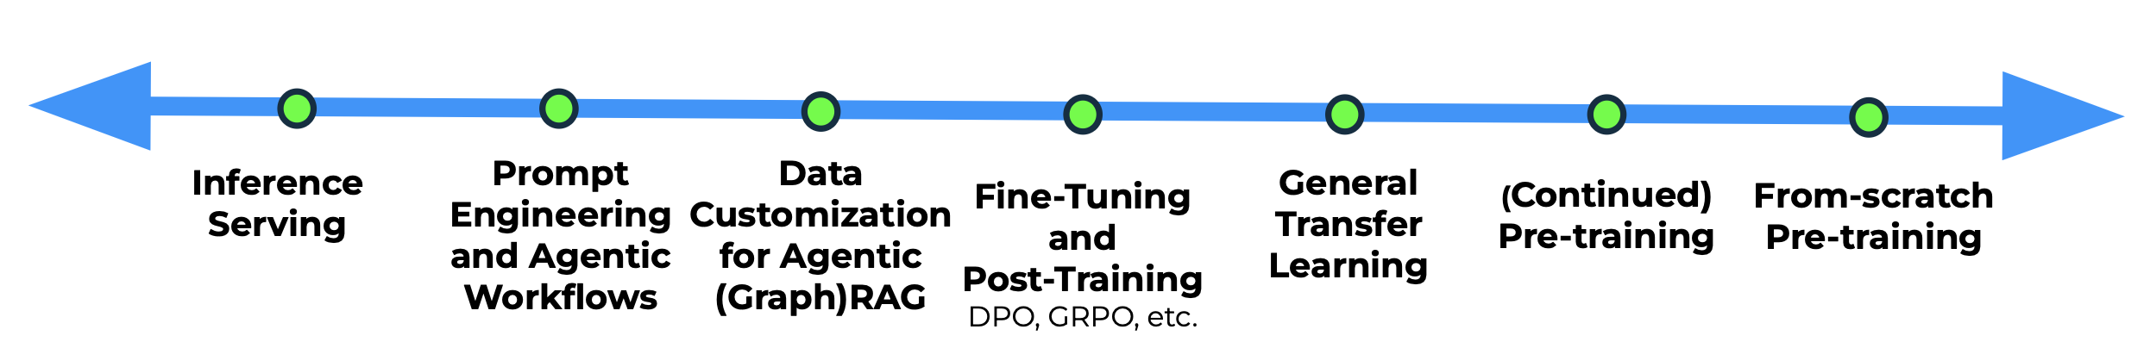
LLM Customization Spectrum
Cheaper
Easier
Less Powerful
More Common
Costlier
Harder
More Powerful
Less Common
Inference-only
Customization
Training-based
Customization
Model Object | Frozen | Modified
Prevalence in Practice | Dominant among enterprises | SFT also popular; others mostly at tech firms
Applicability | Specific to promptable LMs | Applicable to any DL model
Tools | Complex landscape | Mostly just PyTorch + HF
Credit: RapidFire AI overview

Slide 5
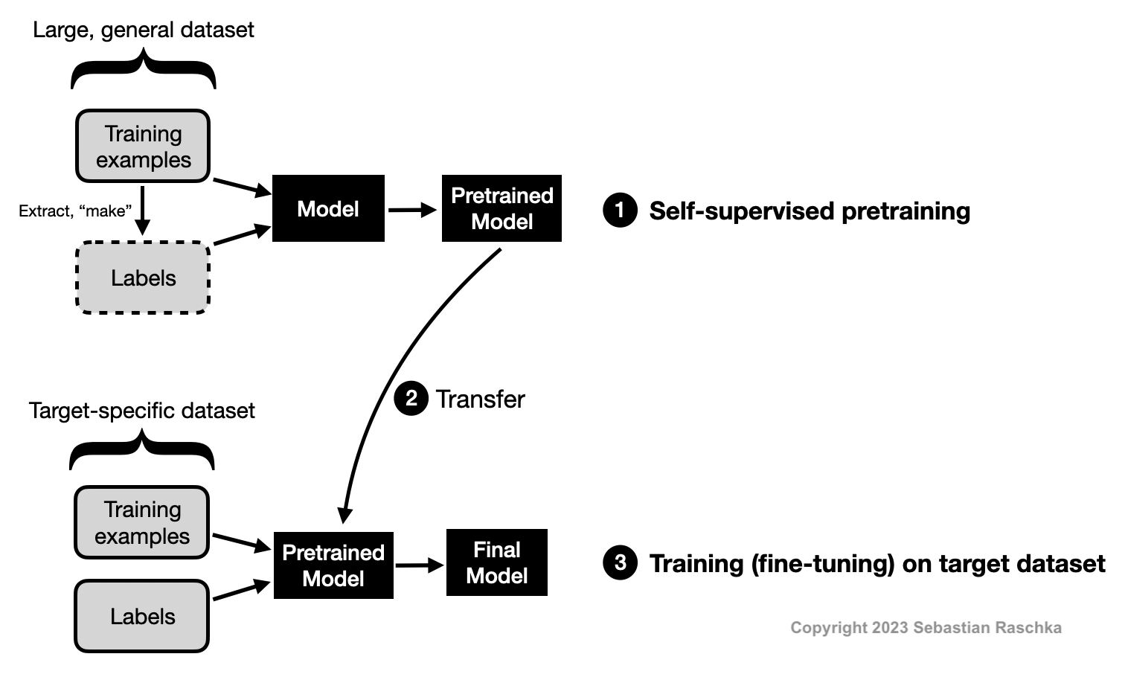
Customization is Transfer Learning
Credit: https://sebastianraschka.com/faq/docs/self-supervised.html

Slide 6
Outline
LLM Customization Spectrum
Continued Pre-Training (CPT)
Supervised Fine-Tuning (SFT)
  LoRA
Post-Training/Reinforcement Fine-Tuning (RFT)

Slide 7
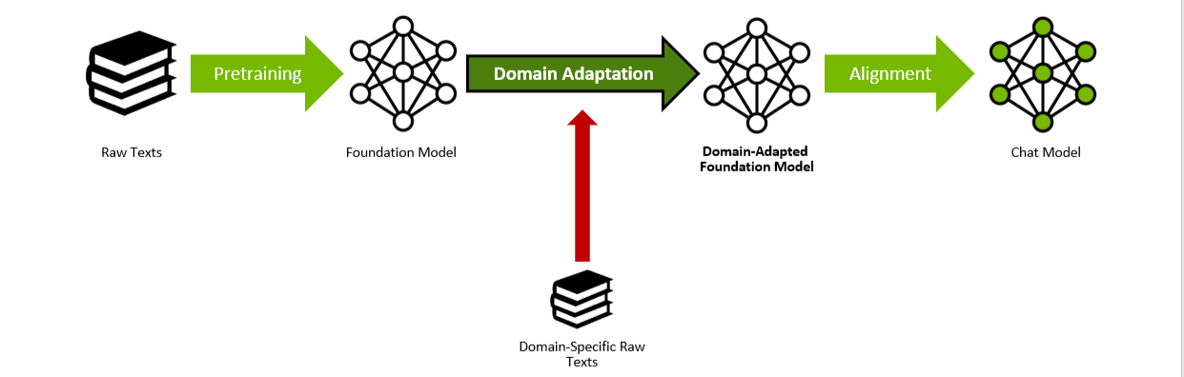
Continued Pretraining
Continue training of pre-trained LLM on new dataset
  No labels needed; same self-supervision objective function
Adapts model’s latent representation to new domain distribution
“Don't Stop Pretraining: Adapt Language Models to Domains and Tasks”. ACL 2020.
https://arxiv.org/abs/2004.10964

Slide 8
Schematic of CPT
New Pretrained Model

Slide 9
CPT: Design Decisions and Tradeoffs
When it matters: Base LLM is weak on domain’s jargon, conventions, structure, e.g., legal, biomed, internal code, niche SQL dialects; teaches knowledge, not behavior
Key Design Decisions and Tradeoffs:
  Data Mix: Fraction of in-domain vs. general; too pure -> catastrophic forgetting; too dilute -> no meaningful shift
  Corpus Size: Main cost knob; unlabeled data is massive
  Stopping Condition: Evaluate on both general and domain-specific capabilities

Slide 10
Outline
LLM Customization Spectrum
Continued Pre-Training (CPT)
Supervised Fine-Tuning (SFT)
  LoRA
Post-Training/Reinforcement Fine-Tuning (RFT)

Slide 11
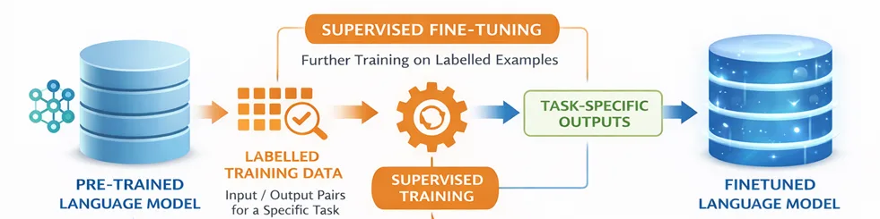
Supervised Fine-Tuning (SFT)
Workhorse of LLM customization
Adapts model’s latent representation to new domain distribution
  But supervised, i.e., needs task-specific (input, output) pairs
  Brings down generality of AGI model back to task-specificity
Closer to canonical “training” from classical ML/DL
  Same bias-variance-noise tradeoffs on training data
Credit: https://devblogs.microsoft.com/foundry/beyond-the-prompt-why-and-how-to-fine-tune-your-own-models/

Slide 12
Schematic of SFT (Full Parameter)
Finetuned Model

Slide 13
SFT Data Sources
Common practice is to get signal from appl. production logs
  Prompting/context eng. allows you ship an MVP
Synthesis with more powerful LLM
SME hand-crafted and/or rule-based heuristics
Same tradeoffs as creating evals data (Topic 1)

Slide 14
Outline
LLM Customization Spectrum
Continued Pre-Training (CPT)
Supervised Fine-Tuning (SFT)
  LoRA
Post-Training/Reinforcement Fine-Tuning (RFT)

Slide 15
Issues with Plain SFT
Plain SFT (“full parameter FT”) often has pitfalls:
  Overfitting
  Catastrophic forgetting
  Higher cost of training vs. inference-only customization
  Model size, GPU cost, hosting/DevOps complexity
One SFT run per application/task amplifies above issues

Slide 16
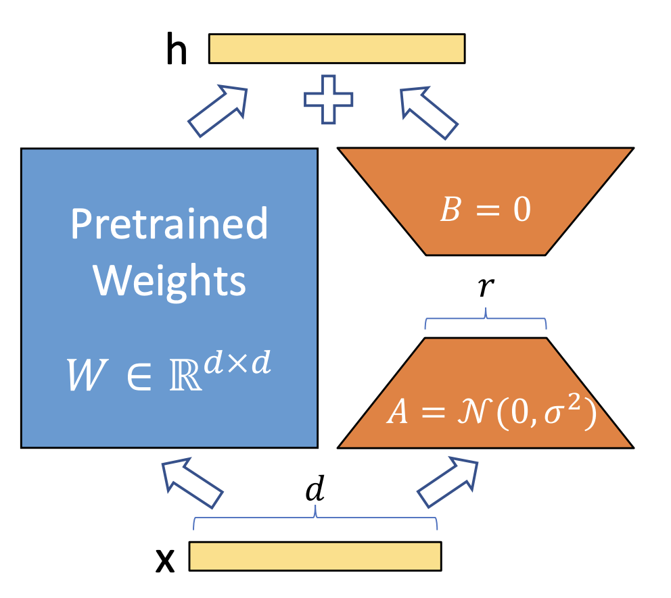
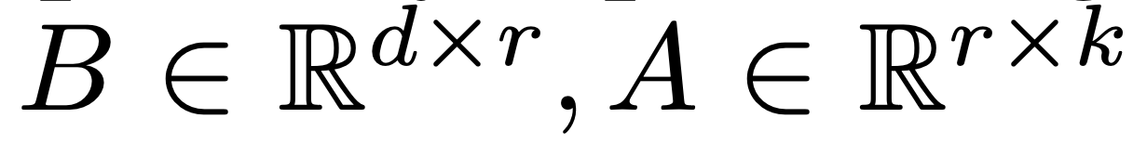
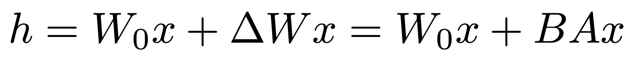
Low-Rank Adapters (LoRA)
Main Idea: Freeze base LLM weights and instead train smaller set of additive parameters per layer, aka adapters
  Adapters have roughly ~0.1-1% of base weights
  Results often not that far from full FT but fraction of cost
“LoRA: Low-Rank Adaptation of Large Language Models”. ICLR 2022.
https://arxiv.org/pdf/2106.09685

Slide 17
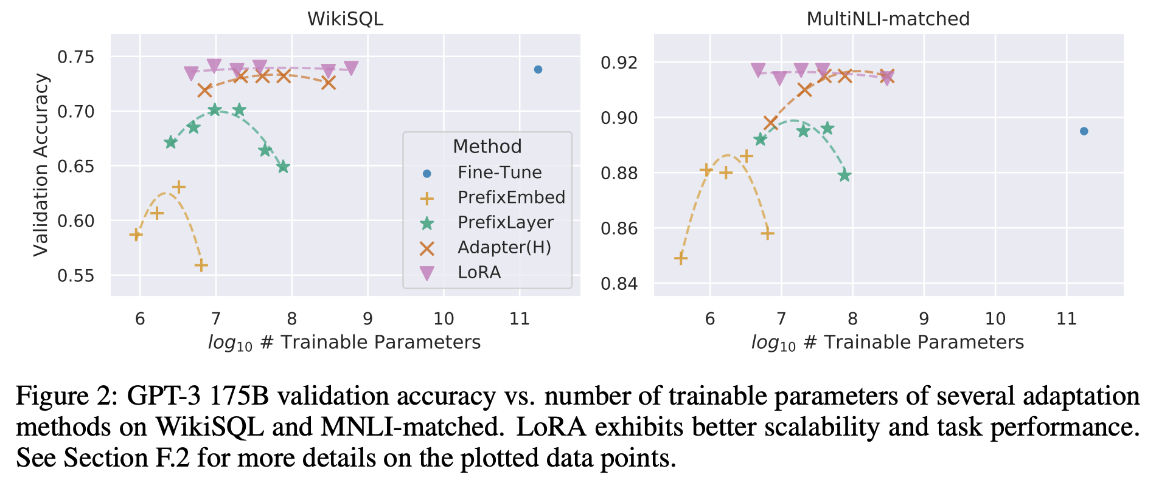
LoRA FT Accuracy vs. Parameters
“LoRA: Low-Rank Adaptation of Large Language Models”. ICLR 2022.
https://arxiv.org/pdf/2106.09685

Slide 18
Schematic of SFT (LoRA)
LoRA FT Model

Slide 19
Advantages of LoRA
LoRA FT has become the default method of “SFT” in practice
  Quantized LoRA (QLoRA): Base model weights quantized in addition; complementary trick
Multiple practical advantages of LoRA/QLoRA:
  Accuracy Benefits: Lower risk of overfitting or forgetting
  Training Runtime: Much faster than full FT (even 10x)
  Memory Footprint: Smaller GPUs suffice for training
  Storage: Adapters are MBs, not GBs; host base model once and numerous adapters per task or group
  “Multi-LoRA” Deployment: Merge different adapters into one set of base weights at inference time on the fly

Slide 20
SFT: Design Decisions and Tradeoffs
When it matters: Need even higher accuracy on specific tasks; lower cost and/or latency
Key Design Decisions and Tradeoffs:
  Sourcing and mixing labeled data (quality > quantity)
  Full FT vs. LoRA
  Traditional training tradeoffs (e.g., hyperparameter tuning)

Slide 21
SFT in Project 2
Project 2 involves domain-specific jargon and constraints
  Bespoke database schema identifiers, SQL queries
  Query latency matters — human in the loop
Key knobs to focus on:
  LoRA Rank: Capacity of adapter; 8 to 64 typical
  Target Modules: Which layers get adapters; usually attention projections; often defaults suffice but worth trying
  Learning Rate and LR Scheduler: Typical SGD knobs
Tip: Do not replicate base model over and over!

Slide 22
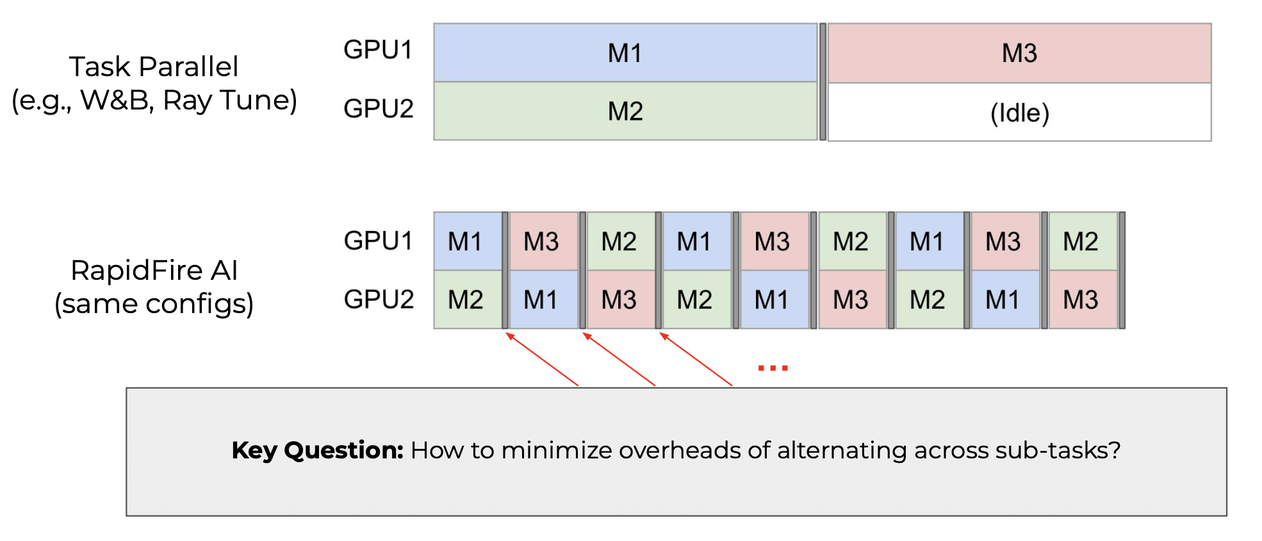
SFT with RapidFire AI
Credit: RapidFire AI overview

Slide 23
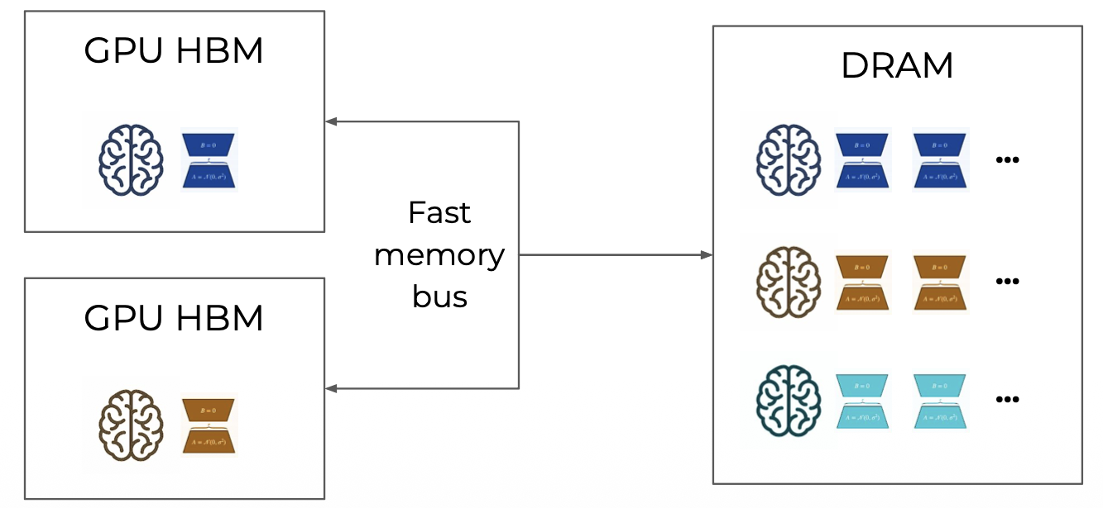
SFT with RapidFire AI
Basic Idea: Shared memory dictionary in DRAM to spill/load per-config adapters and unique base models
Credit: RapidFire AI overview

Slide 24
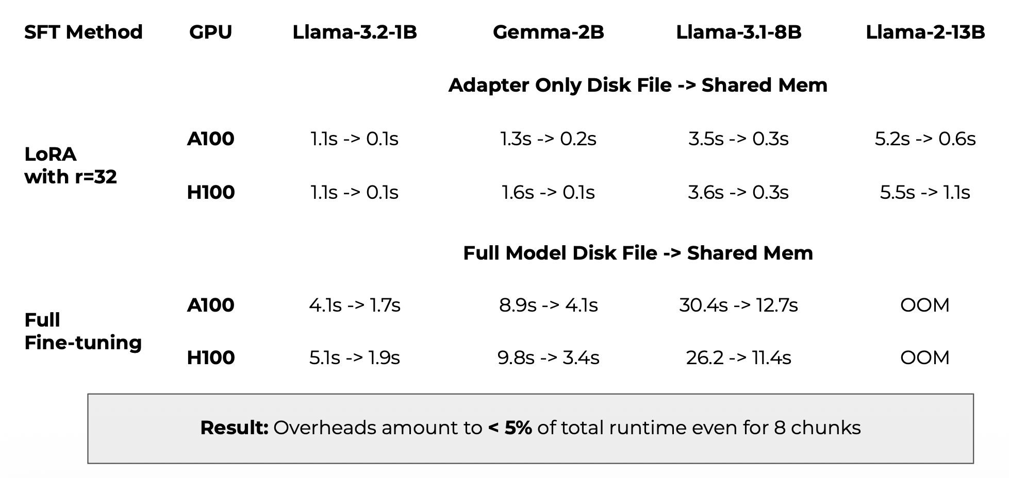
SFT with RapidFire AI
Credit: RapidFire AI overview

Slide 25
Outline
LLM Customization Spectrum
Continued Pre-Training (CPT)
Supervised Fine-Tuning (SFT)
  LoRA
Post-Training/Reinforcement Fine-Tuning (RFT)

