Slide 1
CSE/DSC 234
Data-Centric AI and AI Engineering
Arun Kumar
Topic 3: Agent Engineering

Slide 2
Outline
Motivation
Design Foundations
Harness Eng. and Components
Multi-Agent Workflows
Observability and Evals

Slide 3
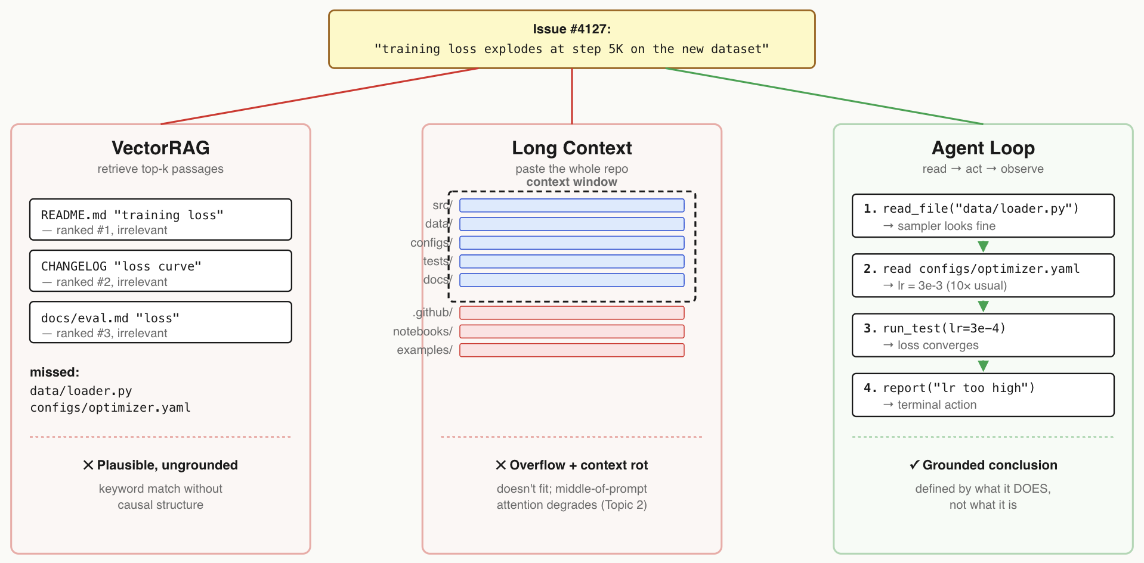
Running Example
Example: Triaging a GitHub issue for an AI training codebase

Slide 4
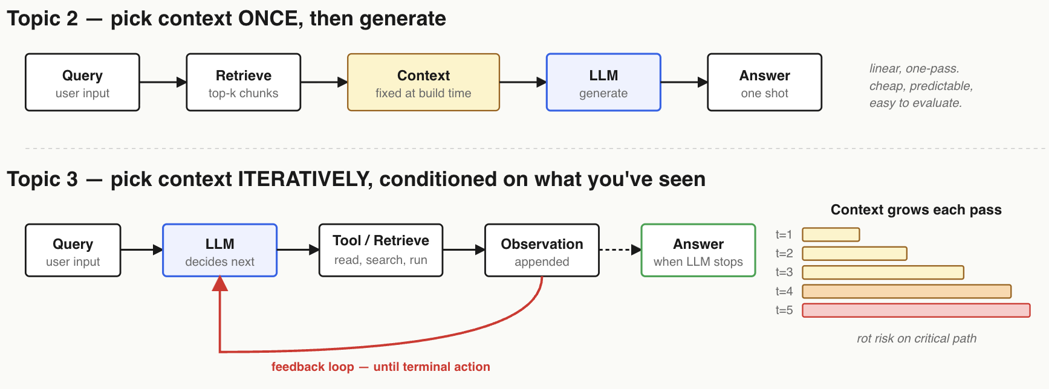
Beyond Context/Retrieval Eng.
Fundamentally, context/retrieval eng. is a static chain workflow
Agentic workflows add dynamism and/or autonomy to enable multi-turn context creation and usage

Slide 5
New Risks of Agentic Workflows
Risk of Compounding Errors:
  Bad result at one turn could poison all subsequent turns
Termination Condition:
  Tradeoffs of when to stop; too early: unfinished or hallucinated work; too late: wasted token spend, latency
Higher Risk of Context Rot:
  Context keeps growing every turn; context rot risk is on the critical path by design

Slide 6
Outline
Motivation
Design Foundations
Harness Eng. and Components
Multi-Agent Workflows
Observability and Evals

Slide 7
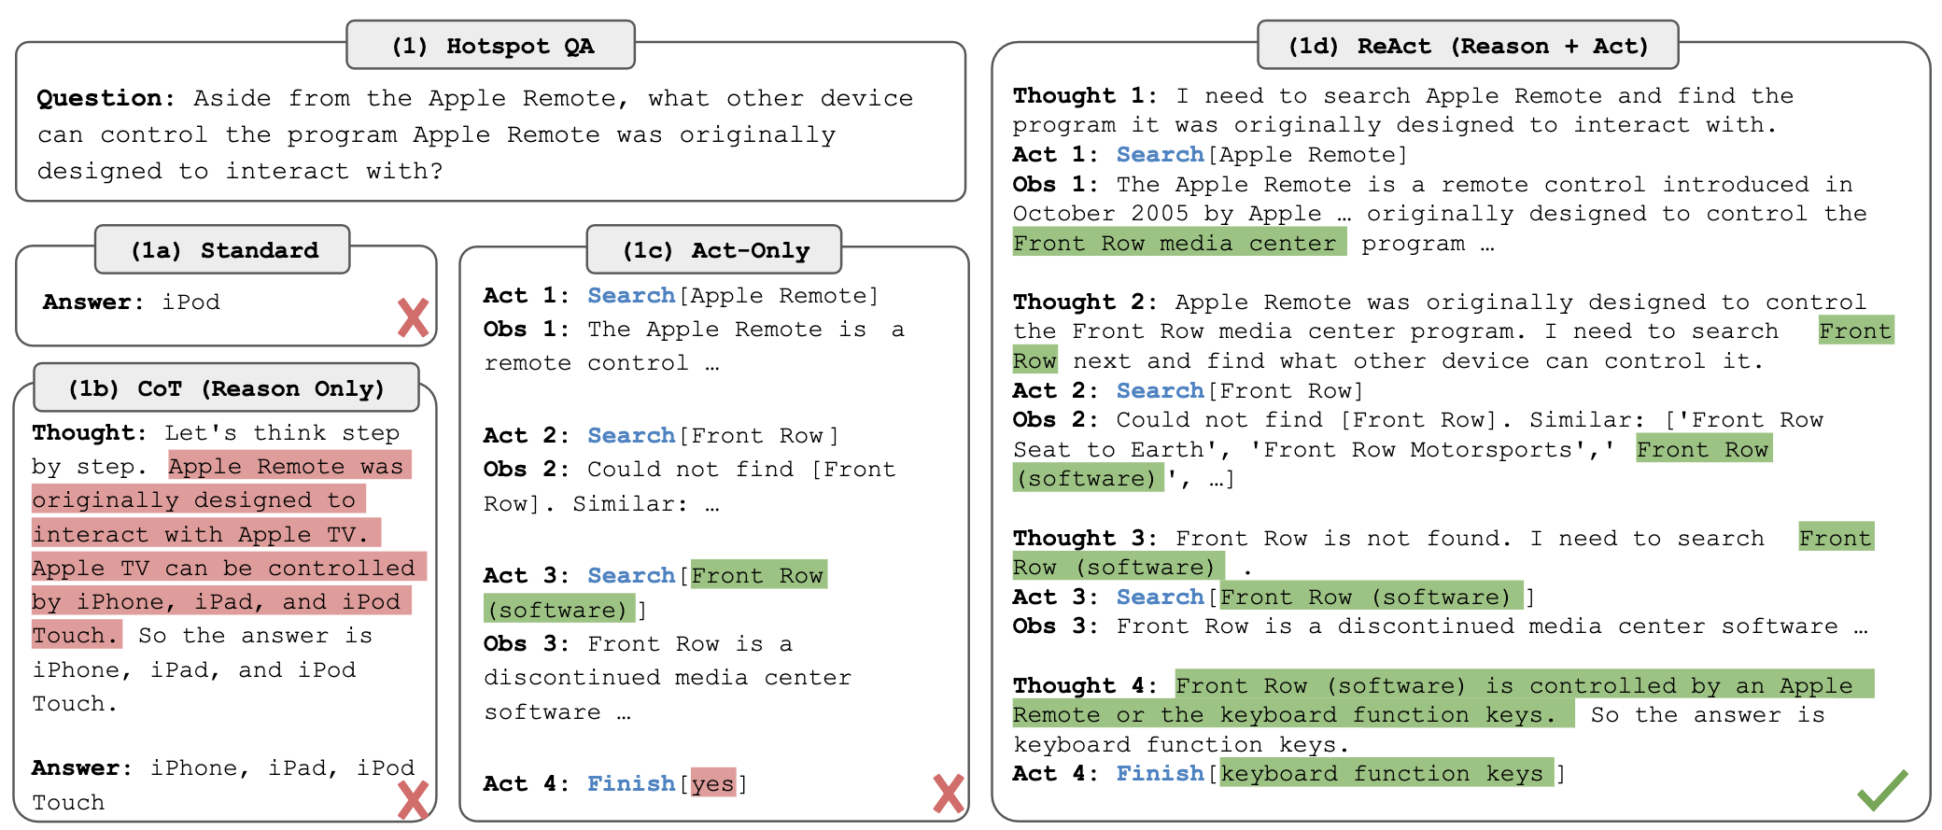
Pivot Point: ReAct as Core Loop
Key Idea: Mix the capabilities of Reasoning-oriented and Action-oriented LLM usage; has become de facto standard
ReAct: Synergizing Reasoning and Acting in Language Models. ICLR 2023.
https://arxiv.org/abs/2210.03629

Slide 8
Why Combine Reasoning + Action?
Neither is enough on its own:
  Reasoning-only: No ground truth; often confidently wrong
  Action-only: No deliberation; often wanders, doesn’t recover
ReAct:
  Reasoning steers action; actions lead to new observations; observations steer reasoning
  Virtuous feedback loop; each constrains the other
  Loosely, akin to a RAG setup where the LLM writes its own queries, iteratively, conditioned on what it produces!
ReAct: Synergizing Reasoning and Acting in Language Models. ICLR 2023.
https://arxiv.org/abs/2210.03629

Slide 9
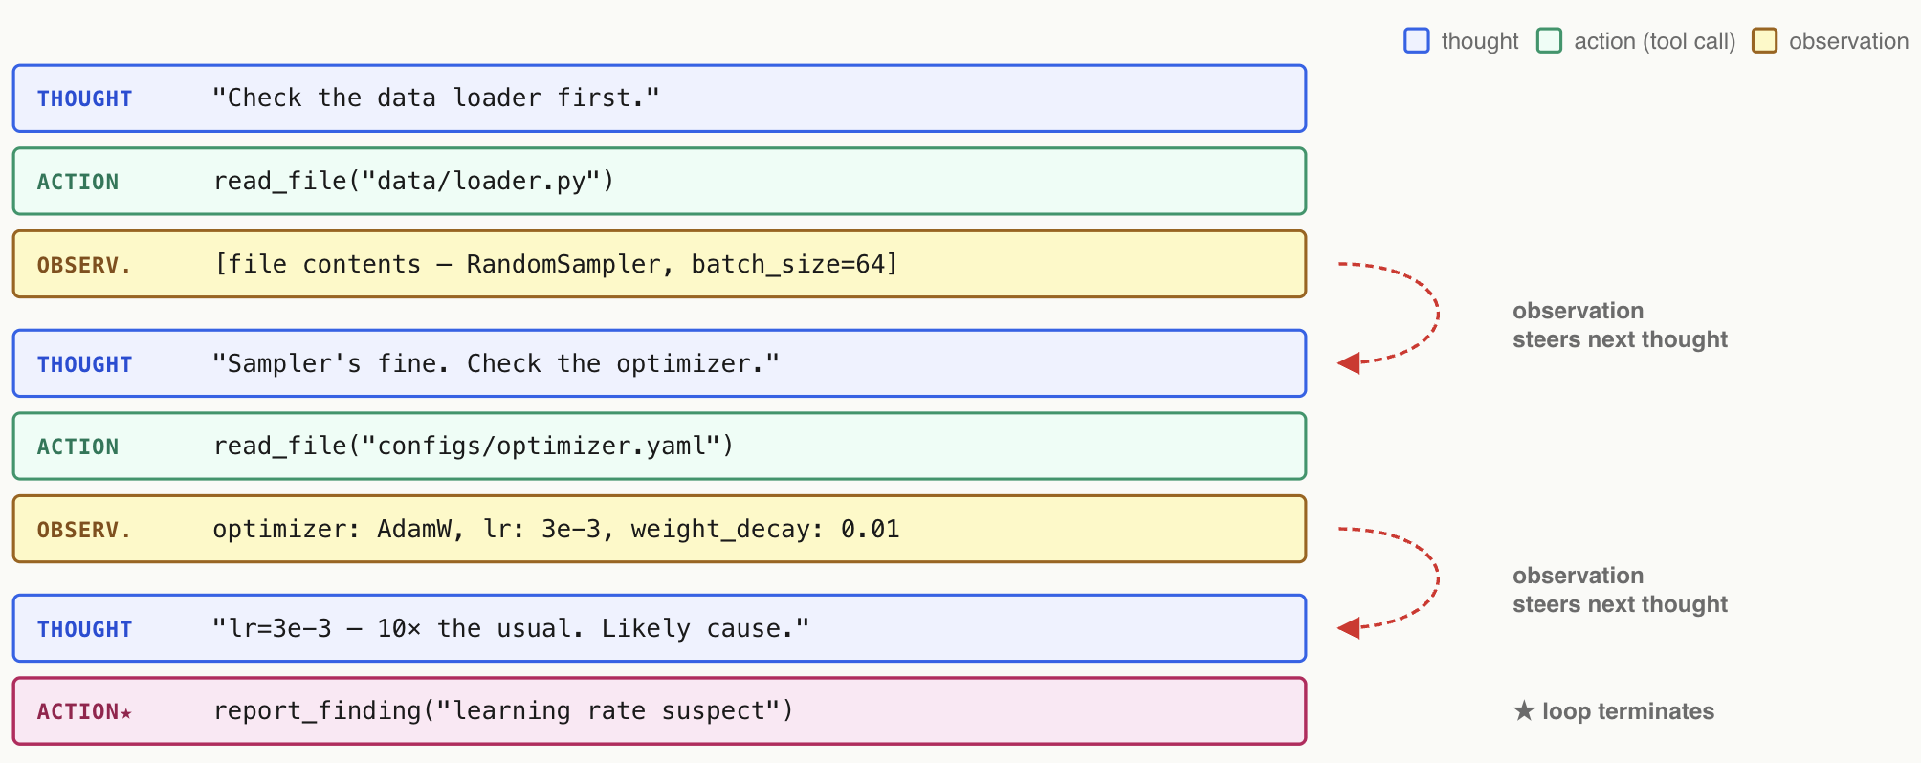
Running Example

Slide 10
Key Failure Modes of Core Loop
Compounding Errors
Termination Condition
Tool Misfire: Wrong tool(s), then reasons confidently with that
Hallucinated Observations: LLM writes its own “results” without calling correct tools
Cost/Latency Blowup: 3-step task can blow up to 50 iterations!
Defenses involve tradeoffs:
  Step budgets
  Validated schemas
  Observation echo checks
  Retry with reflection (cf. “Reflexion”)

Slide 11
Outline
Motivation
Design Foundations
  Agentic Workflows
Harness Eng. and Components
Multi-Agent Workflows
Observability and Evals

Slide 12
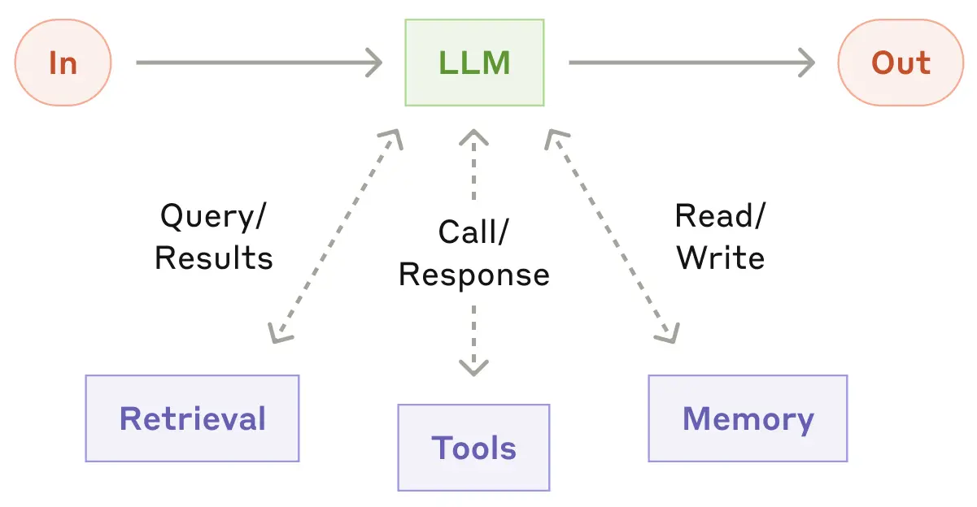
Core Component: Augmented LLM
LLM does not just look at input but it is empowered to interact with the environment in both I/O directions:
Building Effective Agents. Anthropic. 2024
https://www.anthropic.com/engineering/building-effective-agents

Slide 13
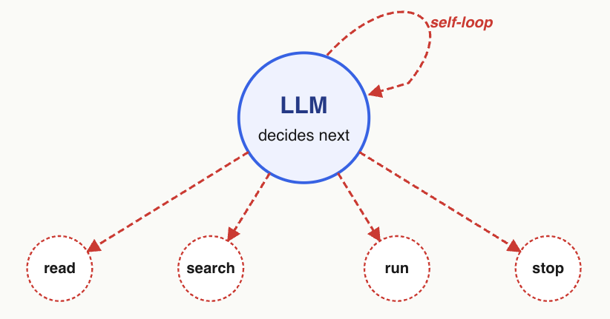
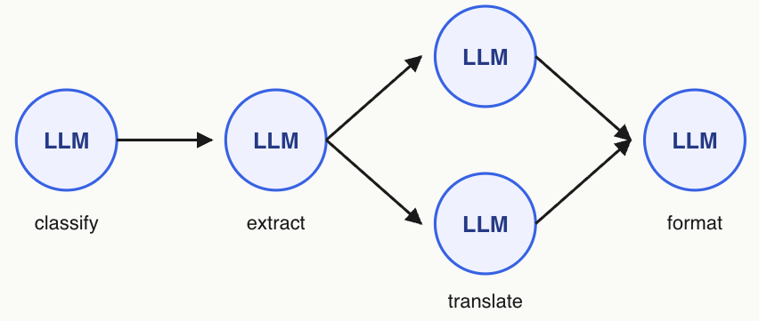
Workflow vs. Agent
Boils down to deterministic vs. probabilistic control flow
Workflow is fixed graph; “agent” offers LLM more autonomy
Vertices and edges fixed at design time;
some edges/paths can be conditional
Vertices and edges chosen at run time by LLM based on content of query / intermediates
 | Workflow | Agent
Structure | Predictable | Flexible
Cost | Cheaper | Costlier
Debugging / Evals | Easier to do | Harder to do

Slide 14
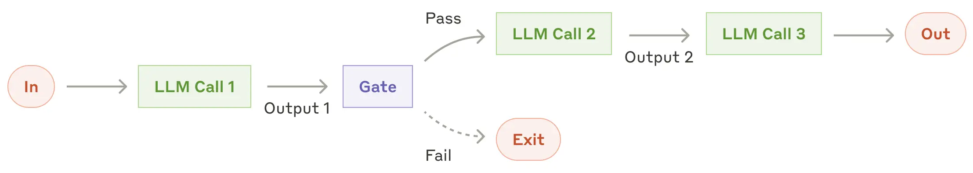
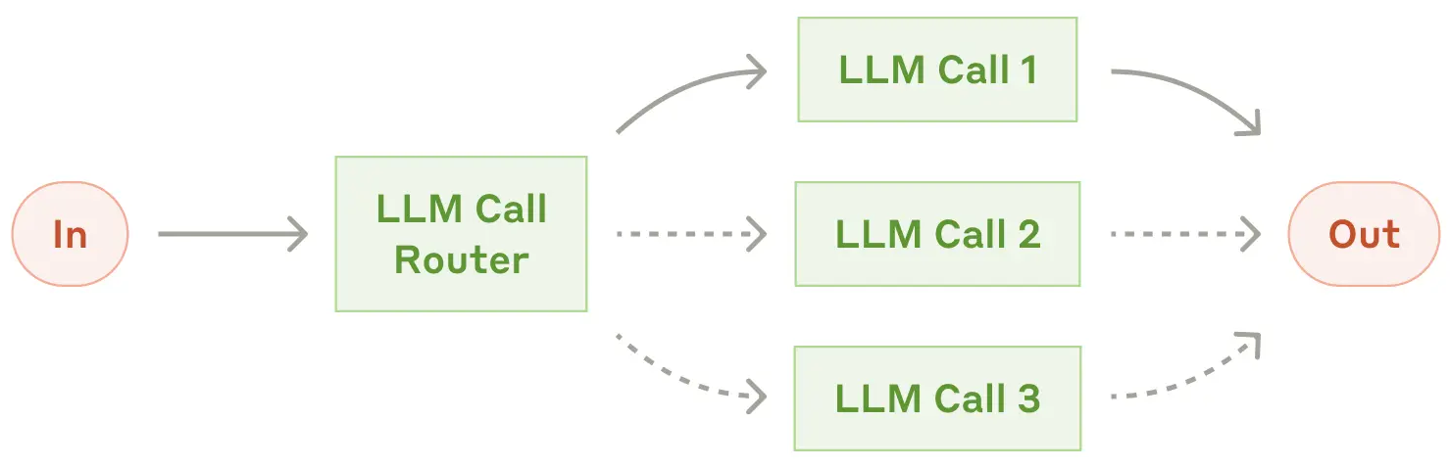
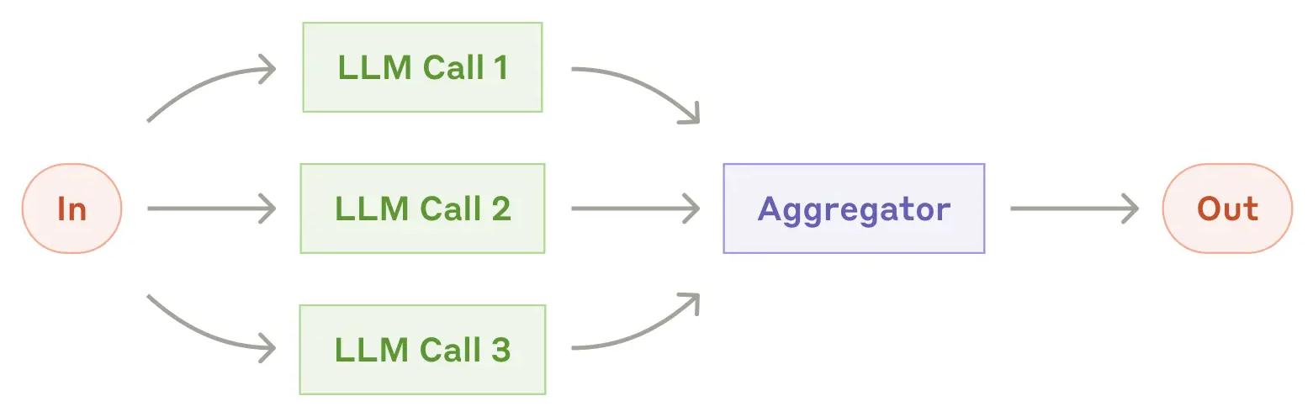
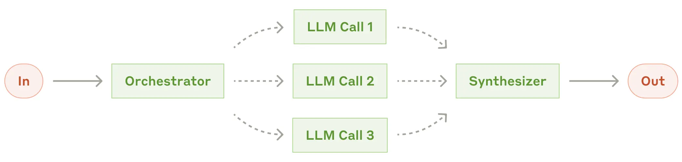
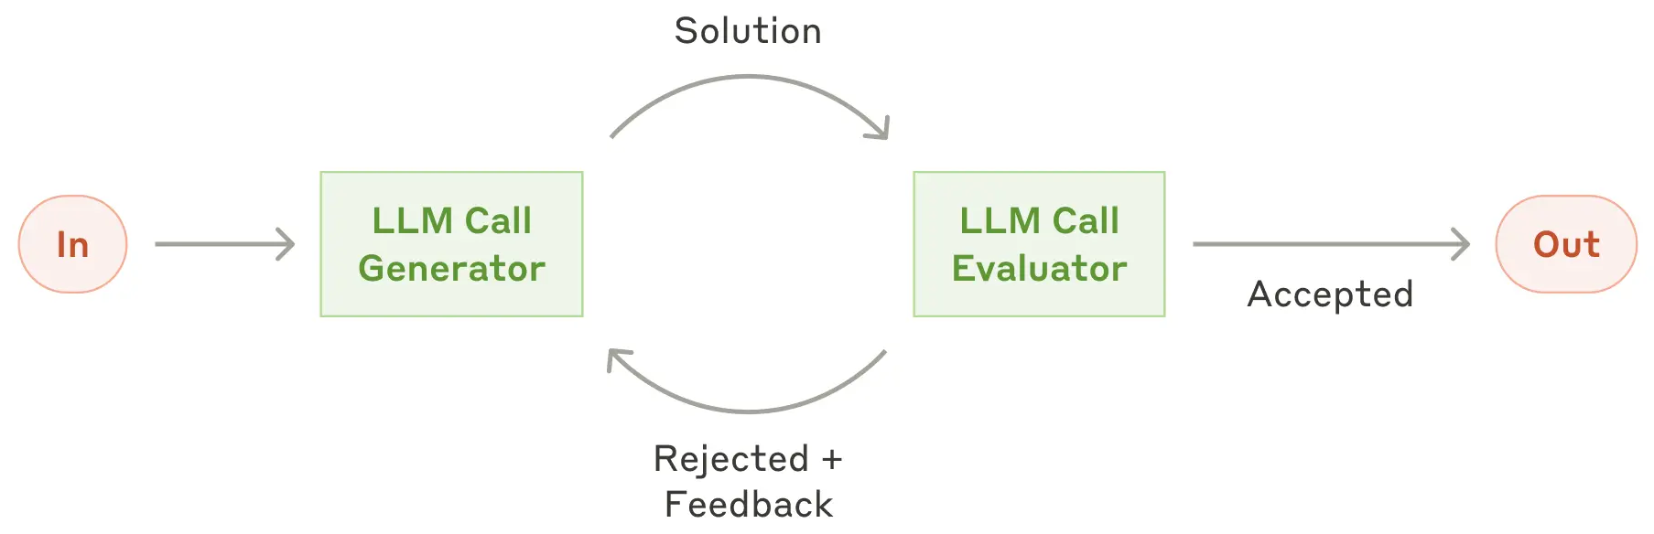
5 Major Workflow Design Patterns
1. Prompt Chaining
2. Routing
3. Parallelization
4. Orchestrator-Workers
5. Evaluator-Optimizer

Slide 15
5 Major Workflow Design Patterns
Pattern | Topology | Who picks next step? | Who picks when to stop?
Chaining / Routing / Parallelization | Fixed (authored DAG) | Code | Code
Evaluator-Optimizer | Fixed loop | LLM (revise vs. accept) | LLM
Orchestrator-Workers | LLM picks subtasks; shape fixed | LLM (picks subtasks) | LLM
(Full-Blown) Agent | LLM picks freely; tools predefined | LLM (picks tools & steps) | LLM

Slide 16
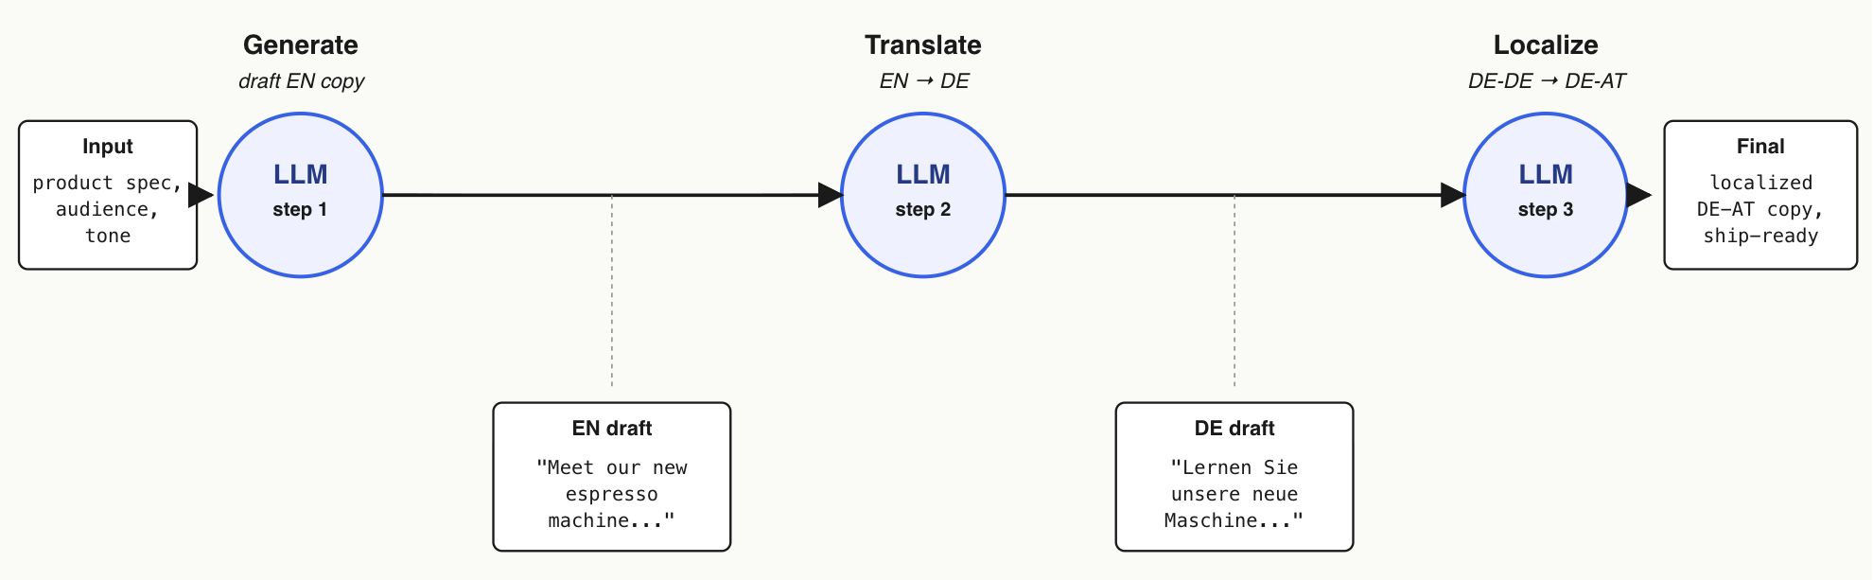
Example: Prompt Chaining
Marketing Copy Pipeline

Slide 17
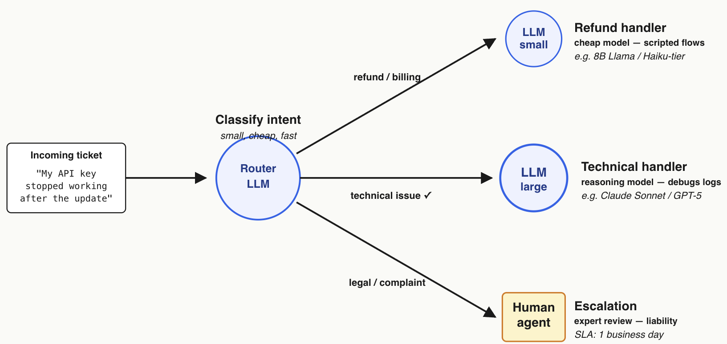
Example: Routing
Customer Support Triage

Slide 18
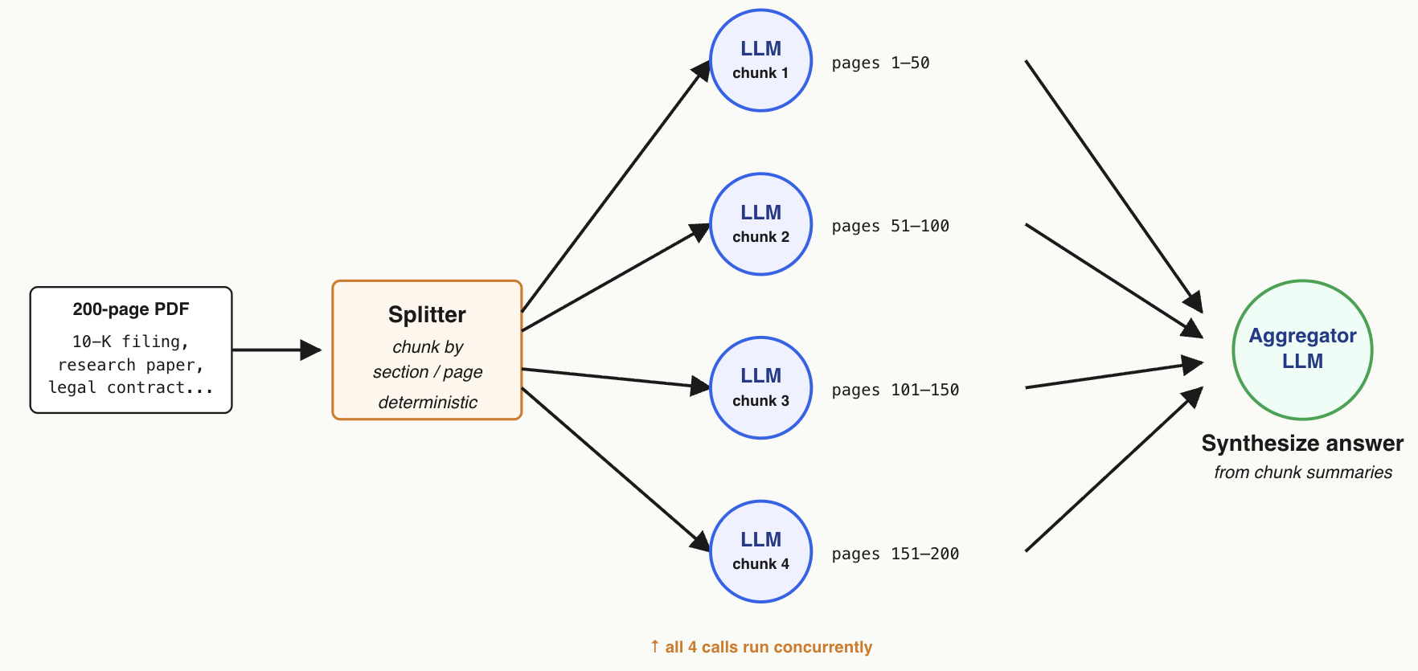
Example: Parallelization
Large Document Q&A

Slide 19
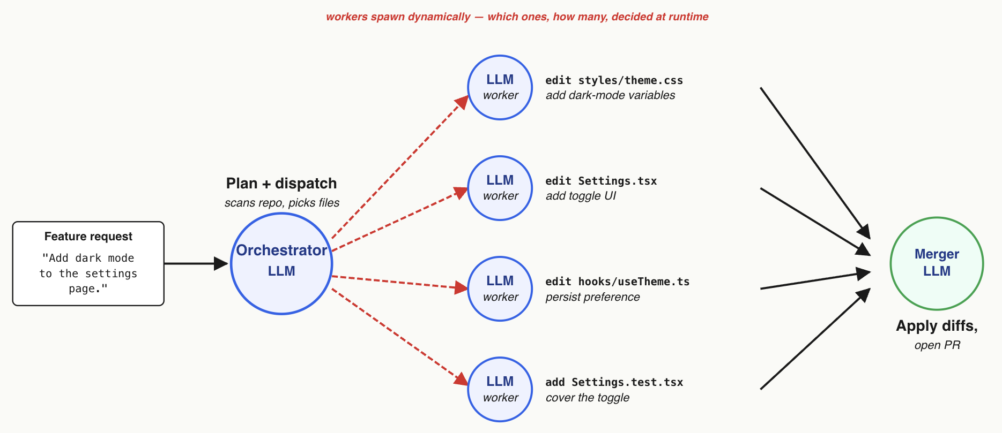
Example: Orchestrator-Workers
Coding Agent

Slide 20
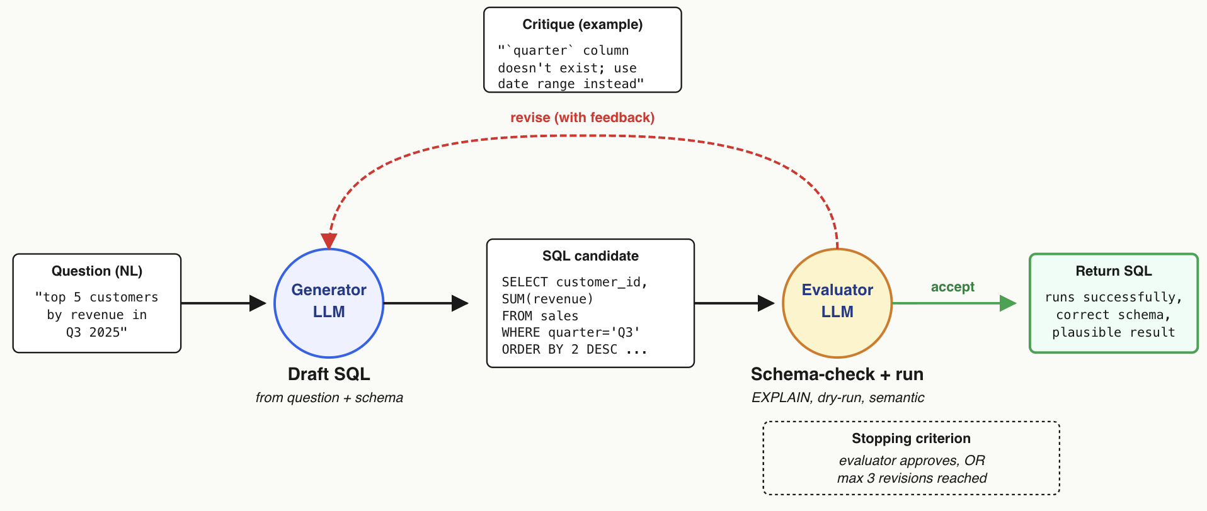
Example: Evaluator-Optimizer
NL-to-SQL with Schema Checker

Slide 21
Workflow vs. Agent vs. Both
When to reach for workflow vs. agent vs. both?
 | Workflow | Agent
Structure | Can draw control flow upfront | Truly unknown until run time
Intermediates | Need control over this | Open-ended
Cost / Latency | Constraints are strict | Overshooting acceptable
Many non-trivial AI applications often compose workflow patterns and agentic elements
  “Agentic workflow” term encompasses full spectrum
Best Practice: Do NOT build an agent if a workflow suffices! :)

Slide 22
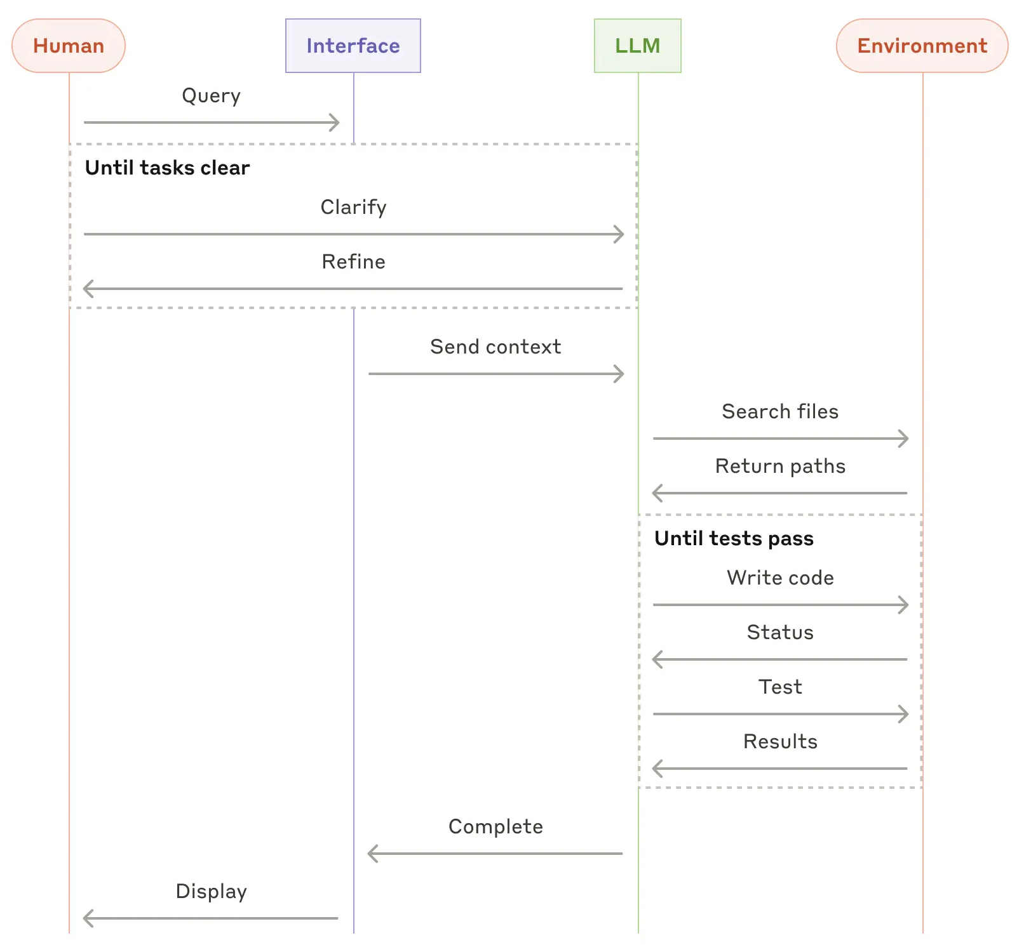
Example: Coding Agent

Slide 23
Outline
Motivation
Design Foundations
Harness Eng. and Components
Multi-Agent Workflows
Observability and Evals

Slide 24
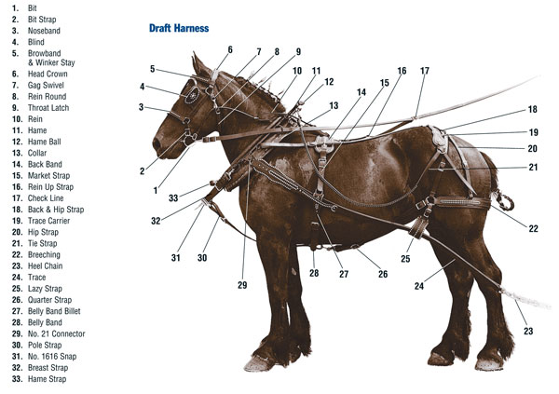
What is a “Harness”?

Slide 25
Harness Engineering for LLMs
“Harness” is a loose software eng. term for everything that surrounds the LLM(s) to boost functionality, provide reliability, and integration with application
  Code loops, prompt/context/retrieval management, tools and dispatchers, memory management, guardrails, etc.
  LLM provides “horsepower” of reasoning/decision-making; harness harnesses it to meet application goals
  Not a clean partition but a useful software design concept
  In practice: LLM API calls < 5% of effort; 95% is harness! :)

Slide 26
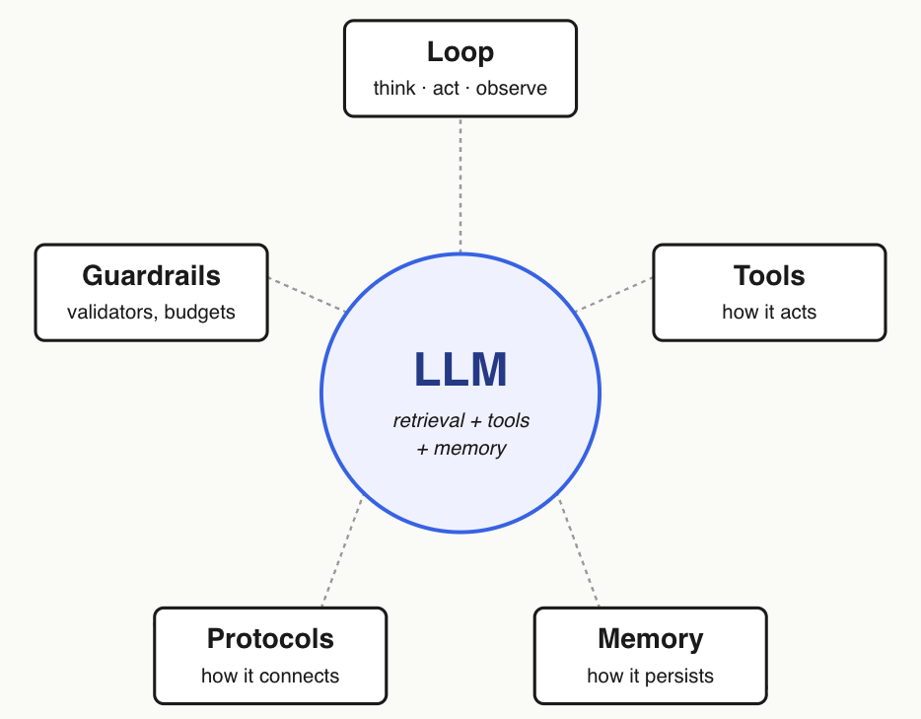
Harness Engineering for LLMs

Slide 27
Outline
Motivation
Design Foundations
Harness Eng. and Components
  Tools: For Actions
  Memory: For Persistence
  Protocols: For Connectivity
Multi-Agent Workflows
Observability and Evals

Slide 28
Tools: Why?
“Package” pre-existing software to enable an LLM to use it as part of its agentic workflow:
  Makes LLMs more useful for more types of work
  More timely inputs from and/or actions on environment
  More grounded reasoning/results, less hallucination
  Validation in the loop to reduce compounding errors
Defining a tool is more akin to data annotation than coding!

Slide 29
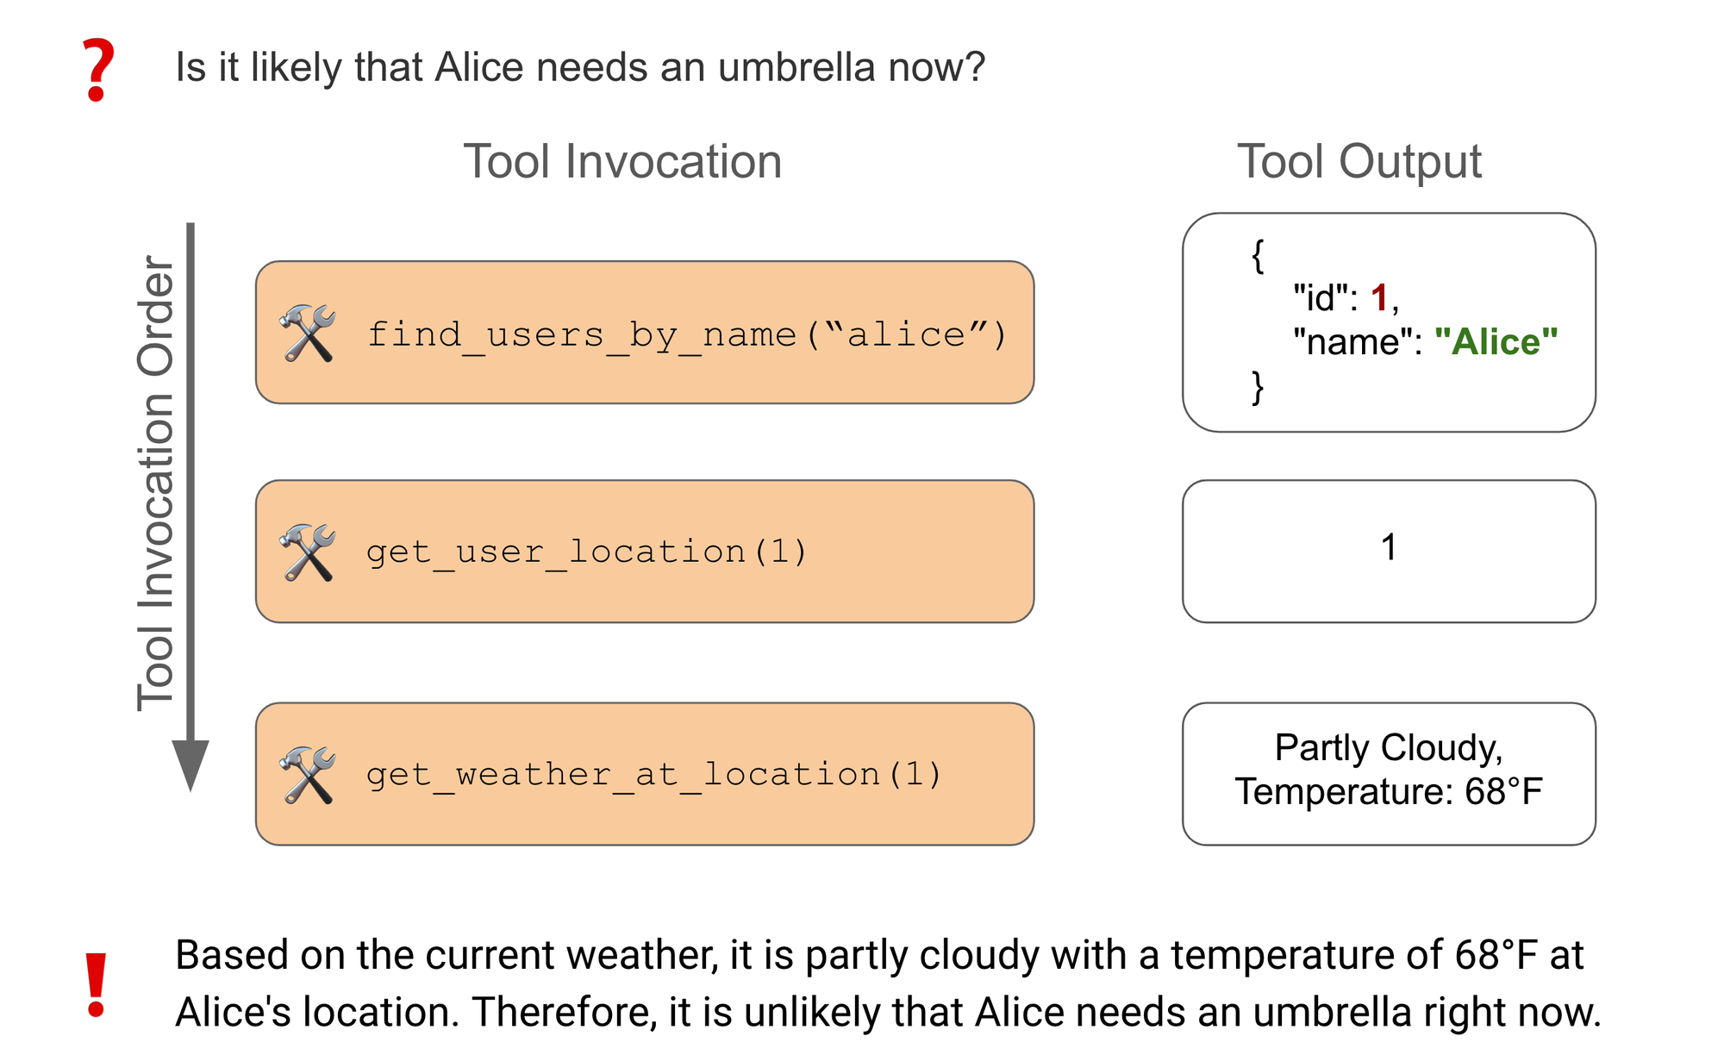
Tools: Why?
Credit: https://www.langchain.com/blog/benchmarking-agent-tool-use

Slide 30
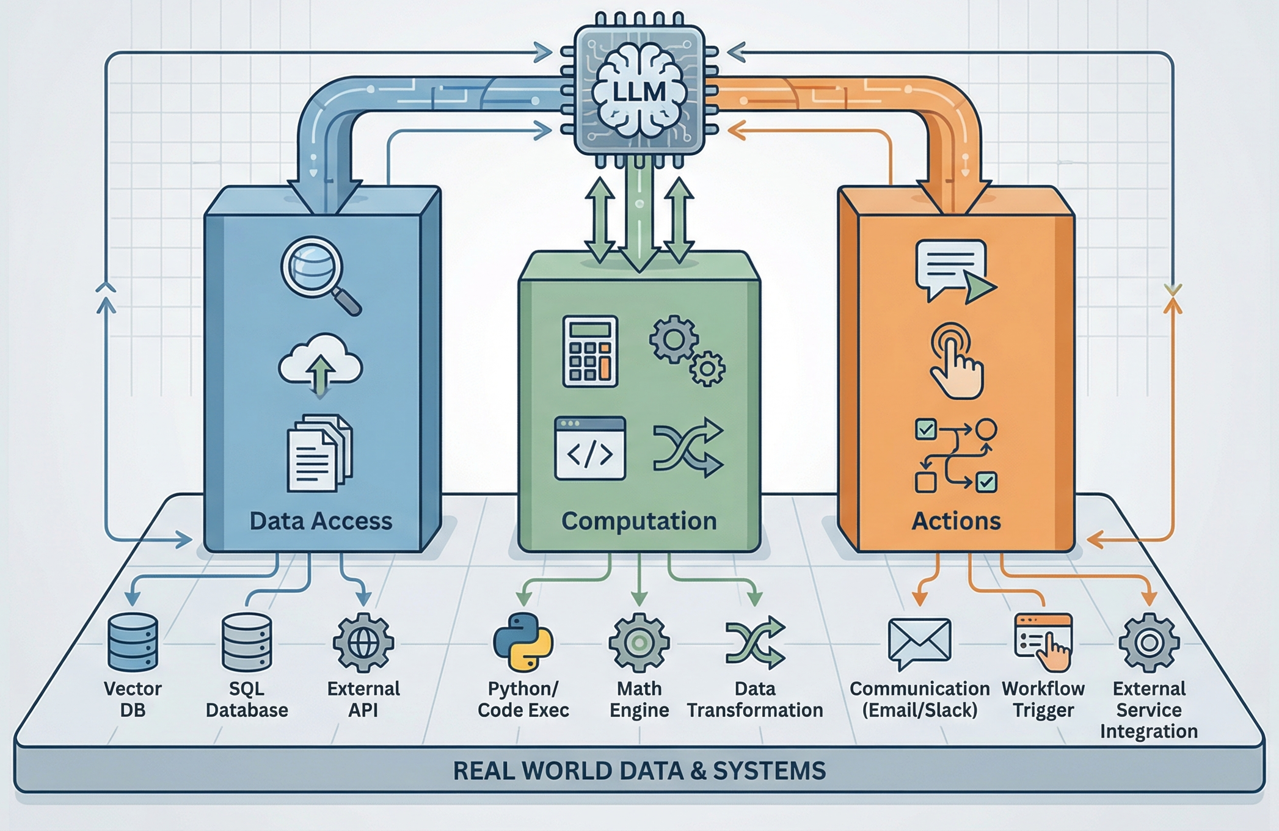
Tools: Why?
Credit: https://machinelearningmastery.com/mastering-llm-tool-calling-the-complete-framework-for-connecting-models-to-the-real-world/

Slide 31
Tools: What?
A tool definition is just an API with functions, names and types of inputs/outputs, descriptions for everything, and error info.
{
name: "searchFlights",
description: "Search for available flights",
inputSchema: {
type: "object",
properties: {
origin: { type: "string", description: "Departure city" },
destination: { type: "string", description: "Arrival city" },
date: { type: "string", format: "date", description: "Travel date" }
},
required: ["origin", "destination", "date"]
}
}
searchFlights (origin: "NYC", destination: "Barcelona", date: "2024-06-15")
Source: https://modelcontextprotocol.io/docs/learn/server-concepts#tools

Slide 32
Tools: What?
Names: Make it descriptive, e.g., get_user_emails, not getue3
Params: What LLM would name them, e.g., recipient, not r0
Description: Explain what it does, when to use it, AND when NOT to use it
Errors: Written for the LLM to recover from, e.g., not “404”; say “user_id 12345 doesn’t exist; try list_users() first”
Source: https://modelcontextprotocol.io/docs/learn/server-concepts#tools

Slide 33
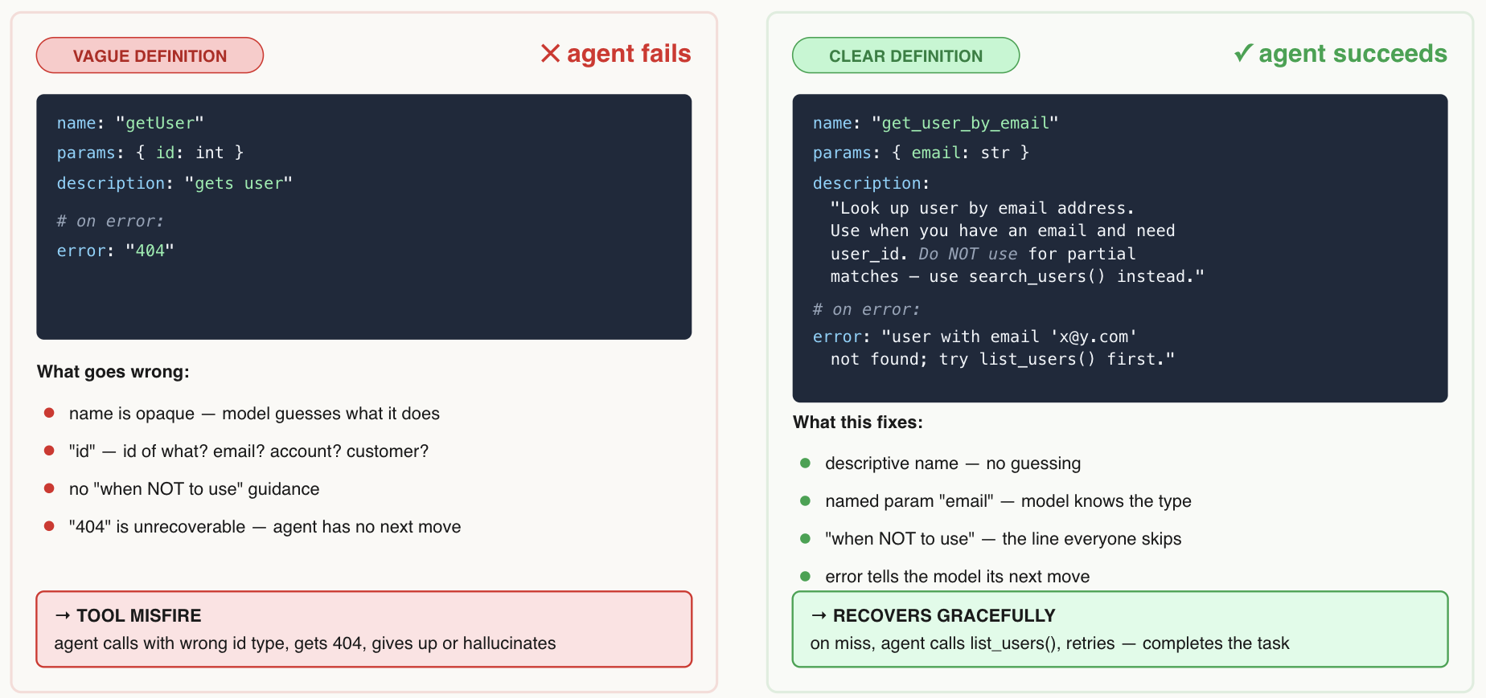
Tools: What?
More precision in tool definitions is better for reliability

Slide 34
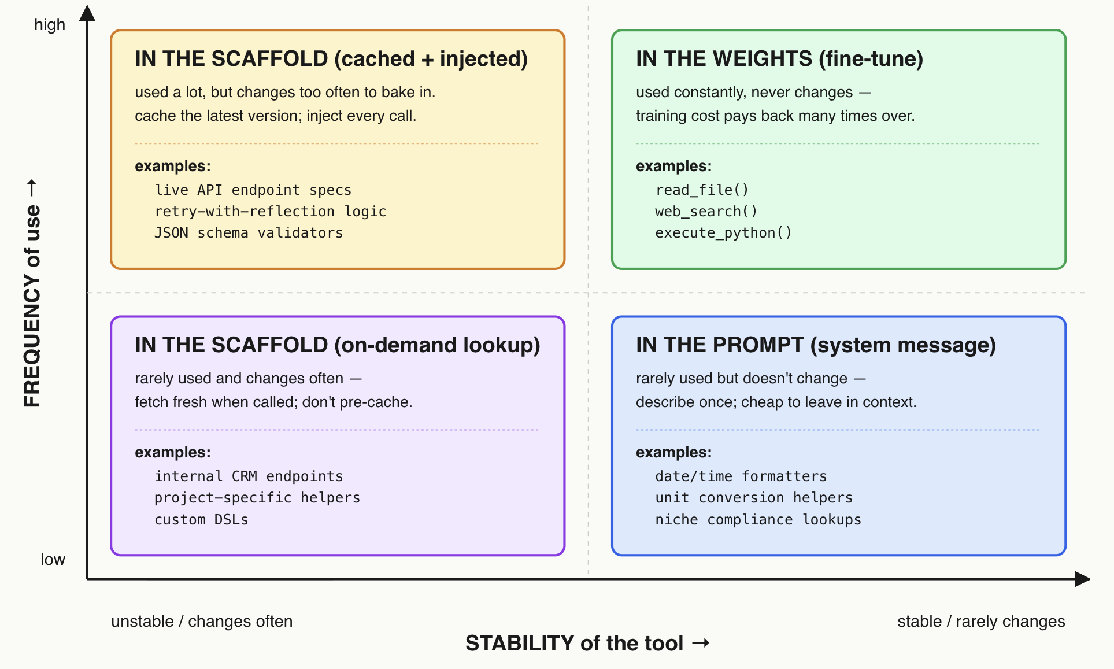
Tools: Where?
Tool use can be “taught” in multiple places based on stability of tool and frequency of use by application

Slide 35
Outline
Motivation
Design Foundations
Harness Eng. and Components
  Tools: For Actions
  Memory: For Persistence
  Protocols: For Connectivity
Multi-Agent Workflows
Observability and Evals

Slide 36
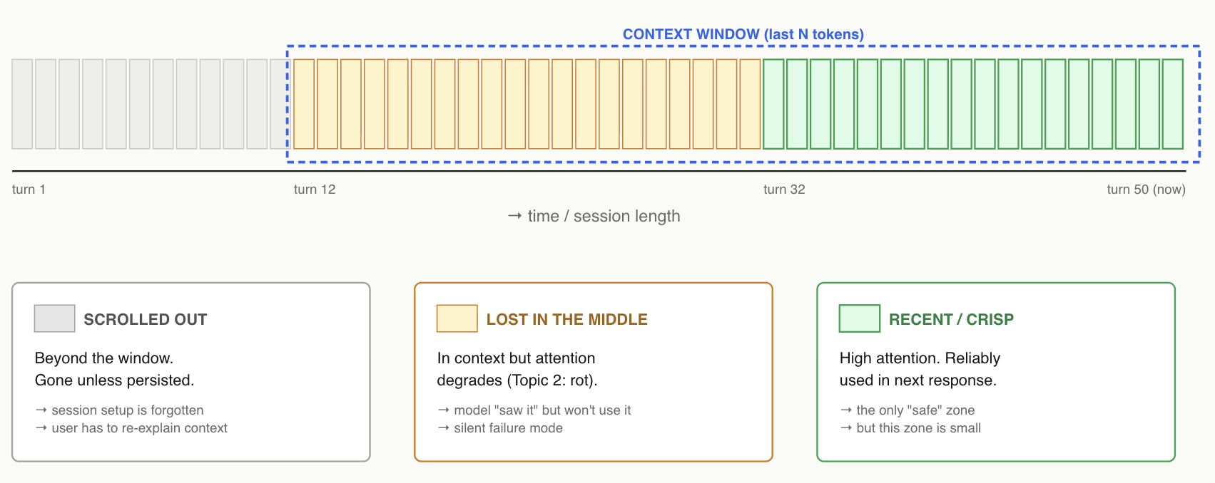
Memory: Why?
Balances a fundamental tradeoff on managing intermediates:
  Get rid of them -> Likely useful info. lost
  All inside context window -> Risk of context rot

Slide 37
Memory: Three Tiers
Now-canonical notion of 3 tiers of “memory” for AI applications:
  Observation Stream: Every event, timestamped, append-only log
  Reflection: LLM periodically synthesizes higher-level beliefs, e.g., “this repo uses pytest”
  Plan: Forward-looking, regenerated as conditions change
Retrieval must take into account recency, relevance, and LLM-rated importance; the agent runs LLM-as-judge on its own past!
Generative Agents: Interactive Simulacra of Human Behavior. UIST 2023.
https://arxiv.org/pdf/2304.03442

Slide 38
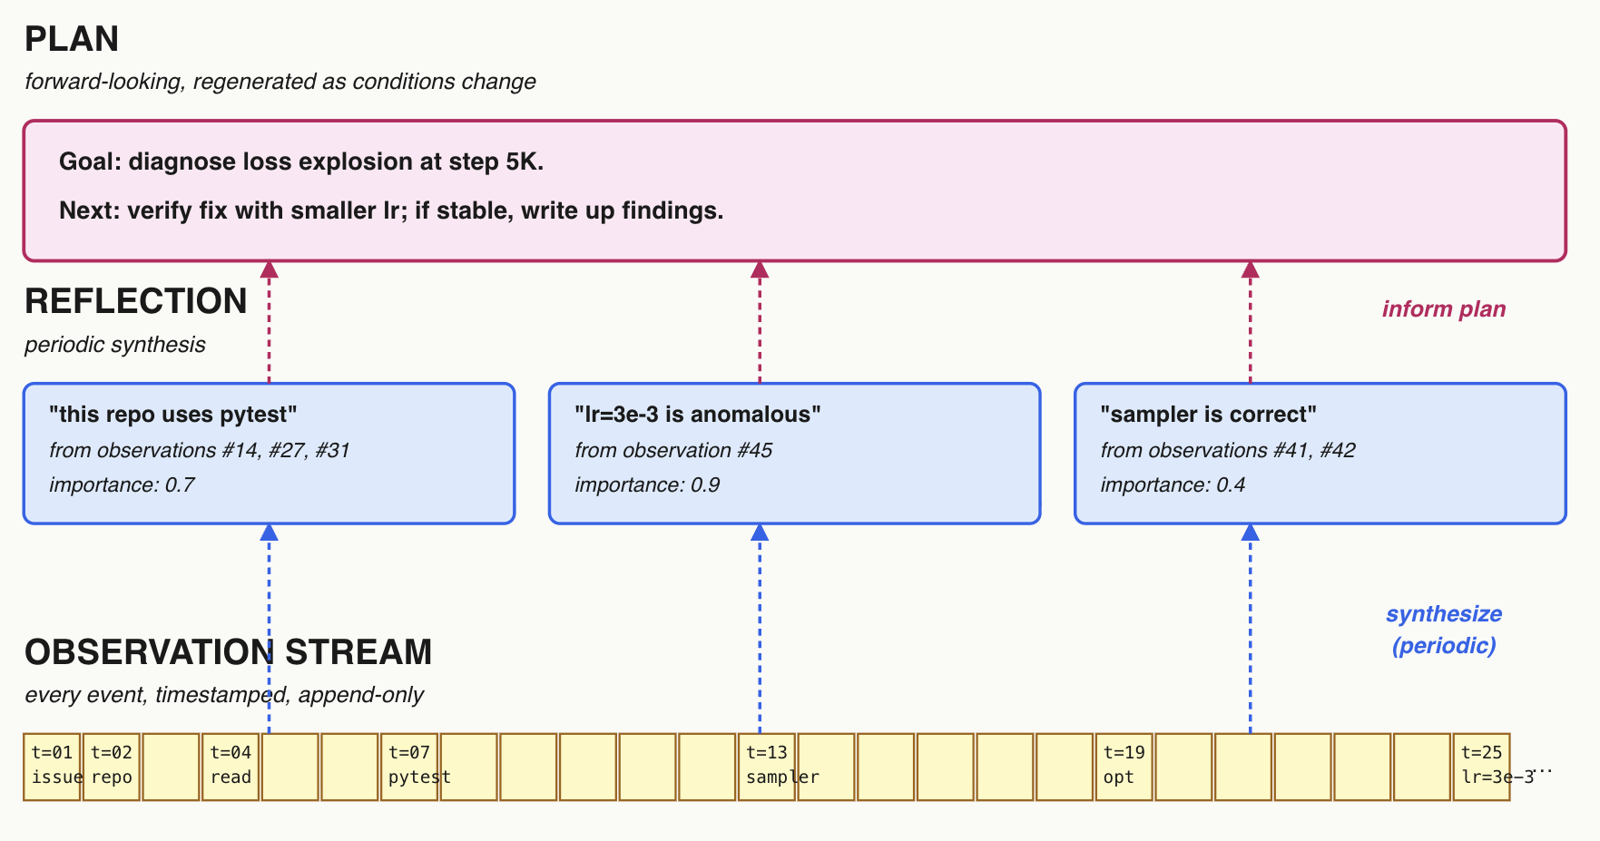
Running Example

Slide 39
Memory Management Principles
“Memory” for LLMs/agent is NOT like system DRAM!
  More is NOT always better (context rot, token spend, etc.)
  Inherently lossy notions of “summarization” needed
Production memory management must aggressively handle this tradeoff of what to “forget” and how much:
  Do you really need full trace of older turn? Do you really need tool call specifics after context enriched?
  Use LLM itself to summarize at different stages / levels? KG/ontology to guide structured summaries?

Slide 40
Scope of Agent Memory
4 main levels:
  Per-session vs. per-user vs. per-team vs. per-org.
Considerations and tradeoffs:
  Different stores with cross-references?
  What system substrate?
  Levels of summarization?
  Access control, privacy, security, governance
Still an active area of research!

Slide 41
Outline
Motivation
Design Foundations
Harness Eng. and Components
  Tools: For Actions
  Memory: For Persistence
  Protocols: For Connectivity
Multi-Agent Workflows
Observability and Evals

Slide 42
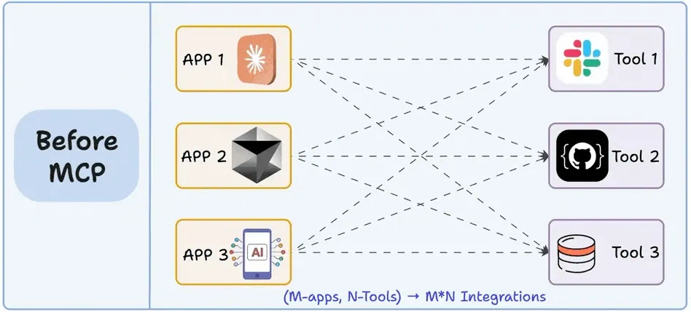
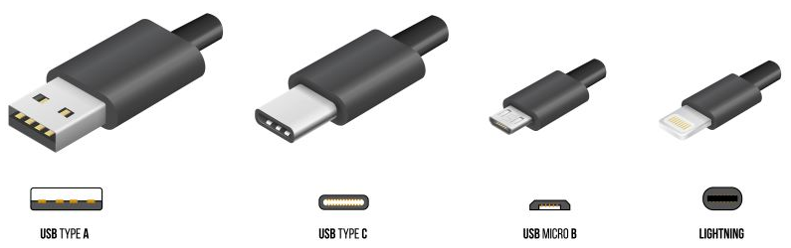
Protocols: Why?
Problem: ~2 years ago, every agent eng. framework needed to implement its own interface to tools
  Integrations were bespoke, non-portable, error-prone
  “M x N complexity” of integrations
Pressing need for a standard for agent-tool communication

Slide 43
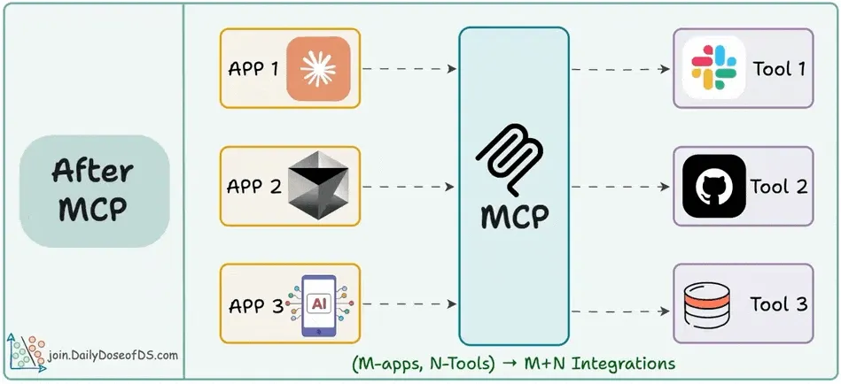
Model Context Protocol (MCP)
Open protocol introduced by Anthropic in Nov 2024
Unified how any LLM had to “understand” how to use any tool
Has become industry standard AI infra. used by all vendors
  Under Linux Foundation
  ~100mil monthly SDK downloads!
Source: https://blog.dailydoseofds.com/p/the-mn-integration-problem-solved?ref=dailydev

Slide 44
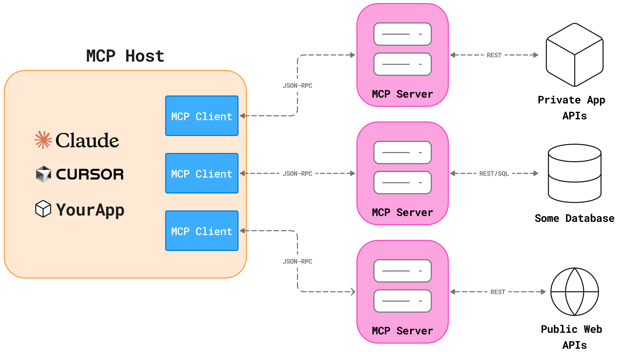
Model Context Protocol (MCP)
Host (your appl.) <-> Client (runtime) <-> Server (the tool)
Source: https://mcpcat.io/blog/mcp-server-client-host

Slide 45
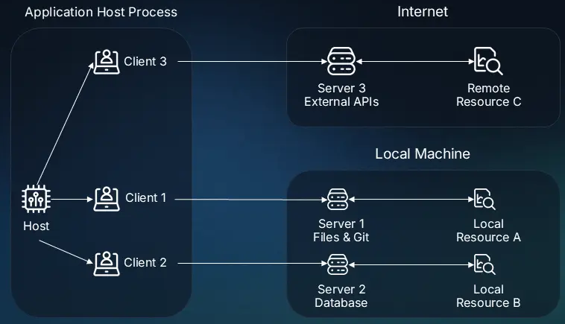
Model Context Protocol (MCP)
MCP Servers can be on local machine too, not just remote
Source: https://www.descope.com/learn/post/mcp

Slide 46
Model Context Protocol (MCP)
An MCP Server has 3 primitives: Tools, Resources, Prompts
Tools (Model-Controlled):
  Executable functions that an AI appl. can invoke to perform actions, such as running a DB query, sending an email, calling a weather API
Resources (Application-Controlled):
  Read-only data sources that provide context info. to an AI appl., such as file contents, logs, DB records, API responses
Prompts (User-Controlled):
  Pre-defined instruction templates that help an LLM use tools or resources well, e.g., a “Code Review” prompt, few-shot examples

Slide 47
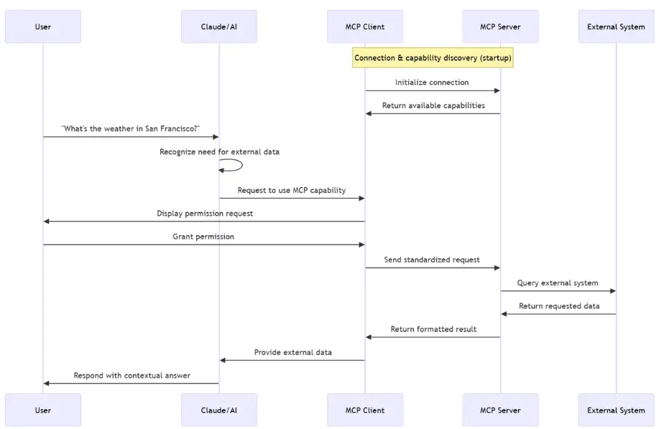
Model Context Protocol (MCP)

Slide 48
Model Context Protocol (MCP)
Data Layer:
  JSON-RPC 2.0 messaging structure and semantics
Transport Layer:
  STDIO for local communication
  HTTP Post for inter-machine communication
Request Handlers:
  Internal logic that listens for incoming calls, e.g., list_tools, call_tool, and executes the corresponding backend action
State & Session Management:
  Manages stateful connections and carries context from one request to the next within a session
Examples: https://modelcontextprotocol.io/examples

Slide 49
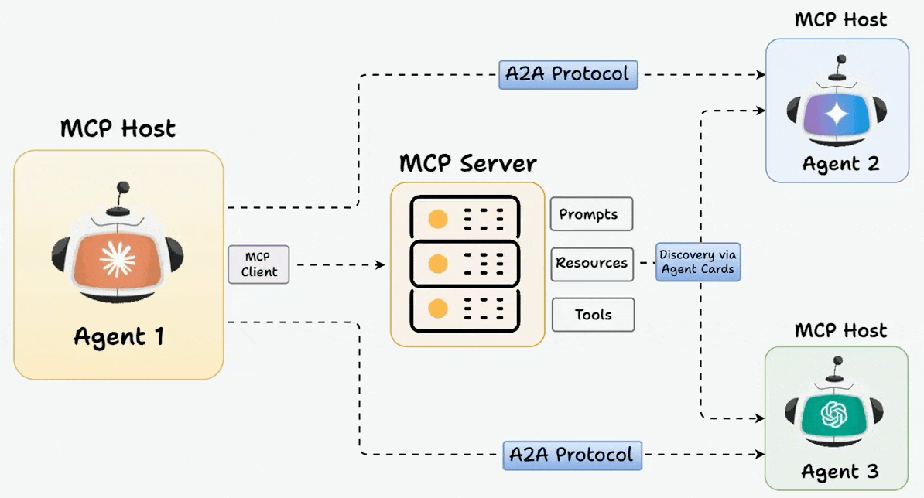
Agent 2 Agent Protocol (A2A)
Problem: Agents now talk with other agents too, not just tools
A2A introduced by Google in 2025
  Think of A2A as “horizontal” and MCP as “vertical”
  Also industry standard now; also under Linux Foundation
  Notions agent “cards”, “tasks”, “lifecycle”, etc. for discovery of agents, inter-agent communication, task delegation, etc.

Slide 50
Recap: Harness Engineering

Slide 51
Outline
Motivation
Design Foundations
Harness Eng. and Components
Multi-Agent Workflows
Observability and Evals

Slide 52
Why Multiple Agents?
Recall issues of context rot, context window limit, token limits
So, in a complex AI application, it is sometimes worthwhile to decompose work to alleviate 3 key pressure points:
  Context: One agent’s window fills with all info. vs. Separate (sub-)agents with their own windows
  Objectives: Separation of concerns, e.g., “research AND critique AND format” could cause “conflict of interest”
  Permissions: Contain security blast radius with designated (sub-)agent roles and access control/permissions
But it introduces a new complexity: How to coordinate?

Slide 53
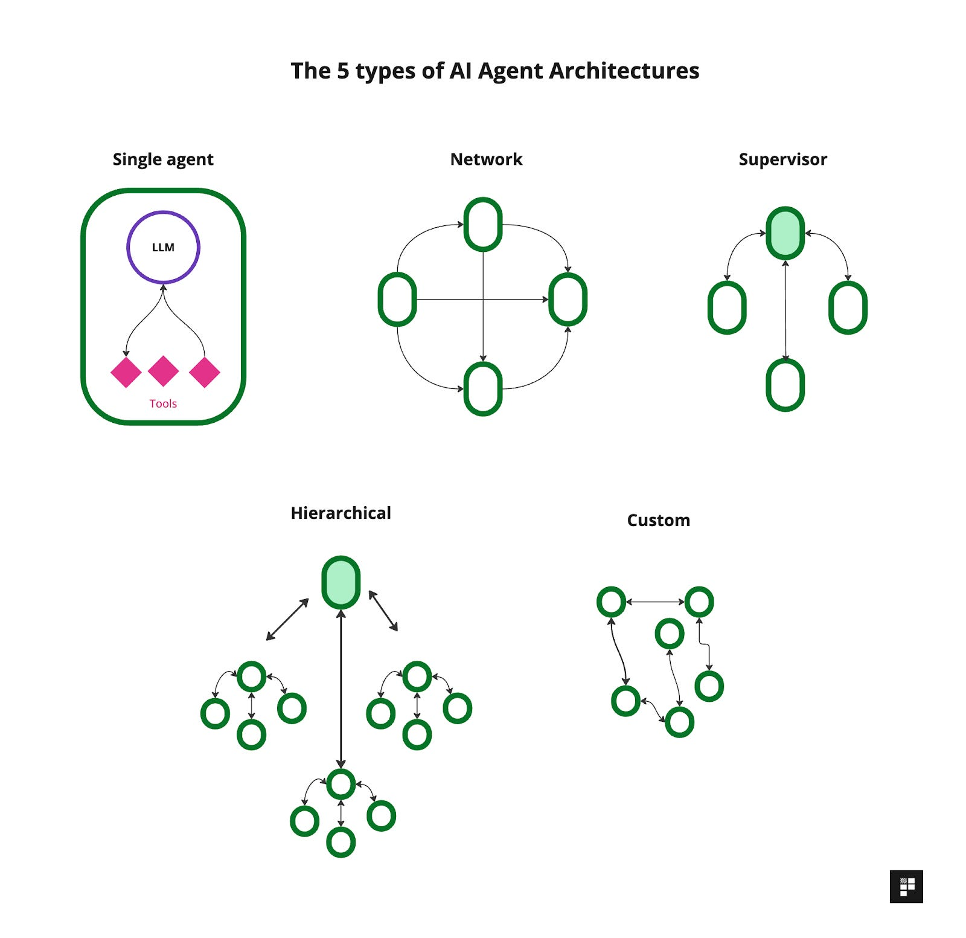
Multi-Agent Topologies
A few major topologies of multi-agent workflows:
  Peer-to-Peer/Network: Debate / vote toward consensus
  Supervisor: Decomposes and delegates to subordinates
    Hierarchical: Recursive supervision
  Pipeline: Specialists hand off in sequence

Slide 54
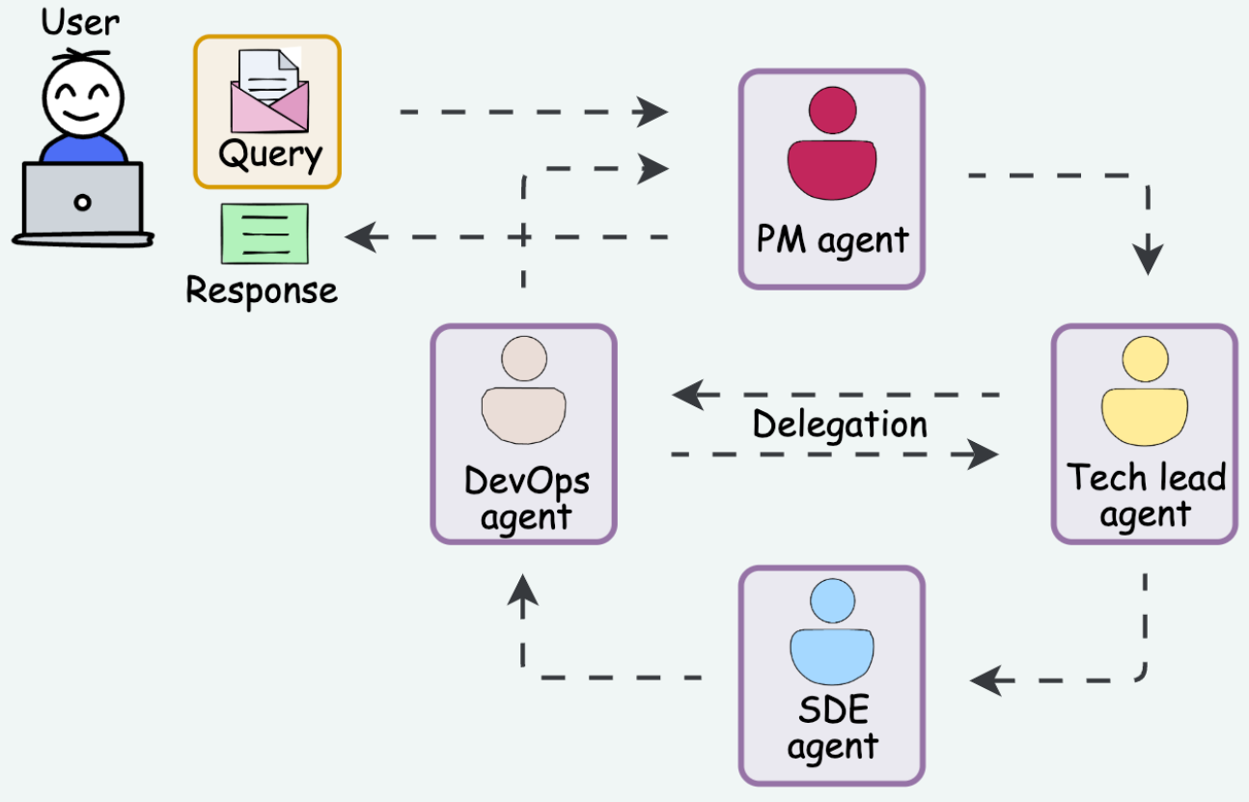
Multi-Agent Topologies
Agent roles are reusable: planner, researcher, writer, critic, etc.
How they coordinate affects eval metrics, latency, costs, etc.
Often anthropomorphized based on human team structures!

Slide 55
Tradeoffs of Multi-Agent Workflows
Multi-agent workflow structure is NOT always necessary nor always useful
  Mo’ agents, mo’ problems! :)
  More evals, traces to debug, contradictions, costs, etc.
Only a few successful multi-agent workflows in production so far
Different agent eng. frameworks have their own terminologies but are essentially interchangeable
  LangGraph, CrewAI, OpenAI Agents SDK, Google ADK
  All rely on MCP servers as their tool layer

Slide 56
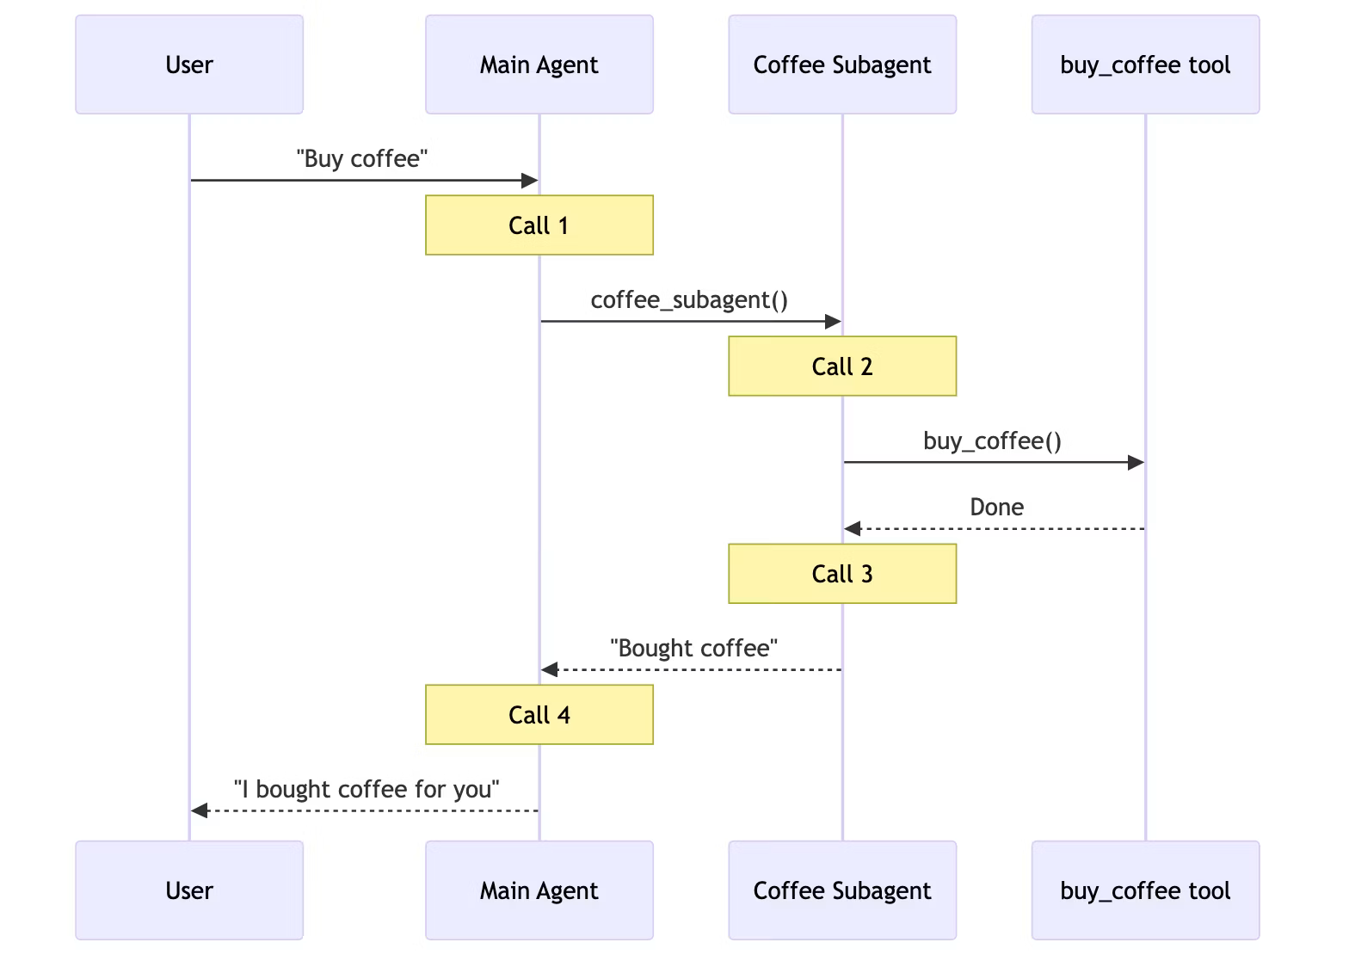
Example: Multi-Agent Workflow
Source: https://docs.langchain.com/oss/python/langchain/multi-agent

Slide 57
Outline
Motivation
Design Foundations
Harness Eng. and Components
Multi-Agent Workflows
Observability and Evals

Slide 58
Why Observability?
As agentic apps become more complex and multi-step, need to keep a tab on what they do at every step
Trace: A log of every “thought”, action, or observation by an AI application at production/inference time
  Input, output, timestamp, other metadata
  Full prompt each turn (system + history + tools)
  Tool calls WITH arguments AND results
  Per-step latency and tokens
  Loop termination cause
Observability: Managing all trace data for all AI applications

Slide 59
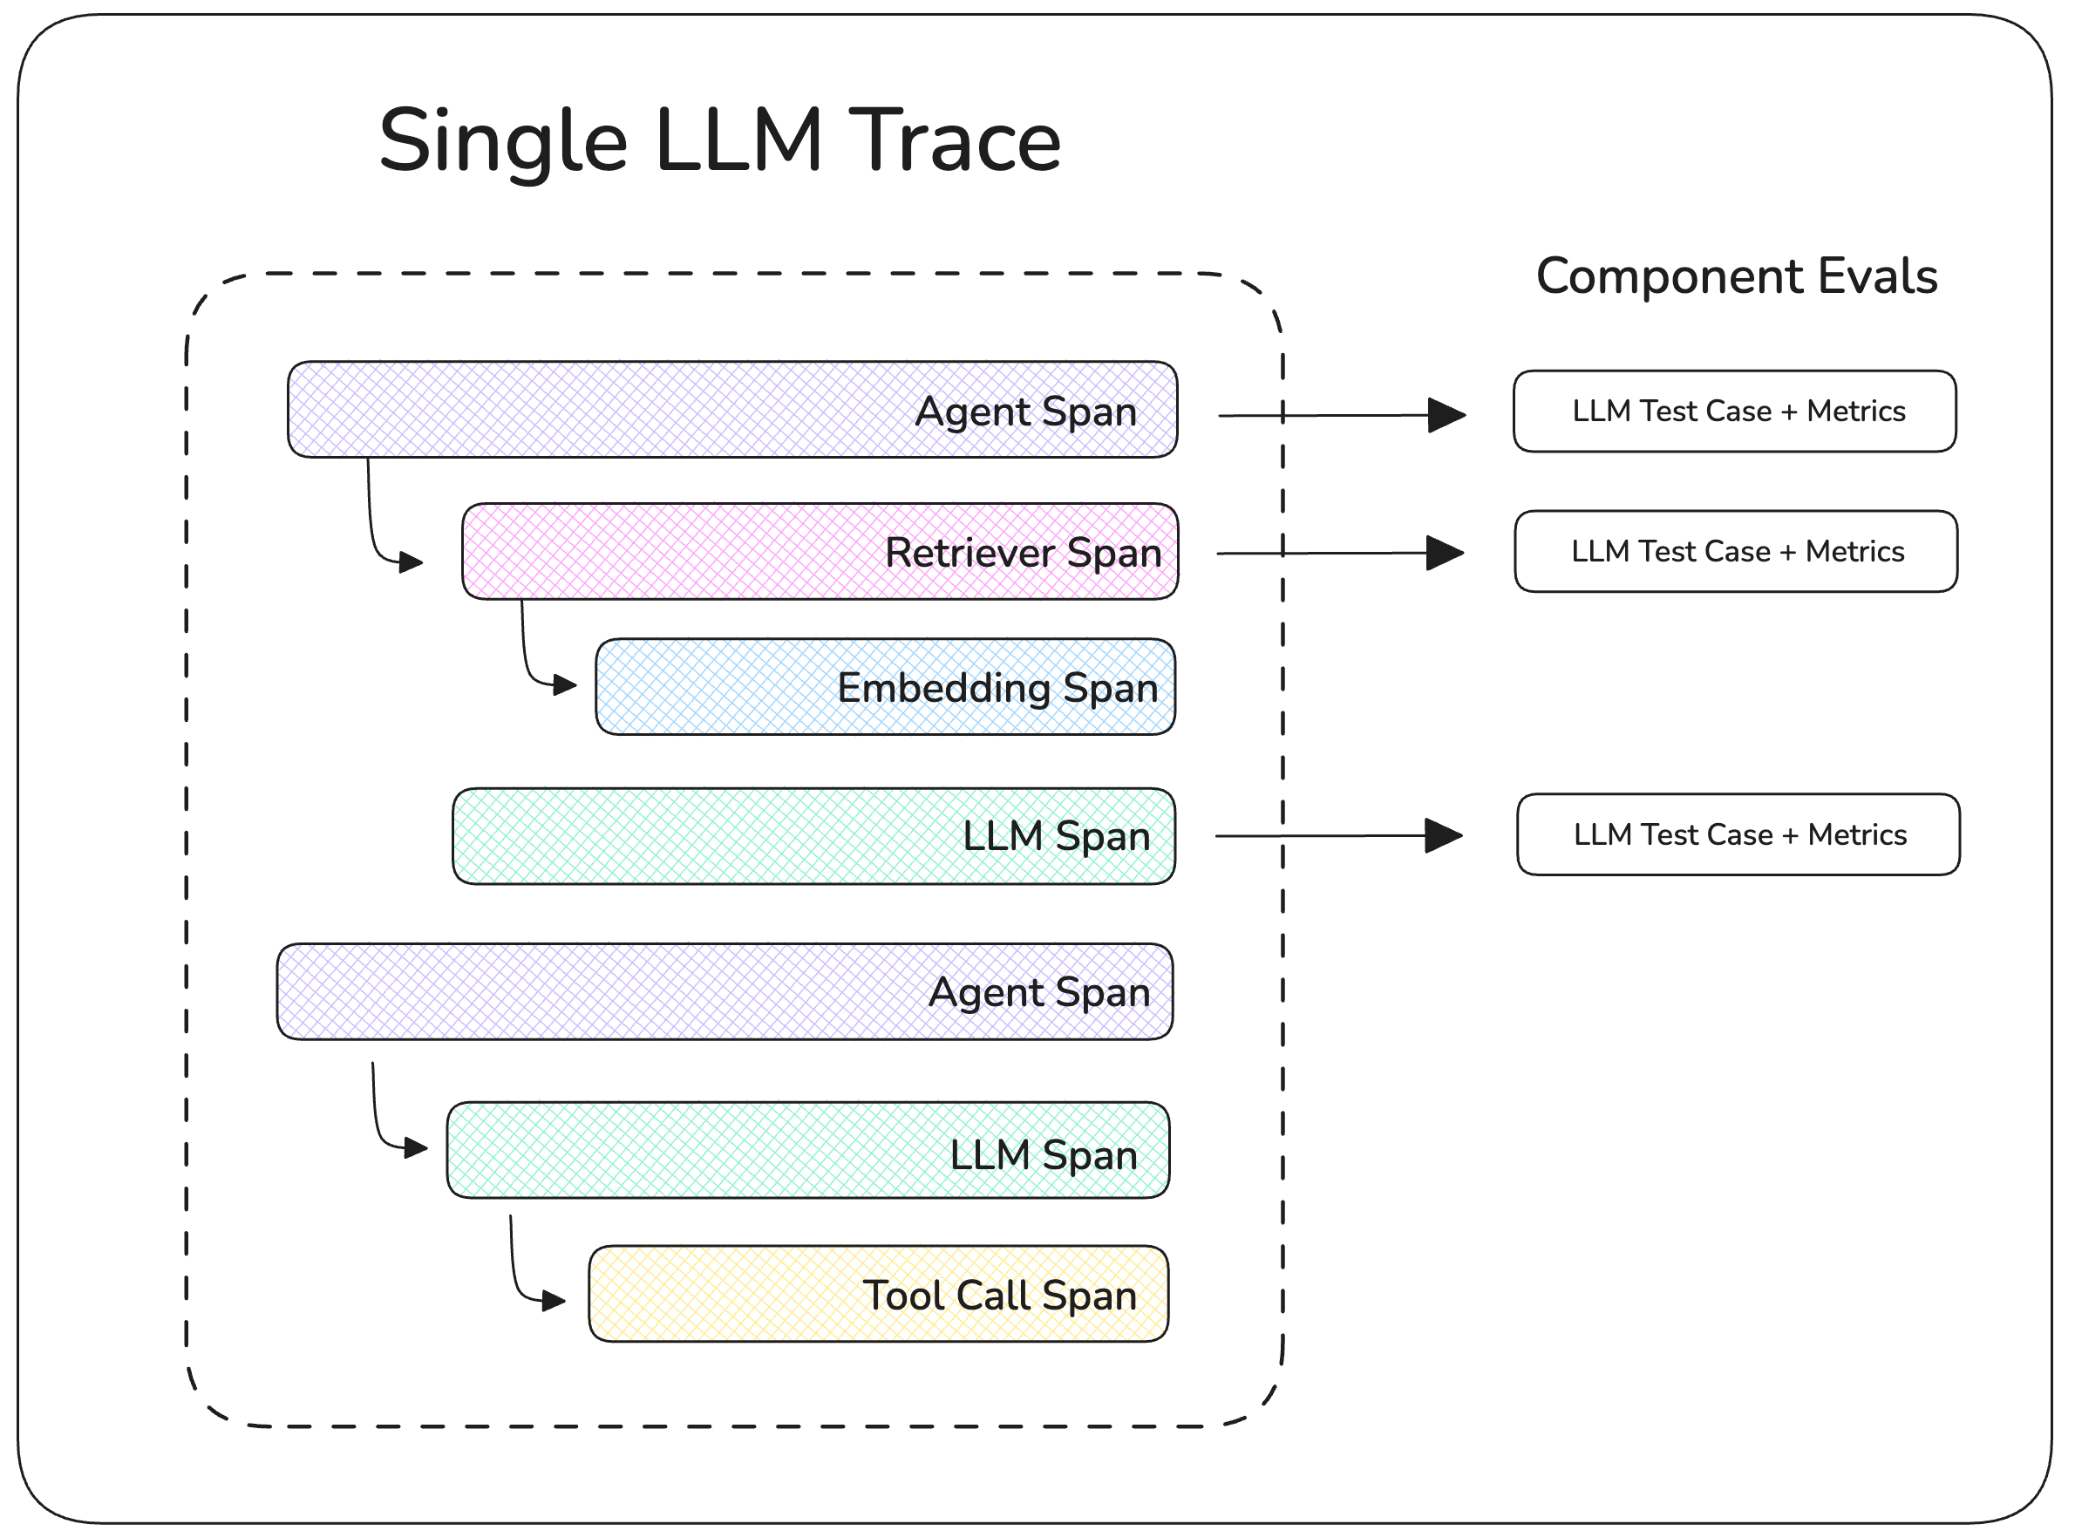
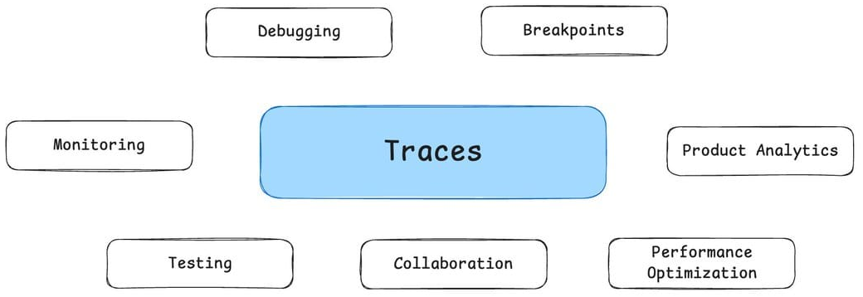
Traces for Agentic Workflows
Traces are critical for various purposes: debugging, auditing, monitoring, etc.

Slide 60
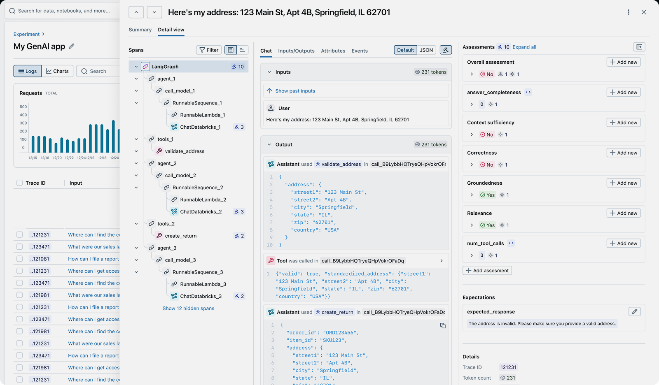
Traces for Agentic Workflows
Various tools exist to auto-track them: MLflow, W&B, LangSmith, Arize AI, etc.
Source: https://mlflow.org/llm-tracing

Slide 61
Open Question: Evals for Agents
How does one evaluate an agentic workflow?
No single best approach or consensus yet
Best practice is to track at least 4 groups of items:
  Outcomes: Did it complete the task? (Accuracy)
  Tool Use: Did it use the right tools, right args? (Accuracy)
  Process: Was the path reasonable? (Efficiency, Cost)
  Failure Modes: Where did it break? (Reliability)

Slide 62
Outline
Motivation
Design Foundations
Harness Eng. and Components
Multi-Agent Workflows
Observability and Evals

Slide 63
Review Questions
How does an agentic workflow differ fundamentally from context/retrieval engineering?
What is the ReAct loop, and why combine reasoning with acting rather than using either alone?
List 3 failure modes of the core agent loop and one defense for each.
What single most important property distinguishes a workflow from an agent, and what are the practical consequences for cost, structure, and evals for the two?
Name 3 major agentic workflow design patterns, and for each say who picks the next step and who picks when to stop.
What is a “harness” in LLM/agent engineering?
What problem motivated MCP? How does it solve it?
Your AI colleague proposes a single agent workflow to handle IT support tickets that fall into 3 disparate buckets (refunds, technical, legal). Do you agree? Justify why or why not?

