Slide 1
CSE/DSC 234
Data-Centric AI and AI Engineering
Arun Kumar
Topic 2: Retrieval and Context Engineering

Slide 2
Outline
Introduction
Prompt Engineering
Retrieval and Context Engineering
  Retrieval vs. Long Context
  VectorRAG
  GraphRAG
  Other Forms of RAG

Slide 3
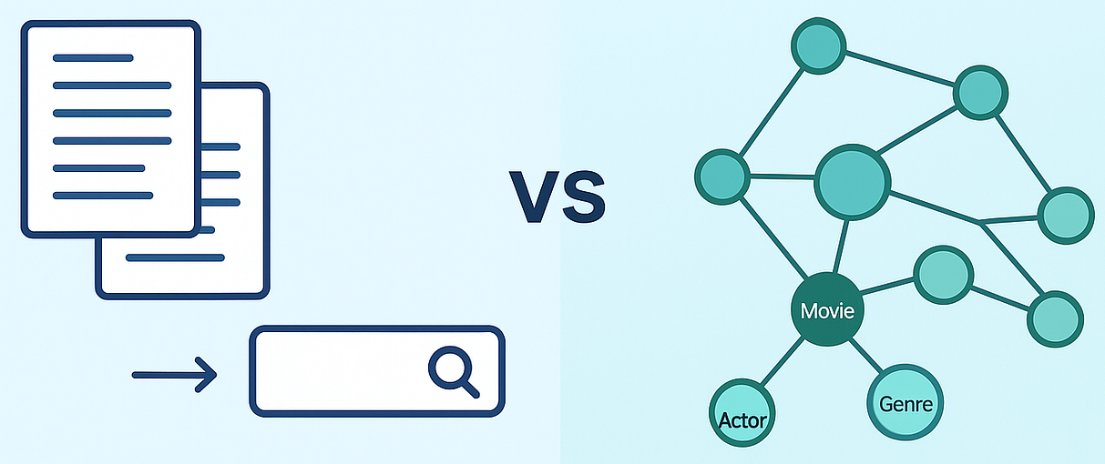
Motivation for GraphRAG
VectorRAG retrieves top-K passages by semantic similarity
  Works when the answer lives in a few specific chunks but fails when no single chunk contains the answer!
Two main failure modes:
  Global Sensemaking, e.g., “What are the main themes?”
  Multi-hop Reasoning, e.g., “How does X connect to Y via Z?”
Retrieval type queries insufficient; need summarization type too

Slide 4
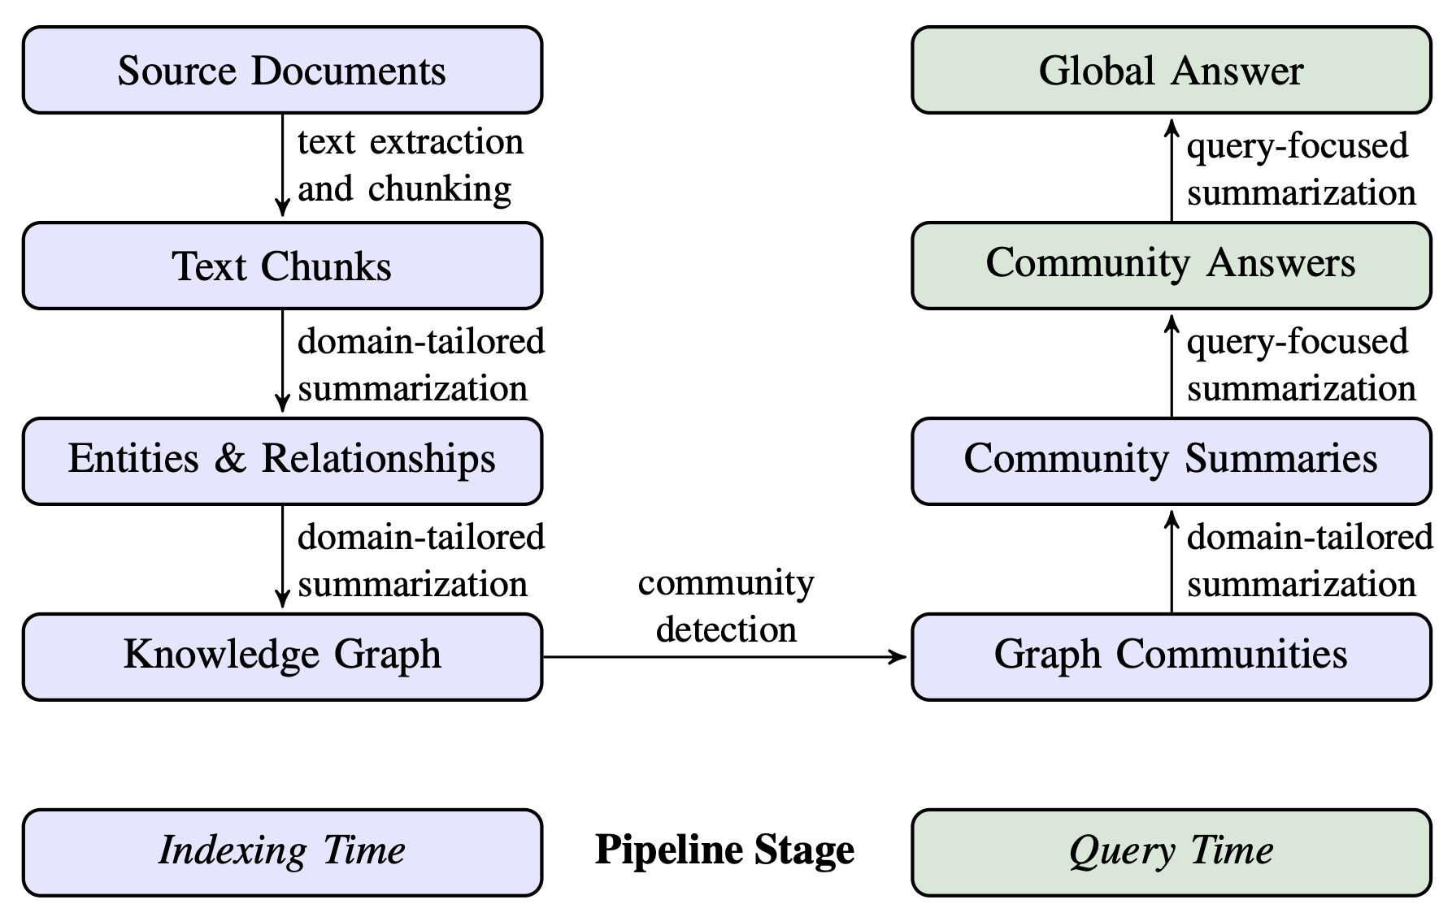
The GraphRAG Approach
From Local to Global: A Graph RAG Approach to Query-Focused Summarization. 2024.
https://arxiv.org/pdf/2404.16130

Slide 5
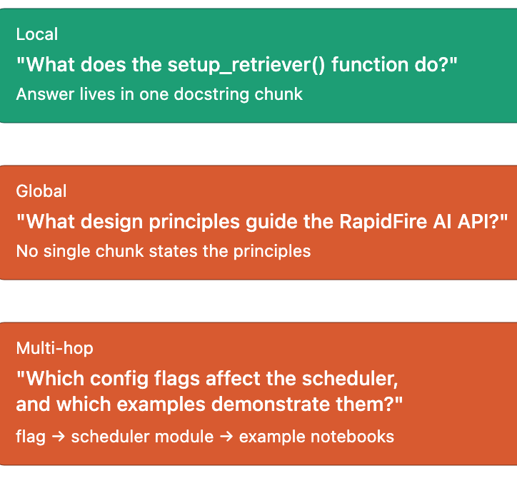
Example Queries for GraphRAG
Corpus: RapidFire AI documentation as in Project 1
Needs theme aggregation
Needs entity traversal

Slide 6
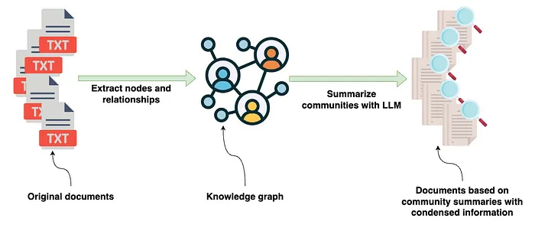
Graph Construction Stage
Knowledge Graph (KG) / Knowledge Base (KB) construction is well-studied in NLP+DB intersection
  Need notions of entities and relationships (an ontology)
  SOTA is to use LLMs to convert corpus into KG/KB
Expensive but one-time “indexing” stage; stored in Graph DBMS

Slide 7
Summarization Stage
Leiden algorithm for community detection (semantic clustering)
  Graph-oriented and preserves semantic coherence
  LLM produces one summary per community at each level
At query time need a “MapReduce” computation:
  MAP: Each summary answers query + emits usefulness score
  REDUCE: Merge answers, weighted by usefulness

Slide 8
GraphRAG in Practice
GraphRAG is not only for global queries; also has Local Mode:
  Seed graph search with entities in query
  Expand N hops on edges, gather neighbor text + relationships
  Useful for multi-hop and entity-centric queries
  Example: “Which config flags affect the scheduler?”
    Seed is “scheduler”
    1-hop expansion reaches per-flag neighbor node
In production, systems often route queries across multiple retrieval modes rather than picking just one: VectorRAG, GraphRAG global mode, GraphRAG local mode, BM25, etc.

Slide 9
Outline
Introduction
Prompt Engineering
Retrieval and Context Engineering
  Retrieval vs. Long Context
  VectorRAG
  GraphRAG
  Other Forms of RAG

Slide 10
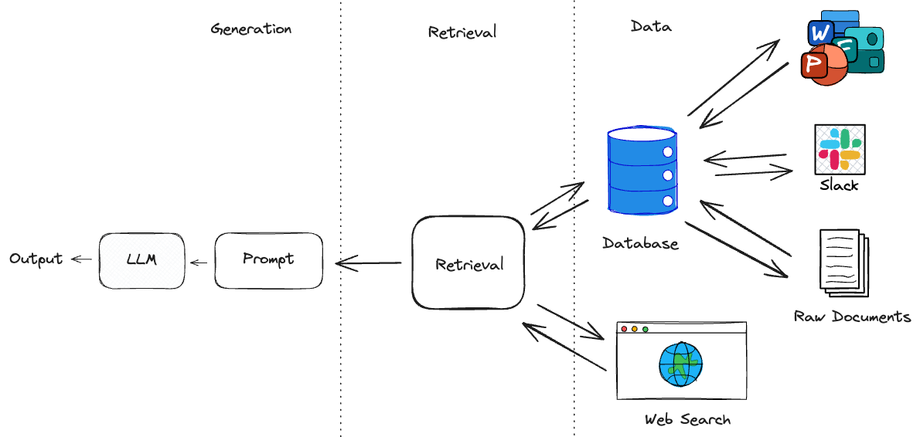
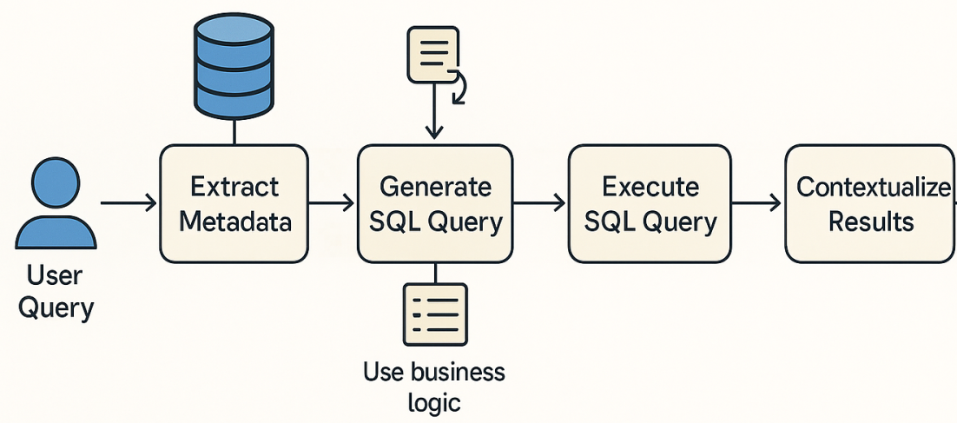
Other Forms of RAG
“Retrieval” can be via any mechanism, not just vectors/graphs
Other popular forms in use today:
  Structured Retrieval: SQL, HTML/Wiki Navigation
  Web Search
  Tool API Calls, Model Context Protocol (more in Topic 3)

Slide 11
Peer Instruction Activity
(Switch to Google Form)

