Slide 1
CSE/DSC 234
Data-Centric AI and AI Engineering
Arun Kumar
Topic 2: Retrieval and Context Engineering

Slide 2
Outline
Introduction
Prompt Engineering
Retrieval and Context Engineering
  Retrieval vs. Long Context
  VectorRAG
  GraphRAG
  Other Forms of RAG

Slide 3
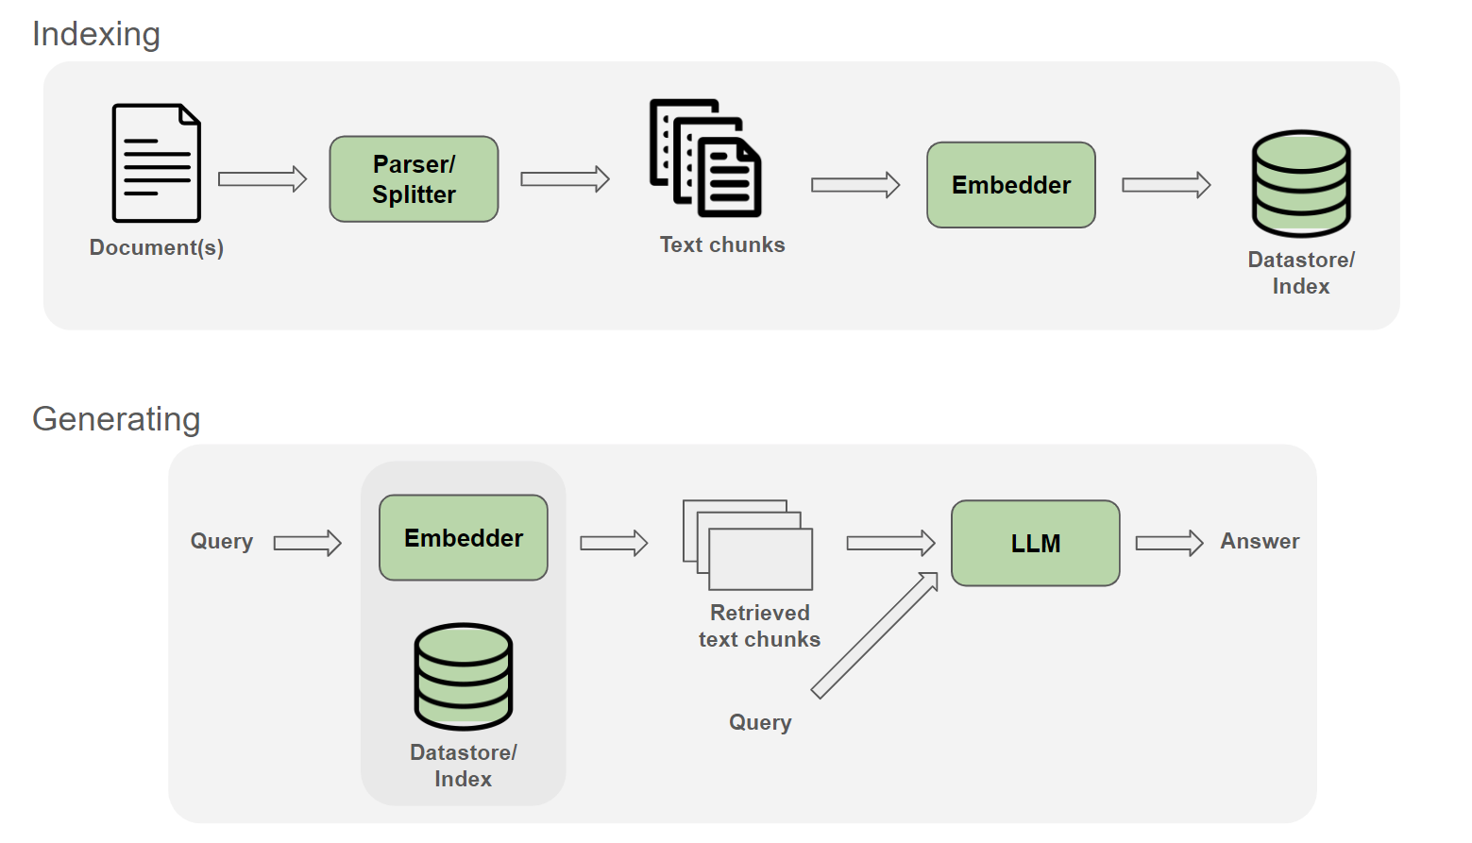
The Canonical VectorRAG

Slide 4
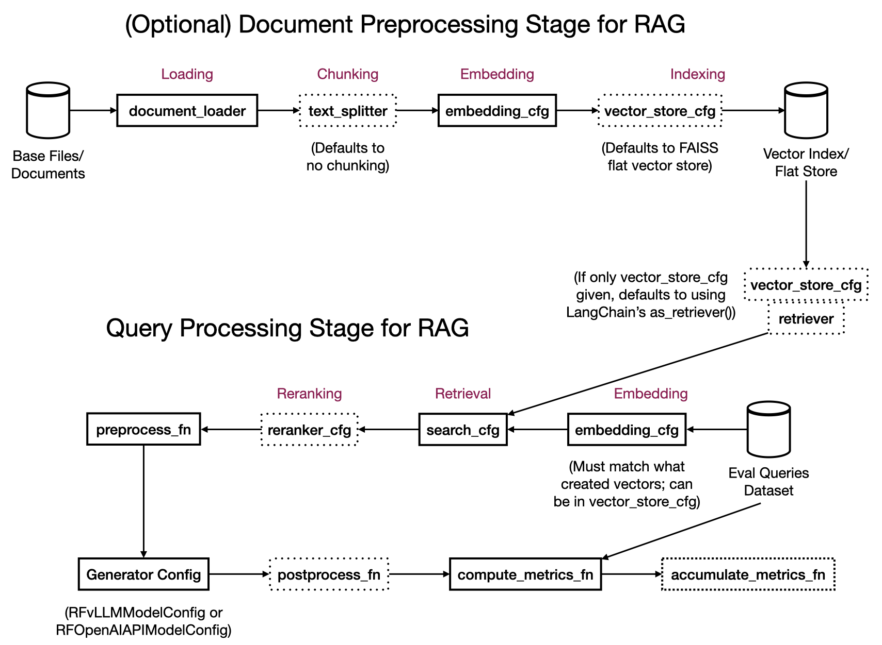
VectorRAG Pipeline in RapidFire AI
https://oss-docs.rapidfire.ai/en/latest/ragspecs.html

Slide 5
Parts of Canonical VectorRAG
Parsing and Splitting/Chunking: Turn raw data/docs into retrieval units
Embedding: Encode each chunk as a dense vector
Indexing: Store vectors for fast (approximate) nearest-neighbor (NN/ANN) search
Retrieval: Fetch top-K candidates from one or more sources; fuse into a single ranked list
Reranking: Rescore top-K to reorder chunks by relevance to query
Context Stitching: Assemble the final prompt—system instructions plus ordered, deduped, formatted, budgeted context
Generation: LLM produces a grounded answer with citations or abstains

Slide 6
More Advanced VectorRAG
Architecture | Description | Control | Flexibility | Latency | Example Use Case
2-Step RAG | Retrieval always happens before generation. Simple and predictable | ✅ High | ❌ Low | ⚡ Fast | FAQs, documentation bots
Agentic RAG | An LLM-powered agent decides when and how to retrieve during reasoning | ❌ Low | ✅ High | ⏳ Variable | Research assistants with access to multiple tools
Hybrid | Combines characteristics of both approaches with validation steps | ⚖️ Medium | ⚖️ Medium | ⏳ Variable | Domain-specific Q&A with quality validation
https://docs.langchain.com/oss/python/langchain/retrieval

Slide 7
1. Parsing and Splitting/Chunking
Q: How to divvy up the base data/docs for effective retrieval?
Options for Parsing:
  Deterministic parsers to extract exact components
  ML/LLM-infused parsers to include OCR on multimodal docs
Options for Splitting/Chunking:
  Fixed chunk size; optional overlap via sliding window
  Sentence/paragraph-aware
  Semantic: Metadata-based, topic-based, LLM-based, etc.
  Hierarchical, Hybrid, Multimodal, etc.

Slide 8
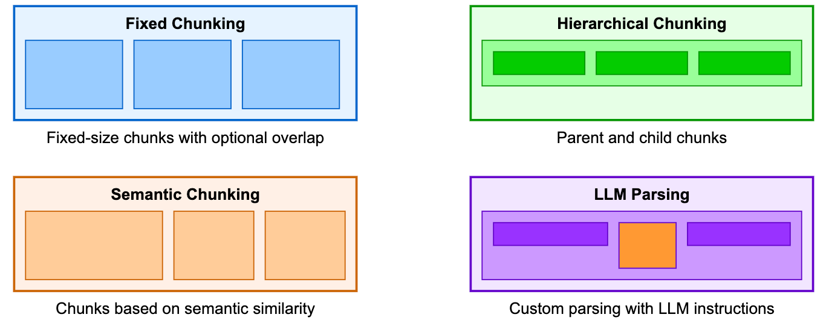
1. Parsing and Splitting/Chunking
Q: How to divvy up the base data/docs for effective retrieval?

Slide 9
1. Parsing and Splitting/Chunking
Q: How to divvy up the base data/docs for effective retrieval?
Basic Tradeoff on chunking scheme + size:
  Too small -> fragments answers, lower quality
  Too large -> dilutes embeddings, wastes context, higher latency
Some best practices:
  Try to align with in-built structure in docs, e.g., subsections
  Use a hierarchy of chunks if possible
No universal optimal chunking/size. Tune on your own eval set!

Slide 10
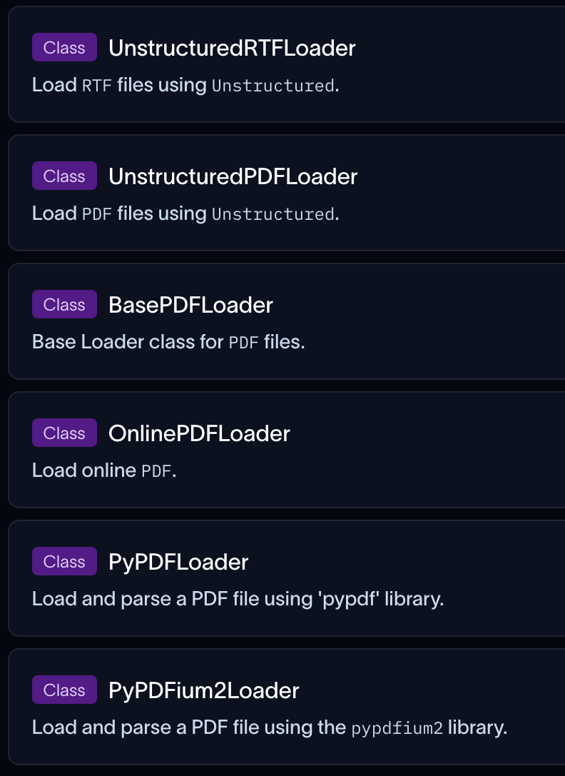
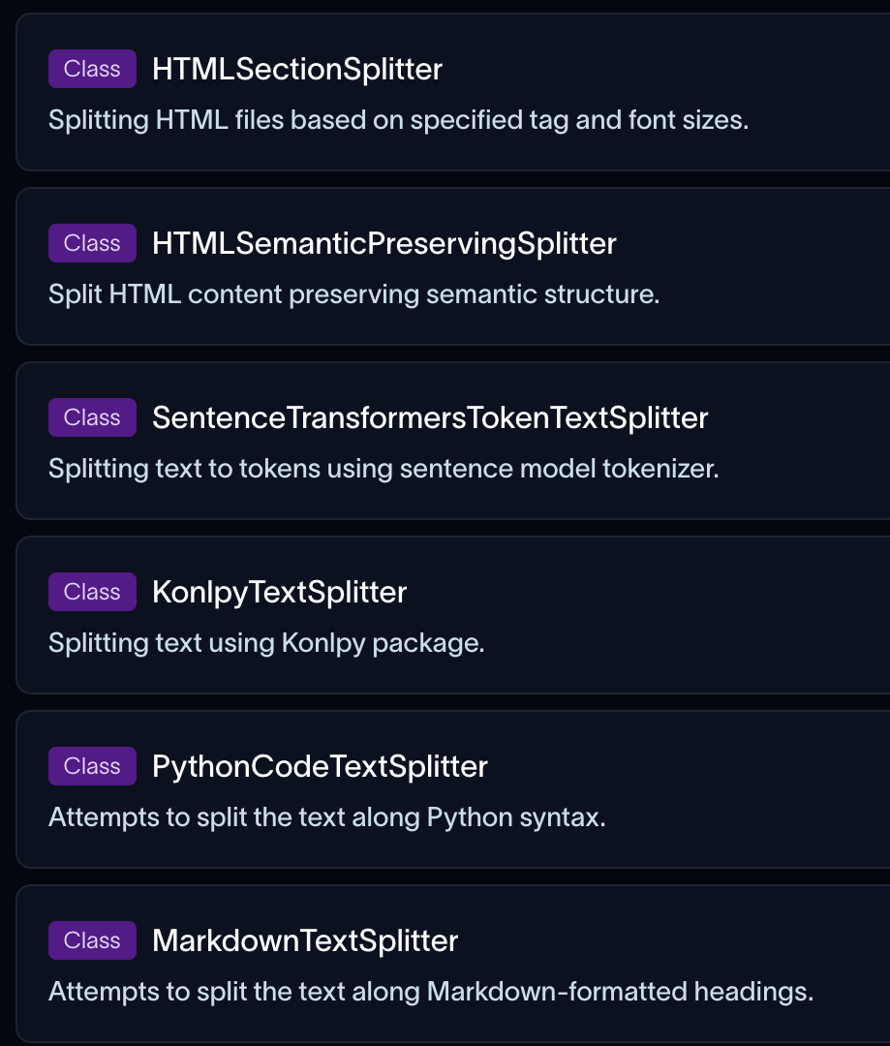
1. Parsing and Splitting/Chunking
RAG/agent engineering frameworks such as LangChain and LlamaIndex have many off-the-shelf parsers and chunkers/splitters
https://reference.langchain.com/python/langchain-community/document-loaders
https://reference.langchain.com/python/langchain-text-splitters

Slide 11
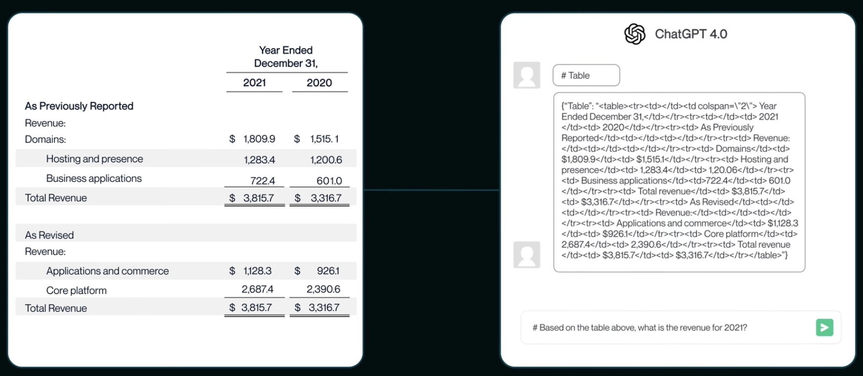
Parsing and Chunking for Project 1
For Project 1: Peruse the docs of LangChain and any additional third party loaders and/or splitters you use
Example: Unstructured.io for table structure extraction
https://docs.unstructured.io/welcome

Slide 12
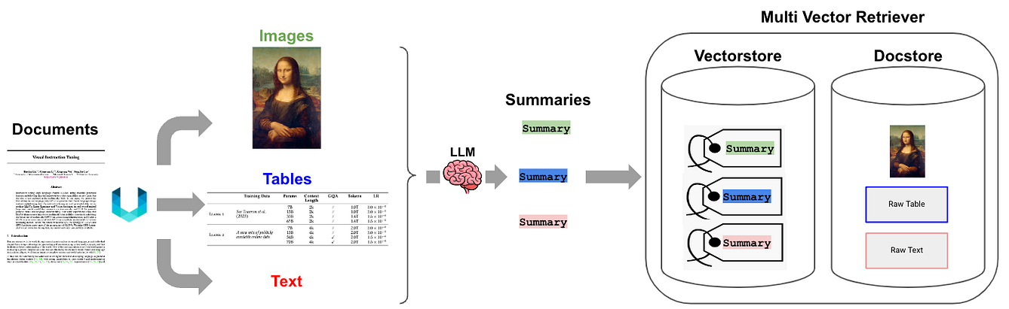
1. Complexity of Multimodal Data
Multimodal data, e.g., PDFs or DOCs with text, tables, images, etc. present additional complexity for parsing + splitting/chunking
Typical workflow decomposes them into text, tables, and images to handle each modality separately
Source: https://blog.gopenai.com/extracting-knowledge-from-pdfs-a-step-by-step-rag-implementation-with-langchain-2f163628da8b

Slide 13
1. Complexity of Multimodal Data
Multiple tradeoffs inherent in such complex extraction:
  Layout itself might be information: Multi-column flow, headers/footers, footnotes, sidebars. Naive top-to-bottom extraction scrambles reading order.
  Tables: Cell structure carries meaning; flattening to plaintext loses rows/columns; chunking mid-table fragments the relationship
  Figures and Images: need OCR (scanned), captions, and/or VLM descriptions to be retrievable
  Equations and Code: LaTeX/MathML and indentation are semantically load-bearing; easily mangled by generic parsers
  Cross-references: “see Figure 3”, “Table 2 above”, etc., break when the referent lands in a different chunk
Source: https://blog.gopenai.com/extracting-knowledge-from-pdfs-a-step-by-step-rag-implementation-with-langchain-2f163628da8b

Slide 14
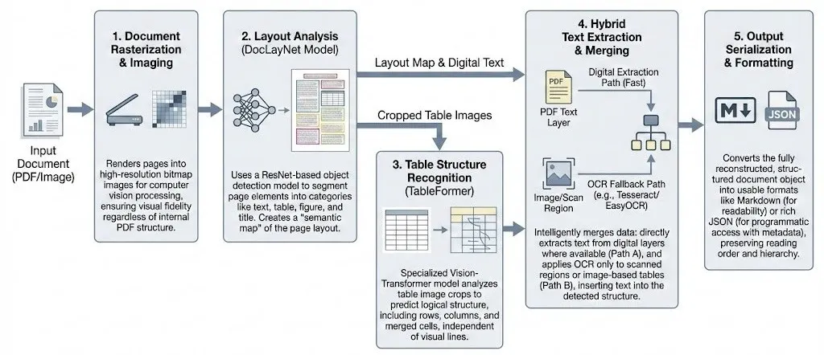
1. Complexity of Multimodal Data
PDF parsers such as unstructured.io have complex AI-infused workflows to extract the unimodal components
Source: https://medium.com/@gjs190201/why-your-pdf-parser-fails-and-how-computer-vision-fixes-it-8a08dccd8bec

Slide 15
1. Complexity of Multimodal Data
Some best practices:
  Rolling out your own could be a rabbithole!
  Off-the-shelf tooling: Unstructured.io, LlamaParse, Docling, Azure Document Intelligence, Marker; varying fidelity vs. cost vs. latency
  Typical pattern in practice: Parse to a semi-structured intermediate (markdown/JSON + image refs + table objects), then chunk semantically by section, not by token count alone
Source: https://blog.gopenai.com/extracting-knowledge-from-pdfs-a-step-by-step-rag-implementation-with-langchain-2f163628da8b

Slide 16
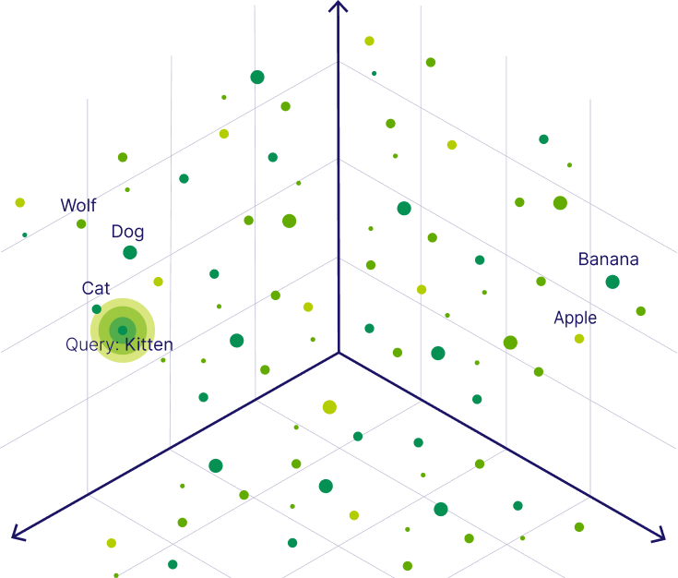
2. Embedding
Q: How to map chunks and queries to useful latent vector space?
“Useful” means geometric proximity ~ semantic proximity

Slide 17
2. Embedding: Design Decisions
Model class: Closed (e.g., OpenAI, Cohere, Voyage) vs. open (e.g., BGE, E5, Jina, Nomic)
Dimensionality: Typically 384 to 3072; Matryoshka models allow nested truncation
Domain: General-purpose vs. domain-tuned (legal, medical, code, multilingual)
What to embed: chunk only vs. chunk + metadata vs. parent-aware
Hosting: API vs. self-hosted GPU vs. CPU edge

Slide 18
2. Embedding: Tradeoffs
Knowledge Level: General models offer broad coverage vs. domain-tuned models are narrower but more precise and likely more familiar with domain-specific lingo
DevOps Burden: Closed APIs (zero infra. vs. rate limits and lock-in) vs. self-hosted (control vs. complexity)
Versioning: Embedding decision is a long-ish commitment; model swap -> full re-index required!
Quality vs. Dimensionality: Storage, memory, latency, and thus cost all scale linearly
No universal optimal embedding scheme/size. Tune on your own eval set!

Slide 19
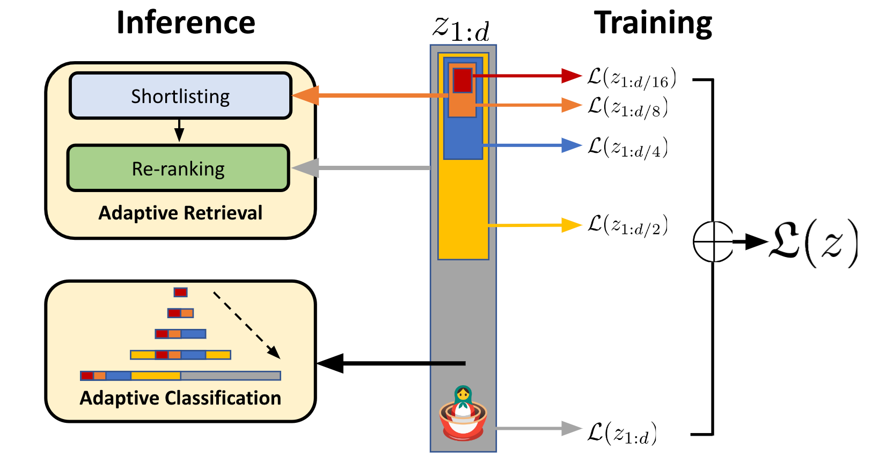
2. Embedding: Matryoshka
Model trained with multiple usable nested embeddings, i.e., the first 64, 128, etc. dimensions are each independently meaningful (like the Russian dolls)
Adaptive cost vs. recall per query, not per corpus, e.g., store full 3072-dim, use only 256 for retrieval, full dim for reranking
2-6x faster ANN search with minimal recall loss; smooth quality-cost curve instead of step function
Rising popularity in practice: OpenAI text-embedding-3-*, Nomic Embed, Snowflake Arctic, etc.
Matryoshka Representation Learning
https://arxiv.org/pdf/2205.13147

Slide 20
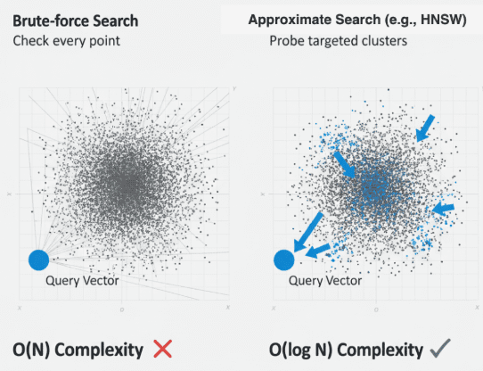
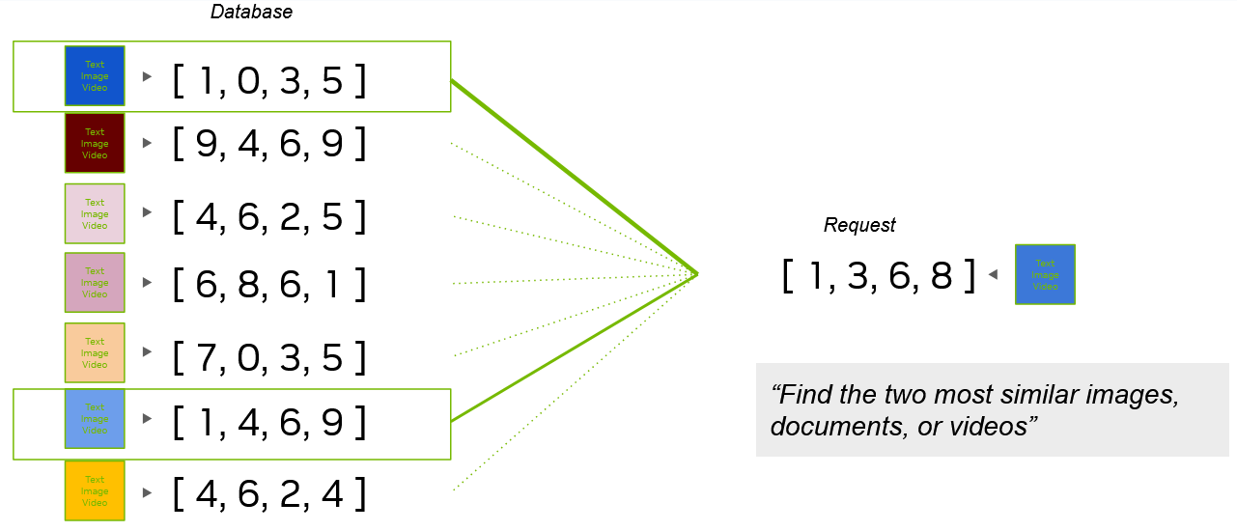
3. Indexing
Q: How to store embeddings to support fast retrieval with (A)NN?

Slide 21
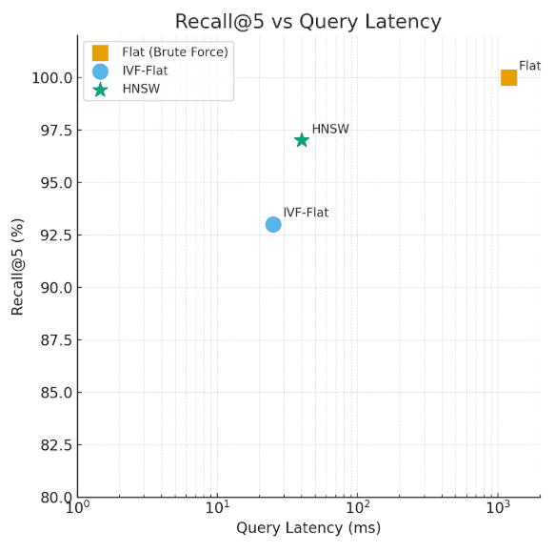
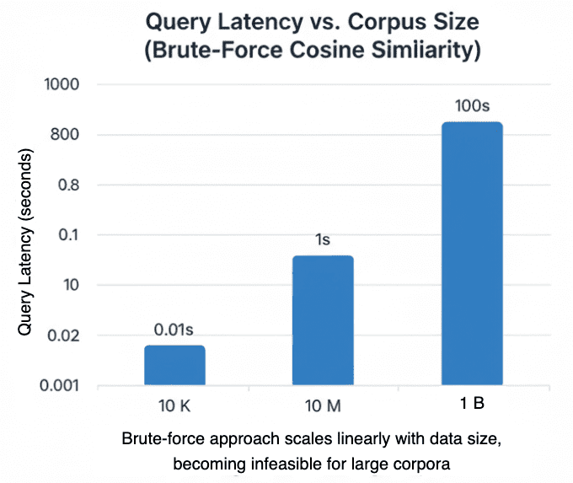
3. Indexing: When ANN?
Small scale: Brute force exact matrix multiply on GPU suffices
Large scale: ANN becomes only feasible option in production
Source: https://pyimagesearch.com/2026/02/16/vector-search-with-faiss-approximate-nearest-neighbor-ann-explained/

Slide 22
3. Indexing: Design Decisions
ANN Index Structure: HNSW (graph-oriented), IVF (clustering-based), product quantization (compression)
Hybrid Indexes: Vector + Text Inverted Index (BM25) for dense+sparse fusion
Metadata Filters: Date, source, owner, etc. might have filter predications: pre-search vs. post-search vs. in-line during search
Update Model: Batch re-indexing vs. incremental upsert
Common Stores Today: FAISS, pgvector, Chroma, Pinecone, Weaviate, Qdrant; DBMS vendors too have their own

Slide 23
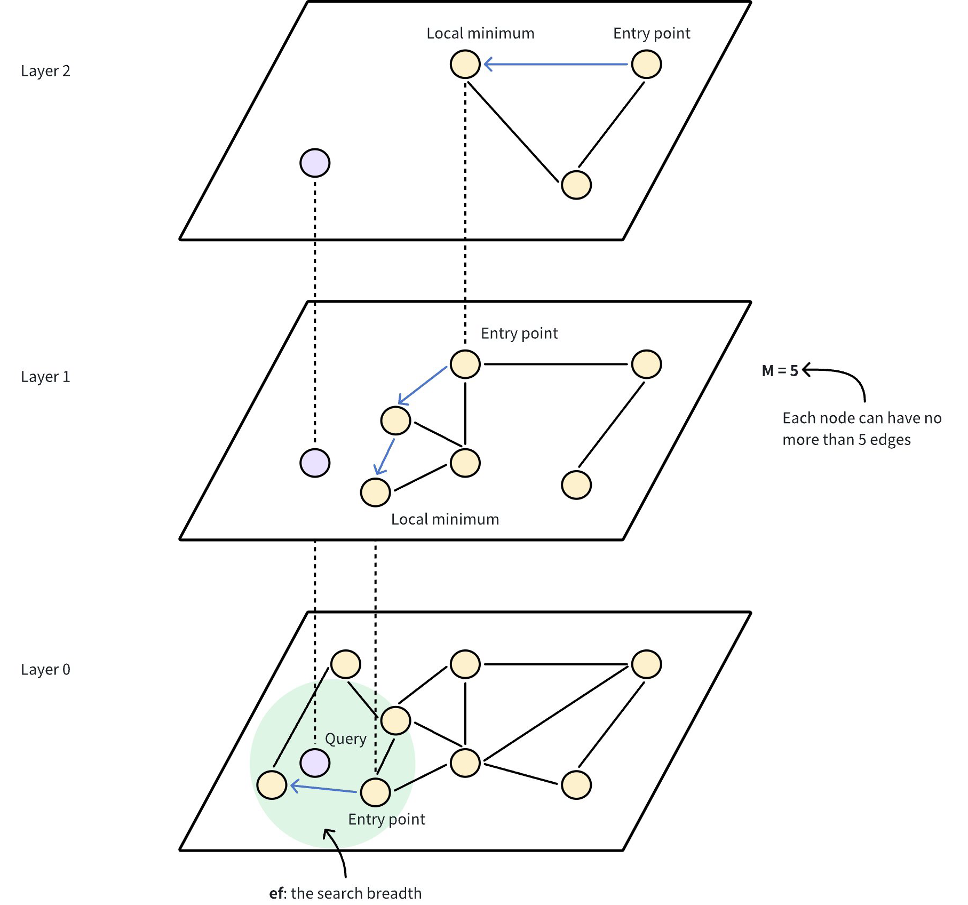
3. Indexing: HNSW
Hierarchical Navigable Small Worlds (HNSW) is a popular graph-oriented vector index structure for fast retrieval
Nodes represent data points (vectors)
Layers consolidate proximity info.
https://milvus.io/docs/hnsw.md

Slide 24
3. Indexing: Tradeoffs and Best Practices
Tradeoffs:
  Recall vs. latency vs. DRAM vs. update cost—pick 3!
    HNSW: fast and accurate, but DRAM-heavy, slow update
    IVF + PQ: more compact in memory, more tunable, but lower recall ceiling
  DevOps Burden: Vendor-hosted vs. self-hosted
Some best practices:
  HNSW popular for read-heavy, infrequent-update workloads; IVF + PQ for when DRAM tight and/or corpus too huge
  Always co-locate metadata for filtering; vector-only indexes hit access-control walls fast!
No universal optimal indexing scheme. Tune for your workload!

Slide 25
4. Retrieval
Q: How to retrieve top-K matches quickly and accurately?
Standalone vector search is limited; often exact keyword/phrase (e.g., IDs, names, error codes, etc.) match needed
Good ol’ IR-style keyword search (e.g., BM25) helps there; AKA “sparse” retrieval in RAG world
Typically, “hybrid” search = dense (ANN on vectors) + sparase (BM25) + rerank (e.g., with RRF) or weighted scores

Slide 26
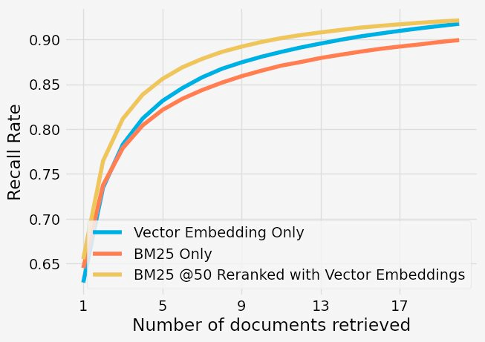
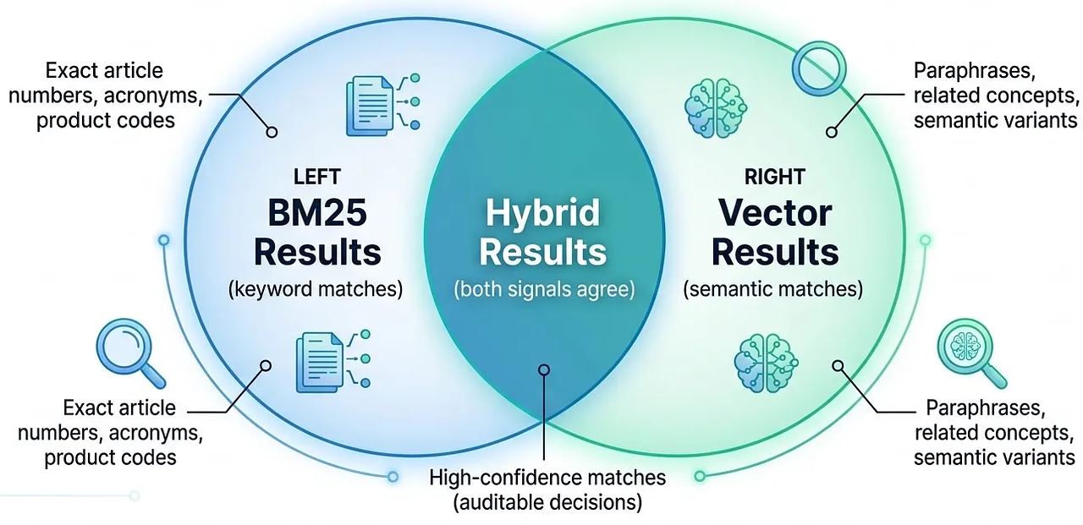
4. Retrieval: Hybrid Search
BM25 vs. Vector only vs. Both
Source: https://levelup.gitconnected.com/hybrid-search-is-not-one-thing-reliable-enterprise-ai-systems-b41ba0ee9964

Slide 27
4. Retrieval: More Design Decisions
K in top-K: How many to retrieve per index?
Predicates: How to constitute them on metadata?
Query Rewriting Upstream: Before query sent to search:
  HyDE (Hypothetical Document Embeddings): Ask LLM to “guess” an answer and embed that too for actual search!
  Multi-query: Ask LLM to create variations of query
  Decomposition / Expansion: Classical IR style techniques
  Can also mix and match among the above
Source-Separated Indexes: Maintain separate indexes for different corpora / modalities / teams

Slide 28
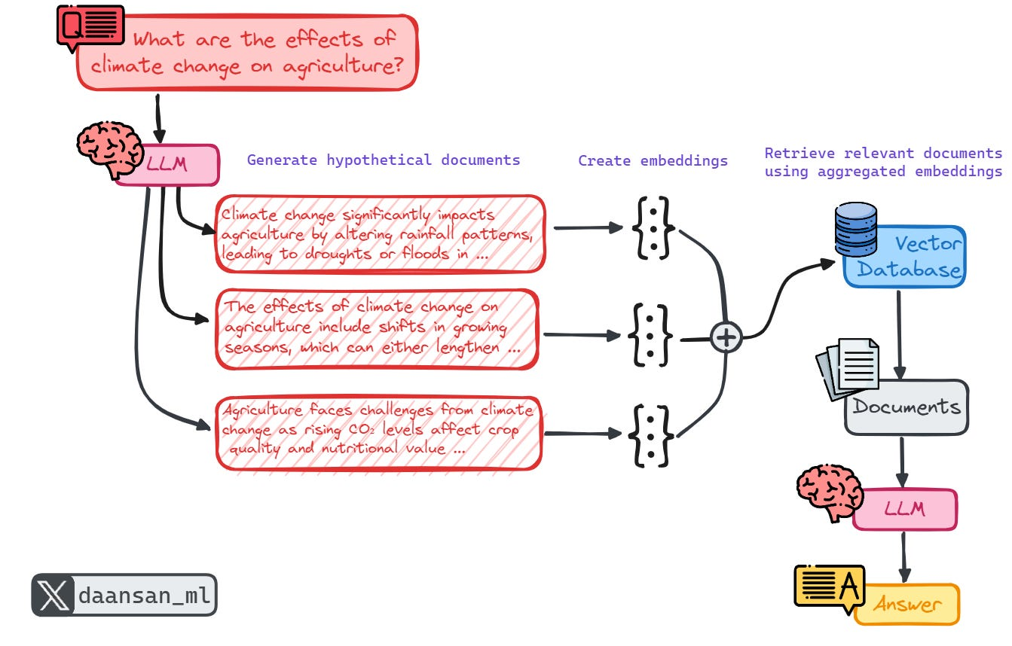
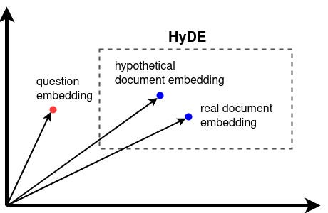
4. Retrieval: More Design Decisions
Why HyDE usually helps
Source: https://mlpills.substack.com/p/issue-85-advanced-retrieval-strategies

Slide 29
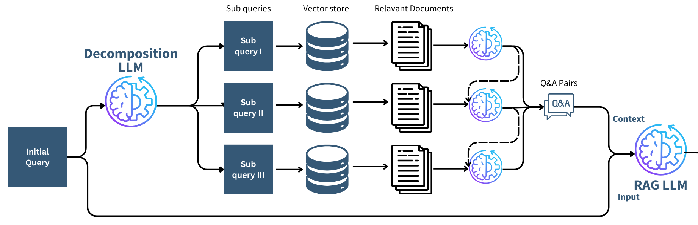
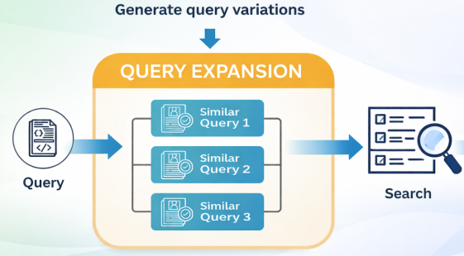
4. Retrieval: More Design Decisions
Query Decomposition
Multi-Query Expansion
Source: https://towardsdatascience.com/advanced-retrieval-techniques-for-better-rags-c53e1b03c183/

Slide 30
4. Retrieval: Tradeoffs
Sparse vs. Dense: Sparse can miss paraphrasing, while dense can miss exact terms
K: Larger value helps recall, but adds more latency and downstream costs (for reranking, context length, etc.)
Query Rewriting: Can help recall, but adds more latency, possibly more costs, and another non-trivial knob to debug!
Multi-Source Fusion: Helps coverage but complicates evals and debugging
No universal optimal retrieval scheme or K! Tune on eval set

Slide 31
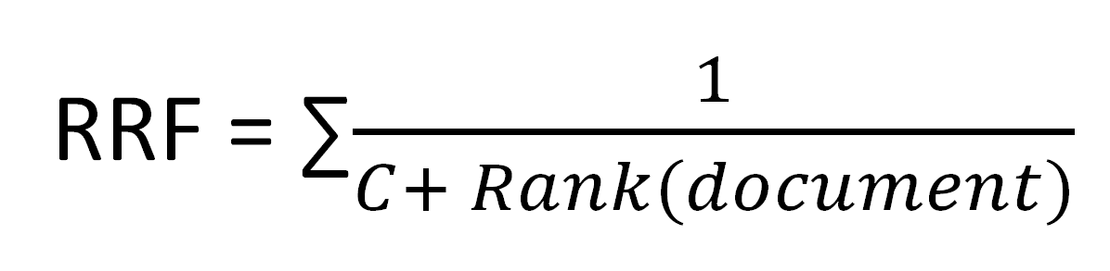
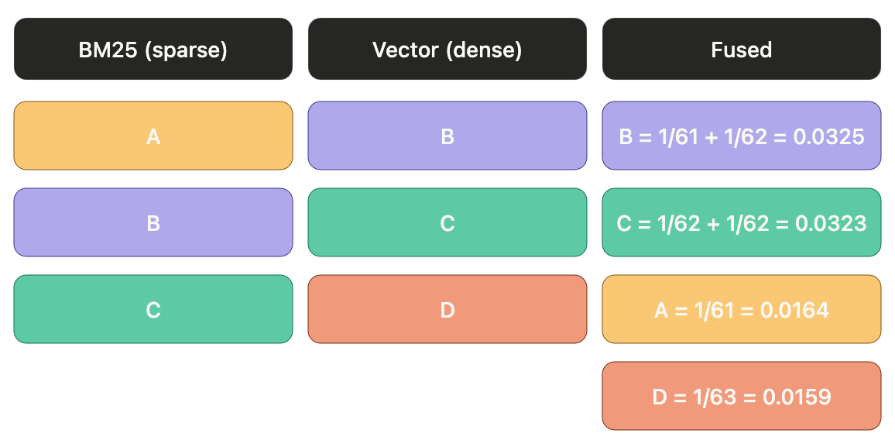
4. Retrieval: Some Best Practices
Typically K ~ 10 to 50 per index; narrow further with reranking
Do query rewriting only if eval shows recall is bottleneck
Carefully debug queries that have zero retrieval results!
Default to hybrid search with Reciprocal Rank Fusion (RRF); almost always beats unimodal retrieval
C ~ 60 in practice
Typically not much impact from tuning up or down

Slide 32
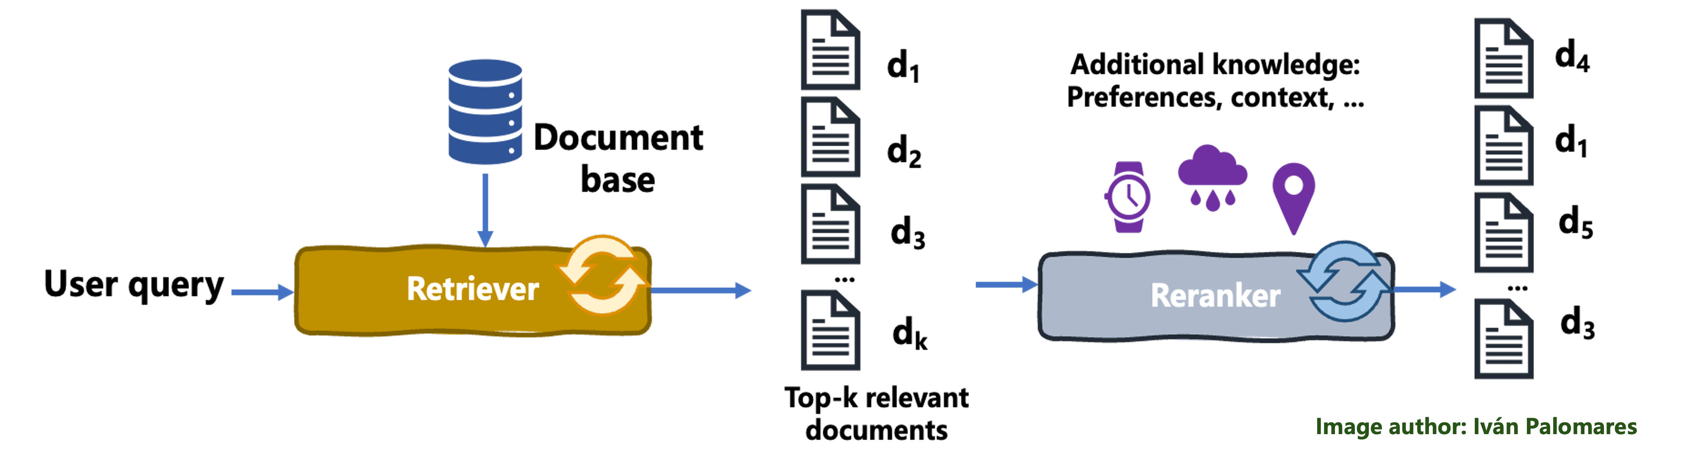
5. Reranking
Q: When does reordering the retrieved and fused results help?
Reranking applies query-aware ML (cross-encoders, ColBERT, LLMs, etc.) to rescore retrieved (and fused) results
Better-ranked top-K -> fewer chunks needed -> less lost-in-the-middle exposure downstream
Reranking is how high recall can become high precision too; without it, you either lose accuracy (small K, miss answers) or eat lost-in-the-middle (big K, drown them)

Slide 33
5. Reranking: Design Decisions
Cross-Encoder Rerankers: Joint (query, chunk) scoring; the standard precision-quality choice, e.g., Cohere Rerank, BGE, MS-MARCO MiniLM
Late-Interaction: per-token scoring; often more accurate than cross-encoder but slower (e.g. ColBERT)
SLM-as-Reranker: SLM scores (query, chunk); flexible reasoning, slower and costlier
On top of any reranker, can do Score Fusion: blend reranker score with metadata signals (recency, authority, popularity, etc.)

Slide 34
5. Reranking: Tradeoffs
Often results in significant boost to precision@K (even 30%) but with slightly more latency and cost
Cross-encoders cannot be pre-indexed; every query is a fresh forward pass
Reranker model domain match matters as much as embedding model domain match
LLM rerankers are flexible but expensive at high QPS

Slide 35
5. Reranking: Some Best Practices
Rerank when retrieval recall is high but precision is low—a common RAG failure pattern
Default to a self-hosted Cross-Encoder (Cohere, BGE) before reaching for ColBERT or SLM rerankers
Make it top-5 to top-10 after (fusion and) reranking; more chunks ≠ better answers (Lost-in-the-Middle)
No universal best option! Eval and tune reranker quality separately from retriever quality

Slide 36
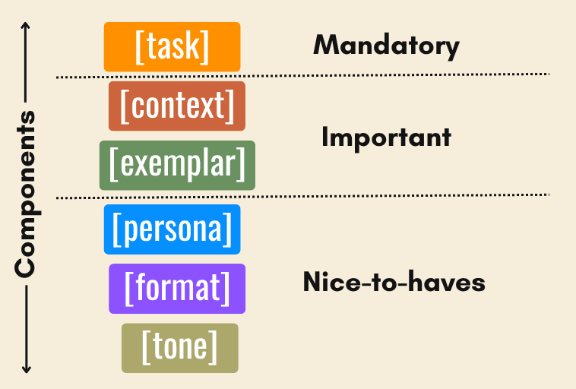
6. Context Stitching
Q: How to organize and compose the final prompt?
Recollect best practices from prompt engineering
Ordering: Put best chunks at start or end
Format: MD, JSON, XML
Cleanup: Dedupe overlaps, summarize chunks
Budget: Account for token rate limits

Slide 37
6. Context Stitching: Tradeoffs and Best Practices
Tradeoffs:
  Longer context can help recall but can cause context rot and raise latency and costs
  Compression: Reverse tradeoffs as above
  Heavy formatting helps citation but can cost token
  Aggressive abstention instructions help reduce hallucination
Some best practices:
  Number the chunks and instruct the model to cite by number
  Put user’s query at the end; recency bias can help
  Cap context at the model’s effective recall length, not its advertised window
No universal best option! Eval it, version it, regression test it

Slide 38
7. Generation: Design Decisions
Produce a faithful grounded answer under constraints—or abstain
Model: Size, family (reasoning vs. instruct), open vs. closed
Decoding: Temperature, top-p; determinism vs. diversity
Constrained Decoding: JSON schema or grammar for parseable output
Tool calling: Re-retrieve, calculator, code, etc. vs. free text
Reasoning Budget: Think-before-answer for harder synthesis
Self-checks: Self-consistency, draft-then-verify

Slide 39
7. Generation: Tradeoffs and Best Practices
Tradeoffs:
  Bigger model, reasoning, self-checks: higher faithfulness, but also higher latency and cost
  Temperature: low => more consistent but brittle; high => more creative but hallucinatory
  Constrained decoding: parseable, but occasional quality hit
Some best practices:
  Temperature: 0.0-0.3 typical for factual RAG
  Constrained decoding when output is parsed downstream
  Reasoning models when faithfulness > latency (e.g., legal, medical, audit)
  Add a cheap second-pass verifier for high-stakes answers
No universal optimal choice! Tune it on your eval set

Slide 40
Parts of Canonical VectorRAG
Parsing and Splitting/Chunking: Turn raw data/docs into retrieval units
Embedding: Encode each chunk as a dense vector
Indexing: Store vectors for fast (approximate) nearest-neighbor (NN/ANN) search
Retrieval: Fetch top-K candidates from one or more sources; fuse into a single ranked list
Reranking: Rescore top-K to reorder chunks by relevance to query
Context Stitching: Assemble the final prompt—system instructions plus ordered, deduped, formatted, budgeted context
Generation: LLM produces a grounded answer with citations or abstains

Slide 41
Review Questions
Briefly distinguish prompt eng. vs. retrieval eng. vs. context eng.
Will ever-growing context windows obviate retrieval? Why or why not?
What is the lost-in-the-middle problem? How does context rot relate?
Name the 7 parts of a canonical VectorRAG pipeline. Why that order?
What is the core tradeoff in chunk scheme and size selection?
Why is swapping an embedding model a costly decision? What are Matryoshka embeddings and how do they help resolve that issue?
What is hybrid search? Why does it usually beat pure vector search?
How do the retriever and reranker components of a canonical RAG pipeline divide responsibility for recall vs. precision?
Name key levers in context stitching for configuring output quality.
You are an AI eng. at an enterprise AI team. Your AI colleague suggests leveraging the full 10M-token context window of new LLMs to skip RAG altogether for an internal Q&A chatbot. Do you agree? Why or why not?

