Slide 1
CSE/DSC 234
Data-Centric AI and AI Engineering
Arun Kumar
Topic 2: Retrieval and Context Engineering

Slide 2
Outline
Introduction
Prompt Engineering
Retrieval and Context Engineering
  Retrieval vs. Long Context
  VectorRAG
  GraphRAG
  Multimodal and Other Forms of RAG

Slide 3
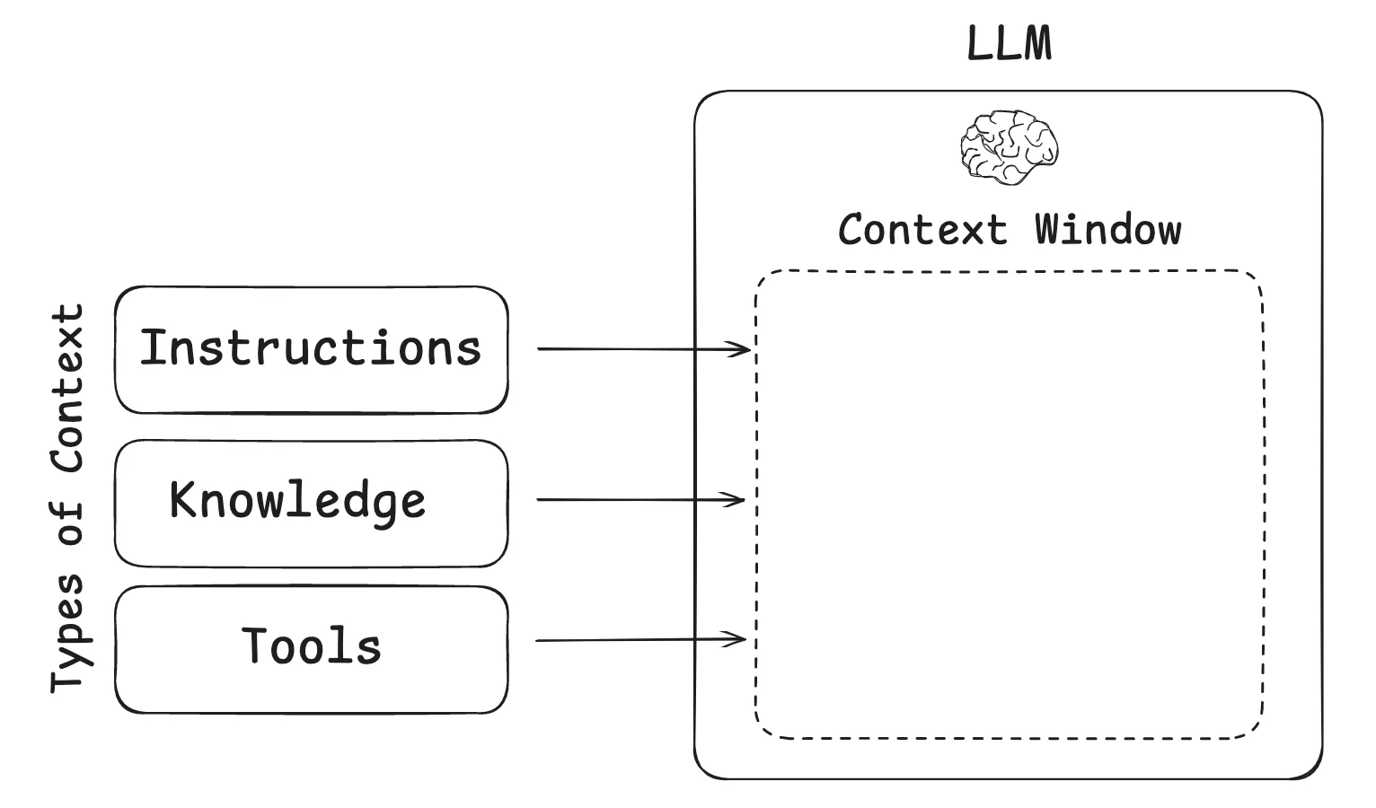
In-Context Learning
LLMs resuscitated an age-old AI fact: “learning” ≠ “training”!
  E.g., k-NN is an ML model with no “training” phase
The “context window” of a frozen LLM is itself a canvas for learning at inference time, aka In-Context Learning (ICL)

Slide 4
In-Context Learning
ICL is the algorithmic phenomenon that led to new AI engineering mechanisms to improve LLM applications:
  Prompt eng. -> Retrieval eng. -> Context eng. -> Agent eng.
  Prompt eng.: Crafting the input (instructions, examples, format) to steer LLM behavior via ICL
  Retrieval eng.: Designing systems that dynamically fetch external info. and inject it into prompt at inference time
  Context eng.: Assembling and managing everything in the context window at inference time—instructions, retrieved data, tool outputs, prior turns, memory, state, etc.—under token and latency budgets.

Slide 5
Outline
Introduction
Prompt Engineering
Retrieval and Context Engineering
  Retrieval vs. Long Context
  VectorRAG
  GraphRAG
  Multimodal and Other Forms of RAG

Slide 6
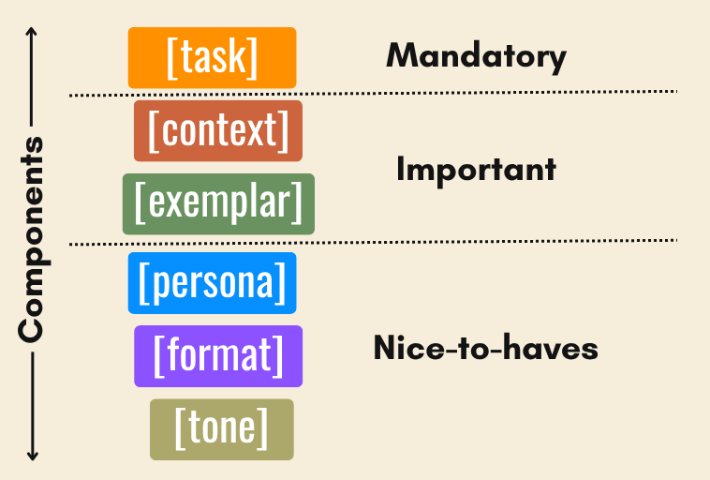
Prompt Engineering
Typically, Prompt = Task + Context + Examples + Output Format
  Can add Guardrails, Persona, Tone, etc. too
Good prompts are specifications, not “incantations”
Under-specification is the #1 failure mode of LLMs (Gulf of Spec.)

Slide 7
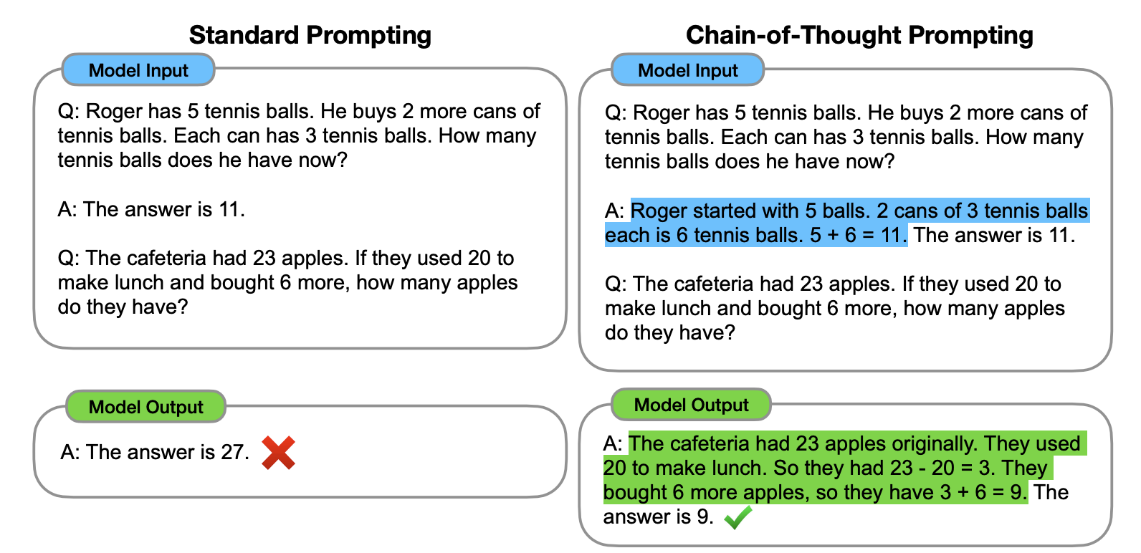
Prompting Methodologies
Zero-Shot: Just the task, no (input, output) examples
One/Few-Shot: Provide one or few (input, output) examples for LLM to learn with ICL
Chain of Thought (COT): Demonstrate step by step reasoning, not just answers, for LLM to learn with ICL

Slide 8
Outline
Introduction
Prompt Engineering
Retrieval and Context Engineering
  Retrieval vs. Long Context
  VectorRAG
  GraphRAG
  Multimodal and Other Forms of RAG

Slide 9
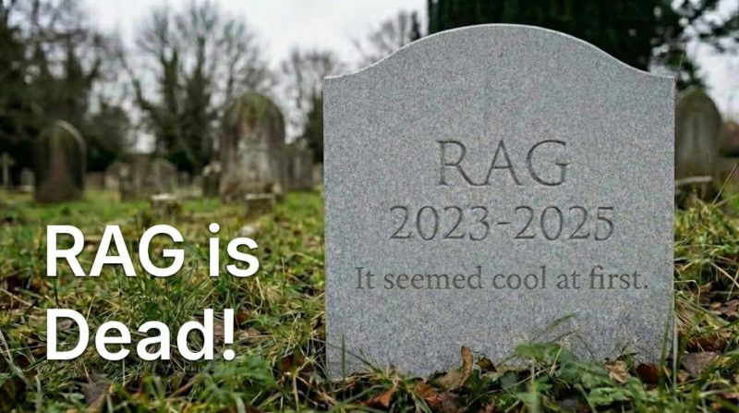




RAG is Dead!

Slide 10
Outline
Introduction
Prompt Engineering
Retrieval and Context Engineering
  Retrieval vs. Long Context
  VectorRAG
  GraphRAG
  Multimodal and Other Forms of RAG

Slide 11
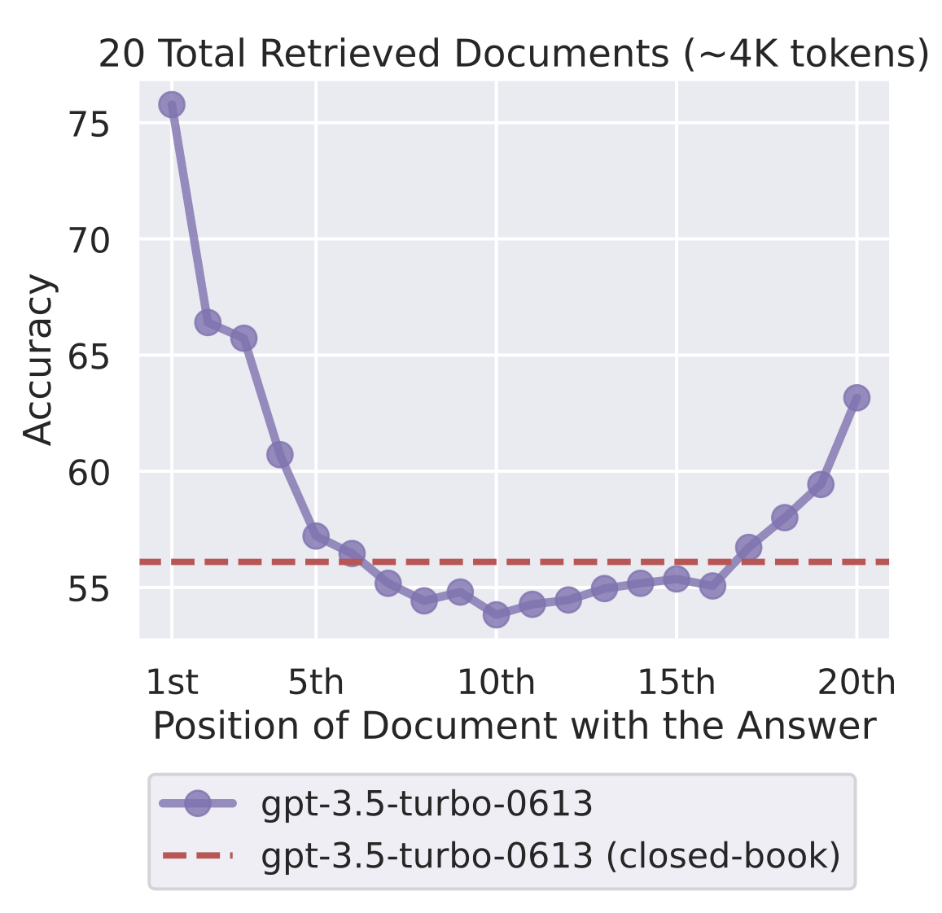
So, Is RAG Really Dead?
Yes and No. :)
  Yes: The specific algorithm proposed in Piktus et al. 2021
  No: Idea/mechanism of “retrieval augmentation” for generation
Q: But won’t ever growing context windows obviate retrieval?
LLM | Input Limit
Claude Opus 4.7 | 1M
Claude Sonnet 4.6 | 1M
GPT-5.4 | 1M
Gemini 3.1 Pro | 1M
Llama 4 Scout | 10M
Vs.

Slide 12



So, Is RAG Really Dead?
Real-world AI applications: revenge of the Pareto Frontier!
Long context dominates quality when content fits cleanly; retrieval dominates cost and latency at scale; corpus size and query type set the operating point
Quality / Eval Metrics
Total
Cost
Inference Latency

Slide 13
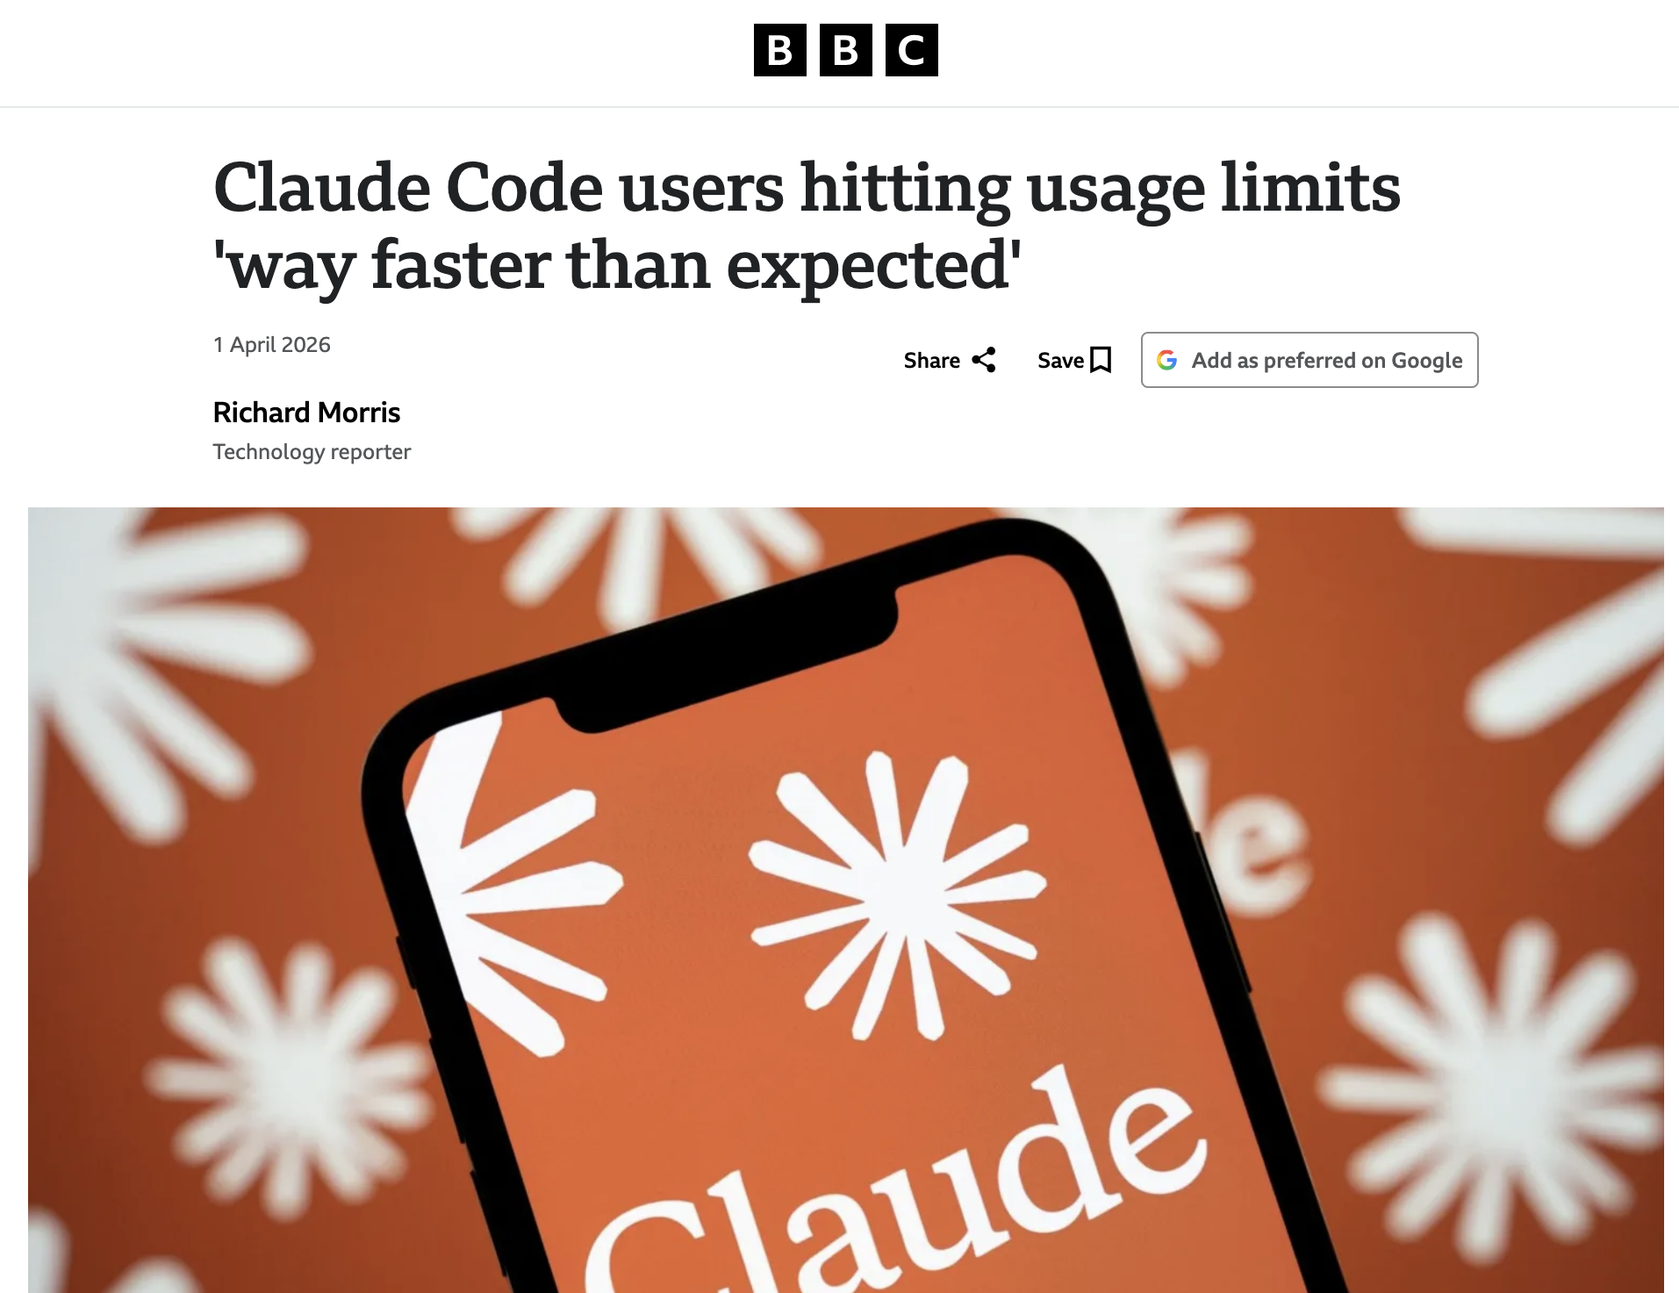
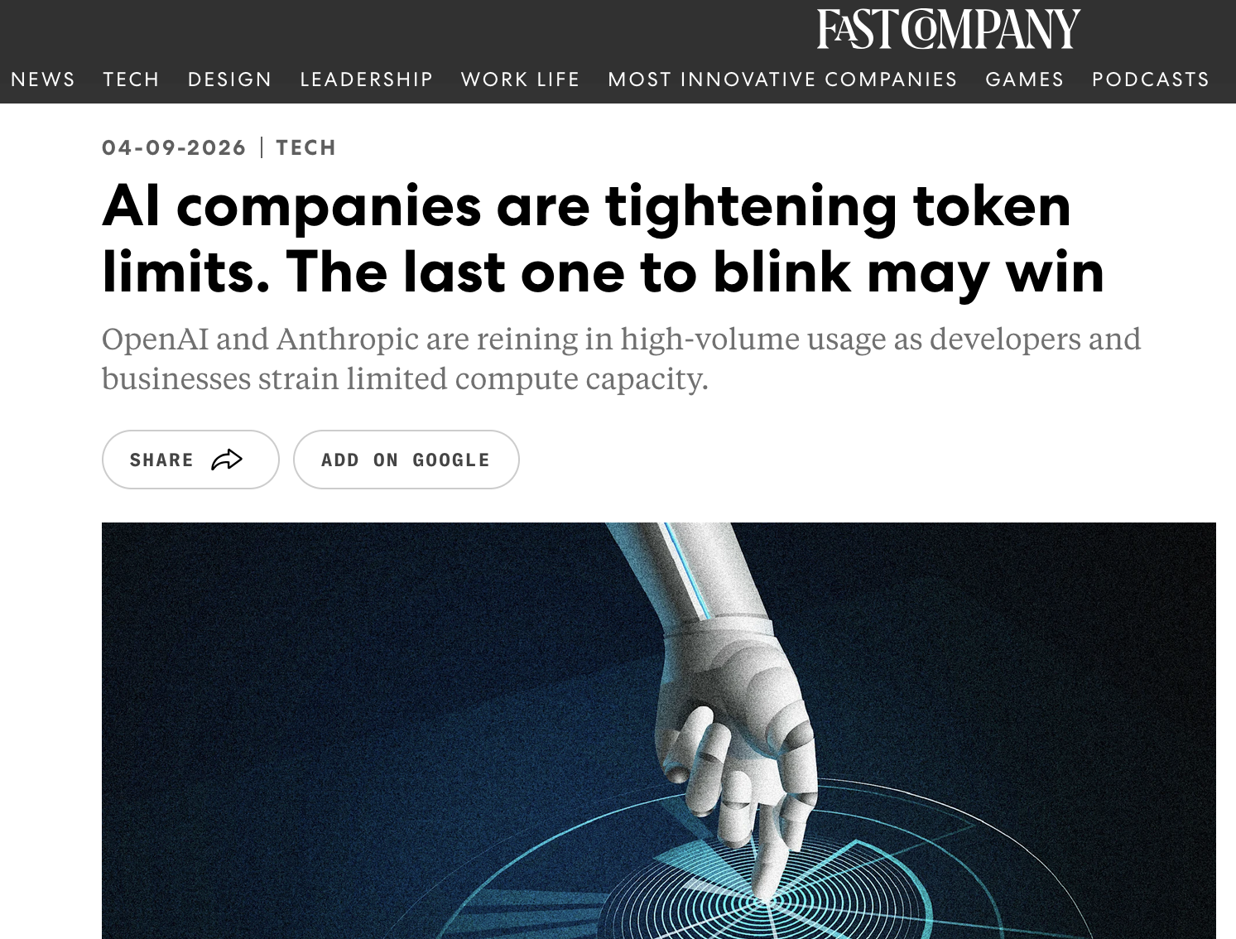

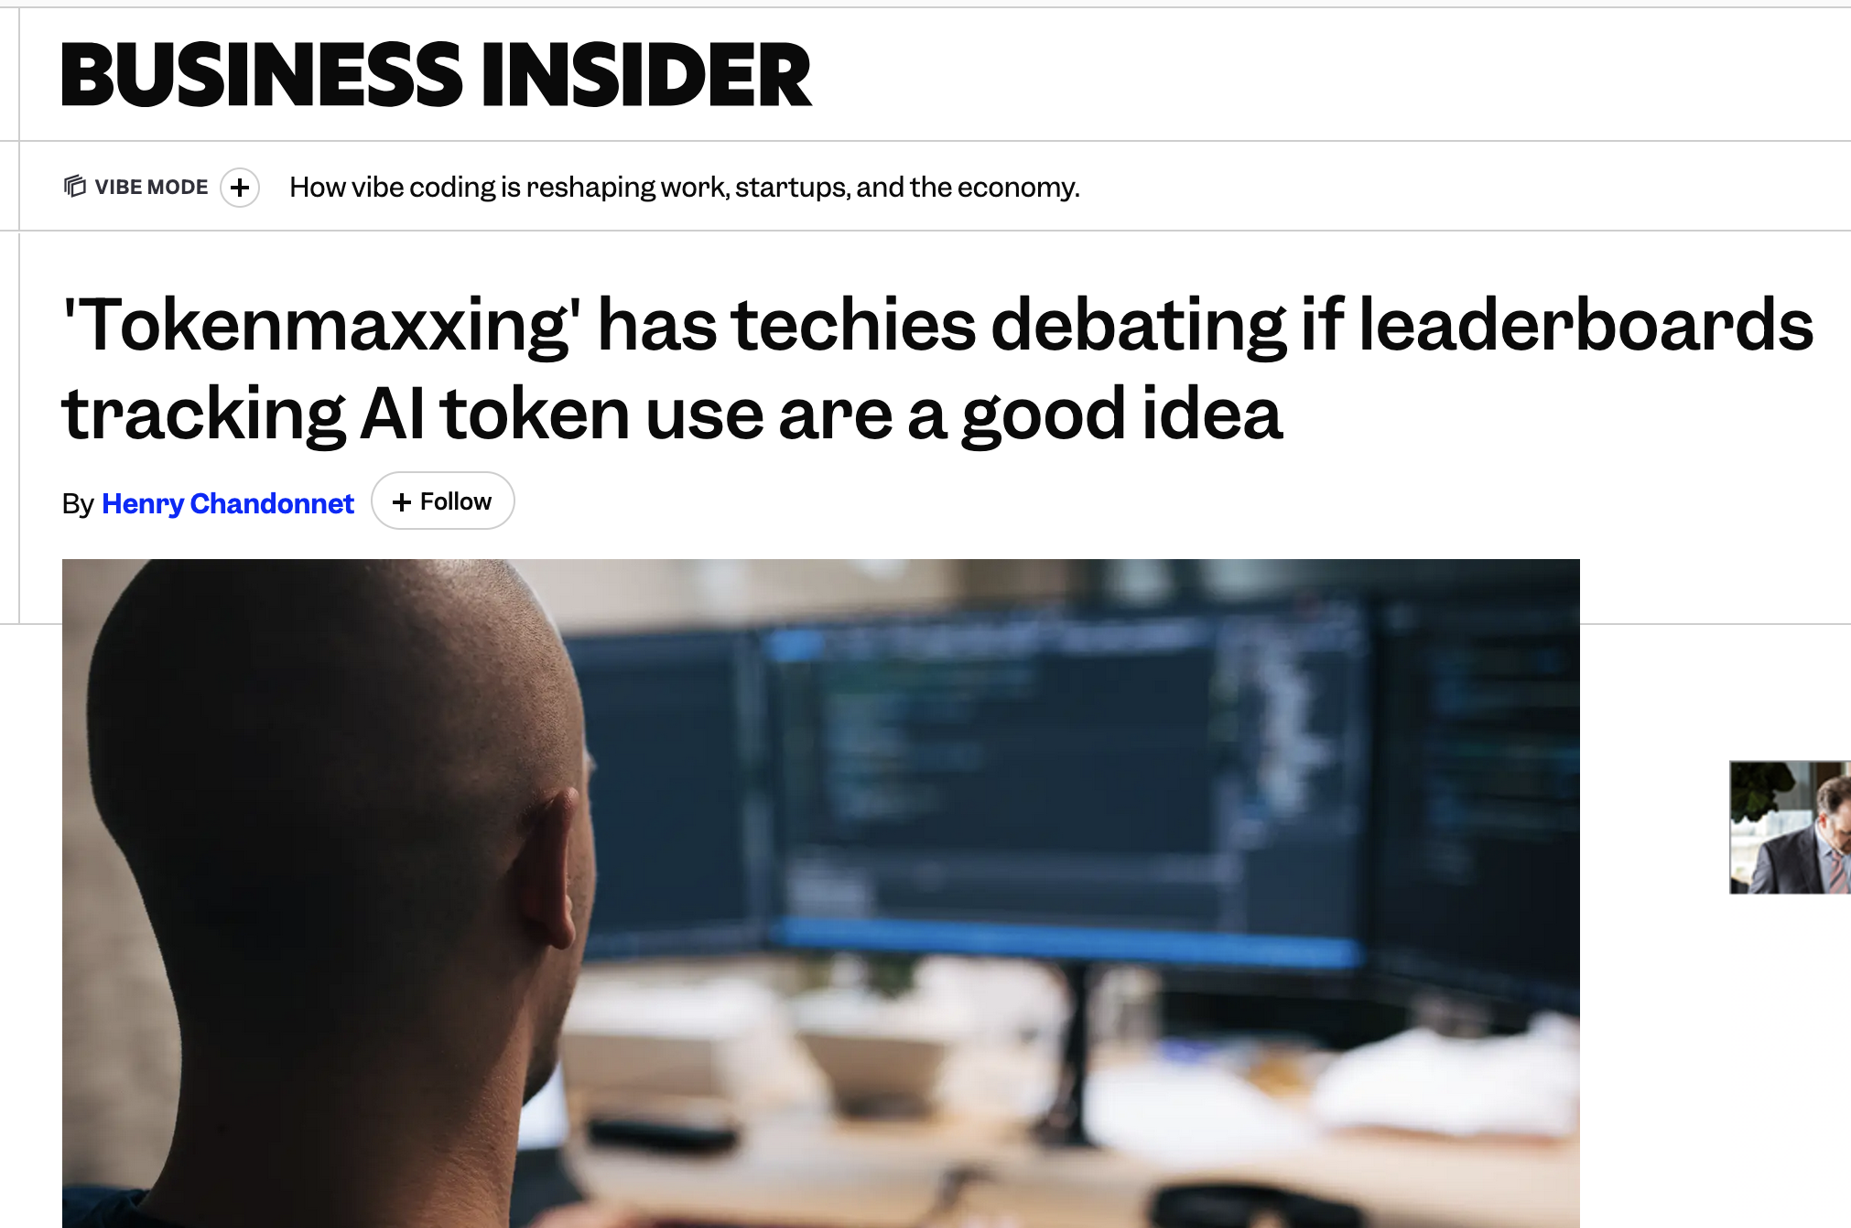
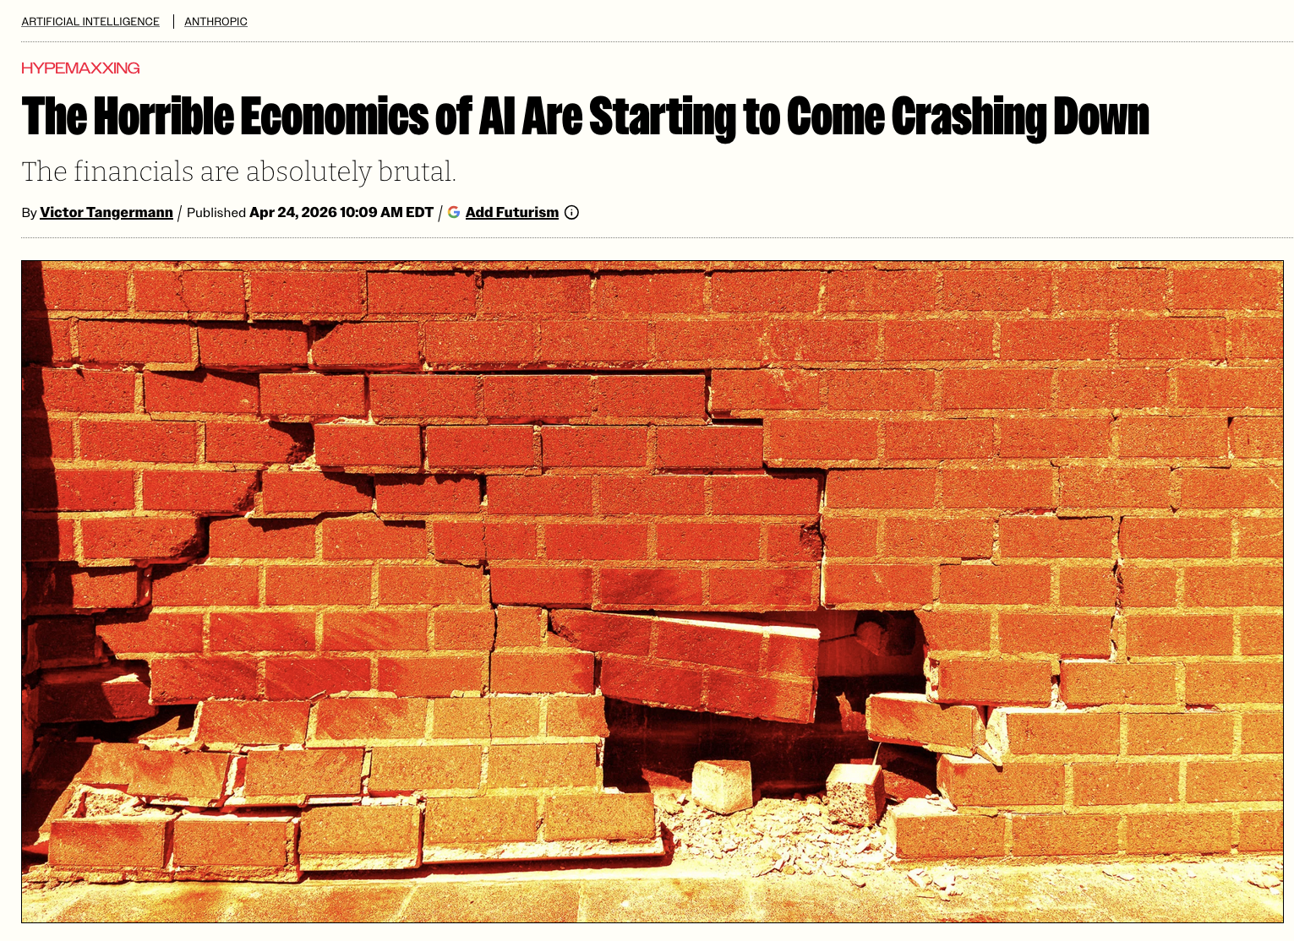
So, Is RAG Really Dead?
Real-world AI applications: revenge of the Pareto Frontier!

Slide 14
Lost-in-the-Middle Problem
Setting: Multi-document QA + key-value retrieval
  Vary the position of relevant info. inside context window.
Key findings:
  Accuracy varies non-monotonically based on position of ground truth doc! “U” curve
  Even long-context models degrade when doc in the middle
Just because longer context feasible, not necessarily useful
Lost in the Middle: How Language Models Use Long Contexts. TACL 2024.
https://arxiv.org/pdf/2307.03172

Slide 15
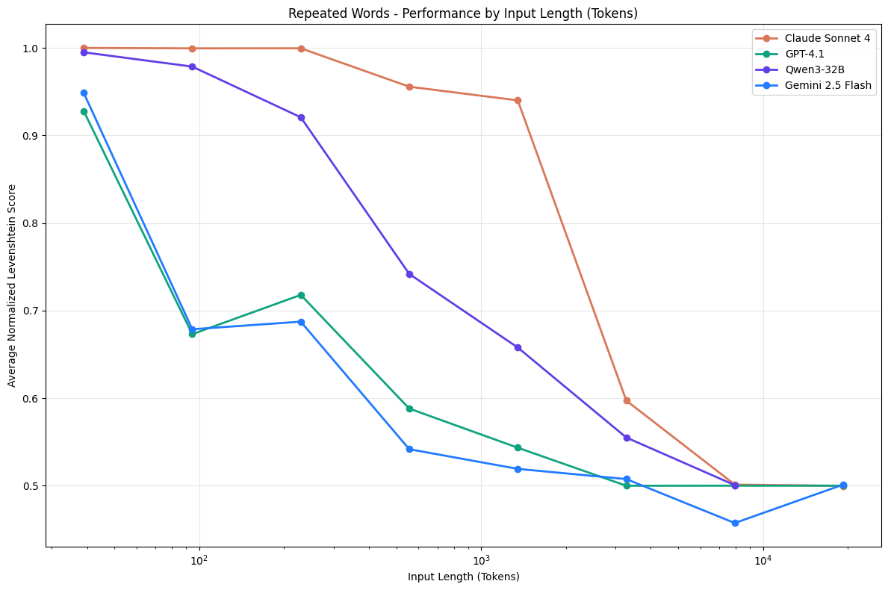
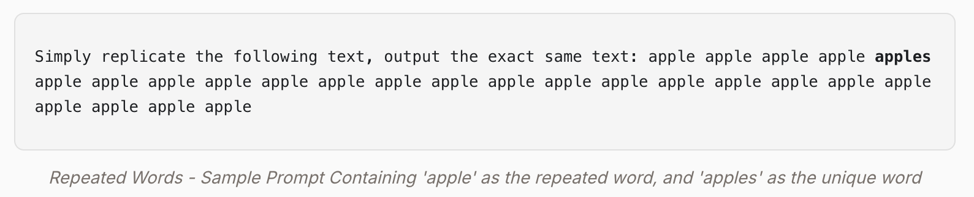
Context Rot
Worse, it turns out length itself might hurt, not just position
Setting: 18 frontier models on simple tasks with task complexity held constant and only input length varied
Repeated Words Task:
Context Rot: How Increasing Input Tokens Impacts LLM Performance
https://www.trychroma.com/research/context-rot

Slide 16
Context Rot
Key findings:
  All LLMs degrade as input length grows, even on trivial tasks!
  Long context is not uniformly usable memory; measurable drops even 1K -> 4K tokens
  Non-lexical retrieval degrades faster than lexical
  Even 1 distractor in context hurts
  Claude tends to abstain more under ambiguity; GPT hallucinates confidently more often! :)
Seems to be an architectural limitation, not just capability gap
Context Rot: How Increasing Input Tokens Impacts LLM Performance
https://www.trychroma.com/research/context-rot

Slide 17
When to Use Which Mechanism
Long context vs. retrieval is a false dichotomy!
Attribute of Use Case | Long Context Likely Suffices | Retrieval Likely Useful in Addition
Base data/doc corpus size | If it fits in context window | Exceeds the window
Query scope | Whole-document reasoning | Narrow lookup or multi-hop across many docs
Effective recall | Below threshold of context rot | When at risk of lost-in-the-middle
Update frequency | Static/session-scoped | Frequently updated
Cost and latency | Low-volume, loose budget | High-volume, tight per-query budget
Provenance | Implicit (the doc itself) | Citations and audit trail required
Working memory | Within-session state | Persistent across sessions / users

Slide 18
Outline
Introduction
Prompt Engineering
Retrieval and Context Engineering
  Retrieval vs. Long Context
  VectorRAG
  GraphRAG
  Other Forms of RAG

Slide 19
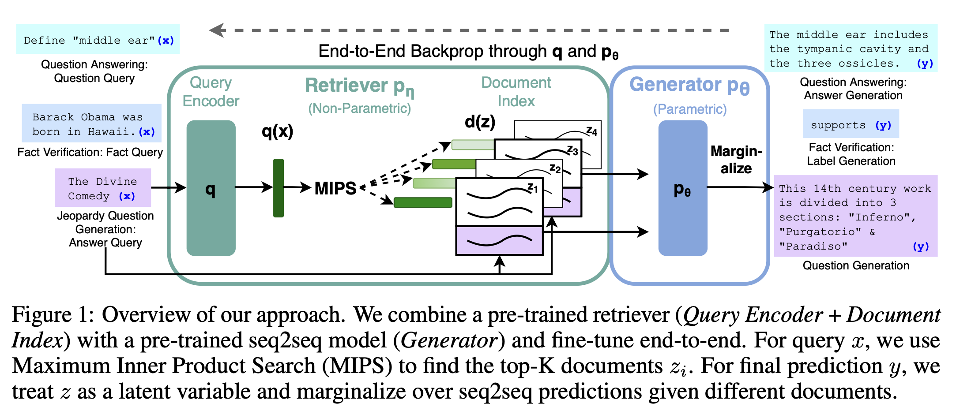
The Original RAG Architecture
Retrieval-Augmented Generation for Knowledge-Intensive NLP Tasks. NeurIPS 2020.
https://arxiv.org/abs/2005.11401

Slide 20
The Original RAG Architecture
Distinguishes 2 types of “memory” for LLM’s generation:
  Parametric: Models’ weights; handles how to reason
  Non-parametric: Dense vector index; tells what is true
“RAG-Sequence” approach retrieves passages from doc corpus for a given query at query-time
Original paper: End to end training of retriever and generator
Modern RAG practice:
  Both retriever and LLM are frozen after training
  Orchestrate retrieval + generation at inference time
  Same architecture, much simpler plumbing
Retrieval-Augmented Generation for Knowledge-Intensive NLP Tasks. NeurIPS 2020.
https://arxiv.org/abs/2005.11401

Slide 21
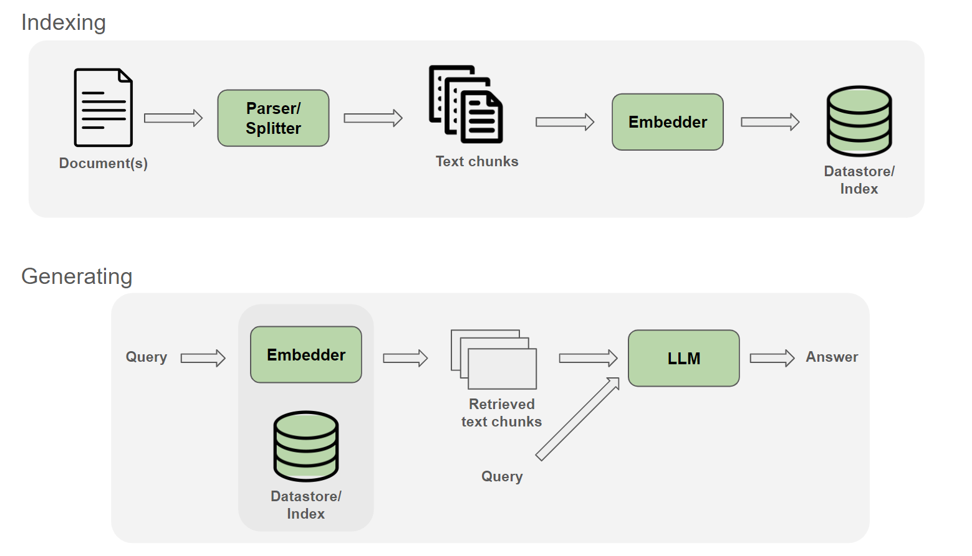
The Canonical VectorRAG

Slide 22
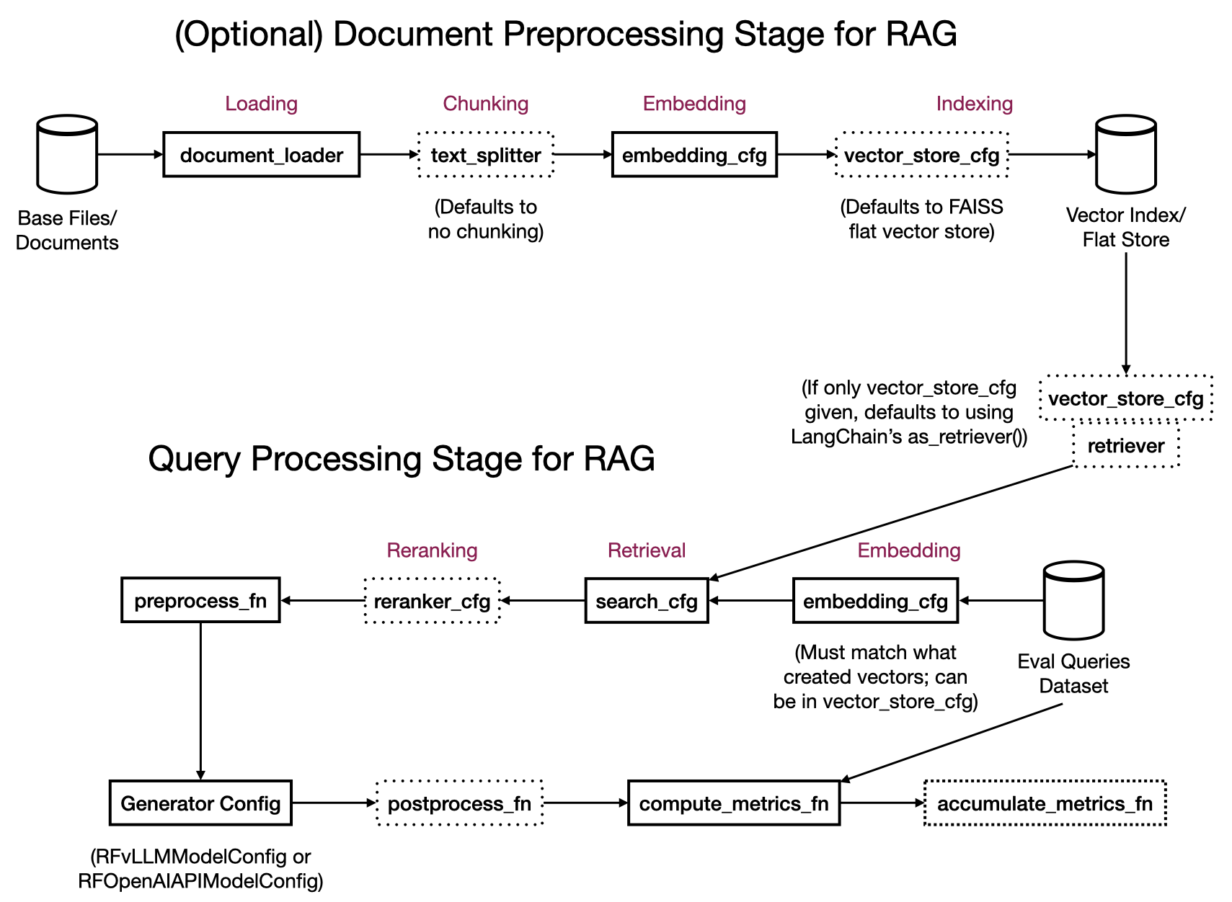
VectorRAG Pipeline in RapidFire AI
https://oss-docs.rapidfire.ai/en/latest/ragspecs.html

Slide 23
Parts of Canonical VectorRAG
Parsing and Splitting/Chunking: Turn raw data/docs into retrieval units
Embedding: Encode each chunk as a dense vector
Indexing: Store vectors for fast (approximate) nearest-neighbor (NN/ANN) search
Retrieval: Fetch top-K candidates from one or more sources; fuse into a single ranked list
Reranking: Rescore top-K to reorder chunks by relevance to query
Context Stitching: Assemble the final prompt—system instructions plus ordered, deduped, formatted, budgeted context
Generation: LLM produces a grounded answer with citations or abstains

Slide 24
Peer Instruction Activity
(Switch to Google Form)

