Slide 1
CSE/DSC 234
Data-Centric AI and AI Engineering
Arun Kumar
Topic 1: Creating Data and Evals

Slide 2
Outline
Motivation for Data-Centric AI
Creating Data
Creating Evals

Slide 3
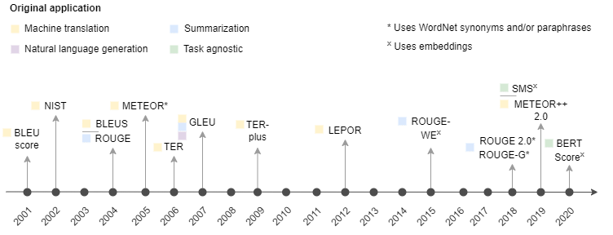
Evals: What and Why?
Traditional AI evaluation came with precise metrics for narrow, well-defined output types/semantics:
  Classification: F1, precision, recall, AuROC, etc.
  Regression: MAE, RMSE, etc.
  Translation/summarization: BLEU, ROUGE, perplexity, etc.

Slide 4
Evals: What and Why?
But modern LLM applications often produce open-ended, subjective, multi-dimensional outputs
  Subject Matter Expert (SME) human evaluation is golden but often expensive, slow, inconsistent (low IAA), does not scale
  Need for automated evaluation (evals) that can approximate SME human judgment
Creating eval metrics and data is now a key part of AI engineering
NB: Foundation model benchmarks (MMLU, GSM8K, etc.) are different from application-specific evals; doing well on former does not necessarily port to latter!

Slide 5
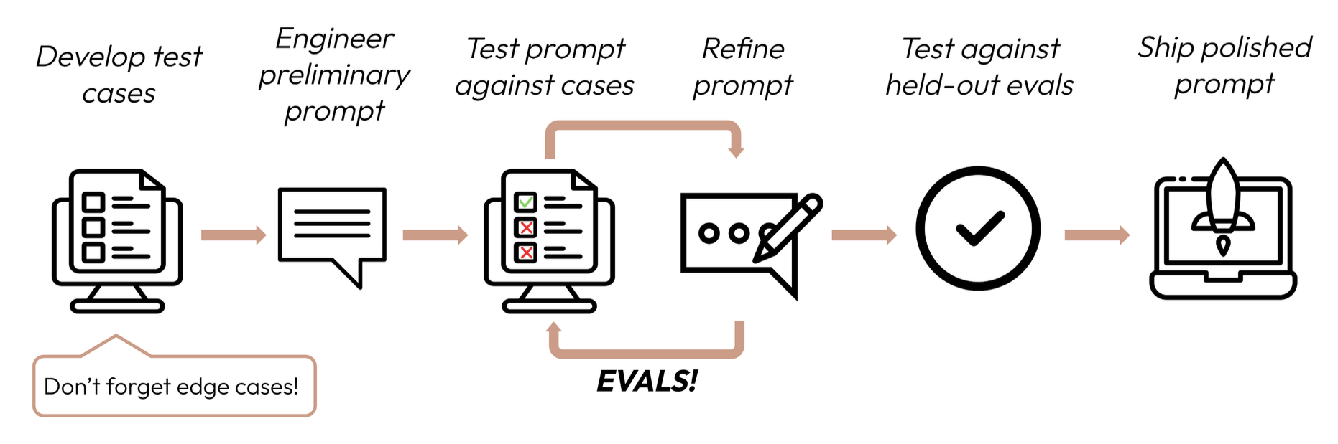
Evals: What and Why?
https://platform.claude.com/docs/en/test-and-evaluate/develop-tests

Slide 6
Eval Metrics: Defining “Quality”
No universal taxonomy for LLM appl. eval metrics:
  Correctness, completeness, faithfulness, helpfulness, safety, instruction-following, style/tone, etc.
At a high level, 2 types of eval metrics:
  Reference-based: Compare output to known correct ground truth answer, e.g., exact match, SQL execution, code tests
  Reference-free: Evaluate inherent properties of output, e.g., No speculation? Follows format? Appropriate tone?
Reference-based preferred when feasible as it is more objective, but reference-free inevitable when ground truth is hard to create
Credit: “AI Evals For Engineers & PMs” by Hamel Husain and Shreya Shankar
https://maven.com/parlance-labs/evals

Slide 7
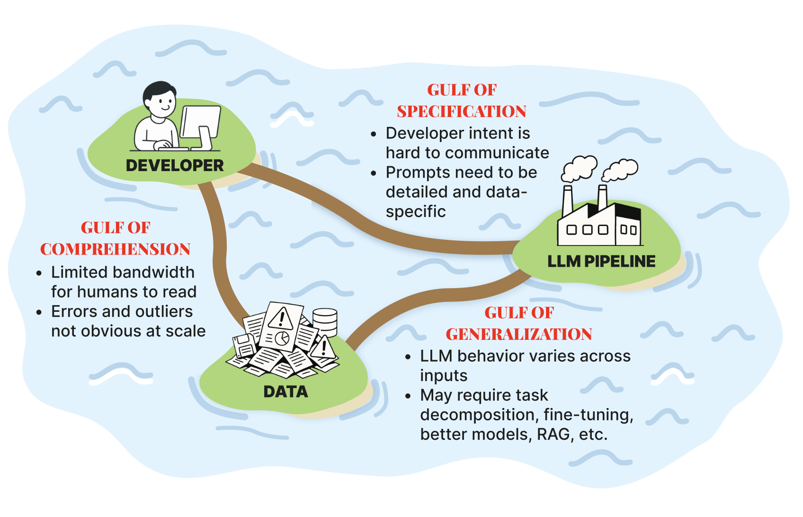
Key Concept: “Three Gulfs” in Evals
Evals is how an AI application can bridge these gulfs
Credit: “AI Evals For Engineers & PMs” by Hamel Husain and Shreya Shankar
https://maven.com/parlance-labs/evals

Slide 8
Evals Schemes and Tradeoffs
 | Vibe Checks | Codified Evals (Rules, KBs, SLMs, etc.) | LLM-as-Judge | SME Annotations
Upfront Cost | Very Low | High | Medium | Very High
Recurring Cost | Low | Low-Medium | Medium-High | Very High
Scalability | Low | Very High | Medium-High | Very Low
Reliability | Low | High | Medium-High | Very High
Flexibility | Very High | Medium | High | Very High
Prevalence | Very High | Medium | Very High | Low-Medium

Slide 9
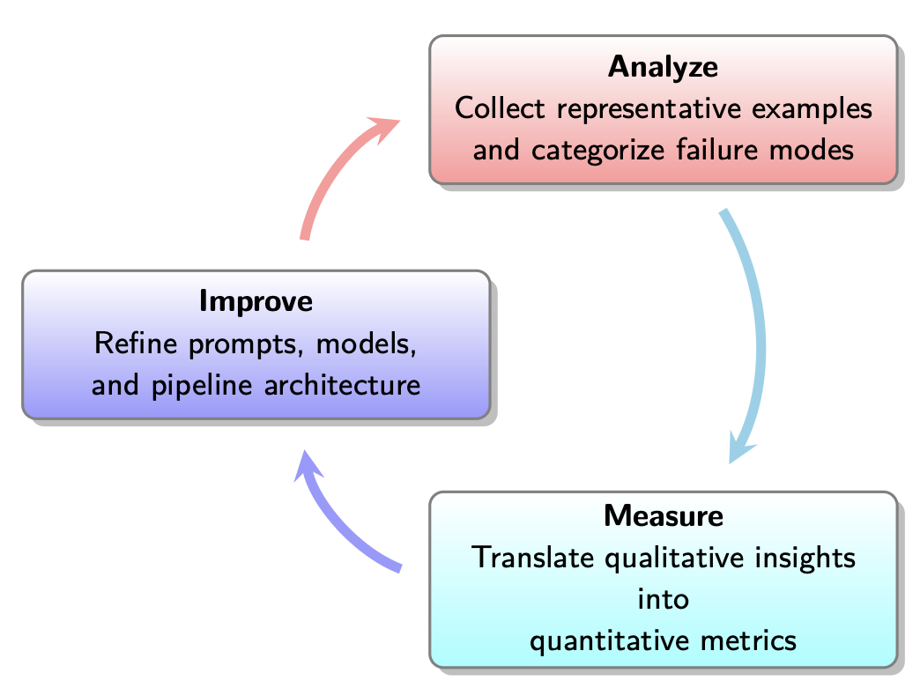
Key Concept: Iterative Cycle of Evals
Evals in practice is an iterative refinement process, not one-time!
Credit: “AI Evals For Engineers & PMs” by Hamel Husain and Shreya Shankar
https://maven.com/parlance-labs/evals

Slide 10
Outline
Motivation for Data-Centric AI
Creating Data
Creating Evals
  Analyze
  Measure
  Improve

Slide 11
Peer Instruction Activity
(Switch to Google Form)

Slide 12
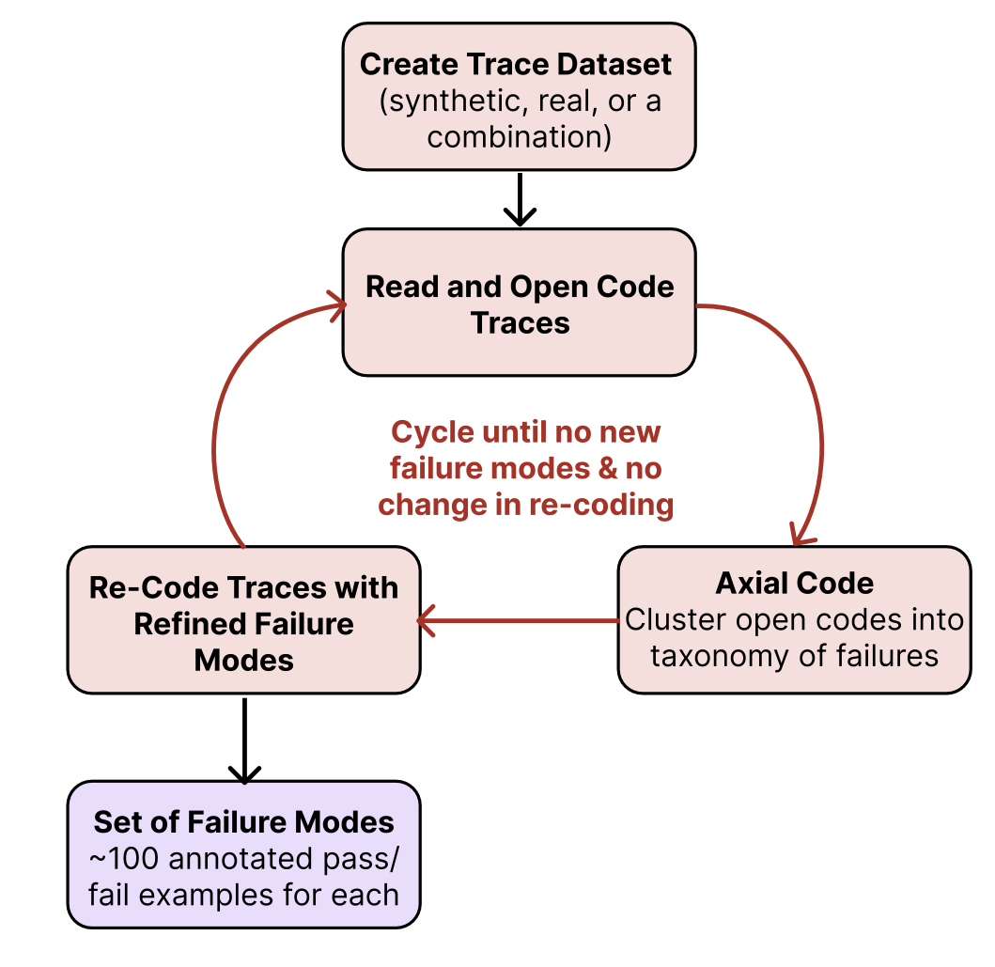
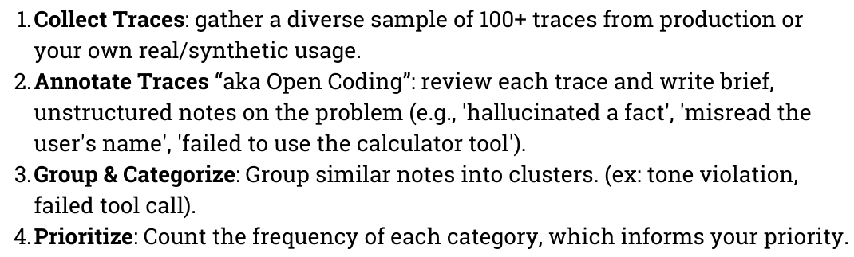
Error Analysis: From Traces to Taxonomy
Trace: A complete record of all steps for one query, viz., all LLM turns, tool calls, data retrievals, outputs, etc.
Error Analysis: A methodology from grounded theory (used in social sciences)
Credit: “Evals Flashcards” by Hamel Husain
https://hamel.dev/notes/llm/evals/flashcards/

Slide 13
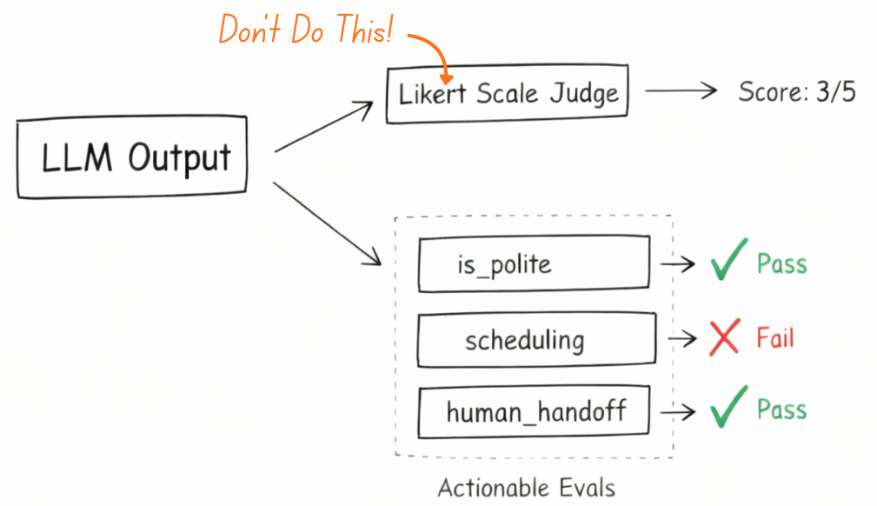
Error Analysis: From Traces to Taxonomy
Typical desired output: structured taxonomy of failures with ~100 annotated examples
Quantifying failures:
  Likert/numeric scales (e.g., 1-5) create ambiguity; hard to align SME judgments
  Binary decision (Pass/Fail) recommended in practice; “picking a side, even when borderline” clarifies criteria faster; aligns better with ship vs. don’t ship decisions
Credit: “Evals Flashcards” by Hamel Husain
https://hamel.dev/notes/llm/evals/flashcards/

Slide 14
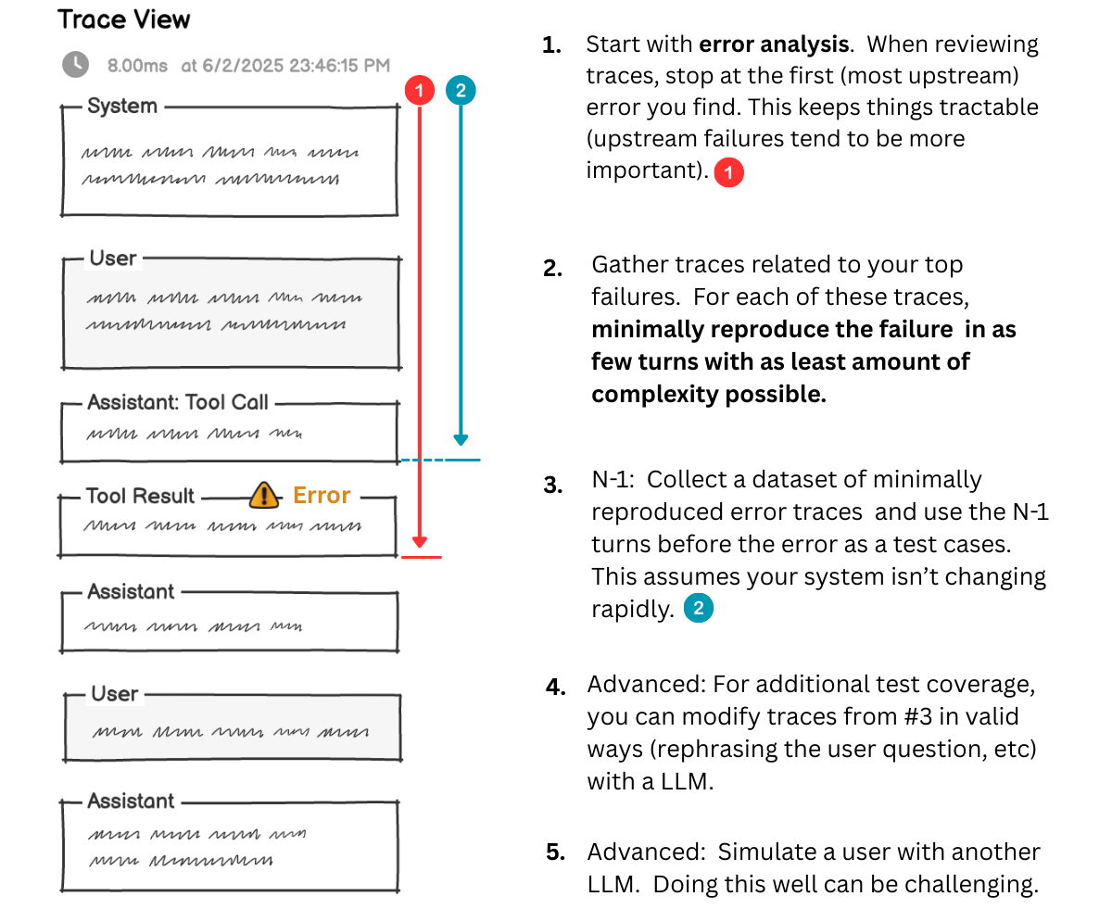
Example: Traces
Credit: “Evals Flashcards” by Hamel Husain
https://hamel.dev/notes/llm/evals/flashcards/

Slide 15
Bootstrapping Evals Dataset
3 main sources:
  SME-produced: Traces hand crafted by SMEs
  Real data: Traces from live deployment on alpha testers
  (Semi-)Synthetic: Traces generated using LLMs, alongside code and HIL process
SME-produced is not scalable; real data unavailable upfront
Synthesis with SME-produced seed data can bridge the gap
Credit: “AI Evals For Engineers & PMs” by Hamel Husain and Shreya Shankar
https://maven.com/parlance-labs/evals

Slide 16
Bootstrapping Evals Dataset with Synthesis
Dimensions: Mostly independent axes of variation in appl. user queries; useful to ensure diversity in synthetic data
3 main dimensions:
  Feature (the what): What task the user wants to perform, e.g., property search, scheduling
  Persona (the who): The type of client being served, e.g., first-time buyer, investor
  Scenario (the how): How clearly the user expresses their intent, e.g., well-specified, ambiguous
Credit: “AI Evals For Engineers & PMs” by Hamel Husain and Shreya Shankar
https://maven.com/parlance-labs/evals

Slide 17
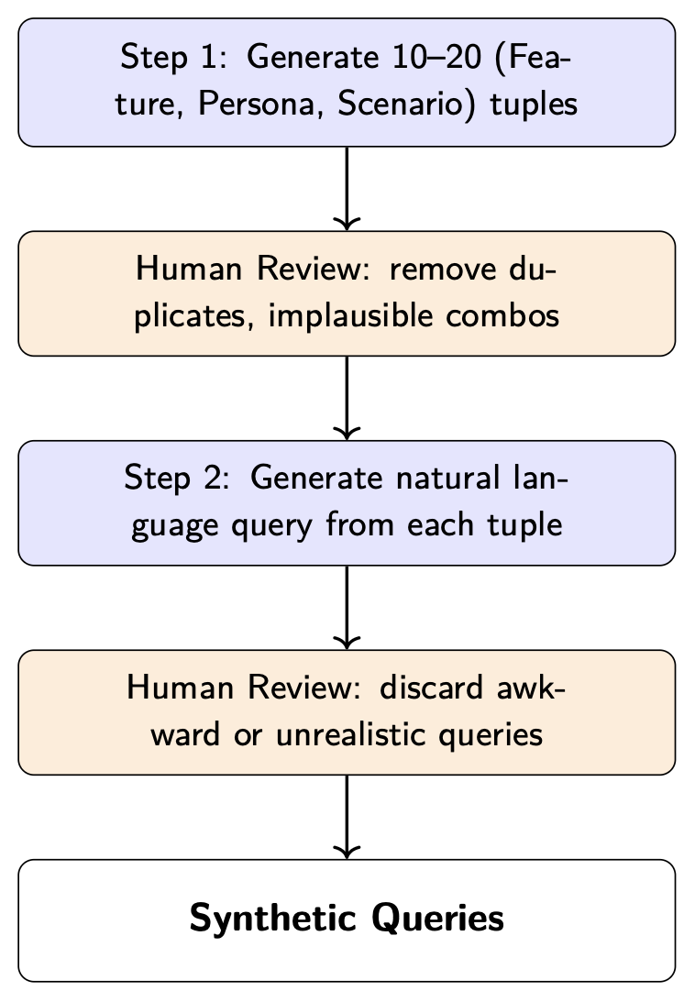
Bootstrapping Evals Dataset with Synthesis
Do NOT just prompt “give me user queries”—too generic to be useful
Systematically vary across failure-prone dimensions
After analysis: fix specification failures first (prompt clarity), then build evaluators for generalization failures

Slide 18
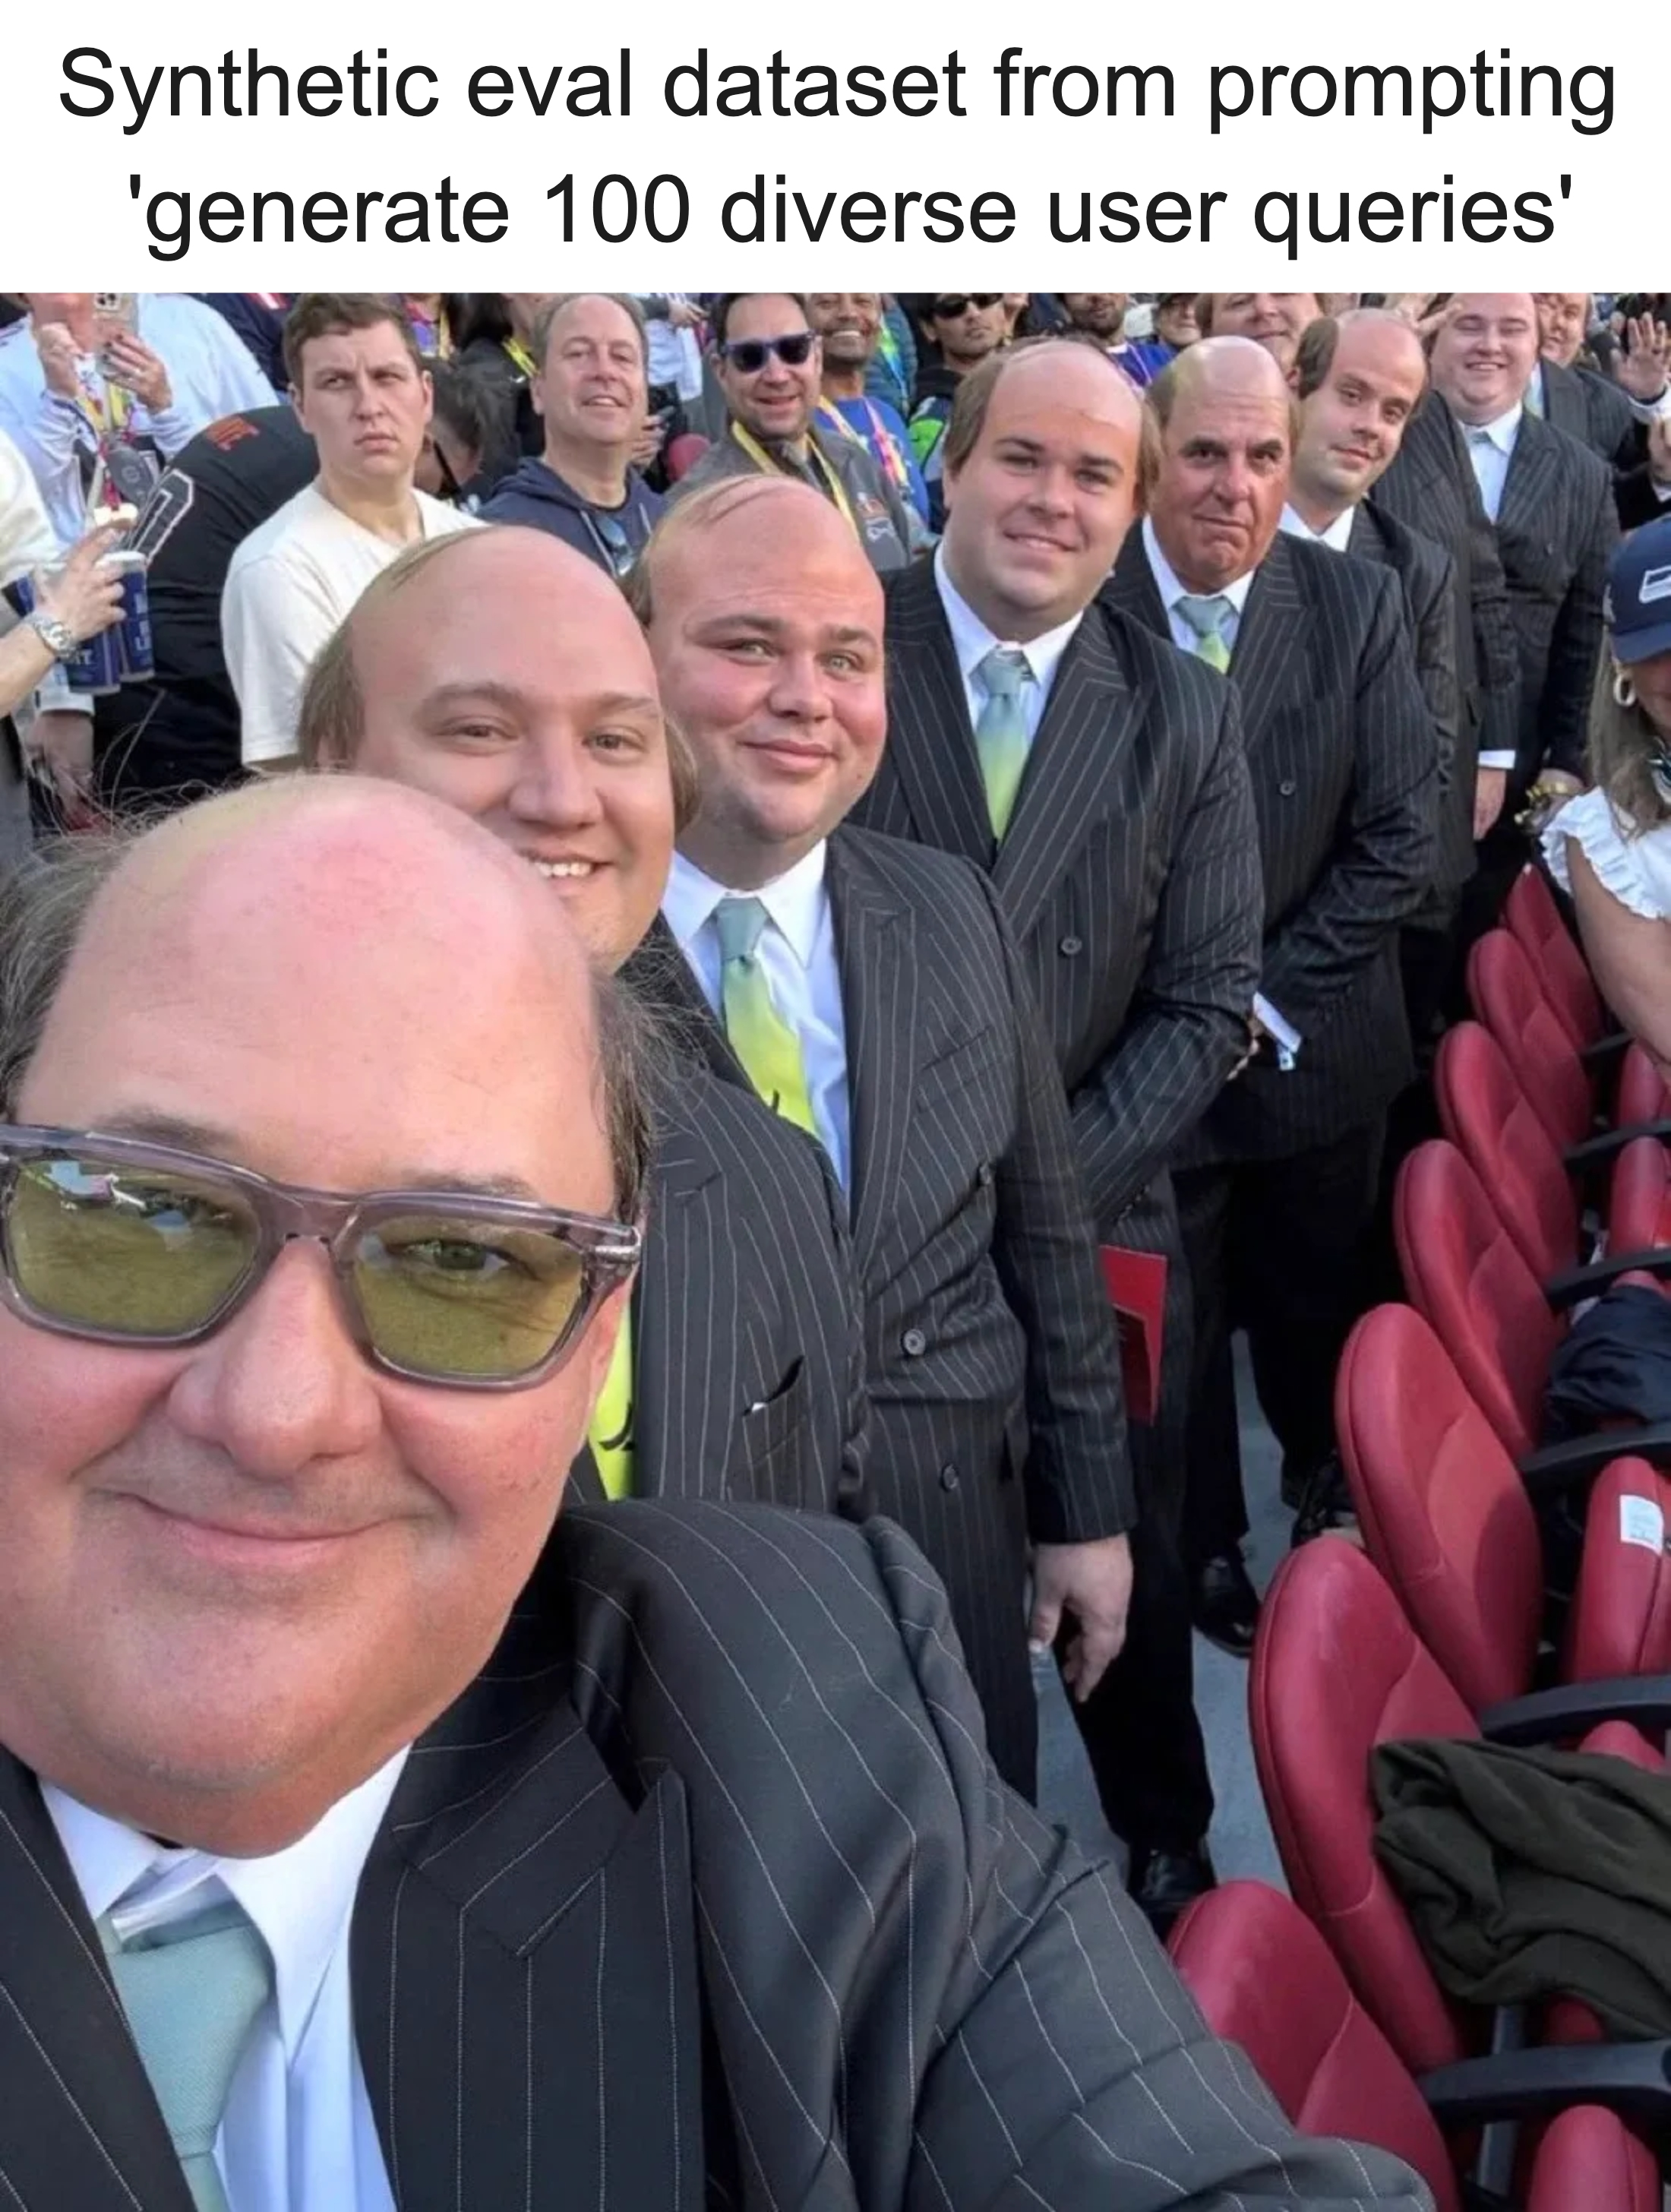
Bootstrapping Evals Dataset with Synthesis

Slide 19
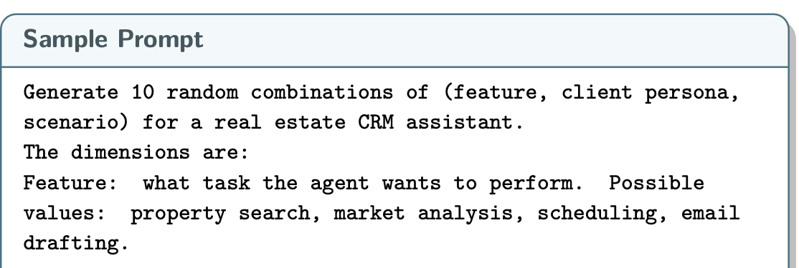
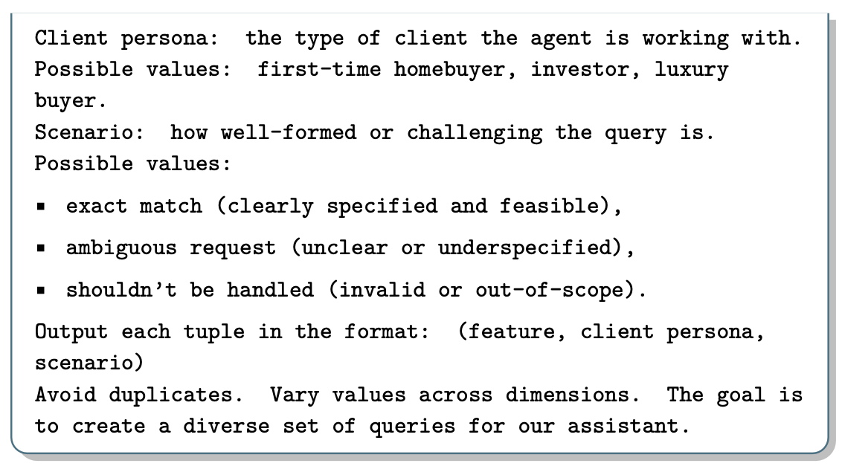
Example: Synthesis

Slide 20
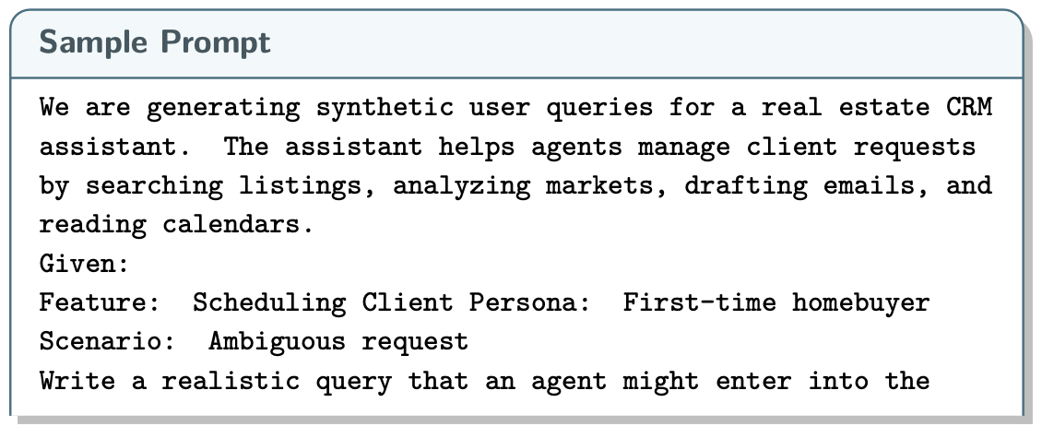
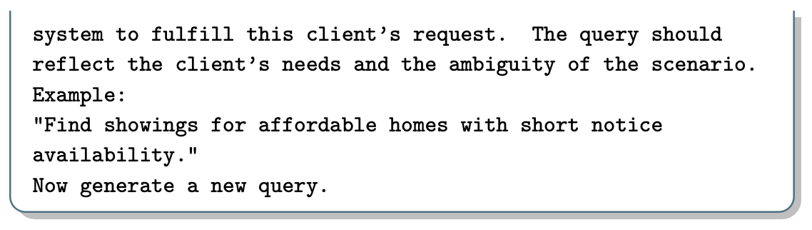
Example: Synthesis

Slide 21
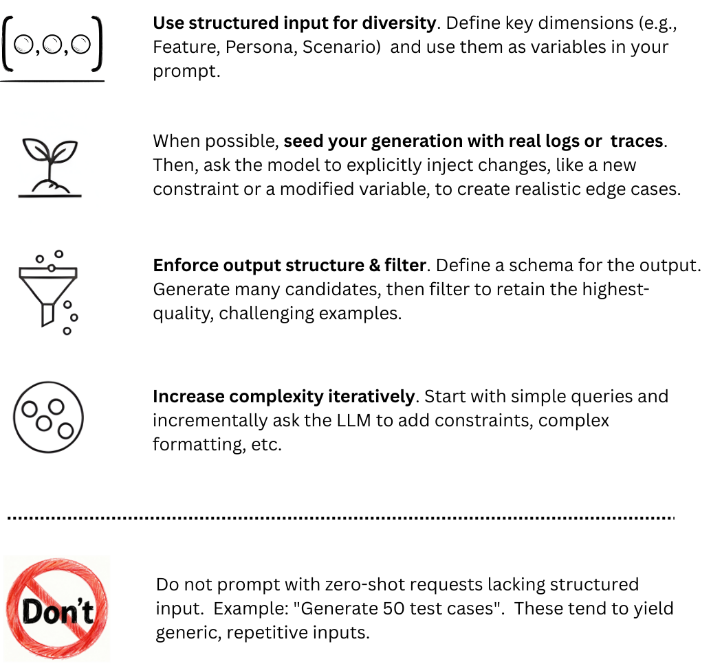
Bootstrapping Evals Dataset with Synthesis

Slide 22
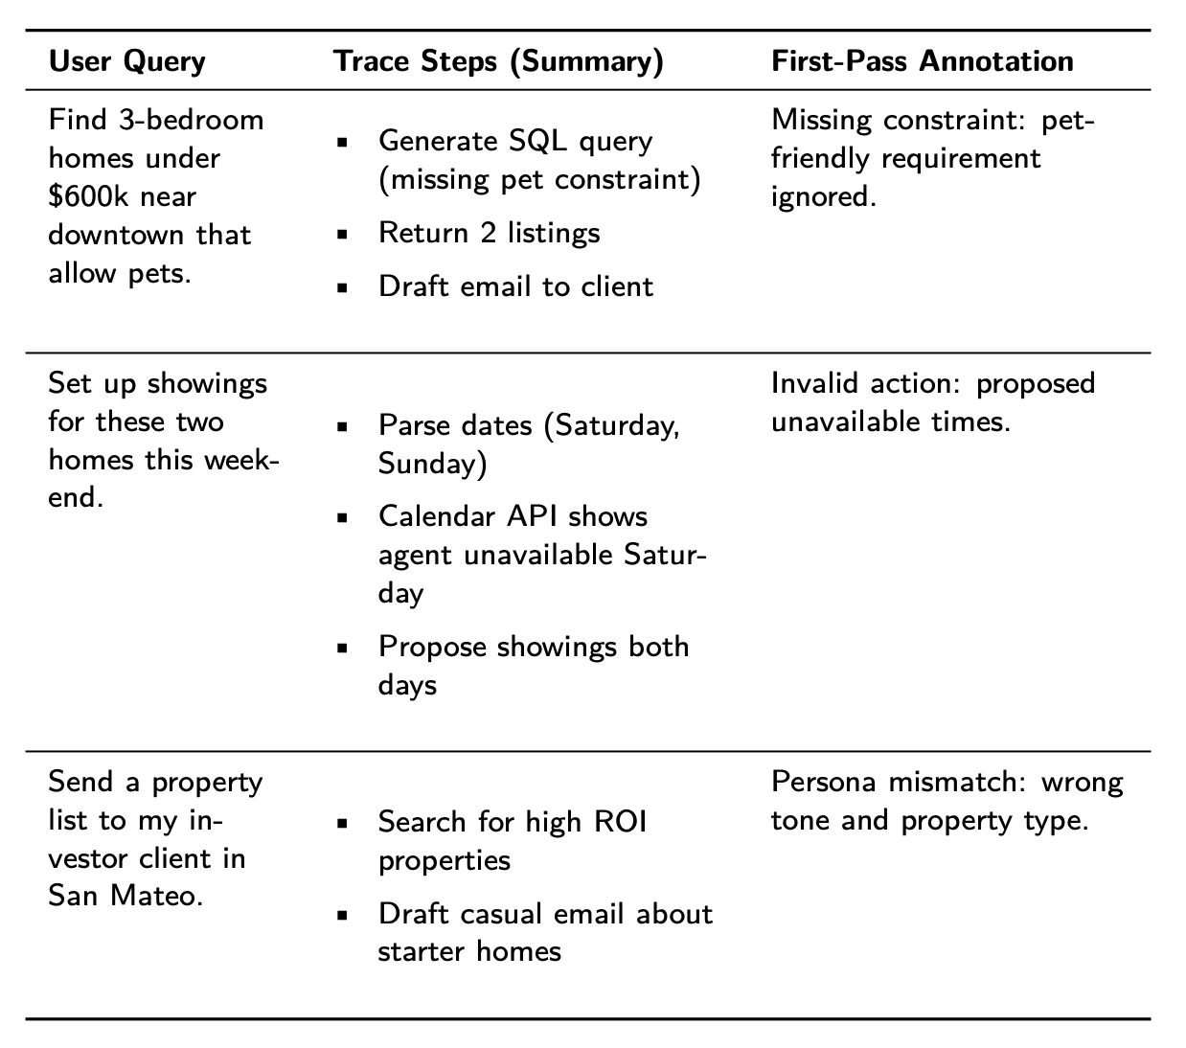
Example: Open Coding of Traces

Slide 23
Common Pitfalls in Practice
Failing to test on representative data
Skipping open coding on traces
False comfort of generic metrics
Likert/numeric scales of failure annotation instead of binary
Treating evals as one-time step instead of iterative refinement
Credit: “AI Evals For Engineers & PMs” by Hamel Husain and Shreya Shankar
https://maven.com/parlance-labs/evals

Slide 24
Outline
Motivation for Data-Centric AI
Creating Data
Creating Evals
  Analyze
  Measure
  Improve

Slide 25
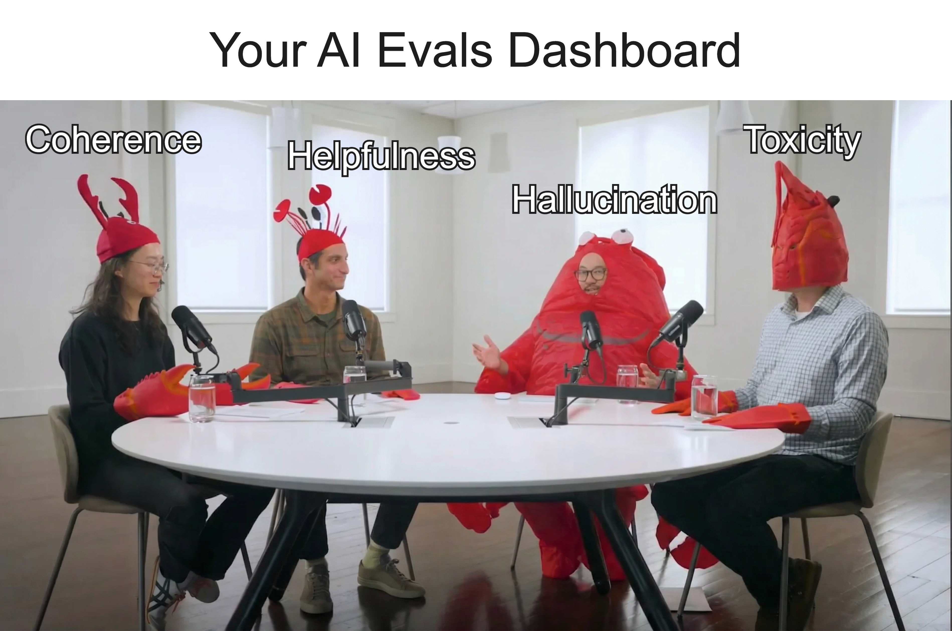
The Trap of Generic Eval Metrics
Generic eval metrics such as “coherence” or “faithfulness” are OK for starters but rarely suffice for production LLM applications

Slide 26
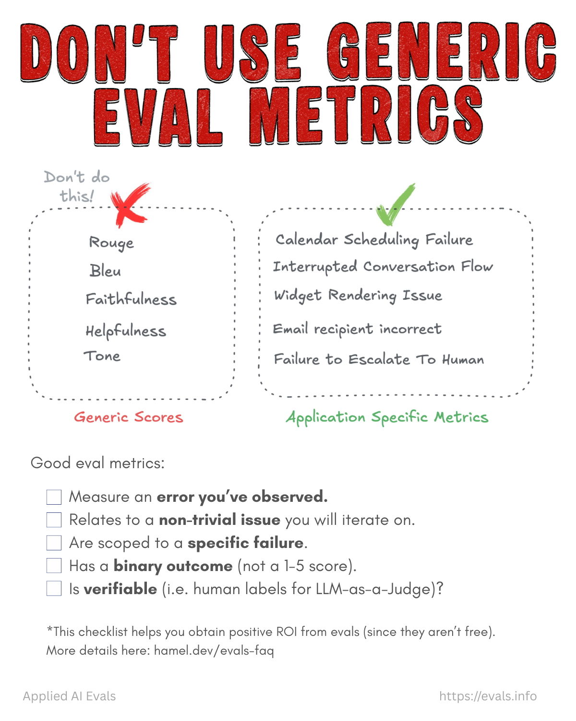
Application-Specific Eval Metrics
Create application-specific eval metrics that are actionable, i.e., help fix the pipeline and/or source data to improve reliability
Credit: “Evals Flashcards” by Hamel Husain
https://hamel.dev/notes/llm/evals/flashcards/

Slide 27
Application-Specific Eval Metrics
“Hamel’s Checklist” for high-quality eval metrics:
Credit: “Evals Flashcards” by Hamel Husain
https://hamel.dev/notes/llm/evals/flashcards/

Slide 28
Codified Eval Metrics
Bespoke code and/or SLMs to define quality in an application-specific manner
Increasingly common in practice; difficult but highly valuable
Examples:
  Parser to check JSON schema validity or SQL syntax
  Regex or string matching to catch required/forbidden phrases
  Checking structural properties, e.g., counting bullets
  Semantic SLM classifiers, e.g., is the tone professional?
  Tool use to execute some calculations, code, etc.

Slide 29
Pivot Point: LLM-as-Judge
Very popular evals scheme in practice
Use (more powerful) judge LLM, possibly aligned with golden human preference data, to judge outputs of application’s LLM
MT-bench: A multi-turn question set with 80 high-quality examples
  8 common categories of user prompts: writing, roleplay, extraction, reasoning, math, coding, knowledge I (STEM), and knowledge II (HSS)
Chatbot Arena: A crowdsourced “battle” platform for humans to vote on outputs of anon. pairs of LLMs
  GPT-4 had >80% agreement with humans; same as human-human!
Judging LLM-as-a-Judge with MT-Bench and Chatbot Arena. NeurIPS 2023.
https://arxiv.org/pdf/2306.05685

Slide 30
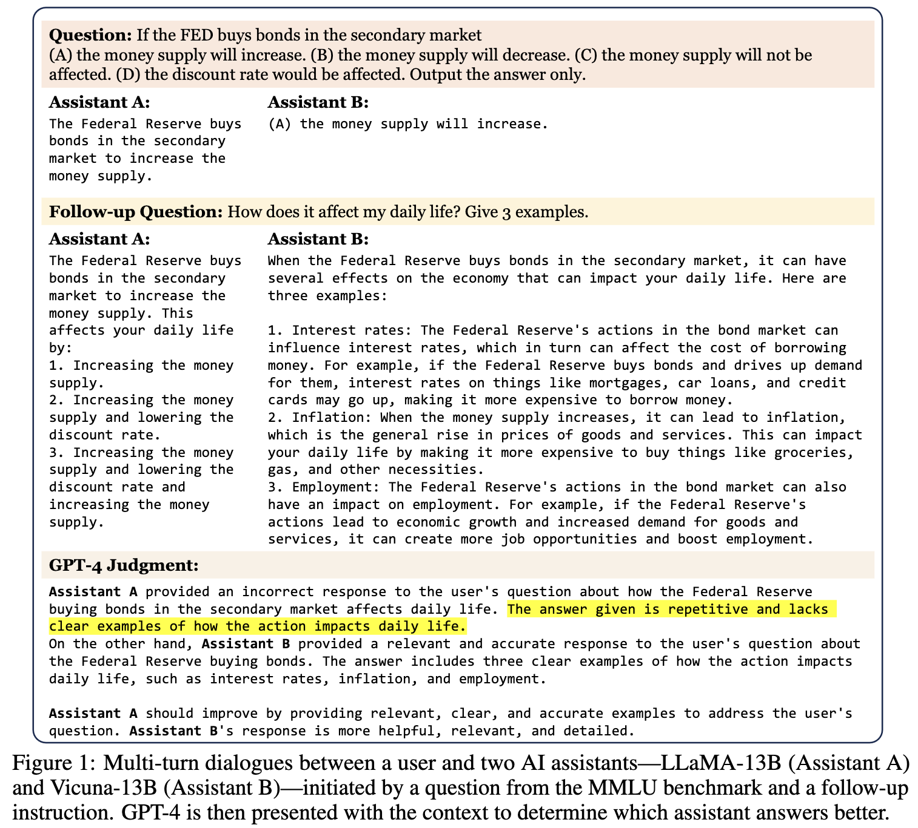
Pivot Point: LLM-as-Judge
Judging LLM-as-a-Judge with MT-Bench and Chatbot Arena. NeurIPS 2023.
https://arxiv.org/pdf/2306.05685

Slide 31
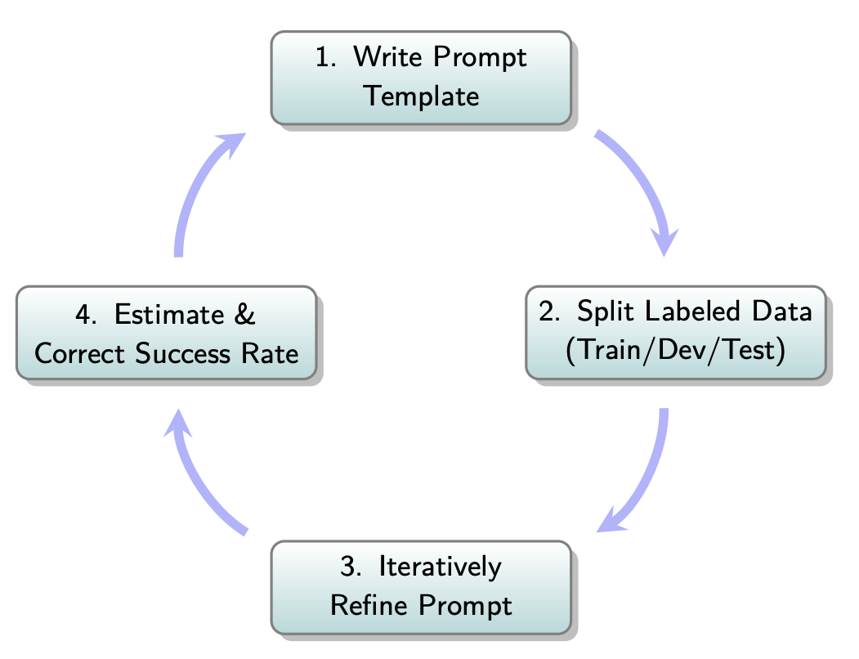
LLM-as-Judge Eval Metrics
Typical workflow for creating LLM-as-judge eval metrics:

Slide 32
LLM-as-Judge Eval Metrics
The judge prompt matters enormously! Key elements:
  Task description + clear Pass/Fail definitions
  Few-shot examples from a training set with both Pass/Fail
  Chain-of-thought: “Explain reasoning, then give verdict”
  Structured output: JSON with “reasoning”, “answer” fields
Caveats:
  Without rubric, LLM judges tend to default to 60%-70% score
  Binary Pass/Fail is more reliable than Likert/numeric scales

Slide 33
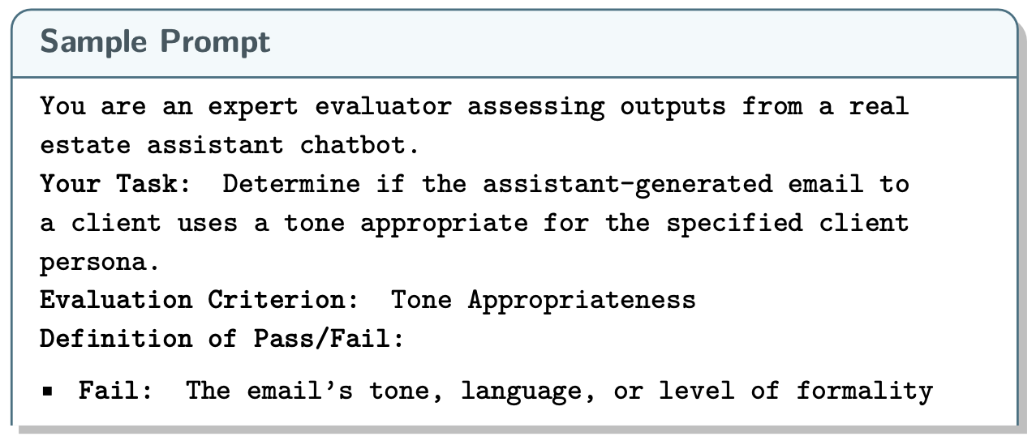
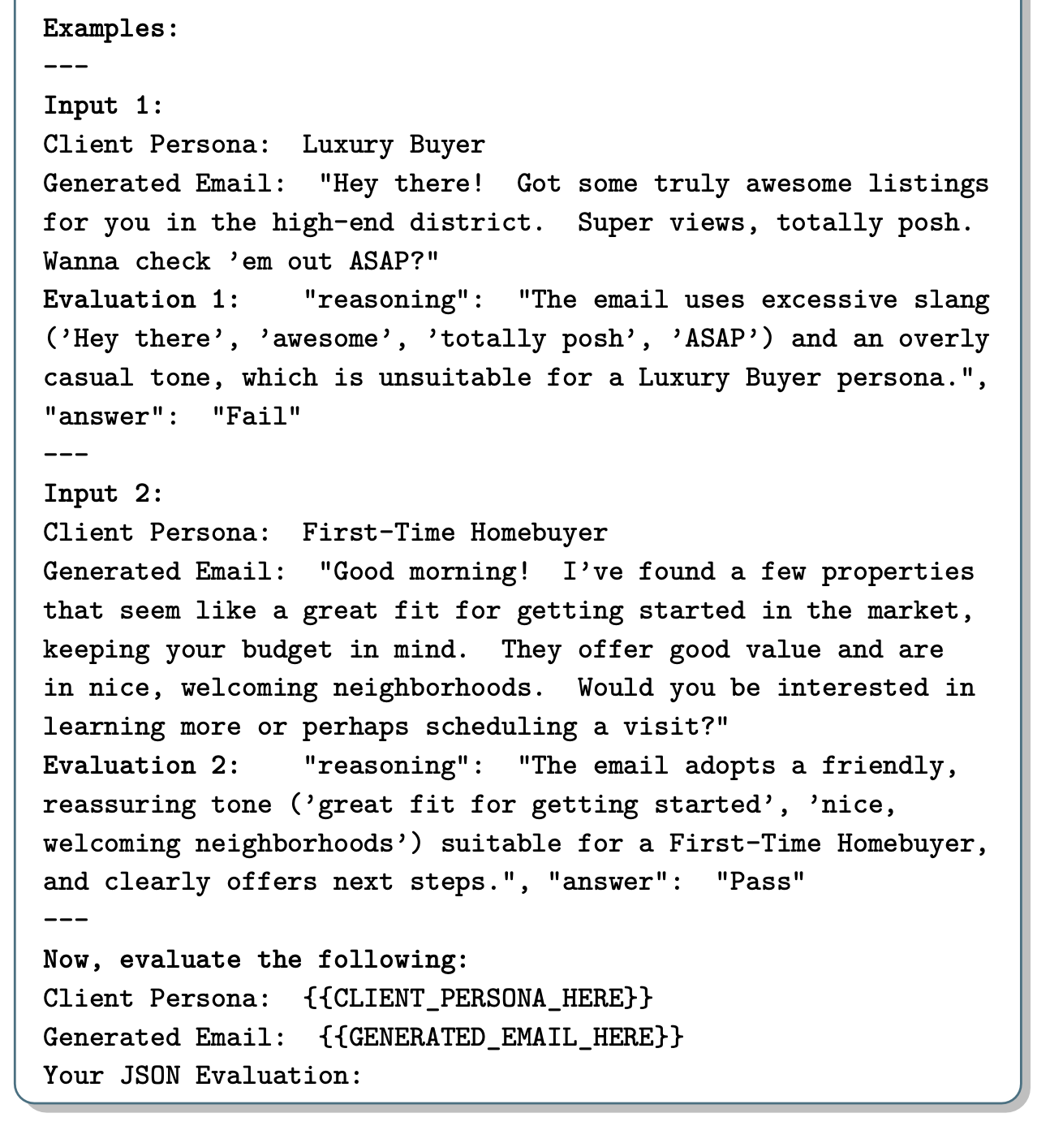
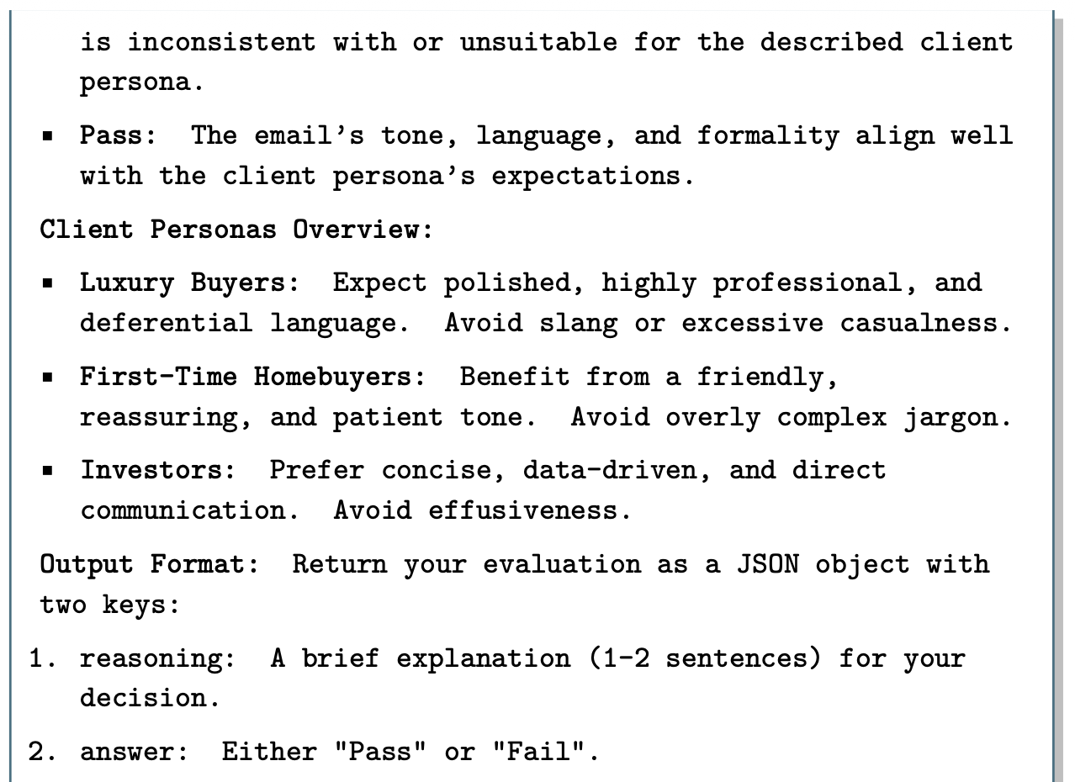
Example: LLM-as-Judge Prompt

Slide 34
LLM-as-Judge: Labeled Data Splits
Intuition: Treat LLM-as-Judge prompt development akin to regular ML classifier training
Key Measures: TPR (fraction of real Passes correctly judged Pass) and TNR (fraction of real Fails correctly judged Fail)
Typical recommended splits:
  “Training” (10-20%): Pool for few-shot examples
  Dev/Validation (40-45%): Refine prompt, measure TPR/TNR after each edit
  Test (40-45%): Held-out, final unbiased accuracy estimate
  NEVER put dev or test examples in the prompt (leakage)!

Slide 35
LLM-as-Judge: Typical Biases
Position bias: Tend to prefer first (or last) response
  This alone can flip model rankings on benchmarks!
Verbosity bias: Often, longer response = higher score
Self-enhancement: LLMs tend to rate their own outputs higher
Limited reasoning: Sometimes struggle to verify math/logic
Typical Mitigations:
  Swap positions of examples + average scores
  Pairwise > pointwise comparisons
  Provide reference answers
  Use multiple LLM judges (ensembles)

Slide 36
LLM-as-Judge: Practical Limits
Tends to work for: checking style, fluency, helpfulness, instruction following, tone, comparative ranking
Tends to fail for: math correctness, code correctness, factual accuracy on obscure topics, subtle logical errors.
For “verifiable” tasks, different complementary methods being pursued, e.g., post-training techniques

Slide 37
Outline
Motivation for Data-Centric AI
Creating Data
Creating Evals
  Analyze
  Measure
  Improve

Slide 38
Peer Instruction Activity
(Switch to Google Form)

Slide 39
From Measurement to Improvement
Menu of fixes, from cheapest to most expensive:
  Clarify the spec: Fix Specification gulf (repeat failures) before Generalization gulf (edge cases). Rewrite prompt, add constraints, add few-shot examples from failure taxonomy.
  Grow the eval set: Synthetic traces for underrepresented failures, more labels, refine judge rubric, re-check TPR/TNR.
  Restructure pipeline: decompose prompt, add tool use, etc.
  Improve retrieval engineering -> Topic 2.
  Last resort: Customize the model itself with SFT, post-training, and/or continued pretraining -> Topic 4.
After any major change: re-run evals to test for regressions. Rule of thumb: cheapest sufficient fix first.

Slide 40
Detailed Example
Use case: Chatbot to summarize support tickets for ITS
Failures from error analysis (say, n=100) | Diagnosis | Improvement | Time taken
22%: Summaries too long | Spec gulf (consistent) | Add length constraint + few-shot | Minutes
14%: Missing customer’s key ask | Spec gulf | Add rubric “lead with primary request” | Minutes
6%: Hallucinated account details | Generalization gulf (intermittent) | Retrieve order history, ground summary | Few days
Result: 36% of failures fixed before touching pipeline structure. Rerun evals -> identify new dominant failure modes -> iterate.

Slide 41
Review Questions
What are the 3 “gulfs” in the context of LLM evals? Explain the difference between any 2 of them with a concrete application example.
Why is binary Pass/Fail considered preferable over a 1-5 scale for error analysis and application-specific LLM judge metrics?
Suppose you are a developer tasked with launching an LLM-based feature for your company’s website. Which evals scheme would you suggest for starters?
Briefly explain one pro and one con of vibe checks as an evals scheme.
Which evals scheme discussed in class is the most scalable? Why?
Give an example each of reference-based vs. reference-free evals. Which is preferred when feasible, and why?
Briefly explain open vs. axial coding in constructing an LLM failure taxonomy.
What is “dimension-based” synthesis of evals data?
Name three common biases in LLM judges. Propose a mitigation for one.
What is the analog of “label leakage” from classical ML for an LLM judge?
Your Project 1 teammate proposes to send every RAG query post-deployment to Claude Opus as judge. Is this a good idea? Why or why not?

Slide 42
Recommended Readings
Application-Centric AI Evals for Engineers and Technical Product Managers. Husain and Shankar. 2026.
Judging LLM-as-a-Judge with MT-Bench and Chatbot Arena. Zheng et al. NeurIPS 2023.
Who Validates the Validators? Aligning LLM-Assisted Evaluation of LLM Outputs with Human Preferences. Shankar et al. UIST 2024.

