Slide 1
CSE/DSC 234
Data-Centric AI and AI Engineering
Arun Kumar
Topic 1: Creating Data and Evals

Slide 2
Outline
Motivation for Data-Centric AI
Creating Data
  Human Feedback and Annotation
  Data Curation and Structure
  Data Synthesis
  Multimodal Data
Creating Evals

Slide 3
Why Synthetic Data?
Human annotation is expensive, slow, may have limited diversity
  InstructGPT: ~13K demo examples; does not scale to millions
Synthesis: LLM-assisted generation/refinement of labeled data for their own use!
Advantages:
  Cheap, fast
  Target-customizable; can reach complexity humans find hard
Risks:
  Quality control is harder
  “Model collapse”
  Bias amplification

Slide 4
Pivot Point: Self-Instruct
First work showing LLMs can bootstrap their own instruction-tuning data
  175 human-written seed tasks -> LLM generates new instructions + input-output pairs -> filter -> fine-tune
  52K instructions, 82K instances suffices for GPT-3 + Self-Instruct to be comparable to InstructGPT-001!
Stanford Alpaca: same idea with GPT-3.5 + LLaMA 7B for under $600; democratized chat models
But: generated instructions skew simple and repetitive; heavy on classification, light on reasoning
Self-Instruct: Aligning Language Models with Self-Generated Instructions. ACL 2023
https://arxiv.org/abs/2212.10560

Slide 5
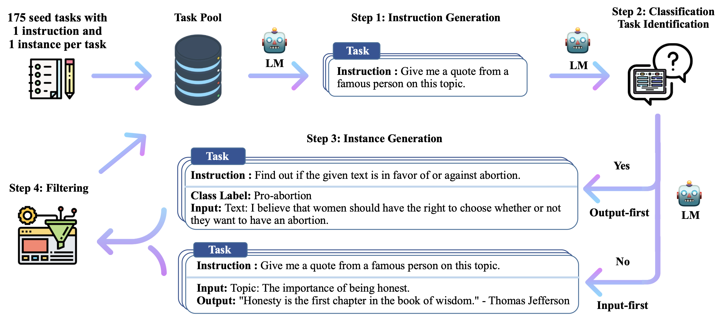
Pivot Point: Self-Instruct
Self-Instruct: Aligning Language Models with Self-Generated Instructions. ACL 2023
https://arxiv.org/abs/2212.10560

Slide 6
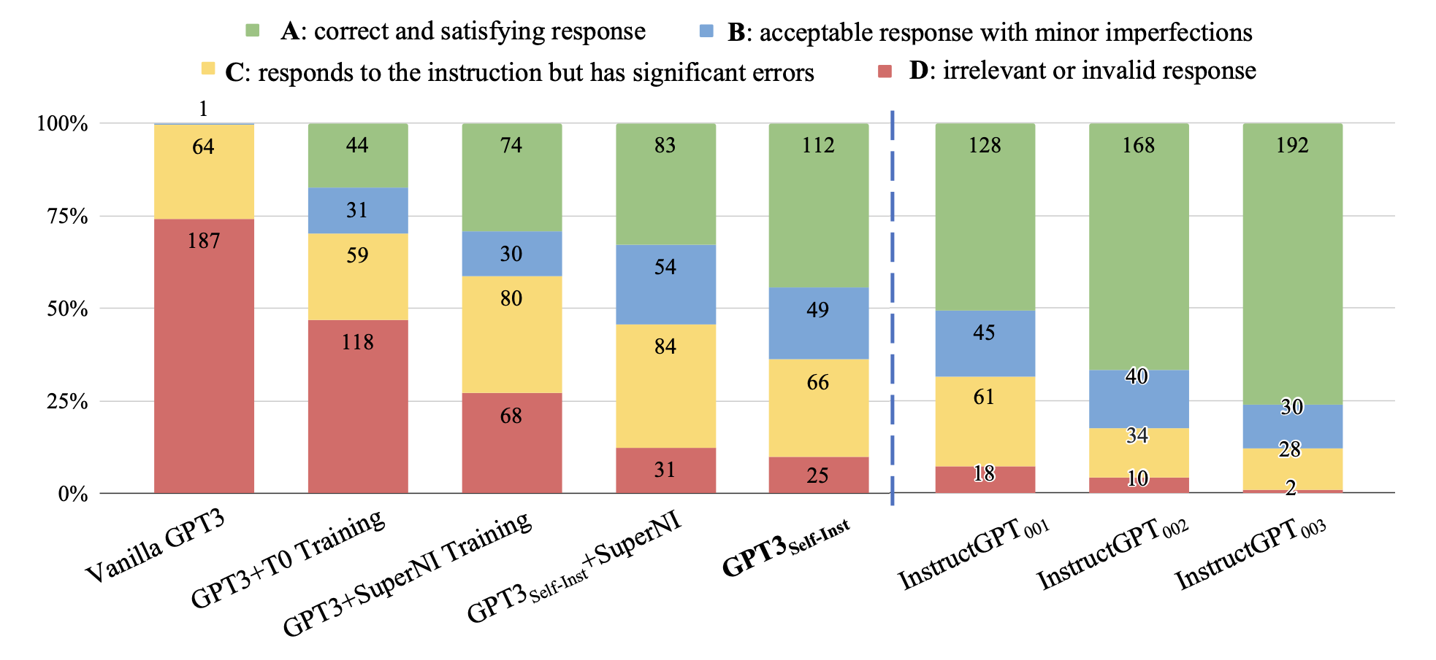
Pivot Point: Self-Instruct
Self-Instruct: Aligning Language Models with Self-Generated Instructions. ACL 2023
https://arxiv.org/abs/2212.10560

Slide 7
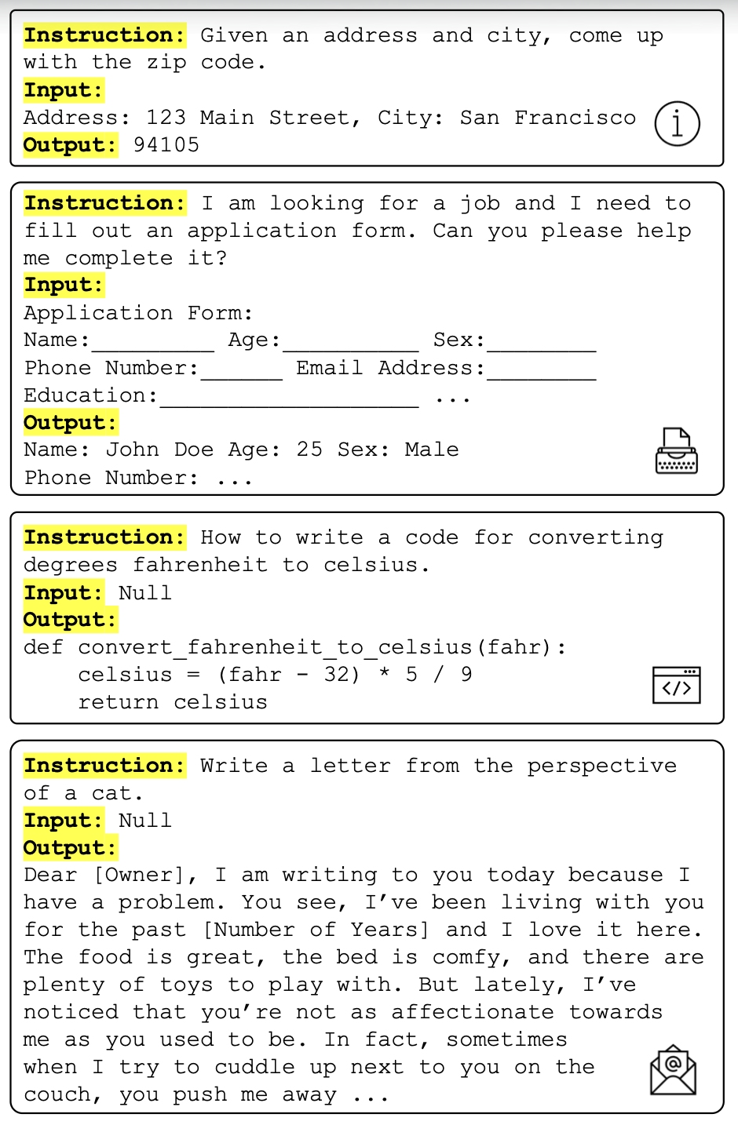
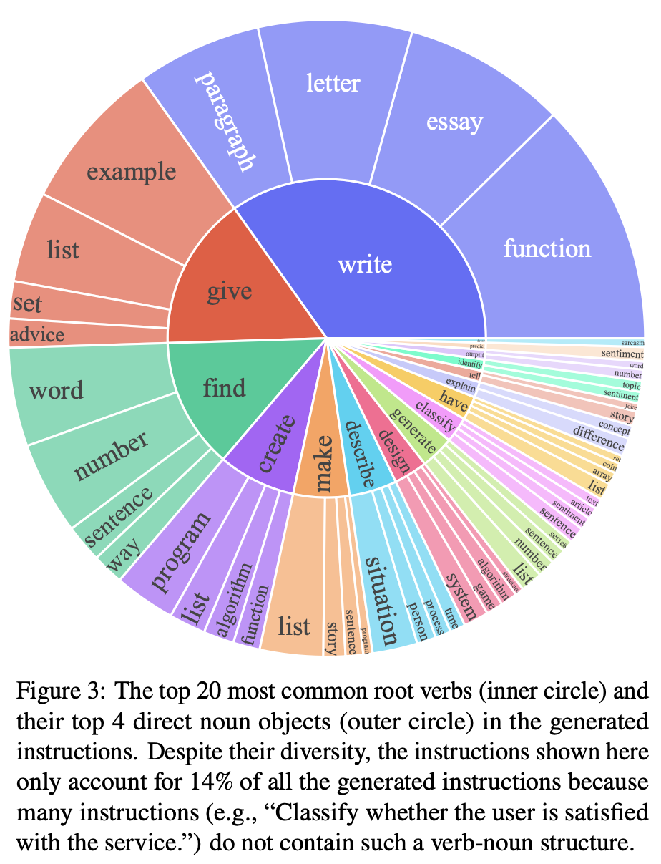
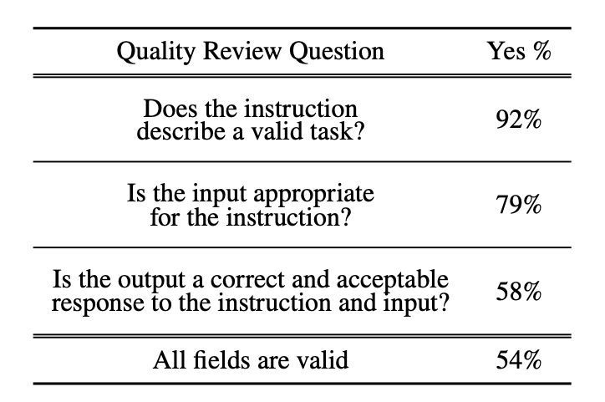
Pivot Point: Self-Instruct
Self-Instruct: Aligning Language Models with Self-Generated Instructions. ACL 2023
https://arxiv.org/abs/2212.10560

Slide 8
Case Study: Evol-Instruct/WizardLM
Directly tackles the key issue with Self-Instruct, viz., simple, repetitive instructions
Evol-Instruct: Iteratively rewrite instructions to raise complexity
  In-depth: Add constraints, deepen reasoning, complicate input
  In-breadth: Mutate into new instructions to raise diversity
  Evolution operators are prompt-engineered, not learned
  52K seeds -> 4 epochs -> WizardLM
On hard instructions, preferred over ChatGPT!
  In-depth was more impactful than in-breadth for quality
WizardLM: Empowering Large Language Models to Follow Complex Instructions. ICLR 2024
https://arxiv.org/abs/2304.12244

Slide 9
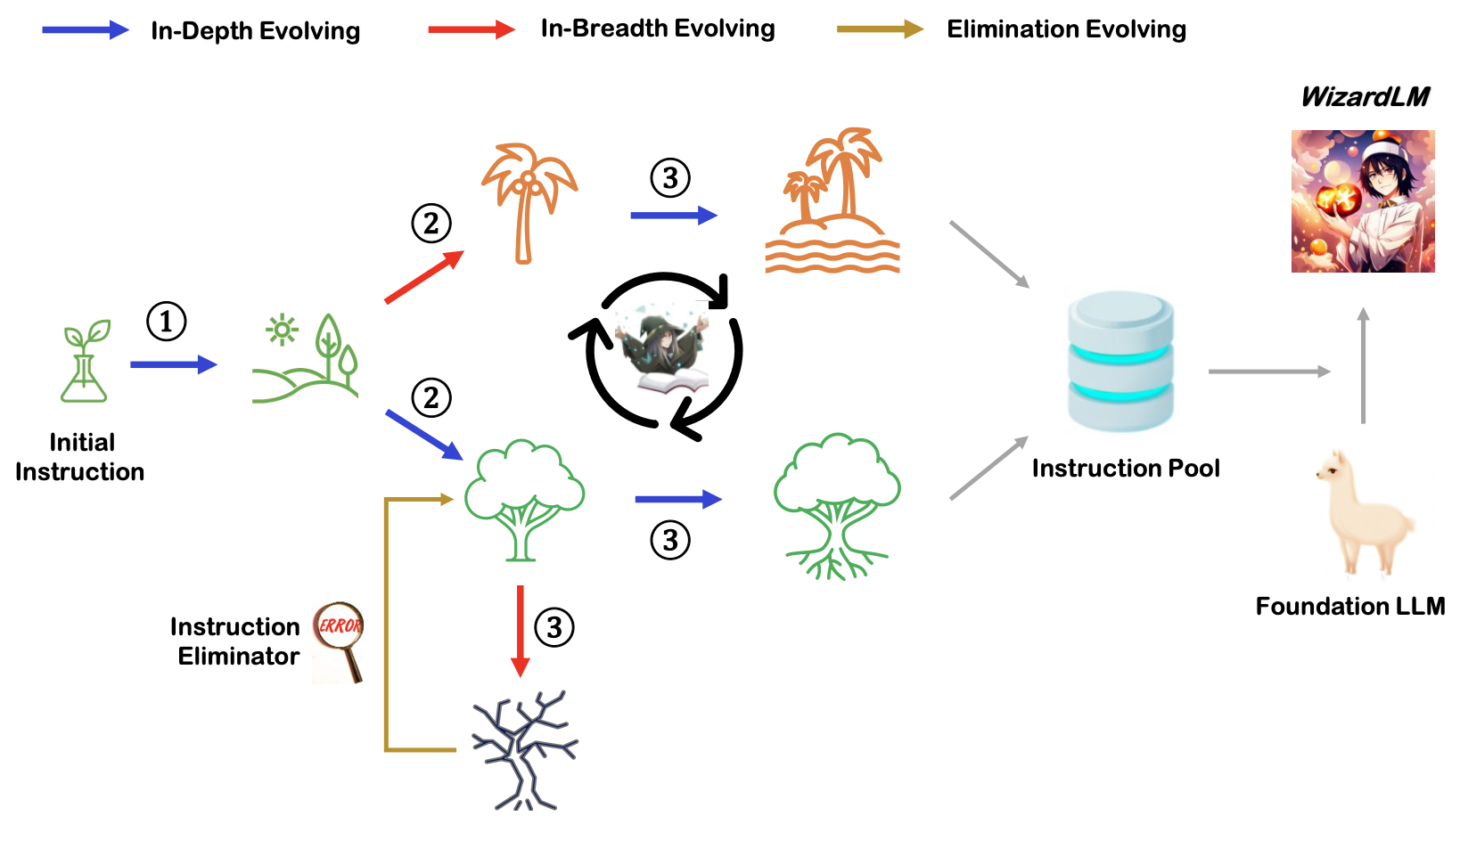
Case Study: Evol-Instruct/WizardLM
WizardLM: Empowering Large Language Models to Follow Complex Instructions. ICLR 2024
https://arxiv.org/abs/2304.12244

Slide 10
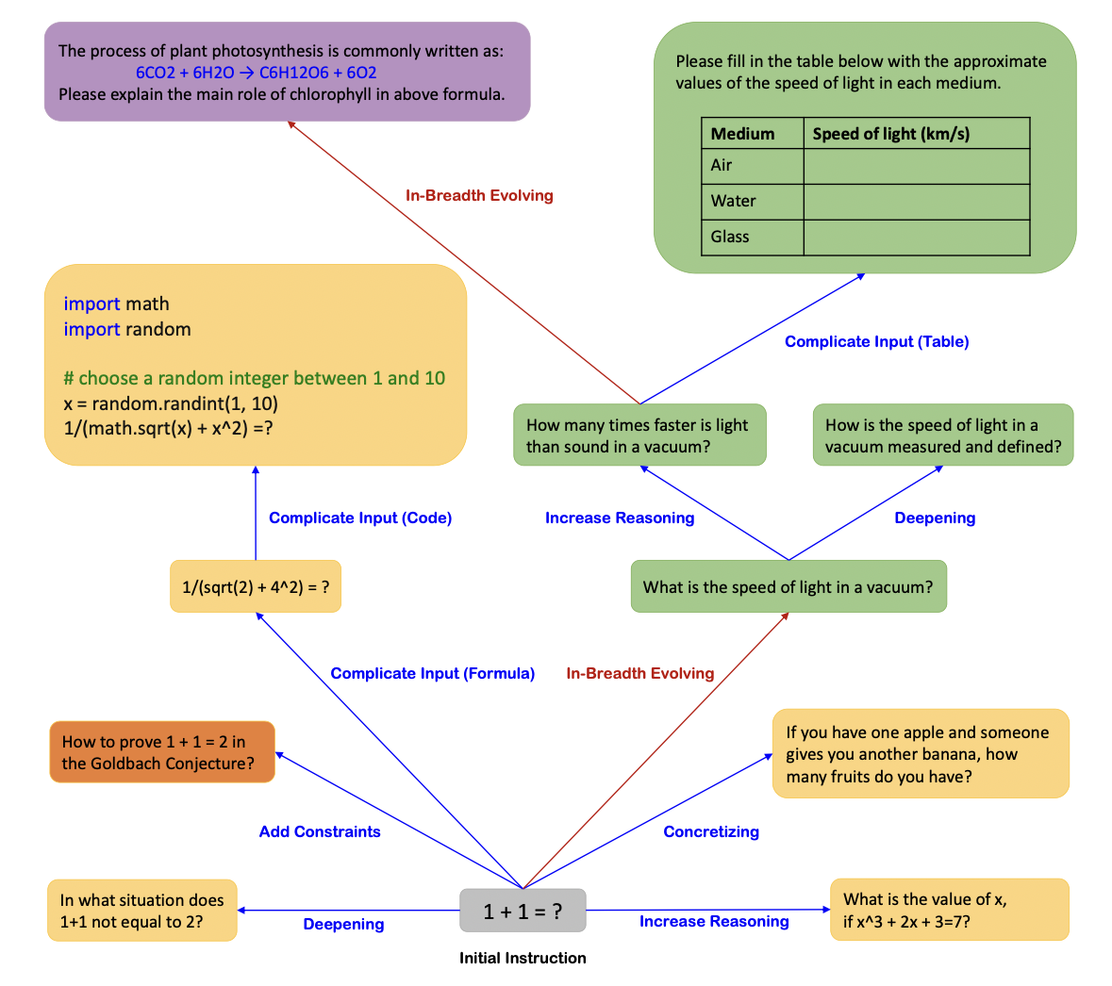
Case Study: Evol-Instruct/WizardLM
WizardLM: Empowering Large Language Models to Follow Complex Instructions. ICLR 2024
https://arxiv.org/abs/2304.12244

Slide 11
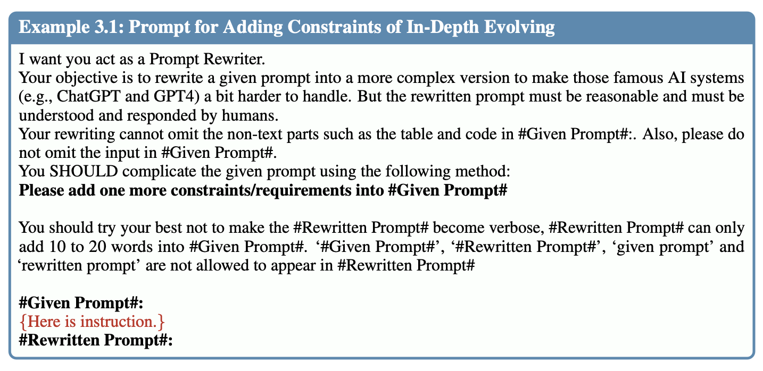
Case Study: Evol-Instruct/WizardLM
WizardLM: Empowering Large Language Models to Follow Complex Instructions. ICLR 2024
https://arxiv.org/abs/2304.12244

Slide 12
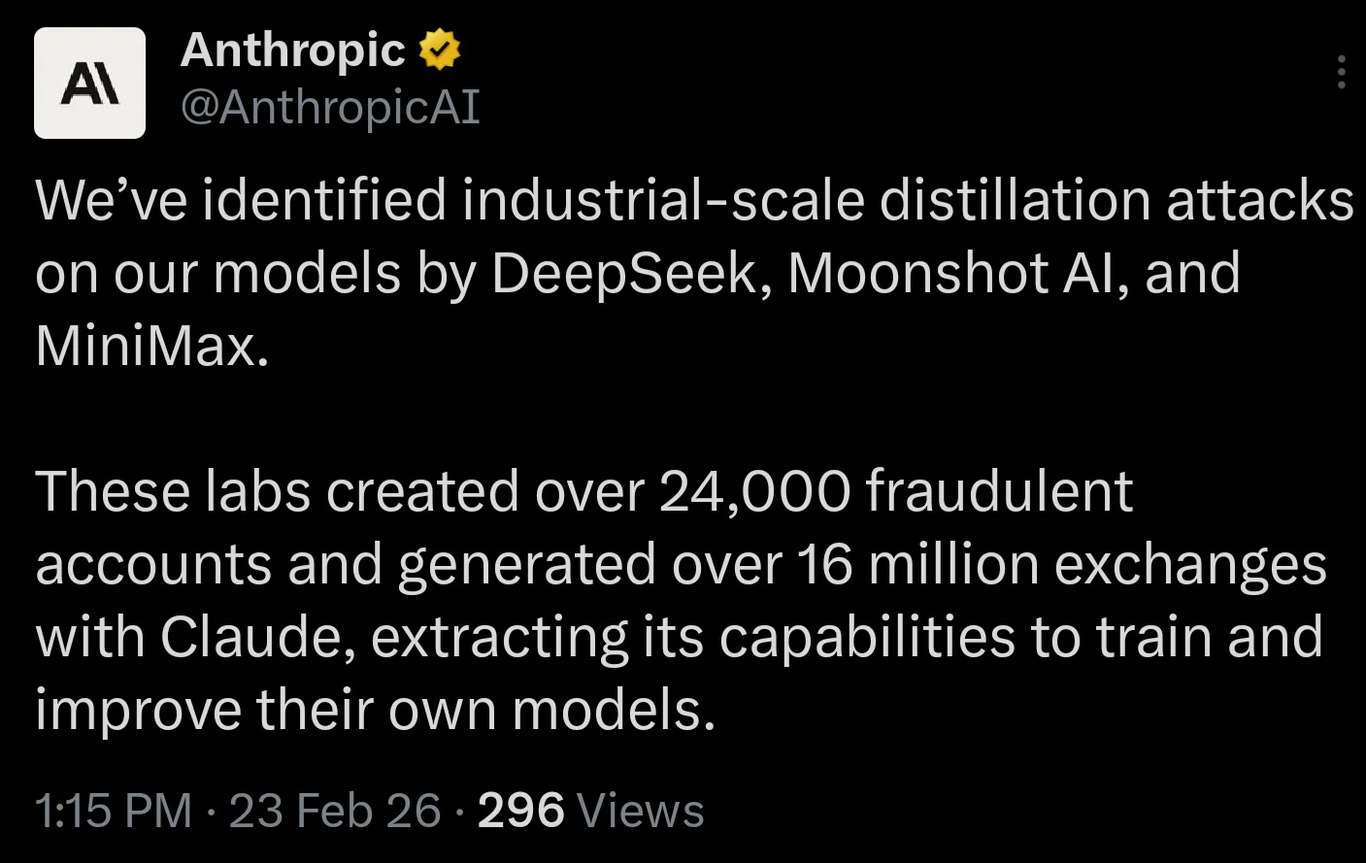
Distillation as a Source of Data
Use frontier model as “teacher” to generate data for student
  Alpaca: GPT-3.5 -> 52K examples -> LLaMA 7B
  Orca: GPT-4’s chain-of-thought -> student learns reasoning
Caveat: Terms of Service often prohibit training “competitors” on outputs of frontier models!
  Open LLMs also increasingly used as teachers

Slide 13
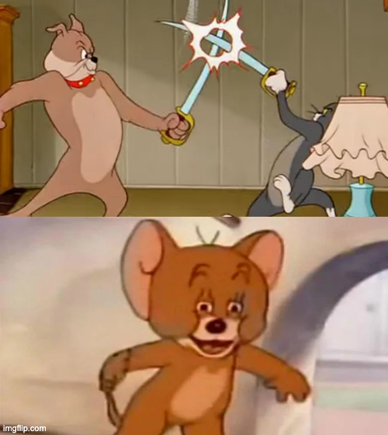
Distillation as a Source of Data
American
Frontier AI Firms
Chinese
Frontier AI Firms
Rest of the World

Slide 14
Model Collapse Phenomenon
Generative AI models of successive generations being trained on their own outputs -> diversity collapses, tails disappear!
Typical prevention/mitigation:
  Track provenance and mix synthetic with high-quality “real” (human-generated) data
  Monitor for diversity metrics
Area of active research; still no comprehensive general solution
AI models collapse when trained on recursively generated data. Nature 2024
https://www.nature.com/articles/s41586-024-07566-y

Slide 15
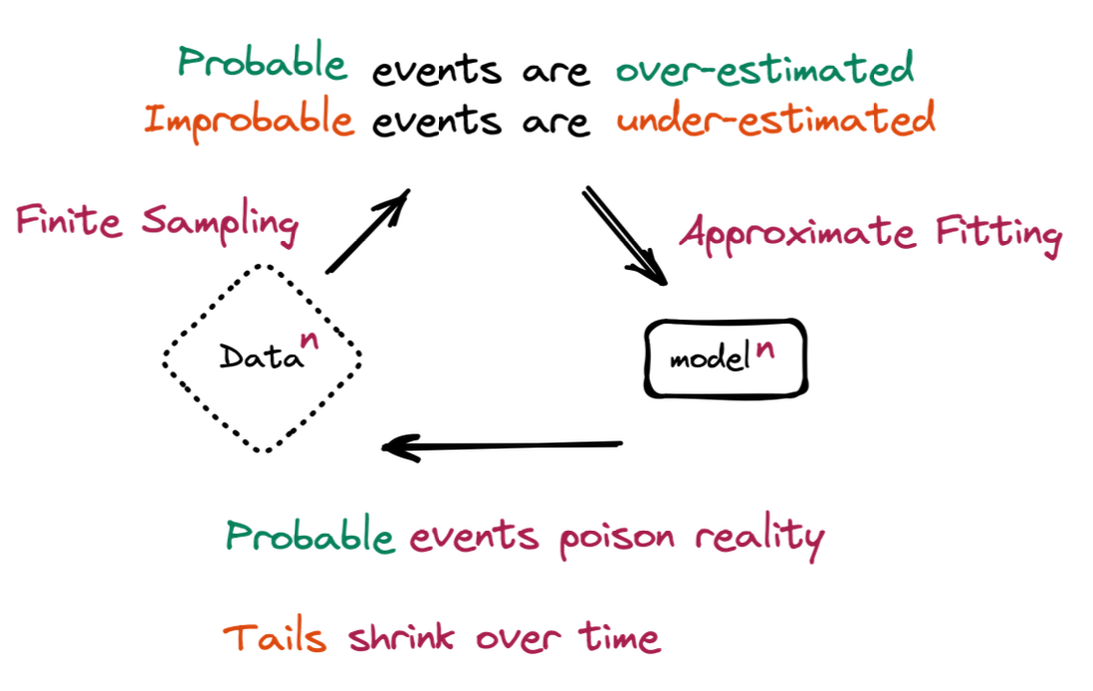
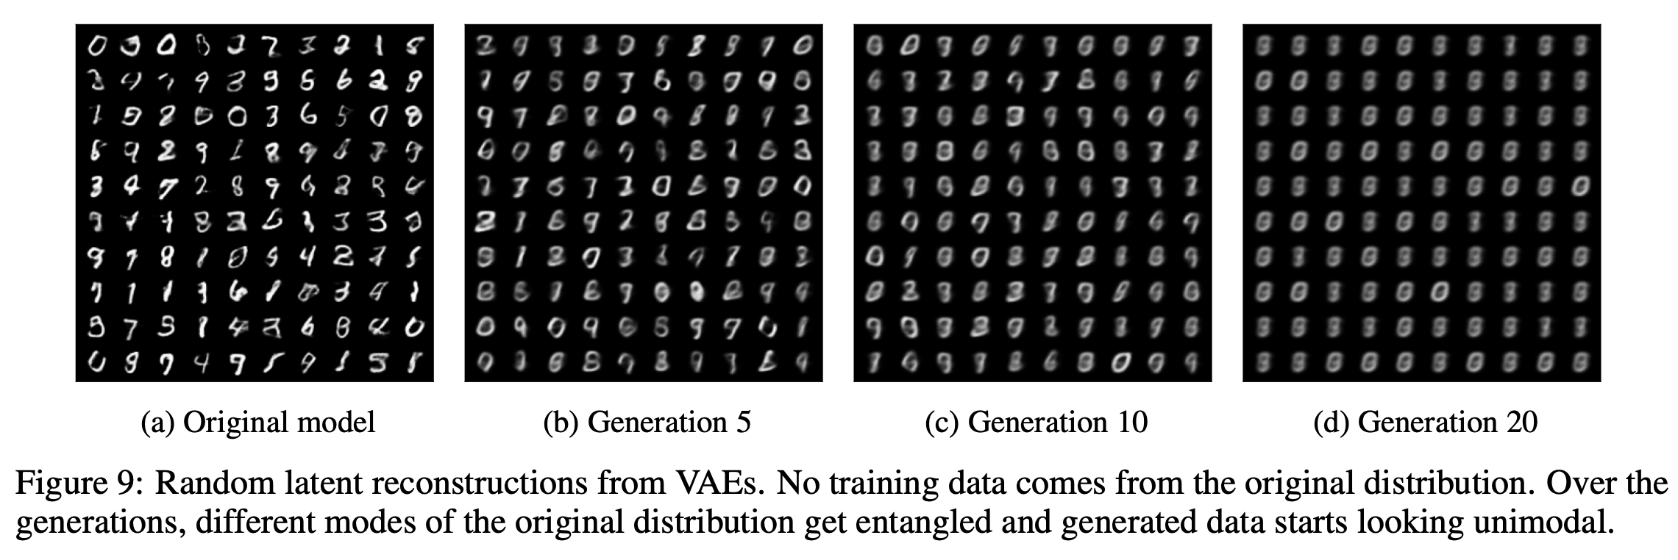
Model Collapse Phenomenon
AI models collapse when trained on recursively generated data. Nature 2024
https://www.nature.com/articles/s41586-024-07566-y

Slide 16
Scaling Diversity in Synthetic Data
Single prompt template leads to narrow distribution; need to vary context systematically
Strategies to diversify:
  Persona-driven: “You are a biology professor”, “You are a teen”, etc.
  Domain-targeted: code, math, medical, legal
  Taxonomy-driven: enumerate knowledge areas, generate per area
  Dimension-based generation: Define dimensions of variation (feature x persona x scenario), generate tuples, then expand each tuple into realistic queries

Slide 17
Quality Filtering on Synthetic Data
Raw synthetic output is usually noisy; must filter aggressively
Typical Approaches:
  Rule-based: length, coherence, regex, etc.
  Model-based: LLM-as-judge scoring; fine-tuned SLMs
  Embedding-based deduplication
Practical guideline: Generate ~100K examples -> filter to ~10K; remember: curation > volume
  Example: LIMA (Zhou et al., NeurIPS 2023): 1,000 curated examples matched 50K noisy ones

Slide 18
Outline
Motivation for Data-Centric AI
Creating Data
  Human Feedback and Annotation
  Data Curation and Structure
  Data Synthesis
  Multimodal Data
Creating Evals

Slide 19
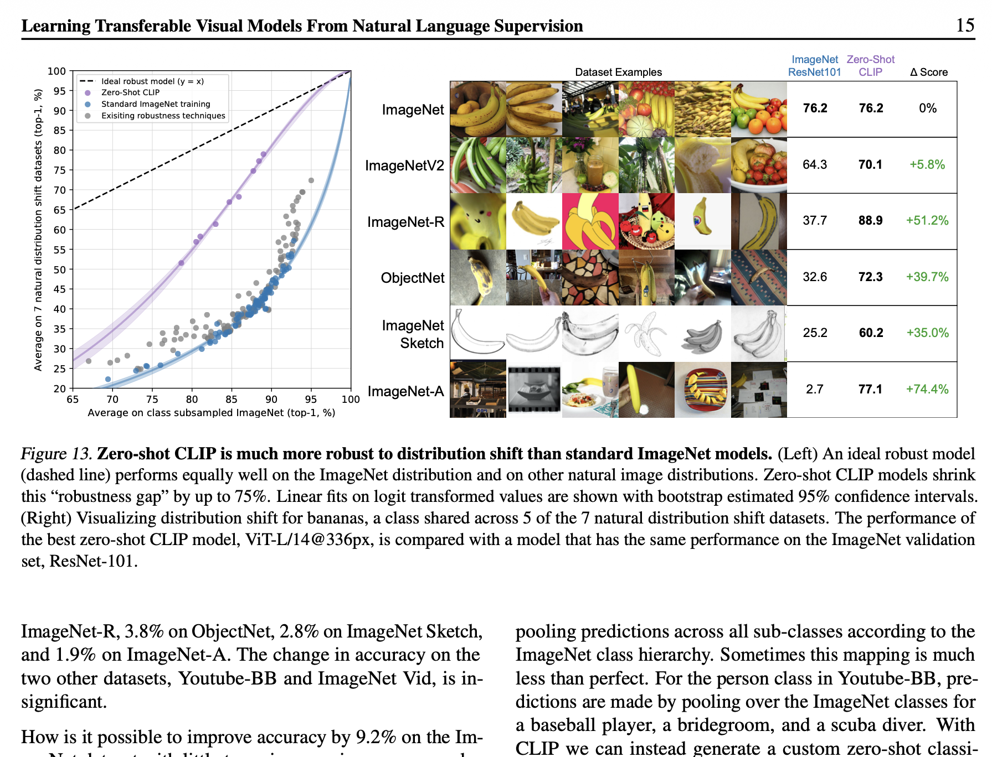
Multimodal Data
Many applications now need joint modalities-aware annotations: image+text, image+text+tabular, video+text, etc.

Slide 20
Multimodal Data
Key challenges for multimodal annotations:
  Curation across disparate modalities harder to commoditize
  Quality (e.g., image alt-text usually too coarse)
  Diversity across concepts/styles/languages tougher to ensure
  Noise and inconsistencies
  Scaling to large corpora

Slide 21
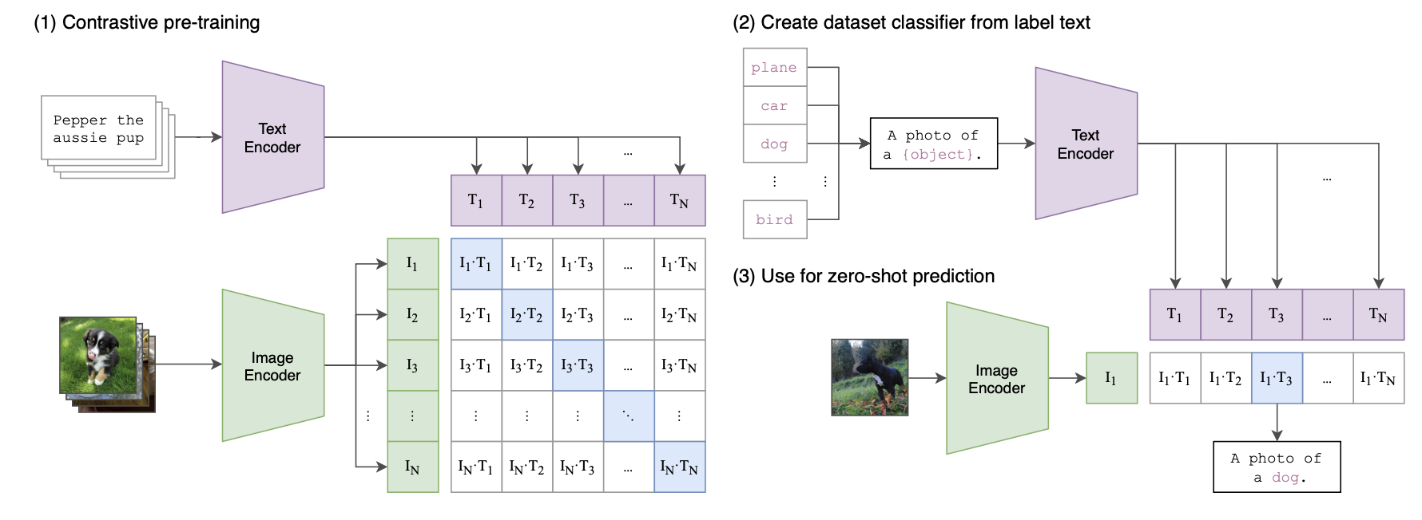
Pivot Point: CLIP for Filtering
CLIP: Contrastive Language-Image Pretraining
  OpenAI sourced 400mil pairs from Web data
  Simple dual encoder DL architecture
  Contrastive loss to learn shared image-text embedding space
Learning Transferable Visual Models From Natural Language Supervision. ICML 2021
https://proceedings.mlr.press/v139/radford21a/radford21a.pdf

Slide 22
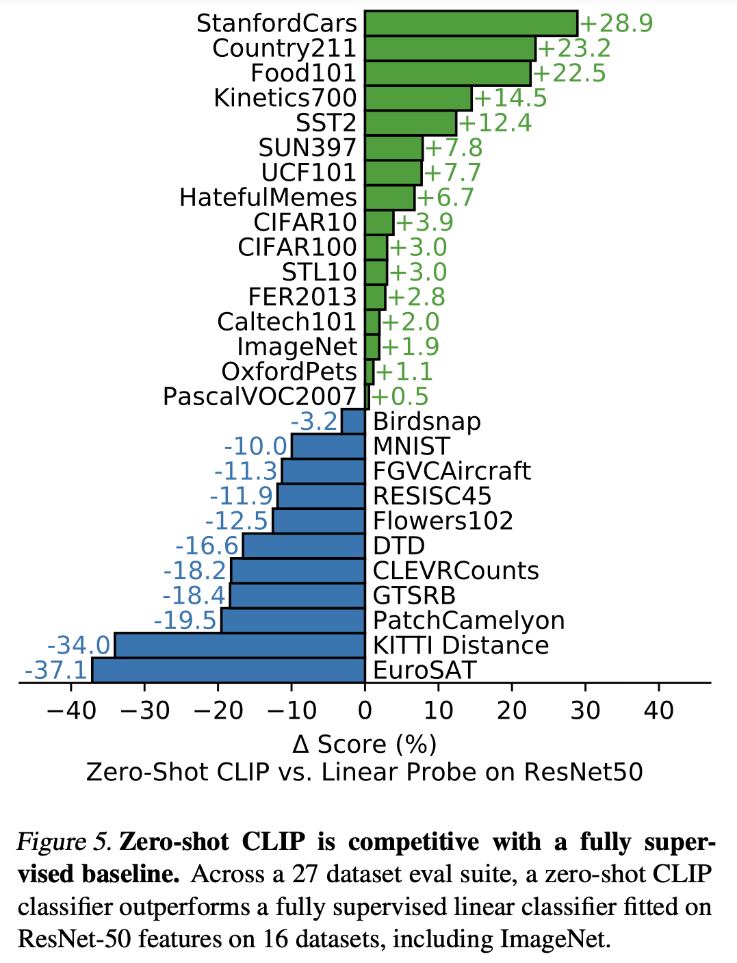
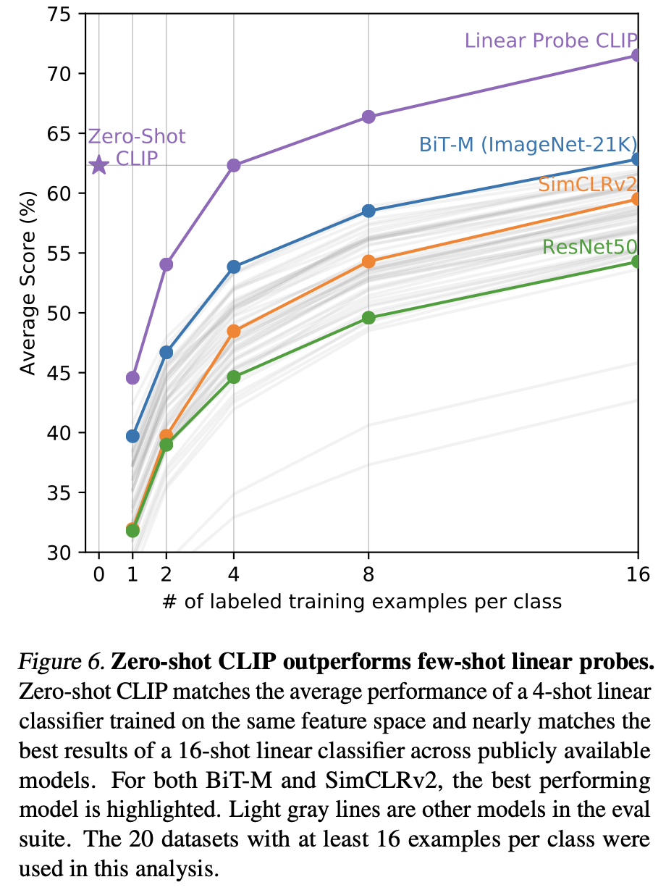
Pivot Point: CLIP for Filtering
Learning Transferable Visual Models From Natural Language Supervision. ICML 2021
https://proceedings.mlr.press/v139/radford21a/radford21a.pdf

Slide 23
Pivot Point: CLIP for Filtering
CLIP score = cosine similarity between image and text
  Valuable quality signal for multimodal data curation
  Keep pairs above threshold => huge quality improvement
  Threshold is model-dependent and calibrated per dataset
  For instance, LAION-5B used ~0.28 with ViT-B/32 on web crawled image-text pairs
  Now standard for image->text and text->image tasks
Learning Transferable Visual Models From Natural Language Supervision. ICML 2021
https://proceedings.mlr.press/v139/radford21a/radford21a.pdf

Slide 24
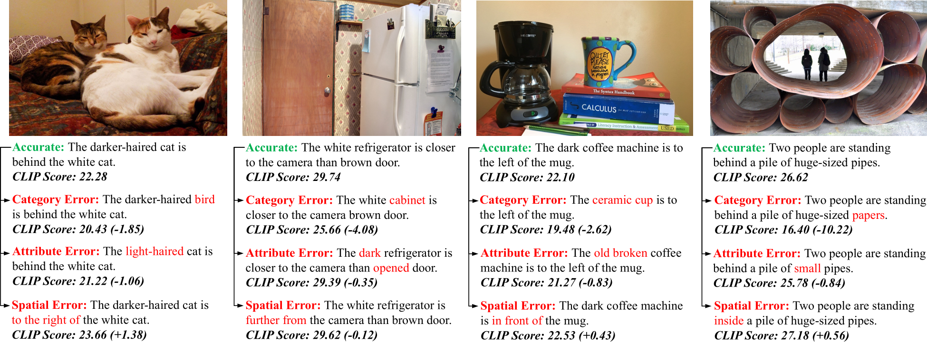
Pivot Point: CLIP for Filtering
Learning Transferable Visual Models From Natural Language Supervision. ICML 2021
https://proceedings.mlr.press/v139/radford21a/radford21a.pdf

Slide 25
LLM-based Multimodal Annotations
Q: Can text-only LLMs help “see” images in multimodal data?
LLaVA: Large Language and Vision Assistant
  Key insight: Structured image descriptions (captions + bounding boxes from COCO) enable a text-only LLM to produce visual instruction data without new human annotation!
  GPT-4 generates visual instruction data from just image captions + bounding boxes; never sees the images!
  150K visual instruction examples across 3 types: conversations, detailed descriptions, complex reasoning QA
Bridges the previous sections we discussed: data synthesis with LLM help + distillation + multimodal annotation
Visual Instruction Tuning. NeurIPS 2023
https://arxiv.org/pdf/2304.08485

Slide 26
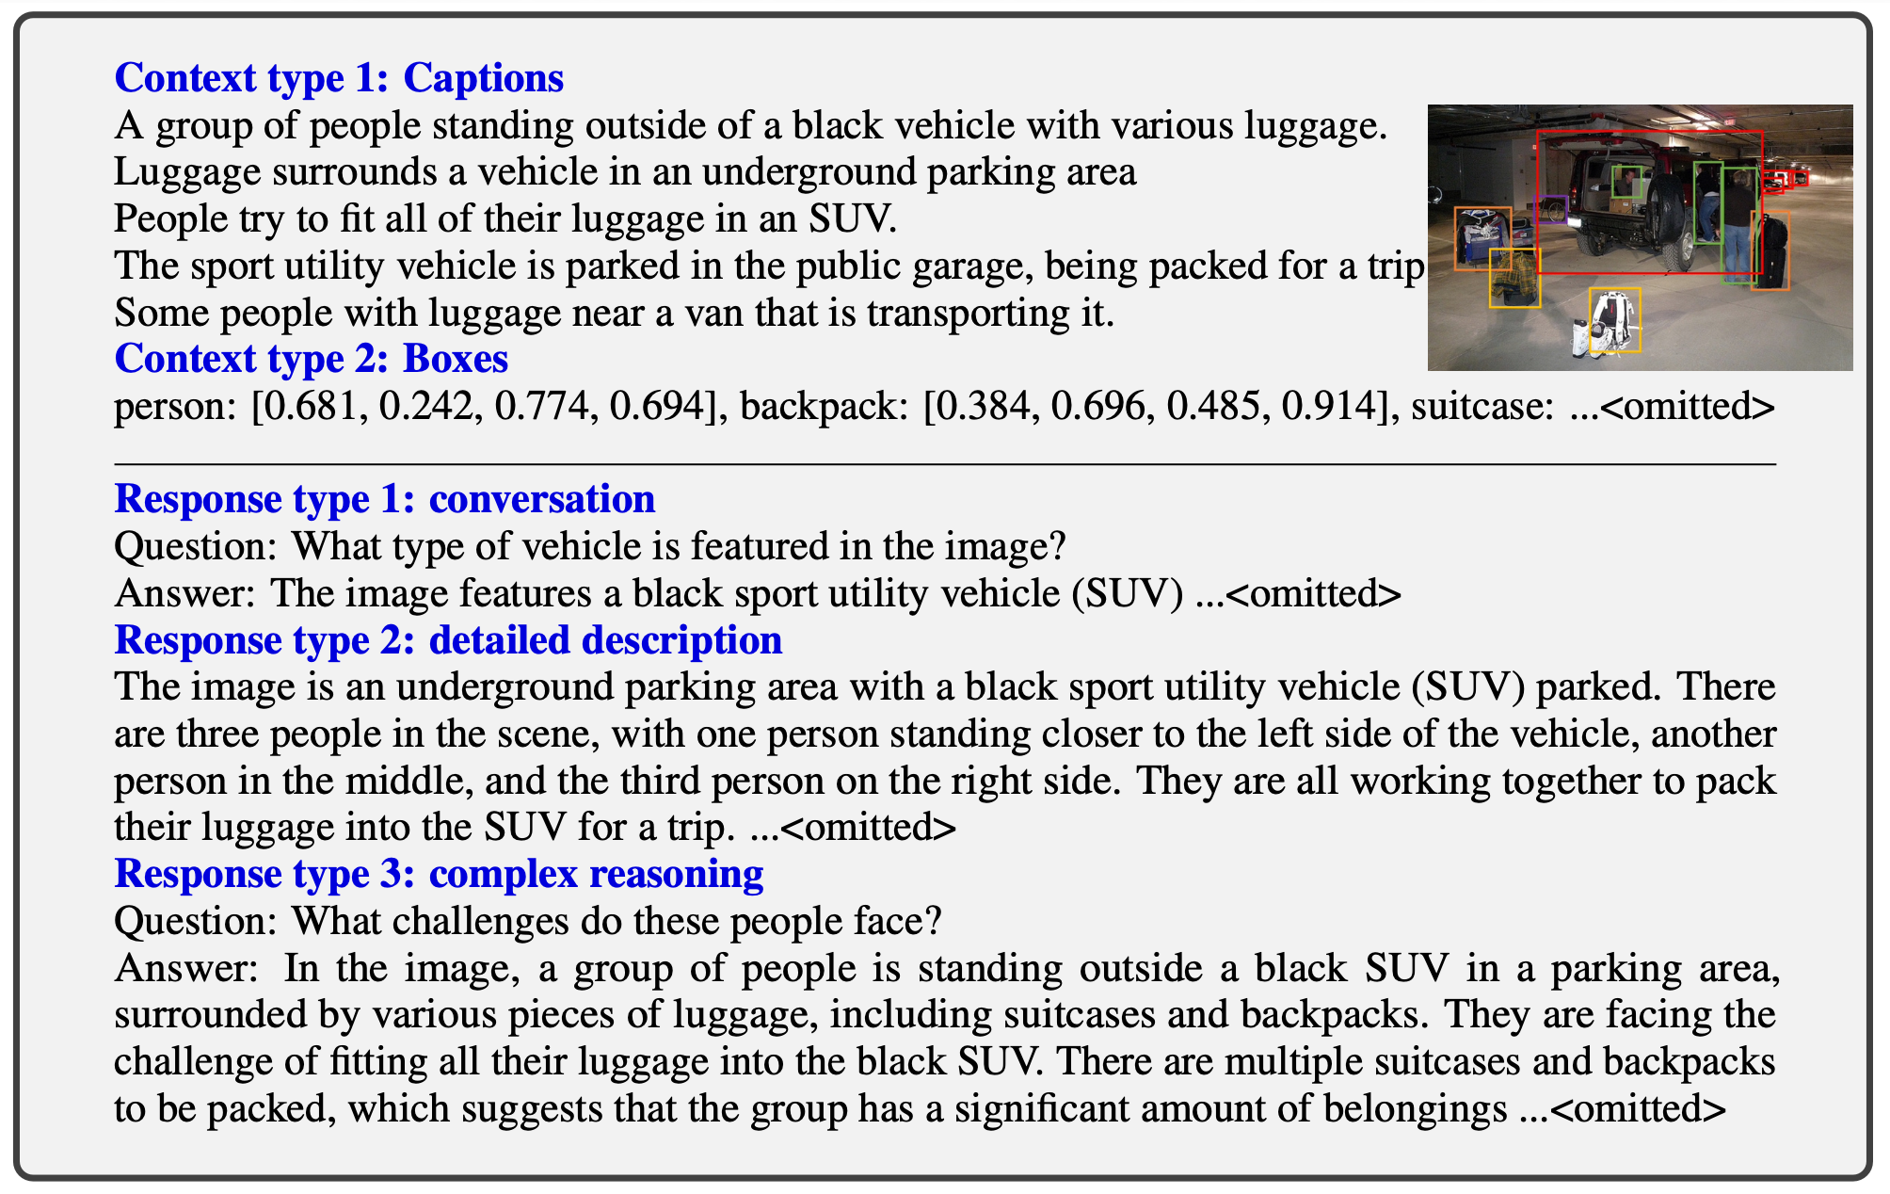
LLM-based Multimodal Annotations
Visual Instruction Tuning. NeurIPS 2023
https://arxiv.org/pdf/2304.08485

Slide 27
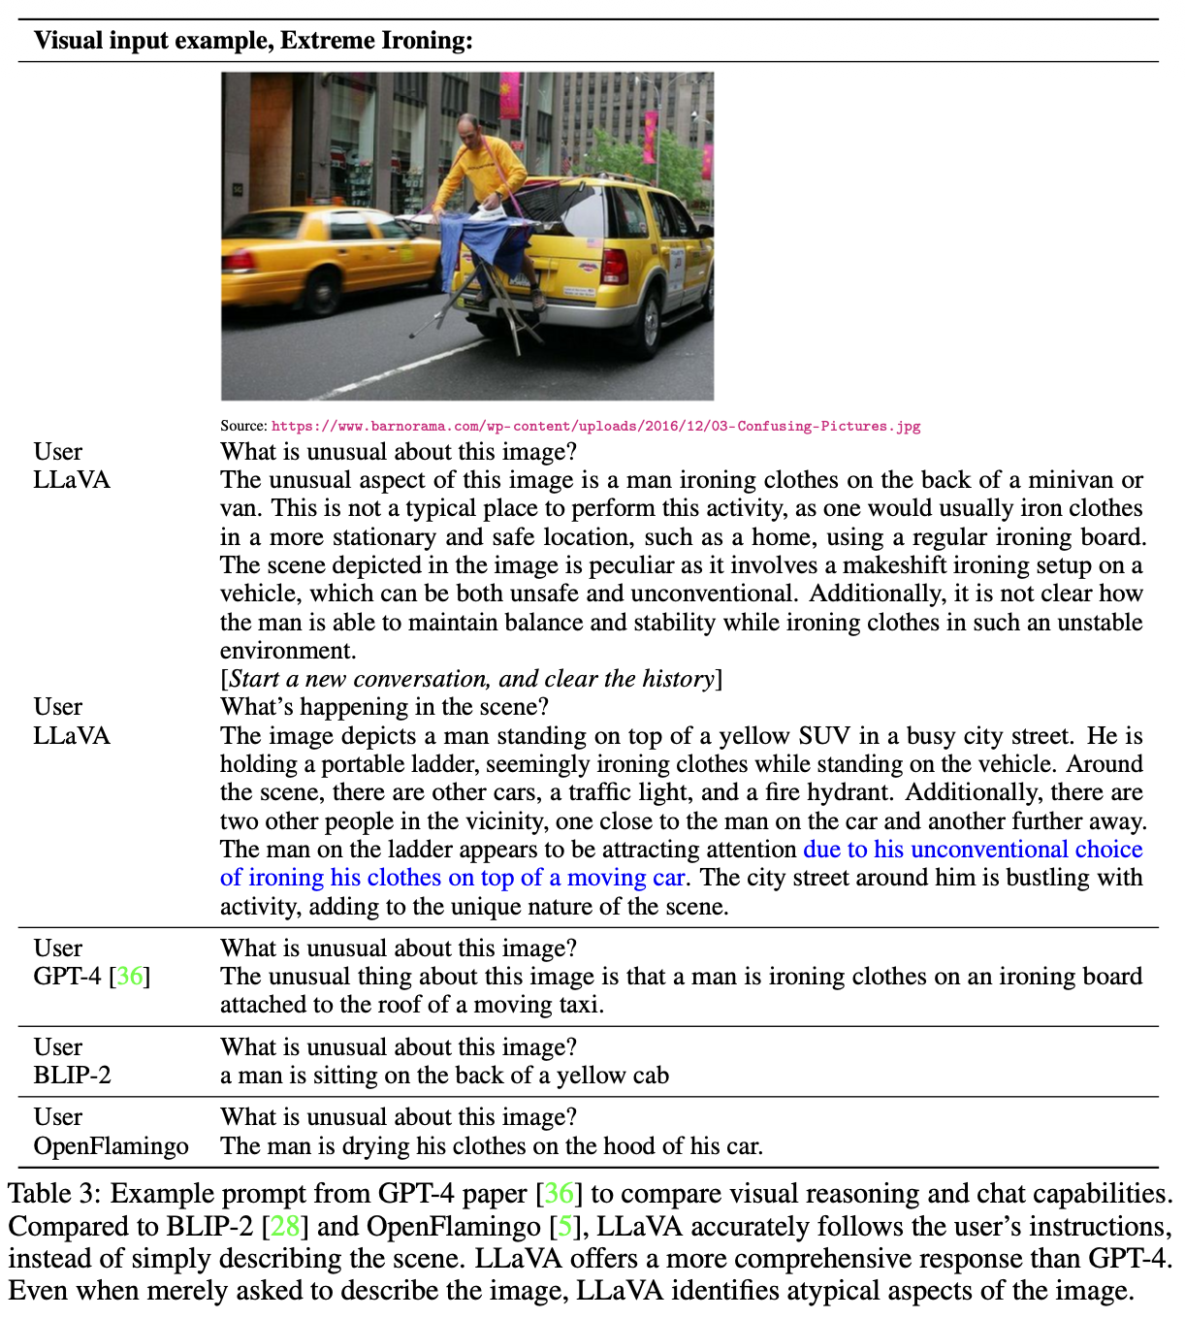
LLM-based Multimodal Annotations

Slide 28
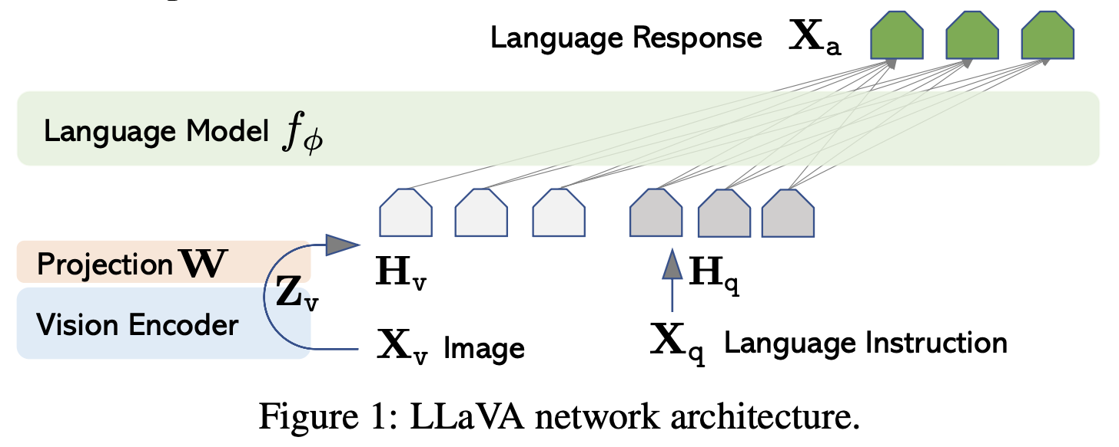
LLM-based Multimodal Annotations
Simple DL model architecture!
  Vicuna LLM + pre-trained CLIP visual encoder ViT-L/14
Visual Instruction Tuning. NeurIPS 2023
https://arxiv.org/pdf/2304.08485

Slide 29
Multimodal Data: Bigger Picture
DCAI principles apply across all modalities, e.g., filtering (CLIP score), deduplication (perceptual hashing), mixing modalities carefully, documenting choices, etc.
  Tool specifics differ, similar data-centric engineering mindset
Video and audio face more challenges, e.g., temporal alignment and modality-specific noise
Training strategy matters for mixed modality data: staged training (align modalities first -> instruction-tune) is now standard vs. mix and train in one go
  Active area of research: modality ratios, training ordering, quality variation across modalities

Slide 30
Review Questions
Why is the new data synthesis mechanism introduced in Self-Instruct so pivotal in data-centric AI? Explain with an example.
Evol-Instruct proposes two evolution strategies: in-depth and in-breadth. Explain the difference with a concrete example. Which strategy was found to be more impactful for data annotation quality?
What is distillation in the context of synthetic data? Briefly explain a legal issue that can arise when using frontier models as teachers.
Briefly describe a concrete mitigation for model collapse. Explain why it works.
Why is annotation diversity important in the context of LLM-based data synthesis? Briefly explain one strategy to achieve diversity.
What is CLIP score? Why is it so important in multimodal AI?
In LLaVA, GPT-4 never saw any images. So, how did it lead to models that can perform complex reasoning QA over images?
Suppose you are part of the AI team at a leading hospital. Your team generates 100K synthetic instruction examples for a multimodal medical Q&A chatbot. Your AI algorithmics colleague proposes to use all examples without filtering to fine-tune a model. List 3 reasons to them why that is likely not a good idea.

