Slide 1
CSE/DSC 234
Data-Centric AI and AI Engineering
Arun Kumar
Topic 1: Creating Data and Evals

Slide 2
Outline
Motivation for Data-Centric AI
Creating Data
Creating Evals

Slide 3
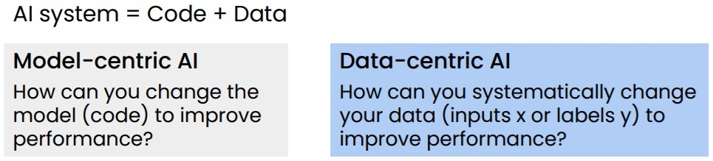
From Model-Centric to Data-Centric
Transformers now dominate; DL architectures converged
“Scaling laws”: data matters as much as parameters
Yet dataset eng. remains “artisanal—painstaking and expensive”
DCAI = systematically engineering data to build AI systems
Andrew Ng Talk on Data-Centric AI 2021

Slide 4
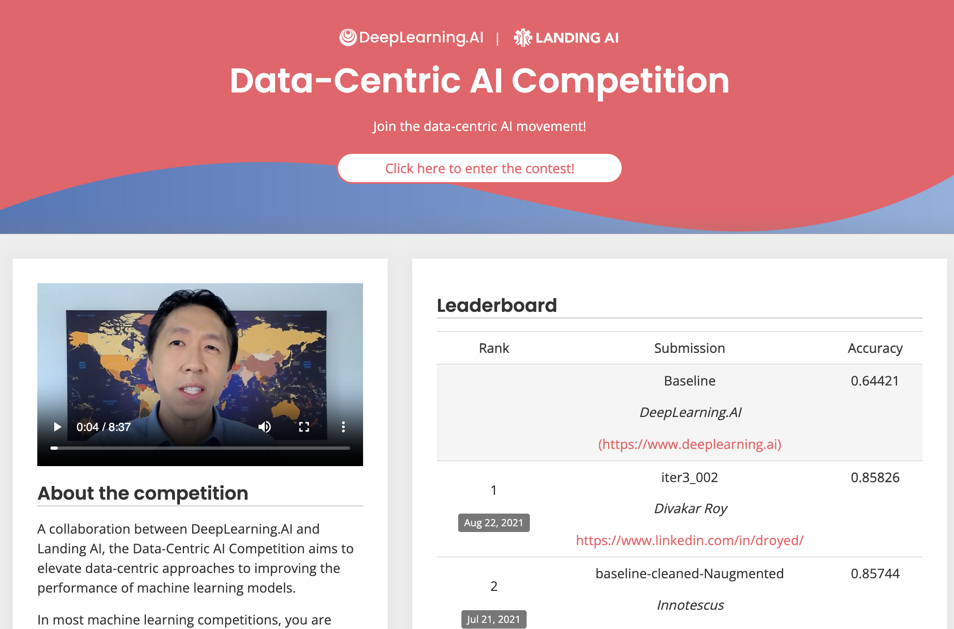
From Model-Centric to Data-Centric
DCAI Competition: improve dataset, hold model fixed
https://https-deeplearning-ai.github.io/data-centric-comp/

Slide 5
From Model-Centric to Data-Centric
Two main levers:
  Better data (refine quality)
  More data (collect, augment, and/or synthesize)

Slide 6
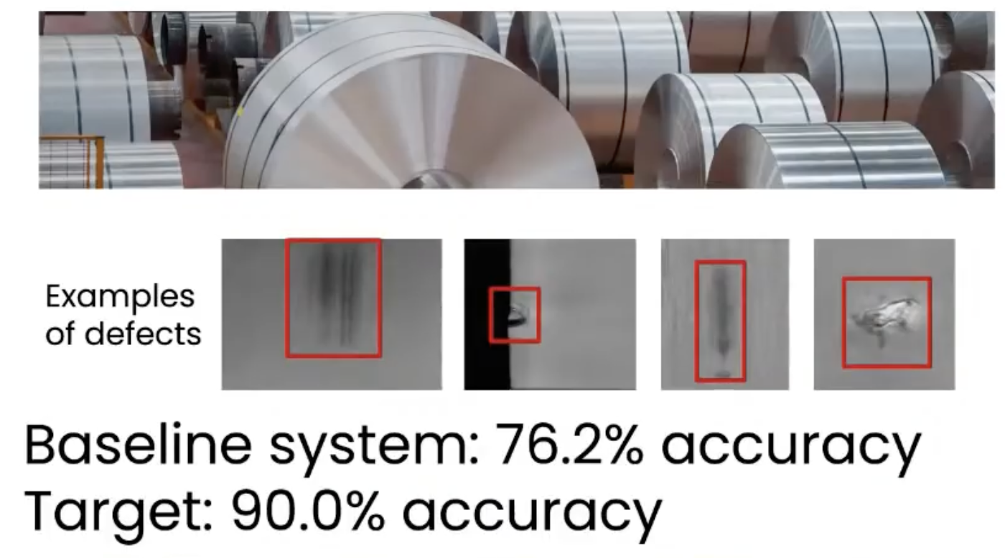
Real-World AI Data Problems
Label inconsistency; annotators disagree; e.g., “chipped” vs. “scratched”
Tweaking the model/hyperparameters -> No improvement
Fixing labeling errors -> 16% lift!

Slide 7
Real-World AI Data Problems
Label inconsistency; annotators disagree
  ~3.3% label errors in top 10 ML benchmark test sets!
Bias and fairness baked into datasets, not just models
Many small-data domains; cannot rely on scale alone
“Everyone wants to do the model work, not the data work”

Slide 8
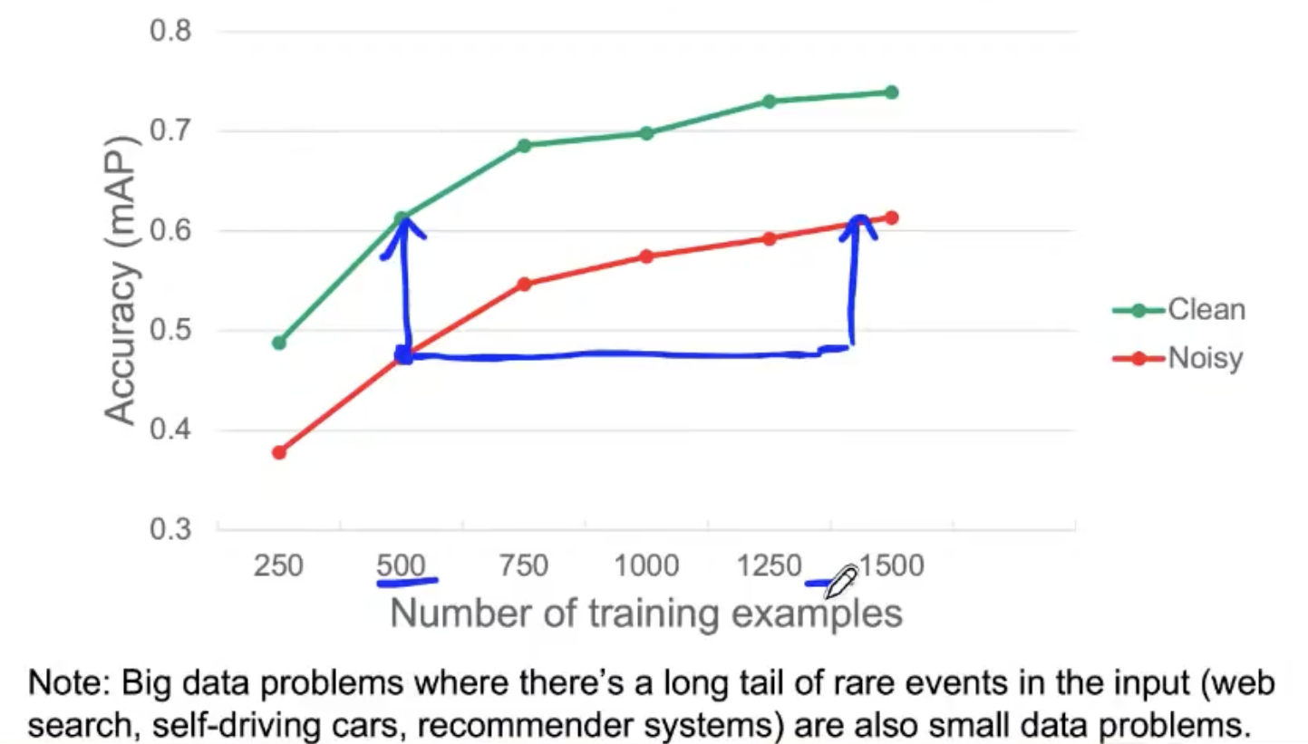
Quality > Quantity
Core insight: curated subset beats full noisy dataset.
But “quality” depends on what you're optimizing for.
Phi-1: 1.3B code model matched larger models via “textbook-quality” data.
FineWeb-Edu: 1.3T from 15T -> better benchmarks by filtering hard.

Slide 9
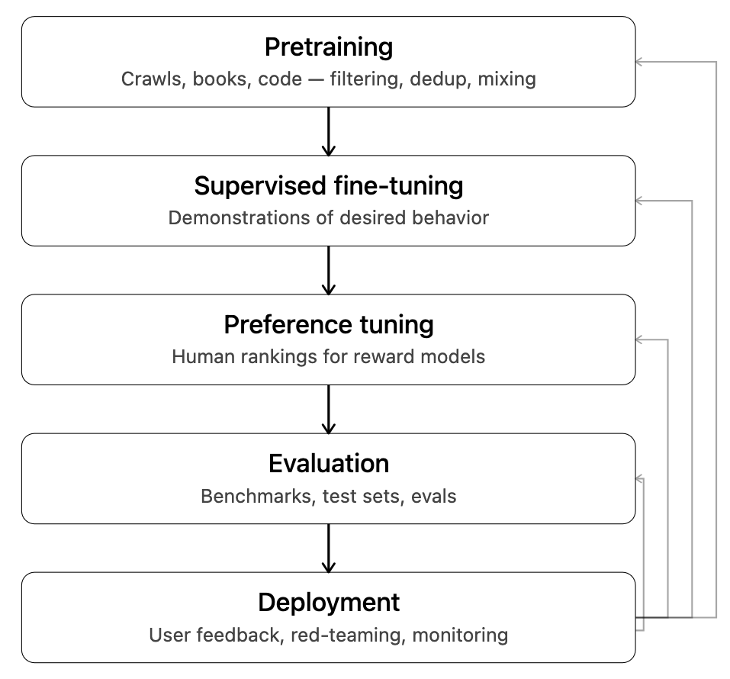
Data in LLM Development Lifecycle
“Creating data” is continuous engineering, not a one-time step

Slide 10
Outline
Motivation for Data-Centric AI
Creating Data
Creating Evals

Slide 11
Outline
Motivation for Data-Centric AI
Creating Data
  Human Feedback and Annotation
  Data Curation and Structure
  Data Synthesis
  Multimodal Data
Creating Evals

Slide 12
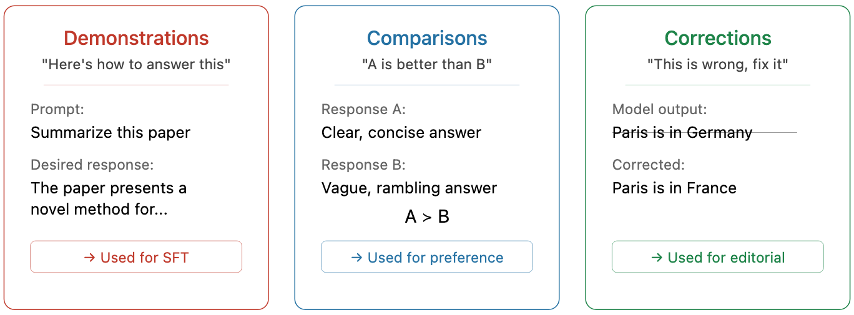
Human Feedback as Training Signal
Classical ML: labels -> fixed ground “truth”
LLMs: feedback is typically subjective, comparative, ongoing
  Shift: from “annotate once” to continuous feedback loops

Slide 13
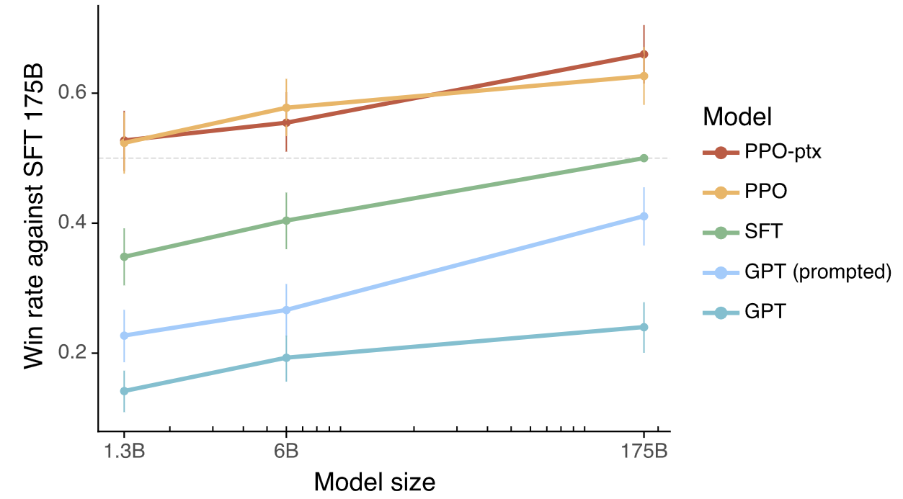
Pivot Point in AI: InstructGPT
Showed how to make LLMs follow task-agnostic “instructions”
First at-scale success of Reinforcement Learning with Human Feedback (RLHF) paradigm
40 screened contractors, detailed guidelines, calibration rounds
1.3B InstructGPT preferred over 175B GPT-3!
100x fewer params! Quality human feedback >> raw scale

Slide 14
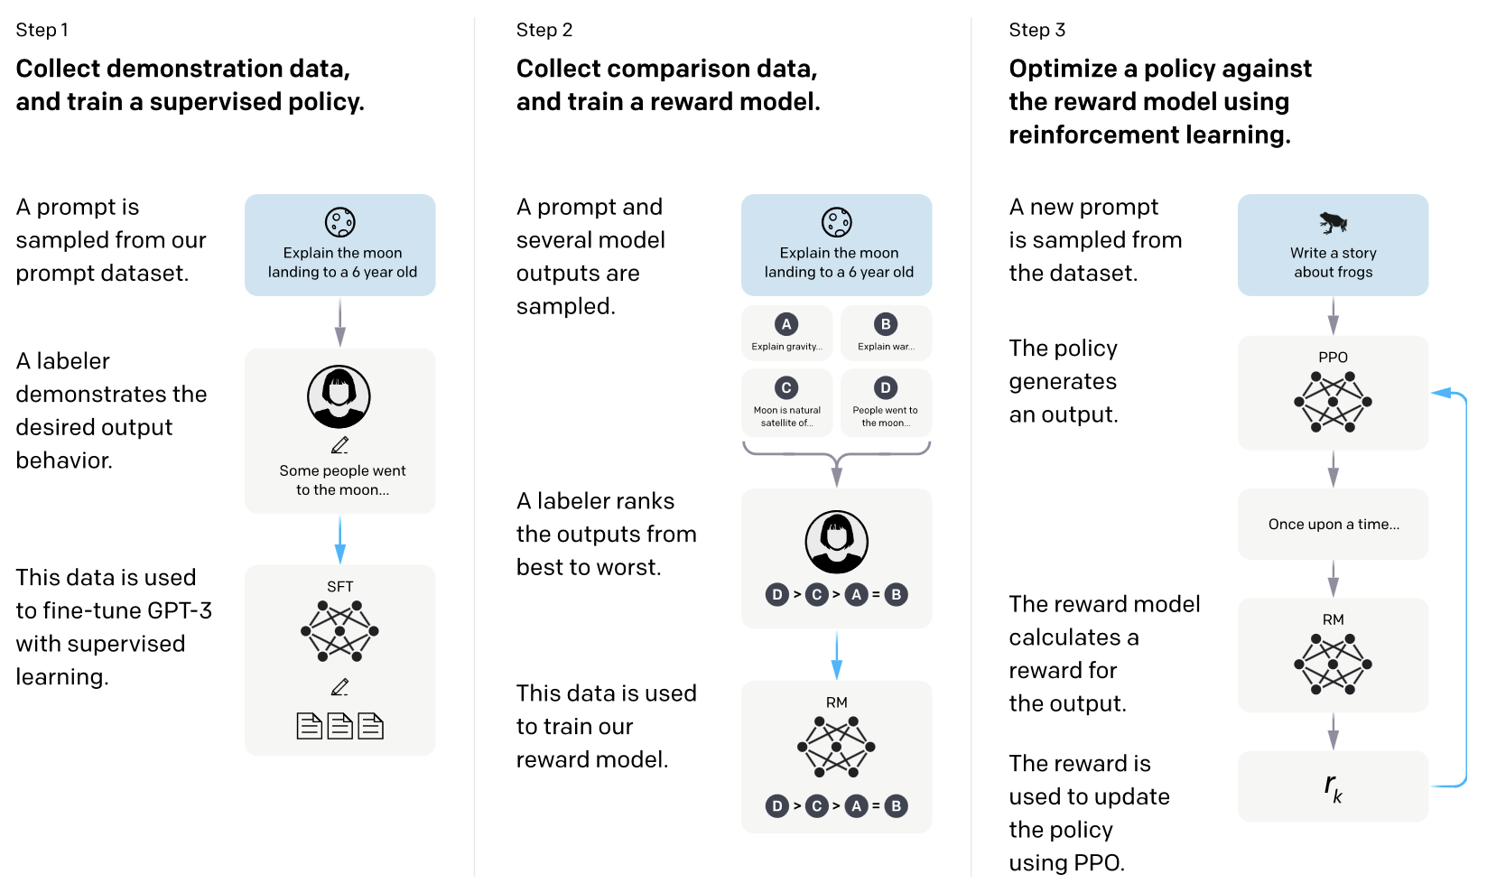
Pivot Point in AI: InstructGPT
Supervised
Fine-Tuning (SFT)
RL via Proximal Policy Optimization (PPO)
Reward Model (RM)

Slide 15
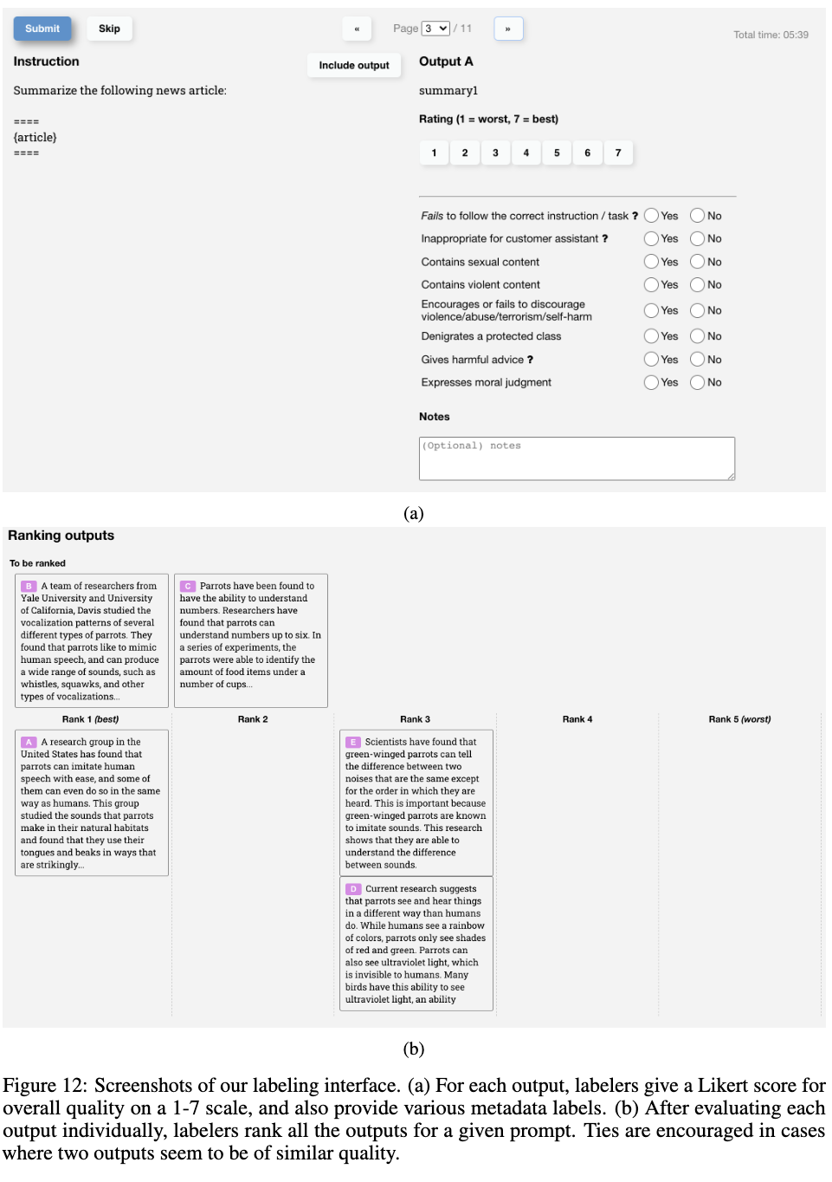
Pivot Point in AI: InstructGPT

Slide 16
Beyond RLHF: Post-Training Toolkit
Direct Preference Optimization (DPO): skip reward model, optimize directly on preferences; much simpler than PPO
Constitutional AI (Anthropic) / RLAIF: model self-critiques via principles; replaces human labelers with AI feedback
RLVR: verifiable rewards for math/code (no human needed)
Group Relative Policy Optimization (GRPO); skip critic model; sample N completions per prompt, normalize rewards within group; ~50% memory reduction vs PPO
Typically modern post-training = SFT -> Preference FT -> RLVR
Each stage has its own data requirements

Slide 17
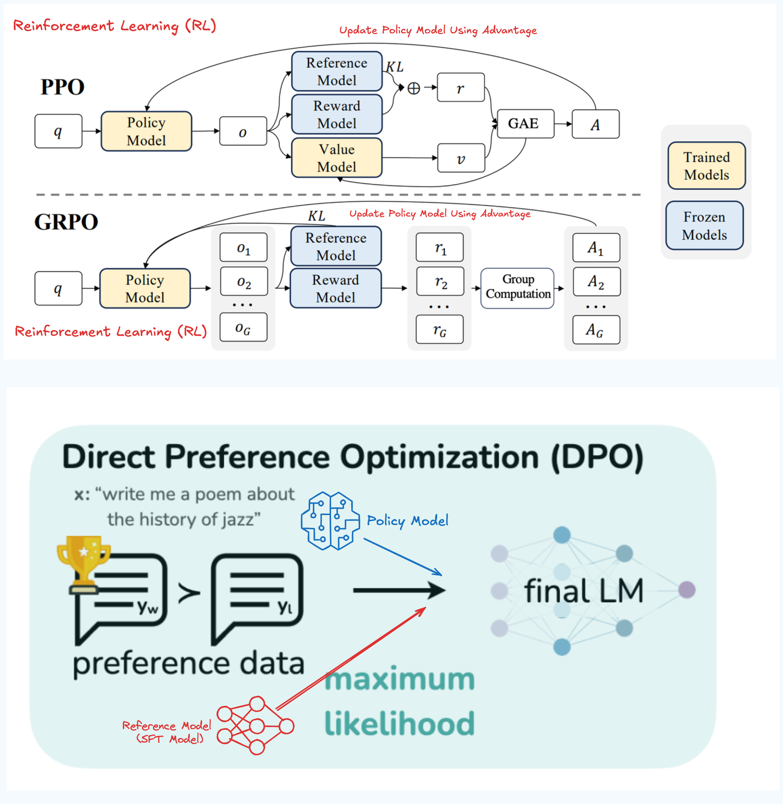
Beyond RLHF: Post-Training Toolkit
Will revisit these 3 methods in Topic 4: Model Customization

Slide 18
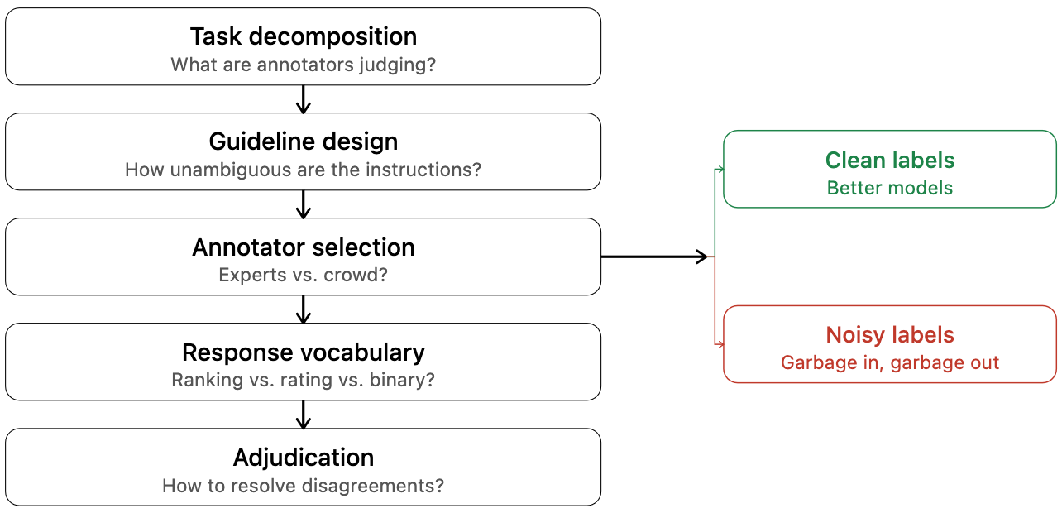
Annotation is a Design Problem
InstructGPT’ success was partly annotation engineering

Slide 19
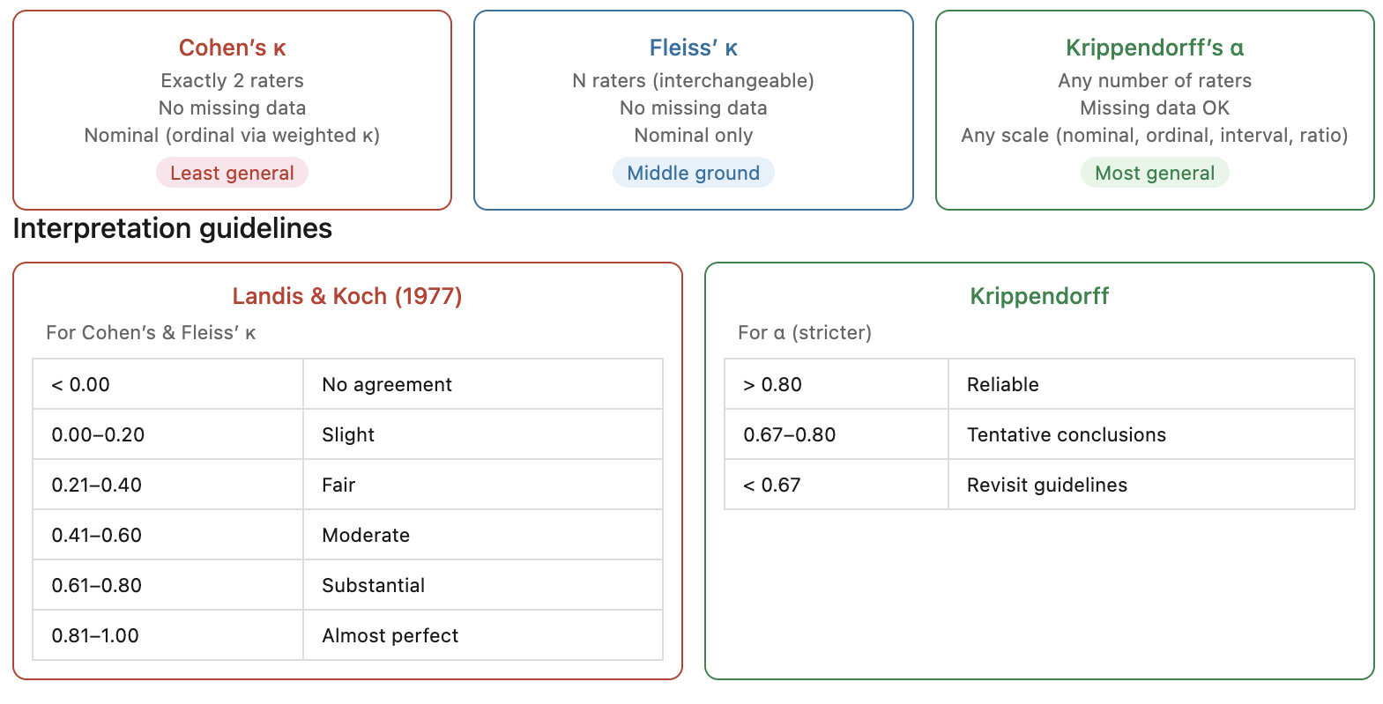
Measuring Annotation Quality
If annotators disagree, your ground “truth” is not entirely “true”
But high agreement <> Validity; can be consistently wrong!
Metrics (increasing generality):

Slide 20
Measuring Annotation Quality
Example: Annotation Table
Item | Annotator A | Annotator B | Annotator C
1 | + | + | +
2 | + | + | −
3 | − | − | −
4 | + | − | +
5 | − | −
6 | − | + | −

Slide 21
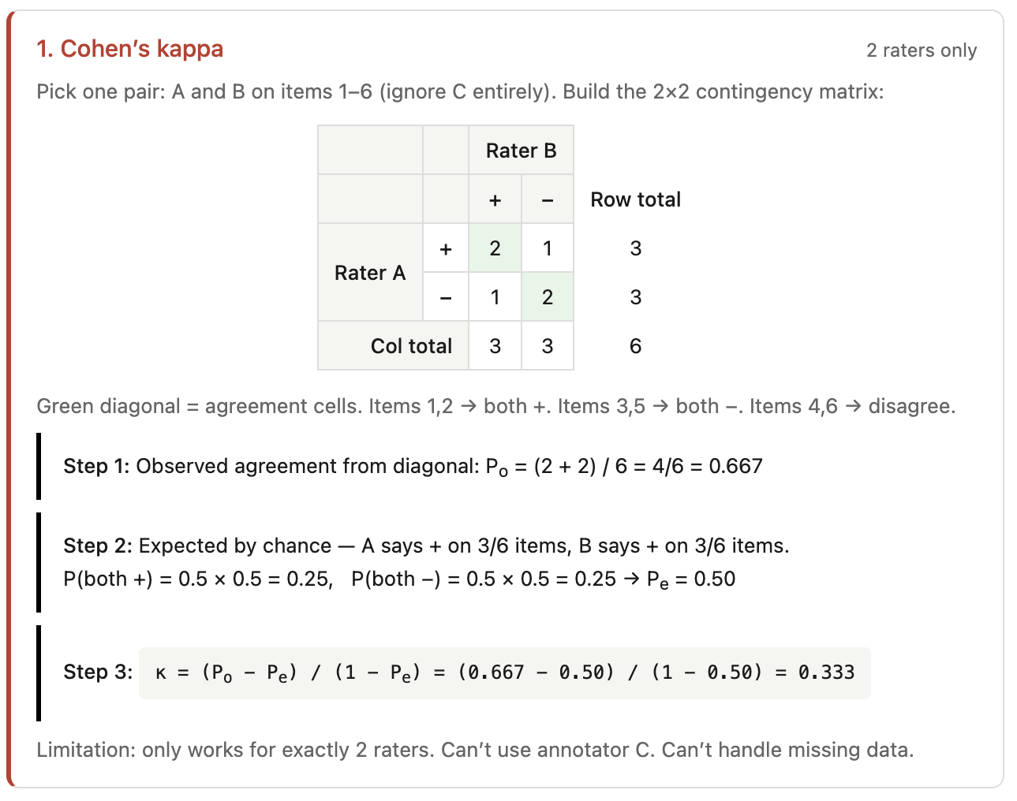
Cohen’s Kappa
 | A | B | C
1 | + | + | +
2 | + | + | −
3 | − | − | −
4 | + | − | +
5 | − | −
6 | − | + | −

Slide 22
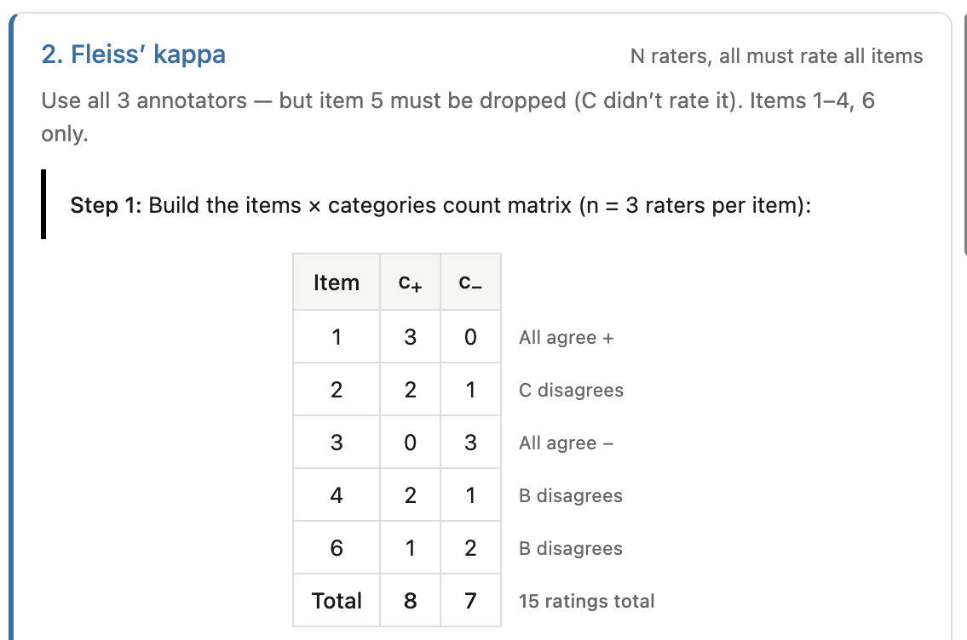
Fleiss’ Kappa: Step 1
 | A | B | C
1 | + | + | +
2 | + | + | −
3 | − | − | −
4 | + | − | +
5 | − | −
6 | − | + | −

Slide 23
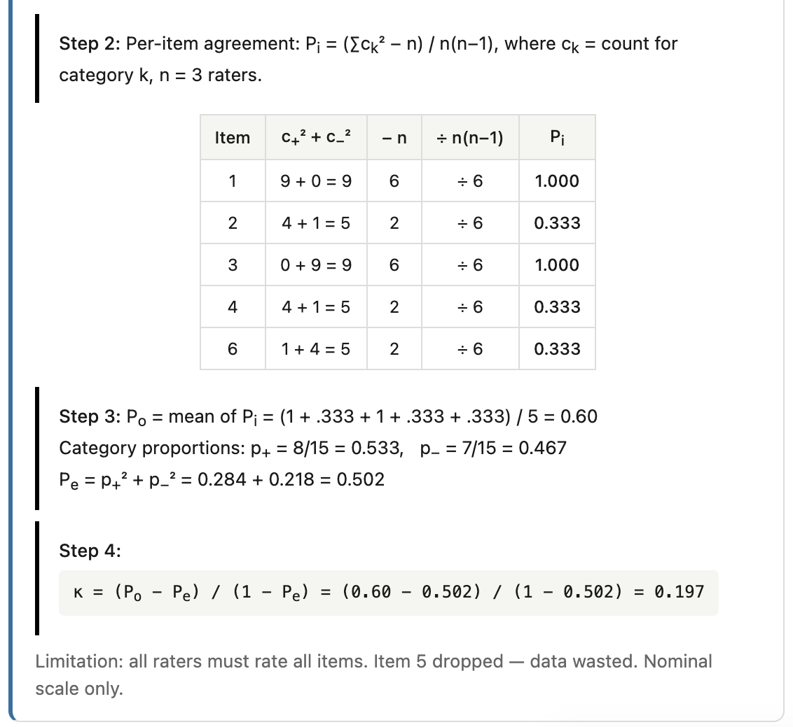
Fleiss’ Kappa: Step 2
 | A | B | C
1 | + | + | +
2 | + | + | −
3 | − | − | −
4 | + | − | +
5 | − | −
6 | − | + | −

Slide 24
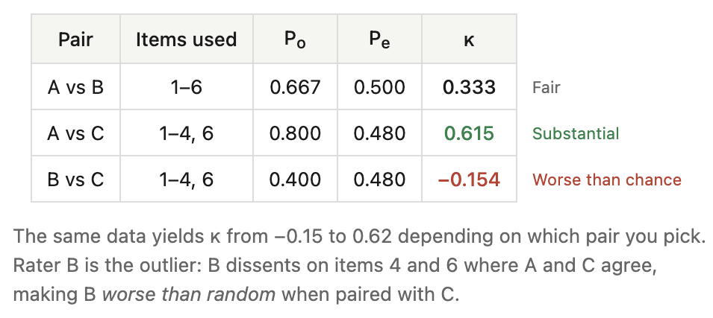
Cohen’s vs. Fleiss’ Kappa
Cohen’s Kappa can be misleading if pairs are cherrypicked!
Fleiss’ Kappa pools all annotators and is more robust
Multi-rater metrics more common in practice
 | A | B | C
1 | + | + | +
2 | + | + | −
3 | − | − | −
4 | + | − | +
5 | − | −
6 | − | + | −

Slide 25
Disagreement is Also a Signal
Traditional: Disagreement = Error -> Fix it!
Modern: Disagreement = Genuine ambiguity in data/semantics?
Examples: sarcasm (α < 0.35), toxicity, hate speech
Recourse for ambiguous semantics:
  Soft labels: keep probability distribution instead of majority vote (e.g., 60% toxic / 40% not)
  Annotator-specific models: learn each rater’s calibration separately (e.g., CrowdLayer, learning from crowds)
  Report full distributions: don’t collapse to a single label; downstream model trains on the disagreement itself

Slide 26
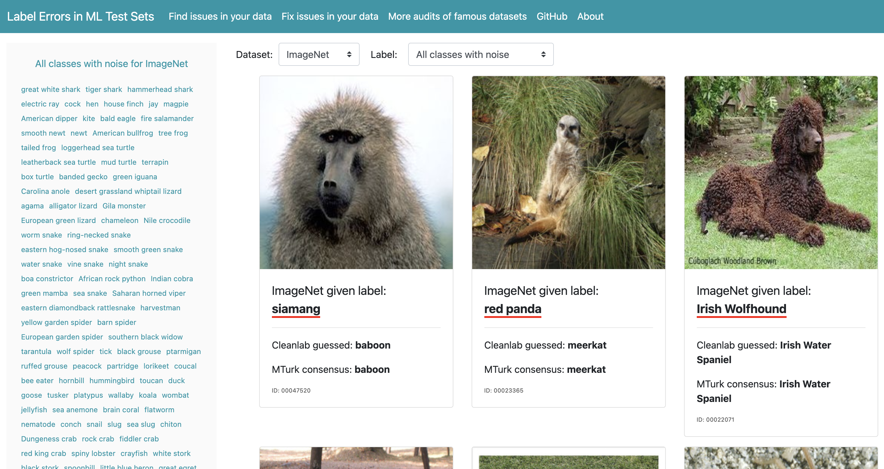
Label Errors are Ubiquitous in AI!
Northcutt et al., NeurIPS 2021:
  Errors found in test sets of 10 popular ML benchmarks!
  ≥3.3% average; ImageNet validation ≥6%!
  Model rankings change on corrected test sets
labelerrors.com

Slide 27
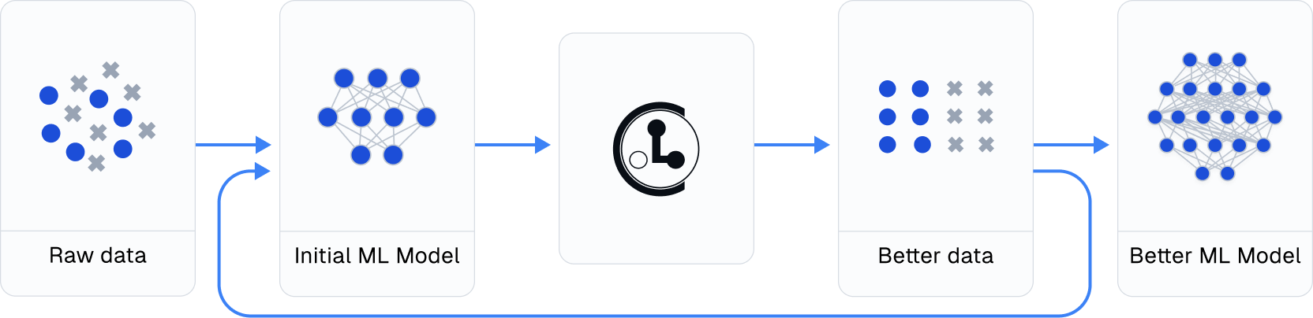
Grappling with Label Errors
Confident Learning:
  Predicted probabilities + Given labels -> estimate joint distribution of noisy vs. true labels -> find errors
  Model-agnostic; no hyperparameters
Open-sourced as cleanlab
https://github.com/cleanlab/cleanlab

Slide 28
Outline
Motivation for Data-Centric AI
Creating Data
  Human Feedback and Annotation
  Data Curation and Structure
  Data Synthesis
  Multimodal Data
Creating Evals

Slide 29
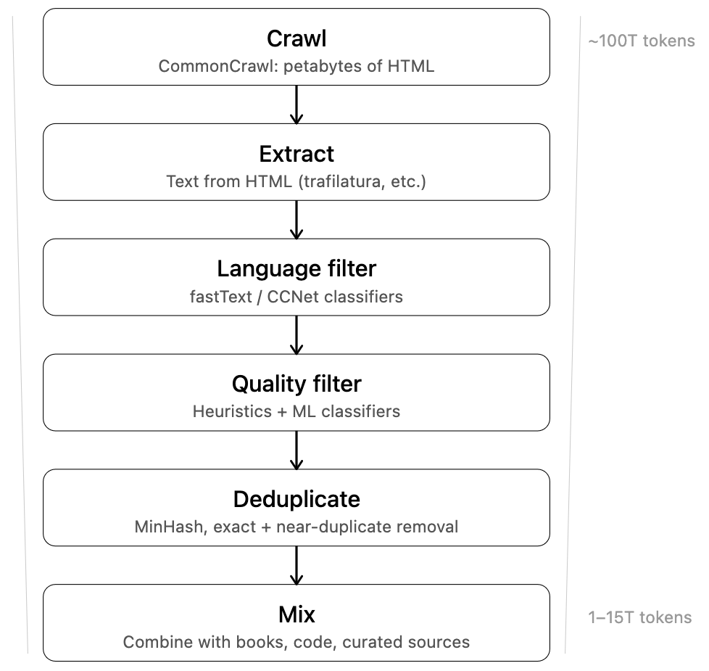
Typical Data Pipeline of Pretraining

Slide 30
What Makes Text “High Quality”?
Heuristic Rules:
  Cheapest, fastest
  Min length, uppercase ratio, blocklists, perplexity via KenLM trained on Wikipedia
  Used by C4, Gopher; runs on CPU; billions of docs
Lightweight Classifiers:
  Still fast, but learns patterns beyond hand-coded rules
  fastText trained on Wikipedia-like vs. random web
  Used by CCNet, FineWeb

Slide 31
What Makes Text “High Quality”?
LLM-as-Judge:
  More expensive to bootstrap, but captures subtle quality signals
  Used by FineWeb-Edu; Llama-3-70B scores 500K pages for educational quality, distill into a small classifier, apply at scale; 15T → 1.3T tokens
Human Annotation:
  Most expensive and likely slowest
  RedPajama-V2: 40+ quality signals per document, human-verified
  Highest fidelity but does not scale to full crawls
  Used for evaluation/calibration more than bulk filtering

Slide 32
Peer Instruction Activity
(Switch to Google Form)

Slide 33
Data Deduplication
Duplicates => memorization, regurgitation, wasted compute!
Methods to deduplicate at scale:
  Exact hash
  URL-based deduplication
  Line-level
  MinHash LSH (n-gram shingles, Jaccard ~0.8)
  SemDeDup (embedding-based)
Scale: 100B+ docs -> need LSH, Bloom filters
SlimPajama: Global dedup. of RedPajama; better benchmarks

Slide 34
Data Mixing
Diverse mixes of sources outperform uniform sourcing.
LLM pretraining = mix of web, books, code, Wikipedia, papers.
  Example: LLaMA: ~67% web, 4.5% Wikipedia, 4.5% books, 6.5% code.
How to choose:
  Manual tuning
  DoReMi (proxy model)
  Ablation

Slide 35
Open Datasets for Pretraining
Popular large datasets:
  C4 (2019, 175B)
  The Pile (2020, 825GB)
  RedPajama-V2 (2023, 30T)
  RefinedWeb (2023)
  FineWeb/FineWeb-Edu (2024, 15T/1.3T)
Trend: more openness, better tooling, principled curation
Document your data: Gebru et al., “Datasheets for Datasets”

Slide 36
Key Takeaways
AI in practice has shifted from model-centric to data-centric. Creating/curating data is now a first-class citizen.
Human feedback (demonstrations, comparisons, corrections, etc.) are a critical signal.
Label errors are ubiquitous in AI. Annotation quality is measurable (IAA).
Typical curation at scale = Filtering + Dedup. + Mixing.
Data quality > quantity.

Slide 37
Recommended Readings
Andrew Ng, “MLOps: Model-Centric to Data-Centric AI” 2021
Ouyang et al., InstructGPT, NeurIPS 2022
Rafailov et al., DPO, NeurIPS 2023
Northcutt et al., Confident Learning, JAIR 2021 + cleanlab.ai

Slide 38
Review Questions
Define data-centric AI. How does it differ from model-centric AI? Are there other prominent forms of “centricity” for AI?
What are the 3 main types of human feedback signals used in LLM post-training? Which type of training stage does each primarily feed?
Briefly explain one statistical difference between Cohen’s kappa and Fleiss’ kappa. Why is Krippendorff’s alpha preferable in practice?
Does a Fleiss’ kappa score of 1.0 mean the labels are perfect? Why or why not? Explain your rationale with an example.
InstructGPT at 1.3B was preferred over GPT-3 at 175B. What does this imply about where AI practitioners should invest effort?
When should annotator disagreement be treated as a signal rather than noise? What are two concrete strategies for preserving that signal?
When is LLM-as-Judge useful for quality filtering? When is it not? Why?
Why is mixing data sources useful for LLM pretraining?

Slide 39
Outline
Motivation for Data-Centric AI
Creating Data
  Human Feedback and Annotation
  Data Curation and Structure
  Data Synthesis
  Multimodal Data
Creating Evals

