Slide 1
CSE/DSC 234
Data-Centric AI and AI Engineering
Spring 2026
Arun Kumar

Slide 2
About Myself
2009: Bachelors in CSE from IIT Madras, India
Summers: 110F!
2009—16: MS and PhD in CS from UW-Madison
PhD thesis area: Data systems for ML workloads
Winters: —40F!
2016-: UC San Diego CSE
2019-: + UC San Diego HDSI
2024-: + RapidFire AI, Inc.
Ahh! :)

Slide 3
My Current Research
New abstractions, algorithms, and software systems
to “democratize” ML/AI from a
data management/systems standpoint
System Efficiency
(Lower time/costs)
+
Human Efficiency
(Higher productivity)
Democratization =
Practical and scalable data systems for AI
Inspired by principles of databases and systems
Exploit insights from learning theory and optimization theory
ML/AI
Data
Management
Systems

Slide 4
What is this course about? Why take it?

Slide 5
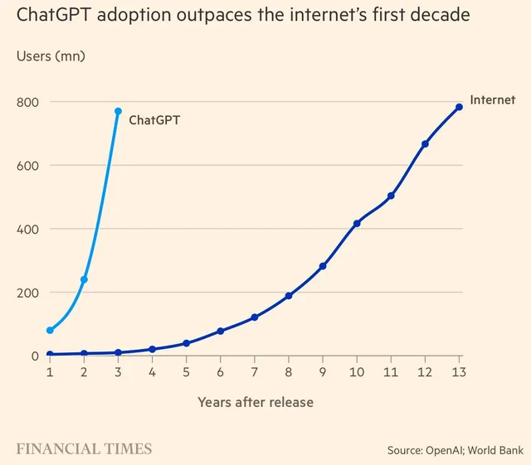
1. ChatGPT Takes the World by Storm!

Slide 6
Why was ChatGPT a pivot point in AI?

Slide 7
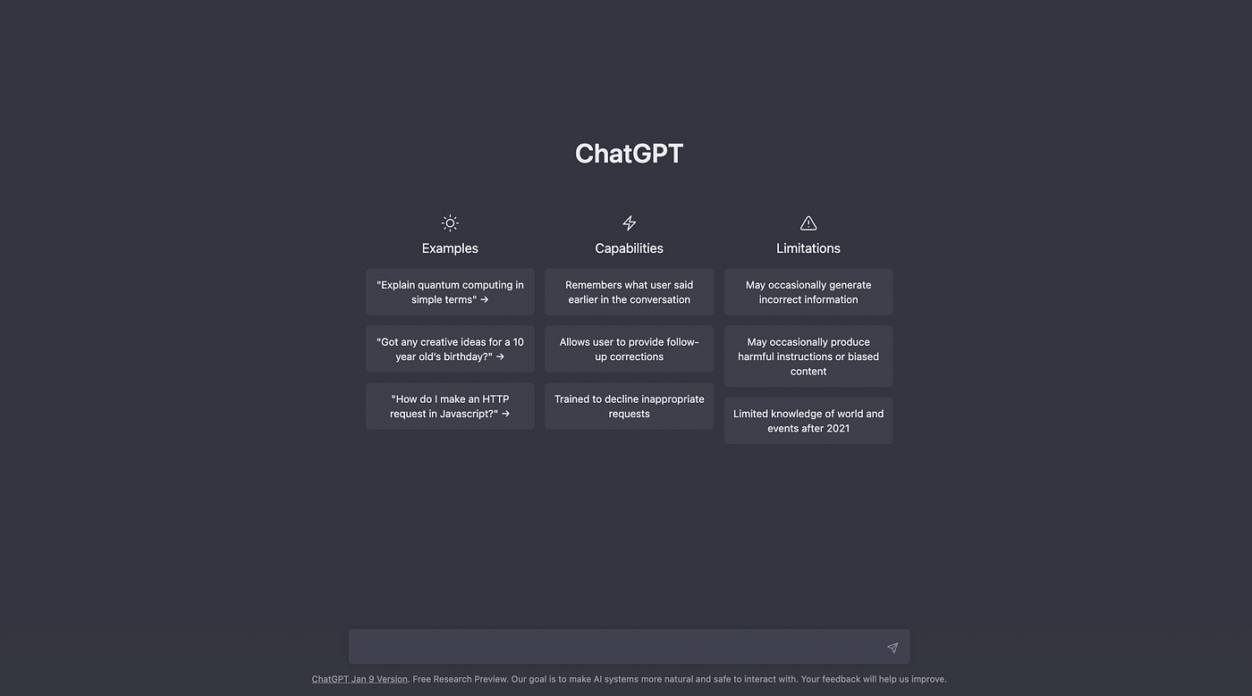
From Task-Specific AI to General AI (AGI)

Slide 8
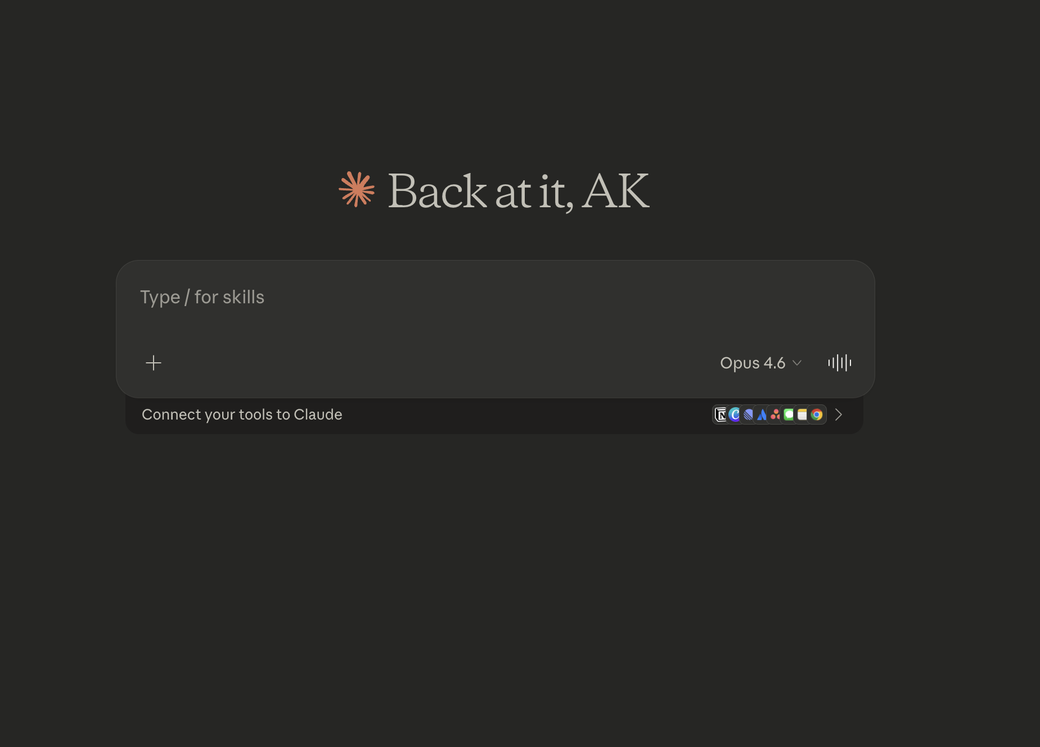
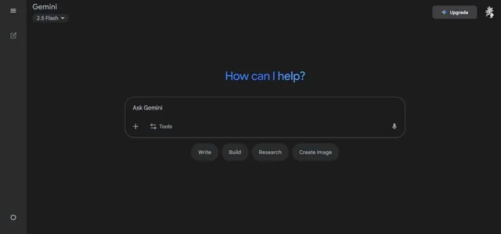
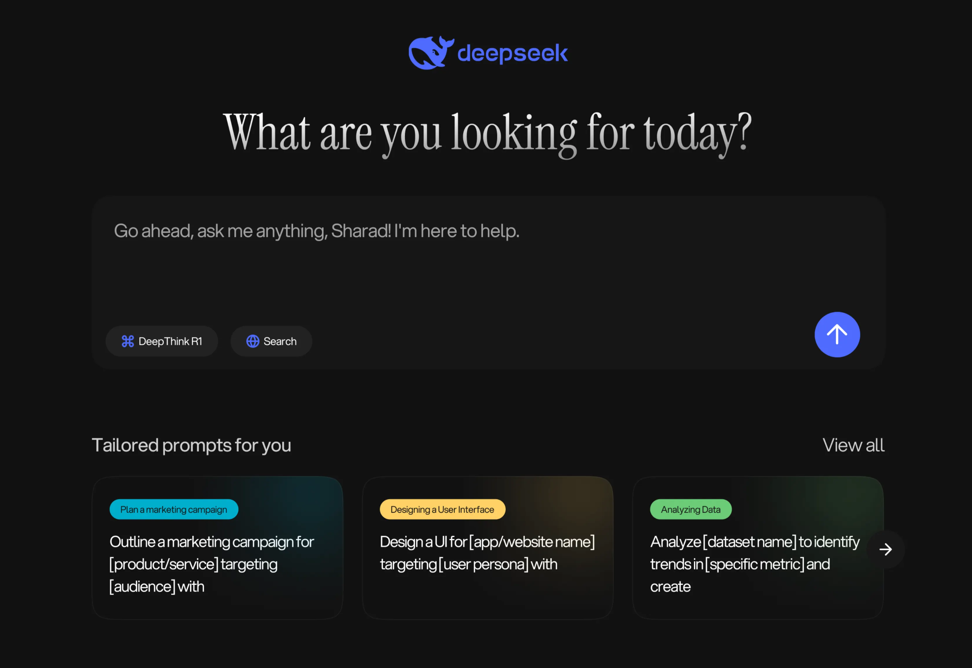
Cambrian Explosion of (Multimodal) LLMs

Slide 9
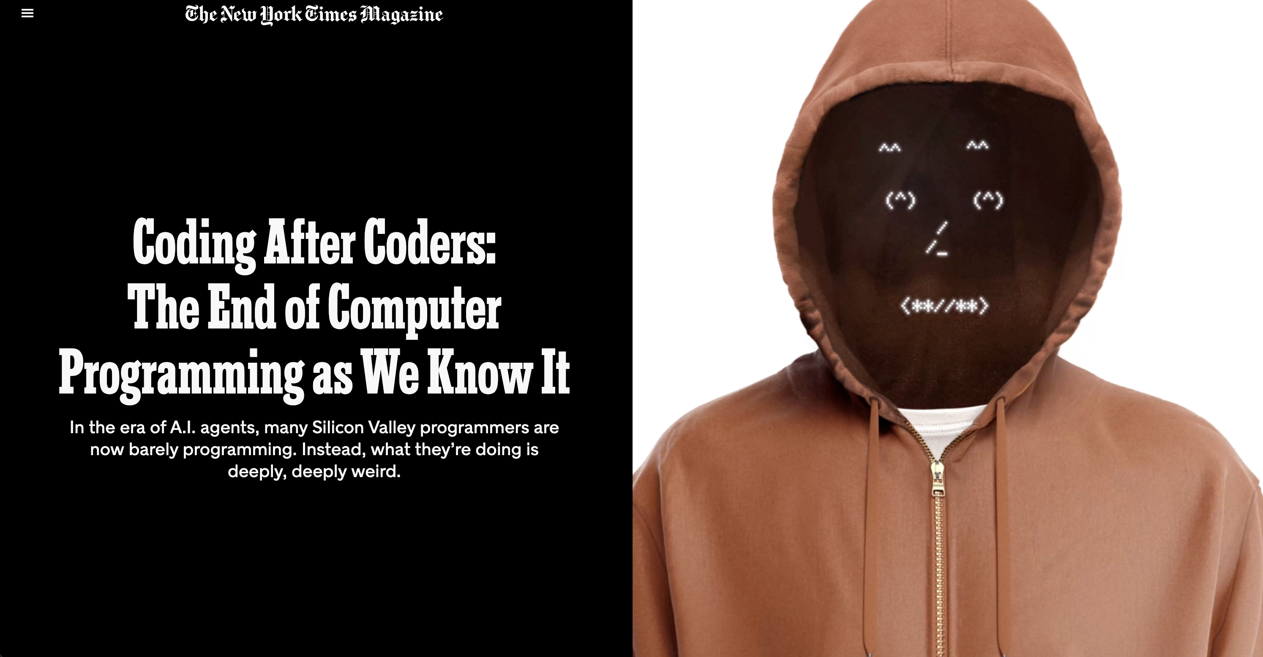
2. The End of Coding as We Know/Knew It

Slide 10
Who will write and test code now?

Slide 11
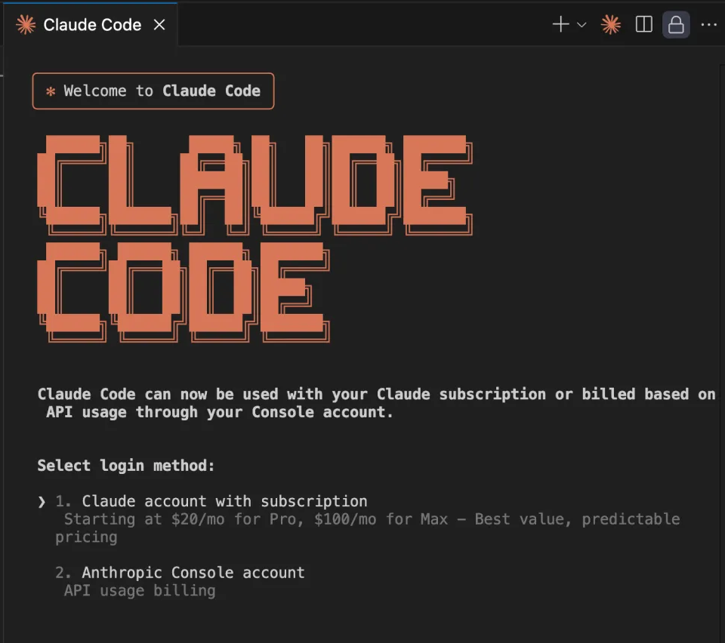
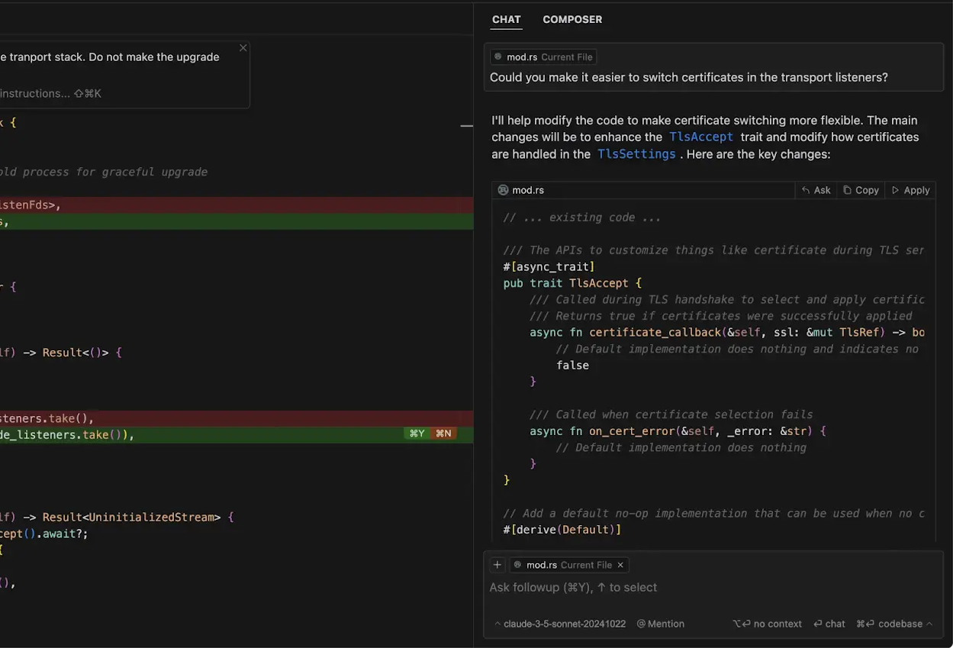
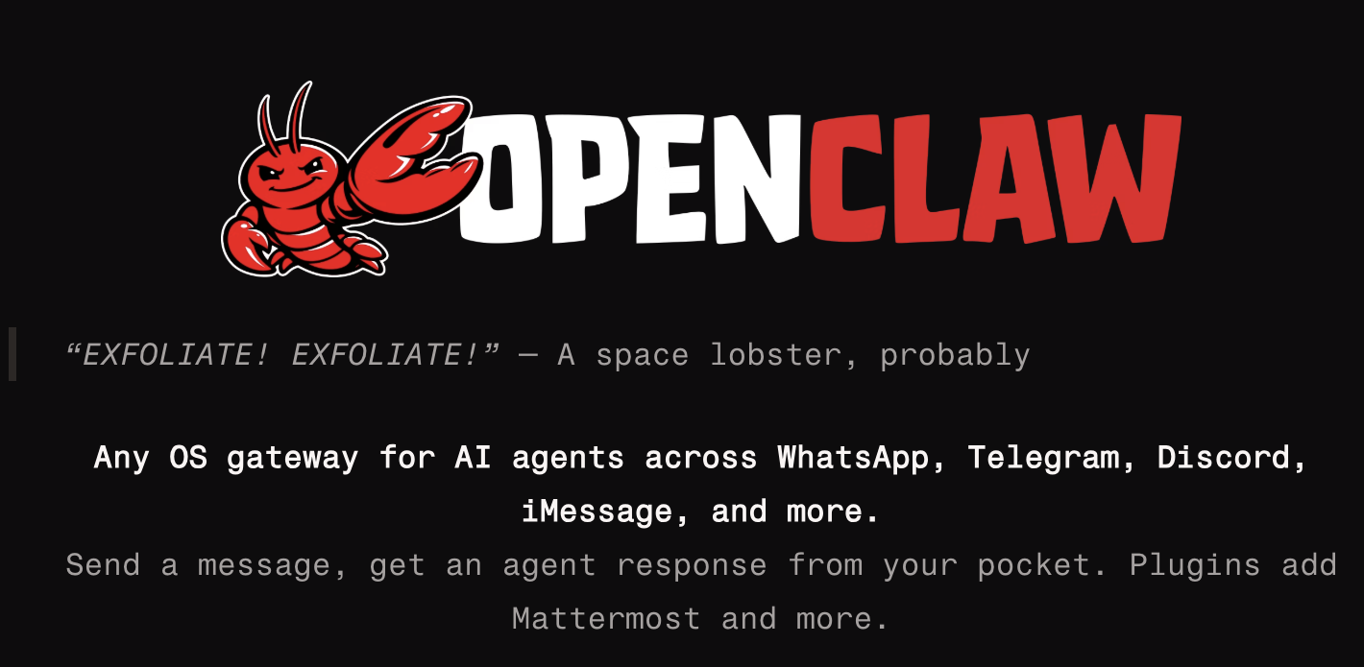
AGI as Pair Programmer/Coding Team!

Slide 12
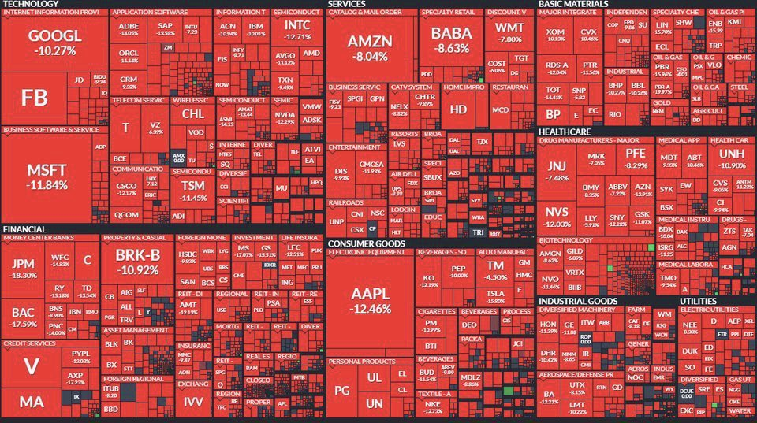
3a. DeepSeek R1 Wipes Out 1 Trillion in US Stocks

Slide 13
Why did the markets freak out?

Slide 14
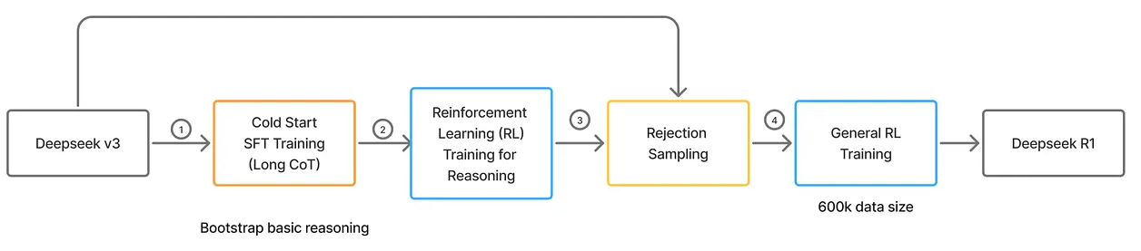
DeepSeek Moment: Beyond More Data + Compute
https://rajeshparikh.substack.com/p/qwen-3-and-deepseek-r1s-post-training
https://arxiv.org/abs/2501.12948

Slide 15
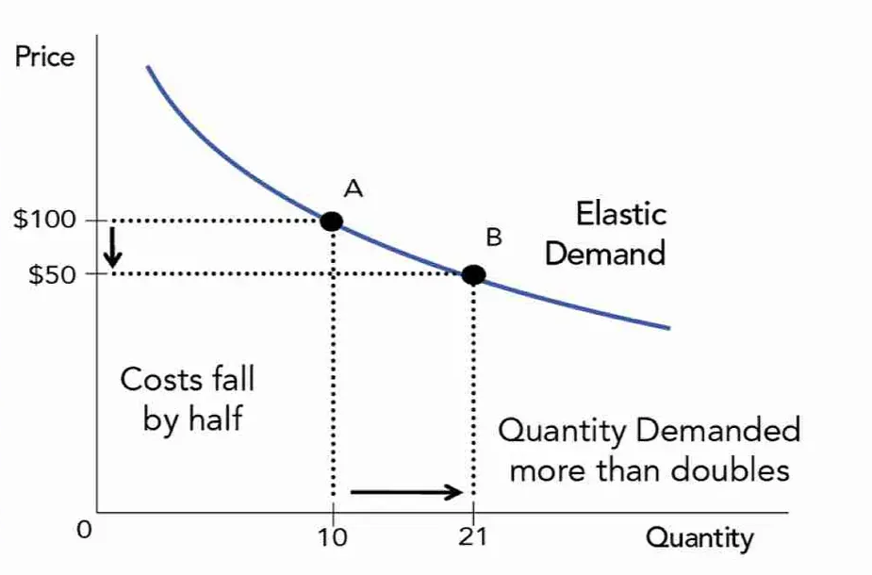
But … Jevons Paradox is Real

Slide 16
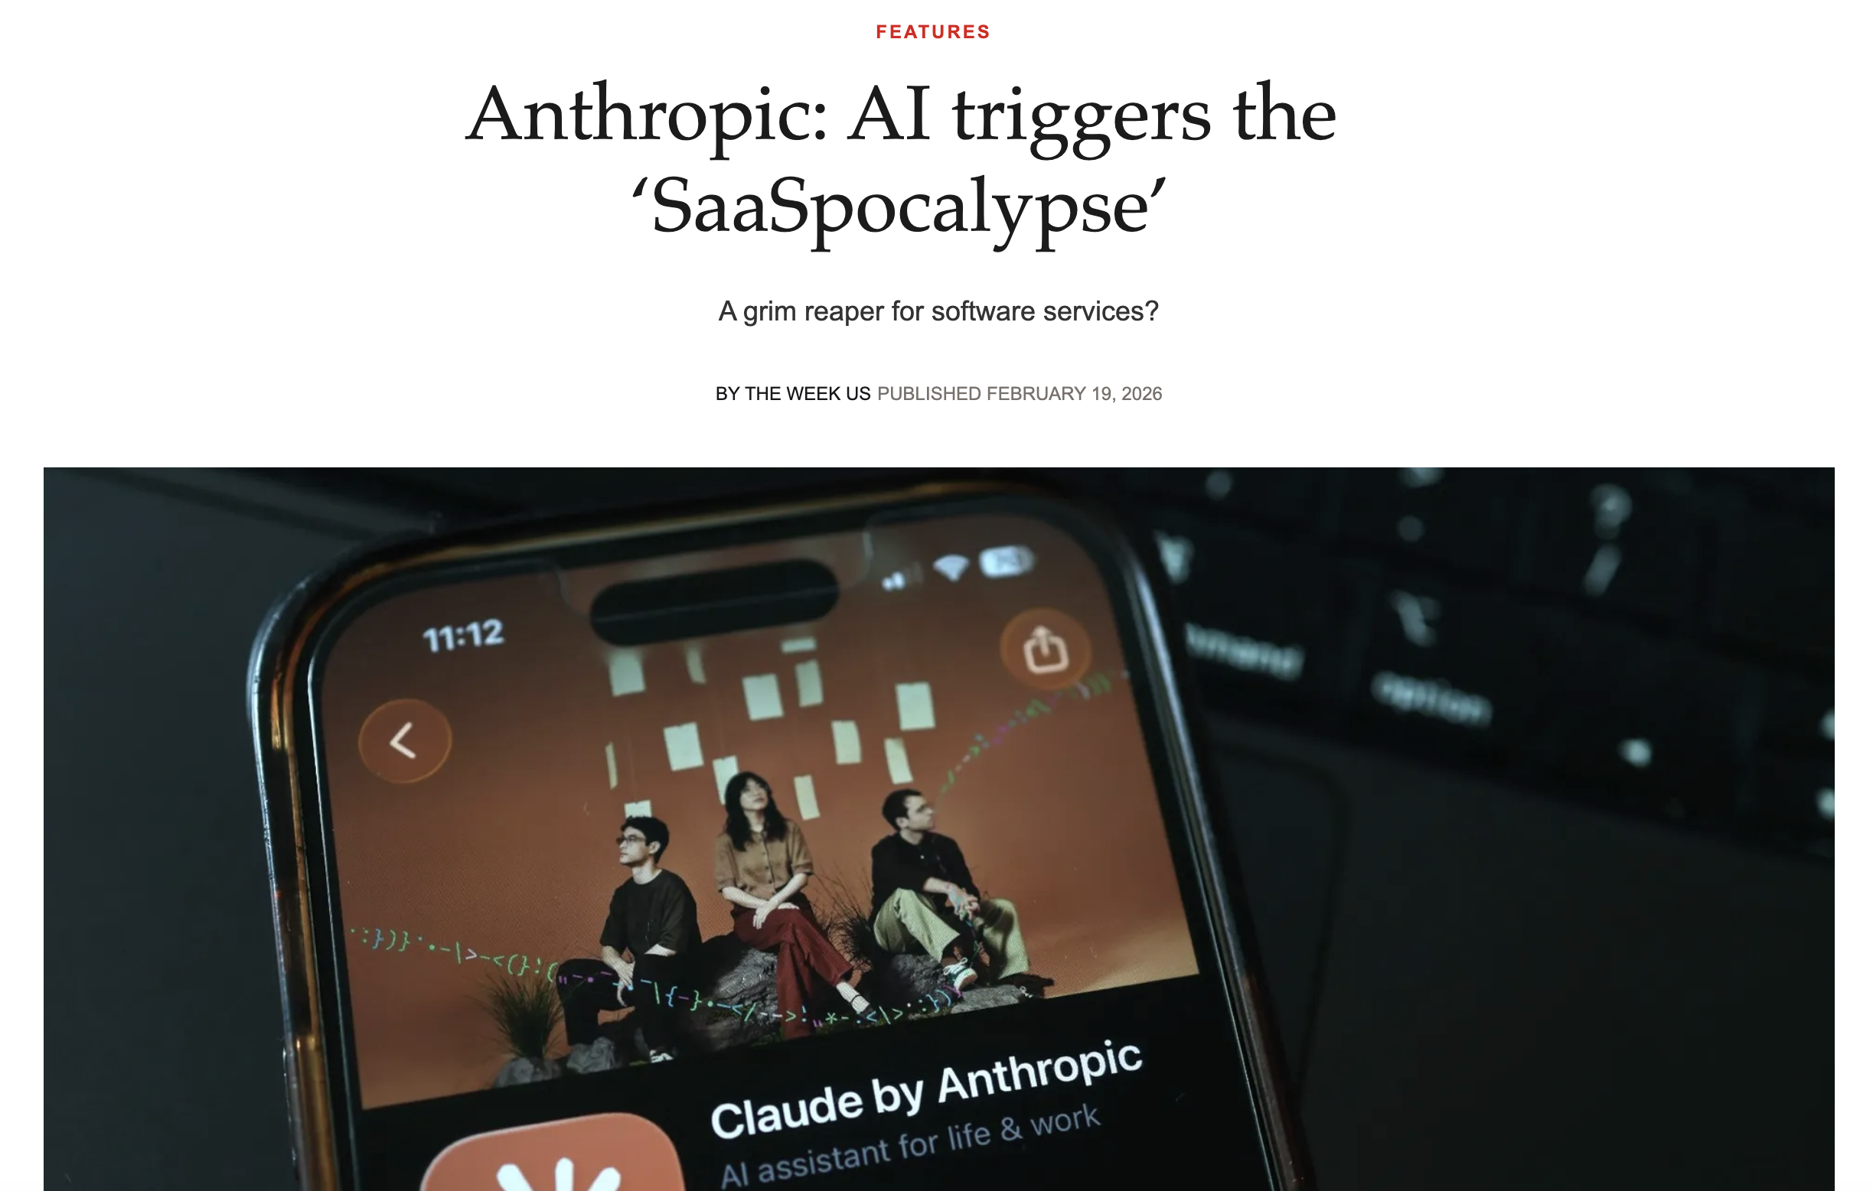
3b. Claude Triggers Collapse in SaaS Stocks

Slide 17
Why did the markets freak out, again?!

Slide 18
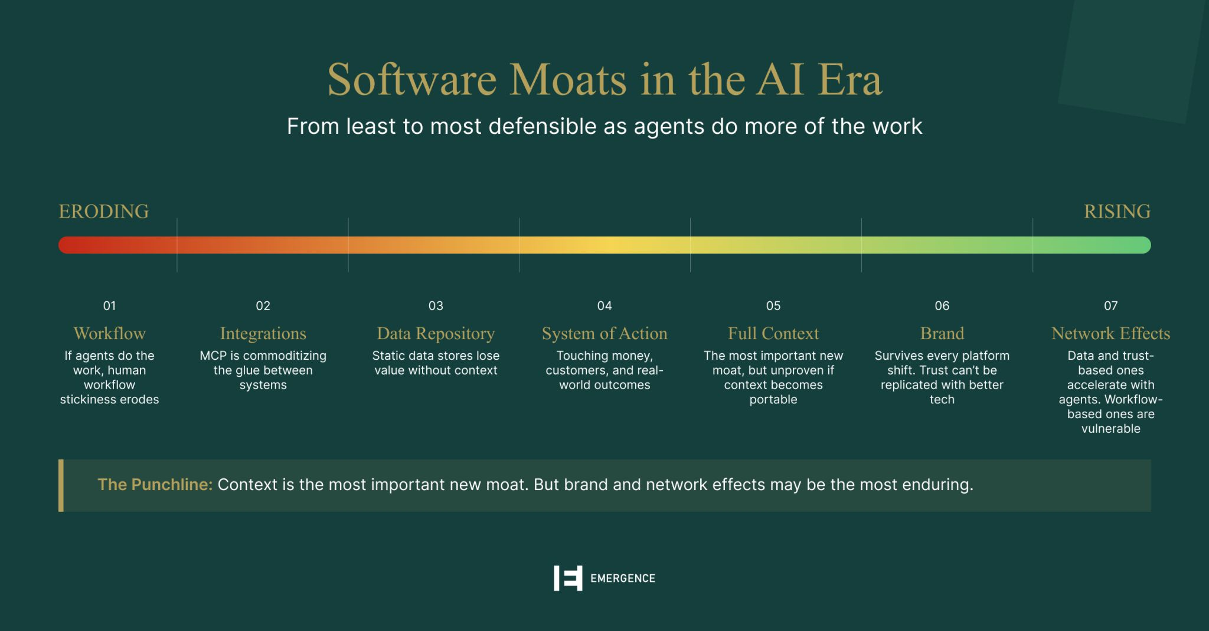
Software Moats are Indeed Under Threat

Slide 19
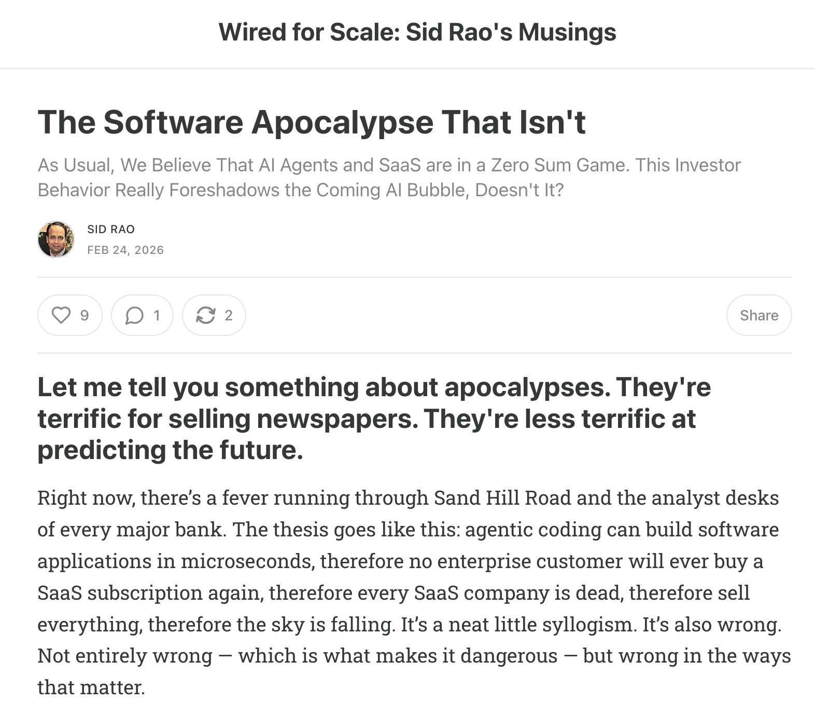
But … SaaS as a Category is Not Dead
https://www.srao.blog/p/the-software-apocalypse-that-isnt

Slide 20
Innumerable enterprise applications are being disrupted by AGI

Slide 21
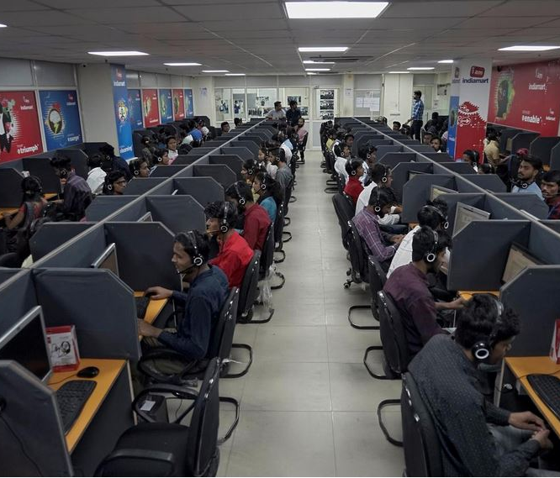




Slide 22
Domain sciences also being disrupted*
Pre-LLM era Deep Learning (DL) already disrupted most natural sciences!

Slide 23





Slide 24
We are not living in “normal” times. :)

Slide 25

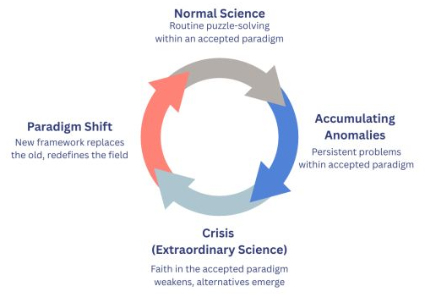

Slide 26
But what more is there to all this than just taking a bunch of ML/AI courses?

Slide 27
Academic ML/AI
Machine Learning Algorithms
Deep Learning Algorithms
Large Language Models
Natural Language Processing
Information Retrieval
Computer Vision
…

Slide 28
Real-World ML/AI 101
Almost all of your ML / AI courses put together! :)

Slide 29
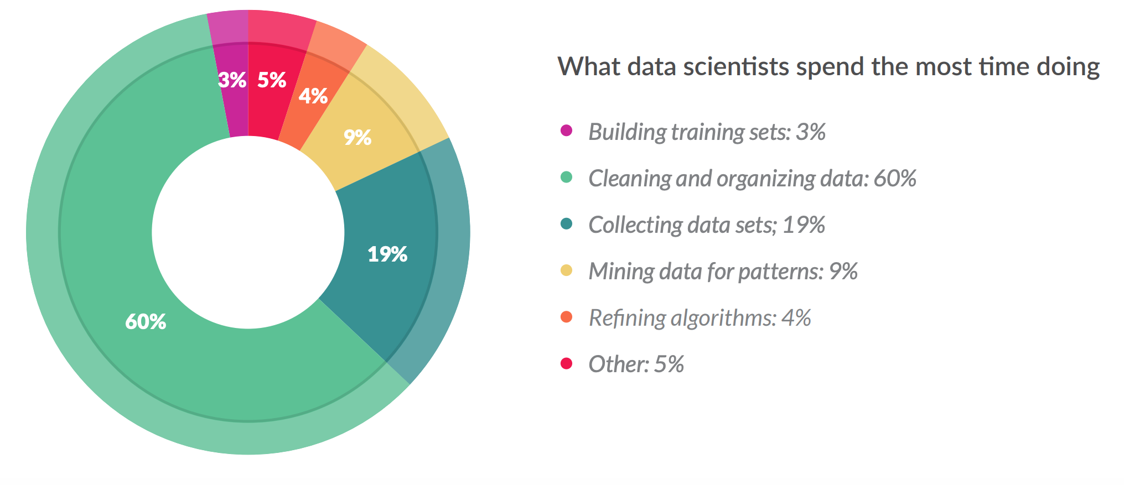
Real-World ML/AI 101
This was in 2016!
If anything, “mining/algorithms” parts have shrunk further. :)

Slide 30
Real-World ML/AI 101
The Rise of “Data-Centric” AI

Slide 31
Real-World ML/AI 101
https://datacentricai.org/

Slide 32
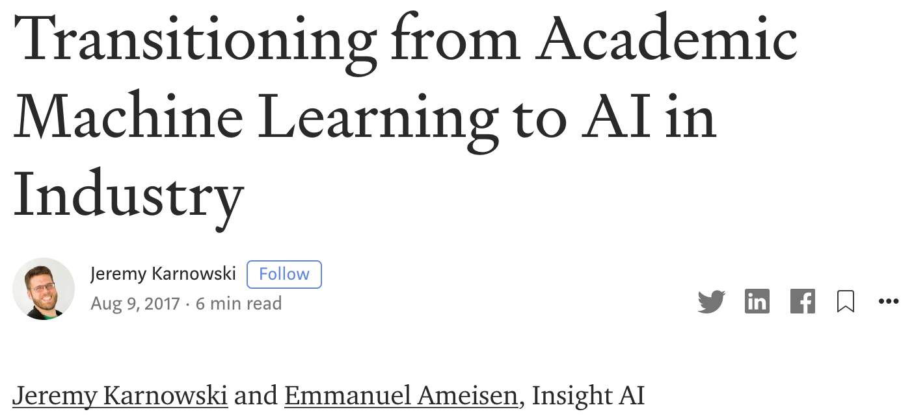
Real-World ML/AI 101
System design
Structured ML modules
Software testing
Integrating with data infrastructure
Model serving
All of these are still relevant but in a new form!
https://blog.insightdatascience.com/preparing-for-the-transition-to-applied-ai-8eaf53624079

Slide 33
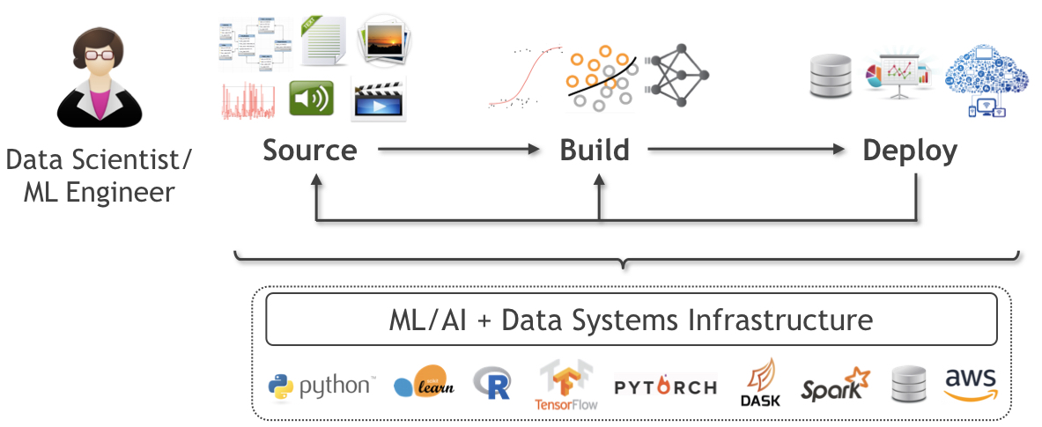
The Old Lifecycle: ML/DL Engineering
Feature Engineering
Training & Inference
Model Selection
Data Acquisition
Data Preparation
Serving
Monitoring

Slide 34
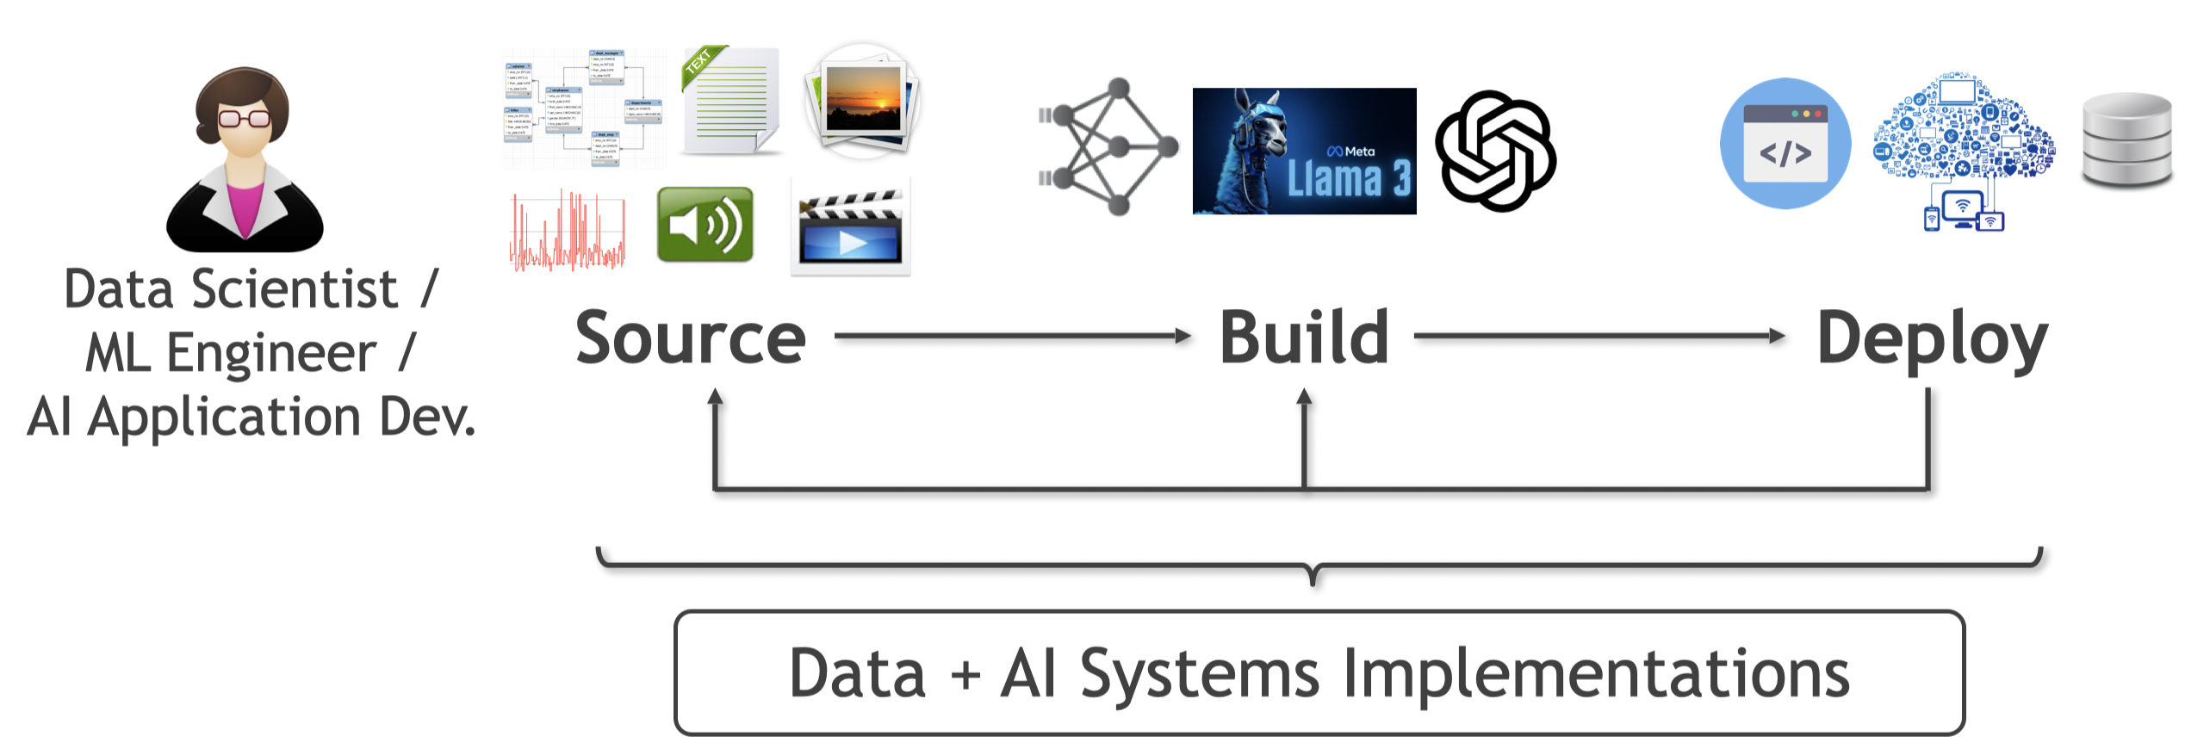
The New Lifecycle: AI Engineering
AI Engineer /
Forward Deployed Engineer (FDE)
Data Acquisition
Data Preparation
Create Evals
Context Engineering
Agent Engineering
LLM Customization
Guardrails
Monitoring

Slide 35
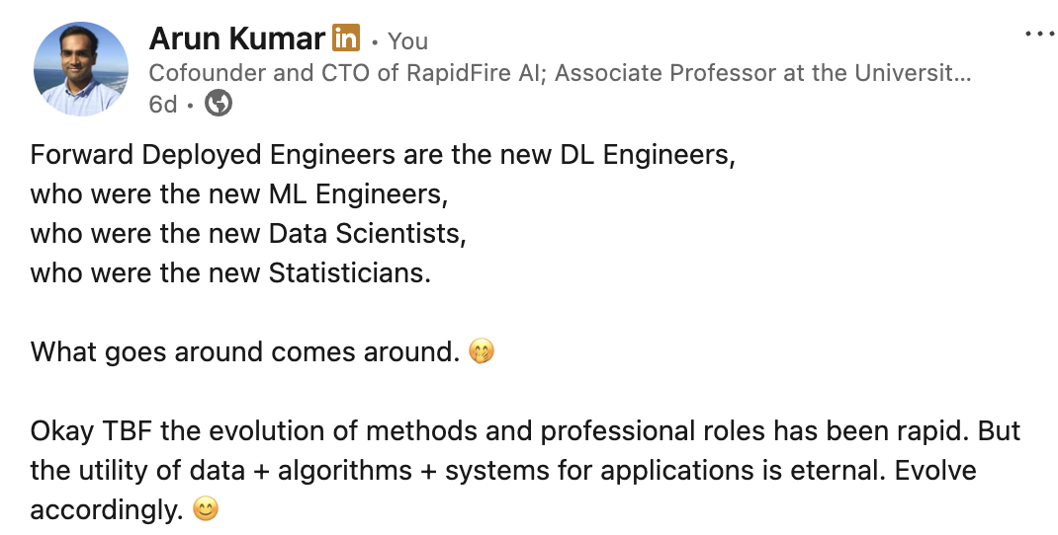
Out with the Old, in with the New!

Slide 36
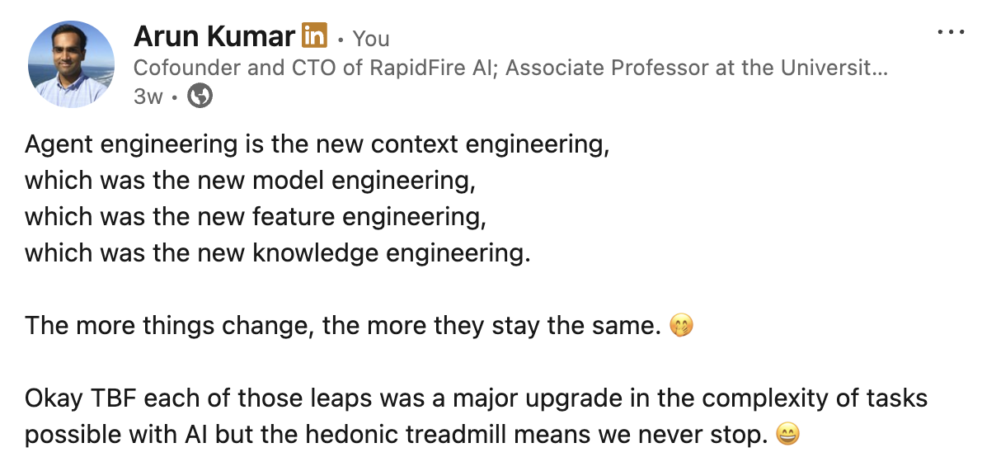
Out with the Old, in with the New!

Slide 37
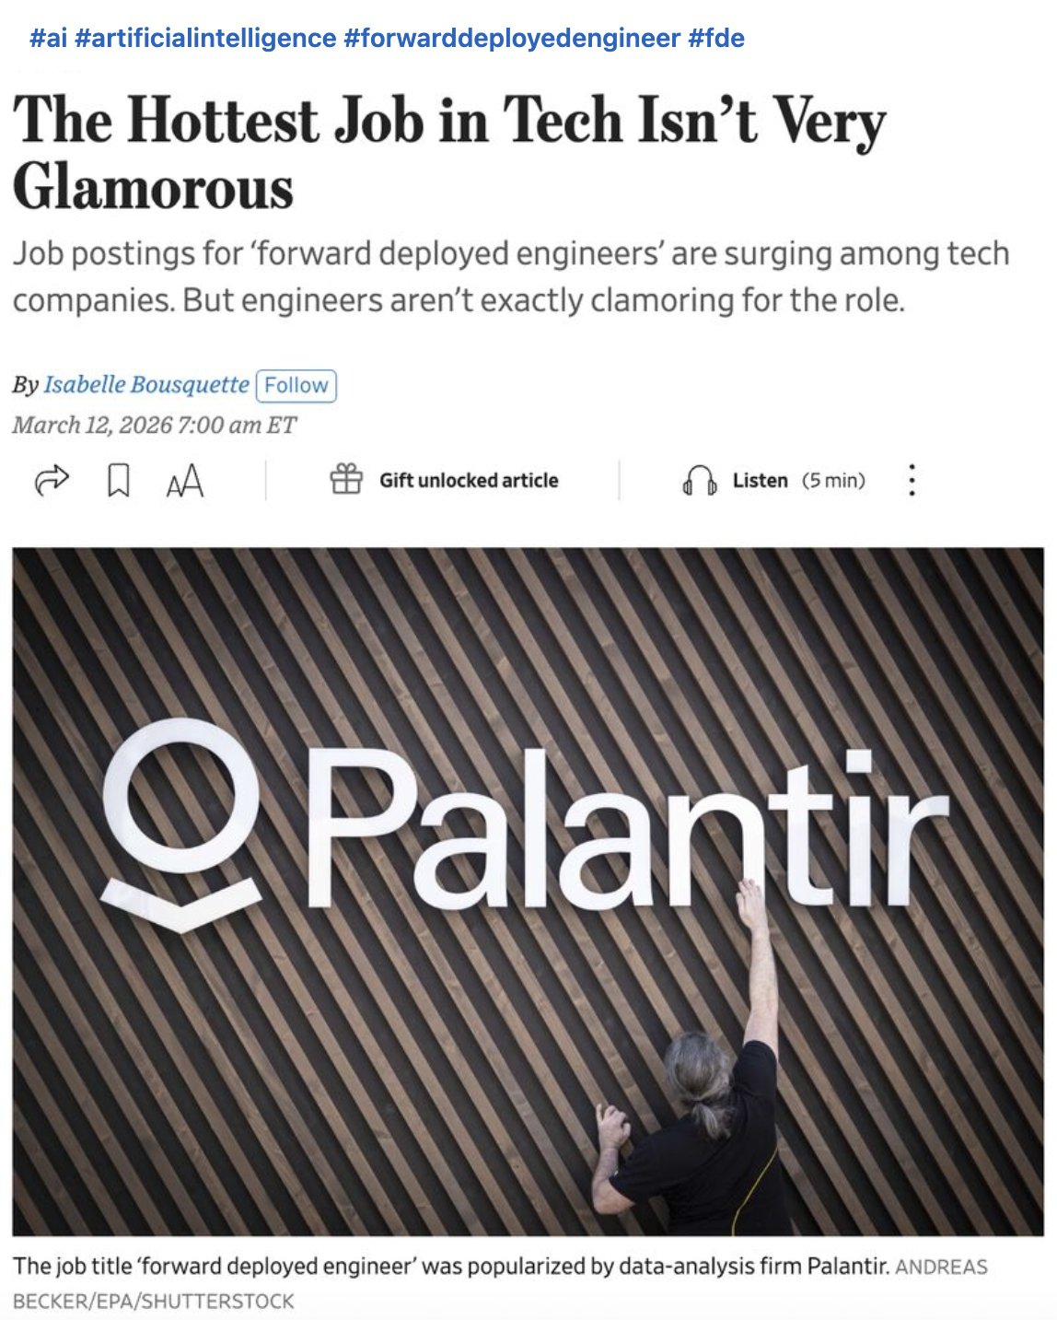
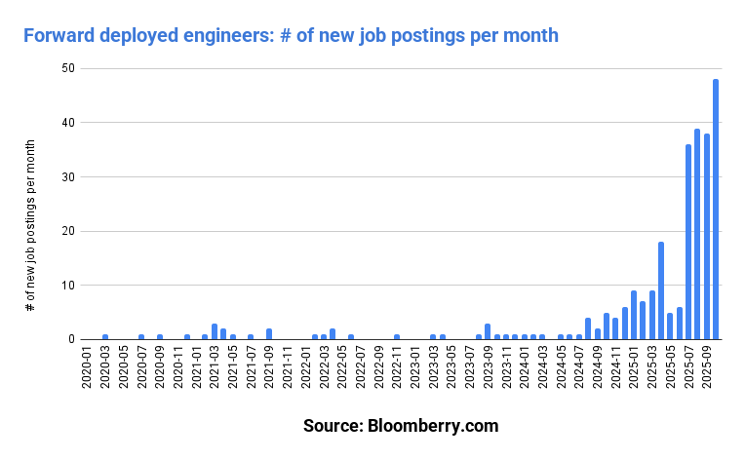
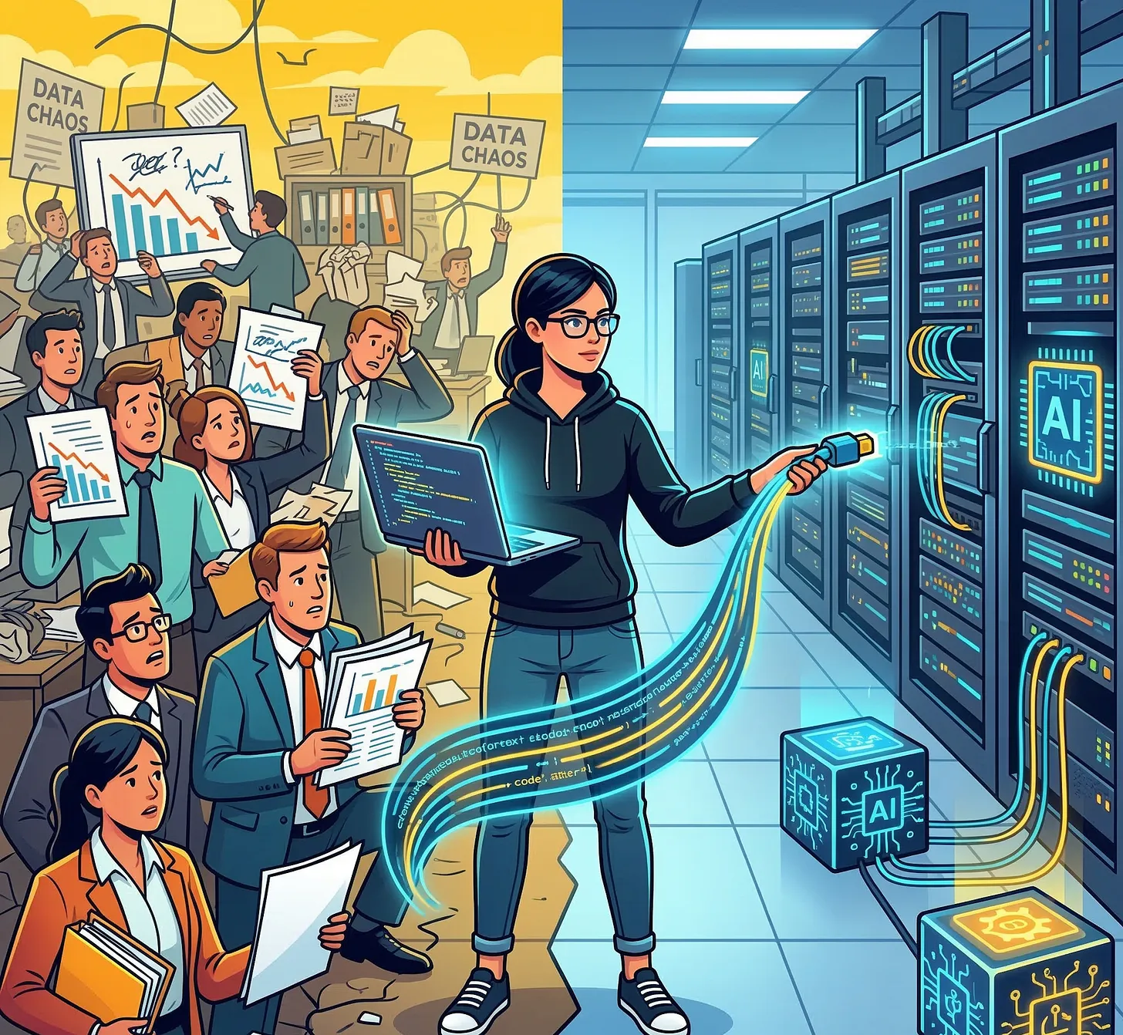
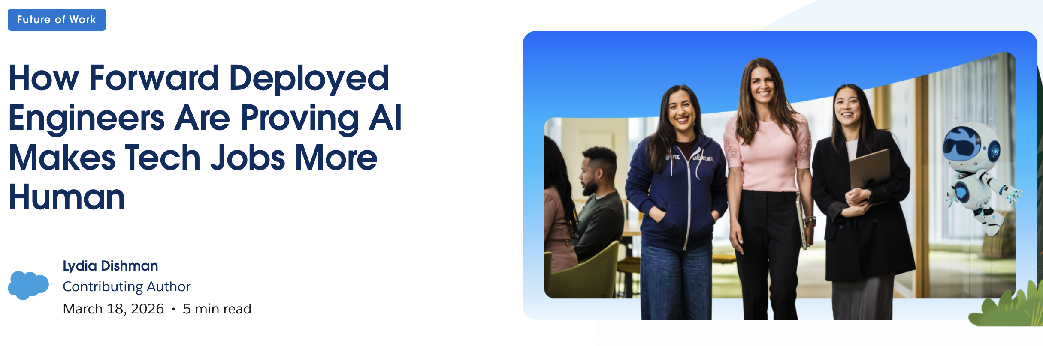
Out with the Old, in with the New!

Slide 38
FDEs are basically “AGI babysitters” for a product team. :)

Slide 39
CSE/DSC 234 will get you to think about the
data and engineering aspects of A(G)I applications
AI
Data
Management
Software Engineering
“Data-Centric AI …”: How to acquire, annotate, synthesize, and curate data and data-informed evals?
“… AI Engineering”: How to go from data + LLMs/AGI APIs to shippable software systems?
3 Main Stages:
  Source: Raw application -> AI-ready data + evals
  Build: AI-ready data + evals -> A(G)I pipelines
  Deploy: Productionize A(G)I pipelines

Slide 40
Focus on Practical Concerns
Key concerns in AI algorithmics:
Accuracy/Quality Metrics
Runtime efficiency (sometimes)
Additional key practical concerns in AI engineering:
Usability + Reliability
Scalability + Efficiency at scale
Manageability
Total Cost of Ownership (TCO)

Slide 41
Real-World AI: Pareto Surfaces
Q: Suppose you are given 4 LLM pipelines A, B, C, and D with accuracies of 95%, 85%, 90%, and 85%, resp. for a spam detection task. Which one will you pick?
Q: What about now?
Real-world AI applications grapple with multi-dimensional Pareto surfaces: accuracy/reliability metrics, TCO, inference latency, tool availability, explainability, compliance metrics, etc.
Multi-objective optimization criteria set by application needs and business policies.
95%
A
E
Accuracy
90%
C
Pareto
Frontier
85%
D
B
$1K
$10K
Monetary cost

Slide 42
Learning Outcomes of this Course
Understand the data-centric engineering challenges across the AI application lifecycle—from creating data and evals to retrieval, customization, and deployment—and how to handle them in practice.
Build and evaluate LLM-powered applications (RAG, SFT, agents, etc.) using systematic experimentation rather than ad hoc prompting.
Reason about practical tradeoffs between accuracy/eval metrics, cost, latency, reliability, etc. in real AI applications.
Think critically about the fast-evolving landscape of AI engineering tools, methodologies, and R&D to discern from the hype what actually matters in production.

Slide 43
What this course is NOT about
NOT a course on basics of AI or databases
  Sanity check! You must know what all these terms mean: LLM, prompt, tokenization, embedding, transformer, gradient descent, fine-tuning, GPU
NOT a course on ML/AI algorithmics; we focus on the data and engineering systems around LLMs
NOT a course on how to just use/prompt LLM APIs
NOT a course on ML systems internals; take Hao’s DSC/CSE 291 (Deep Learning Systems) for that

Slide 44
Now for the logistics …

Slide 45
Prerequisites
A full course on ML algorithms (e.g., CSE 151 or 258) is absolutely necessary. It could have been taken at UCSD or elsewhere.
Python programming knowhow is also necessary.
Introductory courses on NLP/LLMs and on databases/data management are also highly recommended but not strictly required.
Substantial project or industrial experience on relevant topics can be substituted for prior coursework and Python experience, subject to the instructor’s consent. Email the instructor if you would like to enroll but are unsure if you satisfy the prerequisites.
https://cseweb.ucsd.edu/classes/sp26/cse234-a/index.html

Slide 46
Components and Grading
Midterm Exam: 15%
Cumulative Final Exam: 35%
AI Engineering Project 1: 20%
AI Engineering Project 2: 20%
Peer Instruction (PI) Activities: 10% (8 x 1.25%)
See course website for more details on A(G)I use for Projects, Academic Integrity policies, Exam logistics, Midterm “Second Chance”, and PI Activities logistics
https://cseweb.ucsd.edu/classes/sp26/cse234-a/index.html

Slide 47
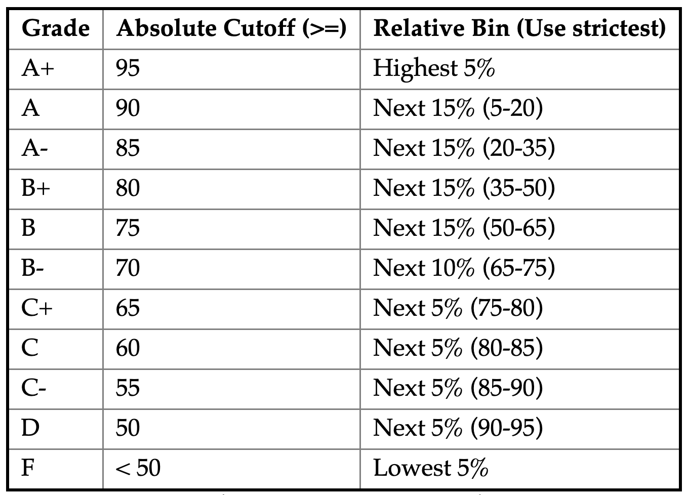
Grading Scheme
Hybrid of absolute and relative; grade is the better of the two
Example: Score 89 and 60%le; Rel: B+; Abs: A-; so, A-

Slide 48
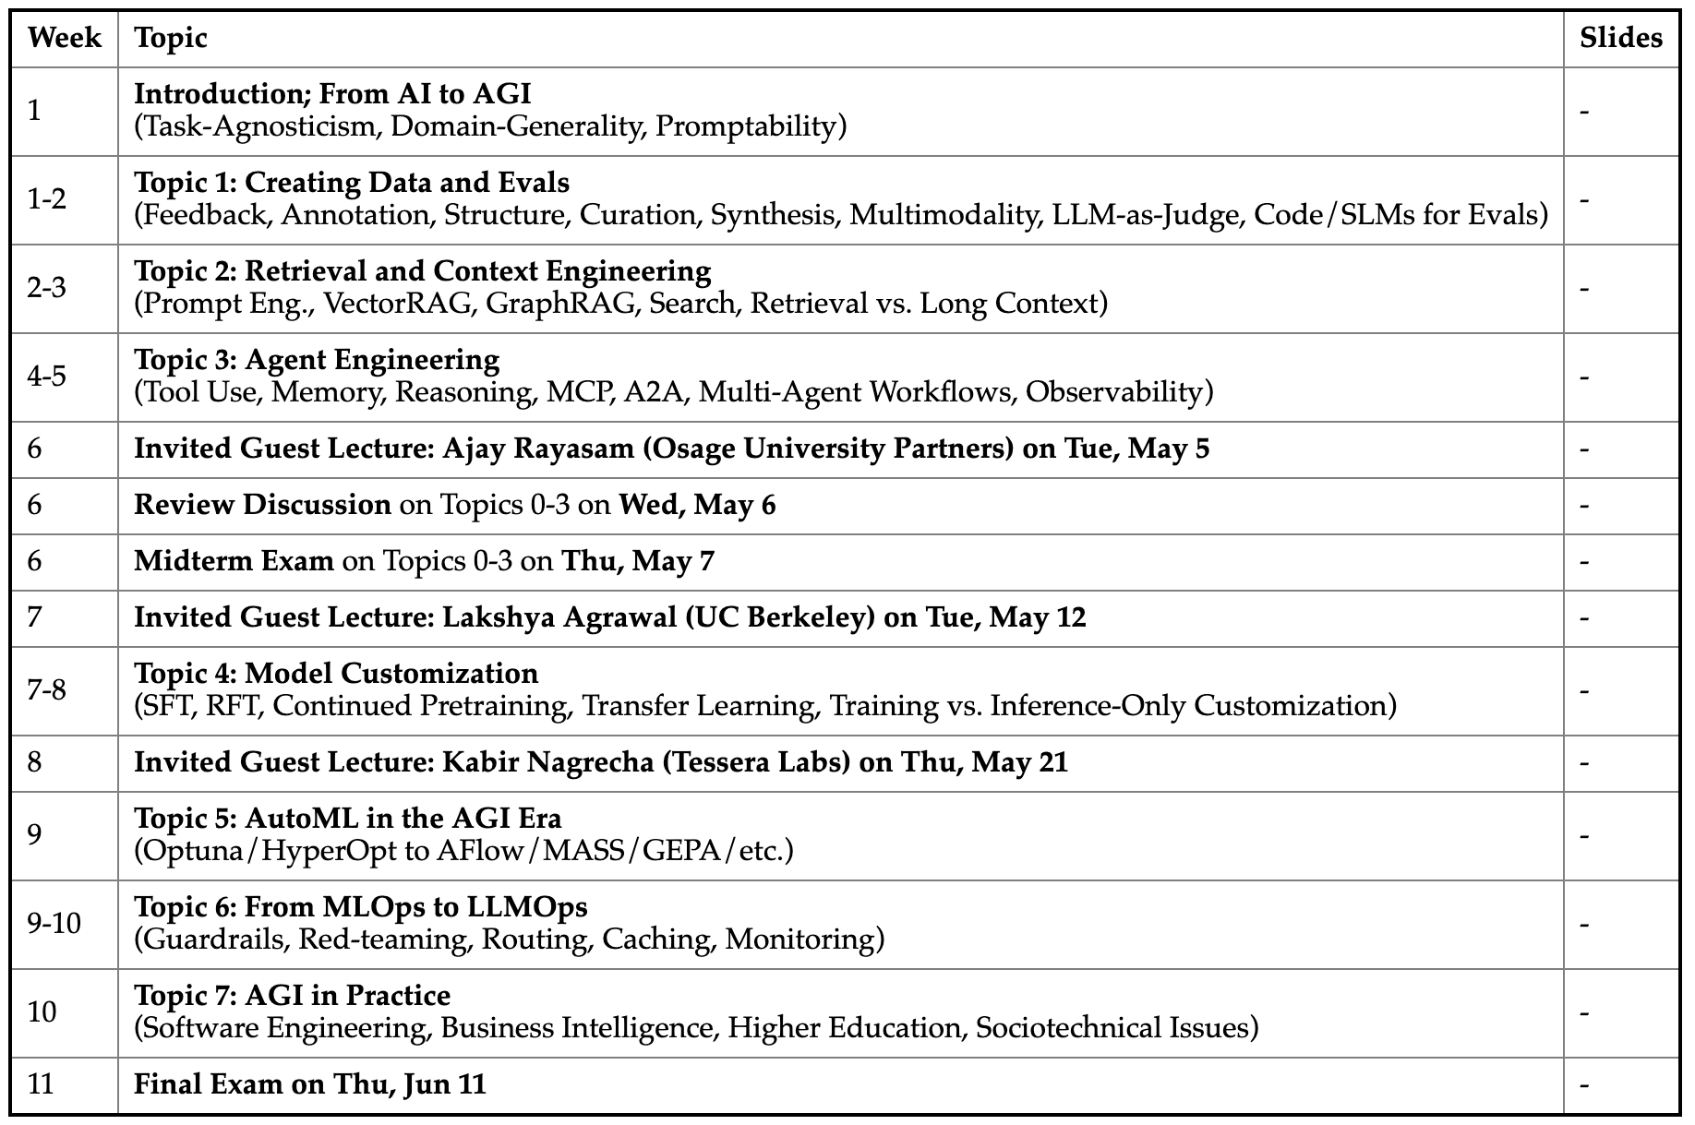
Tentative Course Schedule
Source
Build
Deploy

Slide 49
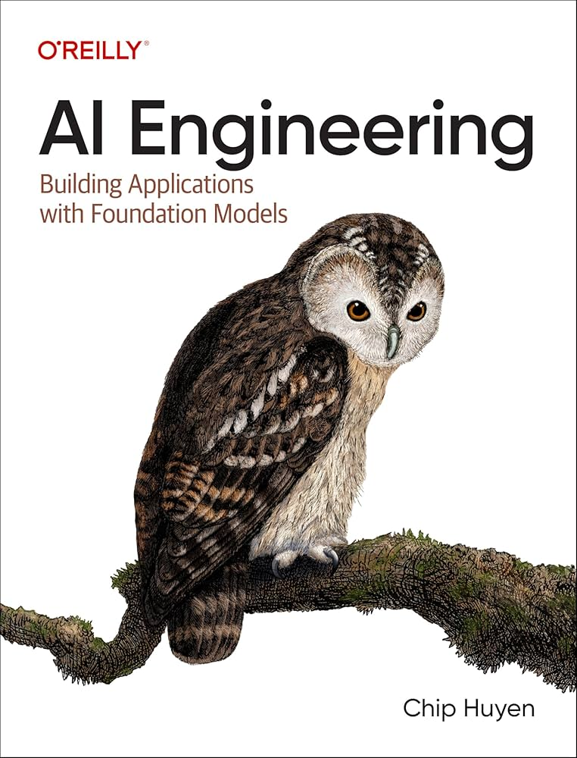
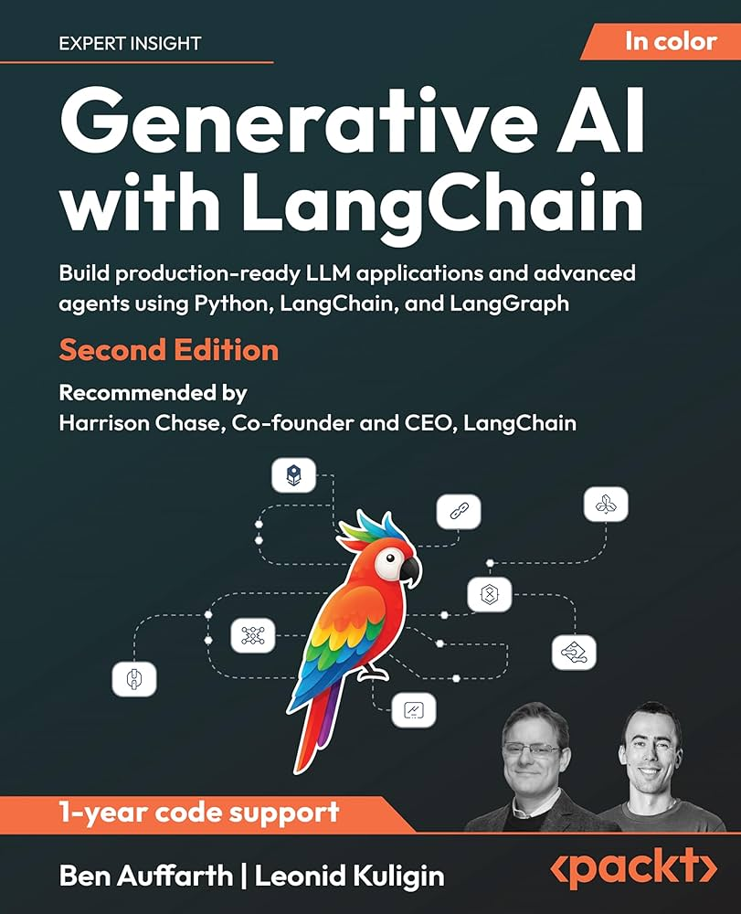
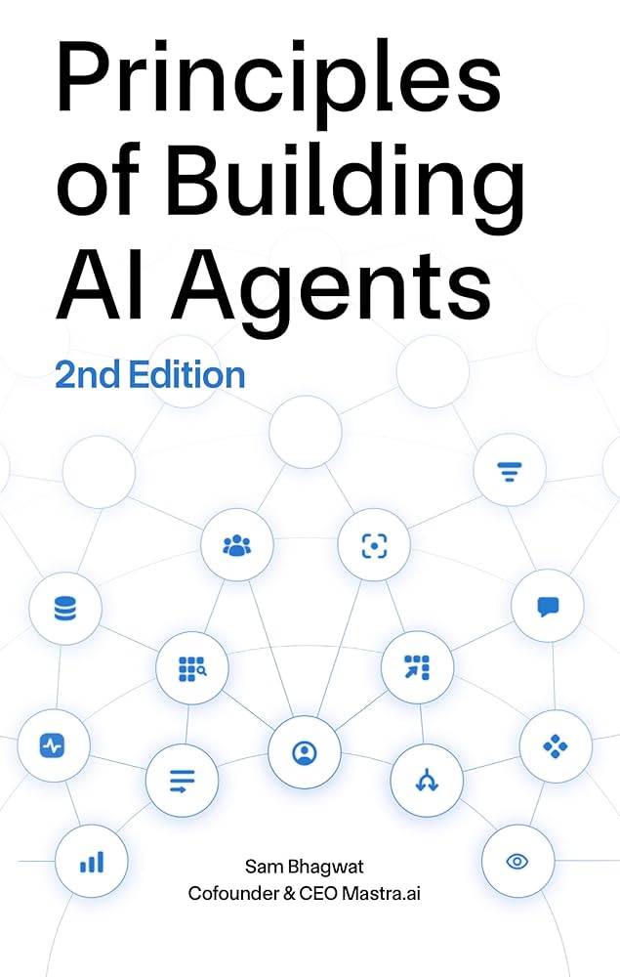
Suggested Textbooks

Slide 50
Day-to-day Logistics
Lectures, Exams, Peer Instruction (PI) Activities are in-person only
  Automatically podcast to podcast.ucsd.edu
  Standard UCSD policy on makeup for exams / PI activities
  Special circumstances: contact me upfront to discuss
Discussion slot will likely be via Zoom only
Attending Lectures/Discussions live is optional
Google Forms for PI Activities
Canvas for submitting AI Engineering Projects, all grade releases, all Exercise and Exam documents
Piazza for all announcements and asynchronous Q&A
  Do help out your peers by discussing questions
https://cseweb.ucsd.edu/classes/sp26/cse234-a/index.html

Slide 51
Course Administrivia
Lectures: TuTh 5-6:20pm PT @ WLH 2001
  Podcast always available for async. viewing
Instructor: Arun Kumar; akk018 [at] ucsd.edu
  Office hours: Thu 3:30-4:30 pm PT @ 3218 CSE & Zoom
Piazza: https://piazza.com/ucsd/spring2026/csedsc234
Teaching Assistants:
  Ruobing Han, Manas Jain, Raghav Jain, and Har Simrat Singh
See course website for TA contact info. and their OHs
https://cseweb.ucsd.edu/classes/sp26/cse234-a/index.html

Slide 52
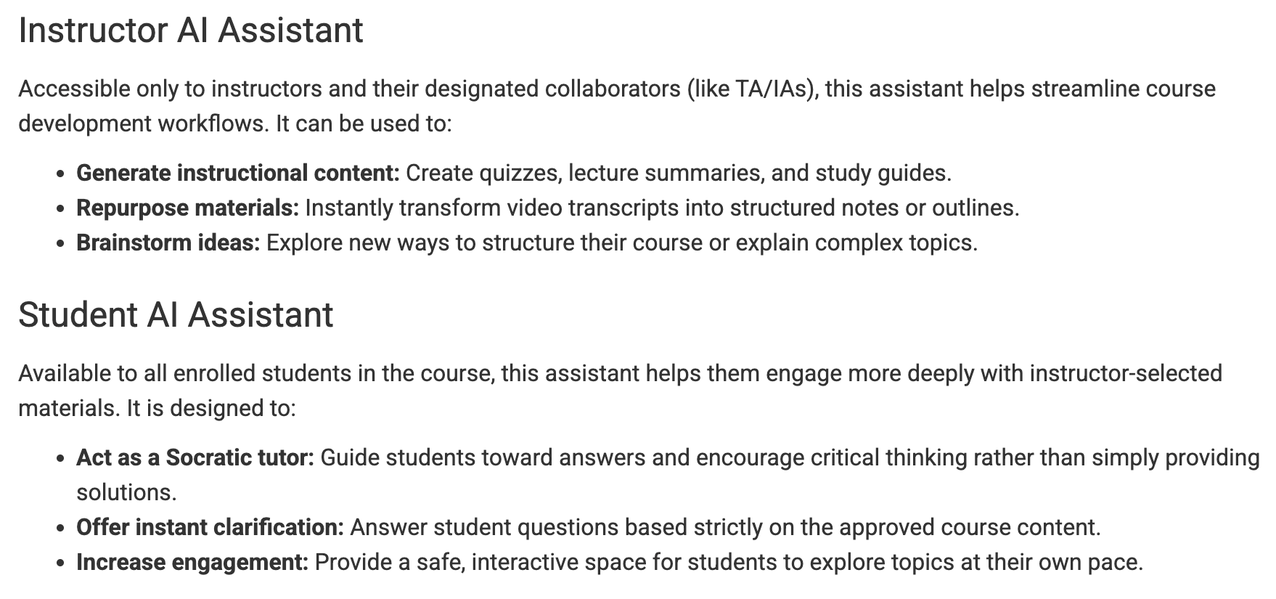
Triton AI Student Assistant Pilot
https://tritonai.ucsd.edu/tritongpt/instruction.html

Slide 53
General Dos and Do NOTs
Do:
Come to lectures in person as much as possible, ask questions, and participate actively in class discussions and PI Activities
Review slides and podcast videos by yourself
Follow all announcements and participate in discussions on Piazza; pitch in to answer peers’ questions
Use “CSE234”/“DSC234” as subject prefix for all emails to me/TAs
Do NOT:
Record anything in class without explicit permission from me and all other participants
Harass, intimidate, or intentionally talk over other students
Violate academic integrity on any graded components

