Slide 1
CSE 132C
Database System Implementation
Arun Kumar
Topic 7: ML for RDBMSs
Optional; NOT included in the syllabus for Final Exam

Slide 2
ML for Systems
Q: Why bother applying ML to well-studied systems issues?
Jeff Dean’s rationales (from NIPS MLSys’17 keynote):
  Hand-crafted heuristics are pervasive but not very adaptive; data-driven ML can improve system metrics
  User-tunable knobs have exploded and are painful
  Hardware has caught up with ML/DL demands; cloud resources are cheap and widely available
  Automated ML simplifies use of ML for systems
Also, cynically: “ML for Systems” is a hot/ controversial topic for publications! May get a lot of (not all wanted) attention! :)
http://learningsys.org/nips17/assets/slides/dean-nips17.pdf

Slide 3
ML for Systems
http://learningsys.org/nips17/assets/slides/dean-nips17.pdf

Slide 4
ML for Systems
http://learningsys.org/nips17/assets/slides/dean-nips17.pdf

Slide 5
ML for Systems
http://learningsys.org/nips17/assets/slides/dean-nips17.pdf

Slide 6
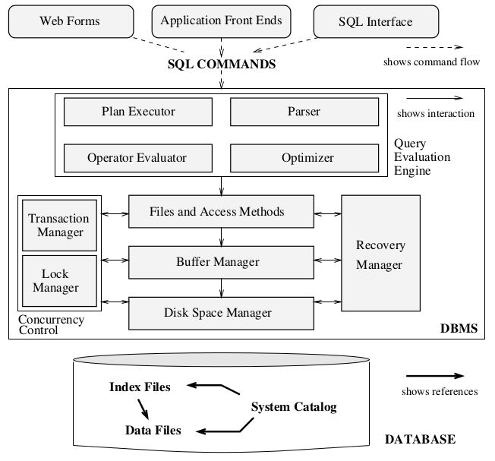
ML for an RDBMS
Q: Where is ML potentially helpful in an RDBMS?
Natural language
interfaces (NLIs)
Learned Query Processing and Query Optimization
Learned Access Methods
Learned Caching and Scheduling Policies
ML for Knob Tuning and
Resource Management

Slide 7
ML for Knob Tuning/Resource Mgmt
Motivation: Modern RDBMSs have 100s of config parameters (buffers for EMS, degree of parallelism, etc.)
  Mixture of continuous and discrete parameters
  Effects on query latency, etc. can be non-monotonic
  Optimal settings highly dependent on schema properties, database instance, hardware, auxiliary data structures, and query workload properties
  Impossible for DBAs to keep up, esp. cloud
Why ML? Adapt quickly to instance/query workload/etc.; target flexibility (latency/utilization/etc.); can be more accurate
“Autonomous”/“Self-driving” are the industry buzzwords

Slide 8
Example
https://www.cs.cmu.edu/~pavlo/papers/p1009-van-aken.pdf

Slide 9
Natural Language Interfaces (NLIs)
Motivation: SQL is too hard for non-technical business users (sales, marketing, etc.) and lay public
  NLIs allow more people to exploit relational databases
  No need to learn complex syntax or even schema details
  Regular conversational style interactions
Why ML? State-of-the-art in natural language processing (NLP) is DL-based; pure parsing/rule-based is too brittle
  Extremely challenging to automatically infer both structure and literals from NL query to translate to proper SQL!
  AFAIK, no robust open-domain commercial system today

Slide 10
Example
https://arxiv.org/pdf/1804.00401.pdf

Slide 11
Learned Scheduling/Caching Policies
Motivation: Existing heuristic policies may not exploit data/query distributions well and thus waste runtime
Why ML? By learning the underlying data/workload distributions, ML can help reduce runtimes/resource wastage
  Learned schedulers: better load balancing to reduce worker idle times to improve utilization and/or latency
  Learned caching/buffering: better retention and eviction decisions to increase cache hits and reduce latency

Slide 12
Examples
http://alexbeutel.com/papers/CIDR2019_SageDB.pdf
https://arxiv.org/pdf/1907.02394.pdf

Slide 13
Learned Access Methods
Motivation: Existing access methods may be wasting some system resources (memory, storage, runtime, etc.) because they do not exploit database instance distributions
Why ML? By learning/approximating the underlying data distributions, ML can help reduce resource demands
  Resource reduction target depends on use-case
  Learned index structures: reduce memory/storage footprint of index, while maintaining or reducing query latency
  Learned compression formats: reduce memory/storage footprint and file I/O time

Slide 14
Examples
https://www.cl.cam.ac.uk/~ey204/teaching/ACS/R244_2018_2019/papers/Kraska_SIGMOD_2018.pdf
https://arxiv.org/pdf/1905.08898.pdf ; https://arxiv.org/pdf/1912.01668.pdf
https://ieeexplore.ieee.org/document/8712659

Slide 15
Learned Query Processing
Motivation: Existing phy. op. impl. are not exploiting database instance distributions well; can save some runtime or improve runtime predictability by doing so
Why ML? By learning/approximating the underlying data distributions, ML can reduce runtimes/improve accuracy
  Learned sorting: the closer the distribution is to pre-sorted, the less time we can spend on sorting
  Learned joins: learn the distribution and location of the join attributes to reduce hash look up and/or sorting needs
  Learned query plans: Improve runtime predictability

Slide 16
Examples
http://alexbeutel.com/papers/CIDR2019_SageDB.pdf
http://www.vldb.org/pvldb/vol12/p1733-marcus.pdf

Slide 17
Learned Query Optimizers
Motivation: Existing optimizers have many heuristics (join orders, plan selection, cardinality estimation, etc.)
Why ML? By learning/approximating the underlying data distributions, ML can reduce runtimes for final plan
  Learned join order: Use join attribute distribution info and reinforcement learning to figure better join orders
  Learned plan rewrites: Use database instance properties and attribute distributions to rewrite plans

Slide 18
Examples
http://www.vldb.org/pvldb/vol12/p1705-marcus.pdf
https://arxiv.org/pdf/1808.03196.pdf

Slide 19
Takeaways: ML for RDBMSs
Many parts of the RDBMS stack may benefit from ML/DL
ML for Knob Tuning and Resource Management
Natural language interfaces (NLIs)
Learned Caching/Scheduling Policies
Learned Access Methods
Learned Query Processing/Optimization
…
Apart from above, note that ML is already common in other data systems settings: data integration, data cleaning, etc.
Data systems will keep evolving due to evolution of hardware, cloud, and ML capabilities; stay informed of latest research!

