Slide 1
CSE 132C
Database System Implementation
Arun Kumar
Topic 6: Parallel RDBMSs and Dataflow Systems
Chapter 22 till 22.5 of Cow Book; extra references listed

Slide 2
Outline
Parallel RDBMSs
Cloud-Native RDBMSs
Beyond RDBMSs: A Brief History
“Big Data” Systems aka Dataflow Systems

Slide 3
Parallel DBMSs: Motivation
Scalability: Database is too large for a single node’s disk
Performance: Exploit multiple cores/disks/nodes
… while maintaining almost all other benefits of (R)DBMSs!

Slide 4
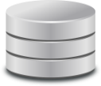
Three Paradigms of Parallelism
Data/Partitioned Parallelism
Contention
Interconnect
Contention
Interconnect
Interconnect
Shared-Disk Parallelism
Shared-Memory Parallelism
Shared-Nothing Parallelism
Symmetric Multi-Processing (SMP)
Massively Parallel
Processing (MPP)

Slide 5
Shared-Nothing Parallelism
Followed by almost all parallel RDBMSs (and “Big Data” sys.)
1 manager node orchestrates multiple worker nodes
Need partitioned parallel implementations of all the relational operators we saw, parallel query proc., parallelism-aware QO
Q: If we give 10 workers (CPUs/nodes) for processing a query in parallel, will its runtime go down by a factor of 10?
It depends!
(Access patterns of the query’s operators, communication
of intermediate data, relative startup overhead, etc.)

Slide 6
Shared-Nothing Parallelism
Runtime speedup (fixed data size)
Runtime speedup
12
2
Linear Speedup
8
Linear Scaleup
1
4
Sublinear
Scaleup
0.5
Sublinear
Speedup
1
1
4
8
12
1
4
8
12
Number of workers
Factor (# workers, data size)
Speedup plot / Strong scaling
Scaleup plot / Weak scaling
Q: Is superlinear speedup/scaleup possible?

Slide 7
Shared-Nothing Parallelism: Outline
Data Partitioning
Parallel Operator Implementations
Parallel Query Optimization
Parallel vs “Distributed” DBMSs

Slide 8
Data Partitioning
A part of ETL (Extract-Transform-Load) for database
Typically, record-wise/horizontal partitioning (aka “sharding”)
Three common schemes (given k machines):
  Round-robin: assign tuple i to machine i MOD k
  Hashing-based: needs partitioning attribute(s)
  Range-based: needs ordinal partitioning attribute(s)
Tradeoffs: Round-robin makes all queries touch all workers; hashing-based and range-based for range queries can target workers better but can face skew; hashing-based most common
Replication often used for more availability, performance

Slide 9
Parallel Scans and Select
Intra-operator parallelism is our primary focus
  Inter-operator and inter-query parallelism also possible
Filescan:
  Trivial; worker simply scans its partition and streams it
  Apply selection predicate (if any)
Indexed:
  Depends on data partitioning scheme and predicate
  Same tradeoffs: Hash index vs. B+ Tree index
  Each worker can have its own (sub-)index
  Manager routes query based on matching workers

Slide 10
Parallel Sorting
Naive algorithm:
  Each worker sorts local partition (EMS)
  Manager merges all locally sorted runs
  Issue: Parallelism is limited during merging phase!
Faster algorithm:
  Scan in parallel and range partition data (most likely a repartitioning) based on SortKey
  Each worker sorts local allotted range (EMS); result is globally sorted and conveniently range-partitioned
  Potential Issue: Skew in range partitions; handled by roughly estimating distribution using sampling

Slide 11
Parallel Sorting
Original Partitions
Range-partitioned
Globally Sorted
Assign SortKey
Range splits
Manager
Manager
Manager
Local
EMS
Worker 1
V1
to
V2
Worker 1
V1
to
V2
Worker 1
V1
to
V2
Worker 2
V2
to
V3
Worker 2
V2
to
V3
Worker 2
V2
to
V3
…
…
…
Worker n
Vn-1
to
Vn
Worker n
Vn-1
to
Vn
Worker n
Vn-1
to
Vn
Re-partitioning

Slide 12
Parallel Aggregates and Group By
Without Group By List:
  Trivial for MAX, MIN, COUNT, SUM, AVG (why?)
  MEDIAN requires parallel sorting (why?)
With Group By List:
  If AggFunc allows, pre-compute partial aggregates
  Manager assigns each worker a set of groups (hash partition)
  Each worker communicates its partial aggregate for a group to that group’s assigned worker (aka “shuffle”)
  Each worker finishes aggregating for all its assigned groups

Slide 13
Parallel Group By Aggregate
Original
Partitions
Partial
Aggs
Re-partitioned
Partial Aggs
Final
Aggs
Assign
GroupingList
Hash splits
Local
GrpBY
Again
Manager
Manager
Manager
Manager
Local
GrpBY
Worker 1
Worker 1
Worker 1
Worker 1
G1
G1
G1
Worker 2
Worker 2
Worker 2
Worker 2
G2
G2
G2
…
…
…
…
Worker n
Worker n
Worker n
Worker n
Gn
Gn
Gn
Re-partitioning

Slide 14
Parallel Project
Non-deduplicating Project:
  Trivial; pipelined with Scans/Select
Deduplicating Project:
  Each worker deduplicates its partition on ProjectionList
  If estimated output size is small (catalog?), workers communicate their results to Manager to finish dedup.
  If estimated output size is too large for Manager’s disk, similar algorithm as Parallel Aggregate with Group By, except, there is no AggFunc computation

Slide 15
Parallel Nested Loops Join
Given two tables A and B and JoinAttribute for equi-join
  Manager assigns range/hash splits on JoinAttribute to workers
  Repartitioning of A and B separately using same splits on JoinAttribute (unless pre-partitioned on it!)
  Worker i applies BNLJ locally on its partitions Ai and Bi
  Overall join output is just collection of all n worker outputs
If join is not equi-join, there might be a lot of communication between workers; worst-case: all-to-all for cross-product!

Slide 16
Parallel “Split” and “Merge” for Joins
Repartitioning quite common for parallel (equi-)joins
Functionality abstracted as two new physical operators:
  Split: each worker sends a subset of its partition to another worker based on Manager’s command (hash/range)
  Merge: each worker unions subsets sent to it by others and constructs its assigned (re)partitioned subset
Useful for parallel BNLJ, Sort-Merge Join, and Hash Join

Slide 17
Parallel Sort-Merge and Hash Join
For SMJ, split is on ranges of (ordinal) JoinAttribute; for HJ, split is on hash function over JoinAttribute
Worker i does local join of Ai and Bi using SMJ or HJ

Slide 18

Improved Parallel Hash Join
2-phase parallel HJ to improve performance
Idea: Previous version hash partitions JoinAttribute to n (same as # workers); instead, decouple the two and do a 2-stage process: partition phase and join phase
Partition Phase: Say |A| < |B|; divide A and B into k (can be > n) partitions using h1() s.t. each F x |Ai| < Cluster RAM
Join Phase: Repartition an Ai into n partitions using h2(); build hash table on new Aij at worker j as tuples arrive; repartition Bi using h2(); local HJ of Aij and Bij on worker j in parallel for j = 1 to n; repeat all these steps for each i = 1 to k
Uses all n workers for join of each subset pair

Slide 19
Parallel Query Optimization
Far more complex than single-node QO!
I/O cost, CPU cost, and communication cost for each phy. op.
Space of PQPs explodes: each node can have its own different local sub-plan (e.g., filescan vs. indexed)
Pipeline parallelism and partitioned parallelism can be interleaved in complex ways
Join order enumeration affected: bushy trees can become better!
… (we will skip more details)

Slide 20
Outline
Parallel RDBMSs
Cloud-Native RDBMSs
Beyond RDBMSs: A Brief History
“Big Data” Systems aka Dataflow Systems

Slide 21
Cloud Computing
Compute, storage, memory, networking are virtualized and exist on remote servers; rented by application users
  Manageability: Managing hardware is not user's problem!
  Pay-as-you-go: Fine-grained pricing economics based on actual usage (granularity: seconds to years!)
  Elasticity: Can dynamically add or reduce capacity based on actual workload’s demand
Infrastructure-as-a-Service (IaaS); Platform-as-a-Service (PaaS); Software-as-a-Service (SaaS)

Slide 22
Cloud Computing
Q: How to redesign a parallel RDBMS to best exploit the cloud’s capabilities?

Slide 23
Revisiting Parallelism in the Cloud
Interconnect
Networks have become much faster: 100GbE to even TbE!
Interconnect
Such bundling could under-utilize some resources
Shared-Disk Parallelism
Shared-Nothing Parallelism
Q: How to exploit cloud’s virtualization of compute, memory, and storage resources to improve speed and utilization?

Slide 24
Revisiting Parallelism in the Cloud
The promise of full serverless / resource disaggregation:
All resources (compute, memory, storage) are network-attached and can be elastically added/removed
Get more memory for some phy. ops.
Get more CPUs to better parallelize aggregates
Interconnect
Q: How to fulfill the promise with minimal added latency?

Slide 25
Cloud-Native Parallel RDBMSs
Many cloud vendors, traditional RDBMS companies, startups
Not just running a regular parallel RDBMS on IaaS!
  Higher levels (data model, SQL, parser, etc.) preserved
  Need to revisit, redesign, and reimplement all internals: storage subsystem, memory management, query processing and optimization, transaction management, and more

Slide 26
Key Example:
Shared-disk style
+ elastic compute
Each virtual warehouse is an independent MPP compute cluster
Compressed
columnar format
https://docs.snowflake.net/manuals/user-guide/intro-key-concepts.html#snowflake-architecture

Slide 27
Outline
Parallel RDBMSs
Cloud-Native RDBMSs
Beyond RDBMSs: A Brief History
“Big Data” Systems aka Dataflow Systems

Slide 28
Beyond RDBMSs: A Brief History
Relational model and RDBMSs are too restrictive:
  1. “Flat” tables with few data/attribute types
  2. Restricted language interface (SQL)
  3. Need to know schema first
  4. Optimized for static dataset
Object-Relational DBMSs: UDT, UDFs, text, multimedia, etc.
PL/SQL; recursive SQL; embedded SQL; QBE; visual interfaces
“Schema-later” semi-structured: XML+XQuery; JSON; YAML
Stream data model; “standing” queries; time windows
But the DB community has addressed these issues already!
Ad: Take DSC 104; CSE 132B; CSE 135 on these DB capabilities

Slide 29
So, why did people still need to look beyond RDBMSs?

Slide 30

Beyond RDBMSs: A Brief History
DB folks got blindsided by the rise of Web/Internet giants
4 new concerns of Web giants vs RDBMSs built for enterprises:
  Developability: Custom data models and computations hard to program on SQL/RDBMSs; need for simpler APIs
  Fault Tolerance: Need to scale to 1000s of machines; need for graceful handling of worker failure
  Elasticity: Need to be able to easily upsize or downsize cluster size based on workload
  Cost: Commercial RDBMSs licenses too costly; hired own software engineers to build custom new systems

Slide 31
A new breed of parallel data systems called Dataflow Systems jolted the DB folks from being smug and complacent!

Slide 32
Outline
Parallel RDBMSs
Cloud-Native RDBMSs
Beyond RDBMSs: A Brief History
“Big Data” Systems aka Dataflow Systems
  MapReduce/Hadoop
  Spark

Slide 33
“Big Data”
Marketing term; think “Big” as in “Big Oil” or “Big Government”, not “big building” or “big car”
Wikipedia says: “Data that is so large and complex that existing toolkits [read RDBMSs!] are not adequate [hah!]”
Typical characterization by 3 Vs:
Volume: larger-than-RAM; >= TBs, even Exabytes!
Variety: relations, webpages, docs, tweets, multimedia, etc.
Velocity: high generation rate, e.g., sensors, surveillance, etc.

Slide 34
Why “Big Data” now? 1. Applications
New “data-driven mentality” in almost all applications:
Web: search, e-commerce, e-mails, social media
Science: satellite imagery, CERN’s LHC, document corpora
Medicine: pharmacogenomics, precision medicine
Logistics: sensors, GPS, “Internet of Things”
Finance: high-throughput trading, monitoring
Humanities: digitized books/literature, social media
Governance: e-voting, targeted campaigns, NSA ☺
…

Slide 35
Why “Big Data” now? 2. Storage

Slide 36
Outline
Parallel RDBMSs
Cloud-Native RDBMSs
Beyond RDBMSs: A Brief History
“Big Data” Systems aka Dataflow Systems
  MapReduce/Hadoop
  Spark

Slide 37
What is MapReduce?
A programming model for parallel programs on sharded data + distributed system architecture
Map and Reduce are terms from functional PL; software/data/ML engineer implements logic of Map, Reduce
System handles data distribution, parallelization, fault tolerance, etc. under the hood
Created by Google to solve “simple” data workload: index, store, and search the Web!
Google’s engineers started with MySQL! Abandoned it due to reasons listed earlier (developability, fault tolerance, elasticity, etc.)
https://static.googleusercontent.com/media/research.google.com/en//archive/mapreduce-osdi04.pdf

Slide 38
What is MapReduce?
Standard example: count word occurrences in a doc corpus
Input: A set of text documents (say, webpages)
Output: A dictionary of unique words and their counts
function map (String docname, String doctext) :
for each word w in doctext :
emit (w, 1)
Hmmm, sounds suspiciously familiar! :)
Part of MapReduce API
function reduce (String word, Iterator partialCounts) :
sum = 0
for each pc in partialCounts :
sum += pc
emit (word, sum)

Slide 39
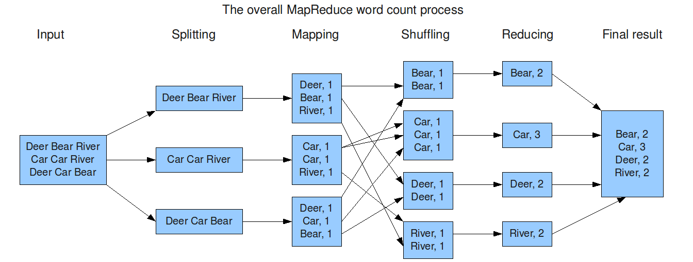
How MapReduce Works
Parallel flow of control and data during MapReduce execution:
Under the hood, each Mapper and Reducer is a separate process; Reducers face barrier synchronization (BSP)
Fault tolerance achieved using data replication

Slide 40
Benefits and Catch of MapReduce
Goal: High-level functional ops to simplify data-intensive programs
Key Benefits:
  Map() and Reduce() are highly general; any data types/structures; great for ETL, text/multimedia
  Native scalability, large cluster parallelism
  System handles fault tolerance automatically
  Decent FOSS stacks (Hadoop and later, Spark)
Catch: Users must learn “art” of casting program as MapReduce
  Map operates record-wise; Reduce aggregates globally
  But MR libraries now available in many PLs: C/C++, Java, Python, R, Scala, etc.

Slide 41
Abstract Semantics of MapReduce
Map(): Process one “record” at a time independently
  A record can physically batch multiple data examples/tuples
  Dependencies across Mappers not allowed
  Emit 1 or more key-value pairs as output(s)
  Data types of input vs. output can be different
Reduce(): Gather all Map outputs across workers sharing same key into an Iterator (list)
  Apply aggregation function on Iterator to get final output(s)
Input Split:
  Physical-level shard to batch many records to one file “block” (HDFS default: 128MB?)
  User/application can create custom Input Splits

Slide 42
Emulate MapReduce in SQL?
Q: How would you do the word counting in RDBMS / in SQL?
First step: Transform text docs into relations and load:
Part of the ETL stage
  Suppose we pre-divide each doc into words w/ schema:
    DocWords (DocName, Word)
Second step: a single, simple SQL query!
SELECT Word, COUNT (*)
FROM DocWords
GROUP BY Word
[ORDER BY Word]
Parallelism, scaling, etc. done
by RDBMS under the hood

Slide 43
More MR Examples: Select Operation
Input Split:
  Shard table tuple-wise
Map():
  On tuple, apply selection condition; if satisfies, emit KV pair with dummy key, entire tuple as value
Reduce():
  Not needed! No cross-shard aggregation here
These kinds of MR jobs are called “Map-only” jobs

Slide 44
More MR Examples: Simple Agg.
Suppose it is algebraic aggregate (SUM, AVG, MAX, etc.)
Input Split:
  Shard table tuple-wise
Map():
  On agg. attribute, compute incr. stats; emit pair with single global dummy key and incr. stats as value
Reduce():
  Since only one global dummy key, Iterator has all suff. stats to unify into global agg.

Slide 45
More MR Examples: GROUP BY Agg.
Assume it is algebraic aggregate (SUM, AVG, MAX, etc.)
Input Split:
  Shard table tuple-wise
Map():
  On agg. attribute, compute incr. stats; emit pair with grouping attribute as key and stats as value
Reduce():
  Iterator has all suff. stats for a single group; unify those to get result for that group
  Different reducers will output different groups’ results

Slide 46
More MR Examples: Matrix Norm
Assume it is algebraic aggregate (Lp,q norm)
Very similar to simple SQL aggregates
Input Split:
  Shard table tuple-wise
Map():
  On agg. attribute, compute incr. stats; emit pair with single global dummy key and stats as value
Reduce():
  Since only one global dummy key, Iterator has all suff. stats to unify into global agg.

Slide 47

What is Hadoop then?
FOSS system implementation with MapReduce as prog. model and HDFS as filesystem
MR user API; input splits, data distribution, shuffling, fault tolerances handled by Hadoop under the hood
Exploded in popularity in 2010s: 100s of papers, 10s of products
A “revolution” in scalable+parallel data processing that took the DB world by surprise
But nowadays Hadoop largely supplanted by Spark
NB: Do not confuse MR for Hadoop or vice versa!

Slide 48
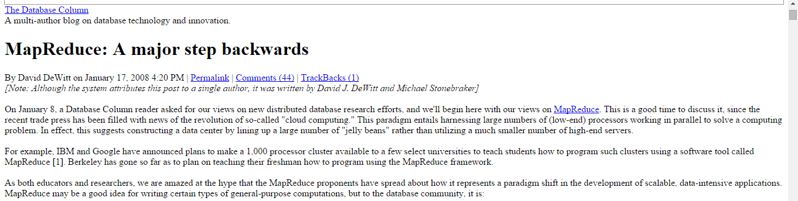


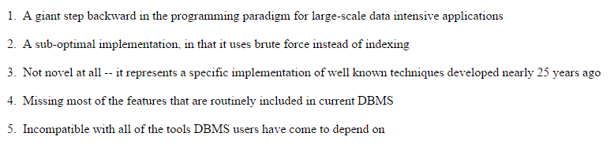
A Spectacular “War of the Worlds”
No declarativity!
Filescan-based!
DeWitt’s work on parallel DBMSs!
Cheap rip-off of RDBMSs!

Slide 49
“Young Turks” vs. “Old Guard”?
Swift and scathing rebuttal from MapReduce/Hadoop world!
DBMSs too high-level/hard to use for low-level text ETL
Meant for “offline” fault-tolerant workloads on cheap nodes
Google awarded a patent for MapReduce (ahem)!
MapReduce/Hadoop not meant to be an RDBMS replacement

Slide 50


Enter Hybrid Systems!
Clever DB researches: “Let’s get the best of both worlds!”
Numerous projects on hybrid systems in industry/academia:
Programming model-level: Bring declarativity from RDBMS world to MapReduce/Hadoop world
SQL dialect
over Hadoop
Dataflow language
over Hadoop
Systems-level: Intermix system implementation ideas
HadoopDB from Yale U.
Microsoft
Polybase

Slide 51
Parallel Data Systems
Parallel RDBMSs
Cloud-Native RDBMSs
Beyond RDBMSs: A Brief History
“Big Data” Systems aka Dataflow Systems
  MapReduce/Hadoop
  Spark

Slide 52

Apache Spark
Dataflow programming model (subsumes most of RA; MR)
  Inspired by Python Pandas style of chaining functions
  Unified storage of relations, text, etc.; custom programs
  System impl. (re)designed from scratch
Tons of sponsors, gazillion bucks, unbelievable hype!
Key idea vs. Hadoop: exploit distributed memory to cache data
Key novelty vs. Hadoop: lineage-based fault tolerance
Open-sourced to Apache; commercialized as Databricks

Slide 53
Distributed Architecture of Spark
https://spark.apache.org/docs/latest/cluster-overview.html

Slide 54
Spark’s Dataflow Programming Model
Transformations are relational ops, MR, etc. as functions
Actions are what force computation; aka lazy evaluation
Resilient Distributed Datasets: A Fault-tolerant Abstraction for In-memory Cluster Computing. In NSDI 2012

Slide 55
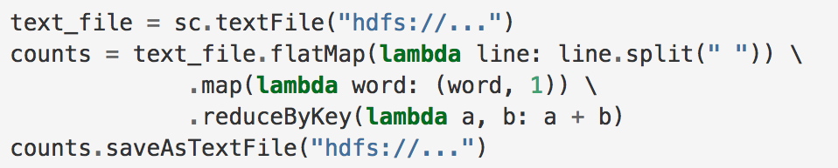
Word Count Example in Spark
Spark RDD API available in Python, Scala, Java, and R
Spark DataFrame API of SparkSQL offers an SQL interface
Can also interleave SQL with DF-style function chaining!
Ad: Take Yoav’s CSE 255 to learn more Spark programming

Slide 56
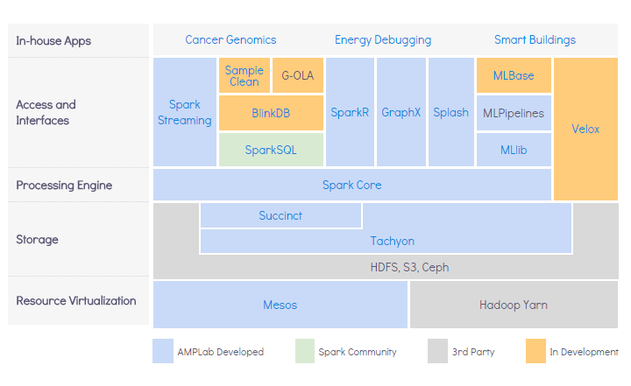
Spark-based Ecosystem of Tools
The Berkeley Data Analytics Stack (BDAS)

Slide 57
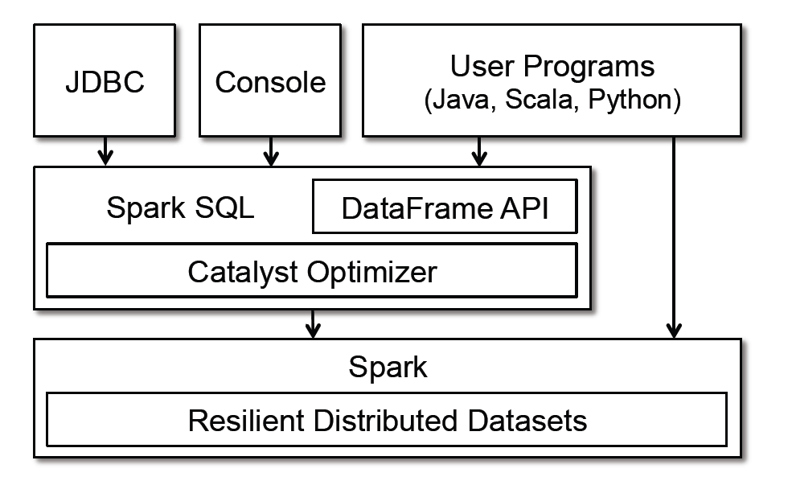
Spark DF API and SparkSQL
Databricks now recommends SparkSQL/DataFrame API; avoid RDD API unless really needed!
Key Reason: Automatic query optimization becomes more feasible
  AKA (painfully) re-learn 40 years of database systems research! :)
Spark SQL: Relational Data Processing in Spark. In SIGMOD 2015.

Slide 58
Query Optimization in Spark
Common automatic query optimizations (from RDBMS world) are now performed in Spark’s Catalyst optimizer:
Projection pushdown:
  Drop unneeded columns early on
Selection pushdown:
  Apply predicates close to base tables
Join order optimization:
  Not all joins are equally costly
Fusing of aggregates
…
Spark SQL: Relational Data Processing in Spark. In SIGMOD 2015.

Slide 59
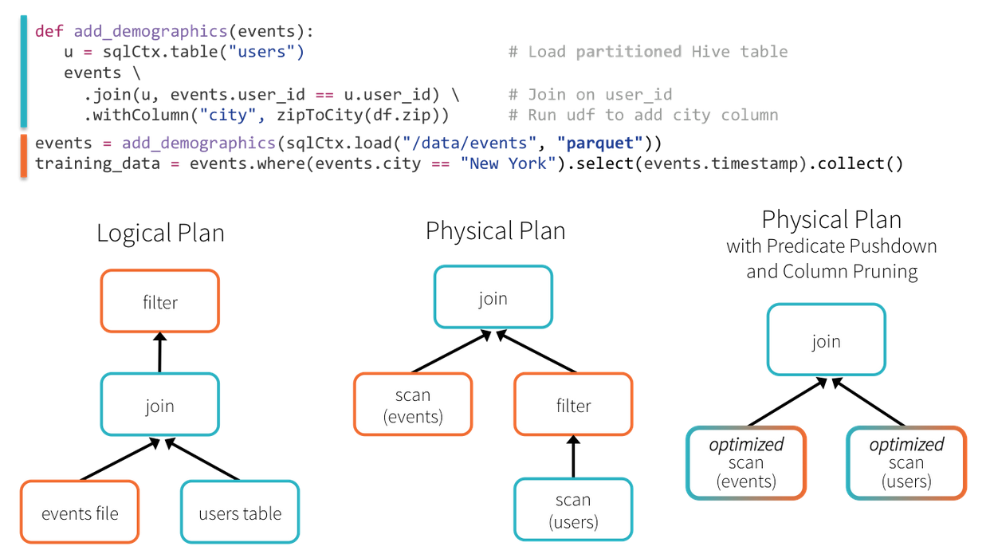
Query Optimization in Spark
Databricks is building yet another parallel RDBMS! :)
Spark SQL: Relational Data Processing in Spark. In SIGMOD 2015.

Slide 60
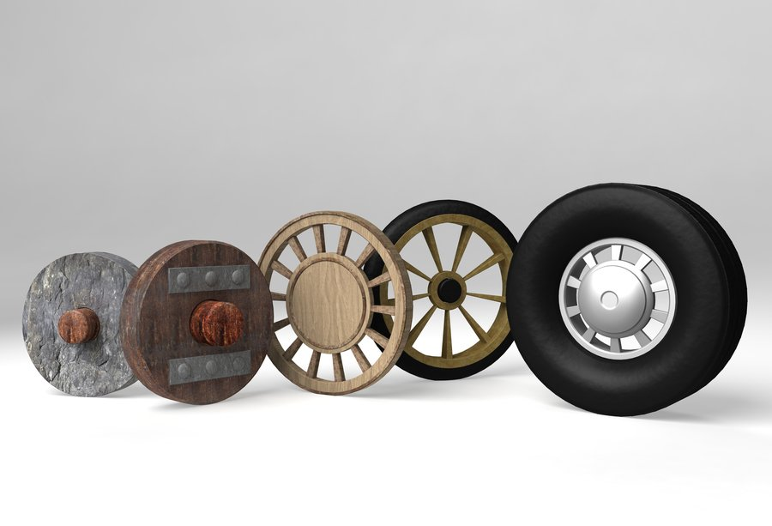
Reinventing the Wheel?

Slide 61
New Paradigm of Data “Lakehouse”
Data “Lake”: Loose coupling of data file format and data/query processing stack (vs. RDBMS’s tight coupling); many frontends
If interested, check out this vision paper on the future of data lakes and data lakehouses:
http://cidrdb.org/cidr2021/papers/cidr2021_paper17.pdf

Slide 62
… which too is a form of DBMS! :)

Slide 63
References and More Material
MapReduce/Hadoop:
  MapReduce: Simplified Data Processing on Large Clusters. Jeffrey Dean and Sanjay Ghemawat. In OSDI 2004.
  More Examples: http://bit.ly/2rkSRj8
  Online Tutorial: http://bit.ly/2rS2B5j
Spark:
  Resilient Distributed Datasets: A Fault-tolerant Abstraction for In-memory Cluster Computing. Matei Zaharia and others. In NSDI 2012.
  More Examples: http://bit.ly/2rhkhEp, http://bit.ly/2rkT8Tc
  Online Guide: https://spark.apache.org/docs/2.1.0/sql-programming-guide.html

Slide 64
Parallel Data Systems
Parallel RDBMSs
Cloud-Native RDBMSs
Beyond RDBMSs: A Brief History
“Big Data” Systems aka Dataflow Systems
  MapReduce/Hadoop
  Spark

