Slide 1
CSE 132C
Database System Implementation
Arun Kumar
Topic 4: Query Processing; Operator Implementation
Chapters 12.1-12.3 and 14 of Cow Book
Slide ACKs: Jignesh Patel

Slide 2

Lifecycle of a Query
Query Result
Query
Database Server
Query
Scheduler
Parser
Optimizer
Select R.text from
Report R, Weather W
where W.image.rain()
and W.city = R.city
and W.date = R.date
and
R.text.
matches(“insurance claims”)
Execute
Operators
|…|……|………..|………..|
|…|……|………..|………..|
|…|……|………..|………..|
|…|……|………..|………..|
|…|……|………..|………..|
|…|……|………..|………..|
|…|……|………..|………..|
|…|……|………..|………..|
|…|……|………..|………..|
|…|……|………..|………..|
|…|……|………..|………..|
Query
Syntax Tree and
Logical Query Plan
Physical
Query Plan
Query
Result
Segments

Slide 3
Recall the Netflix Schema
Ratings
RatingID | Stars | RateDate | UID | MID
1 | 3.5 | 08/27/15 | 79 | 20
… | … | … | … | …
UID | Name | Age | JoinDate
79 | Alice | 23 | 01/10/13
80 | Bob | 41 | 05/10/13
Users
Movies
MID | Name | Year | Director
20 | Inception | 2010 | Christopher Nolan
16 | Avatar | 2009 | Jim Cameron

Slide 4
Example SQL Query
RatingID | Stars | RateDate | UID | MID
UID | Name | Age | JoinDate
MID | Name | Year | Director
SELECT M.Year, COUNT(*) AS NumBest
FROM Ratings R, Movies M
WHERE R.MID = M.MID
AND R.Stars = 5
GROUP BY M.Year
ORDER BY NumBest DESC
Suppose, we also have a B+Tree Index on Ratings (Stars)

Slide 5
Logical Query Plan
Result Table
SORT
On NumBest
Called “Logical”
Operators
GROUP BY AGGREGATE
M.Year, COUNT(*)
From extended RA
Each one has alternate “physical”
implementations
JOIN
R.MID = M.MID
SELECT
R.stars = 5
SELECT
No predicate
Ratings Table
Movies Table

Slide 6
Physical Query Plan
Result Table
External Merge-Sort
In-mem quicksort; B=50
Called “Physical”
Operators
Hash-based Aggregate
Specifies exact algorithm/code to run for each logical operator, with all parameters (if any)
Index-Nested Loop Join
Indexed Access
Use Index on Stars
File Scan
Read heapfile
This is one of many
physical plans possible for a query!
Ratings Table
Movies Table

Slide 7
Logical-Physical Separation in DBMSs
Logical = Tells you “what” is computed
Physical = Tells you “how” it is computed
Declarativity!
Declarative “querying” (logical-physical separation) is a
key system design principle from the RDBMS world:
Declarativity often helps improve user productivity
Enables behind-the-scenes performance optimizations
People are still (re)discovering the importance of this key system design principle in diverse contexts…
(MapReduce/Hadoop, networking, file system checkers, interactive data-vis, graph systems, large-scale ML, etc.)

Slide 8
Operator Implementations
Select
Project
Join
Set Operations
Group By Aggregate
Need scalability to larger-than-memory (on-disk) datasets and
high performance at scale!

Slide 9
But first, what metadata does the RDBMS have?

Slide 10
System Catalog
Set of pre-defined relations for metadata about DB (schema)
For each Relation:
Relation name, File name
File structure (heap file vs. clustered B+ tree, etc.)
Attribute names and types; Integrity constraints; Indexes
For each Index:
Index name, Structure (B+ tree vs. hash, etc.); IndexKey
For each View:
View name, and View definition

Slide 11
Statistics in the System Catalog
RDBMS periodically collects stats about DB (instance)
For each Table R:
Cardinality, i.e., number of tuples, NTuples (R)
Size, i.e., number of pages, NPages (R), or just N_{R} or N
For each Index X:
Cardinality, i.e., number of distinct keys IKeys (X)
Size, i.e., number of pages IPages (X) (for a B+ tree, this
    is the number of leaf pages only)
Height (for tree indexes) IHeight (X)
Min and max keys in index ILow (X), IHigh (X)

Slide 12
Operator Implementations
Select
Project
Join
Set Operations
Group By Aggregate
Need scalability to larger-than-memory (on-disk) datasets and
high performance at scale!

Slide 13

Selection: Access Path
Access path: how exactly is a table read (“accessed”)
Two common access paths:
  File scan:
  Read the heap/sorted file; apply SelectCondition
  I/O cost: O(N)
  Indexed:
  Use an index that matches the SelectCondition
  I/O cost: Depends! For equality check, O(1) for hash index, and O(log(N)) for B+-tree index

Slide 14
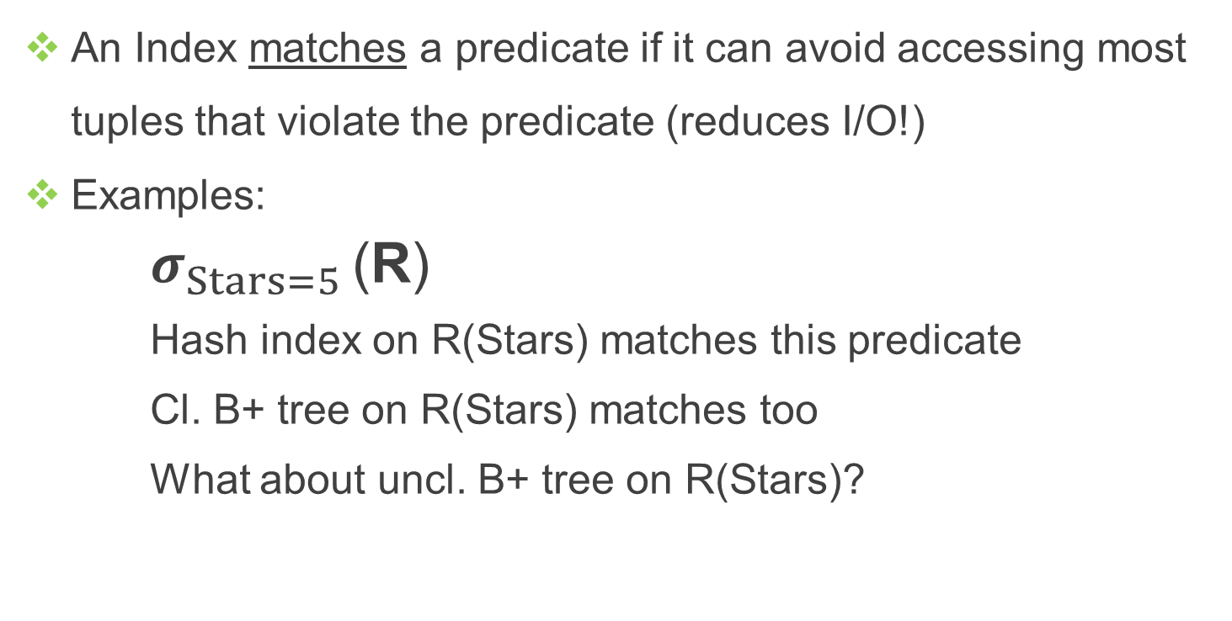
Indexed Access Path
R
RatingID | Stars | RateDate | UID | MID

Slide 15



Selectivity of a Predicate
Selectivity of SelectionCondition = percentage of number of tuples in R satisfying it (in practice, count pages, not tuples)
R
RatingID | Stars | RateDate | UID | MID
2 | 3.0 | … | … | …
39 | 5.0 | … | … | …
12 | 2.5 | … | … | …
402 | 5.0 | … | … | …
293 | 2.5 | … | … | …
49 | 1.0 | … | … | …
66 | 2.5 | … | … | …
Selectivity = 2/7 ~ 28%
Selectivity = 3/7 ~ 43%
Selectivity = 1/7 ~ 14%

Slide 16
Selectivity and Matching Indexes
An Index matches a predicate if it brings I/O cost very close to (N * predicate’s selectivity); compare to file scan!
R
RatingID | Stars | RateDate | UID | MID
2 | 3.0 | … | … | …
39 | 5.0 | … | … | …
12 | 2.5 | … | … | …
402 | 5.0 | … | … | …
293 | 2.5 | … | … | …
49 | 1.0 | … | … | …
66 | 2.5 | … | … | …
N x Selectivity = 2
Hash index on R(Stars)
Cl. B+ tree on R(Stars)
Uncl. B+ tree on R(Stars)?
Assume only one tuple per page

Slide 17

Matching an Index: More Examples
R
RatingID | Stars | RateDate | UID | MID
Hash index on R(Stars) does not match! Why?
Cl. B+ tree on R(Stars) still matches it! Why?
Cl. B+ tree on R(Stars,RateDate)?
Cl. B+ tree on R(Stars,RateDate,MID)?
Cl. B+ tree on R(RateDate,Stars)?
Uncl. B+ tree on R(Stars)?
B+ tree has a
nice “prefix-match”
property!

Slide 18

Prefix Matching for CNF Predicates
Express SelectionCondition in Conjunctive Normal Form (CNF), i.e., Pred1 AND Pred2 AND … (each is a “conjunct”)
Given IndexKey k of B+ tree index, if any prefix subset of k appears in any conjunct, it matches the predicate
Example:
IndexKey (UID, Stars)? (Stars, UID)?
IndexKey (UID, Stars, MID)?
IndexKey (Stars, UID, MID)?
IndexKey (MID, UID, Stars)?
IndexKey UID? IndexKey Stars?
Conjunct is a prefix of IndexKey
IndexKey is a subset of Conjunct:
“Primary Conjunct”

Slide 19
More Examples for Index Matching
R
RatingID | Stars | RateDate | UID | MID
Cl. B+ tree index on R(UID,Stars,MID)?
Cl. B+ tree index on R(Stars,MID,UID)?
Hash index on R(UID,Stars)?
Hash index on R(UID,Stars,MID)?
Hash index on R(Stars,MID,UID)?
Hash index on R(UID)? On R(Stars)?
Hash index does not have the “prefix-match” property of a B+ tree index!
Primary conjuncts!

Slide 20
Matching an Index: Multiple Matches
R
RatingID | Stars | RateDate | UID | MID
Cl. B+ tree index on R(UID,Stars)?
What if we also have an index (hash or tree) on MID?
Multiple indexes match non-identical portions of predicate
We can use both indexes and intersect the sets of RecordIDs!
Sometimes, unions of RecordID sets for disjunctions

Slide 21
Matching an Index: More Examples
Given hash index on <a> and hash index on <b>
Predicate: (a = 7 OR b < 5)
Which index matches?
Given hash index on <a> and cl. B+ tree index on <b>
Predicate: (a = 7 AND b < 5)
Which index matches?
Given hash index on <a> and cl. B+ tree index on <b>
Predicate: (a = 7 OR c > 10) AND (b < 5)
Which index matches?
Neither! Recall CNF!
Both! Can intersect RecordIDs!
Only B+ tree on b

Slide 22
Operator Implementations
Select
Project
Join
Set Operations
Group By Aggregate
Need scalability to larger-than-memory (on-disk) datasets and
high performance at scale!

Slide 23

Project
R
RatingID | Stars | RateDate | UID | MID
SELECT R.MID, R.Stars FROM Ratings R
Trivial to implement! Read R and discard other attributes
I/O cost: N_{R}, i.e., Npages(R) (ignore output write cost)
SELECT DISTINCT R.MID, R.Stars FROM Ratings R
Relational Project!
Need to deduplicate tuples of (MID,Stars) after discarding other attributes; but these tuples might not fit in memory!

Slide 24

Project: 2 Alternative Algorithms
Sorting-based:
    Idea: Sort R on ProjectionList (External Merge Sort!)
    1. In Sort Phase, discard all other attributes
    2. In Merge Phase, eliminate duplicates
    Let T be the temporary “table” after step 1
    I/O cost: NR + NT + EMSMerge(NT)
Hashing-based:
    Idea: Build a hash table on R(ProjectionList)

Slide 25
Hashing-based Project
To build a hash table on R(ProjectionList), read R and discard other attributes on the fly
If the hash table fits entirely in memory:
Done!
I/O cost: N_{R}
If not, 2-phase algorithm:
Partition
Deduplication
Q: What is the size of a hash table built on a P-page file?
Needs B >= F x N_{T}
F x P pages
(“Fudge factor” F ~ 1.4
for overheads)

Slide 26

Original
R
Partitions
of T
Hashing
OUTPUT
1
1
INPUT
hash
func.
h1
2
Assuming uniformity,
size of a T partition
= N_{T} / (B-1)
2
. . .
B-1
B-1
Size of a hash table
on a partition
= F x N_{T} / (B-1)
Disk
B buffer pages
Disk
Partition phase
Partitions
of T
Output
Thus, we need:
(B-2) >= F x NT / (B-1)
hash
func.
h2
Hash table for
partition i
Rough:
h2
I/O cost: N_{R} + N_{T} + N_{T}
Input buffer
for partition i
Output
buffer
If B is smaller, need to partition recursively!
Disk
B buffer pages
Disk
Deduplication phase

Slide 27
Project: Comparison of Algorithms
Sorting-based vs. Hashing-based:
1. Usually, I/O cost (excluding output write) is the same:
      N_{R} + 2N_{T} (why is EMSMerge(NT) only 1 read?)
2. Sorting-based gives sorted result (“nice to have”)
3. I/O could be higher in many cases for hashing (why?)
In practice, sorting-based is popular for Project
If we have any index with ProjectionList as subset of IndexKey
Use only leaf/bucket pages as the “T” for sorting/hashing
If we have tree index with ProjectionList as prefix of IndexKey
  Leaf pages are already sorted on ProjectionList (why?)
    Just scan them in order and deduplicate on-the-fly!

Slide 28
Operator Implementations
Select
Project
Join
Set Operations
Group By Aggregate
Need scalability to larger-than-memory (on-disk) datasets and
high performance at scale!

Slide 29

Join
This course: we focus primarily on equi-join
(the most common, important, and well-studied form of join)
R
RatingID | Stars | RateDate | UID | MID
U
UserID | Name | Age | JoinDate
We study 4 major (equi-) join implementation algorithms:
Page/Block Nested Loop Join (PNLJ/BNLJ)
Index Nested Loop Join (INLJ)
Sort-Merge Join (SMJ)
Hash Join (HJ)

Slide 30
Nested Loop Joins: Basic Idea
“Brain-dead” idea: nested for loops over the tuples of R and U!
For each tuple in Users, t_{U} :
For each tuple in Ratings, t_{R} :
If they match on join attribute, “stitch” them, output
But we read pages from disk, not single tuples!

Slide 31

Page Nested Loop Join (PNLJ)
“Brain-dead” nested for loops over the pages of R and U!
For each page in Users, p_{U} :
For each page in Ratings, p_{R} :
Check each pair of tuples from p_{R} and p_{U}
If any pair of tuples match, stitch them, and output
U is called “Outer table”
R is called “Inner table”
Outer table should be
the smaller one:
I/O Cost:
N_{U} ≤ N_{R}
Q: How many buffer pages are needed for PNLJ?

Slide 32
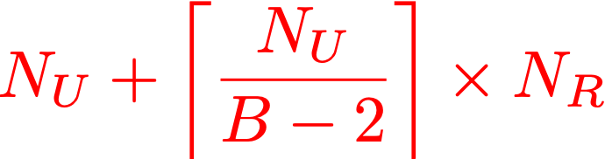
Block Nested Loop Join (BNLJ)
Basic idea: More effective usage of buffer memory (B pages)!
For each sequence of B-2 pages of Users at-a-time :
For each page in Ratings, pR :
Check if any pR tuple matches any U tuple in memory
If any pair of tuples match, stitch them, and output
I/O Cost:
Step 3 (“brain-dead” in-memory all-pairs comparison) could be quite slow (high CPU cost!)
In practice, a hash table is built on the U pages in-memory to reduce #comparisons (how will I/O cost change above?)

Slide 33
Index Nested Loop Join (INLJ)
Basic idea: If there is an index on R or U, why not use it?
Suppose there is an index (tree or hash) on R (UID)
For each sequence of B-2 pages of Users at-a-time :
Sort the U tuples (in memory) on UserID
For each U tuple t_{U} in memory :
Lookup/probe index on R with the UserID of t_{U}
If any R tuple matches it, stitch with t_{U}, and output
I/O Cost: NU + NTuples(U) x IR
Index lookup cost IR depends on index properties (what all?)
A.k.a Block INLJ (tuple/page INLJ are just silly!)
Q: Why does step 2 help? Why not buffer index pages?

Slide 34
Sort-Merge Join (SMJ)
Basic idea: Sort both R and U on join attr. and merge together!
Sort R on UID
Sort U on UserID
Merge sorted R and U and check for matching tuple pairs
If any pair matches, stitch them, and output
I/O Cost: EMS(N_{R}) + EMS(N_{U}) + N_{R} + N_{U}
If we have “enough” buffer pages, an improvement possible:
No need to sort tables fully; just merge all their runs together!

Slide 35

Sort-Merge Join (SMJ)
Basic idea: Obtain runs of R and U and merge them together!
Obtain runs of R sorted on UID (only Sort phase)
Obtain runs of U sorted on UserID (only Sort phase)
Merge all runs of R and U together and check for matching tuple pairs
If any pair matches, stitch them, and output
I/O Cost: 3 x (N_{R} + N_{U})
How many buffer pages needed?
# runs after steps 1 & 2 ~ NR/2B + NU/2B
So, we need B > (NR + NU)/2B
Just to be safe:
N_{U} ≤ N_{R}

Slide 36
Review Questions!
R
RatingID | Stars | RateDate | UID | MID
U
UID | Name | Age | JoinDate
Given tables R and U with N_{R} = 1000, N_{U} = 500, NTuples(R) = 80,000, and NTuples(U) = 25,000. Suppose all attributes are 8 bytes long (except Name, which is 40 bytes). Let B = 400. Let UID be uniformly distributed in R. Ignore output write costs.
What is the I/O cost of projecting R on to Stars (with deduplication)?
What are the I/O costs of BNLJ and SMJ for a join on UID?
What are the I/O costs of BNLJ and SMJ if B = 50 only?
Which buffer replacement policy is best for BNLJ, if B = 800?

Slide 37
Hash Join (HJ)
Basic idea: Partition both on join attr.; join each pair of partitions
Partition U on UserID using h1()
Partition R on UID using h1()
For each partition of Ui :
Build hash table in memory on Ui
Probe with Ri alone and check for matching tuple pairs
If any pair matches, stitch them, and output
N_{U} ≤ N_{R}
U becomes “Inner table”
R is now “Outer table”
I/O Cost: 3 x (N_{U} + N_{R})
This is very similar to the hashing-based Project!

Slide 38

Original U
OUTPUT
Partitions of U
Hash Join
1
1
INPUT
hash
func.
h1
2
Similarly, partition R with same h1 on UID
2
. . .
B-1
N_{U} ≤ N_{R}
B-1
Memory requirement:
B buffer pages
Disk
Partition phase
Disk
(B-2) >= F x NU / (B-1)
Partitions
of U and R
Rough:
Output
hash
func.
h2
Hash table on Ui
I/O cost: 3 x (N_{U} + N_{R})
Q: What if B is lower?
h2
Q: What about skews?
Input buffer
for Ri
Output
buffer
Q: What if N_{U} > N_{R}?
Disk
B buffer pages
Disk
Stitching Phase
“Hybrid” Hash Join algorithm
exploits memory better and has slightly lower I/O cost

Slide 39

Join: Comparison of Algorithms
N_{U} ≤ N_{R}
B buffer pages
Block Nested Loop Join vs Hash Join:
      Identical if (B-2) > F x NU! Why? I/O cost?
      Otherwise, BNLJ is potentially much higher! Why?
Sort Merge Join vs Hash Join:
      To get I/O cost of 3 x (NU + NR), SMJ needs:
      But to get same I/O cost, HJ needs only:
      Thus, HJ is often more memory-efficient and faster
Other considerations:
      HJ could become much slower if data has skew! Why?
      SMJ can be faster if input is sorted; gives sorted output
Query optimizer considers all these when choosing phy. plan

Slide 40
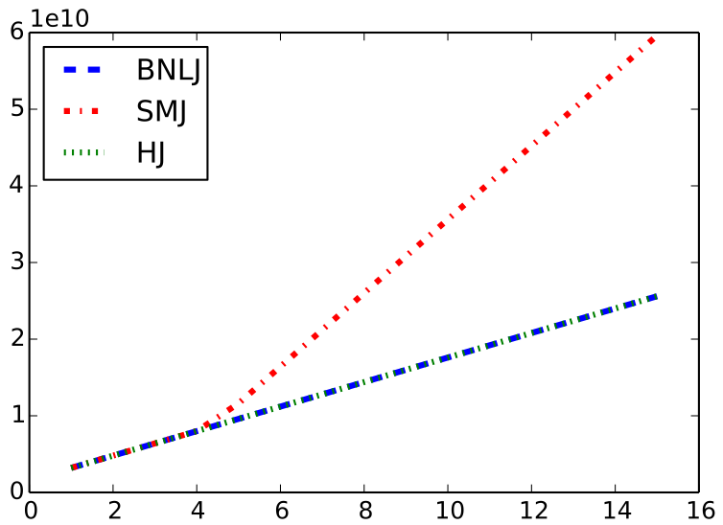
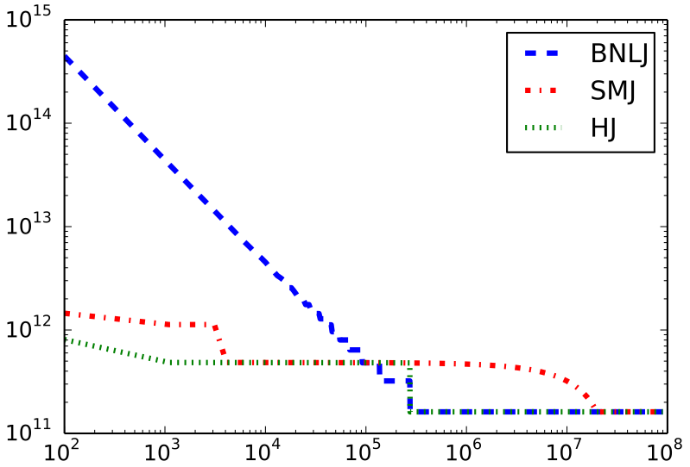

Join: Crossovers of I/O Costs
We plot the I/O costs of BNLJ, SMJ, and HJ
8GB memory; 8KB pages
(So, B = 1m)
Arity of both R and U = 40
|U| = 5m; NU ~ 195K
|R| = 500m; NR ~ 19.5M
|U| = 5m; NU ~ 195K
fails
Usually, HJ dominates!
I/O cost in pages
NTuples(R) / 5m
Vary buffer memory

Slide 41

More General Join Conditions
N_{A} ≤ N_{B}
If JoinCondition has only equalities, e.g., A.a1 = B.b1 and A.a2 = B.b2
HJ: works fine; hash on (a1, a2)
SMJ: works fine; sort on (a1, a2)
  INLJ: use (build, if needed) a matching index on A
    What about disjunctions of equalities?
If JoinCondition has inequalities, e.g., A.a1 > B.b1
HJ is useless
    SMJ and INLJ are also mostly unhelpful! Why?
Inequality predicates might lead to large outputs!

Slide 42
Operator Implementations
Select
Project
Join
Set Operations
Group By Aggregate
Need scalability to larger-than-memory (on-disk) datasets and
high performance at scale!

Slide 43
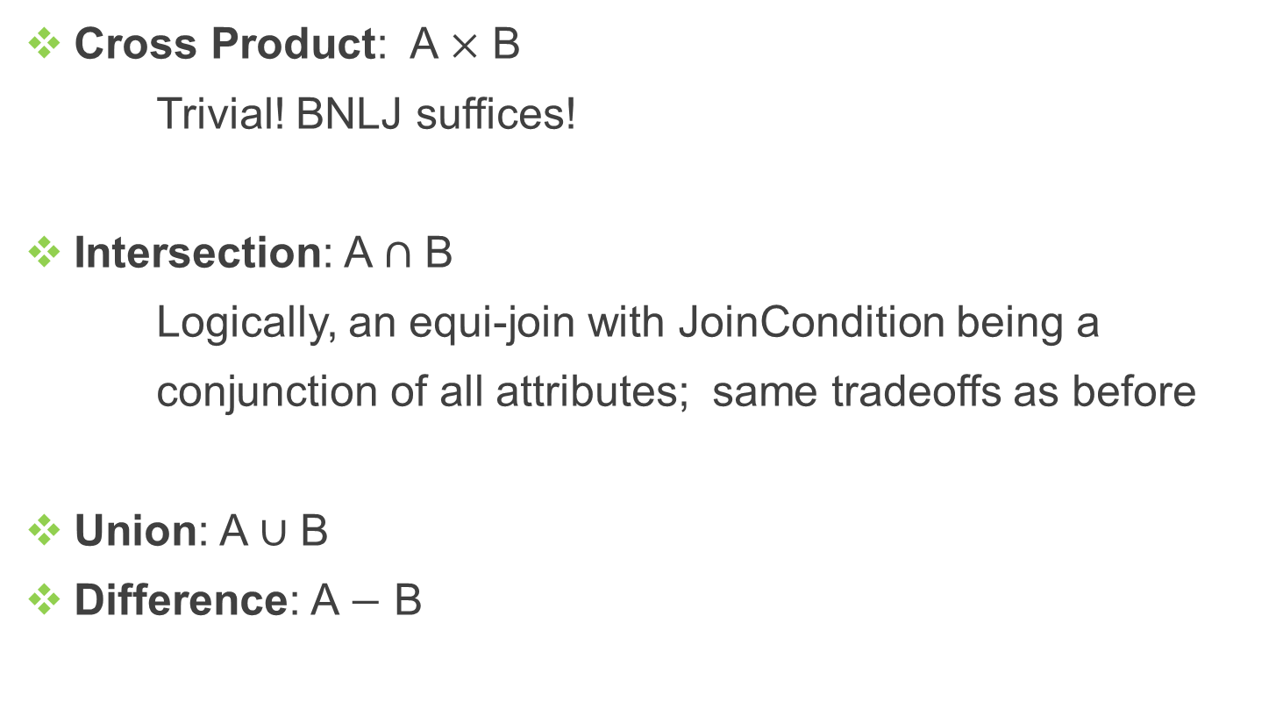
Set Operations
Similar to intersection, but need to deduplicate upon matches and output only once!
Sounds familiar?

Slide 44
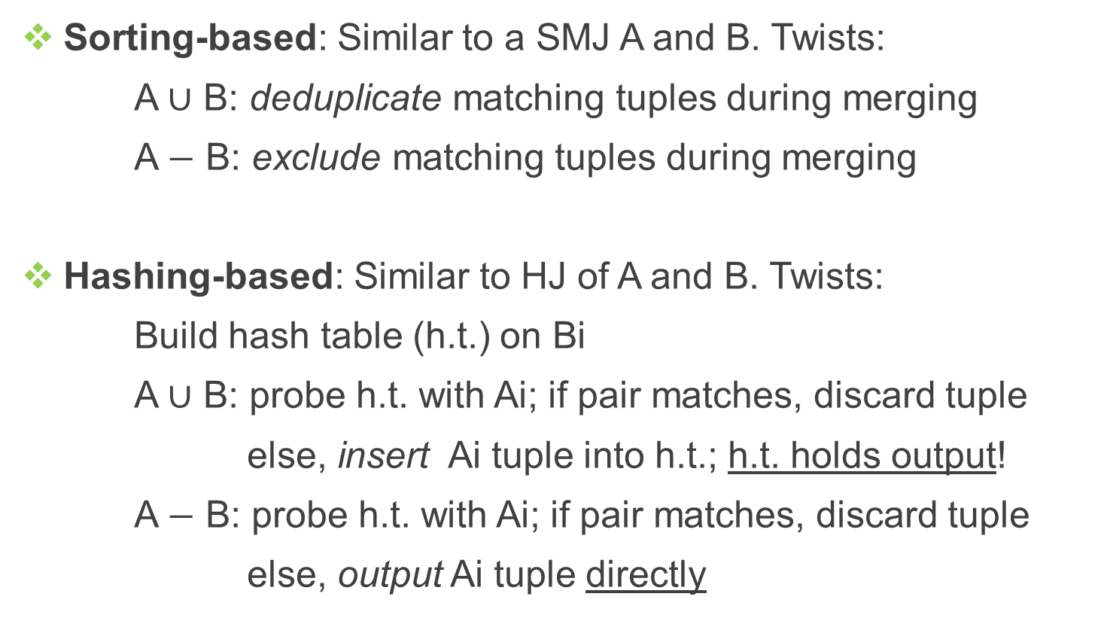
Union/Difference Algorithms

Slide 45
Operator Implementations
Select
Project
Join
Set Operations
Group By Aggregate
Need scalability to larger-than-memory (on-disk) datasets and
high performance at scale!

Slide 46
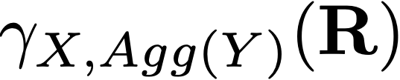
Group By Aggregate
“Grouping Attributes”
(Subset of R’s attributes)
A numerical attribute in R
“Aggregate Function”
(SUM, COUNT, MIN, MAX, AVG)
Easy case: X is empty!
Simply aggregate values of Y
Q: How to scale this to larger-than-memory data?
Difficult case: X is not empty
“Collect” groups of tuples that match on X, apply Agg(Y)
3 algorithms: sorting-based, hashing-based, index-based

Slide 47
Group By Aggregate: Easy Case
All 5 SQL aggregate functions computable incrementally, i.e., one tuple at-a-time by tracking some “running information”
RatingID | Stars
2 | 3.0
39 | 5.0
12 | 2.5
402 | 5.0
293 | 2.5
49 | 1.0
66 | 2.5
3.0; 8.0; 10.5;
15.5; 18.0; 19, 21.5
SUM: Partial sum so far
COUNT is similar
MAX: Maximum seen so far
3.0; 5.0
MIN is similar
3.0; 2.5; 1.0
Q: What about AVG?
Track both SUM and COUNT!
In the end, divide SUM / COUNT

Slide 48

Group By Aggregate: Difficult Case
Collect groups of tuples (based on X) and aggregate each
MID | UID | Stars
21 | 3 | 3.0
55 | 294 | 5.0
80 | 12 | 2.5
21 | 32 | 5.0
55 | 24 | 2.0
55 | 19 | 1.0
21 | 11 | 4.0
55 | 123 | 4.0
21 | 3 | 3.0
21 | 32 | 5.0
21 | 11 | 4.0
AVG for 21 is 4.0
55 | 294 | 5.0
55 | 24 | 2.0
55 | 19 | 1.0
55 | 123 | 4.0
AVG for 55 is 3.0
80 | 12 | 2.5
AVG for 80 is 2.5
Q: How to collect groups? Too large?

Slide 49
Group By Agg.: Sorting-Based
Sort R on X (drop all but X U {Y} in Sort phase to get T)
Read in sorted order; for every distinct value of X:
Compute the aggregate on that group (“easy case”)
Output the distinct value of X and the aggregate value
I/O Cost: NR + NT + EMSMerge(NT)
Q: Which other sorting-based op. impl. had this cost?
Improvement: Partial aggregations during Sort Phase!
Q: How does this reduce the above I/O cost?

Slide 50
Group By Agg.: Hashing-Based
Build h.t. on X; bucket has X value and running info.
Scan R; for each tuple in each page of R:
If h(X) is present in h.t., update running info.
Else, insert new X value and initialize running info.
H.t. holds the final output in the end!
I/O Cost: N_{R}
Q: What if h.t. using X does not fit in memory
(Number of distinct values of X in R is too large)?

Slide 51
Group By Agg.: Index-Based
Given B+ Tree index s.t. X U {Y} is a subset of IndexKey:
Use leaf level of index instead of R for sort/hash algo.!
Given B+ Tree index s.t. X is a prefix of IndexKey:
Leaf level already sorted! Can fetch data records in order
If AltRecord approach used, just one scan of leaf level!
Q: What if it does not use AltRecord?
Q: What if X is a non-prefix subset of IndexKey?

Slide 52
Review Questions
Suppose we have infinite buffer memory. Which join algorithm will have the lowest I/O cost? What about Project?
Given tables A and B such that they are both sorted on the joining attributes. Which join algorithm is preferable?
Why does SMJ not suffer from the skew problem HJ does?
How does SMJ give sorted outputs? Why not HJ?
Given a B+ Tree on Ratings(UID,MID) with AltRecord, what is the I/O cost of computing the average rating for each user? For each movie?
How to impl. VARIANCE aggregate efficiently? MEDIAN?

