Slide 1
CSE 132C
Database System Implementation
Arun Kumar
Topic 1: Data Storage Management
Chapters 8 and 9 (except 8.5.4 and 9.2) of Cow Book
Slide ACKs: Jignesh Patel, Paris Koutris

Slide 2
Lifecycle of an SQL Query
Query Result
Query
Database Server
Query
Scheduler
Parser
Optimizer
Select R.text from
Report R, Weather W
where W.image.rain()
and W.city = R.city
and W.date = R.date
and
R.text.
matches(“insurance claims”)
Execute
Operators
|…|……|………..|………..|
|…|……|………..|………..|
|…|……|………..|………..|
|…|……|………..|………..|
|…|……|………..|………..|
|…|……|………..|………..|
|…|……|………..|………..|
|…|……|………..|………..|
|…|……|………..|………..|
|…|……|………..|………..|
|…|……|………..|………..|
Query
Syntax Tree
Query Plan
Query
Result
Segments

Slide 3
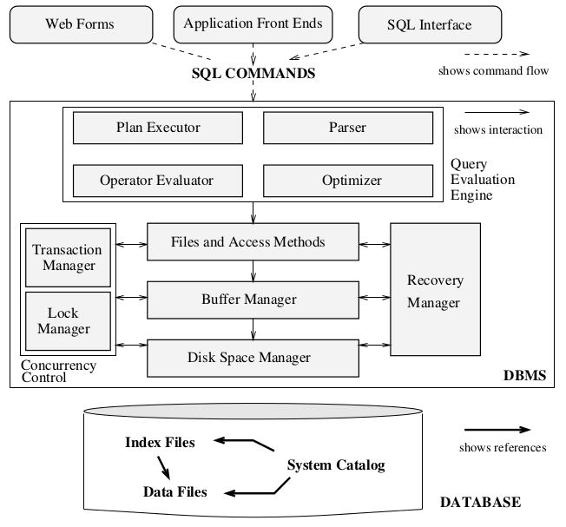
RDBMS Architecture
Storage
Management
Subsystem

Slide 4
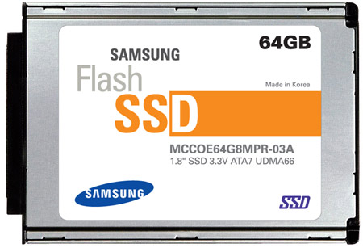
Another View of Storage Manager
Access Methods
Sorted File
Hash Index
Concurrency Control Manager
Heap File
B+-tree Index
Recovery Manager
Buffer Manager
I/O Manager
I/O Accesses

Slide 5
Outline
Data Storage (Disks)
Buffer Management
File Organization
New Storage Hardware

Slide 6
Memory/Storage Hierarchy
CPU
~MBs
~$2/MB
~100GB/s
Cache
~10GB/s
100s
~10GBs
~$5/GB
Main Memory
Price
Access Speed
Capacity
A C C E S S C Y C L E S
Non-Volatile RAM
~TBs
~$200/TB
~GB/s
10⁵ – 10⁶
Flash Storage
10⁷ – 10⁸
Magnetic Hard Disk Drive (HDD)
~10TBs
~$30/TB
~200MB/s
~50MB/s
Tape
~PBs; ~$10/TB

Slide 7
Magnetic Hard Disk (Disk for short)
Widely used secondary storage device
Data storage/retrieval units: disk blocks or pages
Unlike DRAM, different disk pages have different retrieval times based on location
  Need to optimize layout of data on disk pages
  Orders of magnitude performance gaps possible!

Slide 8
Components of a Disk

Slide 9
Components of a Disk
1 block = n contiguous sectors
(n fixed during disk configuration)

Slide 10
How does a Disk Work?
Magnetic changes on platters to store bits
Spindle rotates platters
7200 to 15000 RPM
(Rotations Per Minute)
Head reads/writes track
Exactly 1 head can read/write at a time
Arm moves radially to position head on track

Slide 11
How is the Disk Integrated?
OS interfaces
with the
Disk Controller

Slide 12
Disk Access Times
Access time = Rotational delay + Seek time + Transfer time
Rotational delay
  Waiting for sector to come under disk head
  Function of RPM; typically, 0-10ms (avg v worst)
Seek time
  Moving disk head to correct track
  Typically, 1-20ms (high-end disks: avg is 4ms)
Transfer time
  Moving data from/to disk surface
  Typically, hundreds of MB/s!

Slide 13
Typical Modern Disk Spec
Western Digital Blue WD10EZEX (from Amazon)
Capacity | 1TB
RPM | 7200
Transfer | 6 Gb/s
#Platters | Just 1!
Avg Seek | 9ms
Price | USD 33!

Slide 14
Data Organization on Disk
Disk space is organized into files; relation is stored as a file
Files are made of pages; each page is physically laid out on 1 or more disk blocks
  Typical block size: 512B; page size: 4KB or 8KB
  OS/RAM page size is not necessarily same as disk block
  Page size is always a multiple of disk block size but can be much higher, e.g., even 1 MB
  Page is basic unit of reads/writes to disk by OS
File data (de-)allocated in increments of pages on disk
Pages contain records (physical version of tuples)

Slide 15
Disk Data Layout Principles
Sequential access vs. Random access
  Reading contiguous blocks together amortizes seek time and rotational delay
  For a transfer rate of 200MB/s, sequential reads can be ~200MB/s, but random reads ~0.3MB/s
  Better to lay out pages of a file contiguously on disk
“Next” block concept:
  On same track (in rotation order), then same cylinder, and then adjacent cylinder

Slide 16
Review
Why does a magnetic hard disk have seek time?
If RPM of a given magnetic hard disk is 6000, what is the average rotational delay?
What causes the random vs. sequential access latency dichotomy on a magnetic hard disk?
Which part(s) of the disk access latency does not change between random vs. sequential access?

Slide 17
Is it possible to exploit RAM better and avoid going to disk all the time?

Slide 18
Outline
Data Storage (Disks)
Buffer Management
File Organization
New Storage Hardware

Slide 19
Buffer Management
Pages should be in DRAM for DBMS query processor
  But not all pages of a database might fit in DRAM!
Buffer Pool
  A part of main memory that DBMS manages
  Divided into buffer frames (slots for pages)
Buffer Manager
  Subsystem of DBMS to read pages from disk to buffer pool and write “dirty” pages back to disk

Slide 20
Buffer Management
Page Requests from Higher Levels of DBMS
Buffer Pool
Page in an
occupied frame
Free frames
RAM
Disk
Buffer Replacement Policy
decides which frame to evict
DB

Slide 21
Page Requests to Buffer Manager
Request a page for query processing (read or write)
Release a page when no longer needed
Notify if a page is modified (a write op happened)

Slide 22
Buffer Manager’s Bookkeeping
2 variables per buffer frame maintained
Pin Count
  Current number of “users” of the page in the frame
  “Pinning” means PinCount++; page requested
  “Unpinning” means PinCount is 0; page released
Dirty Bit
  Set when a user notifies that page was modified
  Must write this page back to disk in due course!
Q: What if 2 users pin and modify the same page?!

Slide 23
Handling Page Requests
Choose a frame for replacement (buffer replacement policy); it should have Pin Count 0!
If chosen frame has Dirty Bit set, “flush” it to disk
Read requested page from disk into chosen frame
Pin the page and return the frame address
Is page in
buffer pool?
No
Yes
Return address of the frame in the pool
Increment Pin Count

Slide 24
Buffer Replacement Policy
Policy to pick the frame for replacement
Has a major impact on I/O cost (number of disk I/Os) of a query based on its data access pattern
Popular policies:
  Least Recently Used (LRU)
  Most Recently Used (MRU)
  “Clock” (LRU variant with lower overhead)
  First In First Out (FIFO), Random, etc.

Slide 25
Least Recently Used (LRU)
Queue of pointers to frames with PinCount of 0
Add newly unpinned frame to end of queue
For replacement, grab frame from front of queue
Example:
5 pages on disk:
A, B, C, D, E
3 frames in pool
Page request sequence:
Request A, Request B, Modify A, Request D,
Release B, Release A, Request E, Request C,
Release C, Release D, Release E

Slide 26
Least Recently Used (LRU)
Buf. Pool
Release B
Release A
Page
- | - | -
0 | 0 | 0
0 | 0 | 0
A | B | D
1 | 0 | 1
1 | 0 | 0
A | B | D
0 | 0 | 1
1 | 0 | 0
PC
DB
and so on
Request A
Request D
Request E
Release C
A | - | -
1 | 0 | 0
0 | 0 | 0
A | B | D
1 | 1 | 1
1 | 0 | 0
A | E | D
0 | 1 | 1
1 | 0 | 0
C | E | D
0 | 1 | 1
0 | 0 | 0
Request B
Modify A
Request C
Flush A!
A | B | -
1 | 1 | 0
0 | 0 | 0
A | B | -
1 | 1 | 0
1 | 0 | 0
C | E | D
1 | 1 | 1
0 | 0 | 0
Queue of pointers:
F1
F0

Slide 27
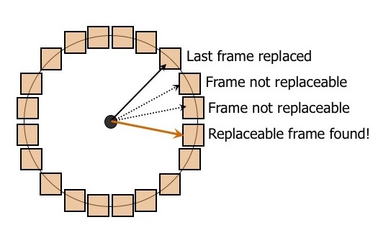
Clock Algorithm
Variant of LRU with lower overhead (no queue)
N buffer frames treated logically as a circle: the “clock”
Current variable points to a frame: the “hand”
Each frame has Referenced Bit (along with PC, DB)
Finding a frame to replace:
  If PC > 0, increment Current
  If PC == 0 :
    If RB == 1, set its RB = 0 and increment Current
    If RB == 0, pick this frame!

Slide 28
Sequential Flooding
LRU performs poorly when file is repeatedly scanned
Given: Num. buffer frames < Num. pages in file
Then, every page request causes a disk I/O!
Q: Which other replacement policy is better for this case?
LRU, Clock, MRU, FIFO, or Random?

Slide 29
DBMS vs. OS Filesystem
Q: DBMS sits on top of OS filesystem; so, why not just let
OS handle database file layout and buffer management?
DBMS knows fine-grained information of data access patterns of this “application” compared to OS
  Can pre-fetch pages as per query semantics
  Can better interleave I/Os and computations
  Can exploit multiple disks more effectively (RAID)
Own buffer pool lets DBMS adjust buffer replacement policy, pin pages to memory, and flush dirty pages

Slide 30
Outline
Data Storage (Disks)
Buffer Management
File Organization
New Storage Hardware

Slide 31
Data Organization Basics: Recap
Disk space organized into files; relations are stored as files
Files are made up of pages
  File data (de-)allocated in increments of disk pages
Pages contain records (physical version of tuples)
  Higher levels operate on sets of records
How pages are organized in a file: Page Layout
How records are organized in a page: Record Layout

Slide 32
Unordered (Heap) Files
Simplest structure; records/pages in no particular order
Pages added/deleted as table grows/shrinks
Metadata tracked to enable record-level access:
  Pages in the file via PageID
  Records in a page via RecordID
  Free space on a page
Operations on the file: insert/delete file, read a record with given RID, scan records (maybe given a predicate), insert/delete record(s)

Slide 33
Heap File as Linked Lists
Data
Page
Data
Page
Data
Page
Full Pages
Header
Page
Data
Page
Data
Page
Data
Page
Pages with
Free Space
(Filename, Header PageID) stored in known catalog
Each page has 2 pointers (PageIDs) and data records
Pages in second list have some free space
Q: Why would free space arise in pages?

Slide 34
Heap File as Page Directory
Data
Page 1
Header
Page
Data
Page 2
Data
Page N
Directory
Entry in directory for each page:
  Is it free or full?
  How many bytes of free space?
Faster to identify page with free space to add records

Slide 35
Data Organization Basics: Recap
Disk space organized into files; relations are stored as files
Files are made up of pages
  File data (de-)allocated in increments of disk pages
Pages contain records (physical version of tuples)
  Higher levels operate on sets of records
How pages are organized in a file: Page Layout
How records are organized in a page: Record Layout

Slide 36
Record Layout Desiderata
Higher levels (queries) operate on sets of records
Records are stored in slotted pages
  Page is a collection of slots; one record per slot
Physically, RecordID = <PageID, SlotNumber>!
Many record layouts possible
Need to support record-level operations efficiently
  Insert a record or multiple records
  Read/update/delete a record given its RecordID
  Scan all records (possibly applying a predicate)

Slide 37
Record Layout and Format Outline
Layout of fixed-length records:
  Packed layout
  Unpacked layout
Layout of variable-length records
Record format for fixed-length records
Record formats for variable-length records
  Delimiter-based
  Pointer-based

Slide 38
Layout of Fixed-length Records
Slot 1
Slot 1
Slot 2
Slot 2
. . .
. . .
Free
Space
Slot N
Slot N
Slot M
Number
of slots
N
. . .
1
1
1
Number
of records
0
M
M ... 3 2 1
Bitmap
Packed
Unpacked
Recall that RecordID = <PageID, SlotNumber>
Con for Packed: moving/deleting records alter RIDs
Con for Unpacked: extra space used by bitmap

Slide 39
Layout of Variable-length Records
Start
Page
num
= 11
Rid=?
Rid= (11, 1)
-1,
0
-1,
0
0,
70
70,
50
6
Book-keeping
120,
40
560,
90
5
4
3
2
1
0
Free Space
Pointer
Dir. grows backwards
Slot directory
Slot num
Slot entry: offset, length

Slide 40
Layout of Variable-length Records
A big pro: moving records on page does not alter RIDs
Good for fixed-length records too
Deleting a record: offset is set to -1
Inserting a new record:
  Any available slot can be used (incl. in free space)
  If not enough free space, reorganize

Slide 41
Fixed-length Record Format
All records in a file are same “type” and length
System catalog contains attribute data type lengths
F1
F2
F3
F4
L1
L2
L3
L4
Base address (B)
Address = B+L1+L2

Slide 42
Variable-length Record Formats
F1 F2 F3 F4
Delimiter
symbol
Field
Count
4
$
$
$
$
Array of
Integer
Offsets
Both store fields consecutively; count fixed by schema!
Con of delimiter-based: need to scan record from start to retrieve even a single field (attribute)
Cons of pointer-based: small dir. overhead; growing records require maintaining dir.; records larger than a page!

Slide 43
Column Store Layout
Consider the following SQL query:
Movies (M)
MovieID | Name | Year | Director
SELECT COUNT(DISTINCT Year) FROM Movies M
Q: Why bother reading other attributes?
Most “analytics” queries read only one or a few attributes; reading other attributes wastes I/O time
“Column store” RDBMSs lay out relations in column-major order to help speed up such queries

Slide 44
Column Store Layout
MovieID | Name | Year | Director
20 | Inception | 2010 | Christopher Nolan
16 | Avatar | 2009 | Jim Cameron
53 | Gravity | 2013 | Alfonso Cuaron
74 | Blue Jasmine | 2013 | Woody Allen
Pages in a column store layout:
20, 16, 53, 74
Inception, Avatar
Gravity, Blue Jasmine
2010, 2009, 2013, 2013
…
High potential for
data compression!
Q: When might a column store cause poorer performance?

Slide 45
Outline
Data Storage (Disks)
Buffer Management
File Organization
New Storage Hardware

Slide 46
Storage/Memory Hierarchy
CPU
Cache
100s
Main Memory
Price
Access Speed
Capacity
A C C E S S C Y C L E S
Non-Volatile Memory?
10⁵ – 10⁶
Flash Storage
10⁷ – 10⁸
Magnetic Hard Disk Drive (HDD)
Tape

Slide 47
Flash Solid State Drive vs. Magnetic Disk
Roughly speaking, flash SSD combines persistence of magnetic disks with speed closer to DRAM
Random reads/writes not much worse than sequential
  “Locality of reference” different for data/file layout
  But still block-addressable like magnetic disks
Data access latency: 100x faster!
Data transfer throughout: Also 10-100x higher
Parallel read/writes more feasible
But cost per GB can be 3x-5x higher
Read-write impact asymmetry leads to lower lifetimes

Slide 48
Flash SSDs in RDBMSs
Q: How best to exploit flash SSDs for RDBMSs?
Various ideas explored in research:
Fully replace magnetic disks
Supplement HDDs; but to store which part of DB?
  Just the “logs” of transactions
  Index structures
  “Hot” relations/data structures
Requires reimplementing RDBMS internals
No consensus yet but “fully replace” becoming common

Slide 49
NVMs vs. Disks
Roughly speaking, NVMs are like persistent DRAM, but with similar capacity as SSDs
Random R/W with less-to-no SSD-style wear and tear
  Byte-addressability (not blocks like SSDs/HDDs)
  “Locality of reference” concept radically changes
Latency, throughput, parallelism, etc. similar to DRAM
Yet to see light of day in production settings
Cost per GB: No one knows yet. :)
Active area of research in comp. arch. + DB systems

Slide 50
Recap
Data Storage (Disks)
  Storage hierarchy
  Disk architecture and access times
Buffer Management
  Buffer manager and buffer pool
  Buffer replacement algorithms (LRU, clock, etc.)
File Organization
  Page layouts (heap files)
  Record layouts (fixed, variable, columnar)
New Storage Hardware

