Slide 1
CSE 132C
Database System Implementation
Spring 2023
Arun Kumar

Slide 2
About Myself
2009: Bachelors in CSE from IIT Madras, India
Summers: 110F!
2009—16: MS and PhD in CS from UW-Madison
PhD thesis area: Data systems for ML workloads
Winters: —40F!
2016-: Asst. Prof. at UC San Diego CSE
2019-: + Asst. Prof. at UC San Diego HDSI
2021: Assoc. Prof. at CSE & HDSI
Ahh! :)

Slide 3
What is this course about? Why take it?

Slide 4


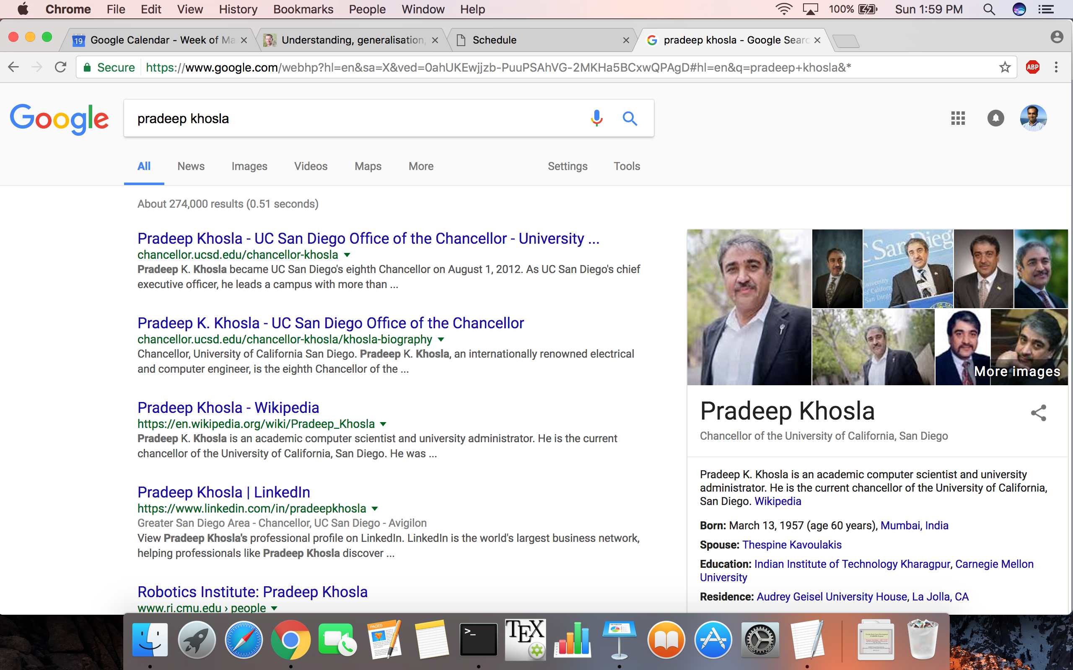
Large-scale data management systems are the cornerstone of many digital applications, both traditional and modern

Slide 5
Our primary focus will be the relational data model and Relational Database Management Systems (RDBMS)

Slide 6
Relational model in a nutshell
Basically, Relation:Table :: Pilot:Driver (okay, a bit more)
RatingID | Rating | Date | UserID | MovieID
1 | 3.5 | 08/27/15 | 23294 | 20
2 | 4.0 | 07/20/15 | 4232 | 293
3 | 2.5 | 08/02/15 | 54551 | 846
… | … | … | … | …
The model formalizes “operations” to manipulate relations

Slide 7
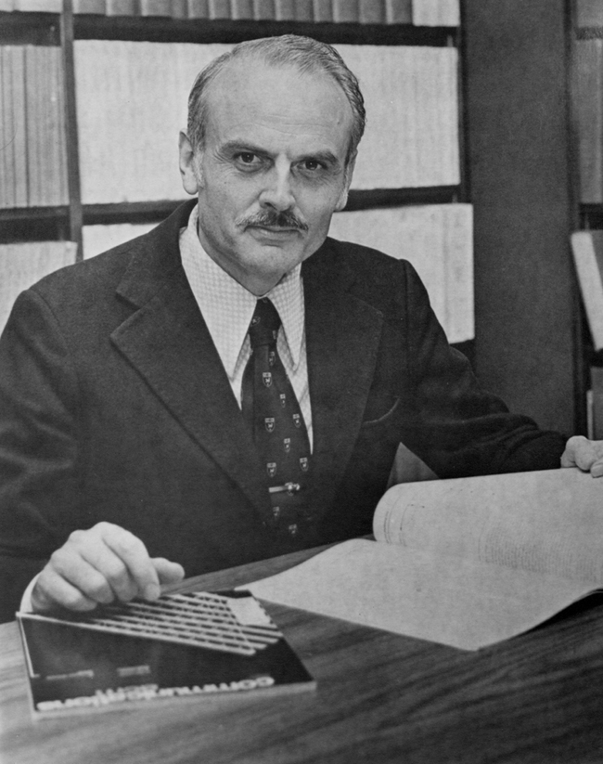
Relational model in a nutshell
Invented by E. F. Codd in 1970s at IBM Research in CA

Slide 8
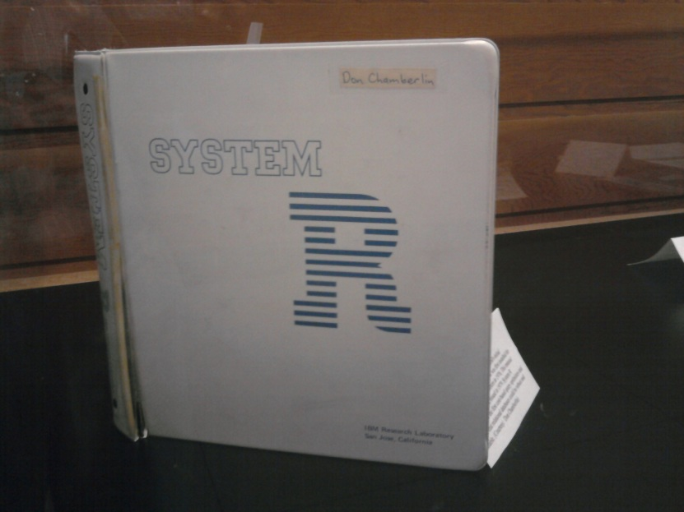

Relational DBMS in a nutshell
First RDBMSs: System R (IBM) and Ingres (Berkeley) in 1970s
A rare photo of the original System R manual
Mike Stonebraker won the Turing Award in 2015!

Slide 9
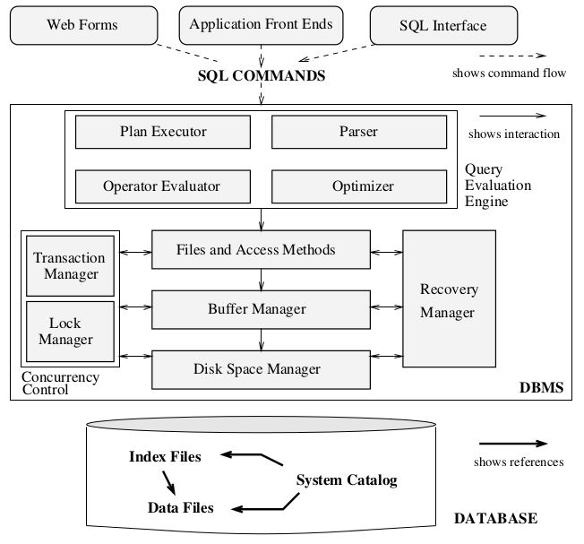
Relational DBMS in a nutshell
A software system that implements the relational model, i.e., enables users to store and process relational databases

Slide 10







Relational DBMS in a nutshell
RDBMS software is now a USD 20+ billions/year
industry; many open source RDBMSs also exist
People still start companies about what are basically RDBMSs!

Slide 11
CSE 132C will get you to think critically about the implementation of database systems
Data storage, file organization, and buffer management
How are large structured datasets stored and organized?
How are queries handled?
Indexing, sorting, relational operator implementation, and query processing
How to make it faster and more scalable?
Query optimization; parallel RDBMSs
Recent developments and trends
Dataflow Systems; Cloud-native RDBMSs; ML for RDBMSs; Key-value stores

Slide 12
(Tentative) Course Schedule
Week | Topic
1 | Introduction; Recap of Relational Algebra and SQL
1-2 | Data Storage; Buffer Management; File Organization
3-4 | Indexing (B+ Tree; Hash Index)
4-5 | External Sorting
5-7 | Relational Operator Implementations; Query Processing
7 | Midterm Exam on May 15 (Mon)
7-8 | Query Optimization
9 | Parallel and Cloud-native RDBMSs; Dataflow Systems
10 | ML for RDBMSs
11 | Final Exam on Jun 15 (Thu)
There will also be 2 invited guest lectures from industry

Slide 13
What this course is NOT about
NOT a course on relational model or SQL
  Take CSE 132A or DSC 100 instead
NOT a course on how to use SQL/RDBMSs for DB applications
  Take CSE 132B instead
NOT a training module for how to use MapReduce or Spark

Slide 14







CSE 132 Database Course Series
CSE 132A
CSE 132B
SELECT … FROM … WHERE
RDBMS
CSE 132C
Database

Slide 15

Course Textbook
Prescribed Textbook:
“Database Management Systems” 3rd Edition
Raghu Ramakrishnan and Johannes Gehrke
Aka The “Cow Book”
Which cow are you?
Optional Textbook:
“Database Systems: The Complete Book”
H.G. Molina, J.D. Ullman, and J. Widom

Slide 16
Prerequisites
CSE 132A or equivalent introductory DB course or DSC 102
    Waivers possible; email me with justification (e.g., a DB course elsewhere or real-world experience with RDBMSs)
CSE 120 or CSE 132B may be helpful but not required
C++ is necessary for programming projects; check course webpage for resources
https://cseweb.ucsd.edu/classes/sp23/cse132C-a/index.html

Slide 17
Components and Grading
Programming Project 1 (Buffer Manager): 7%
Programming Project 2 (B+ Tree Index): 20%
Quizzes: 10% (2 x 5%); in-person only, on paper
Midterm Exam: 15%; in-person only, on paper
Cumulative Final Exam: 40%; in-person only, on paper
Peer Instruction Activities: 5%; in-person only, Google Forms
Peer Evaluation Activities: 3%; on Canvas only
https://cseweb.ucsd.edu/classes/sp23/cse132C-a/index.html

Slide 18
Grading Scheme
Hybrid of relative and absolute; grade is better of the two
Grade | Relative Bin (Use strictest) | Absolute Cutoff (>=)
A+ | Highest 5% | 95
A | Next 10% (5-15) | 90
A- | Next 15% (15-30) | 85
B+ | Next 15% (30-45) | 80
B | Next 15% (45-60) | 75
B- | Next 15% (60-75) | 70
C+ | Next 5% (75-80) | 65
C | Next 5% (80-85) | 60
C- | Next 5% (85-90) | 55
D | Next 5% (90-95) | 50
F | Lowest 5% | < 50
Example: Score 82 but 33%le; Rel.: B-; Abs.: B+; so, B+

Slide 19
Course Administrivia
Lectures: MWF 4-4:50pm PT @ WLH 2205
  Live attendance optional; automatically podcast
  Discussion slot (Fri 5-6pm PT) will be used only a few times
Instructor: Arun Kumar; akk018 [at] ucsd.edu
  Office hours: Mon 5-6pm PT @ CSE 3218
Piazza: TBD
  For async. Q&A/discussions, all announcements
Canvas for Peer Evaluation Activities; async.
Google Forms for Peer Instruction Activities; in-class only
TA: Kyle Luoma; see course homepage for details
https://cseweb.ucsd.edu/classes/sp23/cse132C-a/index.html

Slide 20
Programming Projects
BadgerDB: An RDBMS skeleton in C++ from UW-Madison
Project 1: Buffer Manager; implement the clock algorithm
Project 2: B+ Tree Index; implement insert/update/delete ops
Teams of 2 or 1 only; submit team via TA’s Google Form
Academic Integrity policies:
  OK to discuss with peers at conceptual level, generic errors
  No sharing of code across teams
  CoPilot-style LLMs are OK to use while coding to assist you
  Do NOT post your code online or search for solutions online
See course projects page for more details
https://cseweb.ucsd.edu/classes/sp23/cse132C-a/index.html

Slide 21
Tentative Schedule for Prog. Projects
Date | Agenda
Thu, Apr 13 | Project 1 released
Fri, Apr 14 | Discussion on Project 1 by TA
Tue, Apr 25 | Project 1 due
Thu, Apr 27 | Project 2 released
Fri, Apr 28 | Discussion on Project 2 by TA
Thu, May 25 | Project 2 due
No late days! Plan your work upfront.
Try to join the discussions by the TA on the projects.
https://cseweb.ucsd.edu/classes/sp23/cse132C-a/index.html

Slide 22
Peer Activities
Peer Instruction Activities: 5 x 1%
  Open-ended question prompt to discuss with peers
  First answer by yourself; then discuss; then answer again
  In-person only on random lecture dates; via Google Forms
  6 activities in total; top 5 scores retained
Peer Evaluation Activities: 2 x 1.5%
  Open-ended questions based on industry guest lectures
  Asynchronous online submission on Canvas
  OK to discuss with peers but full answer by yourself
  Submissions evaluated anonymously by 3 peers
https://cseweb.ucsd.edu/classes/sp23/cse132C-a/index.html

Slide 23
General Dos and Do NOTs
Do:
Try to join the lectures and discussions in person
View and review podcast videos asynchronously yourself
Follow all announcements and participate in Q&A/discussions on Piazza
Use “CSE132C:” as subject prefix for all emails to me/TA
Do NOT:
Record in class without explicit permission of the instructor and other participating students
Harass, intimidate, or intentionally talk over other students
Violate Academic Integrity on any graded components; I am very strict on this matter!

Slide 24
Questions?

Slide 25
Example DB: Netflix, Hulu, etc.
Ratings
RatingID | NumStars | Timestamp | UserID | MovieID
1 | 3.5 | 08/27/15 | 79 | 20
… | … | … | … | …
UserID | Name | Age | JoinDate
79 | Alice | 23 | 01/10/13
… | … | …
Users
Movies
MovieID | Name | ReleaseDate | Director
20 | Inception | 07/13/2010 | Christopher Nolan
… | … | …

Slide 26
Recap: Relational Model

Slide 27
Relational Model: Basic Terms
What is a Relation?
What are Attributes?
What are Domains?
What is Arity?
Ratings
RatingID | NumStars | Timestamp | UserID | MovieID
1 | 3.5 | 08/27/15 | 79 | 20
2 | 4.0 | 07/20/15 | 4232 | 293
3 | 2.5 | 08/02/15 | 54551 | 846
… | … | … | … | …
Integers
Real
…
A glorified table!
These things
The mathematical “domains” for the attributes
Number of attributes

Slide 28
Relational Model: Basic Terms
What are Tuples?
What is Cardinality?
Ratings
RatingID | NumStars | Timestamp | UserID | MovieID
1 | 3.5 | 08/27/15 | 79 | 20
2 | 4.0 | 07/20/15 | 4232 | 293
3 | 2.5 | 08/02/15 | 54551 | 846
… | … | … | … | …
These things
Number of tuples

Slide 29

Referring to “tuples”: Two notations
Without using attribute names (positional/sequence)
Using attribute names (named/set)
Ratings (R)
RatingID | NumStars | Timestamp | UserID | MovieID
1 | 3.5 | 08/27/15 | 79 | 20
2 | 4.0 | 07/20/15 | 4232 | 293
3 | 2.5 | 08/02/15 | 54551 | 846
… | … | … | … | …
t[1] = 3.5
t.NumStars = 3.5

Slide 30
Relational Model: Basic Terms
What is Schema?
Ratings
RatingID | NumStars | Timestamp | UserID | MovieID
1 | 3.5 | 08/27/15 | 79 | 20
2 | 4.0 | 07/20/15 | 4232 | 293
3 | 2.5 | 08/02/15 | 54551 | 846
… | … | … | … | …
The relation name, and the name and logical descriptions of the attributes (including domains)
Aka “metadata”

Slide 31
Relational Model: Basic Terms
What is an Instance?
Ratings
RatingID | NumStars | Timestamp | UserID | MovieID
1 | 3.5 | 08/27/15 | 79 | 20
2 | 4.0 | 07/20/15 | 4232 | 293
3 | 2.5 | 08/02/15 | 54551 | 846
… | … | … | … | …
RatingID | NumStars | Timestamp | UserID | MovieID
3292 | 1.5 | 06/27/14 | 794 | 10
294122 | 4.0 | 07/10/14 | 232 | 329
74423 | 0.5 | 03/08/14 | 8451 | 846
… | … | … | … | …
Instance 1
Instance 2
A given relation populated with a set of tuples
(loose analogy: schema:instance::type:value in PL)

Slide 32
Relational Model: Basic Terms
Ratings
What is a Relational Database?
RatingID | NumStars | Timestamp | UserID | MovieID
1 | 3.5 | 08/27/15 | 79 | 20
… | … | … | … | …
UserID | Name | Age | JoinDate
79 | Alice | 23 | 01/10/13
… | … | …
Users
Movies
MovieID | Name | ReleaseDate | Director
20 | Inception | 07/13/2010 | Christopher Nolan
… | … | …
A collection of relations; similarly, schema vs. instance

Slide 33
“Write Operations” on a Relation
Insert
  Add tuples to a relation
Delete
  Remove tuples from a relation (typically based on “predicate” matches, e.g., “NumStars <= 4.5”
Modify
  Logically, deletes + inserts, but typically implemented as in-place updates to a relation instance

Slide 34
“Read Operations” on a Relation
“Select”
  Select all tuples from Ratings with “UserID == 19”
“Project”
  Select only Director attribute from Movies
“Aggregate”
  Select Average of all NumStars in Ratings
And a few more formal “algebraic” operations …

Slide 35
Recap: Relational Algebra

Slide 36
Basic Relational Operations
Select
Project
Rename
Cross Product (aka Cartesian Product)
Set Operations:
Union
Set Difference

Slide 37
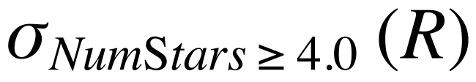
Select
Ratings (R)
RatingID | NumStars | Timestamp | UserID | MovieID
1 | 3.5 | 08/27/15 | 79 | 20
2 | 4.0 | 07/20/15 | 80 | 20
3 | 2.5 | 08/02/14 | 79 | 16
4 | 4.5 | 03/05/14 | 80 | 16
Example: Get all ratings with 4.0 or more stars
Select
“Operator”
“Selection condition/predicate”

Slide 38
Select
R
RatingID | NumStars | Timestamp | UserID | MovieID
1 | 3.5 | 08/27/15 | 79 | 20
2 | 4.0 | 07/20/15 | 80 | 20
3 | 2.5 | 08/02/14 | 79 | 16
4 | 4.5 | 03/05/14 | 80 | 16
Schema preserved
Subset of tuples
(satisfying selection condition)
R’
RatingID | NumStars | Timestamp | UserID | MovieID
2 | 4.0 | 07/20/15 | 80 | 20
4 | 4.5 | 03/05/14 | 80 | 16

Slide 39

Complex Selection Conditions
R
RatingID | NumStars | Timestamp | UserID | MovieID
1 | 3.5 | 08/27/15 | 79 | 20
2 | 4.0 | 07/20/15 | 80 | 20
3 | 2.5 | 08/02/14 | 79 | 16
4 | 4.5 | 03/05/14 | 80 | 16
R’
RatingID | NumStars | Timestamp | UserID | MovieID
1 | 3.5 | 08/27/15 | 79 | 20

Slide 40
Basic Relational Operations
Select
Project
Rename
Cross Product (aka Cartesian Product)
Set Operations:
Union
Set Difference

Slide 41
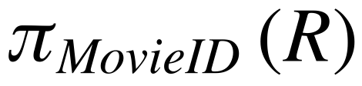
Project
Ratings (R)
RatingID | NumStars | Timestamp | UserID | MovieID
1 | 3.5 | 08/27/15 | 79 | 20
2 | 4.0 | 07/20/15 | 80 | 20
3 | 2.5 | 08/02/14 | 79 | 16
4 | 4.5 | 03/05/14 | 80 | 16
Example: Get all MovieIDs
“Projection list”

Slide 42
Project
R
RatingID | NumStars | Timestamp | UserID | MovieID
1 | 3.5 | 08/27/15 | 79 | 20
2 | 4.0 | 07/20/15 | 80 | 20
3 | 2.5 | 08/02/14 | 79 | 16
4 | 4.5 | 03/05/14 | 80 | 16
R’
Schema reduced (to projection list)
MovieID
20
16
Tuple values “deduplicated”
(slightly different semantics in SQL)

Slide 43
Composition of Relational Ops
R
RatingID | NumStars | Timestamp | UserID | MovieID
1 | 3.5 | 08/27/15 | 79 | 20
2 | 4.0 | 07/20/15 | 80 | 20
3 | 2.5 | 08/02/14 | 79 | 16
4 | 4.5 | 03/05/14 | 80 | 16
Example: Get UserID and NumStars of ratings
with less than 3 stars
R’
UserID | NumStars
79 | 2.5
RelOp(Relation) gives a Relation

Slide 44
Basic Relational Operations
Select
Project
Rename
Cross Product (aka Cartesian Product)
Set Operations:
Union
Set Difference

Slide 45

Rename
Ratings (R)
RatingID | NumStars | Timestamp | UserID | MovieID
1 | 3.5 | 08/27/15 | 79 | 20
2 | 4.0 | 07/20/15 | 80 | 20
3 | 2.5 | 08/02/14 | 79 | 16
4 | 4.5 | 03/05/14 | 80 | 16
Example: Rename Timestamp to RateDate

Slide 46
Rename
R
RatingID | NumStars | Timestamp | UserID | MovieID
1 | 3.5 | 08/27/15 | 79 | 20
2 | 4.0 | 07/20/15 | 80 | 20
3 | 2.5 | 08/02/14 | 79 | 16
4 | 4.5 | 03/05/14 | 80 | 16
Instance preserved
Schema modified
R’
RatingID | NumStars | RateDate | UserID | MovieID
1 | 3.5 | 08/27/15 | 79 | 20
2 | 4.0 | 07/20/15 | 80 | 20
3 | 2.5 | 08/02/14 | 79 | 16
4 | 4.5 | 03/05/14 | 80 | 16

Slide 47
Basic Relational Operations
Select
Project
Rename
Cross Product (aka Cartesian Product)
Set Operations:
Union
Set Difference

Slide 48

Cross Product
UserID | Name | Age | JoinDate
79 | Alice | 23 | 01/10/13
80 | Bob | 41 | 05/10/13
Users (U)
Movies (M)
MovieID | Name | ReleaseYear | Director
20 | Inception | 2010 | Christopher Nolan
16 | Avatar | 2009 | Jim Cameron
Cartesian product (construct all pairs of tuples across tables)
Schema of output “concatenates” the input schemas
Be careful with attribute name conflicts! Use Rename op

Slide 49
Cross Product
UserID | Name | Age | JoinDate
79 | Alice | 23 | 01/10/13
80 | Bob | 41 | 05/10/13
Users (U)
Movies (M)
MovieID | Name | ReleaseYear | Director
20 | Inception | 2010 | Christopher Nolan
16 | Avatar | 2009 | Jim Cameron
UserID | U.Name | Age | JoinDate | MovieID | M.Name | ReleaseYear | Director
79 | Alice | 23 | 01/10/13 | 20 | Inception | 2010 | Christopher Nolan
79 | Alice | 23 | 01/10/13 | 16 | Avatar | 2009 | Jim Cameron
80 | Bob | 41 | 05/10/13 | 20 | Inception | 2010 | Christopher Nolan
80 | Bob | 41 | 05/10/13 | 16 | Avatar | 2009 | Jim Cameron

Slide 50
Basic Relational Operations
Select
Project
Rename
Cross Product (aka Cartesian Product)
Set Operations:
Union
Set Difference

Slide 51

Union
R1
RatingID | NumStars | Timestamp | UserID | MovieID
1 | 3.5 | 08/27/15 | 79 | 20
2 | 4.0 | 07/20/15 | 80 | 20
3 | 2.5 | 08/02/14 | 79 | 16
Union of sets of tuples (instances)
Inputs must have identical schema: “Union-compatible”
R2
RatingID | NumStars | Timestamp | UserID | MovieID
3 | 2.5 | 08/02/14 | 79 | 16
4 | 4.5 | 03/05/14 | 80 | 16
5 | 5.0 | 06/09/13 | 135 | 20

Slide 52
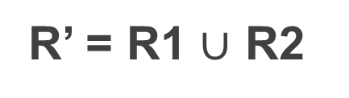
Union
RatingID | NumStars | Timestamp | UserID | MovieID
1 | 3.5 | 08/27/15 | 79 | 20
2 | 4.0 | 07/20/15 | 80 | 20
3 | 2.5 | 08/02/14 | 79 | 16
4 | 4.5 | 03/05/14 | 80 | 16
5 | 5.0 | 06/09/13 | 135 | 20

Slide 53
Basic Relational Operations
Select
Project
Rename
Cross Product (aka Cartesian Product)
Set Operations:
Union
Set Difference

Slide 54

Set Difference
R1
RatingID | NumStars | Timestamp | UserID | MovieID
1 | 3.5 | 08/27/15 | 79 | 20
2 | 4.0 | 07/20/15 | 80 | 20
3 | 2.5 | 08/02/14 | 79 | 16
Set difference of sets of tuples (instances)
Inputs must be “Union-compatible”
R2
RatingID | NumStars | Timestamp | UserID | MovieID
3 | 2.5 | 08/02/14 | 79 | 16
4 | 4.5 | 03/05/14 | 80 | 16
5 | 5.0 | 06/09/13 | 135 | 20

Slide 55
Set Difference
R1
RatingID | NumStars | Timestamp | UserID | MovieID
1 | 3.5 | 08/27/15 | 79 | 20
2 | 4.0 | 07/20/15 | 80 | 20
3 | 2.5 | 08/02/14 | 79 | 16
R2
RatingID | NumStars | Timestamp | UserID | MovieID
3 | 2.5 | 08/02/14 | 79 | 16
4 | 4.5 | 03/05/14 | 80 | 16
5 | 5.0 | 06/09/13 | 135 | 20
R’ = R1 – R2
RatingID | NumStars | Timestamp | UserID | MovieID
1 | 3.5 | 08/27/15 | 79 | 20
2 | 4.0 | 07/20/15 | 80 | 20

Slide 56

Basic Relational Operations
Select
Project
Rename
Cross Product (aka Cartesian Product)
Set Operations:
Union
Set Difference

Slide 57
Derived and Other Relational Ops
Set Operation:
Intersection
Join
Group By Aggregate

Slide 58

Intersection
R1
RatingID | NumStars | Timestamp | UserID | MovieID
1 | 3.5 | 08/27/15 | 79 | 20
2 | 4.0 | 07/20/15 | 80 | 20
3 | 2.5 | 08/02/14 | 79 | 16
Set intersection of sets of tuples (instances)
Inputs must be “Union-compatible”
R2
RatingID | NumStars | Timestamp | UserID | MovieID
3 | 2.5 | 08/02/14 | 79 | 16
4 | 4.5 | 03/05/14 | 80 | 16
5 | 5.0 | 06/09/13 | 135 | 20

Slide 59
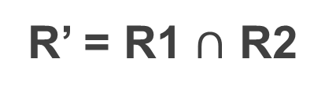
Intersection
R1
RatingID | NumStars | Timestamp | UserID | MovieID
1 | 3.5 | 08/27/15 | 79 | 20
2 | 0.0 | 07/20/15 | 80 | 20
3 | 2.5 | 08/02/14 | 79 | 16
R2
UserID | RatingID | Timestamp | NumStars | MovieID
79 | 3 | 08/02/14 | 2.5 | 16
80 | 2 | 07/20/15 | 4.0 | 20
135 | 5 | 06/09/13 | 5.0 | 20
RatingID | NumStars | Timestamp | UserID | MovieID
3 | 2.5 | 08/02/14 | 79 | 16

Slide 60
Derived and Other Relational Ops
Set Operation:
Intersection
Join
Group By Aggregate

Slide 61


Join
Equivalent Select on Cross Product, but “bypasses” full X
Perhaps the most intensively studied Rel Op!
Several “types” of Joins:
Natural Join and Equi-Join
Condition Join (aka Theta Join)
Semi-Join, Inner Join, Outer Join, Anti-Join, etc.

Slide 62

Natural Join
Ratings (R)
RatingID | NumStars | Timestamp | UserID | MovieID
1 | 3.5 | 08/27/15 | 79 | 20
2 | 4.0 | 07/20/15 | 80 | 20
3 | 2.5 | 08/02/14 | 79 | 16
4 | 4.5 | 03/05/14 | 80 | 16
Movies (M)
MovieID | Name | ReleaseYear | Director
20 | Inception | 2010 | Christopher Nolan
16 | Avatar | 2009 | Jim Cameron

Slide 63
Natural Join
RatingID | NumStars | Timestamp | UserID | MovieID | Name | ReleaseYear | Director
1 | 3.5 | 08/27/15 | 79 | 20 | Inception | 2010 | Christopher Nolan
2 | 4.0 | 07/20/15 | 80 | 20 | Inception | 2010 | Christopher Nolan
3 | 2.5 | 08/02/14 | 79 | 16 | Avatar | 2009 | Jim Cameron
4 | 4.5 | 03/05/14 | 80 | 16 | Avatar | 2009 | Jim Cameron
“Join attributes”: attributes that determine matching tuples Have same name in both inputs! “MovieID” in R and M
Implicit equality condition on join attributes
If > 1 pair, implicit logical “and” of all equality terms
Output schema concatenates input schemas
But join attributes appear only once in output (Project)

Slide 64
Equi-Join
Generalization of the Natural Join
Attribute names of “join attributes” need not be the same
EqualityCondition is a general boolean expression (logical “and”, and/or “or”) of terms with equality predicates only
Join attributes from both R and M in output (no Project)
Perhaps the most important and common type of Join!
Lots of R&D on efficient implementations!

Slide 65
Equi-Join: Example
R₁(J,K)
R₂(P,Q)
T(J,K,P,Q)
J | K
10 | x
20 | y
30 | x
P | Q
x | 4
y | 9
x | 8
J | K | P | Q
10 | x | x | 4
20 | y | y | 9
30 | x | x | 8
10 | x | x | 8
30 | x | x | 4

Slide 66
(Primary) Key-Foreign Key Join
A special kind of equi-join
One of the join attributes is the (Primary) Key of an input relation; the other is a Foreign Key in the other relation
Ratings
RatingID | NumStars | Timestamp | UID | MovieID
UserID | Name | Age | JoinDate
Users
Also a common and important (sub) type of join with even more specialized efficient implementations!

Slide 67
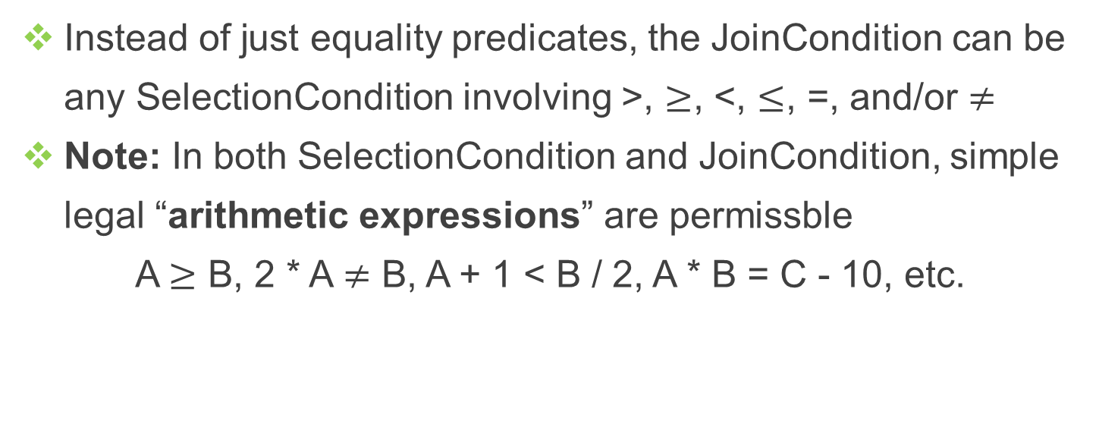
Condition Join (aka “Theta” Join)
Generalization of the Equi-Join

Slide 68
Condition Join: Example
R₁(J,K)
R₂(P,Q)
T(J,K,P,Q)
J | K
10 | x
20 | y
30 | x
P | Q
x | 4
y | 9
x | 12
J | K | P | Q
10 | x | x | 4
20 | y | x | 4
20 | y | y | 9
30 | x | x | 4
30 | x | y | 9
30 | x | x | 12
Perhaps the most difficult type of Join to implement efficiently!

Slide 69
Join Expressions
Can compose many joins into a single complex expression
Ratings
RatingID | NumStars | Timestamp | UserID | MovieID
UserID | UName | Age | JoinDate
Users
MovieID | Name | ReleaseYear | Director
Movies
Q. What do we get as the output?
AllStuff
UserID | UName | Age | JoinDate | RatingID | NumStars | Timestamp | MovieID | Name | ReleaseYEar | Director

Slide 70
Taxonomy of Joins
All kinds of joins
Outer joins
Semi joins
Anti joins
Inner joins
Theta joins
Equi joins
Key-Foreign Key Joins
“Snowflake” joins
Natural joins
“Star” joins

Slide 71
Derived and Other Relational Ops
Set Operation:
Intersection
Join
Group By Aggregate

Slide 72
Group By Aggregate
NOT a part of relational algebra, but “Extended RA”!
Useful for “analytics” queries that aggregate numerical data
Ratings
RatingID | NumStars | Timestamp | UserID | MovieID
What is the average rating for each movie?
How many movies has each user rated?
Standard 5 numerical aggregations supported in SQL:
Count, Sum, Average, Maximum, and Minimum
Extra: Median, Mode, Variance, Standard Deviation, etc.

Slide 73
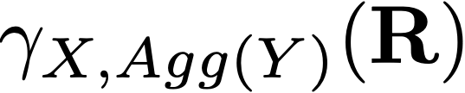
Group By Aggregate
“Grouping Attributes”
(Subset of R’s attributes)
A numerical attribute in R
“Aggregate Function”
(SUM, COUNT, AVG, MAX, MIN)
Output schema will have X and an extra numerical attribute (result of the aggregate function)
Can list multiple aggregate functions in the same operation

Slide 74
Group By Aggregate
R
RatingID | NumStars | Timestamp | UserID | MovieID
1 | 3.5 | 08/27/15 | 79 | 20
2 | 4.0 | 07/20/15 | 80 | 20
3 | 2.5 | 08/02/14 | 79 | 16
4 | 4.5 | 03/05/14 | 80 | 16
What is the average rating for each movie?
R’
MovieID | AVG(NumStars)
20 | 3.75
16 | 3.5

Slide 75

Group By Aggregate
The set of Grouping Attributes can be empty too!
UserID | Name | Age | JoinDate
79 | Alice | 23 | 01/10/13
80 | Bob | 41 | 05/10/13
123 | Carol | 19 | 08/09/14
420 | Dan | 20 | 03/01/15
Users (U)
What is the average age of the users?
U’
AVG(Age)
25.75

Slide 76
Derived and Other Relational Ops
Set Operation:
Intersection
Join
Group By Aggregate

Slide 77
Recap of SQL

Slide 78
Basic Form of an SQL Query
Optional
List of attributes to project
SELECT [DISTINCT] target-list
FROM relation-list
[WHERE condition]
Selection/join condition (optional)
List of relations (possibly with “aliases”)

Slide 79
What does it mean logically?
SELECT [DISTINCT] target-list
FROM relation-list
[WHERE condition]
Cross-product of relations in relation-list
If condition given, apply it to filter out tuples
Remove attributes not present in target-list
If DISTINCT given, deduplicate tuples in result
The above is only a logical interpretation. It is NOT a “plan”
an RDBMS would use in general to run an SQL query!

Slide 80

Example SQL Query
Movies (M)
MovieID | Name | Year | Director
20 | Inception | 2010 | Christopher Nolan
16 | Avatar | 2009 | Jim Cameron
53 | Gravity | 2013 | Alfonso Cuaron
74 | Blue Jasmine | 2013 | Woody Allen
Example: Get the names of movies released in 2013
SELECT M.Name
FROM Movies M
WHERE M.Year = 2013

Slide 81
Example SQL Query
Movies (M)
MovieID | Name | Year | Director
20 | Inception | 2010 | Christopher Nolan
16 | Avatar | 2009 | Jim Cameron
53 | Gravity | 2013 | Alfonso Cuaron
74 | Blue Jasmine | 2013 | Woody Allen
SELECT M.Name FROM Movies M WHERE M.Year = 2013
Name
Gravity
Blue Jasmine

Slide 82
Example SQL Query
Movies (M)
MovieID | Name | Year | Director
20 | Inception | 2010 | Christopher Nolan
16 | Avatar | 2009 | Jim Cameron
53 | Gravity | 2013 | Alfonso Cuaron
74 | Blue Jasmine | 2013 | Woody Allen
SELECT * FROM Movies M
WHERE M.Year = 2013
MovieID | Name | Year | Director
53 | Gravity | 2013 | Alfonso Cuaron
74 | Blue Jasmine | 2013 | Woody Allen

Slide 83

Example SQL Query
Movies (M)
MovieID | Name | Year | Director
20 | Inception | 2010 | Christopher Nolan
16 | Avatar | 2009 | Jim Cameron
53 | Gravity | 2013 | Alfonso Cuaron
74 | Blue Jasmine | 2013 | Woody Allen
Example: Get the names of movies from years other than 2013
SELECT M.Name
FROM Movies M
WHERE M.Year <> 2013

Slide 84

Example SQL Query
Movies (M)
MovieID | Name | Year | Director
20 | Inception | 2010 | Christopher Nolan
16 | Avatar | 2009 | Jim Cameron
53 | Gravity | 2013 | Alfonso Cuaron
74 | Blue Jasmine | 2013 | Woody Allen
Example: For which years do we have movie data?
SELECT M.Year
FROM Movies M

Slide 85
Example SQL Query
Movies (M)
MovieID | Name | Year | Director
20 | Inception | 2010 | Christopher Nolan
16 | Avatar | 2009 | Jim Cameron
53 | Gravity | 2013 | Alfonso Cuaron
74 | Blue Jasmine | 2013 | Woody Allen
SELECT M.Year FROM Movies M
Year
2010
2009
2013
2013
SQL allows repetitions of tuples in a relation!
Not the same semantics as RA’s Project
Called “bag semantics” vs. RA’s set semantics

Slide 86
DISTINCT in SQL
Movies (M)
MovieID | Name | Year | Director
20 | Inception | 2010 | Christopher Nolan
16 | Avatar | 2009 | Jim Cameron
53 | Gravity | 2013 | Alfonso Cuaron
74 | Blue Jasmine | 2013 | Woody Allen
SELECT DISTINCT M.Year
FROM Movies M
Year
2010
2009
2013
DISTINCT needed to achieve set semantics of RA’s Project in SQL

Slide 87
Aliases in SQL
Movies (M)
MovieID | Name | Year | Director
20 | Inception | 2010 | Christopher Nolan
16 | Avatar | 2009 | Jim Cameron
53 | Gravity | 2013 | Alfonso Cuaron
74 | Blue Jasmine | 2013 | Woody Allen
SELECT M.Name FROM Movies M WHERE M.Year = 2013
SELECT Name FROM Movies WHERE Year = 2013
Why bother with the alias? Not needed here!

Slide 88
Aliases in SQL – Useful for Joins!
Movies (M)
MovieID | Name | Year | DirectorID
Directors (D)
DID | Name | Age
Example: Get names of movies directed by “Jim Cameron”
SELECT M.Name
FROM Movies M, Directors D
WHERE D.Name = “Jim Cameron” AND M.DirectorID = D.DID
Aliases help disambiguate attributes with the same name from multiple relations (or even a self-join!)

Slide 89
More SQL Examples
Movies (M)
MovieID | Name | Year | DirectorID
Directors (D)
DID | Name | Age
Example: Get names of movies released in 2013 by Woody Allen or some other director 50 years or older
SELECT M.Name
FROM Movies M, Directors D
WHERE (D.Name = “Woody Allen” OR D.Age >= 50) AND M.Year = 2013
AND M.DirectorID = D.DID

Slide 90
LIKE in SQL
Movies (M)
MovieID | Name | Year | Director
20 | Inception | 2010 | Christopher Nolan
16 | Avatar | 2009 | Jim Cameron
53 | Gravity | 2013 | Alfonso Cuaron
74 | Blue Jasmine | 2013 | Woody Allen
Example: Get the directors of movies that start with “Blue”
SELECT DISTINCT M.Director
FROM Movies M
WHERE M.Name LIKE “Blue%”
“%” matches any number of characters; “_” matches one

Slide 91
ORDER BY in SQL
Movies (M)
MovieID | Name | Year | Director
20 | Inception | 2010 | Christopher Nolan
16 | Avatar | 2009 | Jim Cameron
53 | Gravity | 2013 | Alfonso Cuaron
74 | Blue Jasmine | 2013 | Woody Allen
SELECT M.Name FROM Movies M WHERE M.Year = 2013
ORDER BY M.Name
Name
Gravity
Blue Jasmine
Useful for data readability
Ordering defined by domain semantics
Can specify DESC; multiple attributes
Name
Blue Jasmine
Gravity

Slide 92
LIMIT in SQL
MovieID | Name | Year | Director
20 | Inception | 2010 | Christopher Nolan
16 | Avatar | 2009 | Jim Cameron
53 | Gravity | 2013 | Alfonso Cuaron
74 | Blue Jasmine | 2013 | Woody Allen
SELECT M.Name FROM Movies M WHERE M.Year >= 2010
ORDER BY M.Name
LIMIT 2
Year
Blue Jasmine
Gravity
Inception
Also useful for data readability
Prevents “flooding” of screen with data
Be wary of using it without ORDER BY!

Slide 93
Aggregate Functions in SQL
Movies (M)
MovieID | Name | Year | Director
20 | Inception | 2010 | Christopher Nolan
16 | Avatar | 2009 | Jim Cameron
53 | Gravity | 2013 | Alfonso Cuaron
91 | Interstellar | 2014 | Christopher Nolan
How many movies came out after 2010?
SELECT COUNT(*)
FROM Movies M
WHERE M.Year > 2010

Slide 94
Aggregate Functions in SQL
Movies (M)
MovieID | Name | Year | Director
20 | Inception | 2010 | Christopher Nolan
16 | Avatar | 2009 | Jim Cameron
53 | Gravity | 2013 | Alfonso Cuaron
91 | Interstellar | 2014 | Christopher Nolan
How many movies came out after 2010?
SELECT COUNT(*) FROM Movies M
WHERE M.Year > 2010
COUNT(*)
2

Slide 95
5 Native Aggregate Functions in SQL
COUNT ([DISTINCT] attribute)
AVG ([DISTINCT] attribute)
SUM ([DISTINCT] attribute)
MAX (attribute)
MIN (attribute)

Slide 96
Aggregate Functions in SQL
Movies (M)
MovieID | Name | Year | Director
20 | Inception | 2010 | Christopher Nolan
16 | Avatar | 2009 | Jim Cameron
53 | Gravity | 2013 | Alfonso Cuaron
91 | Interstellar | 2014 | Christopher Nolan
How many directors do we have?
SELECT COUNT(DISTINCT M.Director)
FROM Movies M

Slide 97
Aggregate Functions in SQL
Ratings (R)
RatingID | Stars | UserID | MovieID
1 | 3.5 | 79 | 42
2 | 4.0 | 80 | 20
3 | 2.5 | 79 | 53
4 | 4.5 | 123 | 42
Which MovieID(s) have the highest rating?
SELECT R.MovieID, MAX(R.Stars)
FROM Ratings R
Other attributes NOT allowed in the target-list as such!

Slide 98
Aggregate Functions in SQL
Ratings (R)
RatingID | Stars | UserID | MovieID
1 | 3.5 | 79 | 42
2 | 4.0 | 80 | 20
3 | 2.5 | 79 | 53
4 | 4.5 | 123 | 42
Which MovieID(s) have the highest rating?
SELECT DISTINCT R.MovieID
FROM Ratings R
WHERE R.Stars = (SELECT MAX(R2.Stars)
FROM Ratings R2)

Slide 99
Group By Aggregate in SQL
SELECT [DISTINCT] target-list
FROM relation-list
[WHERE condition]
GROUP BY grouping-list
HAVING group-condition
X
target-list must be in this form:
X’, Agg(Y)
Condition on
each group
in aggregate
Subset of X

Slide 100

Group By Aggregate in SQL
Ratings (R)
RatingID | Stars | UserID | MovieID
1 | 3.5 | 79 | 42
2 | 4.0 | 80 | 20
3 | 2.5 | 79 | 53
4 | 4.5 | 123 | 42
What is the average rating for each movie?
SELECT R.MovieID,
AVG(R.Stars) AS AvgRating
FROM Ratings R
GROUP BY R.MovieID

Slide 101
Group By Aggregate in SQL
Ratings (R)
RatingID | Stars | UserID | MovieID
1 | 3.5 | 79 | 42
2 | 4.0 | 80 | 20
3 | 2.5 | 79 | 53
4 | 4.5 | 123 | 42
SELECT R.MovieID, AVG(R.Stars)
AS AvgRating
FROM Ratings R GROUP BY R.MovieID
MovieID | AvgRating
20 | 4.0
42 | 4.0
53 | 2.5
One tuple in output per unique value of R.MovieID (aka “group”)

Slide 102
Review Question!
Ratings (R)
RatingID | Stars | UserID | MovieID
Movies (M)
MovieID | Name | Year | Director
Get the number of 5-star ratings for each
movie directed by “Christopher Nolan”
SELECT R.MovieID,
COUNT(R.Stars) AS NumHighRatings
FROM Ratings R, Movies M
WHERE M.Director = “Christopher Nolan”
AND R.MovieID = M.MovieID
        AND R.Stars = 5
GROUP BY R.MovieID

Slide 103
Advanced SQL Operations (Optional)
Not included in this course syllabus

Slide 104
UNION in SQL
Ratings (R)
RID | Stars | UID | MID
Movies (M)
MID | Name | Year | Director
Get the IDs of users that have rated a movie directed
by “Ang Lee” or a movie that released in 2013
SELECT R.UID
FROM Ratings R, Movies M
WHERE R.MID = M.MID AND
M.Director = “Ang Lee”
UNION
SELECT R.UID
FROM Ratings R, Movies M
WHERE R.MID = M.MID AND M.Year = 2013
Union-compatible!

Slide 105
Semantics of UNION in SQL
RID | Stars | UID | MID
1 | 3.5 | 79 | 42
2 | 4.0 | 80 | 20
3 | 2.5 | 79 | 53
4 | 4.5 | 123 | 42
MID | Name | Year | Director
20 | Inception | 2010 | Christopher Nolan
42 | Life of Pi | 2012 | Ang Lee
53 | Gravity | 2013 | Alfonso Cuaron
R
M
UID
79
123
SELECT R.UID
FROM Ratings R, Movies M
WHERE R.MID = M.MID AND
M.Director = “Ang Lee”
UNION
SELECT R.UID
FROM Ratings R, Movies M
WHERE R.MID = M.MID AND M.Year = 2013
UID
79

Slide 106
Semantics of UNION in SQL
UID
79
123
UID
79
UNION
UID
79
123
UNION implicitly deduplicates tuples (unlike SELECT)!
Q. How to retain duplicates with UNION?
UID
79
123
UID
79
UNION ALL
UID
79
79
123

Slide 107
INTERSECT in SQL
RID | Stars | UID | MID
1 | 3.5 | 79 | 42
2 | 4.0 | 80 | 20
3 | 2.5 | 79 | 53
4 | 4.5 | 123 | 42
MID | Name | Year | Director
20 | Inception | 2010 | Christopher Nolan
42 | Life of Pi | 2012 | Ang Lee
53 | Gravity | 2013 | Alfonso Cuaron
R
M
UID
79
123
SELECT R.UID
FROM Ratings R, Movies M
WHERE R.MID = M.MID AND
M.Director = “Ang Lee”
INTERSECT
SELECT R.UID
FROM Ratings R, Movies M
WHERE R.MID = M.MID AND M.Year = 2013
INTERSECT
UID
79
UID
79

Slide 108
EXCEPT (Set Difference) in SQL
RID | Stars | UID | MID
1 | 3.5 | 79 | 42
2 | 4.0 | 80 | 20
3 | 2.5 | 79 | 53
4 | 4.5 | 123 | 42
MID | Name | Year | Director
20 | Inception | 2010 | Christopher Nolan
42 | Life of Pi | 2012 | Ang Lee
53 | Gravity | 2013 | Alfonso Cuaron
R
M
UID
79
123
SELECT R.UID
FROM Ratings R, Movies M
WHERE R.MID = M.MID AND
M.Director = “Ang Lee”
EXCEPT
SELECT R.UID
FROM Ratings R, Movies M
WHERE R.MID = M.MID AND M.Year = 2013
EXCEPT
UID
123
UID
79

Slide 109
The Contentious Bag Semantics!
UID
79
79
79
123
123
80
UID
79
123
123
92
UNION ALL
UID
79
79
79
79
123
123
123
123
80
92
Add the number
of repetitions

Slide 110
The Contentious Bag Semantics!
UID
79
79
79
123
123
80
UID
79
123
123
92
EXCEPT ALL
UID
79
79
80
Subtract the number
of repetitions

Slide 111
The Contentious Bag Semantics!
UID
79
79
79
123
123
80
UID
79
123
123
92
INTERSECT ALL
UID
79
123
123
Minimum of the number of repetitions

