Slide 1
CSE 140: Components and Design Techniques for Digital Systems
Lecture 7:
Sequential Networks
CK Cheng
Dept. of Computer Science and Engineering
University of California, San Diego

Slide 2
Part II: Sequential Networks
Introduction
  Sequential Circuits
  Memory Hierarchy
  Basic Mechanism of Memory
Basic Building Blocks
  Latches
  Flip-Flops
  Examples of Memory Modules
Implementation

Slide 3



1. Introduction: What is a sequential circuit?
“A circuit whose output depends on current inputs and past outputs”
“A circuit with memory”
Memory: a key parameter is Time
Memory / Time steps
$s$_{i}
$x$_{i}
$y$_{i}
Clock
Notes:
A combinational logic cannot have some sort of feedback loop where the output of a logic is also the input of it. A sequential network on the other hand can have this feature.

Slide 4
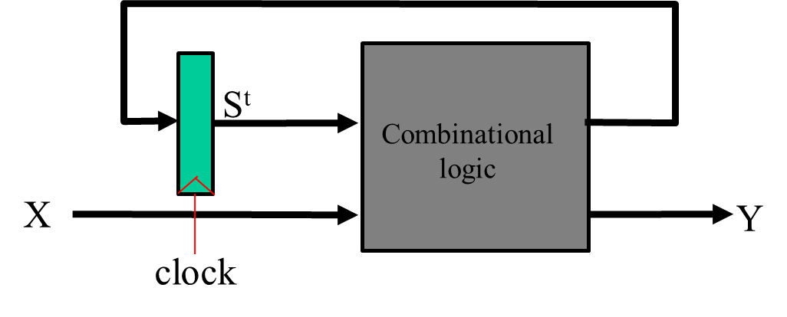
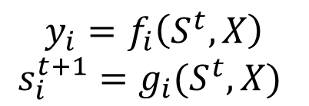
1. Introduction: Sequential Network Key features
Memory / Time steps
Memory: Flip flops
Specification: Finite State Machines
Implementation: Excitation Tables
Main Theme: Timing
Present time = t and next time = t+1
Timing constraints to separate the present and next times.
x_{i}
s_{i}
y_{i}
Clock
$$y_{i}=f_{i}\left(S^{t},X\right)$$
$$s_{i}^{t+1}=g_{i}(S^{t},X)$$
Notes:
A combinational logic cannot have some sort of feedback loop where the output of a logic is also the input of it. A sequential network on the other hand can have this feature.

Slide 5
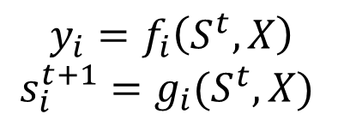
1. Introduction: Sequential Network Key features
Main Theme: Timing
Present time = t and next time = t+1
Timing constraints to separate the present and next times.
$$y_{i}=f_{i}\left(S^{t},X\right)$$
$$s_{i}^{t+1}=g_{i}(S^{t},X)$$
S^{t}
S^{t+1}
Combinational
logic
X
Y
clock
S^{t}
Combinational
logic
X
Y
clock
Notes:
A combinational logic cannot have some sort of feedback loop where the output of a logic is also the input of it. A sequential network on the other hand can have this feature.

Slide 6
1. Introduction: Different Types of Memory/Storage
Typical Computer Memory Hierarchy
Tradeoff between speed (latency) and size
Size relates to
  Storage density (area/bit)
  Power (power/bit)
Registers/Latches
Register File (Static Memory- SRAM)
Cache Memory (Static Memory - SRAM)
Main Memory (Dynamic Memory – DRAM)
NVM Main Memory (Non-Volatile Memory– e.g. Flash)
Disk

Slide 7
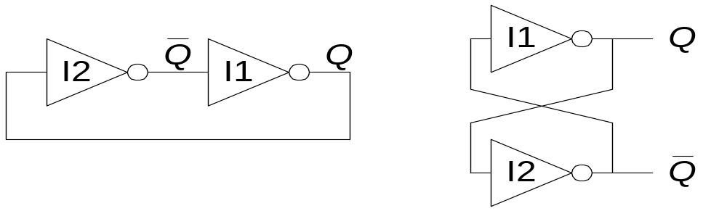
1. Introduction: Fundamental Memory Mechanism

Slide 8
1. Introduction: Memory Mechanism Capacitive Load
Fundamental building block of sequential circuits
Two outputs: Q, Q
There is a feedback loop!
  In a typical combinational logic, there is no feedback loop.
No inputs

Slide 9
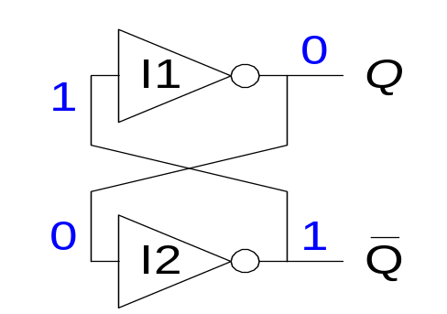
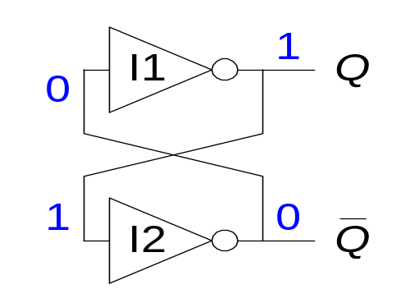
1. Introduction: Capacitive Loads
Consider the two possible cases:
  Q = 0: then Q’ = 1 and Q = 0 (consistent)
  Q = 1: then Q’ = 0 and Q = 1 (consistent)
  Bistable circuit stores 1 bit of state in the state variable, Q (or Q’ )
  Hold the value due to capacitive charges and feedback loop strengthening
But there are no inputs to control the state

Slide 10
Example
Q. Given a memory component made of a loop of inverters, the number of inverters in the loop has to be
Even
Odd
No constraints

Slide 11
1. Introduction: Memory Storage Mechanism
Word line (WL) to access cell
Read – measure voltage difference between B+ and B-
Write – force values of B+ and B- which may flip the cell
Static Random Access Memory - SRAM
WL
B+
B-
Sense Amp
Write Driver

Slide 12
2. Basic Building Blocks
Latches (Level Sensitive)
  SR Latches, D Latches
Flip-Flops (Edge Triggered)
  D FFs, (JK FFs, T FFs)
Examples of Memory Modules
  Registers, Shift Registers, Pattern Recognizers, Counters, FIFOs

Slide 13
2. Basic Building Blocks: Flight attendant call button
Flight attendant call button
  Press call: light turns on
    Stays on after button released
  Press cancel: light turns off
  Logic gate circuit to implement this?
Call
button
Blue light
Bit
Storage
Cancel
button
1. Call button pressed – light turns on
Call
button
Blue light
SR latch implementation
  Call=1 : sets Q to 1 and keeps it at 1
  Cancel=1 : resets Q to 0
Bit
Storage
a
Cancel
button
2. Call button released – light stays on
C
all
S
Call
button
Blue light
button
Bit
Storage
Cancel
button
Blue light
3. Cancel button pressed – light turns off
Q
Cancel
button
R

Slide 14
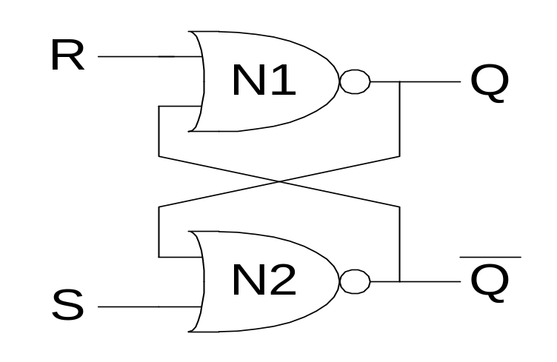
2. Basic Building Blocks: SR (Set/Reset) Latch
SR Latch
Consider the four possible cases:
  S = 1, R = 0
  S = 0, R = 1
  S = 0, R = 0
  S = 1, R = 1

Slide 15
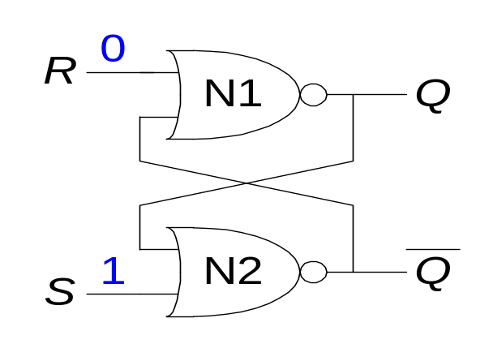
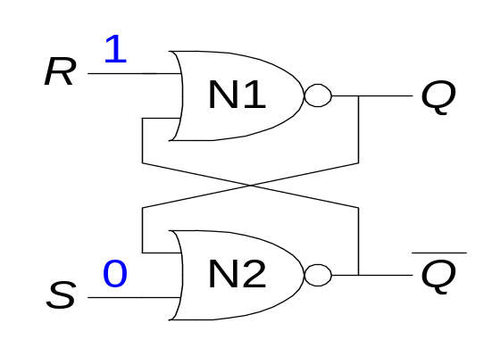
2. Basic Building Blocks: SR Latch Analysis
  S = 1, R = 0: then Q = 1 and Q = 0
  S = 0, R = 1: then Q = 0 and Q = 1

Slide 16
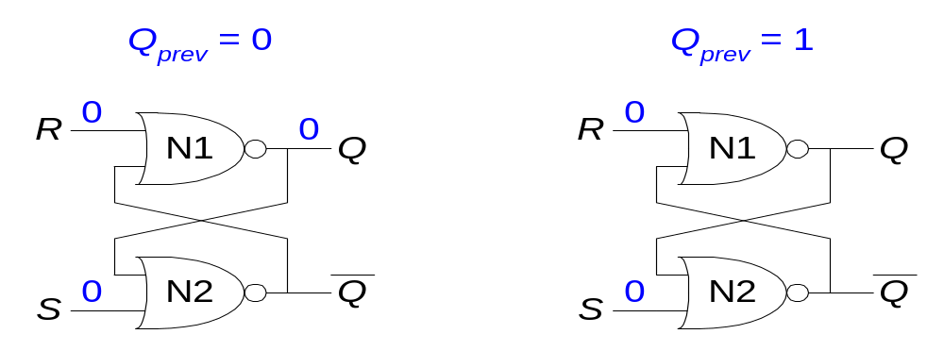
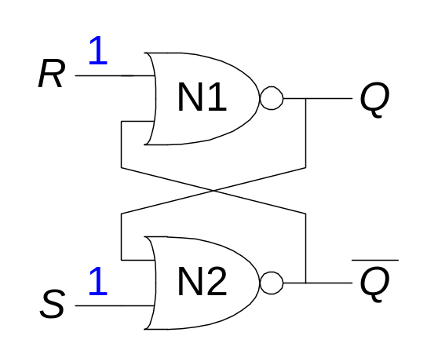
2. Basic Building Blocks: SR Latch Analysis
  S = 0, R = 0: then Q = Q_{prev}
  S = 1, R = 1: then Q = 0 and Q = 0

Slide 17
2. Basic Building Blocks: SR Latch
S
y
y = (S+Q)’
Q
R
Q = (R+y)’
y
S
R
Q
Inputs: S, R State: (Q, y)

Slide 18






Truth table of SR latch with incremental steps in time
id | S | R | Qt | yt | Qt | yt | Qt | yt | Qt | yt
0 | 0 | 0 | 0 | 0 | 1 | 1 | 0 | 0 | 1 | 1
1 | 0 | 0 | 0 | 1 | 0 | 1 | 0 | 1 | 0 | 1
2 | 0 | 0 | 1 | 0 | 1 | 0 | 1 | 0 | 1 | 0
3 | 0 | 0 | 1 | 1 | 0 | 0 | 1 | 1 | 0 | 0
4 | 0 | 1 | 0 | 0 | 0 | 1 | 0 | 1 | 0 | 1
5 | 0 | 1 | 0 | 1 | 0 | 1 | 0 | 1 | 0 | 1
6 | 0 | 1 | 1 | 0 | 0 | 0 | 0 | 1 | 0 | 1
7 | 0 | 1 | 1 | 1 | 0 | 0 | 0 | 1 | 0 | 1
8 | 1 | 0 | 0 | 0 | 1 | 0 | 1 | 0 | 1 | 0
9 | 1 | 0 | 0 | 1 | 0 | 0 | 1 | 0 | 1 | 0
10 | 1 | 0 | 1 | 0 | 1 | 0 | 1 | 0 | 1 | 0
11 | 1 | 0 | 1 | 1 | 0 | 0 | 1 | 0 | 1 | 0
12 | 1 | 1 | 0 | 0 | 0 | 0 | 0 | 0 | 0 | 0
13 | 1 | 1 | 0 | 1 | 0 | 0 | 0 | 0 | 0 | 0
14 | 1 | 1 | 1 | 0 | 0 | 0 | 0 | 0 | 0 | 0
15 | 1 | 1 | 1 | 1 | 0 | 0 | 0 | 0 | 0 | 0
$$y$$
$$S$$
$$y = (S+Q)’$$
$$R$$
$$Q = (R+y)’$$
$$Q$$

Slide 19
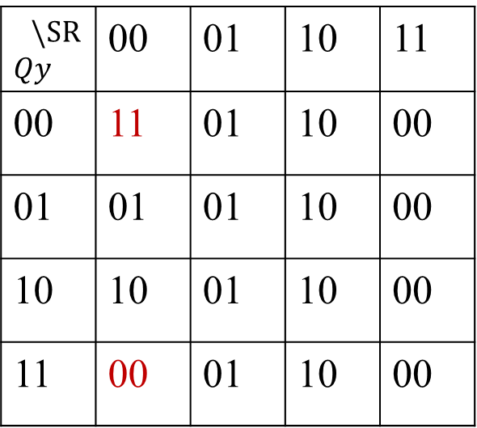
id | S | R | Qt | yt | Qt | yt | Qt | yt | Qt | yt
0 | 0 | 0 | 0 | 0 | 1 | 1 | 0 | 0 | 1 | 1
1 | 0 | 0 | 0 | 1 | 0 | 1 | 0 | 1 | 0 | 1
2 | 0 | 0 | 1 | 0 | 1 | 0 | 1 | 0 | 1 | 0
3 | 0 | 0 | 1 | 1 | 0 | 0 | 1 | 1 | 0 | 0
4 | 0 | 1 | 0 | 0 | 0 | 1 | 0 | 1 | 0 | 1
5 | 0 | 1 | 0 | 1 | 0 | 1 | 0 | 1 | 0 | 1
6 | 0 | 1 | 1 | 0 | 0 | 0 | 0 | 1 | 0 | 1
7 | 0 | 1 | 1 | 1 | 0 | 0 | 0 | 1 | 0 | 1
8 | 1 | 0 | 0 | 0 | 1 | 0 | 1 | 0 | 1 | 0
9 | 1 | 0 | 0 | 1 | 0 | 0 | 1 | 0 | 1 | 0
10 | 1 | 0 | 1 | 0 | 1 | 0 | 1 | 0 | 1 | 0
11 | 1 | 0 | 1 | 1 | 0 | 0 | 1 | 0 | 1 | 0
12 | 1 | 1 | 0 | 0 | 0 | 0 | 0 | 0 | 0 | 0
13 | 1 | 1 | 0 | 1 | 0 | 0 | 0 | 0 | 0 | 0
14 | 1 | 1 | 1 | 0 | 0 | 0 | 0 | 0 | 0 | 0
15 | 1 | 1 | 1 | 1 | 0 | 0 | 0 | 0 | 0 | 0
“State Table” of SR latch
$\backslash SR$ $$Qy$$ | 00 | 01 | 10 | 11
00 | 11 | 01 | 10 | 00
01 | 01 | 01 | 10 | 00
10 | 10 | 01 | 10 | 00
11 | 00 | 01 | 10 | 00

Slide 20
CASES:
SR=01: (Q,y) = (0,1)
SR=10: (Q,y) = (1,0)
SR=11: (Q,y) = (0,0)
SR= 00: (Q,y) does not change if (Q,y)=(1,0) or (0,1)
However, when (Q,y) = (0,0) or (1,1), the output keeps changing
Remark: To verify the design, we need to enumerate all combinations.

Slide 21
State Table and State Diagram
Q y
Q y
State
SR
State
Present
State
Transition
Next
State
State diagram
00
01
10
00
10
State Table
01
10
01
\SR Qy | 00 | 01 | 10 | 11
00 | 11 | 01 | 10 | 00
01 | 01 | 01 | 10 | 00
10 | 10 | 01 | 10 | 00
11 | 00 | 01 | 10 | 00
11
10
01
11
00
11
01
10
00
11
00
11

Slide 22
CASES:
SR=01: (Q,y) = (0,1)
SR=10: (Q,y) = (1,0)
SR=11: (Q,y) = (0,0)
SR= 00: (Q,y) does not change if (Q,y)=(1,0) or (0,1)
However, when (Q,y) = (0,0) or (1,1), the output keeps changing
Q. Suppose that we can set the initial state (Q,y)=(0,1). To avoid the SR latch output from toggling or behaving in an undefined way which input combinations should be avoided:
(S, R) = (0, 0)
(S, R) = (1, 1)
None of the above

Slide 23
CASES:
SR=01: (Q,y) = (0,1)
SR=10: (Q,y) = (1,0)
SR=11: (Q,y) = (0,0)
SR= 00: (Q,y) does not change if (Q,y)=(1,0) or (0,1)
However, when (Q,y) = (0,0) or (1,1), the output keeps changing
We set the initial state (Q,y)=(0,1) or (1,0). To avoid the state (Q,y)= (0,0) or (1,1), we block the input SR=11.
Thus, without input SR=11, the state can only be (Q,y)=(0,1) or (1,0).

Slide 24
SR Latch
00
01
10
00
10
01
10
01
11
10
01
11
00
11
01
10
00
11
00
The only way to reach state (Q,y)=(0,0) or (1,1) is via edge labeled SR=11.
11

Slide 25
SR Latch
00
01
10
00
10
01
10
01
11
10
01
11
00
11
01
10
00
11
00
The only way to reach state (Q,y)=(0,0) or (1,1) is via edge labeled SR=11.
11

Slide 26
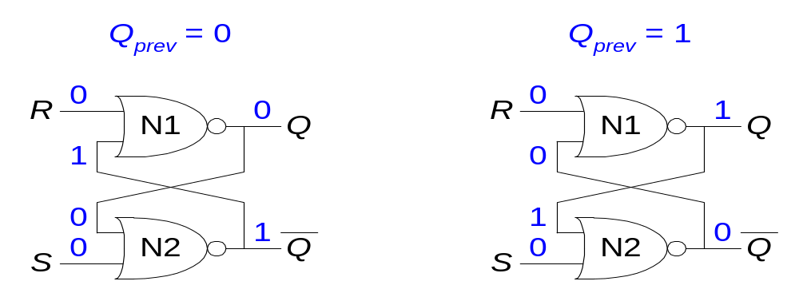
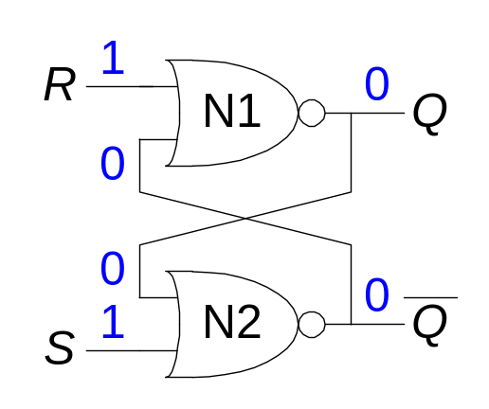
2. Basic Building Blocks: SR Latch Analysis
  S = 0, R = 0: then Q = Q_{prev} and Q = Q_{prev} (memory!)
  S = 1, R = 1: then Q = 0 and Q = 0 (invalid state: Q ≠ NOT Q)

Slide 27
2. Basic Building Blocks: SR Latch
CASES
SR=01: (Q,y) = (0,1)
SR=10: (Q,y) = (1,0)
SR=11: (Q,y) = (0,0)
SR = 00: if (Q,y) = (0,0) or (1,1), the output keeps changing
Solutions: Avoid the case that SR = (1,1).
State table
SR
Characteristic Expression
Q(t+1) = S(t)+R’(t)Q(t)
inputs
00 01 10 11
PS
0 0 0 1 -
1 1 0 1 -
Q(t)
Q(t+1)
NS (next state)

Slide 28
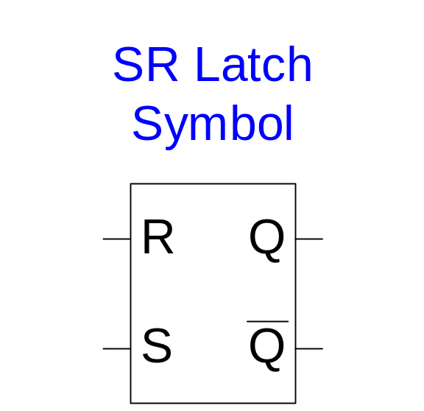
2. Basic Building Blocks: SR Latch Symbol
SR stands for Set/Reset Latch
  Stores one bit of state (Q)
Control what value is being stored with S, R inputs
  Set: Make the output 1 (S = 1, R = 0, Q = 1)
  Reset: Make the output 0 (S = 0, R = 1, Q = 0)
Must do something to avoid
invalid state (when S = R = 1)

Slide 29

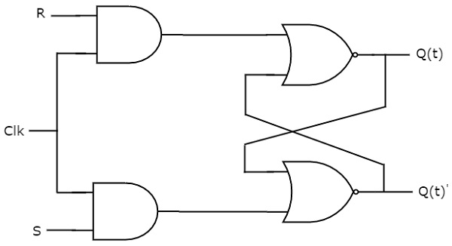
2. Basic Building Blocks: SR Latch Symbol

Slide 30
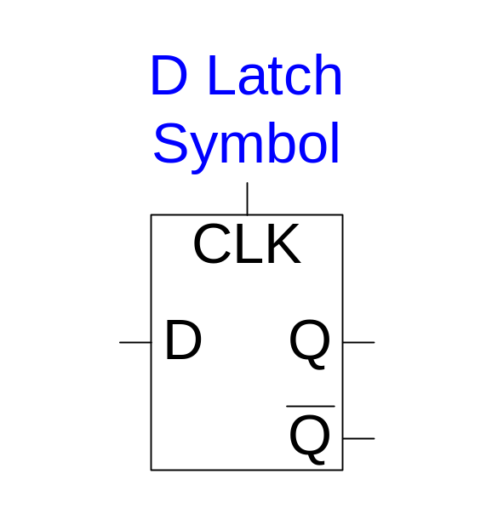
2. Basic Building Blocks: D Latch
Two inputs: CLK, D
  CLK: controls when the output changes
  D (the data input): controls what the output changes to
Function
  When CLK = 1, D passes through to Q (the latch is transparent)
  When CLK = 0, Q holds its previous value (the latch is opaque)
Avoids invalid case when Q ≠ NOT Q

Slide 31
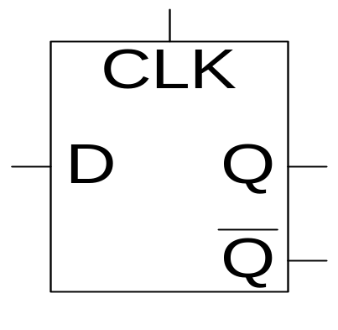
2. Basic Building Blocks: D Latch Internal Circuit

Slide 32
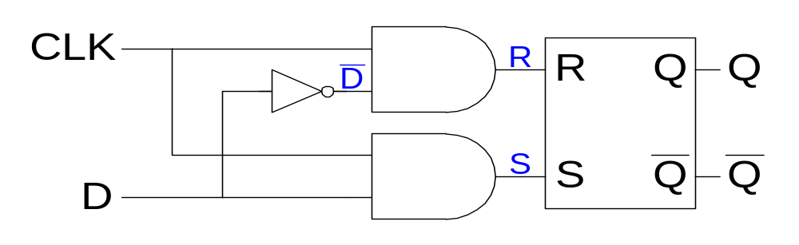
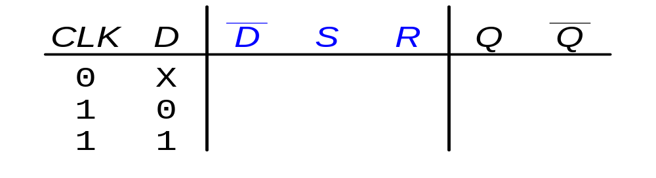
2. Basic Building Blocks: D Latch Internal Circuit

Slide 33
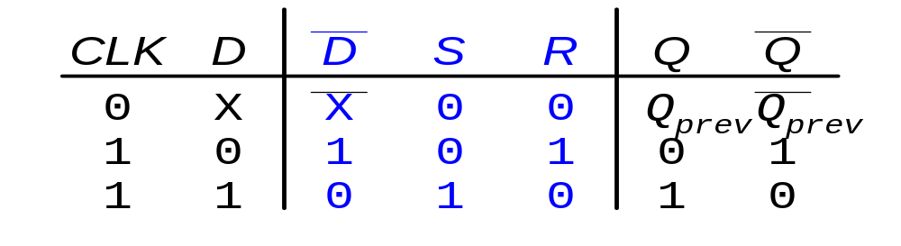
2. Basic Building Blocks: D Latch Internal Circuit

Slide 34
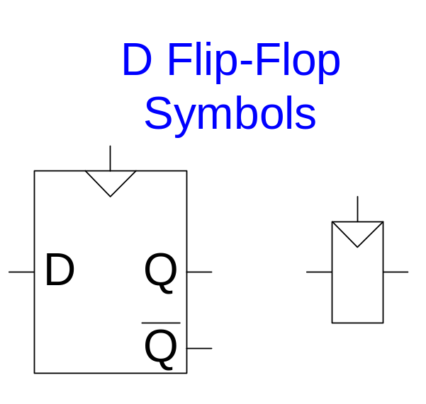
2. Basic Building Blocks: D Flip-Flop
Two inputs: CLK, D
Function
  The flip-flop “samples” D on the rising edge of CLK
    When CLK rises from 0 to 1, D passes through to Q
    Otherwise, Q holds its previous value
  Q changes only on the rising edge of CLK
A flip-flop is called an edge-triggered device because it is activated on the clock edge

Slide 35

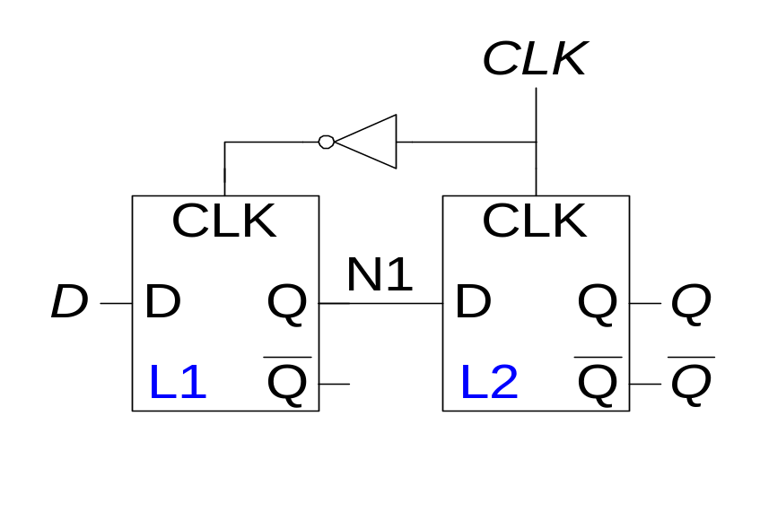
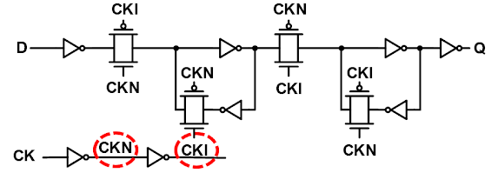
2. Basic Building Blocks: D FF Internal Circuit

Slide 36
D Flip-Flop Internal Circuit
Two back-to-back latches (L1 and L2) controlled by complementary clocks
When CLK = 0
  L1 is transparent, L2 is opaque
  D passes through to N1
When CLK = 1
  L2 is transparent, L1 is opaque
  N1 passes through to Q
Thus, on the edge of the clock (when CLK rises from 0 1)
  D passes through to Q

Slide 37
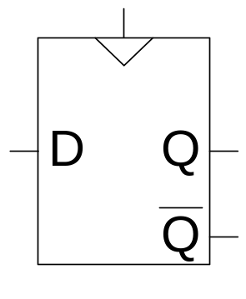
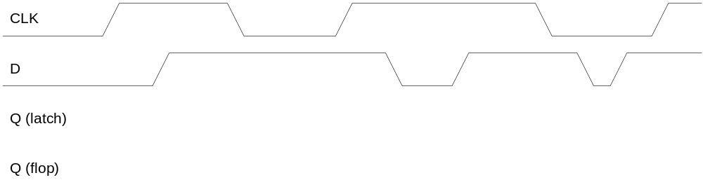
D Flip-Flop vs. D Latch

Slide 38
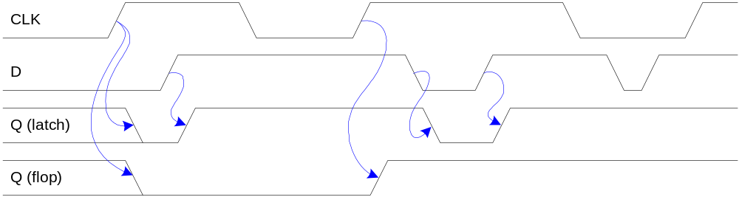
D Flip-Flop vs. D Latch

Slide 39
2. Basic Building Blocks: Latch and FF (two latches)
A latch can be considered as a door
CLK = 0, door is shut
CLK = 1, door is unlocked
A flip-flop is a two-door entrance
CLK = 1
CLK = 0
CLK = 1

Slide 40
2. Basic Building Blocks: D Flip-Flop (Delay)
D
Q
CLK
Q’
Id D Q(t) Q(t+1)
0 0 0 0
1 0 1 0
2 1 0 1
3 1 1 1
State table
D
PS
0 1
0 0 1
1 0 1
NS= Q(t+1)
Characteristic Expression: Q(t+1) = D(t)

Slide 41
2. Examples
Can D flip-flip serve as a memory component?
Yes
No

Slide 42
2. Examples: Rising vs. Falling Edge D FF
The triangle means clock input, edge triggered
Internal design: Just invert servant clock rather than master
D
Q’
D
Q’
Q
Q
Symbol for rising-edge
triggered D flip-flop
Symbol for falling-edge
triggered D flip-flop
rising edges
falling edges
Clk
Clk

Slide 43
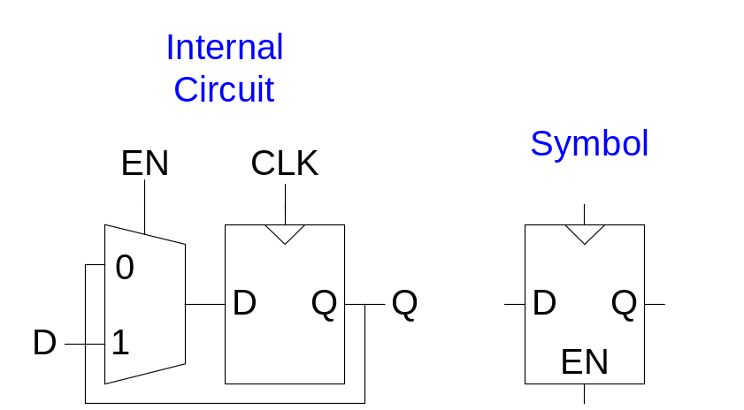
2. Examples: Enabled D-FFs
Inputs: CLK, D, EN
  The enable input (EN) controls when new data (D) is stored
Function
  EN = 1: D passes through to Q on the clock edge
  EN = 0: the flip-flop retains its previous state

Slide 44
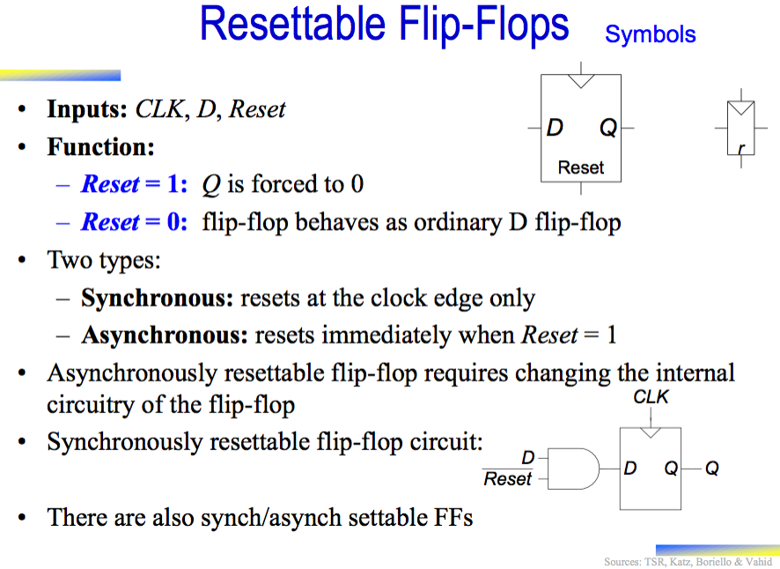

Slide 45
2. Examples: Bit Storage Overview
SR latch
Level-sensitive SR latch
D latch
D flip-flop
S (set)
S
S1
D
S
D latch
D latch
D
Q
’
Dm
Qm
Ds
Qs’
C
C
Q
C
m
Cs
Qs
Q
Q
Q
master
servant
R
R
Clk
R (reset)
R1
S=1 sets Q to 1, R=1 resets Q to 0. Problem: SR=11 yield undefined Q.
S and R only have effect when C=1. We can design outside circuit so SR=11 never happens when C=1. Problem: avoiding SR=11 can be a burden.
SR can’t be 11 if D is stable before and while C=1, and will be 11 for only a brief glitch even if D changes while C=1.
*Transition may cross many levels of latches.
Only loads D value present at rising clock edge, so values can’t propagate to other flip-flops during same clock cycle.
*Transition happens between two level of flip-flops.

Slide 46
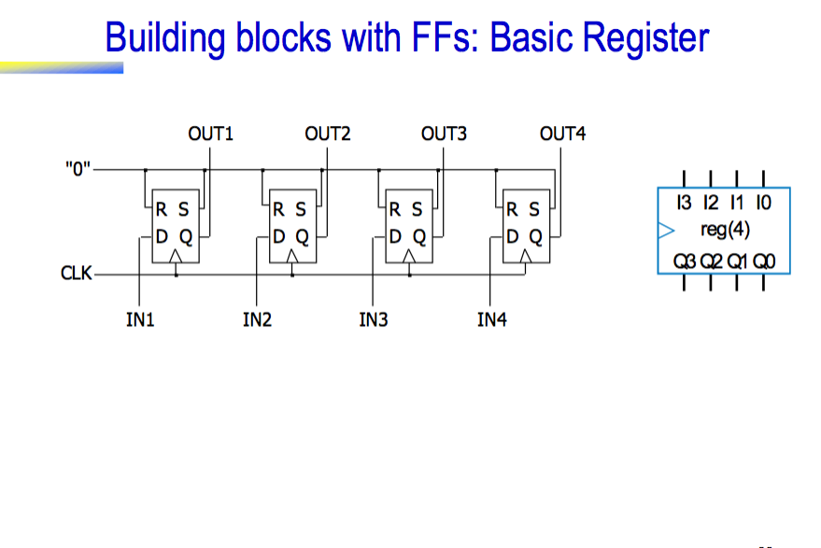

Slide 47
2. Examples: Shift register
Holds & shifts samples of input
OUT1
OUT2
OUT3
OUT4
IN
D
Q
D
Q
D
Q
D
Q
CLK
Time | Input | OUT1 | OUT2 | OUT3 | OUT4
0 | 1 | 0 | 0 | 0 | 0
1 | 0
2 | 1
3 | 1
4 | 0
5 | 0
6 | 0

Slide 48
2. Examples: Shift register
Holds & shifts samples of input
OUT1
OUT2
OUT3
OUT4
IN
D
Q
D
Q
D
Q
D
Q
CLK
Time | Input | OUT1 | OUT2 | OUT3 | OUT4
0 | 1 | 0 | 0 | 0 | 0
1 | 0 | 1 | 0 | 0 | 0
2 | 1 | 0 | 1 | 0 | 0
3 | 1 | 1 | 0 | 1 | 0
4 | 0 | 1 | 1 | 0 | 1
5 | 0 | 0 | 1 | 1 | 0
6 | 0 | 0 | 0 | 1 | 1

Slide 49
2. Examples: Pattern Recognizer
Combinational function of input samples
OUT
OUT1
OUT2
OUT3
OUT4
IN
D
Q
D
Q
D
Q
D
Q
CLK

Slide 50
2. Examples: Counters
Sequences through a fixed set of patterns
OUT1
OUT2
OUT3
OUT4
IN
D
Q
D
Q
D
Q
D
Q
CLK
Counts through : 1000, 1100, 1110, 1111, 0111, 0011, 0001, 0000
Known as Mobius (or Johnson) counter

Slide 51
Appendix: slides on BSV
Describing Sequential Ckts
State diagrams and next-state tables nor are suitable for describing very large digital designs
  large circuits must be described in a modular fashion -- as a collection of cooperating FSMs
BSV is a modern programming language to describe cooperating FSMs
  We will give various examples of FSMs in BSV

Slide 52
Modulo-4 counter circuit
inc
inc
Modulo-4
counter
q0
Read the
counter
1
q1
0
q0^{t+1} = ~inc∙q0^{t} + inc∙~q0^{t}
q1^{t+1} = ~inc∙q1^{t} + inc∙~q1^{t}∙q0^{t} + inc∙q1^{t}∙~q0^{t}
“Optimized” logic
q0^{t+1} = inc ⊕ q0^{t}
q1^{t+1} = (inc == 1) ? q0^{t} ⊕ q1^{t} : q1^{t}

Slide 53
Modulo-4 counter circuit
inc
q0^{t+1} = ~inc∙q0^{t} + inc∙~q0^{t}
q1^{t+1} = ~inc∙q1^{t} + inc∙~q1^{t}∙q0^{t} + inc∙q1^{t}∙~q0^{t}
“Optimized” logic
q0^{t+1} =inc ⊕ q0^{t}
q1^{t+1} =(inc == 1) ? q0^{t}⊕q1^{t}:q1^{t}
q0
1
q1
0
PS\input | inc=0 | inc=1
00 | 00 | 01
01 | 01 | 10
10 | 10 | 11
11 | 11 | 00
PS: q1^{t} q0^{t}, NS: q1^{t+1} q0^{t+1}

Slide 54
modulo4 counter in BSV
State specification
module moduloCounter(Counter);
Reg#(Bit#(2)) cnt <- mkReg(0);
method Action inc;
cnt <={!cnt[1]&cnt[0] | cnt[1]&!cnt[0],
!cnt[0]};
endmethod
method Bit#(2) read;
return cnt;
endmethod
endmodule
Initial value
An action to specify how the value of the cnt is to be set
inc.en
read
~cnt[1]&…
cnt
Notes:
(Andy) ‘r’ and ‘w’ are ‘_read’ and ‘_write’ in BSV, but ‘r’ and ‘w’ are much easier to write on slides.
(Andy) I changed ‘||’ to ‘|’ in the logic because || is the boolean or and | is the bitwise or.

Slide 55
Interface
Modulo counter has the following interface, i.e., type
An interface can have many different implementations
  For example, the numbers may be represented as Gray code
interface Counter;
method Action inc;
method Bit#(2) read;
endinterface

Slide 56
Modules
A module in BSV is like a class definition in Java or C++
  It has internal state
  The internal state can only be read and manipulated by the (interface) methods
  An action specifies which state elements are to be modified
  Actions are atomic -- either all the specified state elements are modified or none of them are modified (no partially modified state is visible)

Slide 57
FIFO Interface
interface Fifo#(numeric type size, type t);
method Bool notFull;
method Bool notEmpty;
method Action enq(t x);
method Action deq;
method t first;
endinterface
x
en
enq
en
deq
notFull
Fifo
module
!full
- enq should be called only if notFull returns True;
- deq and first should be called only if notEmpty returns True
notEmpty
!emty
first
first

Slide 58
One-Element FIFO Implementation
module mkCFFifo (Fifo#(1, t));
Reg#(t) d <- mkRegU;
Reg#(Bool) v <- mkReg(False);
method Bool notFull;
return !v;
endmethod
method Bool notEmpty;
return v;
endmethod
method Action enq(t x);
v <= True; d <= x;
endmethod
method Action deq;
v <= False;
endmethod
method t first;
return d;
endmethod
endmodule
x
en
enq
en
deq
notFull
Fifo
module
!full
notEmpty
!emty
first
first

Slide 59
FIFO Module: methods with guarded interfaces
n
interface Fifo#(numeric type size,
type t);
method Action enq(t x);
method Action deq;
method t first;
endinterface
enab
enq
not full
rdy
enab
deq
FIFO
not empty
rdy
n
not empty
first
rdy
Every method has a guard (rdy wire); the value returned by a value method is meaningful only if its guard is true
Every action method has an enable signal (en wire); an action method is invoked (en is set to true) only if the guard is true
Guards make it possible to transfer the responsibility of the correct use of a method from the user to the compiler
Guards are extraordinarily convenient for programming and also enhance modularity of the code

Slide 60
One-Element FIFO Implementation with guards
module mkCFFifo (Fifo#(1, t));
Reg#(t) d <- mkRegU;
Reg#(Bool) v <- mkReg(False);
method Action enq(t x)
v <= True; d <= x;
endmethod
method Action deq
v <= False;
endmethod
method t first
return d;
endmethod
endmodule
n
if (!v);
enab
enq
not full
rdy
enab
deq
FIFO
not empty
rdy
n
if (v);
not empty
first
rdy
if (v);

