Slide 1
CSE 140: Components and Design Techniques for Digital Systems
Lecture 6: Universal Gates
CK Cheng
Dept. of Computer Science and Engineering
University of California, San Diego

Slide 2
Universal Gates
Universal Set of Gates
  Motivation
  Definition
  Examples
Various Types of Gates
  XOR, XNOR
  NAND, NOR
  Block Diagram Transfers
Notes:
Here we finish up our discussion on combination logic. We first will talk about complete set of gates, then move on to talk about other types of gates such as XOR gates and NAND / NOR gates. We will also talk about block diagram transfers, which is like converting a circuit into an equivalent circuit (i.e. it has the same exact function), but in the process changing and even reducing the number of gates.

Slide 3
Universal Set of Gates: Motivation
AND, OR, NOT: Logic gates related to reasoning from Aristotle (384-322BCE).
NAND, NOR: Inverted AND, Inverted OR gates. For VLSI technologies, all gate outputs are inverted functions (AND, OR operations with a bubble at output).
XOR: Exclusive OR gates can be used for testing, e.g. parity check.
Multiplexer + input table: Table based logic for programmability. FPGA technology.
Neuron and Synapse: Neural network.
Quantum computing: Reversible gates.
In the future, we may have new sets of gates due to new technologies.
Given a set of gates, can the gates in the set cover all possible switching functions?

Slide 4
Universal Set
Universal set is a powerful concept to identify the coverage of a set of gates afforded by a given technology.
Criterion: If the set of gates can implement AND, OR, and NOT gates, the set is universal.

Slide 5
Universal Set Definition
Universal Set: A set of gates such that every switching function can be implemented with the gates in this set.
Examples
{AND, OR, NOT}
{AND, NOT}
{OR, NOT}
Notes:
A universal set simply means that some set of gates can implement any switching function. For example, {AND OR NOR} is a universal set because you can do any possible switching (0 or 1) function with it. {AND NOR} is also universal because you can implement OR with just AND, NOT. Since you can do that, you can implement any switching function.

Slide 6
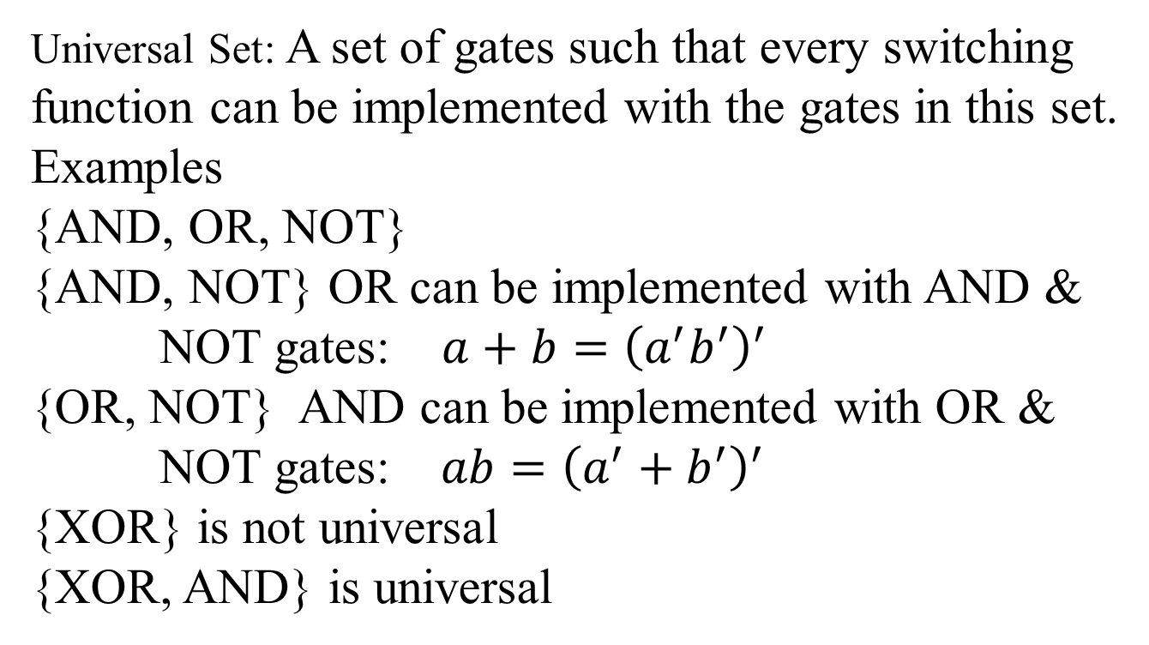
Universal Set: Examples
Universal Set: A set of gates such that every switching function can be implemented with the gates in this set.
Examples
{AND, OR, NOT}
{AND, NOT} OR can be implemented with AND & NOT gates: $a+b={\left(a^{′}b^{′}\right)}^{′}$
{OR, NOT} AND can be implemented with OR & NOT gates: $ab={\left(a^{′}+b^{′}\right)}^{′}$
{XOR} is not universal
{XOR, AND} is universal
Notes:
A universal set simply means that some set of gates can implement any switching function. For example, {AND OR NOR} is a universal set because you can do any possible switching (0 or 1) function with it. {AND NOR} is also universal because you can implement OR with just AND, NOT. Since you can do that, you can implement any switching function.

Slide 7
Universal Set: Example
Is the set {AND, OR} (but no NOT gate) universal?
Yes
No
Note that the set was used in a once popular design style as domino logic for high performance computing.

Slide 8
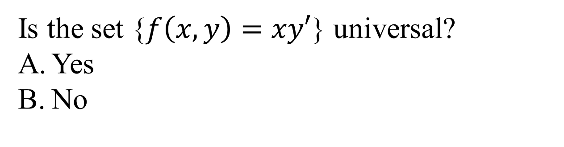
Universal Set: Example
Is the set {$f\left(x,y\right)=xy′$} universal?
Yes
No

Slide 9
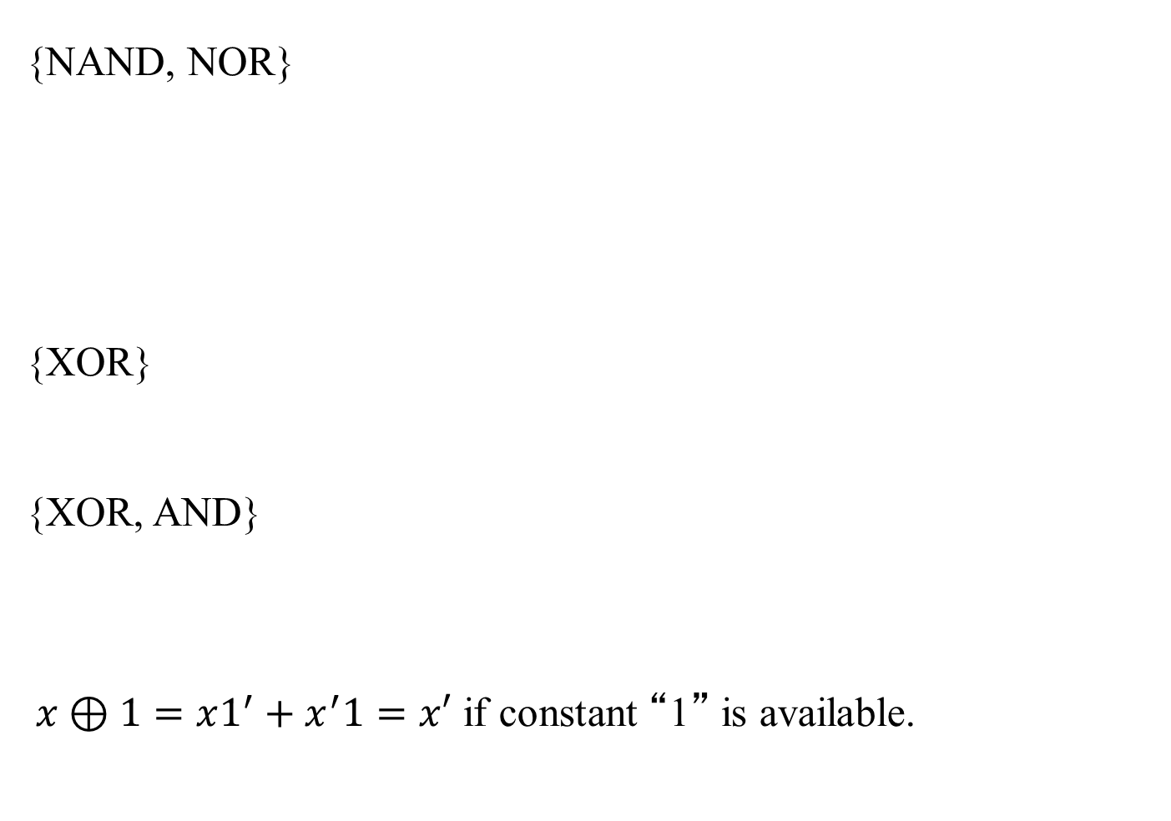
Universal Set: Examples
{NAND, NOR}
{XOR}
{XOR, AND}
$x⊕1=x1^{′}+x^{′}1=x′$ if constant “1” is available.
1
Notes:
We see that a set consisting of just the NAND and NOR gates forms a universal set. We can implement a NOT gate by using a NAND gate and we can form an AND and OR gate by simply negating the NAND and NOR gates.

Slide 10
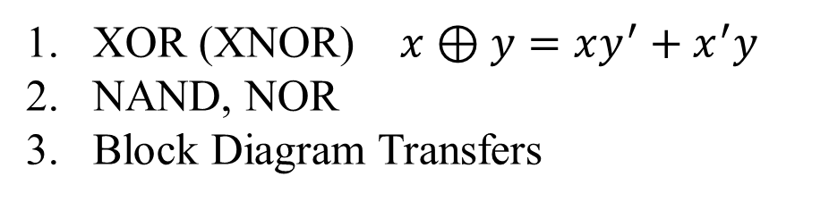
Various Types of Gates: Properties and Usage
XOR (XNOR) $x⊕y=xy^{′}+x^{′}y$
NAND, NOR
Block Diagram Transfers
Notes:
A XOR gate is a gate that is 1 only when one and only one of the two inputs is also 1. If both are 0 or both are 1, then the XOR gate will output a 0 also.

Slide 11
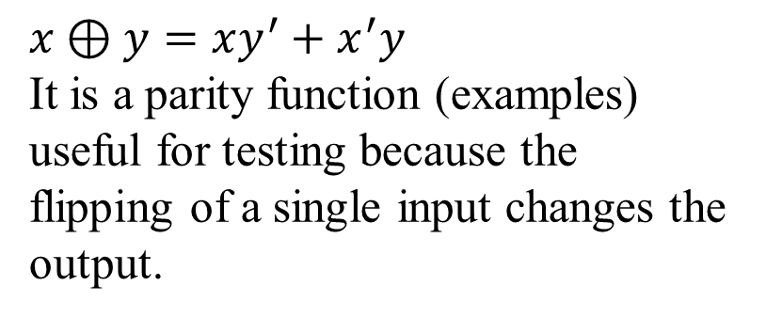




Other Types of Gates: XOR
$$x⊕y=xy^{′}+x^{′}y$$
It is a parity function (examples)
useful for testing because the flipping of a single input changes the output.
$$x$$
$$y$$
$$xy′$$
$$x^{′}y$$
id | x | y | x ⊕ y
0 | 0 | 0 | 0
1 | 0 | 1 | 1
2 | 1 | 0 | 1
3 | 1 | 1 | 0
 | x=0 | x=1
y=0 | 0 | 1
y=1 | 1 | 0
Notes:
A XOR gate is a gate that is 1 only when one and only one of the two inputs is also 1. If both are 0 or both are 1, then the XOR gate will output a 0 also.

Slide 12

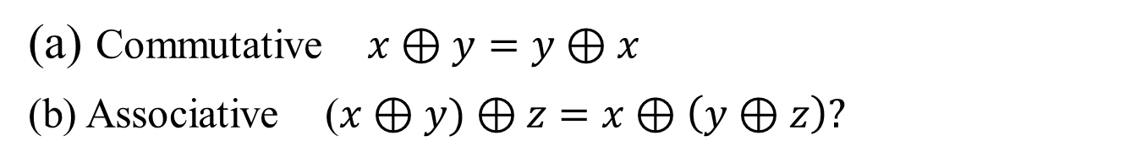



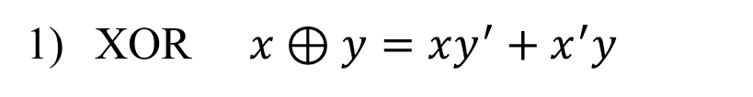
Other Types of Gates: XOR
XOR $x⊕y=xy^{′}+x^{′}y$
$$x$$
$$y$$
$$xy′$$
$$x^{′}y$$
    Commutative $x⊕y=y⊕x$
    Associative ($x⊕y)⊕z$ $=x⊕\left(y⊕z\right)?$
Notes:
A XOR gate is a gate that is 1 only when one and only one of the two inputs is also 1. If both are 0 or both are 1, then the XOR gate will output a 0 also.

Slide 13

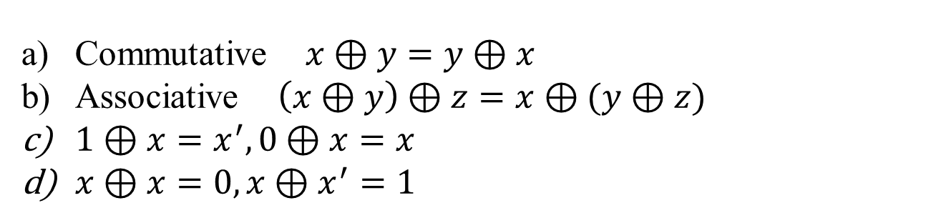



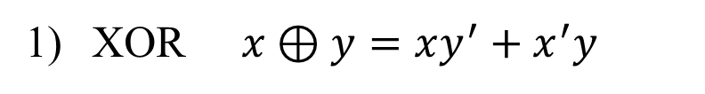
Other Types of Gates: XOR
XOR $x⊕y=xy^{′}+x^{′}y$
$$x$$
$$y$$
$$xy′$$
$$x^{′}y$$
    Commutative $x⊕y=y⊕x$
    Associative $\left(x⊕y\right)⊕z=x⊕(y⊕z)$
    $1⊕x=x^{′}, 0⊕x=x$
    $x⊕x=0, x⊕x^{′}=1$
Notes:
A XOR gate is a gate that is 1 only when one and only one of the two inputs is also 1. If both are 0 or both are 1, then the XOR gate will output a 0 also.

Slide 14
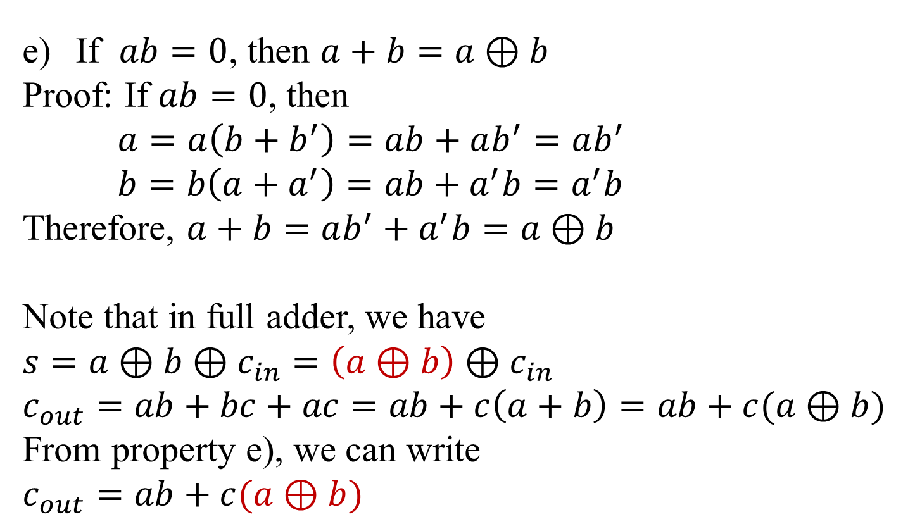
Other Types of Gates: Properties and Usage
If $ab=0$, then $a+b=a⊕b$
Proof: If $ab=0$, then
$a=a\left(b+b^{′}\right)=ab+ab^{′}=ab^{′}$
$b=b\left(a+a^{′}\right)=ab+a^{′}b=a^{′}b$
Therefore, $a+b=ab^{′}+a^{′}b=a⊕b$
Note that in full adder, we have
$$s=a⊕b⊕c_{in}=\left(a⊕b\right)⊕c_{in}$$
$$c_{out}=ab+bc+ac=ab+c\left(a+b\right)=ab+c(a⊕b)$$
From property e), we can write
$$c_{out}=ab+c(a⊕b)$$

Slide 15
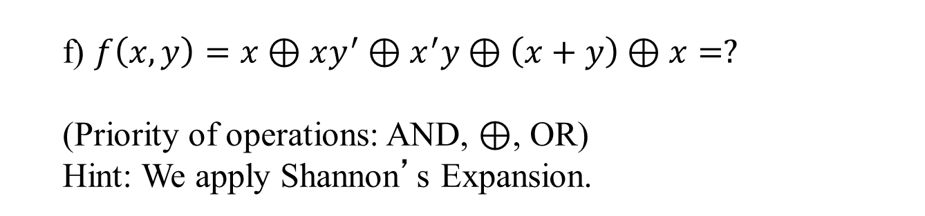
Other Types of Gates: XOR
f) $f\left(x,y\right)=x⊕xy^{′}⊕x^{′}y⊕\left(x+y\right)⊕x=?$
(Priority of operations: AND, ⊕, OR)
Hint: We apply Shannon’s Expansion.

Slide 16
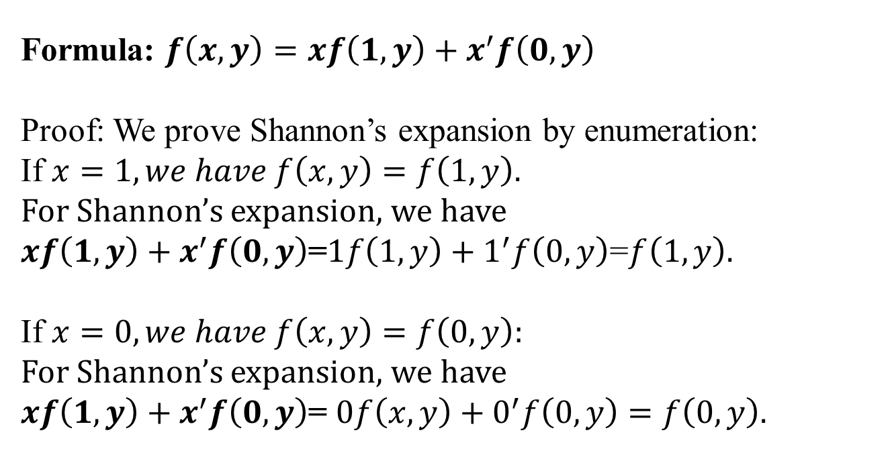
Various Types of Gates: XOR
Shannon’s Expansion (for switching functions)
Formula: $f\left(x,y\right)=xf\left(1,y\right)+x^{′}f\left(0,y\right)$
Proof: We prove Shannon’s expansion by enumeration:
If $x=1, we have f\left(x,y\right)=f\left(1,y\right).$
For Shannon’s expansion, we have
$xf\left(1,y\right)+x^{′}f\left(0,y\right)$=$1f\left(1,y\right)+1^{′}f\left(0,y\right)$=$f\left(1,y\right).$
If $x=0, we have f\left(x,y\right)=f\left(0,y\right):$
For Shannon’s expansion, we have
$xf\left(1,y\right)+x^{′}f\left(0,y\right)$= $0f\left(x,y\right)+0^{′}f\left(0,y\right)=f\left(0,y\right).$
Notes:
Shannon’s Expression is actually very useful equation. It simply says a function can be decomposed by restricting X. Thus we have two cases, one when X is 0 and one when X is 1.

Slide 17
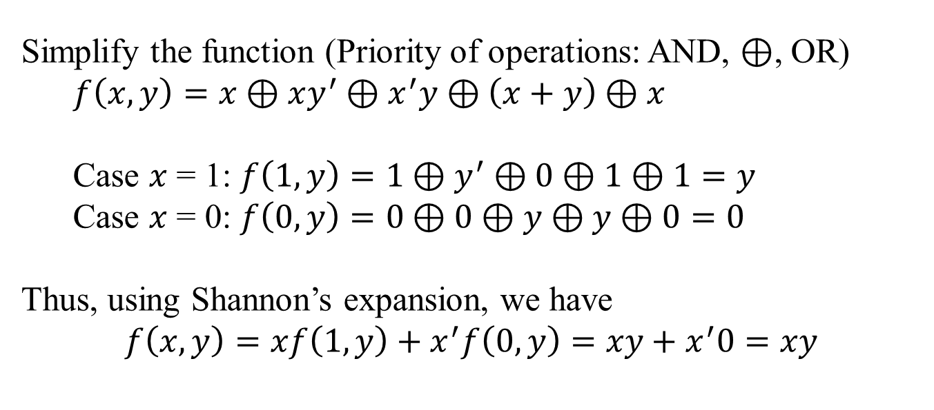
Other types of gates: XOR
Simplify the function (Priority of operations: AND, ⊕, OR)
$f\left(x,y\right)=x⊕xy^{′}⊕x^{′}y⊕\left(x+y\right)⊕x$
Case $x$ = 1: $f\left(1,y\right)=1⊕y^{′}⊕0⊕1⊕1=y$
Case $x$ = 0: $f\left(0,y\right)=0⊕0⊕y⊕y⊕0=0$
Thus, using Shannon’s expansion, we have
$f\left(x,y\right)=xf\left(1,y\right)+x^{′}f\left(0,y\right)=xy+x^{′}0=xy$
Notes:
Using Shannon’s Expression, we can easily solve for the answer to our problem. First we put parentheses around terms with higher precedence (like AND terms), and then from there we apply Shannon’s Expression to derive the two cares of when X is 1 and X is 0. Because we see that when X is 1, the function is Y, and when X is 0, the function is 0, we realize that the function is simply XY.

Slide 18
XOR gates: Examples
Is the equation
a+(b⊕c) = (a+b)⊕(a+c) true?
Yes
No

Slide 19
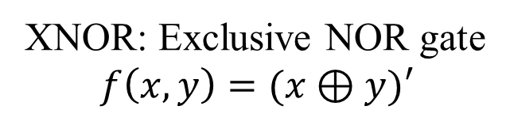
XOR gates: Examples
XNOR: Exclusive NOR gate
$$f\left(x,y\right)=(x⊕y)′$$

Slide 20
Other Types of Gates: NAND, NOR
2) NAND, NOR gates
NAND (NOR) gates are not associative
Let a | b = (ab)’
(a | b) | c ≠ a | (b | c)

Slide 21
Other Types of Gates: Block Diagram Transform
3) Block Diagram Transformation
a) Reduce # of inputs.
⬄
⬄

Slide 22
Other Types of Gates: Block Diagram Transform
b. DeMorgan’s Law
⬄
(a+b)’ = a’b’
⬄
(ab)’ = a’+b’
Notes:
DeMorgan’s Law implies that if you are given a NOR gate, you can convert that to an AND gate with two inverted inputs. Same with a NAND gate, you can replace a NAND gate with a OR gate with two inverted inputs.

Slide 23
Other Types of Gates: Block Diagram Transform
c. Sum of Products (Using only NAND gates)
⬄
⬄
Sum of Products (We create many bubbles with NOR gates)
⬄
⬄
Notes:
As we can see, there is a difference in how we transform our circuit. Comparing the two above, it is clear that using the NAND gates is much preferable to using the NOR gates as there are much less gates in the NAND version.

Slide 24
Other Types of Gates: Block Diagram Transform
d. Product of Sums (NOR gates only)
⬄
⬄
We will create many bubbles with NAND gates.
Notes:
Here we transform a product of sums circuit (two OR gates followed by an AND gate) into one with just NOR gates. We see that in this case, we don’t have a lot of gates like we did in the Sum of Products case.

Slide 25
NAND, NOR gates
Other Types of Gates: Block Diagram Transform
Remark:
Two level NAND gates: Sum of Products
Two level NOR gates: Product of Sums

Slide 26
Part II. Sequential Networks
Memory / Timesteps
Clock
Flip flops
Specification
Implementation
Notes:
A combinational logic cannot have some sort of feedback loop where the output of a logic is also the input of it. A sequential network on the other hand can have this feature.

