Slide 1
Lecture 4: Four Input K-Maps
CSE 140: Components and Design Techniques for Digital Systems
CK Cheng
Dept. of Computer Science and Engineering
University of California, San Diego

Slide 2
Outlines
Switching Algebra vs. Karnaugh Maps
Definitions: implicants, prime implicants, essential prime implicants
Implementation Procedures
Algebra | Variables | Product terms | Minterms | Consensus theorem
K Map | Two-Half Planes | Rectangles | Cells | Adjacency

Slide 3
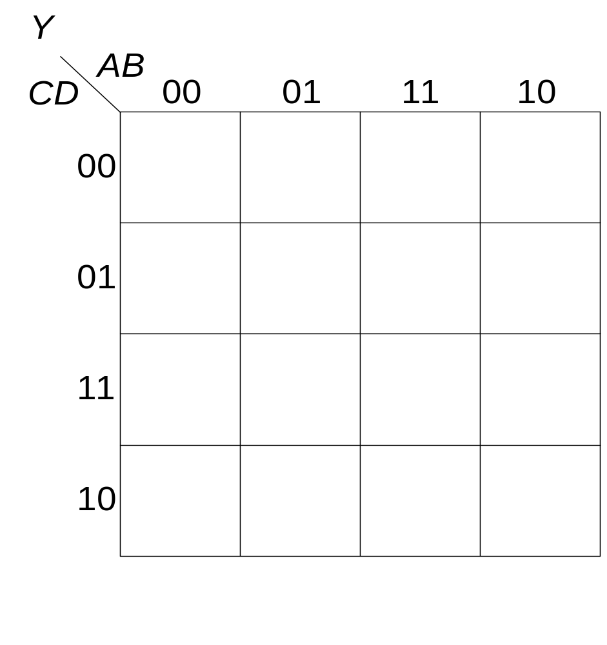
4-input K-map
An example
id | A | B | C | D | Y
0 | 0 | 0 | 0 | 0 | 1
1 | 0 | 0 | 0 | 1 | 0
2 | 0 | 0 | 1 | 0 | 1
3 | 0 | 0 | 1 | 1 | 1
4 | 0 | 1 | 0 | 0 | 0
5 | 0 | 1 | 0 | 1 | 1
6 | 0 | 1 | 1 | 0 | 1
7 | 0 | 1 | 1 | 1 | 1
8 | 1 | 0 | 0 | 0 | 1
9 | 1 | 0 | 0 | 1 | 1
10 | 1 | 0 | 1 | 0 | 1
11 | 1 | 0 | 1 | 1 | 0
12 | 1 | 1 | 0 | 0 | 0
13 | 1 | 1 | 0 | 1 | 0
14 | 1 | 1 | 1 | 0 | 0
15 | 1 | 1 | 1 | 1 | 0

Slide 4
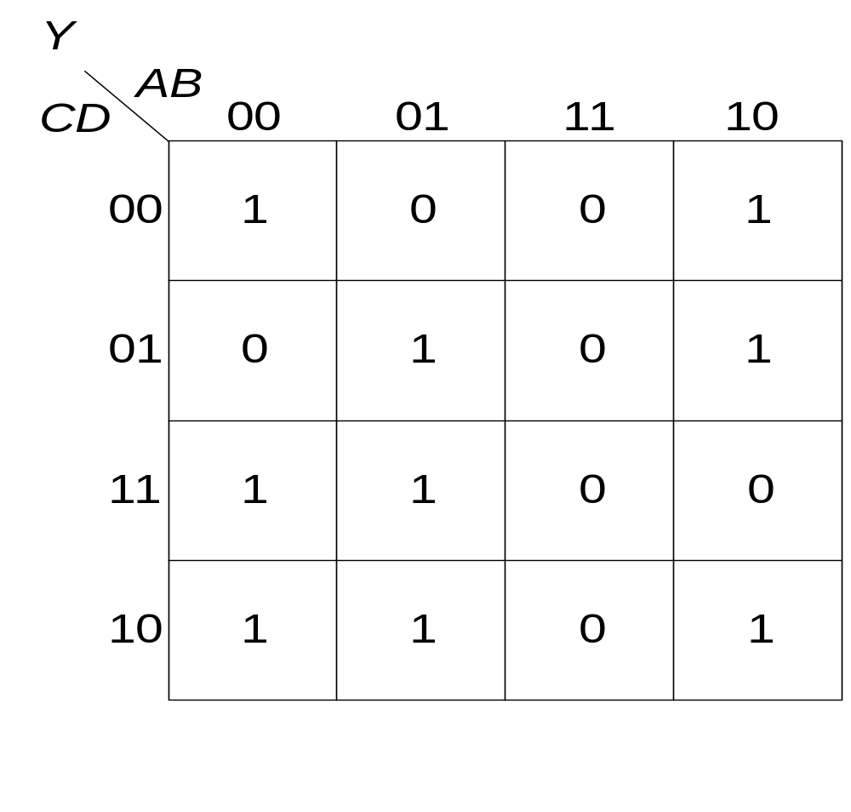
4-input K-map
id | A | B | C | D | Y
0 | 0 | 0 | 0 | 0 | 1
1 | 0 | 0 | 0 | 1 | 0
2 | 0 | 0 | 1 | 0 | 1
3 | 0 | 0 | 1 | 1 | 1
4 | 0 | 1 | 0 | 0 | 0
5 | 0 | 1 | 0 | 1 | 1
6 | 0 | 1 | 1 | 0 | 1
7 | 0 | 1 | 1 | 1 | 1
8 | 1 | 0 | 0 | 0 | 1
9 | 1 | 0 | 0 | 1 | 1
10 | 1 | 0 | 1 | 0 | 1
11 | 1 | 0 | 1 | 1 | 0
12 | 1 | 1 | 0 | 0 | 0
13 | 1 | 1 | 0 | 1 | 0
14 | 1 | 1 | 1 | 0 | 0
15 | 1 | 1 | 1 | 1 | 0

Slide 5
4-input K-map
Arrangement of variables
Adjacency and partition
0 | 4 | 12 | 8
1 | 5 | 13 | 9
3 | 7 | 15 | 11
2 | 6 | 14 | 10

Slide 6
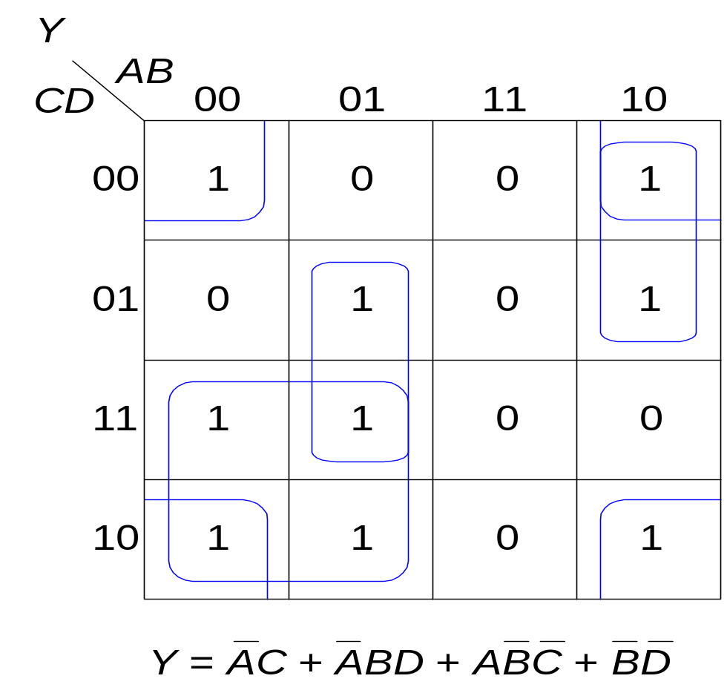
Reading the reduced K-map
0 | 4 | 12 | 8
1 | 5 | 13 | 9
3 | 7 | 15 | 11
2 | 6 | 14 | 10
∑m(2,3,6,7)
∑m(5,7)
∑m(8,9)
∑m(0,2,8,10)

Slide 7
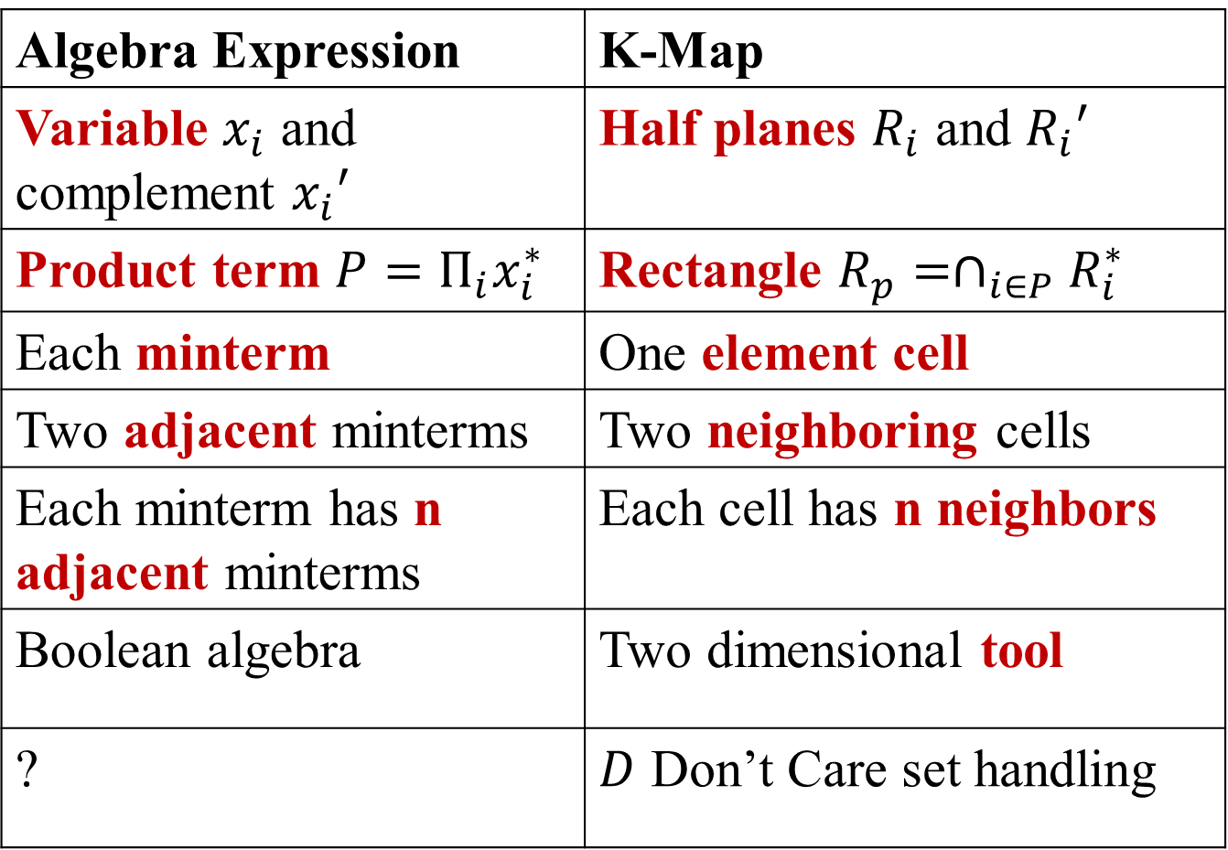
K-Map vs. Switching Algebra Expression
Algebra Expression | K-Map
Variable $x_{i}$ and complement $x_{i}′$ | Half planes $R_{i}$ and $R_{i}′$
Product term $P=Π_{i}x_{i}^{∗}$ | Rectangle $R_{p}=∩_{i∈P}R_{i}^{∗}$
Each minterm | One element cell
Two adjacent minterms | Two neighboring cells
Each minterm has n adjacent minterms | Each cell has n neighbors
Boolean algebra | Two dimensional tool
? | $D$ Don’t Care set handling

Slide 8
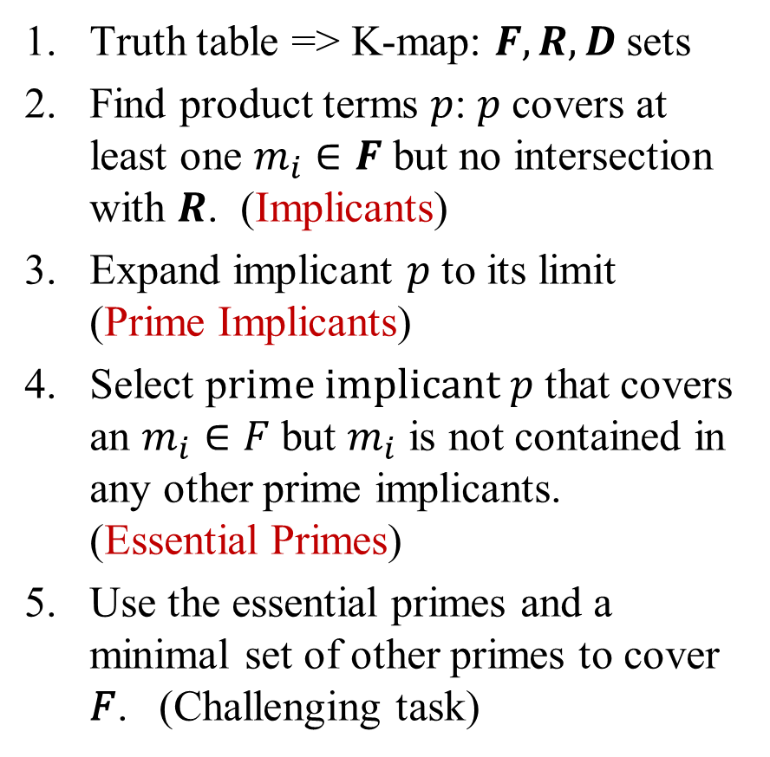
Procedure for finding the minimal function via K-maps (layman’s terms)
Truth table => K-map: $F, R, D$sets
Find product terms $p$: 𝑝 covers at least one $m_{i}∈F$ but no intersection with $R$. (Implicants)
Expand implicant $p$ to its limit (Prime Implicants)
Select p$rime implicant p$ that covers an $m_{i}∈F$ but $m_{i}$ is not contained in any other prime implicants. (Essential Primes)
Use the essential primes and a minimal set of other primes to cover 𝐹. (Challenging task)

Slide 9
Definitions: implicant, prime implicant, essential prime implicant
Implicant: A product term that has non-empty intersection with on-set F and does not intersect with off-set R .
Prime Implicant: An implicant that is not covered by any other implicant.
Essential Prime Implicant: A prime implicant that has an element in on-set F but this element is not covered by any other prime implicants.
Notes:
Implicant, Prime, Essential (Check dictionary)

Slide 10
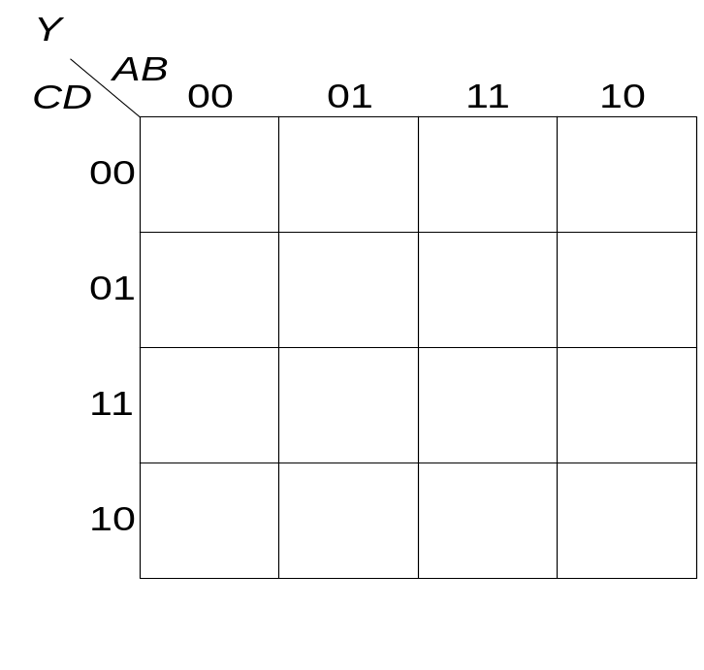
Examples of Primes and Essential Primes

Slide 11
Examples of Primes and Essential Primes

Slide 12
Definition: Prime Implicant
Implicant: A product term that has non-empty intersection with on-set F and does not intersect with off-set R.
Prime Implicant: An implicant that is not covered by any other implicant.
Q: How about this one? Is it a prime implicant?
Yes
No

Slide 13
Definition: Essential Prime
Essential Prime Implicant: A prime implicant that has an element in on-set F but this element is not covered by any other prime implicants.
Q: Is the blue group an essential prime?
Yes
No

Slide 14
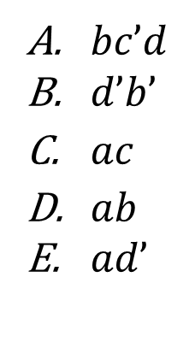
Definition: Essential Prime
Q: Which of the following product term(s) is (are) not an essential prime for the given K-map ?
ab
$bc’d$
$d’b’$
$ac$
$ab$
$ad’$
00
01
11
10
∑m(5,13)
∑m(0,2,8,10)
∑m(10,11,14,15)
∑m(12,13,14,15)
∑m(8,10,12,14)
cd
0 | 4 | 12 | 8
1 | 5 | 13 | 9
3 | 7 | 15 | 11
2 | 6 | 14 | 10
00
1
1
1
01
1
1
11
1
1
10
1
1
1

Slide 15
Procedure for finding the minimal function via K-maps (formal terms)
Convert truth table to K-map
Include all essential primes
Include nonessential primes as needed to completely cover the onset (all cells of value one)

Slide 16
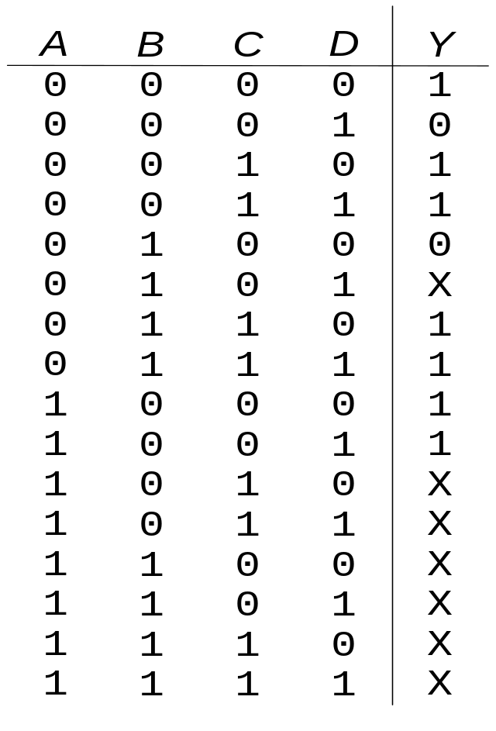

K-maps with Don’t Cares

Slide 17
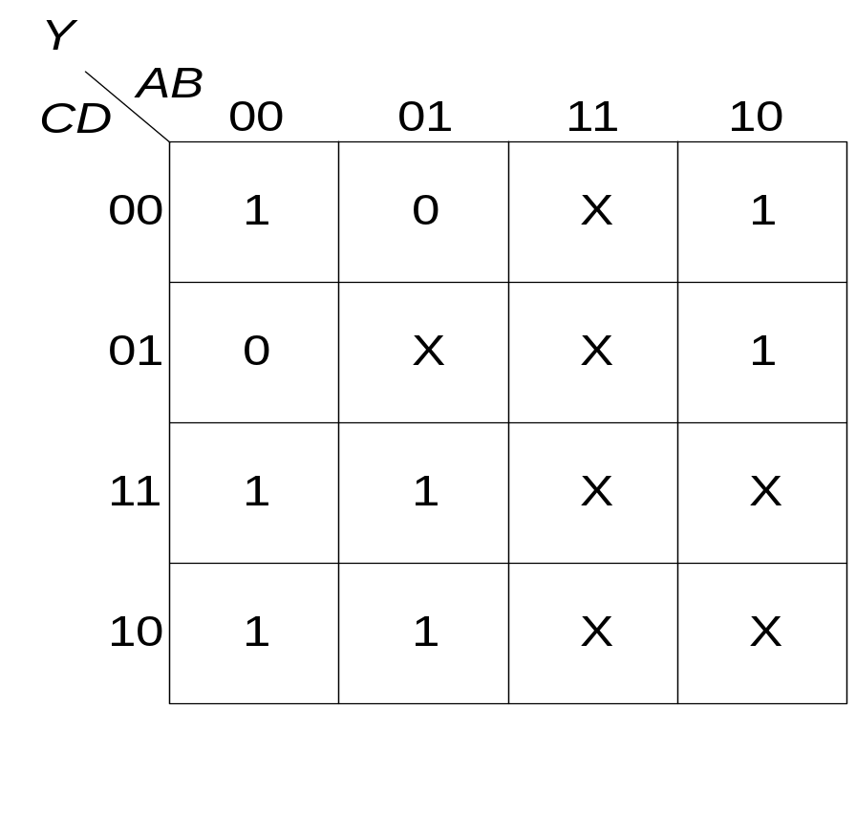
K-maps with Don’t Cares

Slide 18
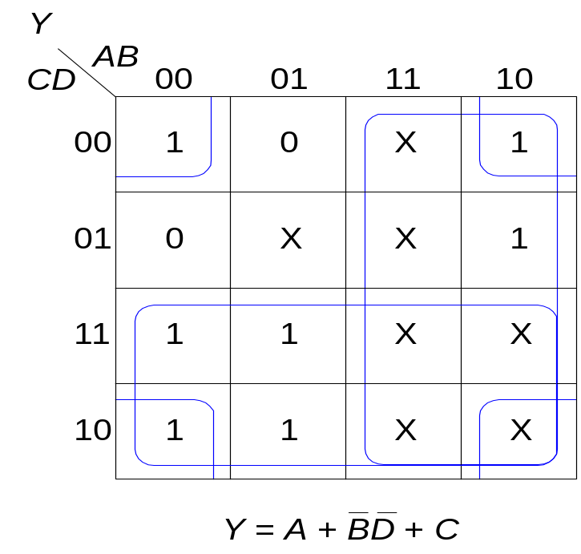
K-maps with Don’t Cares

Slide 19
Reducing Canonical expressions
Given F(a,b,c,d) = Σm (0, 1, 2, 8, 14)
D(a,b,c,d) = Σm (9, 10)
1. Draw K-map
ab
00
01
11
10
cd
00
01
11
10

Slide 20
Reducing Canonical Expressions
Given F(a,b,c,d) = Σm (0, 1, 2, 8, 14)
D(a,b,c,d) = Σm (9, 10)
1. Draw K-map
ab
00
01
11
10
cd
0 4 12 8
00
1 5 13 9
01
11
3 7 15 11
10
2 6 14 10

Slide 21
Reducing Canonical Expressions
Given F(a,b,c,d) = Σm (0, 1, 2, 8, 14)
D(a,b,c,d) = Σm (9, 10)
1. Draw K-map
ab
00
01
11
10
cd
0 4 12 8
00
1 0 0 1
1 5 13 9
01
1 0 0 X
11
3 7 15 11
0 0 0 0
10
2 6 14 10
1 0 1 X

Slide 22
Reducing Canonical Expressions
Draw K-map
Identify Prime implicants
Identify Essential Primes
ab
00
01
11
10
cd
0 4 12 8
00
1 0 0 1
Q: How many primes (P) and essential primes (EP) are there?
Four (P) and three (EP)
Three (P) and two (EP)
Three (P) and three (EP)
Four (P) and Four (EP)
1 5 13 9
01
1 0 0 X
11
3 7 15 11
0 0 0 0
10
2 6 14 10
1 0 1 X

Slide 23
Reducing Canonical Expressions
Prime implicants: Σm (0, 1, 8, 9), Σm (0, 2, 8, 10), Σm (10, 14)
Essential Primes: Σm (0, 1, 8, 9), Σm (0, 2, 8, 10), Σm (10, 14)
ab
00
01
11
10
cd
0 4 12 8
Q: Do the E-primes cover the entire on set?
Yes
No
00
1 0 0 1
1 5 13 9
01
1 0 0 X
11
3 7 15 11
0 0 0 0
10
2 6 14 10
1 0 1 X

Slide 24
Reducing Canonical Expressions
Prime implicants: Σm (0, 1, 8, 9), Σm (0, 2, 8, 10), Σm (10, 14)
Essential Primes: Σm (0, 1, 8, 9), Σm (0, 2, 8, 10), Σm (10, 14)
Min exp: Σ (Essential Primes)=Σm (0, 1, 8, 9) + Σm (0, 2, 8, 10) + Σm (10, 14)
f(a,b,c,d) = ?
ab
00
01
11
10
cd
0 4 12 8
Q: Do the E-primes cover the entire on set?
Yes
No
00
1 0 0 1
1 5 13 9
01
1 0 0 X
11
3 7 15 11
0 0 0 0
10
2 6 14 10
1 0 1 X
Notes:
f(a,b,c,d) = b’c’ + b’d’+ acd‘

Slide 25
Reducing Canonical Expressions
Prime implicants: Σm (0, 1, 8, 9), Σm (0, 2, 8, 10), Σm (10, 14)
Essential Primes: Σm (0, 1, 8, 9), Σm (0, 2, 8, 10), Σm (10, 14)
Min exp: Σ (Essential Primes)=Σm (0, 1, 8, 9) + Σm (0, 2, 8, 10) + Σm (10, 14)
f(a,b,c,d) = b’c’ + b’d’+ acd‘
ab
00
01
11
10
cd
0 4 12 8
Q: Do the E-primes cover the entire on set?
Yes
No
00
1 0 0 1
1 5 13 9
01
1 0 0 X
11
3 7 15 11
0 0 0 0
10
2 6 14 10
1 0 1 X
Notes:
f(a,b,c,d) = b’c’ + b’d’+ acd‘

Slide 26
Another example
Given F(a,b,c,d) = Σm (0, 3, 4, 14, 15)
D(a,b,c,d) = Σm (1, 11, 13)
Draw the K-Map
ab
00
01
11
10
cd
00
01
11
10

Slide 27
Another example
Given F(a,b,c,d) = Σm (0, 3, 4, 14, 15)
D(a,b,c,d) = Σm (1, 11, 13)
ab
00
01
11
10
cd
0 4 12 8
00
1 1 0 0
1 5 13 9
01
X 0 X 0
11
3 7 15 11
1 0 1 X
10
2 6 14 10
0 0 1 0

Slide 28
Reducing Canonical Expressions
Prime implicants: Σm (0, 4), Σm (0, 1), Σm (1, 3), Σm (3, 11), Σm (14, 15), Σm (11, 15), Σm (13, 15)
Essential Primes: Σm (0, 4), Σm (14, 15)
ab
00
01
11
10
cd
0 4 12 8
00
1 1 0 0
1 5 13 9
01
X 0 X 0
11
3 7 15 11
1 0 1 X
10
2 6 14 10
0 0 1 0

Slide 29
Reducing Canonical Expressions
Prime implicants: Σm (0, 4), Σm (0, 1), Σm (1, 3), Σm (3, 11), Σm (14, 15), Σm (11, 15), Σm (13, 15)
Essential Primes: Σm (0, 4), Σm (14, 15)
Min exp: Σm (0, 4), Σm (14, 15), (Σm (3, 11) or Σm (1,3) )
f(a,b,c,d) = a’c’d’+ abc+ b’cd (or a’b’d)
ab
00
01
11
10
cd
0 4 12 8
00
1 1 0 0
1 5 13 9
01
X 0 X 0
11
3 7 15 11
1 0 1 X
10
2 6 14 10
0 0 1 0

