Slide 1
Lecture 1:
Introduction to Digital Logic Design
CSE 140: Components and Design Techniques for Digital Systems
Spring 2022
CK Cheng
Dept. of Computer Science and Engineering
University of California, San Diego
Notes:
Digital: 0, 1 or False, True or GND, Vdd
Logic: Reasoning
Design: Theory + Implementation

Slide 2
Outlines
Staff
  Instructor, TAs, Tutors
Logistics
  Websites, Textbooks, Grading Policy
Motivation
  Moore’s Law, Deep Learning, Quantum Computing
Scope
  Position among CSE courses
  Coverage

Slide 3
Staff: the Instructor
Instructor: CK Cheng
Education: Ph.D. in EECS UC Berkeley
Industrial Experiences: Engineer of AMD, Mentor Graphics, Bellcore; Consultant for technology companies
Email: ckcheng+140@ucsd.edu
Office: Room 2130 CSE Building
Office hours
  TBA
Websites
  http://cseweb.ucsd.edu/~kuan
  http://cseweb.ucsd.edu/classes/sp22/cse140-a

Slide 4
Staff: TAs and Tutors
TAs
Abraham, Elizabeth eabraham@ucsd.edu
Holtz, Chester chholtz@ucsd.edu, Lead TA
Jang, Wonsuk w1jang@ucsd.edu
Li, Yuxin yul801@ucsd.edu
Liu, Isabella lal005ucsd.edu
Ma, Jason jam043@ucsd.edu
Wang, Kanlin kaw008@ucsd.edu
Tutors
Dong, Jiayan jid001@ucsd.edu
Huang, Yucheng yuh032@ucsd.edu
Sun, William wis003@ucsd.edu
Office hours will be posted on the course website (piazza)
Notes:
Office hours and paper correction

Slide 5
Logistics: Class Schedule
Lecture: TR 3:30-4:50PM
Discussion: F 3-350PM
4-5 Homework Assignments, 3 Exams: W4, W7, W10
The Third Exam: Due time M 6:00PM, 6/6/2022

Slide 6
Logistics: Textbooks
Reserved at library
Digital Design and Computer Architecture by David Money Harris and Sarah L. Harris, Morgan Kaufmann (Reading Activities)
Digital Systems and Hardware/Firmware Algorithms, Milos D. Ercegovac and Tomas Lang (System Designs, pdf file will be released)

Slide 7
Logistics: Sites for the Class
Class website
  http://cseweb.ucsd.edu/classes/sp22/cse140-a/index.html
  Syllabus
    Class notes
    Assignment: Homework and Reading Activities
    Exercises: Solutions and Rubrics
Forum: Piazza (Office Hrs., Online Discussion)
Homework and Exam submission: Gradescope
Lecture/Discussion Record: Podcast
Notes:
Joint website

Slide 8
Logistic: Class Expectation
Level 1: Concepts and Methods (Lecture and slides)
  Class attendance of video record
Level 2: Hands on Practices (Exercises)
  Homework
Level 3: Command of Materials (Samples of exams)
  Exams: First part of exam (90%)
Level 4: Extension and Exploration (Content beyond the textbook)
  Exams: Second part of exam (10%)

Slide 9
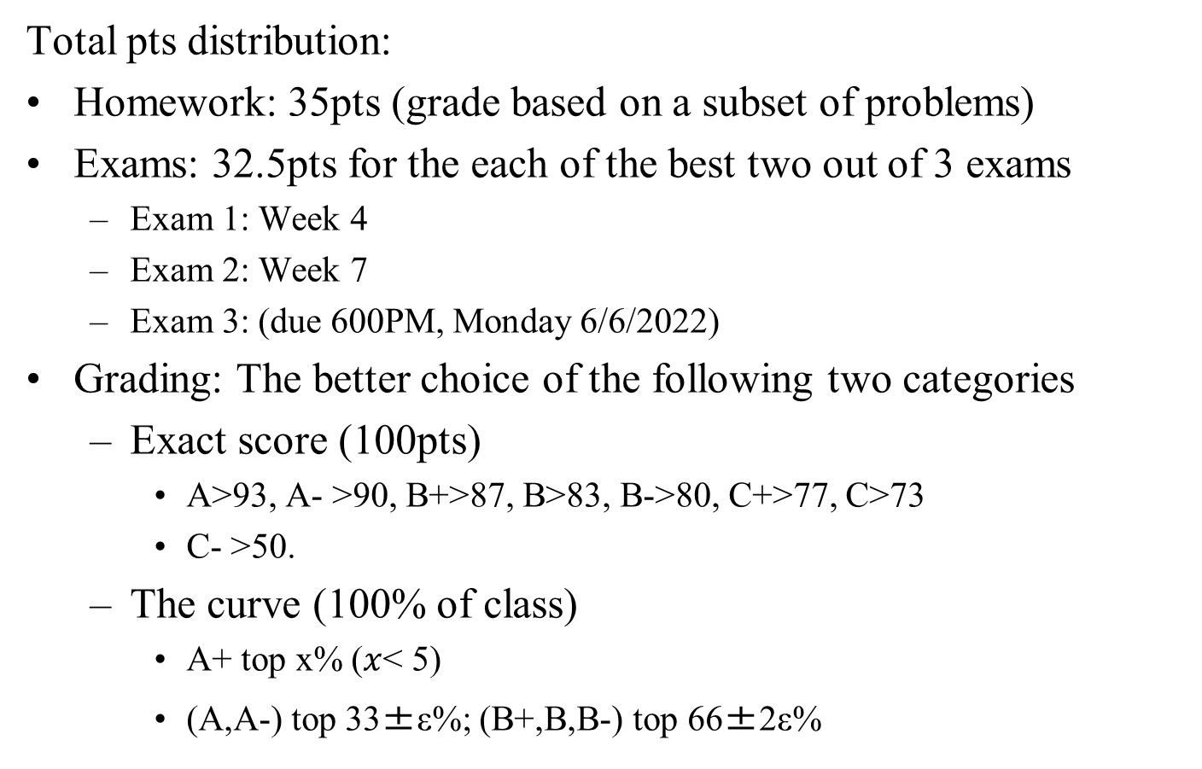
Logistics: Grading
Total pts distribution:
Homework: 35pts (grade based on a subset of problems)
Exams: 32.5pts for the each of the best two out of 3 exams
  Exam 1: Week 4
  Exam 2: Week 7
  Exam 3: (due 600PM, Monday 6/6/2022)
Grading: The better choice of the following two categories
  Exact score (100pts)
    A>93, A- >90, B+>87, B>83, B->80, C+>77, C>73
    C- >50.
  The curve (100% of class)
    A+ top x% ($x$< 5)
    (A,A-) top 33±ε%; (B+,B,B-) top 66±2ε%

Slide 10
Logistic: grading components
  Homework:
    Due Wed night on Gradescope
    Group discussion is encouraged. However, we are required to write individually
  Discount 10% loss of credit for each day after the deadline but no credit after the solution is posted.
  Some parts will be graded by completion only (students are responsible for correct solutions)
  Standard: Posted solutions and rubrics

Slide 11
Logistic: 3 Exams
Exams: take-home exam taken within 48 hours
  Open book, notes, free to check websites
  Solution and grading policy will be posted after the exam.
  Exams are not cumulative but requires a good command of the previous exam content
  Two timeframe options for the class to decide
    80 minutes time frame: Finish the exam in 80 minutes after you start the exam.
    48 hours time frame: Deliver the result in 48 hours after the exam is posted.
  Exam schedule
    Weekends
    Weekdays
    Sunday + Monday

Slide 12
Course Problems…Cheating
What is cheating?
  Studying together in groups is not cheating but encouraged
  Turned-in work must be completely your own.
  Copying someone else’s solution on a HW or Exam is cheating
  Both “giver” and “receiver” are equally culpable
We will be better off to work on the problem alone during the exam.
We have to address the issue once the cheating is reported by someone (e.g. TA, Tutor, Student, etc.).

Slide 13
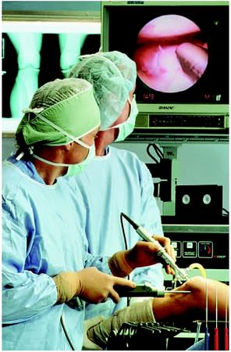

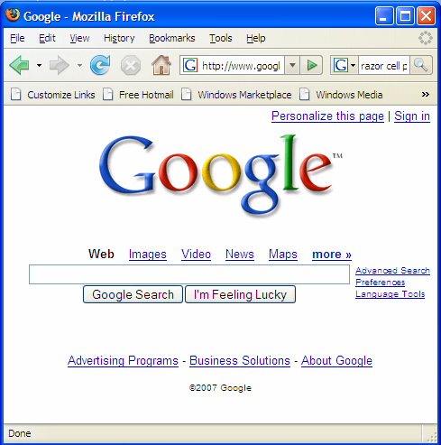
Motivation
Microelectronic technologies have revolutionized our world: cell phones, internet, rapid advances in medicine, etc.
The semiconductor industry has grown from $21 billions in 1985 to $555.9 billions in 2021.

Slide 14

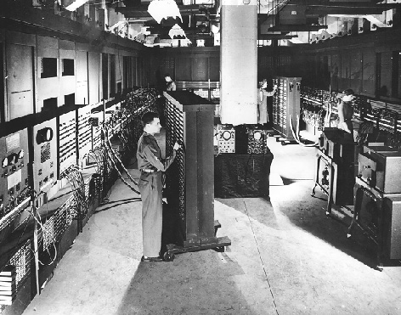
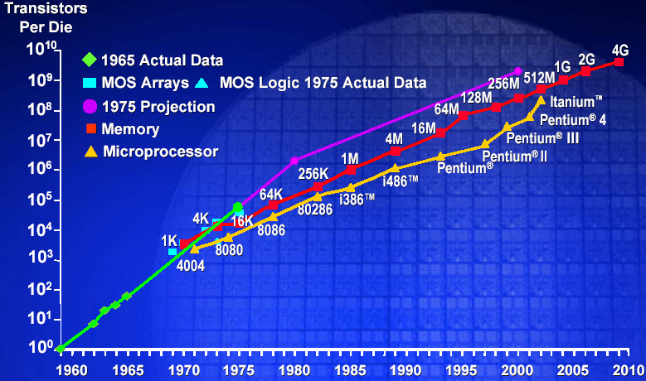
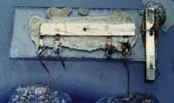
The Digital Revolution
Integrated Circuit: Many digital operations on the same material
Vacuum tubes
Exponential Growth of Computation
(1.6 x 11.1 mm)
ENIAC
Integrated Circuit
Moore’s Law
Stored Program
Model
WWII
1949
1965
Notes:
The stored program model computers and the invention of the transistor and the integrated circuit generated an exponential growth in computing devices and computers – why?
Von neumann architecture – put both data and instructions on the same electronic medium – memory. The whole machine could be constructed from digital logic/circuits.
Digital logic was in turn constructed using electronic circuits – different discrete components vacuum tubes (switches), capacitors, resistors.
But the way digital circuits were constructed underwent a revolution once the transistor came along. The transistor replaced the vacuum tube (both are switches) – given a control signal they either let current pass through them (logic 1) or stop current (logic 0). Discrete circuits were replaced by integrated circuits (everything made from the same silicon material).
The whole computer shrank.

Slide 15
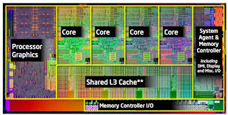
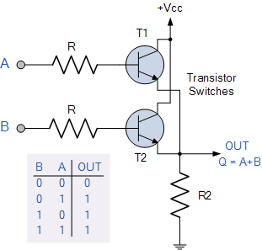
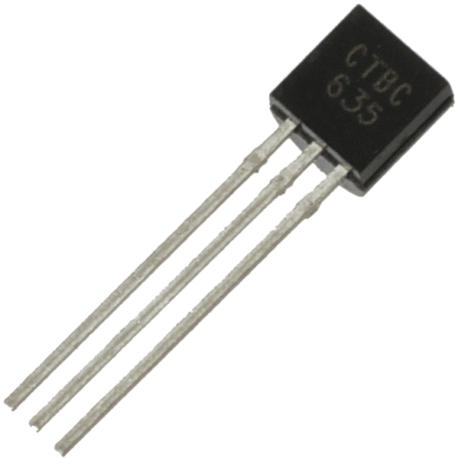
Building complex circuits
Transistor

Slide 16
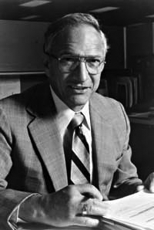
Robert Noyce, 1927 - 1990
Nicknamed “Mayor of Silicon Valley”
Cofounded Fairchild Semiconductor in 1957
Cofounded Intel in 1968
Co-invented the integrated circuit

Slide 17
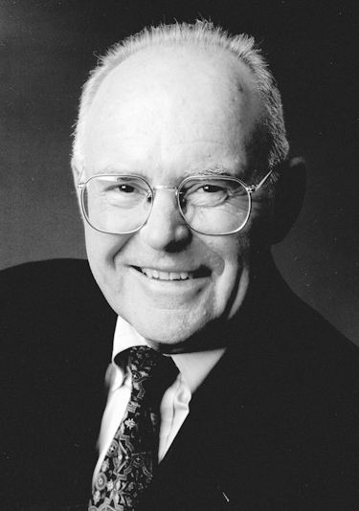
Gordon Moore
Cofounded Intel in 1968 with Robert Noyce.
Moore’s Law: the number of transistors on a computer chip doubles every 1.5 years (observed in 1965)

Slide 18
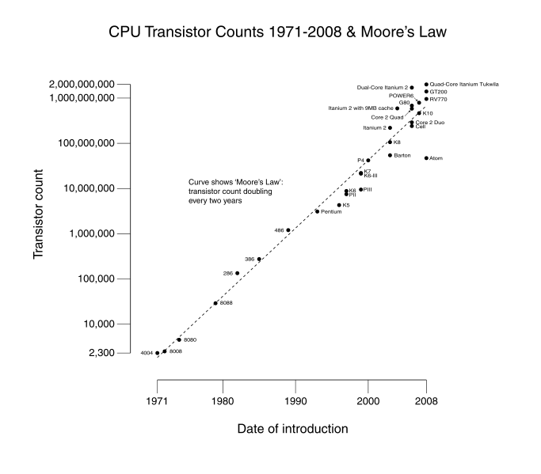
Technology Trends: Moore’s Law
Since 1975, transistor counts have doubled every two years.
Moore’s law: wider applications: larger market: higher revenue: more R&D

Slide 19
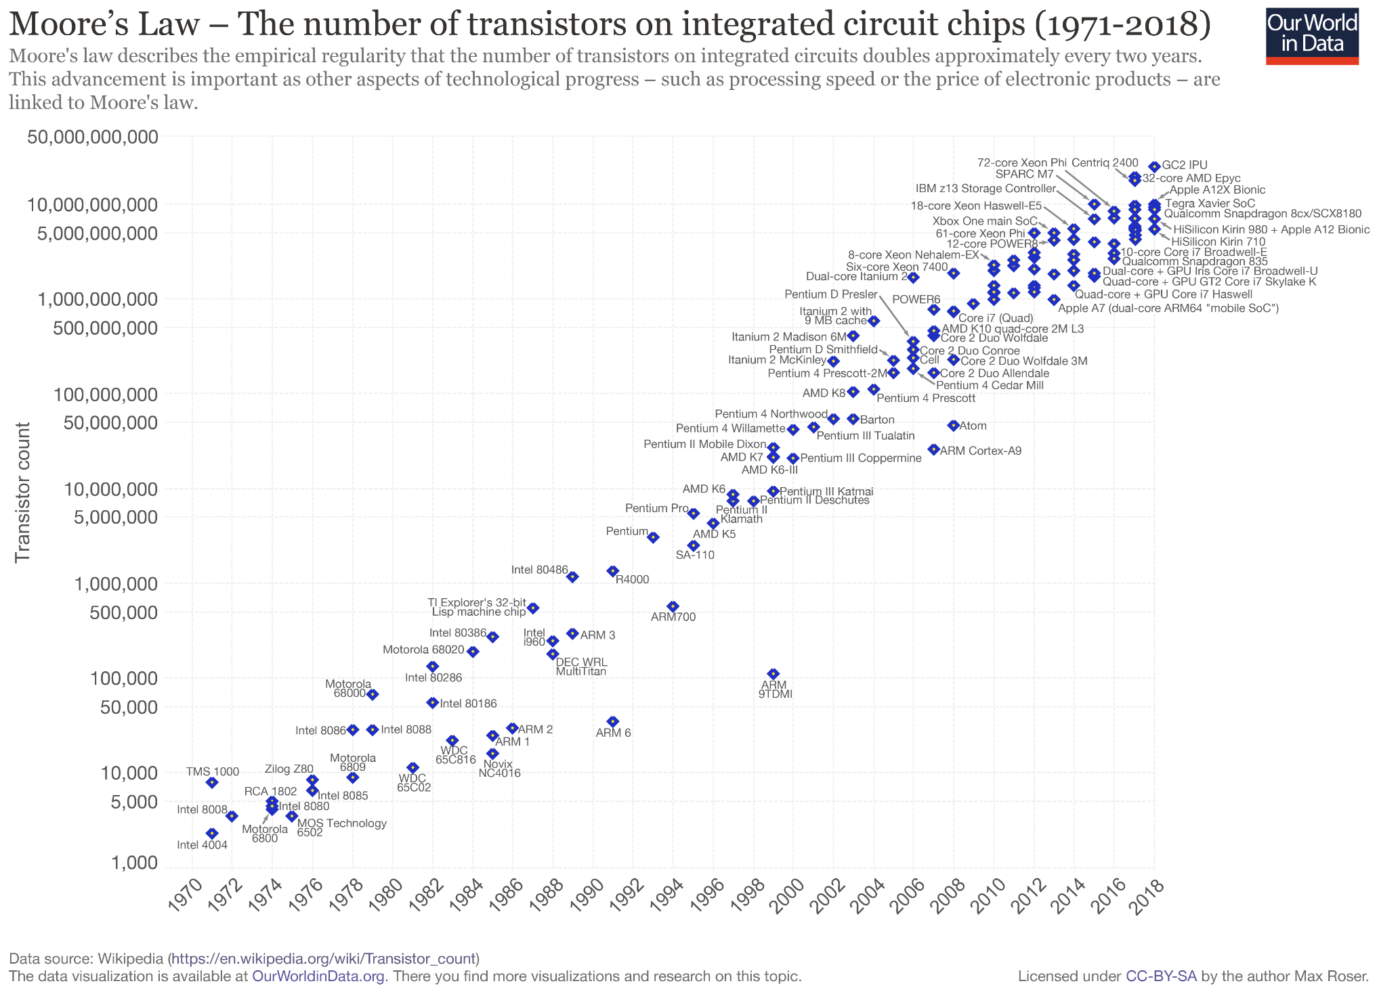
Introduction: Moore in1965
The complexity for minimum component costs has increased at a rate of roughly a factor of two/yr.
Cheng’s talk: http://cseweb.ucsd.edu/~kuan/talk20/KTC2020_CK_201014.pdf
Notes:
Most of you have heard of Moore’s Law. As Gordon Moore proposed it over 50 years ago, it is a law of Value and Cost SCALING. Scaling means cost reduction – again, so that what was impossible before, now becomes possible.
In the industry, we focus on PPAC scaling: power, performance, area, cost. A new technology should be superior in all four of these dimensions.
And Moore’s Law is also about TIME: It means that the semiconductor world advances at roughly One Percent every Week. One week is One percent.

Slide 20
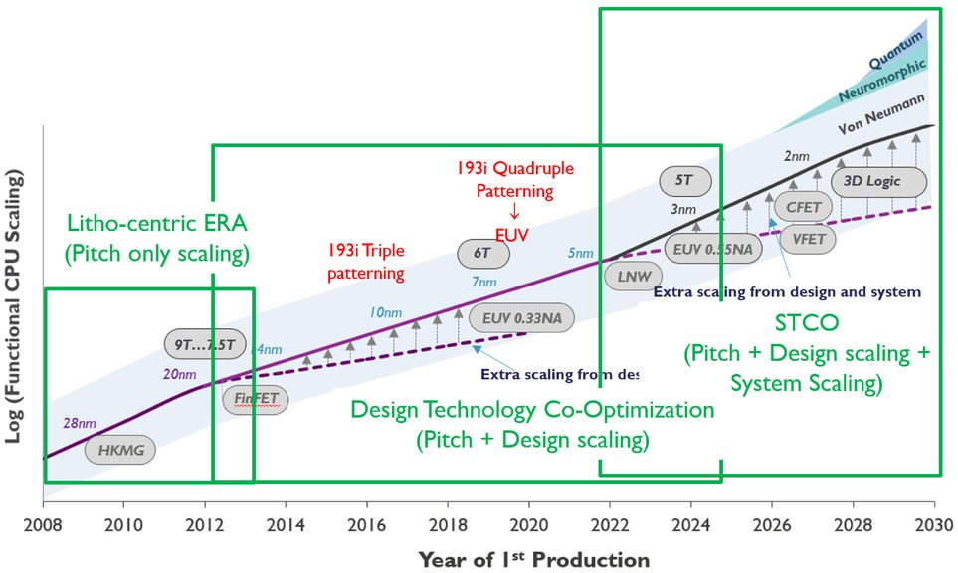
Moore’s Law: Roadmap
Scaling Methods:
+ Pitch only (2008-2013)
+ Design Technology Co-Optimization (DTCO: 2012-2025)
+ System Scaling (STCO: 2022-)
[S. M. Y. Sherazi et al., “Standard-cell design architecture options below 5nm node: The ultimate scaling of FinFET and Nanoshee,”keynote, Proc. SPIE, 2019]

Slide 21
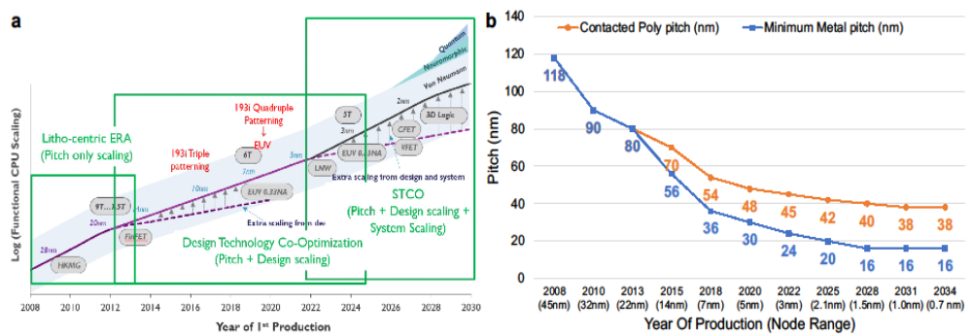
Moore’s Law: Roadmap
Scaling Methods:
+ Pitch only (2008-2013)
+ Design Technology Co-Optimization (DTCO: 2012-2025)
+ System Scaling (STCO: 2022-)
[S. M. Y. Sherazi et al., “Standard-cell design architecture options below 5nm node: The ultimate scaling of FinFET and Nanoshee,”keynote, Proc. SPIE, 2019]

Slide 22
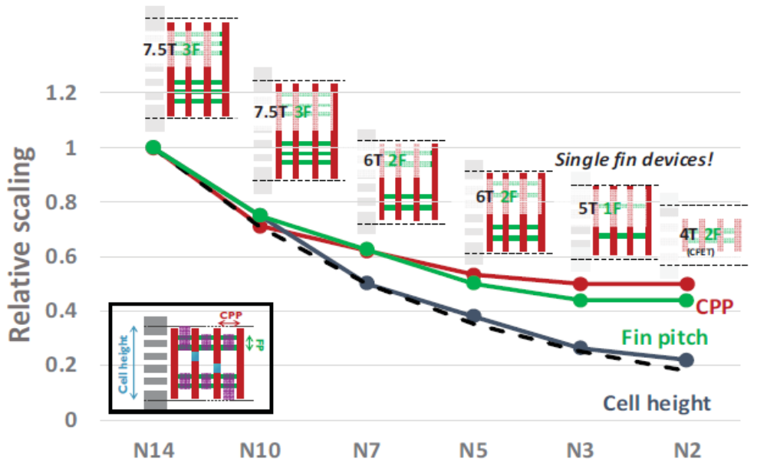
Moore’s Law: Roadmap
Scaling Methods:
+ Pitch only (2008-2013)
+ Design Technology Co-Optimization (DTCO: 2012-2025)
+ System Scaling (STCO: 2022-)
[S. M. Y. Sherazi et al., “Standard-cell design architecture options below 5nm node: The ultimate scaling of FinFET and Nanoshee,”keynote, Proc. SPIE, 2019]

Slide 23
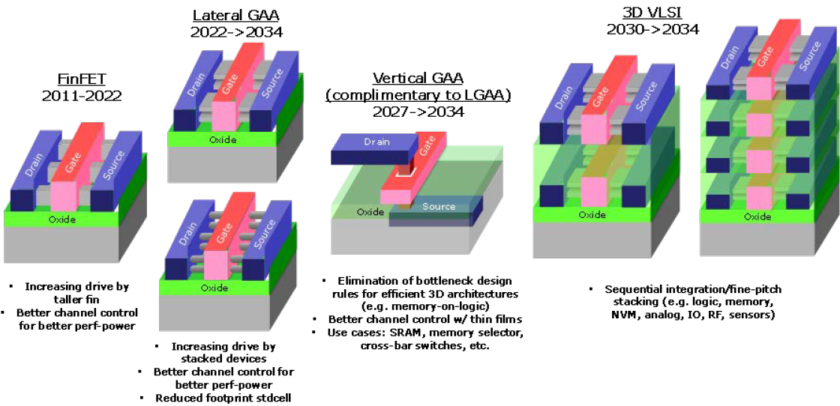
Moore’s Law: System Technology Co-Optimization
2.5D/3D fine-pitch assembly + stacking
Change in the MOSFET device architecture from the 2D planar through 2.5D FinFets to 3D monolithic VLSI
IEEE IRDS Executive Summary, pp. 53, 2020

Slide 24
New Technologies
New materials and fabrication for devices
  Low power devices
  Three dimensional integrated circuits
  Graphene
New architecture
  Machine learning, deep learning
Quantum computing
Understand the principles to explore the future

Slide 25
Artificial Intelligence
Logic and Reasoning
Boolean Satisfiability (SAT)
  Product of sum clauses
  Diagnosis
States and Sequences
  Sequential Machines
  Reachability
  Controllability
One example of the applications and opportunities

Slide 26
Scope
The purpose of this course is that we:
Learn the principles of digital design
Learn to systematically debug increasingly complex designs
Design and build digital systems
Learn what’s under the hood of an electronic component
Prepare for the future technology revolution

Slide 27
Position among CSE Courses
Algos: CSE 100, 101
Application (ex: browser)
CSE 131
CSE 120
Operating
Compiler
System
(Mac OSX)
Software
Assembler
Instruction Set
Architecture
Architecture
Processor
Memory
I/O system
CSE 141
Datapath & Control
CSE 140
Digital Design
Circuit Design
Transistors
Big idea: Coordination of many levels of abstraction
Dan Garcia®

Slide 28
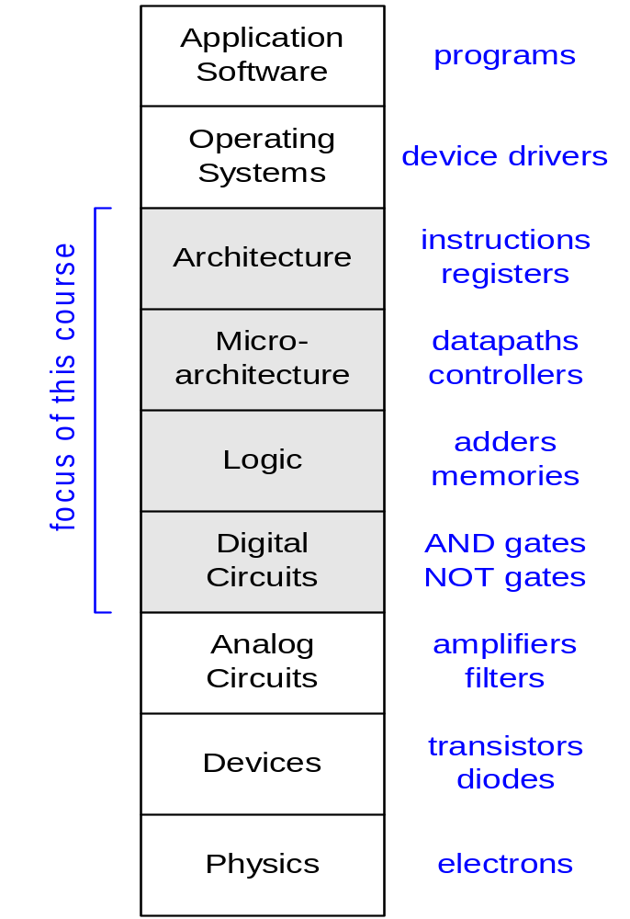
Principle of Abstraction
CSE 30
CSE 141
CSE 140
Abstraction: Hiding details when they are not important

Slide 29
Combinational Logic vs Sequential Network
x₁
.
.
.
x_{n}
x₁
.
.
.
x_{n}
x₁
.
.
.
x_{n}
f_{i}(x)
f_{i}(x,s)
f_{i}(x)
f_{i}(x)
f_{i}(x)
s_{i}
CLK
Sequential Networks
1. Memory
2. Time Steps (Clock)
Combinational logic:
y_{i} = f_{i}(x₁,..,x_{n})
y_{i}^{t} = f_{i} (x₁^{t},…,x_{n}^{t}, s₁^{t}, …,s_{m}^{t})
s_{i}^{t+1} = g_{i}(x₁^{t},…,x_{n}^{t}, s₁^{t},…,s_{m}^{t})

Slide 30
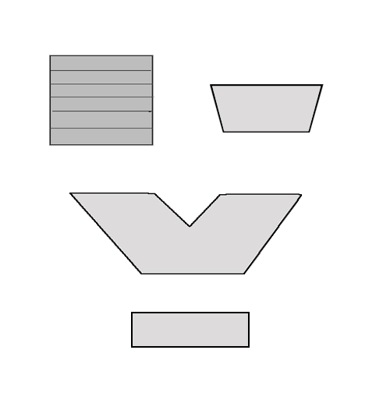
Scope: Overall Picture of CS140
Data Path Subsystem
Input
Control Subsystem
Memory File
Conditions
Pointer
Select
Sequential machine
Mux
ALU
Control
Memory Register
CLK: Synchronizing Clock
Conditions
BSV: Design specification and modular design methodology

Slide 31
Scope
Subjects | Building Blocks | Theory
Combinational Logic | AND, OR, NOT, XOR | Boolean Algebra
Sequential Network | AND, OR, NOT, FF | Finite State Machine
Standard Modules | Operators, Interconnects, Memory | Arithmetics, Universal Logic
System Design | Data Paths, Control Paths | Methodologies
Notes:
Coverage of Midterm 1, Midterm 2, and Final

Slide 32
Combinational Logic
Basics

Slide 33
What is a combinational circuit?
No memory
Realizes one or more functions
Inputs and outputs can only have two discrete values
  Physical domain (usually, voltages) (Ground 0V, Vdd 1V)
  Mathematical domain : Boolean variables (True, False)
Differentiate between different representations:
  physical circuit
  schematic diagram
  mathematical expressions

Slide 34
Binary Digital Logic
Simplest representation is “1” and “0” (base-2).
Choose a physical quantity to represent “1” and “0”
  Usually voltage, but not always (e.g. current, resistance, magnetic polarization, quantum spin, …)
Use a transistor to make the switch (operating as a digital instead of analog device)
  Two states – on / off
  Signals can be high voltage (“1”) or low voltage (“0”)

Slide 35
Basic CMOS
”on” when gate is high
NMOS
PMOS
”on” when gate is low
d
s
g
g
s
d
https://en.wikipedia.org/wiki/CMOS#/media/File:Cmos_impurity_profile.PNG
Complementary Metal Oxide Semiconductor
Invented in the 1960’s, but took over in the 80’s
“on” means low resistance, ”off” means high resistance
Logic “1” and Logic “0” values are arbitrary
  e.g. logic “1” == 1.0 V, logic “0” == 0.0 V
Planar technology
FINFET technology
By Irene Ringworm, CC BY-SA 3.0, https://commons.wikimedia.org/w/index.php?curid=3833512

Slide 36
Transistors as Switches

Slide 37

The most basic CMOS gate - inverter
When “inp” is “1”, then the nmos is on and the pmos is off – output will be ?
When “inp” is “0”, then the nmos is off and the pmos is on – output will be ?
Truth Table
Schematic
Equation
in | out
0 | 1
1 | 0
inp
out
inp
out
out = in’
out =in

Slide 38
Basic Gates – (N)AND gate
AND Y = A & B Y = AB
A | B | Y
0 | 0 | 0
0 | 1 | 0
1 | 0 | 0
1 | 1 | 1
A
B
Y
NAND Y = (A & B)’ Y = (AB)’
What kind of gate is this?
AND
NAND
Inverter
None of the above
A | B | Y
0 | 0 | 1
0 | 1 | 1
1 | 0 | 1
1 | 1 | 0

Slide 39
Basic Gates – (N)OR gate
OR Y = A + B Y = A | B
A | B | Y
0 | 0 | 0
0 | 1 | 1
1 | 0 | 1
1 | 1 | 1
A
NOR Y = (A + B)’ Y = (A | B)’
Y
A | B | Y
0 | 0 | 1
0 | 1 | 0
1 | 0 | 0
1 | 1 | 0
B
A
Bubble means Invert
NOR is universal gate
Y
B

Slide 40
Transistors as Switches: CMOS

Slide 41
Transistors as Switches

Slide 42
Transistors as Switches: Transmission Gate

Slide 43
Transistors as Switches: Transmission Gate

Slide 44
Boolean Algebra
A branch of algebra in which the values of the variables belong to a set B (e.g. {0, 1}), has two operations {+, .} that satisfy the following four sets of laws.
Associative laws: (a+b)+c= a+(b+c), (a·b)·c =a·(b·c)
Commutative laws: a+b=b+a, a·b=b·a
Distributive laws: a+(b·c)=(a+b)·(a+c),
a·(b+c)=a·b+a·c
Identity laws: a+0=a, a·1=a
Complement laws: a+a’=1, a·a’=0
(x’: the complement element of x)

Slide 45
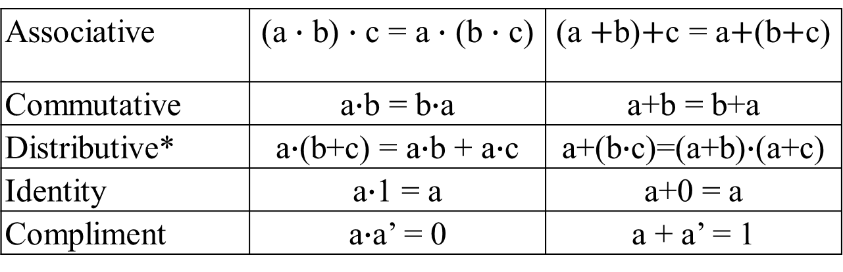
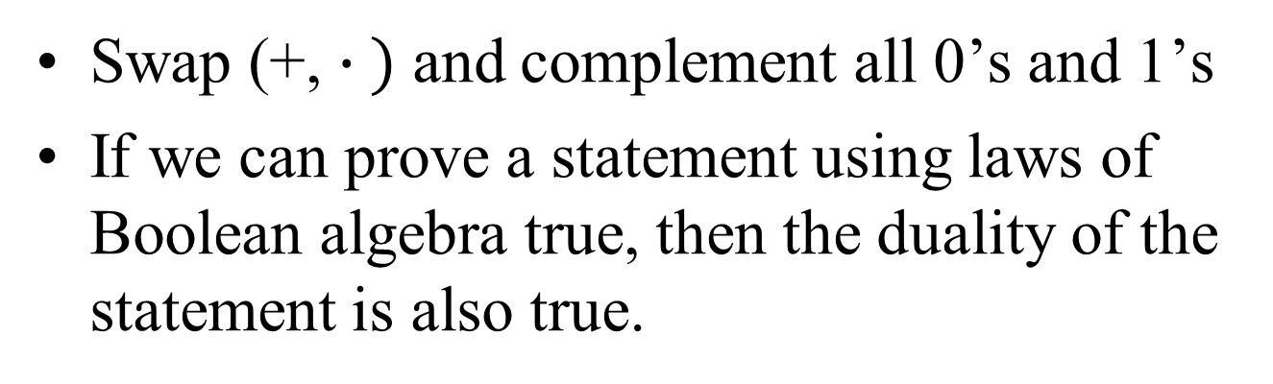
Duality
Swap (+, $∙ )$ and complement all 0’s and 1’s
If we can prove a statement using laws of Boolean algebra true, then the duality of the statement is also true.
Laws and their duals
Associative | (a $∙$ b) $∙$ c = a $∙$ (b $∙$ c) | (a $+$b)$+$c = a$+$(b$+$c)
Commutative | a$∙$b = b$∙$a | a+b = b+a
Distributive* | a$∙$(b+c) = a$∙$b + a$∙$c | a+(b$∙$c)=(a+b)$∙$(a+c)
Identity | a$∙$1 = a | a+0 = a
Compliment | a$∙$a’ = 0 | a + a’ = 1

Slide 46
Representations of combinational circuits:
The Schematic
A
Y
B
What is the simplest combinational circuit that you know?

Slide 47
Representations of combinational circuits
Truth Table: Enumeration of all combinations
Example: AND
id | A | B | Y
0 | 0 | 0 | 0
1 | 0 | 1 | 0
2 | 1 | 0 | 0
3 | 1 | 1 | 1
A
Y=AB
B

Slide 48
Boolean Algebra
Similar to regular algebra but defined on sets with only three basic ‘logic’ operations:
  Intersection: AND (2-input); Operator: ∙ ,&
  Union: OR (2-input); Operator: + ,|
  Complement: NOT ( 1-input); Operator: ‘ ,!
“&, |, !” Symbols in BSV

Slide 49
Some Def’s
Complement : variable with a “BAR” over it or ‘ after it
  A’
Literal : variable or its complement
Implicant: product of literals
  ABC
Implicate: sum of literals
  (A+B+C)
Minterm, maxterm (implicant or implicate that includes all the inputs)
  f(A,B,C,D): ABCD, (A+B+C+D)

Slide 50
Boolean algebra and switching functions
Two-input AND ( ∙ )
Two-input OR (+ )
One-input NOT (Complement, ’ )
AND
OR
A B Y
0 0 0
0 1 0
1 0 0
1 1 1
A B Y
0 0 0
0 1 1
1 0 1
1 1 1
NOT
A Y
0 1
1 0
A
1
A
1
A
1
A
0
A
0
0
A
For an AND gate,
0 at input blocks the other inputs and dominates the output
1 at input passes signal A
For an OR gate,
1 at input blocks the other inputs and dominates the output
0 at input passes signal A

Slide 51
Boolean Algebra
For two Boolean variables X and Y with X=1, Y=0, what is function f(X,Y)=X+Y?
f(X,Y)=0
f(X,Y)=1
f(X,Y)=2

Slide 52
Boolean Algebra
iClicker Q: For two Boolean variables X and Y with X=1, Y=0, what is function f(X,Y)=X+X+Y?
f(X,Y)=0
f(X,Y)=1
f(X,Y)=2

Slide 53
Boolean Algebra
For two Boolean variables X and Y with X=1, Y=0, what is function f(X,Y)=X+XY?
f(X,Y)=0
f(X,Y)=1
f(X,Y)=2

Slide 54
Boolean Algebra
For two Boolean variables X and Y with X=1, Y=0, what is function f(X,Y)=(X+Y)Y?
f(X,Y)=0
f(X,Y)=1
f(X,Y)=2

Slide 55
So, what is the point of representing gates as symbols and Boolean expressions?
Given the Boolean expression, we can draw the circuit it represents by cascading gates (and vice versa)
a
b
ab
ab + cd
c
d
y=e (ab+cd)
cd
e
Logic circuit vs. Boolean Algebra Expression
Simplify the Boolean expression: Reduce the complexity of the circuit

Slide 56
Switching Expression and Logic Diagrams
Switching Expression –
  Equations - # literals, # variables, # operators
    Literal is a variable or its complement (e.g. a, a’)
    Variables (e.g. x)
    Operator (e.g. +, ·)
  Schematic / Logic Diagram - # of gates, # nets (wires), # of pins
    Gate (and, or, etc) – can be more than 2 inputs (e.g. 3 input AND gate)
    Net – wire that connects gates
    Pin - input or output of a gate.

Slide 57
Laws and Logic Diagrams
Associativity Laws
(A+B) + C = A + (B+C)
(AB)C = A(BC)
C
A
A
B
B
C
C
A
A
B
B
C
Notes:
Logic is the same, but timing may be different.
Which one would be choose of (AB)C or A(BC) if A arrives later than B and C signals.

Slide 58
Laws and Logic Diagrams
Distributive Laws
A ∙(B+C) = A ∙ B + A ∙ C
A+B ∙ C = (A+B) ∙(A+C)
A
B
A
B
C
A
C
A
B
A
B
C
A
C
Notes:
Draw / Count
# literals, # operators
# pins.
Show #pins = # literals + #gates * 2– 1.
Each literal has 1 pin, each gate has 1 pin – out connected to 1 pin in (except for primary output) so times 2 pins.
Except output which has only one pin.

Slide 59
Switching Expression and Logic
a
b
a·b
a·b + c·d
c
d
y=e·(a·b+c·d)
c·d
e
Schematic Diagram:
5 primary inputs
1 primary output
4 components (gates)
9 signal nets
12 pins
Boolean Algebra:
5 variables
1 expression
4 operators
5 literals

Slide 60
Switching Expression and Logic
a
b
a·b
Cost: #gates, #nets, #pins
a·b + b’·c
b’
c
y= d’ ·e ·(a·b+b’·c)
b’·c
d’
e
Schematic Diagram:
6 primary inputs
1 primary output
4 gates (3 ANDs, 1 OR)
10 signal nets
11 pins
Nets are wires, Gates ->transistors
Switching Expression:
5 variables
1 expression
4 operators (3 ANDs, 1 OR)
6 literals
Notes:
Show how to count # nets
Show eq for pins
# of literals + 2*# of gates -1 (each gate has an output + one input except for output gate)

Slide 61
Example: f(a, b, c) = ab + a’c + a’b’
# variables
# literals
# gates
Notes:
Draw circuit.
Count # literals = 6
Count # variables = 3
Count # gates = 4 gates
Count # pins = 13 pins
Count # nets = 10
Count # operators (gates) = 4

Slide 62
Which statement is not true in general?
a
b
a·b
Schematic Diagram:
5 primary inputs
4 components (gates)
9 signal nets
12 pins
a·b + c·d
c
d
y=e·(a·b+c·d)
c·d
e
Boolean Algebra: y=e·(a·b+c·d)
5 literals
4 operators
#primary inputs = # literals
#gates = # operators
#nets = #variables + # operators
#pins = # literals + 2 * #operators -1
All of them
Based on CK Cheng – CSE140 Spr18
Notes:
# nets = # variables + # operators - for example, replace e with d’ - reduced # of variables, but # of nets is the same.
# nets = # literals + # operators
Discuss D and why it is true :
Every gate has an output which goes to an input (2 pins) except the last gate
All primary inputs (literals) to to a pin.

Slide 63
Logic Diagram/Schematics
https://commons.wikimedia.org/wiki/File:74181aluschematic.png
Logic circuit vs. Boolean Algebra Expression
Simplify the Boolean expression: Reduce the complexity of the circuit

Slide 64
Next class
Designing Combinational circuits

