Slide 1
CSE 140 Lecture 12
Standard Combinational Modules
CK Cheng
CSE Dept.
UC San Diego

Slide 2
Part III. Standard Modules
Interconnect Modules:
1. Decoder, 2. Encoder
3. Multiplexer, 4. Demultiplexer

Slide 3
Multiplexer
Definition
Logic Diagram
Application

Slide 4
Interconnect: Decoder, Encoder, Mux, DeMux
Processors
Arbiter
P1
Data 1
Mux
Memory Bank
Address 1
Data
P2
Demux
n-m
Address 2
Mux
Address
n
m
2^{m}
Address k
Decoder
Pk
Data k
Decoder: Decode the address to assert the addressed device
Mux: Select the inputs according to the index addressed by the control signals

Slide 5
Multiplexer Definition
A device that interleaves two or more activities
A communications device that combines several signals for transmission over a single medium
A logic circuit that sends one of several inputs out over a single output channel.
The circuit that uses a common communications channel for sending two or more messages or signals.
All of the above

Slide 6
3. Mux (Multiplexer) Definition: A digital module that selects one of data inputs according to the binary address of the selector.
E
Description
If E = 1
y = D_{i} where i = (S_{n-1}, .. , S₀)
Else
y = 0
D₂^{n}₋₁-D₀
y
(Data input)
S_{n-1,0}
(Selector or Address)

Slide 7
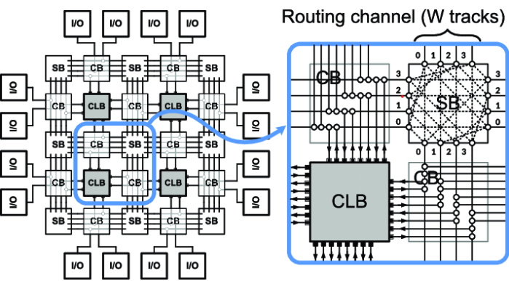
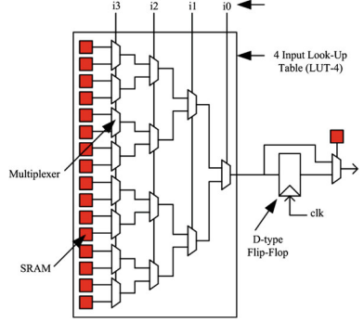
FPGA: Field Programmable Gate Array (Intel, AMD)

Slide 8
Multiplexer (Mux): Definition
Selects between one of N inputs to connect to the output.
log₂N-bit select input – control input
E: Enable
Data input
D₀
0
y: Output
D₁
1
S: Selector or Address

Slide 9
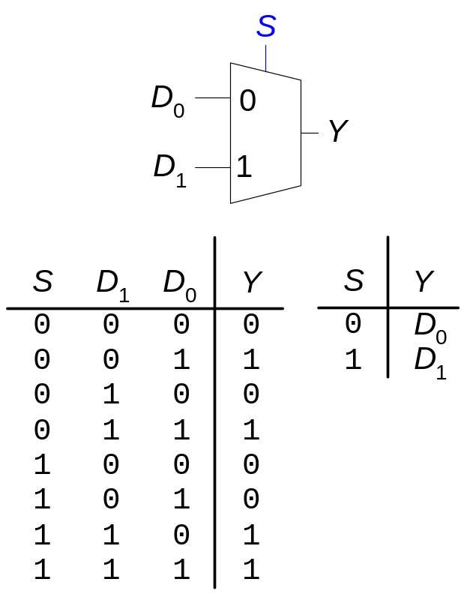
Multiplexer (Mux): Definition
Selects between one of N inputs to connect to the output.
log₂N-bit select input – control input
Example: 2:1 Mux

Slide 10
What is the output of the following MUX?
0
1
Can’t say
E =1
0
0
y
1
1
S=1

Slide 11
Multiplexer Definition: 4-input mux
En
D₀
0
S₁ | S₀ | y
D₁
1
y
D₂
2
D₃
3
S₁
S₀

Slide 12
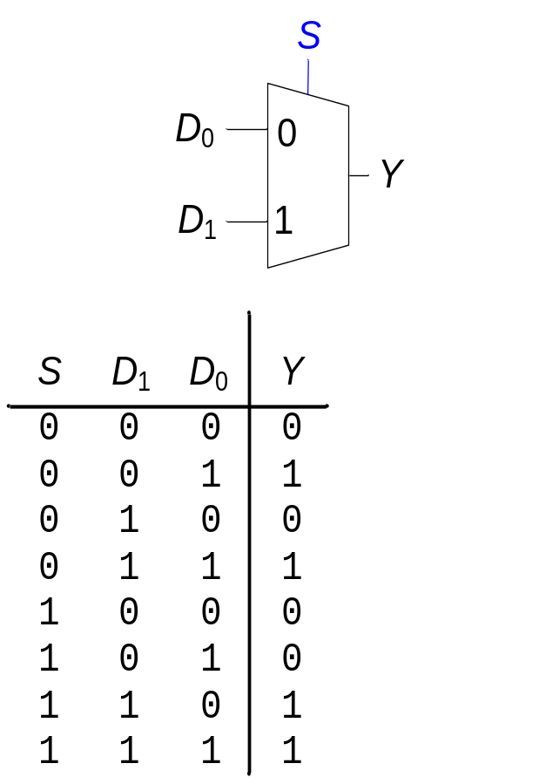
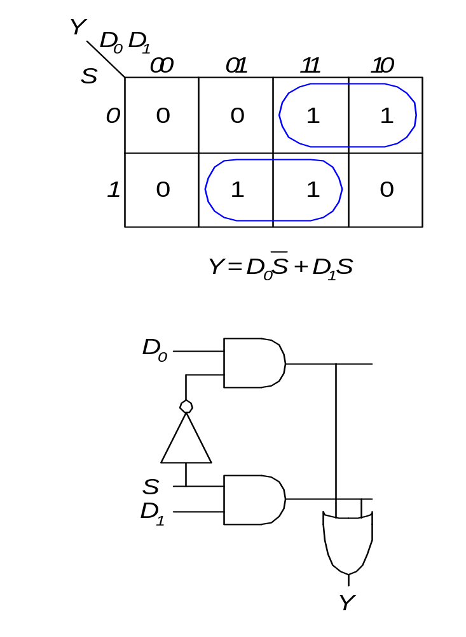
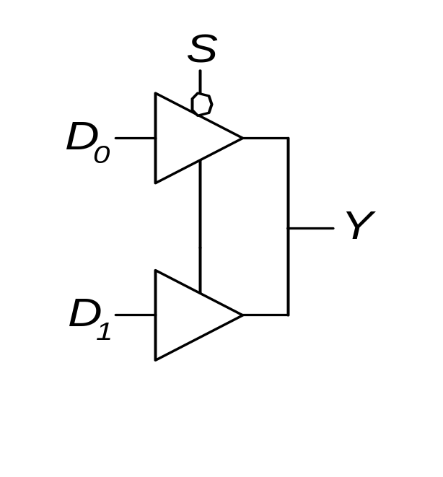
Multiplexer: Logic Diagram
Logic gates
  Sum-of-products
Tristates
  For an N-input mux, use N tristates
  Turn on exactly one to select the appropriate input

Slide 13
Multiplexer Application: universal set {Mux}
We use selector to decompose the function into smaller functions (less number of variables), which follows Shannon’s expansion.
We simplify the decomposed functions using K-map, which follows consensus theorem.

Slide 14
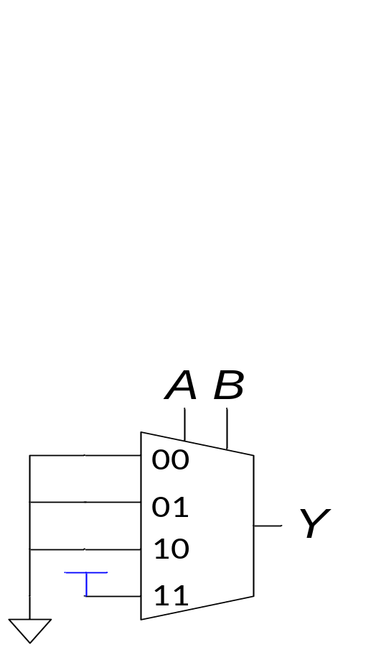
Multiplexer Application
Mux for a Boolean function with truth table as input
Building blocks of FPGA (Field Programmable Gate Array).
For the logic diagram on left, output Y is
AB
(AB)’
A+B
(A+B)’
None of the above

Slide 15
Multiplexer Application: universal set {Mux}
Example 1: Given f (a,b,c) = Σm (0,1,7) + Σd(2), implement with an 8-input Mux.
id | abc | f
0 | 000 | 1
1 | 001 | 1
2 | 010 | -
3 | 011 | 0
4 | 100 | 0
5 | 101 | 0
6 | 110 | 0
7 | 111 | 1
En
0
1
2
3
4
5
6
7
y
S₂
S₁
S₀
a
b
c

Slide 16
Example 2: Given f (a,b,c) = Σm (0,1,7) + Σd(2), implement with 4-input Muxes.
E
ab | c=0 | c=1 | D
00 |  |  | D₀
01 |  |  | D₁
10 |  |  | D₂
11 |  |  | D₃
0
1
y
2
3
S₁
S₀
a
b

Slide 17
Example 3: Given f (a,b,c) = Σm (0,1,7) + Σd(2), implement with 2-input Muxes.
a\bc | 00 | 01 | 10 | 11 | D(b,c)
0 | 1 | 1 | - | 0 | D₀
1 | 0 | 0 | 0 | 1 | D₁
E
0
y
1
a

Slide 18
Example 3: Given f (a,b,c) = Σm (0,1,7) + Σd(2), implement with 2-input Muxes.
a\bc | 00 | 01 | 10 | 11 | D(b,c)
0 | 1 | 1 | - | 0 | D₀
1 | 0 | 0 | 0 | 1 | D₁
E
D₀ (b,c) = b’
D₁ (b,c) = bc
b’
0
c=0 | 1 | -
c=1 | 1 | 0
 | b=0 | b=1
c=0 | 0 | 0
c=1 | 0 | 1
 | b=0 | b=1
y
D₁ (b,c)
1
a

Slide 19
Example 3: Given f (a,b,c) = Σm (0,1,7) + Σd(2), implement with 2-input Muxes.
D₁ (b,c)
b\c | 0 | 1 | D
0 | 0 | 0 | D₀=
1 | 0 | 1 | D₁=
E
b’
0
y
1
a

Slide 20
Example 3: Given f (a,b,c) = Σm (0,1,7) + Σd(2), implement with 2-input Muxes.
D₁ (b,c)
b\c | 0 | 1 | D
0 | 0 | 0 | D₀=0
1 | 0 | 1 | D₁=c
E
E
b’
0
y
0
0
1
c
1
a
b

Slide 21
Example 4: Given f (a,b,c) = Σm (0,2,4,7) + Σd(3,5), implement with 2-input Muxes.
a\bc | 00 | 01 | 10 | 11 | D
0 | 1 | 0 | 1 | - | D₀
1 | 1 | - | 0 | 1 | D₁
E
D₀(b,c)
0
y
D₁(b,c)
1
a

Slide 22
4. Demultiplexers
E
y_{i} = x if i = (S_{n-1}, .. , S₀) & E=1
y_{i} = 0 otherwise
x
y₂n₋₁ -y₀
S(n-1,0)
Control Input

Slide 23
Shifters
Logical shifter: shifts value to left or right and fills empty spaces with 0’s
  Ex: 11001 >> 2 = 00110
  Ex: 11001 << 2 = 00100
Arithmetic shifter: same as logical shifter, but on right shift, fills empty spaces with the old most significant bit (msb).
  Ex: 11001 >>> 2 = 11110
  Ex: 11001 <<< 2 = 00100
Rotator: rotates bits in a circle, such that bits shifted off one end are shifted into the other end
  Ex: 11001 ROR 2 = 01110
  Ex: 11001 ROL 2 = 00111

Slide 24
Shifter
x_{n}
x_{n-1}
x₀
x₋₁
y_{i} = x_{i-1} if E = 1, s = 1, and d = L
= x_{i+1} if E = 1, s = 1, and d = R
= x_{i} if E = 1, s = 0
= 0 if E = 0
s
s / n
E
d
l / r
yn₋₁
y0
x_{i+1}
x_{i}
x_{i-1}
Can be implemented with a mux
s
1
3 2 1 0
d
E
0
yi

Slide 25
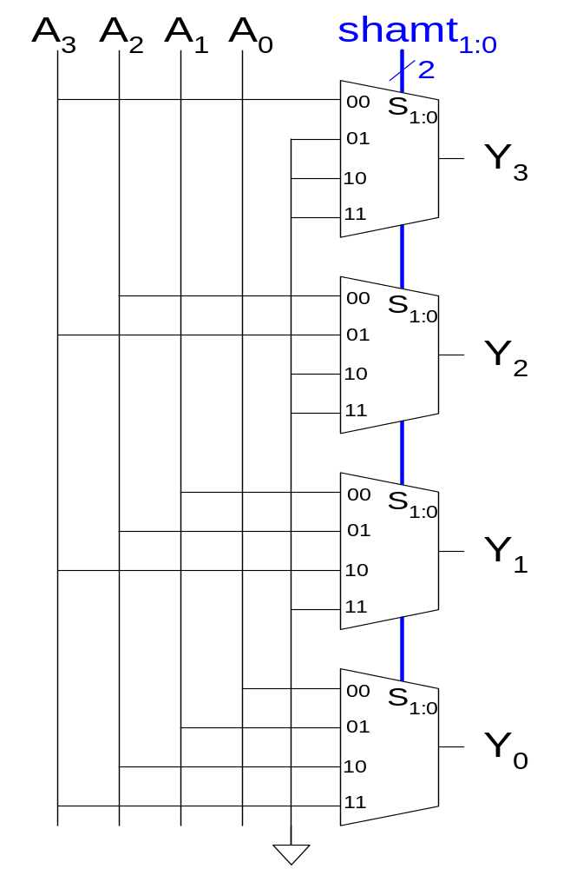
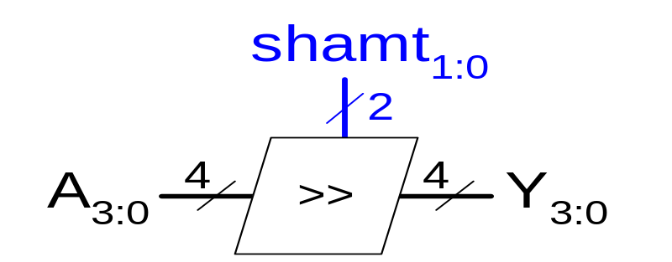
Shifter Design

Slide 26
Barrel Shifter
shift
x
O or 1 shift
0 1
0 1
0 1
s₀
s₁
O or 2 shift
0 1
0 1
0 1
0 1
0 1
s₂
O or 4 shift
y
0 1
0 1
0 1
0 1
0 1
0 1

Slide 27
Shifters as Multipliers and Dividers
A left shift by N bits multiplies a number by 2^{N}
  Ex: 00001 << 2 = 00100 (1 × 2² = 4)
  Ex: 11101 << 2 = 10100 (-3 × 2² = -12)
The arithmetic right shift by N divides a number by 2^{N}
  Ex: 01000 >>> 2 = 00010 (8 ÷ 2² = 2)
  Ex: 10000 >>> 2 = 11100 (-16 ÷ 2² = -4)

