Slide 1
CSE 140 Lecture 11
Standard Combinational Modules
CK Cheng
CSE Dept.
UC San Diego

Slide 2
Part III - Standard Combinational Modules
Introduction
Decoder
  Behavior, Logic, Usage
Encoder
Multiplexer (Mux)
  Behavior, Logic, Usage
Demultiplexier (DeMux)

Slide 3
Part III - Standard Combinational Modules
Signal Transport
Decoder: Decode address
Encoder: Encode address
Multiplexer (Mux): Select data by address
Demultiplexier (DeMux): Direct data by address
Shifter: Shift bit location
Data Operator
Adder: Add two binary numbers
Multiplier: Multiply two binary numbers

Slide 4
Interconnect: Decoder, Encoder, Mux, DeMux
Processors
Arbiter
P1
Data 1
Mux
Memory Bank
Address 1
Data
P2
Demux
n-m
Address 2
Mux
Address
n
m
2^{m}
Address k
Decoder
Pk
Data k
Decoder: Decode the address to assert the addressed device
Mux: Select the inputs according to the index addressed by the control signals

Slide 5
Interconnect: Decoder, Encoder, Mux, DeMux
Arbiter
Processors
P1
Data 1
Mux
Memory Bank
Address 1
Data
P2
Demux
n-m
Address 2
Mux
Address
n
m
2^{m}
Address k
Decoder
Pk
Data k

Slide 6
1. Decoder
Definition
Logic Diagram
Application (Universal Set)
Tree of Decoders

Slide 7
Decoder: Definition
A device that decodes
An electronic device that converts signals from one form to another
A machine that converts a coded text into ordinary language
A device or program that translates encoded data into its original format
All of the above

Slide 8
Decoder Definition: A digital module that converts a binary address to the assertion of the addressed device
E (enable)
I₀
0
0
1
2
3
4
5
6
7
y₀
y₁
y₇
I₁
1
.
.
I₂
2
n to 2^{n} decoder function:
n inputs
n= 3
2^{n} outputs
2³= 8
y_{i} = 1 if E= 1 & (I_{2,} I_{1,} I₀ ) = i
y_{i}= 0 otherwise

Slide 9
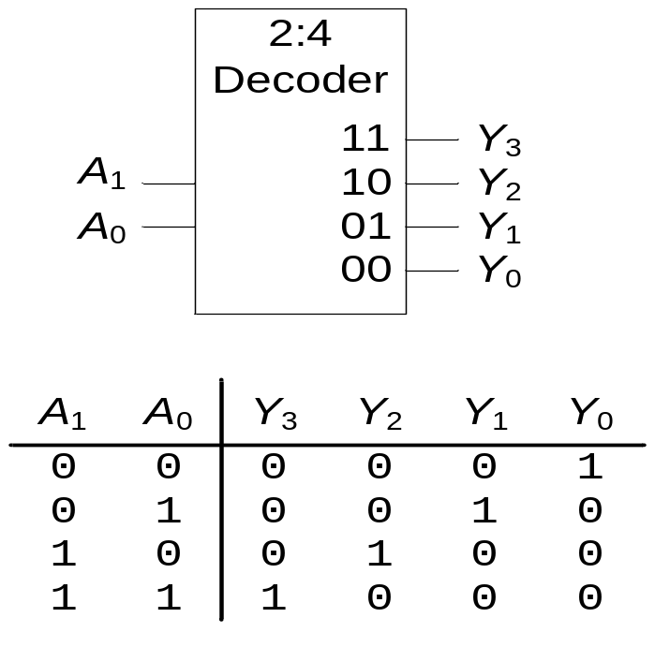
1. Decoder: Definition
N inputs, 2^{N} outputs
One-hot outputs: only one output HIGH at most
E
E= 1

Slide 10
1. Decoder: Definition
Example: A 3-input decoder has how many outputs?
2 outputs
4 outputs
8 outputs
10 outputs
E

Slide 11
Decoder Definition
E (enable)
Example: For a 3-input decoder, suppose
(E,I₂,I₁,I₀)=(1,0,0,0), then (y₇,y₆, …, y₀) is equal to:
(00000000)
(00000001)
(00000010)
(01000000)
(10000000)
I₀
0
0
1
2
3
4
5
6
7
y₀
y₁
y₇
I₁
1
.
.
I₂
2
3 inputs
8 outputs

Slide 12
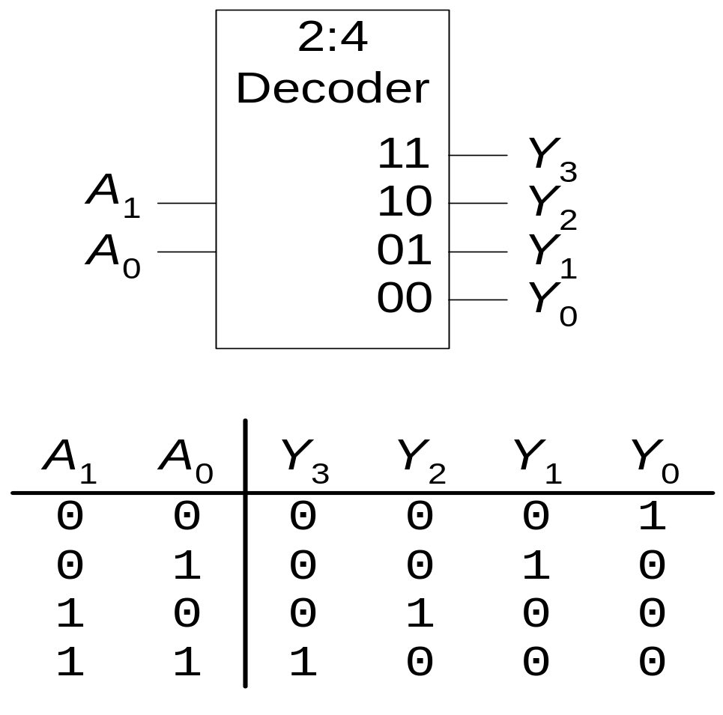
Decoder: Logic Diagram (Inside a decoder)
y₀ = 1 if (A_{1,} A₀ ) = (0,0) & E = 1
E
y_{i} = m_{i} E
A₀’
A₁’
y₀
y₁
.
.
y₃
y₃ = A₁A₀E

Slide 13
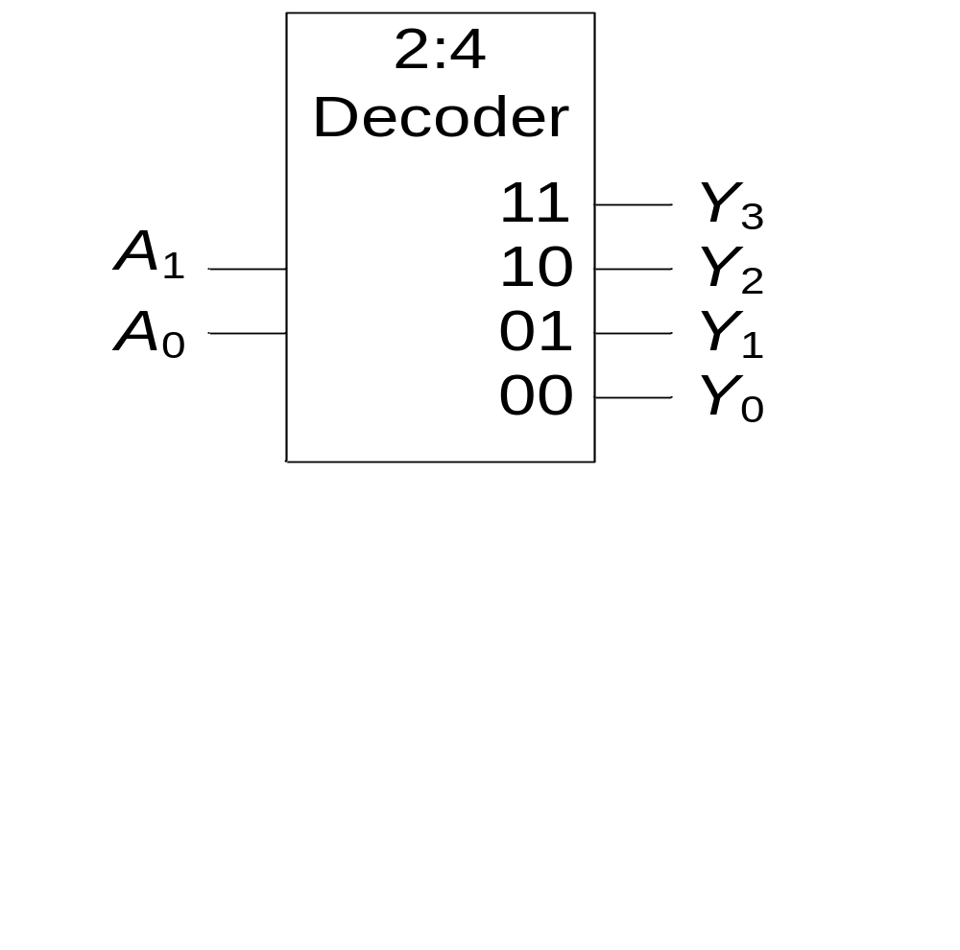
1. Decoder: Definition
PI Q: What is the output Y_{3:0} of the 2:4 decoder for (A₁, A₀) = (1,0)?
(1, 1, 0, 0 )
(1, 0, 1, 1)
(0, 0, 1, 0)
(0, 1, 0, 0)

Slide 14
Decoder Application: universal set {Decoder, OR}
Example:
Implement the following functions with a 3-input decoder and OR gates.
i) f₁(a,b,c) = Σm(1,2,4)
ii) f₂(a,b,c) = Σm(2,3),
iii) f₃(a,b,c) = Σm(0,5,6)

Slide 15
Decoder Application: universal set {Decoder, OR}
Decoder produces minterms when E=1.
We can use an OR gate to collect the minterms to cover the On-set.
For the Don’t Care-Set, we can just ignore the terms.

Slide 16
Decoder Application: universal set {Decoder, OR}
Example:
Implement functions
f₁(a,b,c) = Σm(1,2,4) + Σd(0,5),
f₂(a,b,c) = Σm(2,3) + Σd(1,4),
f₃(a,b,c) = Σm(0,5,6)
y₁
with a 3-input decoder and OR gates.
y₂
y₄
f₁
E=1
y₂
y₃
f₂
y₀
.
.
y₇
c
I₀
0
1
2
3
4
5
6
7
b
I₁
y₀
a
I₂
y₅
y₆
f₃

Slide 17
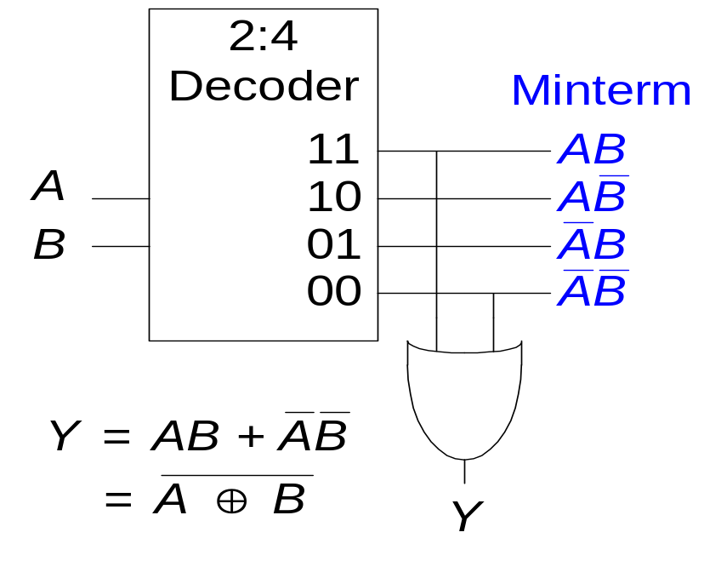
Decoders
OR minterms
E=1

Slide 18
Tree of Decoders: Scale up the size of the decoders using a tree structure
Implement a 4-2⁴ decoder with 3-2³ decoders.
y₀
.
y₇
d
I₀
0
1
2
3
4
5
6
7
c
I₁
b
I₂
y₈
.
y₁₅
I₀
0
1
2
3
4
5
6
7
I₁
I₂
a

Slide 19
Tree of Decoders
Implement a 6-2⁶ decoder with 3-2³ decoders.
E
y₀
E
D0
I_{2,} I_{1,} I₀
y₇
I_{5,} I_{4,} I₃
y₈
D1
I_{2,} I_{1,} I₀
…
y₁₅
…
y₅₆
D7
I_{2,} I_{1,} I₀
y₆₃

Slide 20
Construction: A four variable switching function f(a,b,c,d) can be implemented using which of the following?
1:2 decoders and OR gates
2:4 decoders and OR gates
3:8 decoders and OR gates
All of the above
None of the above

Slide 21
2. Encoder
Definition
Logic Diagram
Priority Encoder

Slide 22
Definition of Encoder
Any program, circuit or algorithm which encodes
In digital audio technology, an encoder is a program that converts an audio WAV file into an MP3 file
A device that convert a message from plain text into code
A circuit that is used to convert between digital video and analog video
All of the above

Slide 23
Encoder Definition: A digital module that converts the assertion of a device to the binary address of the device.
E
I₂^{n}-1…I₀
y_{n-1 …}y₀
A
Encoder Description:
E
At most one I_{i} = 1.
(y_{n-1},.., y₀ ) = i if I_{i} = 1 & Ε = 1
(y_{n-1},.., y₀ ) = 0 otherwise.
A = 1 if E = 1 and one i s.t. I_{i} = 1
A = 0 otherwise.
I₀
0
1
2
3
4
5
6
7
y₀
0
1
2
y₁
y₂
I₇
8 inputs
A
3 outputs

Slide 24
Encoder: Logic Diagram
En
En
y₀
y₁
I₁
I₂
I₃
I₃
I₅
I₆
I₇
I₇
En
En
y₂
I₄
I₅
I₆
I₇
A
I₀
I₁
.
.
I₆
I₇

Slide 25
Priority Encoder:
E
I₀
0
1
2
3
y₀
0
1
y₁
I₃
Eo
Gs

Slide 26
Priority Encoder: Definition
Description: Input (I₂^{n}-1,…, I₀), Output (y_{n-1} ,…,,y₀)
(y_{n-1} ,…,,y₀) = i if I_{i} = 1 & E = 1 & I_{k} = 0
for all k > i (high bit priority) or
for all k< i (low bit priority).
E
E_{o} = 1 if E = 1 & I_{i} = 0 for all i,
G_{s} = 1 if E = 1 & i s.t. I_{i} = 1.
I₀
0
1
2
3
4
5
6
7
y₀
0
1
2
E
y₁
(G_{s} is like A, and E_{o} passes on enable).
y₂
I₇
Eo
Gs

Slide 27
Priority Encoder: Implement a 32-input priority encoder with 8 input priority encoders (high bit priority).
E
I₃₁₋₂₄
y_{32,} y_{31,} y₃₀
Eo
Gs
I₂₃₋₁₆
y_{22,} y_{21,} y₂₀
Eo
Gs
I₁₅₋₈
y_{12,} y_{11,} y₁₀
Eo
Gs
I₇₋₀
y_{02,} y_{01,} y₀₀
Eo
Gs

