Slide 1
CSE 140 Week 6 Discussion
TA: Kanlin Wang

Slide 2
Announcements
HW #3 due next Wednesday 5/11 at 11:59 PM
Midterm 2 coming up soon
Next week discussion will be Midterm 2 review

Slide 3
Outline
Mealy to Moore machine conversion
Pattern Recognizer
Sequential machine synthesis from State diagram to logic diagram — Sequential Circuit Analysis

Slide 4
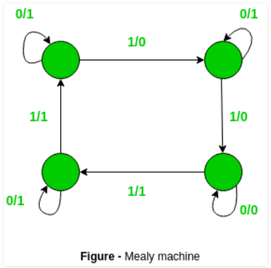
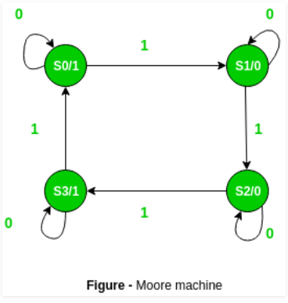
Mealy to Moore machine conversion
Difference between Mealy machine and Moore machine:
Mealy Machine | Moore Machine
Output depends on present state as well as present input | Output depends only upon present state

Slide 5
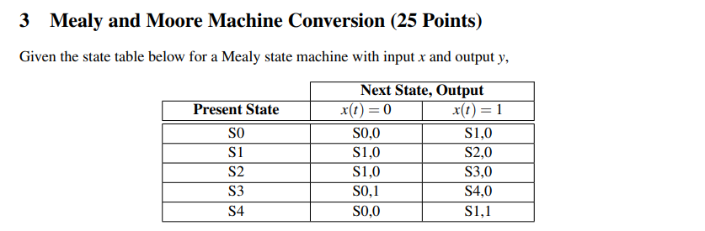

Slide 6
0/0
0/0
0/0
S0
1/0
S1
1/0
S2
0/0
0/1
1/0
1/1
S4
S3
1/0

Slide 7
Identify distinct (NS, y) pair
Replace each distinct (NS, y) pair with distinct new states
Insert rows of present state = new states
s(t) | x(t)=0 | x(t)=1 | y
S0 | S0 | S1 | 0
S1 | S1 | S2 | 0
S2 | S1 | S3 | 0
S3
S4
S5
S6
3.

Slide 8
Identify distinct (NS, y) pair
Replace each distinct (NS, y) pair with distinct new states
Insert rows of present state = new states
s(t) | x(t)=0 | x(t)=1 | y
S0 | S0 | S1 | 0
S1 | S1 | S2 | 0
S2 | S1 | S3 | 0
S3 | S5 | S4 | 0
S4 | S0 | S6 | 0
S5 | S0 | S1 | 1
S6 | S1 | S2 | 1
3.
(S0,0),(S0,1),
(S1,0), (S1,1),
(S2,0),
(S3,0),
(S4,0)
(S0,0),(S5,1),
(S1,0), (S6,1),
(S2,0),
(S3,0),
(S4,0)

Slide 9
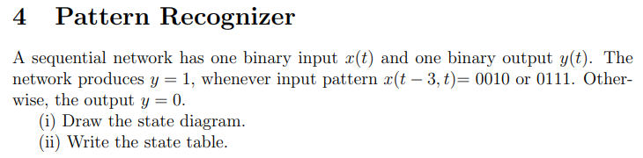

Slide 10
0/1
i)
PS | x(t)=0 | x(t)=1 | y(t) x(t)=0 | y(t) x(t)=1
S
0
00
01
001
011
0/0
1/0
0/0
0/0
00
1/0
001
s
0
1/0
0/0
0/0
1/0
01
011
1/0
1/1

Slide 11
0/1
i)
PS | x(t)=0 | x(t)=1 | y(t) x(t)=0 | y(t) x(t)=1
S | 0 | S | 0 | 0
0 | 00 | 01 | 0 | 0
00 | 00 | 001 | 0 | 0
01 | 0 | 011 | 0 | 0
001 | 0 | 011 | 1 | 0
011 | 0 | S | 0 | 1
0/0
1/0
0/0
0/0
00
1/0
001
s
0
1/0
0/0
0/0
1/0
01
011
1/0
1/1

Slide 12
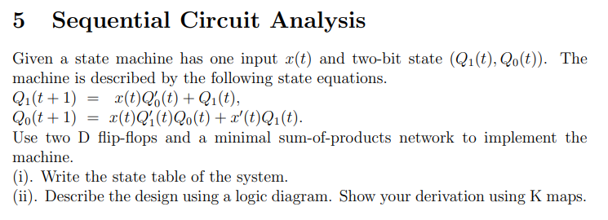
i)

Slide 13
i)
ii)
Q1Q0 | x(t)=0 | x(t)=1
00 | 00 | 10
01 | 00 | 01
10 | 11 | 10
11 | 11 | 10

Slide 14
i)
Q1Q0 | x(t)=0 | x(t)=1
00 | 00 | 10
01 | 00 | 01
10 | 11 | 10
11 | 11 | 10
ii)
K-map for Q1(t+1)
K-map for Q0(t+1)

Slide 15
i)
Q1Q0 | x(t)=0 | x(t)=1
00 | 00 | 10
01 | 00 | 01
10 | 11 | 10
11 | 11 | 10
ii)
K-map for Q1(t+1)
K-map for Q0(t+1)
x(t)\Q1(t)Q2(t) | 00 | 01 | 11 | 10
0 | 0 | 0 | 1 | 1
1 | 1 | 0 | 1 | 1
x(t)\Q1(t)Q2(t) | 00 | 01 | 11 | 10
0 | 0 | 0 | 1 | 1
1 | 0 | 1 | 0 | 0
Q1(t+1) = Q1(t) + x(t)Q0(t)’
Q0(t+1) = x(t)Q1(t)’Q0(t) + x(t)’Q1(t)

Slide 16
ii)
D1 = Q1(t+1) = Q1(t) + x(t)Q0(t)’
D0 = Q0(t+1) = x(t)Q1(t)’Q0(t) + x(t)’Q1(t)

