Slide 1
Discussion 3
Yuxin Li 04/15/22

Slide 2
Agenda
HW2 due Wednesday 4/20 at 11:59 PM
Midterm 1 coming next week
https://cseweb.ucsd.edu//classes/sp21/cse140-a/index.html (previous year course link)

Slide 3
Outline
K-maps
POS expression and SOP expression

Slide 4
K-Maps
Prime Implicant: Obtained by combining all possible maximum number of squares/cells
Essential Prime Implicant: Prime Implicant is essential if it is the only prime implicant that only covers the min-term
  Must be included in every simplified Boolean expression

Slide 5
Warm up
f (a, b, c) = ∑ m(1, 2, 4) + ∑ d(3, 5, 6)

Slide 6
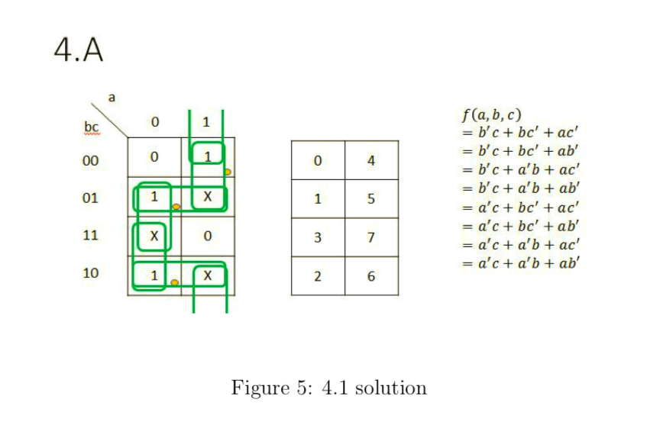
Reference: sp21 hw2 4A

Slide 7
K-map: all possible minimal two-level sum of products expressions?
ab
00 01 11 10
cd
0 | 4 | 12 | 8
1 | 5 | 13 | 9
3 | 7 | 15 | 11
2 | 6 | 14 | 10
1 | 0 | 1 | 1
1 | 1 | 0 | 0
1 | 1 | 1 | X
0 | X | 1 | X
00
01
11
10

Slide 8
K-map: all possible minimal two-level sum of
products expressions?
0 | 4 | 12 | 8
1 | 5 | 13 | 9
3 | 7 | 15 | 11
2 | 6 | 14 | 10
ab
00 01 11 10
Essential Prime Implicants:
cd
1 | 0 | 1 | 1
1 | 1 | 0 | 0
1 | 1 | 1 | X
0 | X | 1 | X
00
∑M(8,10,12,14)
01
∑M(1,3,5,7)
11
10

Slide 9
K-map: all possible minimal two-level sum of
products expressions?
0 | 4 | 12 | 8
1 | 5 | 13 | 9
3 | 7 | 15 | 11
2 | 6 | 14 | 10
ab
00 01 11 10
Essential Prime Implicants:
cd
1 | 0 | 1 | 1
1 | 1 | 0 | 0
1 | 1 | 1 | X
0 | X | 1 | X
00
∑M(8,10,12,14)
01
∑M(1,3,5,7)
11
10

Slide 10
K-map: all possible minimal two-level sum of
products expressions?
Essential Prime Implicants:
0 | 4 | 12 | 8
1 | 5 | 13 | 9
3 | 7 | 15 | 11
2 | 6 | 14 | 10
ab
∑M(8,10,12,14)
00 01 11 10
cd
1 | 0 | 1 | 1
1 | 1 | 0 | 0
1 | 1 | 1 | X
0 | X | 1 | X
∑M(1,3,5,7)
00
01
Prime Implicants that cover the circled cells:
yellow
11
∑M(3,7,11,15) or ∑M(6,7,14,15) or ∑M(10,11,14,15)
10
∑M(0,1) or ∑M(0,8)

Slide 11
K-map: all possible minimal two-level sum of products expressions?
F(a,b,c,d) = ad’ + a’d + cd + a’b’c’
F(a,b,c,d) = ad’ + a’d + cd + b’c’d’
F(a,b,c,d) = ad’ + a’d + bc + a’b’c’
F(a,b,c,d) = ad’ + a’d + bc + b’c’d’
F(a,b,c,d) = ad’ + a’d + ac + a’b’c’
F(a,b,c,d) = ad’ + a’d + ac + b’c’d’

Slide 12
K-map: all possible minimal two-level product of sums expressions?
ab
00 01 11 10
cd
0 | 4 | 12 | 8
1 | 5 | 13 | 9
3 | 7 | 15 | 11
2 | 6 | 14 | 10
1 | 0 | 1 | 1
1 | 1 | 0 | 0
1 | 1 | 1 | X
0 | X | 1 | X
00
01
11
10

Slide 13
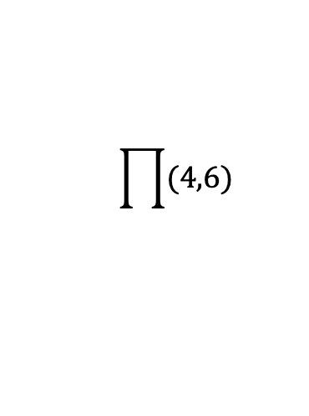
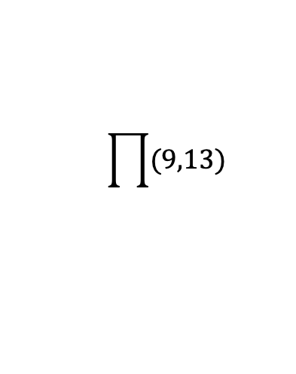
K-map: all possible minimal two-level product
of sums expressions?
0 | 4 | 12 | 8
1 | 5 | 13 | 9
3 | 7 | 15 | 11
2 | 6 | 14 | 10
ab
00 01 11 10
Essential Prime Implicates:
cd
1 | 0 | 1 | 1
1 | 1 | 0 | 0
1 | 1 | 1 | X
0 | X | 1 | X
$$\prod{(9,13)}$$
00
01
$$\prod{(4,6)}$$
11
10

Slide 14
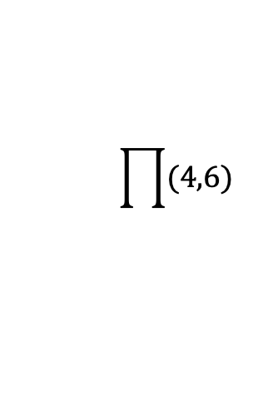
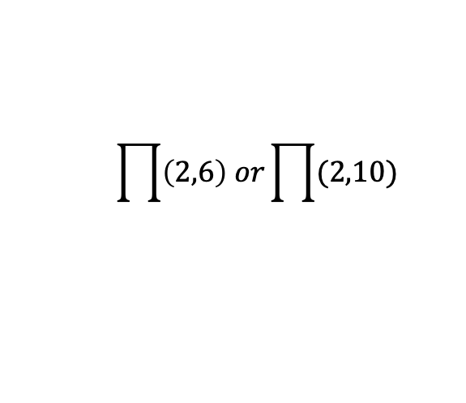
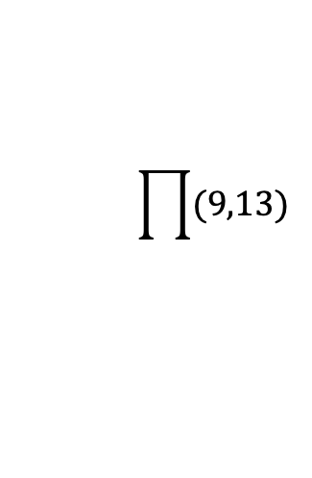
K-map: all possible minimal two-level product
of sums expressions?
0 | 4 | 12 | 8
1 | 5 | 13 | 9
3 | 7 | 15 | 11
2 | 6 | 14 | 10
ab
00 01 11 10
Essential Prime Implicates:
cd
1 | 0 | 1 | 1
1 | 1 | 0 | 0
1 | 1 | 1 | X
0 | X | 1 | X
00
$$\prod{(9,13)}$$
01
$$\prod{(4,6)}$$
11
Prime Implicates that cover the
yellow
circled cells:
10
$$\prod{\left(2,6\right) or\prod{(2,10)}}$$

Slide 15
K-map: all possible minimal two-level product of sums expressions?
F(a,b,c,d) = (a’+c+d’)(a+b’+d)(a+c’+d)
F(a,b,c,d) = (a’+c+d’)(a+b’+d)(b+c’+d)

Slide 16
Extension: K-map for 5-varibles

