Slide 1
CSE 140 Discussion 2
Speaker: Tim (Wonsuk) Jang

Slide 2
Announcements
HW #1 due next Wednesday 4/13 at 11:59 PM
HW #2 out, due Wednesday 4/20 at 11:59 PM
Midterm 1 coming up soon

Slide 3
Today’s Agenda
Consensus Theorem
Shannon’s Expansion
Full Adder and Subtractor
Karnaugh Maps

Slide 4
Consensus Theorem
AB + A’C + BC = AB + A’C
Duality: (A + B)(A’ + C)(B + C) = (A + B)(A’ + C)
Proof: AB + A’C + BC = AB + A’C + (1)BC
= AB + A’C + (A + A’)BC
= AB + A’C + ABC + A’BC
= AB(1 + C) + A’C(1 + B)
= AB + A’C

Slide 5
Consensus Examples
abe + a’bcd + b’d
Consensus of a and a’ (abe, a’bcd) is bcde
Consensus of b and b’ (abe, b’d) is ade
Consensus of b and b’ (a’bcd, b’d) is a’cd
(a + c’d’)(a’ + bc’d’)(bc’d’ + c’d’) = (a + c’d’)(a’ + bc’d’)
Recall (A + B)(A’ + C)(B + C) = (A + B)(A’ + C)
A = a, B = c’d’, A’ = a’, C = bc’d’
Consensus of a and a’ is (bc’d’ + c’d’)

Slide 6
Shannon’s Expansion
Choose a variable to decompose the equation into simpler terms
Sum of Products Form: f(x, y, z) = x f(1, y, z) + x’ f(0, y, z)
Product of Sums Form: f(x, y, z) = (x + f(0, y, z))(x’ + f(1, y, z))
If we were to choose y, we would have:
  f(x, y, z) = y f(x, 1, z) + y’ f(x, 0, z)
  f(x, y, z) = (y + f(x, 0, z))(y’ + f(x, 1, z))

Slide 7
Shannon’s Expansion Example #1
f(x, y, z) = xyz + x’y + z’y
f(x, y, z) = x f(1, y, z) + x’ f(0, y, z)
= x(yz + 0 + z’y) + x’(0 + y + z’y)
= x(y(z+z’)) + x’(y(1+z’))
= xy + x’y
= y

Slide 8
Shannon’s Expansion Example #2
f(x, y, z) = (x + y + z’) (x’ + y’ + z) (z + y)
f(x, y, z) = (x + f(0, y, z))(x’ + f(1, y, z))
= (x + (y + z’)(1)(z + y))(x’ + (1)(y’ + z)(z + y))
= (x + (y + z’)(y + z))(x’ + (y’ + z)(y + z))
= (x + y)(x’ + z)

Slide 9
Full Adder
id | A | B | C_{in} | C_{out} | S
0 | 0 | 0 | 0 | 0 | 0
1 | 0 | 0 | 1 | 0 | 1
2 | 0 | 1 | 0 | 0 | 1
3 | 0 | 1 | 1 | 1 | 0
4 | 1 | 0 | 0 | 0 | 1
5 | 1 | 0 | 1 | 1 | 0
6 | 1 | 1 | 0 | 1 | 0
7 | 1 | 1 | 1 | 1 | 1
Takes 1-bit A, B, C_{in}
Outputs C_{out}, S
C_{in} = Carry In
C_{out} = Carry Out
S = (A+B+C_{in})%2
  If S exceeds 1, then C_{out} = 1

Slide 10
Full Subtractor
id | A | B | B_{in} | B_{out} | D
0 | 0 | 0 | 0 | 0 | 0
1 | 0 | 0 | 1 | 1 | 1
2 | 0 | 1 | 0 | 1 | 1
3 | 0 | 1 | 1 | 1 | 0
4 | 1 | 0 | 0 | 0 | 1
5 | 1 | 0 | 1 | 0 | 0
6 | 1 | 1 | 0 | 0 | 0
7 | 1 | 1 | 1 | 1 | 1
Takes 1-bit A, B, B_{in}
Outputs B_{out}, D
B_{in} = Borrow In
B_{out} = Borrow Out
D = A - B - B_{in}
  If we ever have to perform 0 - 1, then B_{out} = 1

Slide 11
Karnaugh Maps
Reduce boolean expressions by writing the entries of the truth table and reducing the expression to either SOP or POS terms
Row and column entries ordered in gray code (i.e. 00, 01, 11, 10)
Prime Implicant: Obtained by combining all possible maximum number of squares/cells
Essential Prime Implicant: Prime Implicant is essential if it is the only prime implicant that only covers the minterm
  Must be included in every simplified boolean expression
Practice Resource: http://www.32x8.com/index.html

Slide 12
3 way K-map
f(a,b,c) = ∑_{m}(0, 2, 4, 5) = ab’ + a’c’ + b’c’
Prime Implicants:
AB’, A’C’, B’C’
Essential Prime Implicants:
AB’, A’C’
C/AB | 00 | 01 | 11 | 10
0 | 1 | 1 | 0 | 1
1 | 0 | 0 | 0 | 1

Slide 13
3 way K-map with Don’t Cares
f(a,b,c) = ∑_{m}(0, 2, 4, 5) + ∑_{d}(1, 6) = b’ + c’
Prime Implicants:
B’, C’
Essential Prime Implicants:
B’, C’
C/AB | 00 | 01 | 11 | 10
0 | 1 | 1 | X | 1
1 | X | 0 | 0 | 1

Slide 14
3 way K-map for Full Adders
K-map for S:
S = A’B’C_{in} + A’BC_{in}’ + ABC_{in} + AB’C_{in}’
C_{out}= BC_{in} + AB + AC_{in}
C_{in}/AB | 00 | 01 | 11 | 10
0 | 0 | 1 | 0 | 1
1 | 1 | 0 | 1 | 0
K-map for C_{out}:
C_{in}/AB | 00 | 01 | 11 | 10
0 | 0 | 0 | 1 | 0
1 | 0 | 1 | 1 | 1

Slide 15
Simplify Summation Term
Recall
AB’ + A’B = A XOR B,
AB + A’B’ = A XNOR B = (A XOR B)’
Then:
S = A’B’C_{in} + A’BC_{in}’ + ABC_{in} + AB’C_{in}’
= B(AC + A’C_{in}’) + B’(A’C_{in}+AC_{in}’)
= B(A XOR C_{in})’ + B’(A XOR C_{in})
= B XOR (A XOR C_{in})
= B XOR A XOR C_{in}

Slide 16
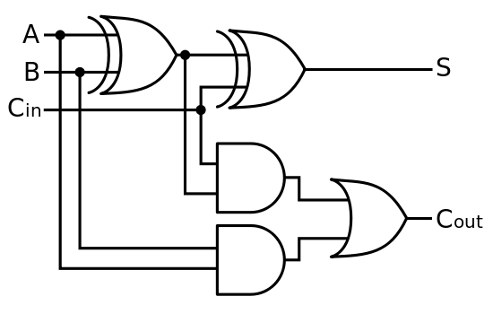
Full Adder Diagram

Slide 17
3 way K-map for Full Subtractors
K-map for D:
D = A’B’B_{in} + A’BB_{in}’ + ABB_{in} + AB’B_{in}’
B_{out}= A’B_{in} + A’B + BB_{in}
B_{in}/AB | 00 | 01 | 11 | 10
0 | 0 | 1 | 0 | 1
1 | 1 | 0 | 1 | 0
K-map for B_{out}:
B_{in}/AB | 00 | 01 | 11 | 10
0 | 0 | 1 | 0 | 0
1 | 1 | 1 | 1 | 0

Slide 18
Simplify Difference Term
Recall
AB’ + A’B = A XOR B,
AB + A’B’ = A XNOR B = (A XOR B)’
D = A’B’B_{in} + A’BB_{in}’ + ABB_{in} + AB’B_{in}’
= A(BB_{in} + B’B_{in}’) + A’(B’B_{in}+BB_{in}’)
= A(B XOR B_{in})’ + A’(B XOR B_{in})
= A XOR B XOR B_{in}

Slide 19
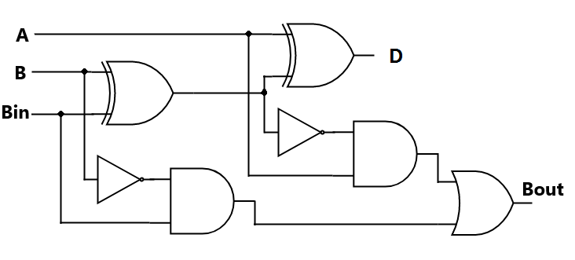
Full Subtractor Diagram

Slide 20
4 way K-map
f(a,b,c, d) = ∑_{m}(0, 1, 8, 9, 10) + ∑_{d}(2, 4, 5, 11, 13)
Prime Implicants:
a’c’, b’d’, b’c’, c’d, ab’
Essential Prime Implicants:
None
cd \ ab | 00 | 01 | 11 | 10
00 | 1 | X | 0 | 1
01 | 1 | X | X | 1
11 | 0 | 0 | 0 | X
10 | X | 0 | 0 | 1

Slide 21
4 way K-map
f(a,b,c, d) = ∑_{m}(0, 1, 8, 9, 10) + ∑_{d}(2, 4, 5, 11, 13)
f = b’d’ + b’c’
f = b’c’ + ab’
f = c’d + b’d’
f = ab’ + b’c’
cd \ ab | 00 | 01 | 11 | 10
00 | 1 | X | 0 | 1
01 | 1 | X | X | 1
11 | 0 | 0 | 0 | X
10 | X | 0 | 0 | 1

