Slide 1
CSE 140: Components and Design Techniques for Digital Systems
Lecture 8:
Sequential Networks and Finite State Machines
CK Cheng
Dept. of Computer Science and Engineering
University of California, San Diego

Slide 2
3. Implementation
Specification:
  Finite State Machine:
    Behavior, State Diagram, State Table
    Register Transfer Level Description
Design Flow
Excitation Table
Mealy and Moore Machines
Examples

Slide 3
Specification
Combinational Logic
  Truth Table
  Boolean Expression
  Logic Diagram (No feedback loops)
Sequential Networks: Finite State Machines
  State Diagram, State Assignment, State Table
  Excitation Table and Characteristic Expression
  Register-Transfer Level Description
  Logic Diagram (FFs and feedback loops)

Slide 4
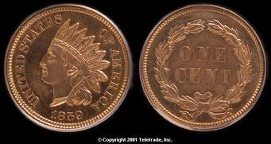
Finite State Machine: Overview using An example
Not all sequences are created equal: A coin has two faces. A toss of the coin lands either Head or Tail with equal probability. A series of tossing creates a sequence. Given two patterns, say HHH and HTT, the pattern appears first wins.
H
H
H
T
H
H
The two patterns have an equal chance to win
HHH wins more times
HTT wins more times
None of the above

Slide 5
Finite State Machine: Not all Sequences are created equal
State Diagram of HHH
S
H/0
H
H/0
H
H/1
H
T/0
T/0
T/0
Different diagrams yield different expectations
State Diagram of HTT
S
H/0
H
T/0
T
T/1
T
T/0
H/0
H/0

Slide 6
Specification: Register-Transfer Level Description
Y
Combinational
A
B
C
D
X
S(t)
CLK
CLK
RTL: Register-Transfer Level Description
VHDL
Verilog
BVS
CLK
Conceptually, we can align all registers into one single column

Slide 7
Design Flow
Input Output Relation
State Diagram (Transition of states)
State Assignment (Map states into binary code)
  Binary code, Gray encoding, One hot encoding, Coding optimization
State Table (Truth table of states)
Excitation Table (Truth table of FF inputs)
  K Map, Minimal Expression
  Logic Diagram
Verification: Simulation

Slide 8
Design Flow: Examples
Example 1: a counter from description, state diagram, state table, netlist, to I/O behavior.
Example 2: a pattern recognizer from state diagram to netlist to demonstrate the difference of two machines.

Slide 9

Example: A Counter
Behavior over time
Symbol/ Circuit
Free running 2 bit Counter
CLK
time
Q₀
Q₁
$$Q\left(t+1\right)=(Q\left(t\right)+1) mod 4$$

Slide 10
Counter: Input-output relation ⇒ State diagram
Diagram that depicts behavior over time
Symbol/ Circuit
2 bit Counter

Slide 11
Counter: State diagram ⇒ State assignment
State Diagram
State Table: Symbol
S₀
Current state | Next State
S₀ | S₁
S₁ | S₂
S₂ | S₃
S₃ | S₀
S₃
S₁
S₂
State Assignment
State | Q₁ | Q₀
S₀ | 0 | 0
S₁ | 0 | 1
S₂ | 1 | 0
S₃ | 1 | 1
Q₁(t) | Q₀(t) | Q₁(t+1) | Q₀(t+1)
State Table: Binary

Slide 12
Counter: State assignment ⇒ Excitation table
S₀
Current state | Next State
S₀ | S₁
S₁ | S₂
S₂ | S₃
S₃ | S₀
S₃
S₁
S₂
State Diagram
Q₁(t) | Q₀(t) | Q₁(t+1) | Q₀(t+1)
0 | 0 | 0 | 1
0 | 1 | 1 | 0
1 | 0 | 1 | 1
1 | 1 | 0 | 0
State Table

Slide 13
Counter: Excitation table ⇒ K map ⇒ Logic Diagram
Q₁(t) | Q₀(t) | Q₁(t+1) | Q₀(t+1)
0 | 0 | 0 | 1
0 | 1 | 1 | 0
1 | 0 | 1 | 1
1 | 1 | 0 | 0
D₀(t) = Q₀(t)’
D₁(t) = Q₀(t) Q₁(t)’ + Q₀(t)’ Q₁(t)
Q₀(t)
D
Q
Combinational circuit
Q’
Q₁(t)
D
Q
Q’
CLK
Circuit with 2 flip flops

Slide 14
Counter: Excitation table ⇒ K map ⇒ Logic Diagram
Q₁(t) | Q₀(t) | Q₁(t+1) | Q₀(t+1)
0 | 0 | 0 | 1
0 | 1 | 1 | 0
1 | 0 | 1 | 1
1 | 1 | 0 | 0
We store the current state using D-flip flops so that:
Inputs to the combinational circuit don’t change while the next output is being computed
The transition to the next state only occurs at the rising edge of the clock
State Table
D
Q
Q’
Q₀(t+1) = Q₀(t)’
Q₁(t+1) = Q₀(t) Q₁(t)’ + Q₀(t)’ Q₁(t)
Q₀(t)
D
Q
Q’
CLK
Q₁(t)

Slide 15
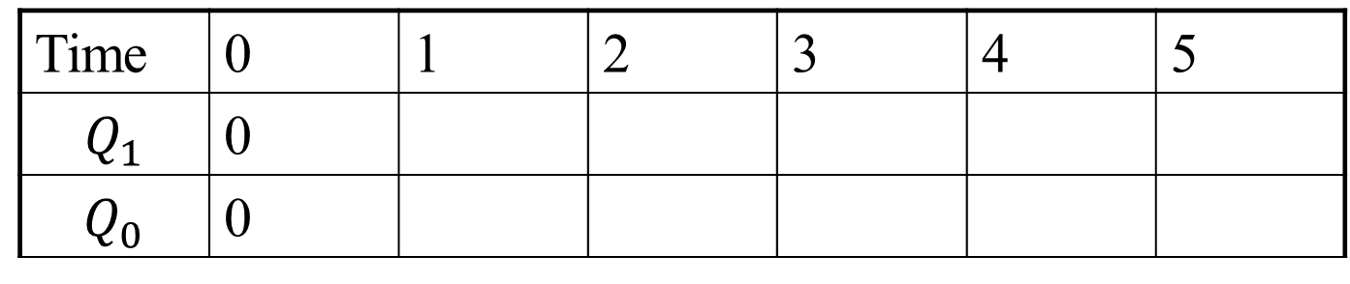
Counter: Verification (Simulation)
D
Q
Q’
Q₀(t)
Current state | Next State
S₀ | S₁
S₁ | S₂
S₂ | S₃
S₃ | S₀
Q
D
Q’
CLK
Q₁(t)
Example: State sequence
Time | 0 | 1 | 2 | 3 | 4 | 5
$$Q_{1}$$ | 0
$$Q_{0}$$ | 0
Notes:
All these forms are equivalent. Given one, we can derive the others.

Slide 16
Example: Simulation from state table/state diagram
PS\Input | X=0 | X=1
S0 | S0,0 | S2,0
S1 | S3,0 | S3,0
S2 | S2,0 | S1,0
S3 | S1,1 | S0,1
1/1
0/0
S0
0/1
S1
S3
1/0
0, 1/0
1/0
S2
Example: Output sequence
0/0
Time | 0 | 1 | 2 | 3 | 4 | 5
Input | 0 | 1 | 1 | 0 | 1 | -
State | S0
Output
Notes:
All these forms are equivalent. Given one, we can derive the others.

Slide 17
Example: Simulation from state table/state diagram
PS\Input | X=0 | X=1
S0 | S0,0 | S2,0
S1 | S3,0 | S3,0
S2 | S2,0 | S1,0
S3 | S1,1 | S0,1
1/1
0/0
S0
0/1
S1
S3
1/0
0, 1/0
1/0
S2
Example: Output sequence
0/0
Time | 0 | 1 | 2 | 3 | 4 | 5
Input | 0 | 1 | 1 | 0 | 1 | -
State | S0 | S0 | S2 | S1 | S3 | S0
Output | 0 | 0 | 0 | 0 | 1 | 0
Notes:
All these forms are equivalent. Given one, we can derive the others.

Slide 18

Example: Life on Mars?
Mars rover has a binary input x. When it receives the input sequence x(t-2, t) = 001 from its life detection sensors, it means that the it has detected life on Mars ☺ and the output y(t) = 1, otherwise y(t) = 0 (no life on Mars ☹).
Implement the Life-on-Mars Pattern Recognizer!

Slide 19
Mars Life Recognizer FSM
Which of the following diagrams is a correct Mealy solution for the 001 pattern recognizer on the Mars rover?
1/1
A.
S0
0/0
S1
0/0
1/0
S2
0/0
1/0
B.
0/0
S0
0/0
S1
1/1
Input/output
1/0
S2
1/0
0/0
C. Both A and B are correct
D. None of the above

Slide 20
Mars Life Recognizer FFs
Pattern Recognizer ‘001’
Mealy Machine
x(t)
1/0
1/1
C1
C2
y(t)
S0
0/0
S1
0/0
S2
CLK
S(t)
1/0
0/0
What does state table need to show to design controls of C1?
next state S(t+1) vs. input x(t), and present state S(t)
output y(t) vs. input x(t), and present state S(t)
output y(t) vs. present state S(t)
None of the above

Slide 21
State Diagram => State Table with State Assignment
1/1
x(t)
C1
C2
y(t)
S0
0/0
S1
0/0
1/0
S2
0/0
CLK
S(t)
1/0
Mealy Machine
S(t)\x | 0 | 1
S0 | S1,0 | S0,0
S1 | S2,0 | S0,0
S2 | S2,0 | S0,1
State Assignment
S0: 00
S1: 01
S2: 10
S(t)\x | 0 | 1
00 | 01,0 | 00,0
01 | 10,0 | 00,0
10 | 10,0 | 00,1
Q₁(t+1)Q₀(t+1), y

Slide 22
State Diagram => State Table => Excitation Table => Circuit
Q₁(t) Q₀(t)\x | 0 | 1
00 | 01,0 | 00,0
01 | 10,0 | 00,0
10 | 10,0 | 00,1
id | Q₁Q₀x | D₁ | D₀ | y
0 | 000 | 0 | 1 | 0
1 | 001 | 0 | 0 | 0
2 | 010 | 1 | 0 | 0
3 | 011 | 0 | 0 | 0
4 | 100 | 1 | 0 | 0
5 | 101 | 0 | 0 | 1
6 | 110
7 | 111
x(t)
C1
C2
y(t)
CLK
S(t)
Mealy Machine

Slide 23
State Diagram => State Table => Excitation Table => Circuit
id | Q₁Q₀x | D₁ | D₀ | y
0 | 000 | 0 | 1 | 0
1 | 001 | 0 | 0 | 0
2 | 010 | 1 | 0 | 0
3 | 011 | 0 | 0 | 0
4 | 100 | 1 | 0 | 0
5 | 101 | 0 | 0 | 1
6 | 110
7 | 111
Q₁(t) Q₀(t)\x | 0 | 1
00 | 01,0 | 00,0
01 | 10,0 | 00,0
10 | 10,0 | 00,1
x(t)
C1
C2
y(t)
CLK
S(t)
Mealy Machine
Example: What to fill in rows 6 and 7 of excitation table?
All 0s
All 1s
All Don’t Cares

Slide 24
State Diagram => State Table => Excitation Table => Circuit
id | Q₁Q₀x | D₁ | D₀ | y
0 | 000 | 0 | 1 | 0
1 | 001 | 0 | 0 | 0
2 | 010 | 1 | 0 | 0
3 | 011 | 0 | 0 | 0
4 | 100 | 1 | 0 | 0
5 | 101 | 0 | 0 | 1
6 | 110 | X | X | X
7 | 111 | X | X | X
D1(t):
Q₀
0 2 6 4
0 1 X 1
1 3 7 5
x(t)
0 0 X 0
Q₁
D1(t) = x’Q0 + x’Q1
D0 (t)= Q’1Q’0 x’
y= Q₁x

Slide 25
State Diagram => State Table => Excitation Table => Circuit
Q’₁
D0
Q0
Q’₀
Q
D
x’
Q’
x’
Q1
y
D1
Q
D
Q₀
Q’
Q1
x
x(t)
C1
C2
y(t)
D1(t) = x’Q0 + x’Q1
D0 (t)= Q’1Q’0 x’
y= Q₁x
CLK
S(t)
Mealy Machine

Slide 26
Mealy and Moore Machines: Canonical Form
x(t)
y(t)
Combinational
Logic
CLK
x(t)
C2
y(t)
x(t)
C1
C2
y(t)
C1
CLK
CLK

Slide 27
Mealy and Moore Machines: Canonical Form
Mealy Machine: y_{i}(t) = f_{i}(X(t), S(t))
Moore Machine: y_{i}(t) = f_{i}(S(t))
s_{i}(t+1) = g_{i}(X(t), S(t))
x(t)
x(t)
C1
C2
y(t)
C1
C2
y(t)
S(t)
CLK
CLK
S(t)
Moore Machine
Mealy Machine

Slide 28
Mealy and Moore Machines: Canonical Form
Mealy Machine: y_{i}(t) = f_{i}(X(t), S(t))
Moore Machine: y_{i}(t) = f_{i}(S(t))
s_{i}(t+1) = g_{i}(X(t), S(t))
Mealy Machine
Moore Machine
x(t)
x(t)
C1
C2
y(t)
C1
C2
y(t)
CLK
S(t)
CLK
S(t)
 | Input
PS | NS, output
 | Input
PS | NS | Output
S
Sj
S
input
Sj
output
Si
input/output
Si
output

Slide 29
Mealy and Moore Machines: Mars Life Recognizer
Which of the following diagrams is a correct Moore solution to the ‘001’ pattern recognizer?
input/output
1/1
A.
1/0
S0
0/0
S1
0/0
S2
0/0
1/0
B.
1
0
1
0
0
1
S3
1
S0
S1
0
S2
0
input
1
0
output
C. Both A and B are correct
D. None of the above

Slide 30
Mealy and Moore Machines: Mars Life Recognizer
Pattern Recognizer ‘001’
x(t)
C1
C2
y(t)
S(t)
1
0
1
S0
0
S1
0
0
S2
0
1
S3
1
CLK
Moore Machine
1
0
What does state table need to show to design controls of C2?
(current input x(t), current state S(t) vs. next state, S(t+1))
(current input, current state vs. current output y(t))
(current state vs. current output y(t) and next state)
(current state vs. current output y(t) )
None of the above

Slide 31
Mealy and Moore Machines: Mars Life Recognizer
1
0
1
S0
0
S1
0
0
S2
0
1
S3
1
1
ID | Q₁Q₀x | D₁ | D₀ | y
0 | 000 | 0 | 1 | 0
1 | 001 | 0 | 0 | 0
2 | 010 | 1 | 0 | 0
3 | 011 | 0 | 0 | 0
4 | 100 | 1 | 0 | 0
5 | 101 | 1 | 1 | 0
6 | 110 | 0 | 1 | 1
7 | 111 | 0 | 0 | 1
S(t)\x | 0 | 1
S0 | S1,0 | S0,0
S1 | S2,0 | S0,0
S2 | S2,0 | S3,0
S3 | S1,1 | S0,1
0
Q₁Q₀\x | 0 | 1
00 | 01,0 | 00,0
01 | 10,0 | 00,0
10 | 10,0 | 11,0
11 | 01,1 | 00,1
Q₁(t+1)Q₀(t+1), y

Slide 32
Mealy and Moore Machines: Mars Life Recognizer
D1(t):
Q₀
0 2 6 4
0 1 0 1
1 3 7 5
x(t)
0 0 0 1
id | Q₁Q₀x | D₁ | D₀ | y
0 | 000 | 0 | 1 | 0
1 | 001 | 0 | 0 | 0
2 | 010 | 1 | 0 | 0
3 | 011 | 0 | 0 | 0
4 | 100 | 1 | 0 | 0
5 | 101 | 1 | 1 | 0
6 | 110 | 0 | 1 | 1
7 | 111 | 0 | 0 | 1
Q₁
D0(t):
Q₀
0 2 6 4
1 0 1 0
1 3 7 5
x(t)
0 0 0 1
Q₁
y(t):
Q₀
0 2 6 4
0 0 1 0
1 3 7 5
x(t)
0 0 1 0
Q₁

Slide 33
Mealy and Moore Machines: Mars Life Recognizer
State Diagram => State Table => Excitation Table => Circuit
D0
Q0
Q
y
D
Q’
Q1
D1
Q
D
Q’
x(t)
C1
C2
y(t)
D₁(t)= Q₁(t)Q₀(t)’+Q₁(t)’Q₀(t) x(t)
D₀(t)= Q₁(t)’Q₀(t)’x(t)’+
Q₁(t)Q₀(t) x(t)’+Q₁(t)Q₀(t)’ x(t)
y(t)= Q₁(t)Q₀(t)
CLK
S(t)
Moore Machine

Slide 34
Conversion from Mealy to Moore Machine
1/1
1
0
1
S0
0
0
S1
0
0
S2
0
1
S3
1
S0
0/0
S1
0/0
1/0
S2
0/0
1
0
1/0
S(t)\x | 0 | 1
S0 | S1,0 | S0,0
S1 | S2,0 | S0,0
S2 | S2,0 | S0,1
S(t)\x | 0 | 1
S0 | S1,0 | S0,0
S1 | S2,0 | S0,0
S2 | S2,0 | S3,0
S3 | S1,1 | S0,1

Slide 35
Conversion from Mealy to Moore Machine
S(t)\x | 0 | 1
S0 | S1,0 | S0,0
S1 | S2,0 | S0,0
S2 | S2,0 | S0,1
S(t)\x | 0 | 1 | y
S0 | S1 | S0 | 0
S1 | S2 | S0 | 0
S2 | S2 | S3 | 0
S3
Algorithm
1. Identify distinct (NS, y) pair
2. Replace each distinct (NS, y) pair with distinct new states
3. Insert rows of present state = new states

Slide 36
Conversion from Mealy to Moore Machine
Mealy
S(t)\x | 0 | 1
S0 | S1,0 | S0,0
S1 | S2,0 | S0,0
S2 | S2,0 | S0,1
S(t)\x | 0 | 1 | y
S0 | S1 | S0 | 0
S1 | S2 | S0 | 0
S2 | S2 | S3 | 0
S3
Moore
1. Find distinct NS, y
2. Add new states to represent distinct NS, y
iClicker
For the above Moore machine, what are the next states with respect to present state S3?
S2, S3, 1
S2, S0, 1
S1, S0, 1
S1, S0. 0
None of the above.

Slide 37
Conversion from Mealy to Moore Machine
1/1
1
0
1
S0
0
0
S1
0
0
S2
0
1
S3
1
S0
0/0
S1
0/0
1
1/0
S2
0/0
0
1/0
S(t)\x | 0 | 1
S0 | S1,0 | S0,0
S1 | S2,0 | S0,0
S2 | S2,0 | S3,0
S3 | S1,1 | S0,1
S(t)\x | 0 | 1
S0 | S1,0 | S0,0
S1 | S2,0 | S0,0
S2 | S2,0 | S0,1
Time | 0 | 1 | 2 | 3 | 4 | 5 | 6 | 7 | 8
x | 0 | 1 | 0 | 0 | 1 | 1 | 0 | 0 | 1
Smealy | S0 | S1 | S0 | S1 | S2 | S0 | S0 | S1 | S2
ymealy
Smoore | S0
ymoore

Slide 38
Conversion from Mealy to Moore Machine
1/1
1
0
1
S0
0
0
S1
0
0
S2
0
1
S3
1
S0
0/0
S1
0/0
1/0
S2
0/0
1
1/0
0
S(t)\x | 0 | 1
S0 | S1,0 | S0,0
S1 | S2,0 | S0,0
S2 | S2,0 | S3,0
S3 | S1,1 | S0,1
S(t)\x | 0 | 1
S0 | S1,0 | S0,0
S1 | S2,0 | S0,0
S2 | S2,0 | S0,1
Time | 0 | 1 | 2 | 3 | 4 | 5 | 6 | 7 | 8
x | 0 | 1 | 0 | 0 | 1 | 1 | 0 | 0 | 1
Smealy | S0 | S1 | S0 | S1 | S2 | S0 | S0 | S1 | S2
ymealy
Smoore | S0
ymoore
iClicker S_{moore}[0-5]
S0,S1,S0,S1,S2,S3
S0,S1,S0,S1,S2,S0
S3,S1,S0,S1,S2,S3
S3,S1,S0,S1,S2,S0
E. None of the above

Slide 39
Conversion from Mealy to Moore Machine
1/1
1
0
1
S0
0
0
S1
0
0
S2
0
1
S3
1
S0
0/0
S1
0/0
1/0
S2
0/0
1
1/0
0
S(t)\x | 0 | 1
S0 | S1,0 | S0,0
S1 | S2,0 | S0,0
S2 | S2,0 | S3,0
S3 | S1,1 | S0,1
S(t)\x | 0 | 1
S0 | S1,0 | S0,0
S1 | S2,0 | S0,0
S2 | S2,0 | S0,1
Time | 0 | 1 | 2 | 3 | 4 | 5 | 6 | 7 | 8
x | 0 | 1 | 0 | 0 | 1 | 1 | 0 | 0 | 1
Smealy | S0 | S1 | S0 | S1 | S2 | S0 | S0 | S1 | S2
ymealy
Smoore | S0
ymoore
iClicker y_{moore}[0-5]
0,0,0,0,1,0
0,0,0,0,0,1
0,1,0,0,0,0
0,0,0,0,0,0,
None of the above

Slide 40
Conversion from Mealy to Moore Machine
Algorithm
1. Identify distinct (NS, y) pair
2. Replace each distinct (NS, y) pair with distinct new states
3. Insert rows of present state = new states
4. Append each present state with its output y

Slide 41
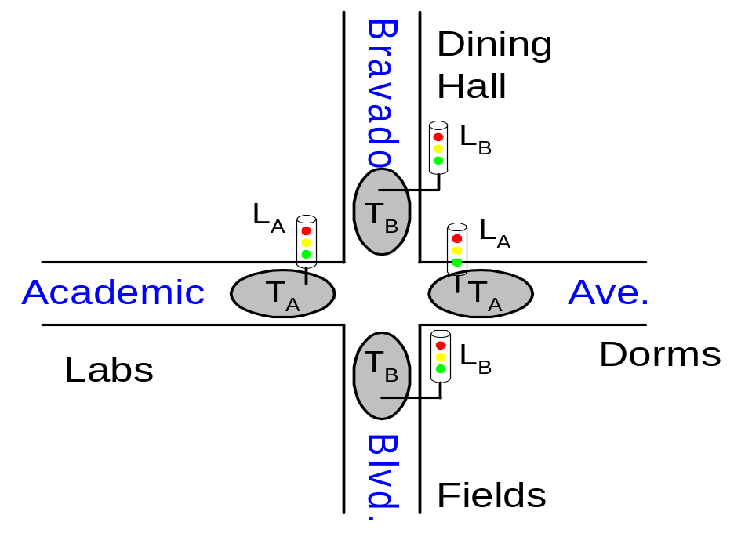
Example: Traffic Light Controller
Traffic sensors: T_{A}, T_{B} (TRUE when there’s traffic)
Lights: L_{A}, L_{B}

Slide 42
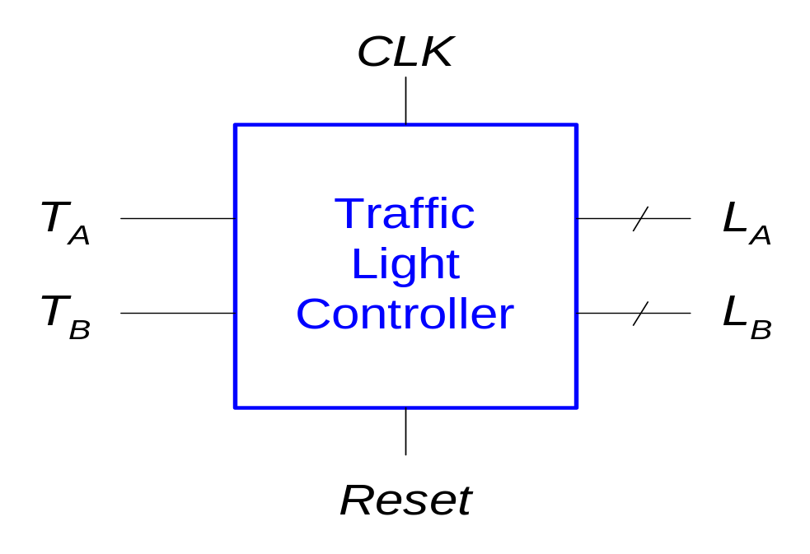
Traffic Light Controller: FSM Black Box
Inputs: CLK, Reset, T_{A}, T_{B}
Outputs: L_{A}, L_{B}

Slide 43
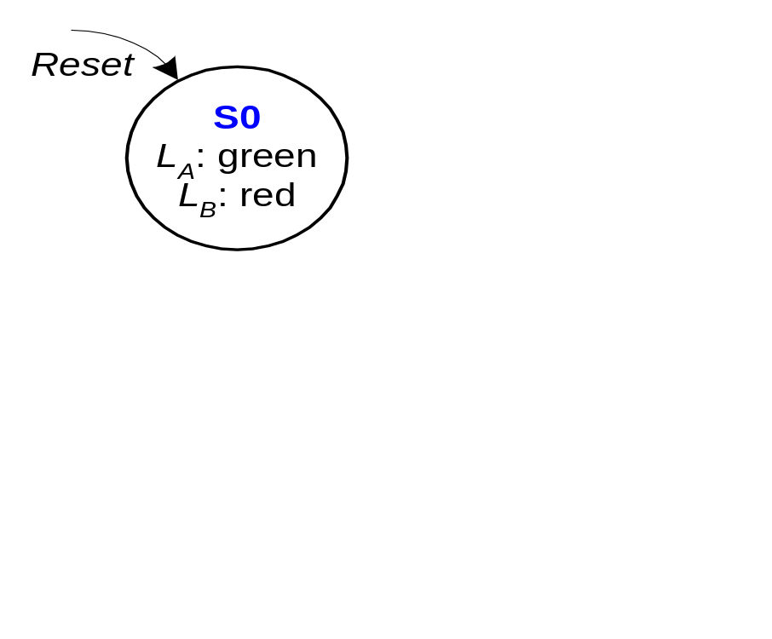
FSM State Transition Diagram
Moore FSM: outputs labeled in each state
States: Circles
Transitions: Arcs

Slide 44
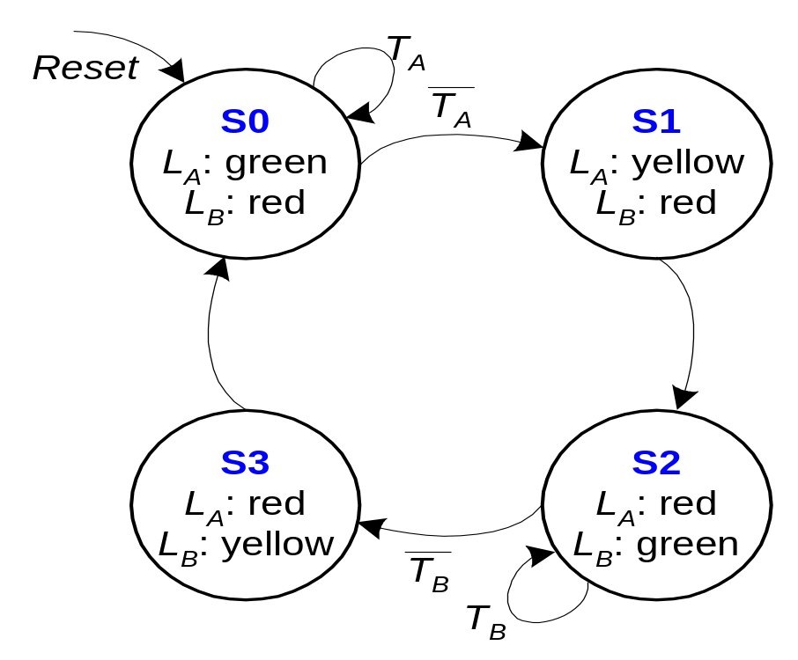
FSM State Transition Diagram
Moore FSM: outputs labeled in each state
States: Circles
Transitions: Arcs

Slide 45
FSM State Transition Table
PS | Inputs |  | NS
 | T_{A} | T_{B}
S0 | 0 | X | S1
S0 | 1 | X | S0
S1 | X | X | S2
S2 | X | 0 | S3
S2 | X | 1 | S2
S3 | X | X | S0

Slide 46
State Transition Table
PS |  | Inputs |  | NS
Q₁(t) | Q₀(t) | T_{A} | T_{B} | Q₁(t +1) | Q₀(t +1)
0 | 0 | 0 | X | 0 | 1
0 | 0 | 1 | X | 0 | 0
0 | 1 | X | X | 1 | 0
1 | 0 | X | 0 | 1 | 1
1 | 0 | X | 1 | 1 | 0
1 | 1 | X | X | 0 | 0
State | Encoding
S0 | 00
S1 | 01
S2 | 10
S3 | 11
Q₁(t+1)= Q₁(t)⊕Q₀(t)
Q₀(t+1)= Q’₁(t)Q’₀(t)T’_{A} + Q₁(t)Q’₀(t)T’_{B}

Slide 47
Traffic Light Controller: FSM Output Table
PS |  | Outputs
Q₁ | Q₀ | L_{A1} | L_{A0} | L_{B1} | L_{B0}
0 | 0 | 0 | 0 | 1 | 0
0 | 1 | 0 | 1 | 1 | 0
1 | 0 | 1 | 0 | 0 | 0
1 | 1 | 1 | 0 | 0 | 1
Output | Encoding
green | 00
yellow | 01
red | 10
L_{A1} = Q₁
L_{A0} = Q’₁Q₀
L_{B1} = Q’₁
L_{B0} = Q₁Q₀

Slide 48
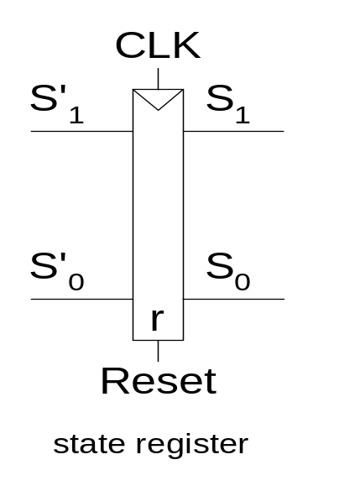
Traffic Light Controller: State Register

Slide 49
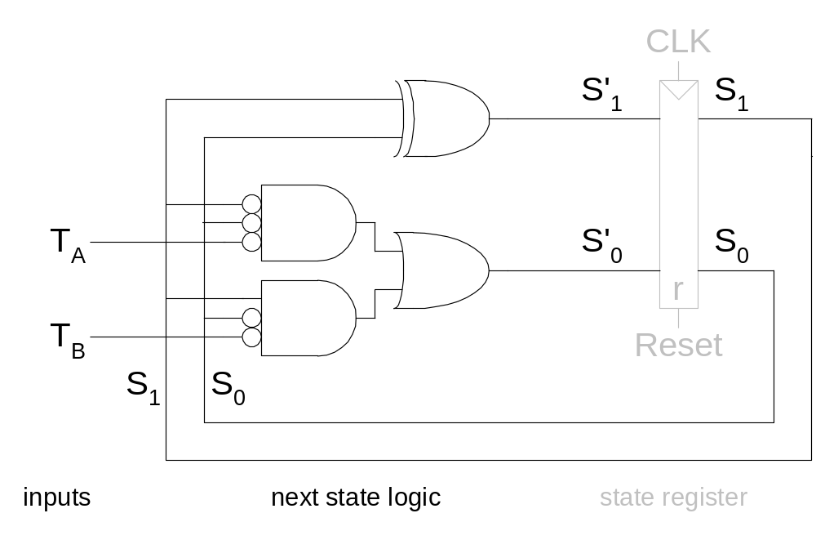
Traffic Light Controller: Logic Diagram

Slide 50
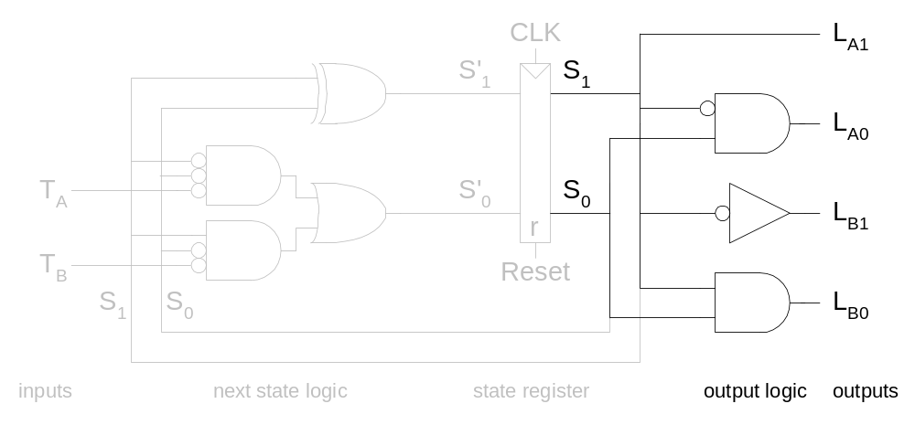
Traffic Light Controller: Output Logic

Slide 51
Summary: Implementation
Set up canonical form
  Mealy or Moore machine
Identify the next states
  state diagram ⇨ state table
  state assignment
Derive excitation table
  Inputs of flip flops
Design the combinational logic
  don’t care set utilization

