Slide 1
Lecture 5: K-Map minimization in larger input dimensions and K-map minimization using max terms
CSE 140: Components and Design Techniques for Digital Systems
CK Cheng
Dept. of Computer Science and Engineering
University of California, San Diego

Slide 2
Part I. Combinational Logic
Specification
Implementation
  K-map:
  Sum of products
  Product of sums

Slide 3
Definitions: Sum of Products and Product of Sums Expressions
Sum of Products Expression
Implicant: A product term that has non-empty intersection with on-setF and does not intersect with off-set R .
Prime Implicant: An implicant that is not a proper subset of any other implicant.
Essential Prime Implicant: A prime implicant that has an element in on-set F but this element is not covered by any other prime implicants.
Product of Sums Expression
Implicate: A sum term that has non-empty intersection with off-set R and does not intersect with on-set F.
Prime Implicate: An implicate that is not a proper subset of any other implicate.
Essential Prime Implicate: A prime implicate that has an element in off-set R but this element is not covered by any other prime implicates.

Slide 4
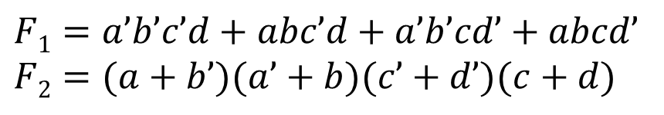
K-Map to Minimized Product of Sums
Sometimes it is easier to reduce the K-map by considering the off-set
$$F1=a’b’c’d+abc’d+a’b’cd’+abcd’$$
$$F2=(a+b’)(a’+b)(c’+d’)(c+d)$$
ab
00
01
11
10
cd
0 | 0 | 0 | 0
1 | 0 | 1 | 0
0 | 0 | 0 | 0
1 | 0 | 1 | 0
00
Q: Which function is simpler for a two-level logic implementation?
F₁
F₂
Two are the same
01
11
10

Slide 5
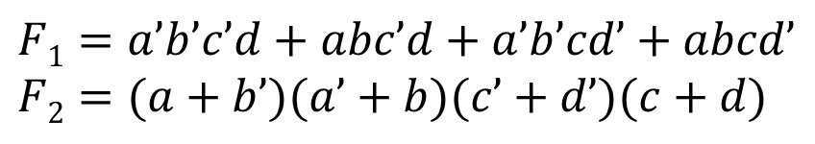
K-Map to Minimized Product of Sums
Sometimes it is easier to reduce the K-map by considering the off-set
$$F1=a’b’c’d+abc’d+a’b’cd’+abcd’$$
$$F2=(a+b’)(a’+b)(c’+d’)(c+d)$$
ab
00
01
11
10
cd
0 | 0 | 0 | 0
1 | 0 | 1 | 0
0 | 0 | 0 | 0
1 | 0 | 1 | 0
00
01
11
10

Slide 6
Another min product of sums example
Given R(a,b,c,d) = Σm (3, 11, 12, 13, 14)
D (a,b,c,d)= Σm (4, 8, 10)
K-map
ab
00
01
11
10
cd
0 4 12 8
00
1 5 13 9
01
11
3 7 15 11
10
2 6 14 10

Slide 7
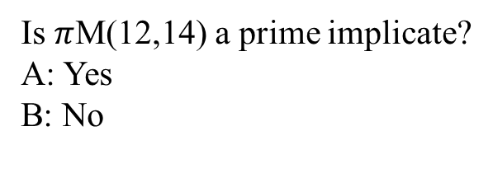
Another min product of sums example
Given R(a,b,c,d) = Σm (3, 11, 12, 13, 14)
D (a,b,c,d)= Σm (4, 8, 10)
ab
00
01
11
10
cd
0 4 12 8
00
1 X 0 X
1 5 13 9
01
1 1 0 1
d
11
3 7 15 11
0 1 1 0
10
2 6 14 10
1 1 0 X
a

Slide 8
Prime Implicates:
ΠM(0,8), ΠM(11,15), ΠM(12,13,14,15), ΠM(6,14)
Q: Which of the following is a not an essential prime implicate?
ΠM(0,8)
ΠM(11,15)
ΠM(12,13,14,15)
ΠM(6,14)
ab
00
01
11
10
cd
0 4 12 8
00
0 1 0 X
1 5 13 9
01
1 1 0 1
d
11
3 7 15 11
1 1 0 0
10
2 6 14 10
1 X 0 1
a

Slide 9
Five variable K-map
a=0
a=1
bc
00
01
11
10
00
01
11
10
de
c
c
00
0 4 12 8
16 20 28 24
01
1 5 13 9
17 21 29 25
e
e
11
3 7 15 11
19 23 31 27
d
d
10
2 6 14 10
18 22 30 26
b
b
a
Neighbors of m₅ are: minterms 1, 4, 7, 13, and 21
Neighbors of m₁₀ are: minterms 2, 8, 11, 14, and 26

Slide 10
Reading a Five variable K-map: An example
a=0
a=1
bc
00
01
11
10
00
01
11
10
de
c
c
00
0 4 12 8
16 20 28 24
1 1
1 1
1
1
01
1 5 13 9
17 21 29 25
e
e
11
3 7 15 11
19 23 31 27
1 1
1 1 1
1 1 1
1 1 1
d
d
10
2 6 14 10
18 22 30 26
b
b
a
Notes:
5 EPIs

Slide 11
Six variable K-map
d
d
0 4 12 8
16 20 28 24
1 5 13 9
17 21 29 25
f
f
3 7 15 11
19 23 31 27
e
e
2 6 14 10
18 22 30 26
c
c
d
d
32 36 44 40
48 52 60 56
33 37 45 41
49 53 61 57
a
f
f
35 39 47 43
51 55 63 59
e
e
34 38 46 42
50 54 62 58
c
c
b

Slide 12
7 Variables and Beyond
Procedure
  Specification
  Prime enumeration
  Essential prime selection
  Logic synthesis
Theory
Methodology
  Data structure
  Algorithms
  Software packages
  Benchmarks

