Slide 1
CSE 140 Lecture 16
System Designs
CK Cheng
CSE Dept.
UC San Diego

Slide 2
System Designs
Introduction
  Methodology and Framework
Components
Specification
Implementation

Slide 3
Introduction
Methodology
  Approach with success stories.
  Hierarchical designs with interface between the modules (BSV).
Data Subsystem and Control Subsystem
  For n-bit data, each operation takes n times or more in hardware complexity.
  Data subsystem carries out the data operations and transports.
  Control system sequences the data subsystem and itself.

Slide 4
I. Introduction: Framework
n=128
Data
Subsystem
n=64
Data
Inputs
Data
Outputs
Control
Signals
Conditions
Control
Inputs
Control
Subsystem
Control
Outputs
Start/Request
Done/Acknowledgement

Slide 5
I. Introduction: Handshaking
Data
Inputs
n=128
n=64
Data
Outputs
Data
Subsystem
Conditions
Control
Signals
Control
Inputs
Control
Outputs
Master that
calls module S
Control
Subsystem
Start/Request
Done/Acknowledgement
X
Y
module S
Z
X
start
Z
done
Y
start
done

Slide 6
Handshaking
start
t
done
t

Slide 7
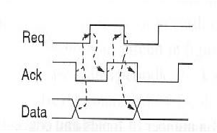
Handshaking

Slide 8
Handshaking: Example
The master module that calls module S controls the following signals
Signal start
Signal done
Signals start and done
None of the above

Slide 9
II. Components
Components
Storage Modules
Operators
Interconnections
Sequential machines
Functions
Data storage
Data operations
Data transport
Control of data operations
Control of data transports
Control of the sequential system
Data
Subsystem
Control
Subsystem

Slide 10
II. Data Subsystem Components
Storage: Register, RAM, FIFO, LIFO, Counter, Shifter
Operator: ALU, Floating Point Operators
Interconnect: Wire, Buses, Crossbars

Slide 11
II. Components: Storage Modules, Register
LD: Load
CLR: Clear
D
LD
CLR
LD
CLR
D
CLK
Q
Q
Q(t+1) = (0, 0, .. , 0) if CLR = 1
= D if LD = 1 and CLR = 0
= Q(t) if LD = 0 and CLR = 0

Slide 12
Modulo-n Counter
D
CNT
CNT
LD
CLR
D
TC
LD
TC
CLR
Clk
Q
Q
Q (t+1) = (0, 0, .. , 0) if CLR = 1
= D if LD = 1 and CLR = 0
= (Q(t)+1)mod n if LD = 0, CNT = 1 and CLR = 0
= Q (t) if LD = 0, CNT = 0 and CLR = 0
TC = 1 if Q (t) = n-1 and CNT = 1
= 0 otherwise

Slide 13
Storage Component: Registers, Array of Registers
D
Registers: If C then R ⬅ D
C
LD
R
Register Array: If C then R_{address} ⬅ D
Sharing connections and controls
D
LD
Decoder
C
address
R

Slide 14
Storage Components: RAM, FIFO, LIFO
RAM
RAM
Decoder
Size of RAM larger
than registers
Performance is slower
Address
FIFO (First in first out)
LIFO (Last in first out:
Stack)

Slide 15
Functional Modules
A
B
CASE Op-Sel Is
When F1, Z <= A op1 B
When F2, Z <= A op2 B
.
.
End CASE
Operation
selection
Op-Sel
OpA
OpB
Z
Z
Example:
CASE Op-Set Is
Z <= (A + B)mod 2^{n} if Op-Sel=addition,
Z <= (A - B)mod 2^{n} if Op-Sel=subtraction
End CASE

Slide 16
Interconnect Modules (Wires and Switches)
Single Lines
Band of Wires
Shared Buses
Crossbar
1. Single line (shifting, time sharing)
Shift Register
Shift Register

Slide 17
2. Band of Wires (BUS)
3. Shared Bus
switch
switch
switch
switch
…..
R0
R1
R2
Rn-1
Switches
x
x
x
x
c
c
d
S
DEMUX
S
MUX
0 1 2 .. n-1
0 1 2 .. n-1
y
y
R0
Rn-1
R0
Rn-1

Slide 18
4. Crossbar (Multiple buses running horizontally)
m simultaneous transfers are possible, but more expensive.
64
Bus 0
R0
Rn-1
Bus n-1
MUX0
MUX1
MUXn-1
…

Slide 19
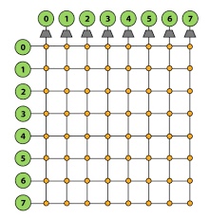
Crossbar Switches: VLSI Design

Slide 20
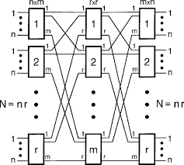
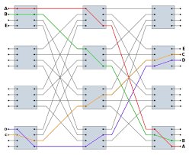
Multistage Network: Clos Network

Slide 21
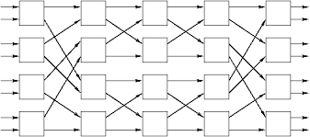
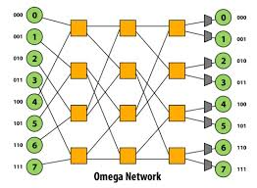
Multistage Networks: Benes and Omega Networks
Blocking: Previous assignment can block the next route.

Slide 22
III. Specification: Program
Objects (Registers, Outputs of combinational logic)
Operation (Logic, Add, Multiplication, DSP, and etc.)
Assignment
Sequencing
Example:
Signal S1, S2, R[15:0]: FFs, Registers, wires
Z ⬅ A + B: Registers, Adder, Interconnect
R1 ⬅ R2: Registers and Interconnect
Begin, End: Control
if ( ) then ( ), ENDIF: Control

Slide 23
S1
Ex. If C then R1← S1
Else R2 ← S2
Endif;
R1
LD
C
S2
R2
LD
A
B
C
If C1 then X ← A
Else X ← B + C
Endif
If C2 then Rg ← X
Endif
Adder
1 0
C1
MUX
C2
Rg
CLK

Slide 24
System Designs
Introduction
  Methodology and Framework
Components
Specification
Implementation

Slide 25
VI. Implementation
Example
Handshaking
  Request and Acknowledgement
Datapath Subsystem
  Data Operators
  Data Transporters
Control Subsystem
  One Hot Machine Design

Slide 26
VI. Implementation: Example
AddModule(X, Y, Z, start, done)
{ Input X[15:0], Y[15:0] type bit-vector,
start type Boolean;
Local-Object A[15:0], B[15:0] type bit-vector;
Output Z[15:0] type bit-vector,
done type Boolean;
S0: If start’ goto S0 || done ⬅1;
S1: A ⬅ X || B ⬅ Y || done ⬅0;
S2: Z ⬅ Add(A, B) || goto S0;
}
Exercise: Go through the handshaking, data subsystem and control subsystem designs.

Slide 27
AddModule(X,Y,start,done)
Call AddModule
X
Y
AddModule
Z
X
start
Z
done
Y
start
done

Slide 28
Example
Suppose that each step (Si) takes one clock cycle. How many clock cycles does the AddModule take to complete one handshaking iteration?
One cycle
Two cycles
More than two cycles

