Slide 1
CSE 140: Components and Design Techniques for Digital Systems
Lecture 8:
Sequential Networks and Finite State Machines
CK Cheng
Dept. of Computer Science and Engineering
University of California, San Diego

Slide 2
Outlines
Specification: Finite State Machine
  State Table, State Diagram, Behavior
Implementation
  Excitation Table
  Mealy and Moore Machines
  Examples

Slide 3
Sequential Networks
Y
Combinational
A
B
C
D
X
S(t)
CLK
CLK
RTL: Register-Transfer Level Description
Components F-Fs
Specification
Implementation: Excitation Table
CLK
Conceptually, we can align all registers into one single column

Slide 4
Specification
Combinational Logic
  Truth Table
  Boolean Expression
  Logic Diagram (No feedback loops)
Sequential Networks:
  State Diagram, State Assignment, State Table
  Excitation Table and Characteristic Expression
  Logic Diagram (FFs and feedback loops)

Slide 5
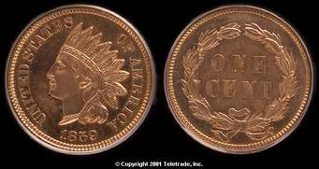
Finite State Machine Overview using An example
Not all sequences are created equal: A coin has two faces. A toss of the coin lands either Head or Tail with equal probability. A series of tossing creates a sequence. Given two patterns, say HHH and HTT, the pattern appears first wins.
H
H
H
T
H
H
The two patterns have an equal chance to win
HHH wins more times
HTT wins more times
None of the above

Slide 6
Not all Sequences are created equal
State Diagram of HHH
S
H/0
H
H/0
H
H/1
H
T/0
T/0
T/0
Different diagrams yield different expectations
State Diagram of HTT
S
H/0
H
T/0
T
T/1
T
T/0
H/0
H/0

Slide 7
Implementation: Design Flow
Input Output Relation
State Diagram (Transition of states)
  State minimization (Reduction)
  Finite state machine partitioning
State Assignment (Map states into binary code)
  Binary code, Gray encoding, One hot encoding, Coding optimization
State Table (Truth table of states)
Excitation Table (Truth table of FF inputs)
  K Map, Minimal Expression
  Logic Diagram

Slide 8
Implementation: Examples
Example 1: a counter from description, state diagram, state table, netlist, to I/O behavior.
Two Machines: Mealy and Moore machines
Example 2: a pattern recognizer from state diagram to netlist to demonstrate the difference of two machines.

Slide 9
Example: A Counter
Behavior over time
Symbol/ Circuit
Free running 2 bit Counter
CLK
time
Q₀
Q₁
What is the expected output of the counter over time?

Slide 10
Finite State Machines: Describing circuit behavior over time
Diagram that depicts behavior over time
Symbol/ Circuit
2 bit Counter

Slide 11
Implementing the 2 bit counter
State Diagram
State Table: Symbol
S₀
Current state | Next State
S₀ | S₁
S₁ | S₂
S₂ | S₃
S₃ | S₀
S₃
S₁
S₂
State Assignment
State | Q₁ | Q₀
S₀ | 0 | 0
S₁ | 0 | 1
S₂ | 1 | 0
S₃ | 1 | 1
Q₁(t) | Q₀(t) | Q₁(t+1) | Q₀(t+1)
State Table: Binary

Slide 12
Implementing the 2 bit counter
S₀
Current state | Next State
S₀ | S₁
S₁ | S₂
S₂ | S₃
S₃ | S₀
S₃
S₁
S₂
State Diagram
Q₁(t) | Q₀(t) | Q₁(t+1) | Q₀(t+1)
0 | 0 | 0 | 1
0 | 1 | 1 | 0
1 | 0 | 1 | 1
1 | 1 | 0 | 0
State Table

Slide 13
State Table
Q₁(t) | Q₀(t) | Q₁(t+1) | Q₀(t+1)
0 | 0 | 0 | 1
0 | 1 | 1 | 0
1 | 0 | 1 | 1
1 | 1 | 0 | 0
D₀(t) = Q₀(t)’
D₁(t) = Q₀(t) Q₁(t)’ + Q₀(t)’ Q₁(t)
Q₀(t)
D
Q
Combinational circuit
Q’
Q₁(t)
D
Q
Q’
CLK
Circuit with 2 flip flops

Slide 14
Q₁(t) | Q₀(t) | Q₁(t+1) | Q₀(t+1)
0 | 0 | 0 | 1
0 | 1 | 1 | 0
1 | 0 | 1 | 1
1 | 1 | 0 | 0
Truth table→K map→Switching function
Q₀(t+1) = Q₀(t)’
Q₁(t+1) = Q₀(t) Q₁(t)’ + Q₀(t)’ Q₁(t)
State Table
D
Q
We store the current state using D-flip flops so that:
Inputs to the combinational circuit don’t change while the next output is being computed
The transition to the next state only occurs at the rising edge of the clock
Q’
Q₀(t)
D
Q
Q’
CLK
Q₁(t)
Implementation of 2-bit counter

Slide 15
Generalized Model of Sequential Circuits
Y
X
S(t)
CLK

Slide 16
Netlist ⬄ State Table ⬄ State Diagram ⬄ Input Output Relation
PS\Input | X=0 | X=1
S0 | S0,0 | S2,0
S1 | S3,0 | S3,0
S2 | S2,0 | S1,0
S3 | S1,1 | S0,1
1/1
0/0
S0
0/1
S1
S3
1/0
0, 1/0
1/0
S2
Example: Output sequence
0/0
Time | 0 | 1 | 2 | 3 | 4 | 5
Input | 0 | 1 | 1 | 0 | 1 | -
State | S0
Output
Notes:
All these forms are equivalent. Given one, we can derive the others.

Slide 17
Netlist ⬄ State Table ⬄ State Diagram ⬄ Input Output Relation
PS\Input | X=0 | X=1
S0 | S0,0 | S2,0
S1 | S3,0 | S3,0
S2 | S2,0 | S1,0
S3 | S1,1 | S0,1
1/1
0/0
S0
0/1
S1
S3
1/0
0, 1/0
1/0
S2
Example: Output sequence
0/0
Time | 0 | 1 | 2 | 3 | 4 | 5
Input | 0 | 1 | 1 | 0 | 1 | -
State | S0 | S0 | S2 | S1 | S3 | S0
Output | 0 | 0 | 0 | 0 | 1 | 0
Notes:
All these forms are equivalent. Given one, we can derive the others.

Slide 18
Implementation
State Diagram => State Table => Logic Diagram
Canonical Form: Mealy and Moore Machines
  Mealy machines: General
  Moore machines: Output is independent of current input.
Excitation Table
  Truth Table of the F-F Inputs
  Boolean algebra, K-maps for combinational logic
Examples
Timing

Slide 19
Canonical Form: Mealy and Moore Machines
x(t)
y(t)
Combinational
Logic
CLK
x(t)
C2
y(t)
x(t)
C1
C2
y(t)
C1
CLK
CLK

Slide 20
Canonical Form: Mealy and Moore Machines
Mealy Machine: y_{i}(t) = f_{i}(X(t), S(t))
Moore Machine: y_{i}(t) = f_{i}(S(t))
s_{i}(t+1) = g_{i}(X(t), S(t))
x(t)
x(t)
C1
C2
y(t)
C1
C2
y(t)
S(t)
CLK
CLK
S(t)
Moore Machine
Mealy Machine

Slide 21
Canonical Form: Mealy and Moore Machines
Mealy Machine: y_{i}(t) = f_{i}(X(t), S(t))
Moore Machine: y_{i}(t) = f_{i}(S(t))
s_{i}(t+1) = g_{i}(X(t), S(t))
Mealy Machine
Moore Machine
x(t)
x(t)
C1
C2
y(t)
C1
C2
y(t)
CLK
S(t)
CLK
S(t)
 | Input
PS | NS, output
 | Input
PS | NS | Output
S
Sj
S
input
Sj
output
Si
input/output
Si
output

Slide 22

Example: Life on Mars?
Mars rover has a binary input x. When it receives the input sequence x(t-2, t) = 001 from its life detection sensors, it means that the it has detected life on Mars ☺ and the output y(t) = 1, otherwise y(t) = 0 (no life on Mars ☹).
Implement the Life-on-Mars Pattern Recognizer!

Slide 23
Mars Life Recognizer FSM
Which of the following diagrams is a correct Mealy solution for the 001 pattern recognizer on the Mars rover?
1/1
A.
S0
0/0
S1
0/0
1/0
S2
0/0
1/0
B.
0/0
S0
0/0
S1
1/1
Input/output
1/0
S2
1/0
0/0
C. Both A and B are correct
D. None of the above

Slide 24
Mars Life Recognizer FFs
Pattern Recognizer ‘001’
Mealy Machine
x(t)
1/0
1/1
C1
C2
y(t)
S0
0/0
S1
0/0
S2
CLK
S(t)
1/0
0/0
What does state table need to show to design controls of C1?
next state S(t+1) vs. input x(t), and present state S(t)
output y(t) vs. input x(t), and present state S(t)
output y(t) vs. present state S(t)
None of the above

Slide 25
State Diagram => State Table with State Assignment
1/1
x(t)
C1
C2
y(t)
S0
0/0
S1
0/0
1/0
S2
0/0
CLK
S(t)
1/0
Mealy Machine
S(t)\x | 0 | 1
S0 | S1,0 | S0,0
S1 | S2,0 | S0,0
S2 | S2,0 | S0,1
State Assignment
S0: 00
S1: 01
S2: 10
S(t)\x | 0 | 1
00 | 01,0 | 00,0
01 | 10,0 | 00,0
10 | 10,0 | 00,1
Q₁(t+1)Q₀(t+1), y

Slide 26
State Diagram => State Table => Excitation Table => Circuit
Q₁(t) Q₀(t)\x | 0 | 1
00 | 01,0 | 00,0
01 | 10,0 | 00,0
10 | 10,0 | 00,1
id | Q₁Q₀x | D₁ | D₀ | y
0 | 000 | 0 | 1 | 0
1 | 001 | 0 | 0 | 0
2 | 010 | 1 | 0 | 0
3 | 011 | 0 | 0 | 0
4 | 100 | 1 | 0 | 0
5 | 101 | 0 | 0 | 1
6 | 110
7 | 111
x(t)
C1
C2
y(t)
CLK
S(t)
Mealy Machine

Slide 27
State Diagram => State Table => Excitation Table => Circuit
id | Q₁Q₀x | D₁ | D₀ | y
0 | 000 | 0 | 1 | 0
1 | 001 | 0 | 0 | 0
2 | 010 | 1 | 0 | 0
3 | 011 | 0 | 0 | 0
4 | 100 | 1 | 0 | 0
5 | 101 | 0 | 0 | 1
6 | 110
7 | 111
Q₁(t) Q₀(t)\x | 0 | 1
00 | 01,0 | 00,0
01 | 10,0 | 00,0
10 | 10,0 | 00,1
x(t)
C1
C2
y(t)
CLK
S(t)
Mealy Machine
iClicker: What to fill in rows 6 and 7 of excitation table?
All 0s
All 1s
All Don’t Cares

Slide 28
State Diagram => State Table => Excitation Table => Circuit
id | Q₁Q₀x | D₁ | D₀ | y
0 | 000 | 0 | 1 | 0
1 | 001 | 0 | 0 | 0
2 | 010 | 1 | 0 | 0
3 | 011 | 0 | 0 | 0
4 | 100 | 1 | 0 | 0
5 | 101 | 0 | 0 | 1
6 | 110 | X | X | X
7 | 111 | X | X | X
D1(t):
Q₀
0 2 6 4
0 1 X 1
1 3 7 5
x(t)
0 0 X 0
Q₁
D1(t) = x’Q0 + x’Q1
D0 (t)= Q’1Q’0 x’
y= Q₁x

Slide 29
State Diagram => State Table => Excitation Table => Circuit
Q’₁
D0
Q0
Q’₀
Q
D
x’
Q’
x’
Q1
y
D1
Q
D
Q₀
Q’
Q1
x
x(t)
C1
C2
y(t)
D1(t) = x’Q0 + x’Q1
D0 (t)= Q’1Q’0 x’
y= Q₁x
CLK
S(t)
Mealy Machine

Slide 30
Moore FSM for the Mars Life Recognizer
Which of the following diagrams is a correct Moore solution to the ‘001’ pattern recognizer?
input/output
1/1
A.
1/0
S0
0/0
S1
0/0
S2
0/0
1/0
B.
1
0
1
0
0
1
S3
1
S0
0
S1
0
S2
0
input
1
0
output
C. Both A and B are correct
D. None of the above

Slide 31
Moore Mars Life Recognizer: FF Input Specs
Pattern Recognizer ‘001’
x(t)
C1
C2
y(t)
S(t)
1
0
1
S0
0
0
S1
0
0
S2
0
1
S3
1
CLK
Moore Machine
1
0
What does state table need to show to design controls of C2?
(current input x(t), current state S(t) vs. next state, S(t+1))
(current input, current state vs. current output y(t))
(current state vs. current output y(t) and next state)
(current state vs. current output y(t) )
None of the above

Slide 32
Moore Mars Life Recognizer: State Table
1
0
1
S0
0
0
S1
0
0
S2
0
1
S3
1
1
ID | Q₁Q₀x | D₁ | D₀ | y
0 | 000 | 0 | 1 | 0
1 | 001 | 0 | 0 | 0
2 | 010 | 1 | 0 | 0
3 | 011 | 0 | 0 | 0
4 | 100 | 1 | 0 | 0
5 | 101 | 1 | 1 | 0
6 | 110 | 0 | 1 | 1
7 | 111 | 0 | 0 | 1
S(t)\x | 0 | 1
S0 | S1,0 | S0,0
S1 | S2,0 | S0,0
S2 | S2,0 | S3,0
S3 | S1,1 | S0,1
0
Q₁Q₀\x | 0 | 1
00 | 01,0 | 00,0
01 | 10,0 | 00,0
10 | 10,0 | 11,0
11 | 01,1 | 00,1
Q₁(t+1)Q₀(t+1), y

Slide 33
Mars Life Recognizer: Circuit Design
D1(t):
Q₀
0 2 6 4
0 1 0 1
1 3 7 5
x(t)
0 0 0 1
id | Q₁Q₀x | D₁ | D₀ | y
0 | 000 | 0 | 1 | 0
1 | 001 | 0 | 0 | 0
2 | 010 | 1 | 0 | 0
3 | 011 | 0 | 0 | 0
4 | 100 | 1 | 0 | 0
5 | 101 | 1 | 1 | 0
6 | 110 | 0 | 1 | 1
7 | 111 | 0 | 0 | 1
Q₁
D0(t):
Q₀
0 2 6 4
1 0 1 0
1 3 7 5
x(t)
0 0 0 1
Q₁
y(t):
Q₀
0 2 6 4
0 0 1 0
1 3 7 5
x(t)
0 0 1 0
Q₁

Slide 34
Mars Life Recognizer Circuit Implementation
State Diagram => State Table => Excitation Table => Circuit
D0
Q0
Q
y
D
Q’
Q1
D1
Q
D
Q’
x(t)
C1
C2
y(t)
D₁(t)= Q₁(t)Q₀(t)’+Q₁(t)’Q₀(t) x(t)
D₀(t)= Q₁(t)’Q₀(t)’x(t)’+
Q₁(t)Q₀(t) x(t)’+Q₁(t)Q₀(t)’ x(t)
y(t)= Q₁(t)Q₀(t)
CLK
S(t)
Moore Machine

Slide 35
Conversion from Mealy to Moore Machine
1/1
1
0
1
S0
0
0
S1
0
0
S2
0
1
S3
1
S0
0/0
S1
0/0
1/0
S2
0/0
1
0
1/0
S(t)\x | 0 | 1
S0 | S1,0 | S0,0
S1 | S2,0 | S0,0
S2 | S2,0 | S0,1
S(t)\x | 0 | 1
S0 | S1,0 | S0,0
S1 | S2,0 | S0,0
S2 | S2,0 | S3,0
S3 | S1,1 | S0,1

Slide 36
Conversion from Mealy to Moore Machine
S(t)\x | 0 | 1
S0 | S1,0 | S0,0
S1 | S2,0 | S0,0
S2 | S2,0 | S0,1
S(t)\x | 0 | 1 | y
S0 | S1 | S0 | 0
S1 | S2 | S0 | 0
S2 | S2 | S3 | 0
S3
Algorithm
1. Identify distinct (NS, y) pair
2. Replace each distinct (NS, y) pair with distinct new states
3. Insert rows of present state = new states

Slide 37
Conversion from Mealy to Moore Machine
Mealy
S(t)\x | 0 | 1
S0 | S1,0 | S0,0
S1 | S2,0 | S0,0
S2 | S2,0 | S0,1
S(t)\x | 0 | 1 | y
S0 | S1 | S0 | 0
S1 | S2 | S0 | 0
S2 | S2 | S3 | 0
S3
Moore
1. Find distinct NS, y
2. Add new states to represent distinct NS, y
iClicker
For the above Moore machine, what are the next states with respect to present state S3?
S2, S3, 1
S2, S0, 1
S1, S0, 1
S1, S0. 0
None of the above.

Slide 38
Conversion from Mealy to Moore Machine
1/1
1
0
1
S0
0
0
S1
0
0
S2
0
1
S3
1
S0
0/0
S1
0/0
1
1/0
S2
0/0
0
1/0
S(t)\x | 0 | 1
S0 | S1,0 | S0,0
S1 | S2,0 | S0,0
S2 | S2,0 | S3,0
S3 | S1,1 | S0,1
S(t)\x | 0 | 1
S0 | S1,0 | S0,0
S1 | S2,0 | S0,0
S2 | S2,0 | S0,1
Time | 0 | 1 | 2 | 3 | 4 | 5 | 6 | 7 | 8
x | 0 | 1 | 0 | 0 | 1 | 1 | 0 | 0 | 1
Smealy | S0 | S1 | S0 | S1 | S2 | S0 | S0 | S1 | S2
ymealy
Smoore | S0
ymoore

Slide 39
Conversion from Mealy to Moore Machine
1/1
1
0
1
S0
0
0
S1
0
0
S2
0
1
S3
1
S0
0/0
S1
0/0
1/0
S2
0/0
1
1/0
0
S(t)\x | 0 | 1
S0 | S1,0 | S0,0
S1 | S2,0 | S0,0
S2 | S2,0 | S3,0
S3 | S1,1 | S0,1
S(t)\x | 0 | 1
S0 | S1,0 | S0,0
S1 | S2,0 | S0,0
S2 | S2,0 | S0,1
Time | 0 | 1 | 2 | 3 | 4 | 5 | 6 | 7 | 8
x | 0 | 1 | 0 | 0 | 1 | 1 | 0 | 0 | 1
Smealy | S0 | S1 | S0 | S1 | S2 | S0 | S0 | S1 | S2
ymealy
Smoore | S0
ymoore
iClicker S_{moore}[0-5]
S0,S1,S0,S1,S2,S3
S0,S1,S0,S1,S2,S0
S3,S1,S0,S1,S2,S3
S3,S1,S0,S1,S2,S0
E. None of the above

Slide 40
Conversion from Mealy to Moore Machine
1/1
1
0
1
S0
0
0
S1
0
0
S2
0
1
S3
1
S0
0/0
S1
0/0
1/0
S2
0/0
1
1/0
0
S(t)\x | 0 | 1
S0 | S1,0 | S0,0
S1 | S2,0 | S0,0
S2 | S2,0 | S3,0
S3 | S1,1 | S0,1
S(t)\x | 0 | 1
S0 | S1,0 | S0,0
S1 | S2,0 | S0,0
S2 | S2,0 | S0,1
Time | 0 | 1 | 2 | 3 | 4 | 5 | 6 | 7 | 8
x | 0 | 1 | 0 | 0 | 1 | 1 | 0 | 0 | 1
Smealy | S0 | S1 | S0 | S1 | S2 | S0 | S0 | S1 | S2
ymealy
Smoore | S0
ymoore
iClicker y_{moore}[0-5]
0,0,0,0,1,0
0,0,0,0,0,1
0,1,0,0,0,0
0,0,0,0,0,0,
None of the above

Slide 41
Conversion from Mealy to Moore Machine
Algorithm
1. Identify distinct (NS, y) pair
2. Replace each distinct (NS, y) pair with distinct new states
3. Insert rows of present state = new states
4. Append each present state with its output y

Slide 42
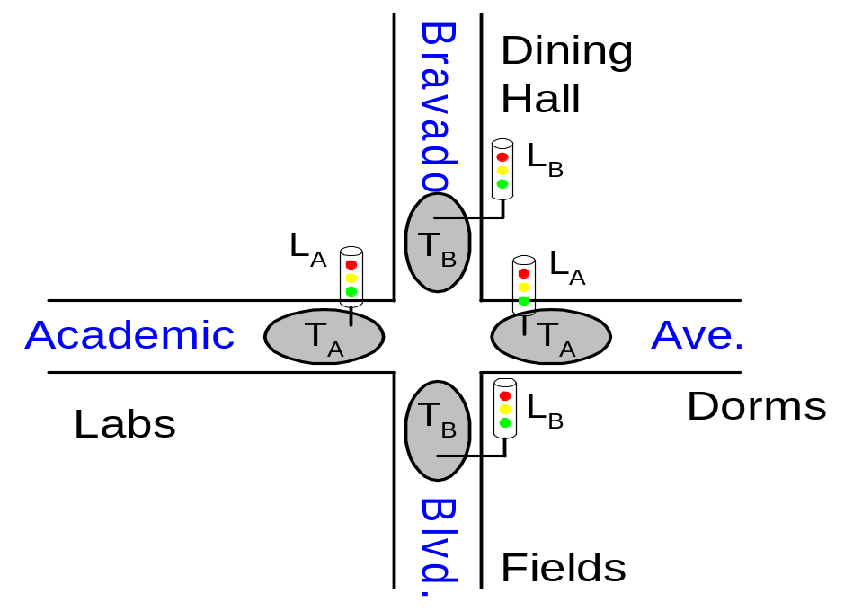
Finite State Machine Example
Traffic light controller
  Traffic sensors: T_{A}, T_{B} (TRUE when there’s traffic)
  Lights: L_{A}, L_{B}

Slide 43
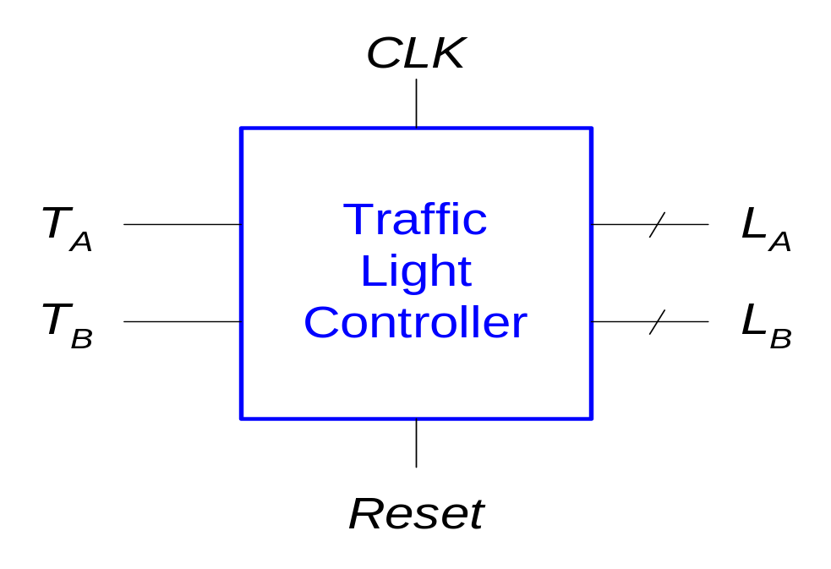
FSM Black Box
Inputs: CLK, Reset, T_{A}, T_{B}
Outputs: L_{A}, L_{B}

Slide 44
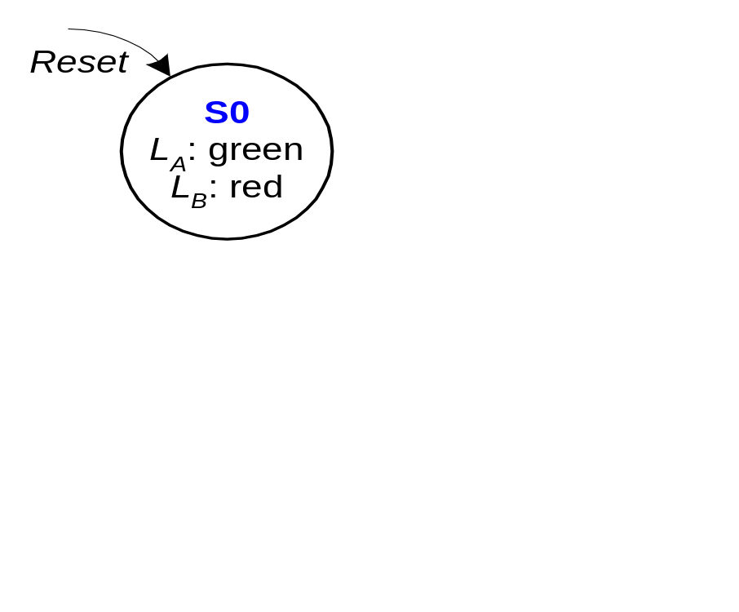
FSM State Transition Diagram
Moore FSM: outputs labeled in each state
States: Circles
Transitions: Arcs

Slide 45
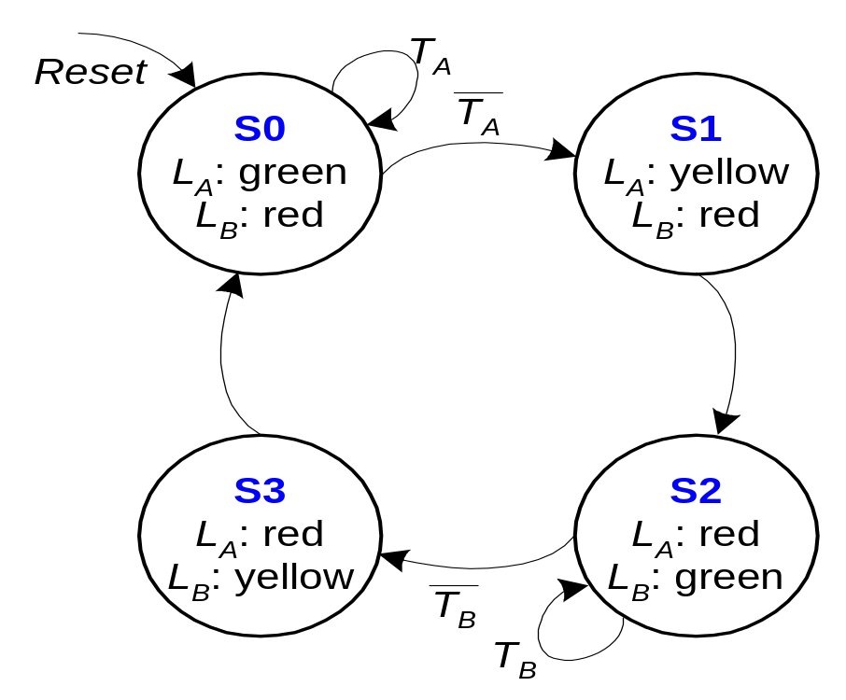
FSM State Transition Diagram
Moore FSM: outputs labeled in each state
States: Circles
Transitions: Arcs

Slide 46
FSM State Transition Table
PS | Inputs |  | NS
 | T_{A} | T_{B}
S0 | 0 | X | S1
S0 | 1 | X | S0
S1 | X | X | S2
S2 | X | 0 | S3
S2 | X | 1 | S2
S3 | X | X | S0

Slide 47
State Transition Table
PS |  | Inputs |  | NS
Q₁(t) | Q₀(t) | T_{A} | T_{B} | Q₁(t +1) | Q₀(t +1)
0 | 0 | 0 | X | 0 | 1
0 | 0 | 1 | X | 0 | 0
0 | 1 | X | X | 1 | 0
1 | 0 | X | 0 | 1 | 1
1 | 0 | X | 1 | 1 | 0
1 | 1 | X | X | 0 | 0
State | Encoding
S0 | 00
S1 | 01
S2 | 10
S3 | 11
Q₁(t+1)= Q₁(t)⊕Q₀(t)
Q₀(t+1)= Q’₁(t)Q’₀(t)T’_{A} + Q₁(t)Q’₀(t)T’_{B}

Slide 48
FSM Output Table
PS |  | Outputs
Q₁ | Q₀ | L_{A1} | L_{A0} | L_{B1} | L_{B0}
0 | 0 | 0 | 0 | 1 | 0
0 | 1 | 0 | 1 | 1 | 0
1 | 0 | 1 | 0 | 0 | 0
1 | 1 | 1 | 0 | 0 | 1
Output | Encoding
green | 00
yellow | 01
red | 10
L_{A1} = Q₁
L_{A0} = Q’₁Q₀
L_{B1} = Q’₁
L_{B0} = Q₁Q₀

Slide 49
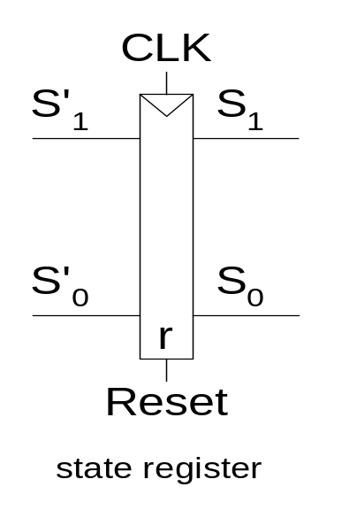
FSM Schematic: State Register

Slide 50
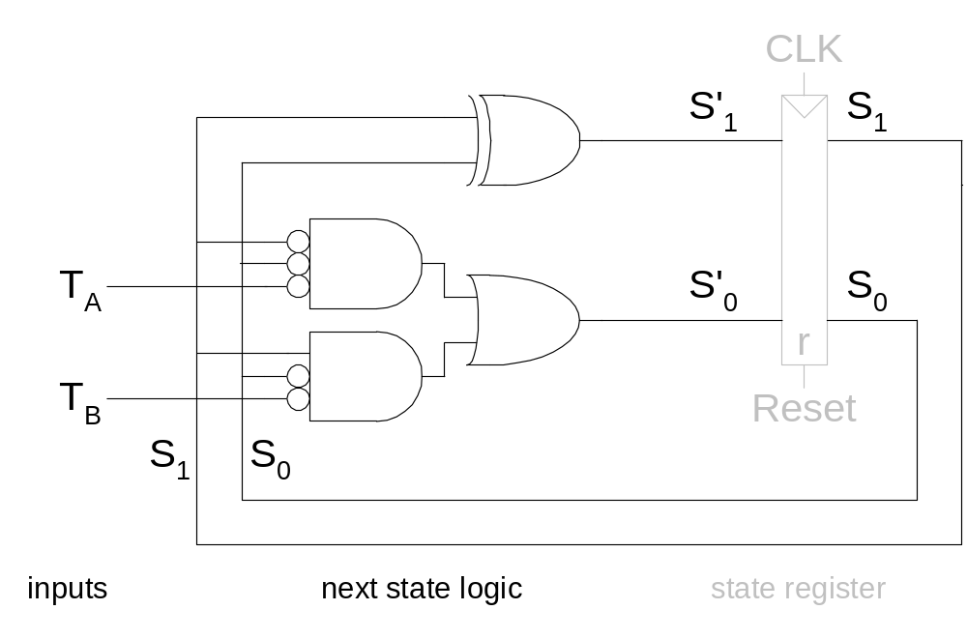
Logic Diagram

Slide 51
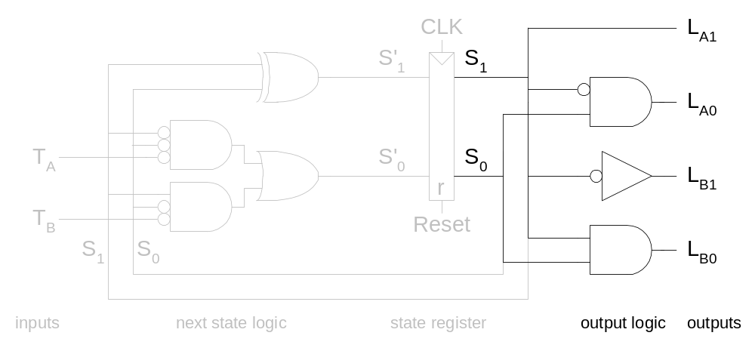
FSM Schematic: Output Logic

Slide 52
Summary: Implementation
Set up canonical form
  Mealy or Moore machine
Identify the next states
  state diagram ⇨ state table
  state assignment
Derive excitation table
  Inputs of flip flops
Design the combinational logic
  don’t care set utilization

