Slide 1
Lecture 4: Four Input K-Maps
CSE 140: Components and Design Techniques for Digital Systems
CK Cheng
Dept. of Computer Science and Engineering
University of California, San Diego

Slide 2
Outlines
Boolean Algebra vs. Karnaugh Maps
  Algebra: variables, product terms, minterms, consensus theorem
  Map: planes, rectangles, cells, adjacency
Definitions: implicants, prime implicants, essential prime implicants
Implementation Procedures

Slide 3
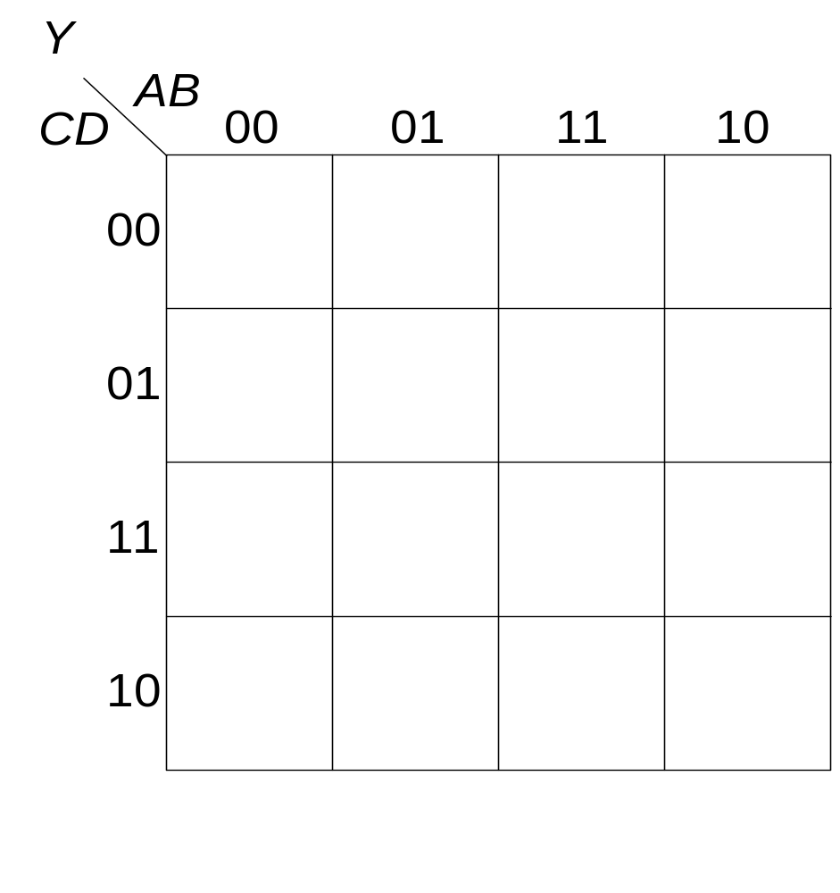
4-input K-map
An example
id | A | B | C | D | Y
0 | 0 | 0 | 0 | 0 | 1
1 | 0 | 0 | 0 | 1 | 0
2 | 0 | 0 | 1 | 0 | 1
3 | 0 | 0 | 1 | 1 | 1
4 | 0 | 1 | 0 | 0 | 0
5 | 0 | 1 | 0 | 1 | 1
6 | 0 | 1 | 1 | 0 | 1
7 | 0 | 1 | 1 | 1 | 1
8 | 1 | 0 | 0 | 0 | 1
9 | 1 | 0 | 0 | 1 | 1
10 | 1 | 0 | 1 | 0 | 1
11 | 1 | 0 | 1 | 1 | 0
12 | 1 | 1 | 0 | 0 | 0
13 | 1 | 1 | 0 | 1 | 0
14 | 1 | 1 | 1 | 0 | 0
15 | 1 | 1 | 1 | 1 | 0

Slide 4
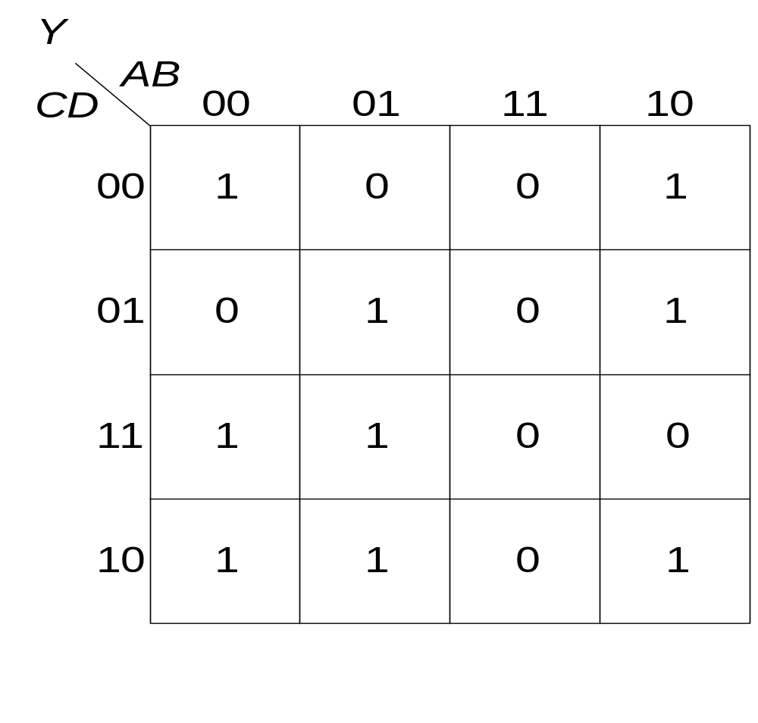
4-input K-map
id | A | B | C | D | Y
0 | 0 | 0 | 0 | 0 | 1
1 | 0 | 0 | 0 | 1 | 0
2 | 0 | 0 | 1 | 0 | 1
3 | 0 | 0 | 1 | 1 | 1
4 | 0 | 1 | 0 | 0 | 0
5 | 0 | 1 | 0 | 1 | 1
6 | 0 | 1 | 1 | 0 | 1
7 | 0 | 1 | 1 | 1 | 1
8 | 1 | 0 | 0 | 0 | 1
9 | 1 | 0 | 0 | 1 | 1
10 | 1 | 0 | 1 | 0 | 1
11 | 1 | 0 | 1 | 1 | 0
12 | 1 | 1 | 0 | 0 | 0
13 | 1 | 1 | 0 | 1 | 0
14 | 1 | 1 | 1 | 0 | 0
15 | 1 | 1 | 1 | 1 | 0

Slide 5
4-input K-map
Arrangement of variables
Adjacency and partition
0 | 4 | 12 | 8
1 | 5 | 13 | 9
3 | 7 | 15 | 11
2 | 6 | 14 | 10

Slide 6
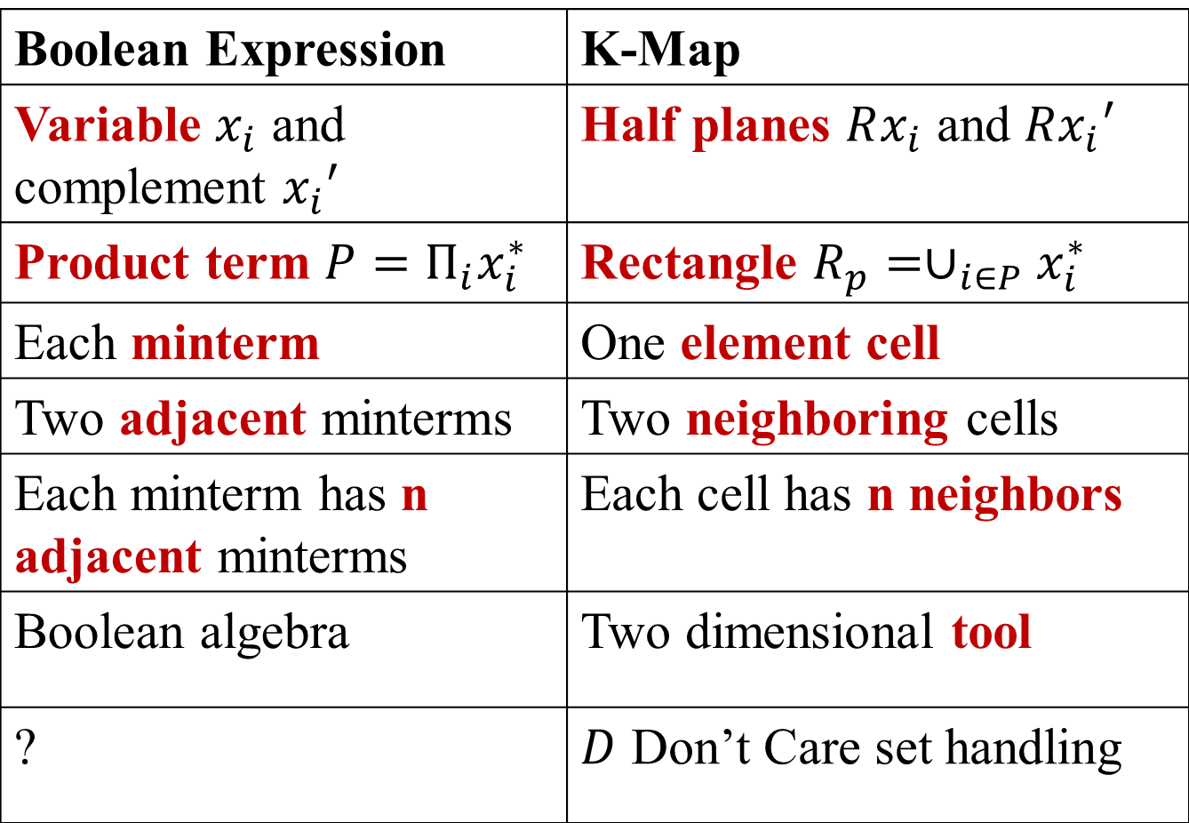
K-Map vs. Boolean Expression
Boolean Expression | K-Map
Variable $x_{i}$ and complement $x_{i}′$ | Half planes $Rx_{i}$ and $Rx_{i}′$
Product term $P=Π_{i}x_{i}^{∗}$ | Rectangle $R_{p}=∪_{i∈P}x_{i}^{∗}$
Each minterm | One element cell
Two adjacent minterms | Two neighboring cells
Each minterm has n adjacent minterms | Each cell has n neighbors
Boolean algebra | Two dimensional tool
? | $D$ Don’t Care set handling

Slide 7
Procedure for finding the minimal function via K-maps (layman terms)
Convert truth table to K-map
Group adjacent ones: In doing so include the largest number of adjacent ones (Prime Implicants)
Create new groups to cover all ones in the map: create a new group only to include at least one cell (of value 1 ) that is not covered by any other group (Essential Prime Impliants)
Select the groups that result in the minimal sum of products (we will formalize this because its not straightforward)

Slide 8
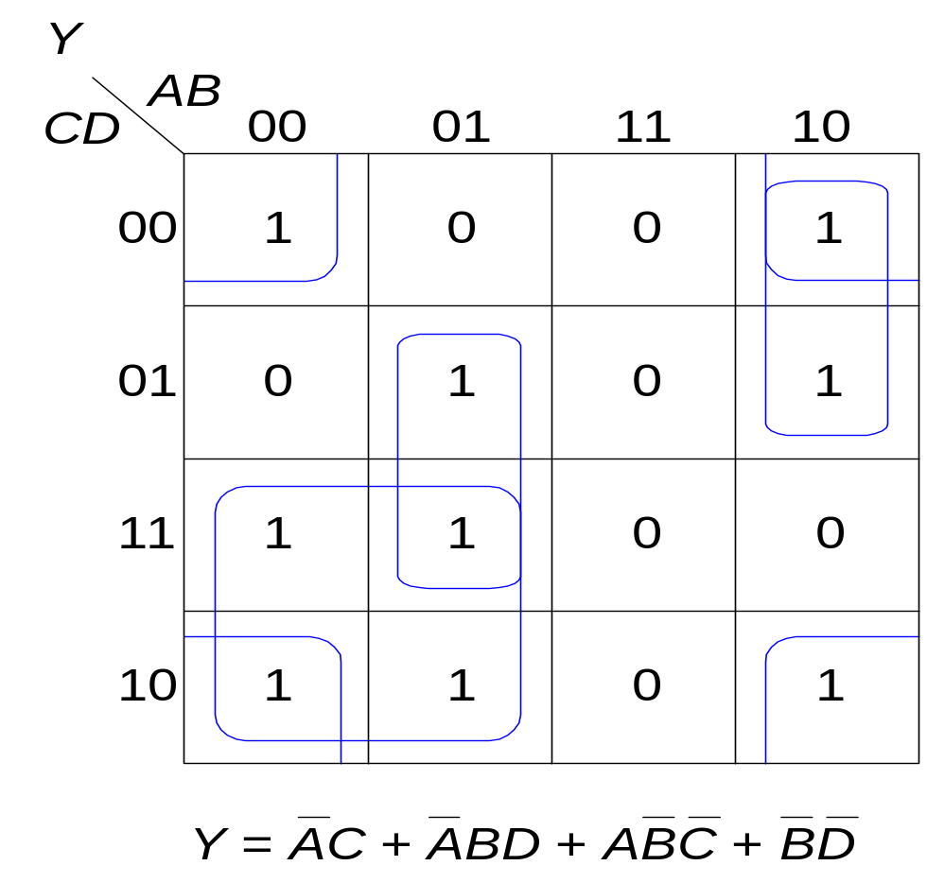
Reading the reduced K-map
0 | 4 | 12 | 8
1 | 5 | 13 | 9
3 | 7 | 15 | 11
2 | 6 | 14 | 10
∑m(2,3,6,7)
∑m(5,7)
∑m(8,9)
∑m(0,2,8,10)

Slide 9
Definitions: implicant, prime implicant, essential prime implicant
Implicant: A product term that has non-empty intersection with on-set F and does not intersect with off-set R .
Prime Implicant: An implicant that is not covered by any other implicant.
Essential Prime Implicant: A prime implicant that has an element in on-set F but this element is not covered by any other prime implicants.
Notes:
Implicant, Prime, Essential (Check dictionary)

Slide 10
Examples of Primes and Essential Primes

Slide 11
Implicant, Prime, Essential Prime
0 | 4 | 12 | 8
1 | 5 | 13 | 9
3 | 7 | 15 | 11
2 | 6 | 14 | 10
Prime
∑m(2,3,6,7)
∑m(5,7)
∑m(8,9)
∑m(0,2,8,10)

Slide 12
Definition: Prime Implicant
Implicant: A product term that has non-empty intersection with on-set F and does not intersect with off-set R.
Prime Implicant: An implicant that is not covered by any other implicant.
Q: How about this one? Is it a prime implicant?
Yes
No

Slide 13
Definition: Essential Prime
Essential Prime Implicant: A prime implicant that has an element in on-set F but this element is not covered by any other prime implicants.
Q: Is the blue group an essential prime?
Yes
No

Slide 14
Definition: Essential Prime
Q: Which of the following product term(s) is (are) not an essential prime for the given K-map ?
ab
bc’d
d’b’
ac
ab
ad’
∑m(5,13)
∑m(0,2,8,10)
∑m(10,11,14,15)
∑m(12,13,14,15)
∑m(8,10,12,14)
00
01
11
10
cd
0 | 4 | 12 | 8
1 | 5 | 13 | 9
3 | 7 | 15 | 11
2 | 6 | 14 | 10
00
1
1
1
01
1
1
11
1
1
10
1
1
1

Slide 15
Procedure for finding the minimal function via K-maps (formal terms)
Convert truth table to K-map
Include all essential primes
Include non essential primes as needed to completely cover the onset (all cells of value one)

Slide 16
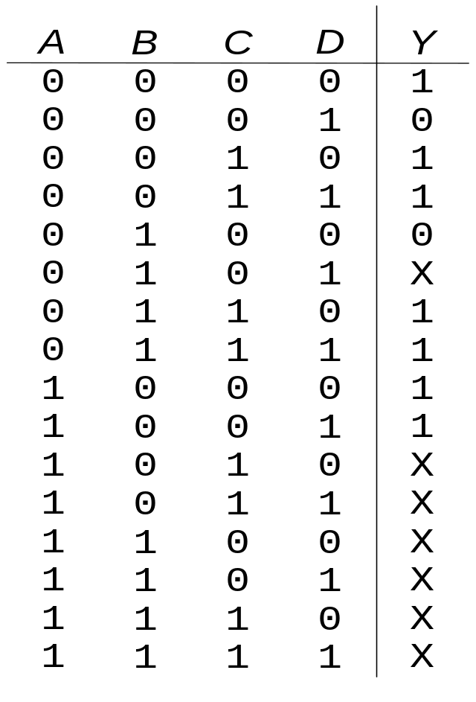

K-maps with Don’t Cares

Slide 17
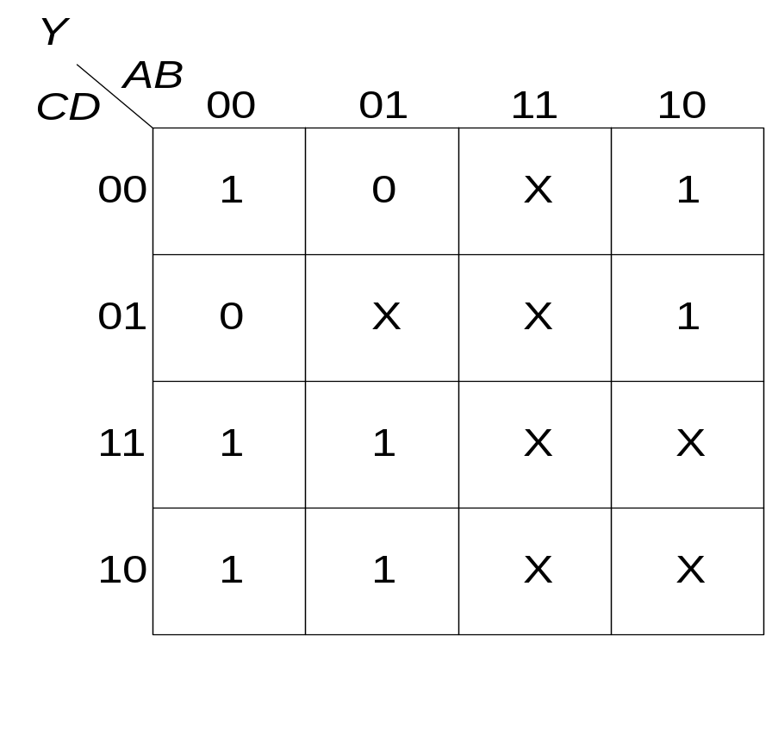
K-maps with Don’t Cares

Slide 18
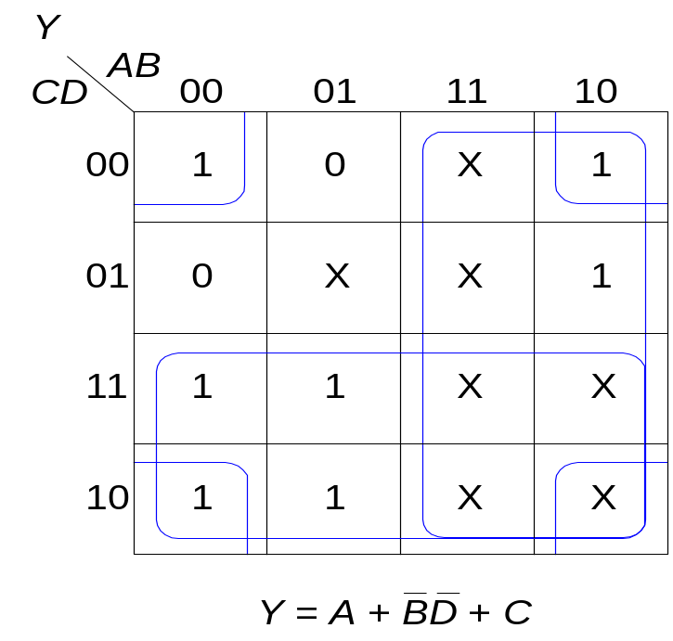
K-maps with Don’t Cares

Slide 19
Reducing Canonical expressions
Given F(a,b,c,d) = Σm (0, 1, 2, 8, 14)
D(a,b,c,d) = Σm (9, 10)
1. Draw K-map
ab
00
01
11
10
cd
00
01
11
10

Slide 20
Reducing Canonical Expressions
Given F(a,b,c,d) = Σm (0, 1, 2, 8, 14)
D(a,b,c,d) = Σm (9, 10)
1. Draw K-map
ab
00
01
11
10
cd
0 4 12 8
00
1 5 13 9
01
11
3 7 15 11
10
2 6 14 10

Slide 21
Reducing Canonical Expressions
Given F(a,b,c,d) = Σm (0, 1, 2, 8, 14)
D(a,b,c,d) = Σm (9, 10)
1. Draw K-map
ab
00
01
11
10
cd
0 4 12 8
00
1 0 0 1
1 5 13 9
01
1 0 0 X
11
3 7 15 11
0 0 0 0
10
2 6 14 10
1 0 1 X

Slide 22
Reducing Canonical Expressions
Draw K-map
Identify Prime implicants
Identify Essential Primes
ab
00
01
11
10
cd
0 4 12 8
00
1 0 0 1
PI Q: How many primes (P) and essential primes (EP) are there?
Four (P) and three (EP)
Three (P) and two (EP)
Three (P) and three (EP)
Four (P) and Four (EP)
1 5 13 9
01
1 0 0 X
11
3 7 15 11
0 0 0 0
10
2 6 14 10
1 0 1 X

Slide 23
Reducing Canonical Expressions
Prime implicants: Σm (0, 1, 8, 9), Σm (0, 2, 8, 10), Σm (10, 14)
Essential Primes: Σm (0, 1, 8, 9), Σm (0, 2, 8, 10), Σm (10, 14)
ab
00
01
11
10
cd
0 4 12 8
PI Q: Do the E-primes cover the entire on set?
Yes
No
00
1 0 0 1
1 5 13 9
01
1 0 0 X
11
3 7 15 11
0 0 0 0
10
2 6 14 10
1 0 1 X

Slide 24
Reducing Canonical Expressions
Prime implicants: Σm (0, 1, 8, 9), Σm (0, 2, 8, 10), Σm (10, 14)
Essential Primes: Σm (0, 1, 8, 9), Σm (0, 2, 8, 10), Σm (10, 14)
Min exp: Σ (Essential Primes)=Σm (0, 1, 8, 9) + Σm (0, 2, 8, 10) + Σm (10, 14)
f(a,b,c,d) = ?
ab
00
01
11
10
cd
0 4 12 8
PI Q: Do the E-primes cover the entire on set?
Yes
No
00
1 0 0 1
1 5 13 9
01
1 0 0 X
11
3 7 15 11
0 0 0 0
10
2 6 14 10
1 0 1 X
Notes:
f(a,b,c,d) = b’c’ + b’d’+ acd‘

Slide 25
Reducing Canonical Expressions
Prime implicants: Σm (0, 1, 8, 9), Σm (0, 2, 8, 10), Σm (10, 14)
Essential Primes: Σm (0, 1, 8, 9), Σm (0, 2, 8, 10), Σm (10, 14)
Min exp: Σ (Essential Primes)=Σm (0, 1, 8, 9) + Σm (0, 2, 8, 10) + Σm (10, 14)
f(a,b,c,d) = b’c’ + b’d’+ acd‘
ab
00
01
11
10
cd
0 4 12 8
PI Q: Do the E-primes cover the entire on set?
Yes
No
00
1 0 0 1
1 5 13 9
01
1 0 0 X
11
3 7 15 11
0 0 0 0
10
2 6 14 10
1 0 1 X
Notes:
f(a,b,c,d) = b’c’ + b’d’+ acd‘

Slide 26
Another example
Given F(a,b,c,d) = Σm (0, 3, 4, 14, 15)
D(a,b,c,d) = Σm (1, 11, 13)
Draw the K-Map
ab
00
01
11
10
cd
00
01
11
10

Slide 27
Another example
Given F(a,b,c,d) = Σm (0, 3, 4, 14, 15)
D(a,b,c,d) = Σm (1, 11, 13)
ab
00
01
11
10
cd
0 4 12 8
00
1 1 0 0
1 5 13 9
01
X 0 X 0
11
3 7 15 11
1 0 1 X
10
2 6 14 10
0 0 1 0

Slide 28
Reducing Canonical Expressions
Prime implicants: Σm (0, 4), Σm (0, 1), Σm (1, 3), Σm (3, 11), Σm (14, 15), Σm (11, 15), Σm (13, 15)
Essential Primes: Σm (0, 4), Σm (14, 15)
ab
00
01
11
10
cd
0 4 12 8
00
1 1 0 0
1 5 13 9
01
X 0 X 0
11
3 7 15 11
1 0 1 X
10
2 6 14 10
0 0 1 0

Slide 29
Reducing Canonical Expressions
Prime implicants: Σm (0, 4), Σm (0, 1), Σm (1, 3), Σm (3, 11), Σm (14, 15), Σm (11, 15), Σm (13, 15)
Essential Primes: Σm (0, 4), Σm (14, 15)
Min exp: Σm (0, 4), Σm (14, 15), (Σm (3, 11) or Σm (1,3) )
f(a,b,c,d) = a’c’d’+ abc+ b’cd (or a’b’d)
ab
00
01
11
10
cd
0 4 12 8
00
1 1 0 0
1 5 13 9
01
X 0 X 0
11
3 7 15 11
1 0 1 X
10
2 6 14 10
0 0 1 0

