Slide 1
CSE 140: Components and Design Techniques for Digital Systems
Lecture 3: Incompletely Specified Functions and K Maps
CK Cheng
Dept. of Computer Science and Engineering
University of California, San Diego

Slide 2
Outlines
Definitions
  Minterms and Maxterms
  Incompletely Specified Function
Implementation: Boolean Algebra vs Map
Karnaugh Maps: Two Dimensional Truth Table
  2-Variable Map
  3-Variable Map
  Up to 6-Variable Map

Slide 3
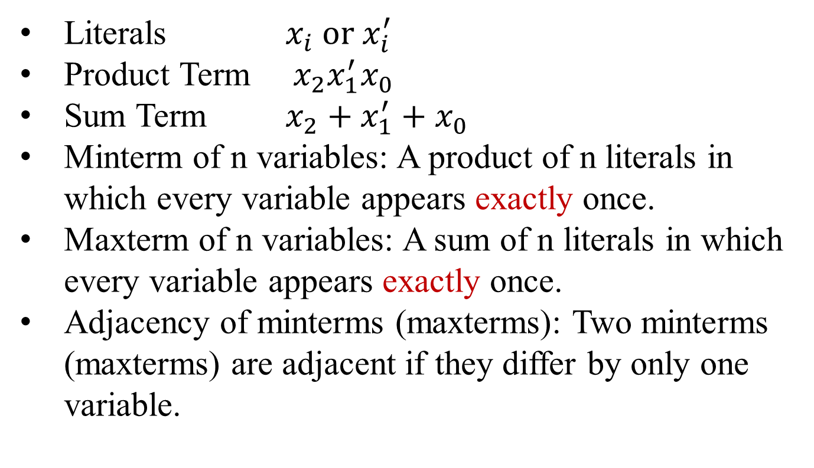
Definitions
Literals $x_{i} or x_{i}^{′}$
Product Term ${ x_{2}x}_{1}^{′}x_{0}$
Sum Term $x_{2}+x_{1}^{′}+x_{0}$
Minterm of n variables: A product of n literals in which every variable appears exactly once.
Maxterm of n variables: A sum of n literals in which every variable appears exactly once.
Adjacency of minterms (maxterms): Two minterms (maxterms) are adjacent if they differ by only one variable.

Slide 4
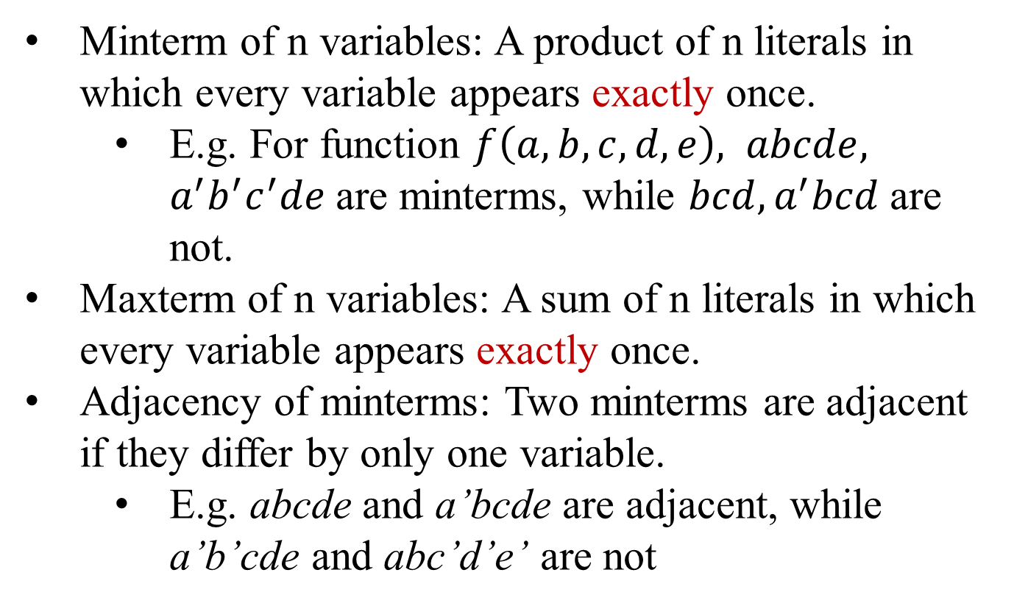
Definitions: Examples
Minterm of n variables: A product of n literals in which every variable appears exactly once.
  E.g. For function $f\left(a,b,c,d,e\right),$ $abcde,$ $a^{′}b^{′}c^{′}de$are minterms, while $bcd, a^{′}bcd$are not.
Maxterm of n variables: A sum of n literals in which every variable appears exactly once.
Adjacency of minterms: Two minterms are adjacent if they differ by only one variable.
  E.g. abcde and a’bcde are adjacent, while a’b’cde and abc’d’e’ are not

Slide 5
iClicker
For two minterms ab’c’d’ and ab’cd’, are they adjacent?
Yes
No
Adjacency allows us to merge the terms to reduce the Boolean expression.

Slide 6
Incompletely Specified Function
Situations where the output of a switching function can be either 0 or 1 for a particular combination of inputs
This is specified by a don’t care in the truth table
Id a b f (a, b)
0 0 0 1
1 0 1 0
2 1 0 1
3 1 1 X (don’t care)
For example:
The input pattern does not happen.
The input pattern happens, but the output is ignored.
Example:
Decimal number 0… 9 uses 4 bits. (1,1,1,1) does not happen.

Slide 7
How to completely specify the truth table in canonical form?
We have three types of output which divides the input space into three sets:
On-set F: All the input conditions for which the output is 1
Off-set R: All the input conditions for which the output is 0
Don’t care set D: All the input conditions for which the output is a ‘don’t care’
Incompletely Specified Function
Example: The truth table on right has
F covers input pattern {(a=1,b=0)}
R covers input pattern {(0,0)}
D covers input patterns {(0,1), (1,1)}
The union of F, R, D is the whole set of all input patterns.
Id | a | b | F
0 | 0 | 0 | 0
1 | 0 | 1 | X
2 | 1 | 0 | 1
3 | 1 | 1 | X

Slide 8
Incompletely Specified Function
Example: The truth table on right has
F covers input pattern (a,b)=(1,0)
R covers input pattern (a,b)=(0,0)
D covers input patterns (a,b)=(0,1) (1,1)
Id | a | b | F
0 | 0 | 0 | 0
1 | 0 | 1 | X
2 | 1 | 0 | 1
3 | 1 | 1 | X
We assign values to elements in don’t care set for logic designs.
Id | a | b | F
0 | 0 | 0 | 0
1 | 0 | 1
2 | 1 | 0 | 1
3 | 1 | 1

Slide 9
Reducing Incompletely Specified Functions
iClicker Q: Which of the following assignment would result in an implementation with the fewest gates?
Id | a | b | F(a,b)
0 | 0 | 0 | X
1 | 0 | 1 | 0
2 | 1 | 0 | 1
3 | 1 | 1 | 0
F(0,0)=1
F(0,0)=0
Neither A or B
Both A and B

Slide 10
Implementation
Specification ➔ Schematic Diagram
Net list,
Switching expression
Obj min cost ➔ Search in solution space
(max performance)
Cost: wires, gates ➔ Literals, product terms,
sum terms
For two level logic (sum of products or product of sums),
we want to minimize # of terms, and # of literals

Slide 11
Implementation: Specification => Logic Diagram
Karnaugh Map: A 2-dimensional truth table
Flow 1: Boolean Algebra
Specification
Truth table
Sum of products (SOP) or product of sums(POS) canonical form
Reduced expression using Boolean algebra
Schematic diagram of two level logic
Flow 2: K Map
Specification
Truth Table
Karnaugh Map (truth table in two dimensional space)
Reduce using K’Maps
Reduced expression (SOP or POS)
Schematic diagram of two level logic

Slide 12
Truth Table vs. Karnaugh Map
2-variable function, f(A,B)
ID | A | B | f(A,B)
0 | 0 | 0 | f(0,0)
1 | 0 | 1 | f(0,1)
2 | 1 | 0 | f(1,0)
3 | 1 | 1 | f(1,1)
 | B=0 | B=1
A=0 | f(0,0) | f(0,1)
A=1 | f(1,0) | f(1,1)

Slide 13
Truth Table
An example of 2-variable function, f(A,B)
ID | A | B | f(A,B) | minterm
0 | 0 | 0 | 0
1 | 0 | 1 | 1 | A’B
2 | 1 | 0 | 1 | AB’
3 | 1 | 1 | 1 | AB

Slide 14
Function can be represented by sum of minterms:
f(A,B) = A’B+AB’+AB
This is not optimal however!
We want to minimize the number of literals and terms.

Slide 15
To minimize the number of literals and terms.
We factor out common terms –
A’B+AB’+AB
= A’B+AB’+AB+AB
=(A’+A)B+A(B’+B)=B+A
Hence, we have
f(A,B) = A+B

Slide 16
How can we guarantee the most reduced expression was reached?
Boolean expressions can be minimized by combining terms
K-maps minimize equations graphically
ID | A | B | f(A,B)
0 | 0 | 0 | f(0,0)
1 | 0 | 1 | f(0,1)
2 | 1 | 0 | f(1,0)
3 | 1 | 1 | f(1,1)
 | B=0 | B=1
A=0 | A’B’ | A’B
A=1 | AB’ | AB

Slide 17
K-Map: Truth Table in 2 Dimensions
B = 0 B = 1
ID | A | B | f(A,B)
0 | 0 | 0 | 0
1 | 0 | 1 | 1
2 | 1 | 0 | 1
3 | 1 | 1 | 1
0 1
A = 0
A = 1
0 1
1 1
2 3

Slide 18
K-Map: Truth Table in 2 Dimensions
B = 0 B = 1
ID | A | B | f(A,B)
0 | 0 | 0 | 0
1 | 0 | 1 | 1
2 | 1 | 0 | 1
3 | 1 | 1 | 1
0 1
A = 0
A = 1
0 1
1 1
2 3
f(A,B) = A + B

Slide 19
Two Variable K-maps
id | a | b | f (a, b)
0 | 0 | 0 | f (0, 0)
1 | 0 | 1 | f (0, 1)
2 | 1 | 0 | f (1, 0)
3 | 1 | 1 | f (1, 1)
# possible 2-variable functions:
For 2 variables as inputs, we have 4=2² entries. Each entry can be 0 or 1. Thus we have 16=2⁴ possible functions.
a
b
f(a,b)

Slide 20
Representation of k-Variable Func.
A cube of 4 variables: (A,B,C,D)
Boolean Expression
Truth Table
Cube
K Map
Binary Decision Diagram
And-Inverter Graph
  Ref: R. Brayton and A. Mishchenko, “ABC: an academic industrial-strength verification tool,” ACM Int. Conf. on Computer Aided Verification, pp. 24-40, 2010.
(0,1,1,0)
(0,1,1,1)
(1,1,1,0)
(1,1,1,1)
B
(0,0,1,0)
(0,0,1,1)
(1,0,1,0)
(1,0,1,1)
C
(0,1,0,1)
(1,1,0,1)
D
(0,0,0,0)
(0,0,0,1)
(1,0,0,0)
(1,0,0,1)
A

Slide 21
Corresponding three variable K-map
Truth table
Id a b c f (a,b,c)
0 0 0 0 1
1 0 0 1 0
2 0 1 0 1
3 0 1 1 0
4 1 0 0 1
5 1 0 1 0
6 1 1 0 1
7 1 1 1 0
Gray code (a,b)
(0,0) (0,1) (1,1) (1,0)
c = 0
c = 1

Slide 22
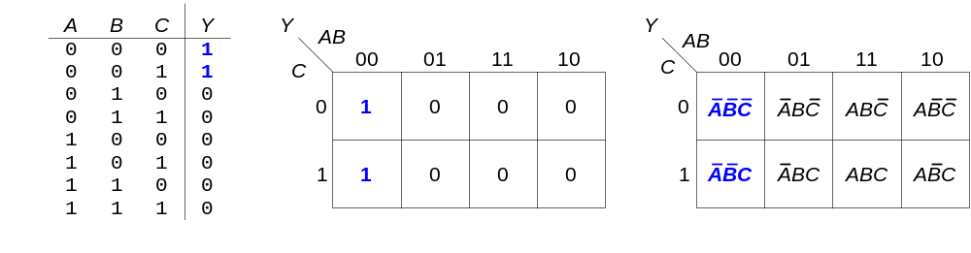
Karnaugh Maps (K-Maps)
K-maps minimize equations graphically
Note that the label decides the order in the map

Slide 24
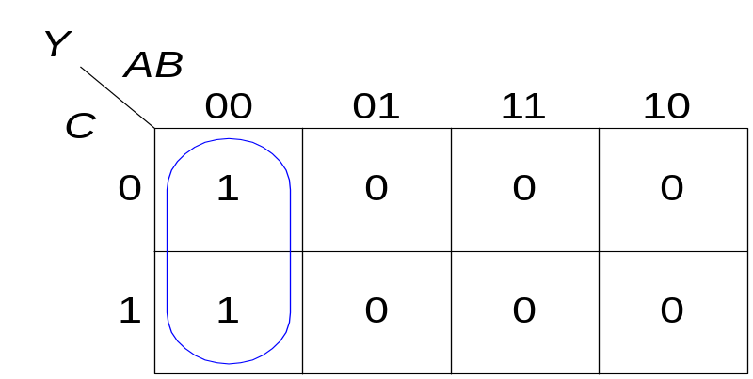
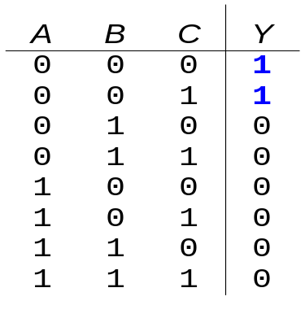
K-map
Circle 1’s in adjacent squares
Find rectangles which correspond to product terms in Boolean expression
y(A,B)=A’B’C’+A’B’C= A’B’(C’+C)=A’B’

Slide 25
Corresponding K-map
Another 3-Input truth table
Id a b c f (a,b,c)
0 0 0 0 0
1 0 0 1 0
2 0 1 0 1
3 0 1 1 0
4 1 0 0 1
5 1 0 1 1
6 1 1 0 X
7 1 1 1 1
(0,0) (0,1) (1,1) (1,0)
c = 0
0 2 6 4
0 1 X 1
1 3 7 5
c = 1
0 0 1 1

Slide 26
Corresponding K-map
Another 3-Input truth table
b = 1
Id a b c f (a,b,c)
0 0 0 0 0
1 0 0 1 0
2 0 1 0 1
3 0 1 1 0
4 1 0 0 1
5 1 0 1 1
6 1 1 0 X
7 1 1 1 1
(0,0) (0,1) (1,1) (1,0)
c = 0
0 2 6 4
0 1 X 1
1 3 7 5
c = 1
0 0 1 1
a = 1
f(a,b,c) = a + bc’

Slide 27
Corresponding K-map
3-input truth table
Id a b c f (a,b,c,d)
0 0 0 0 1
1 0 0 1 1
2 0 1 0 X
3 0 1 1 0
4 1 0 0 1
5 1 0 1 1
6 1 1 0 0
7 1 1 1 0
(0,0) (0,1) (1,1) (1,0)
c = 0
0 2 6 4
1 X 0 1
1 3 7 5
c = 1
1 0 0 1
PI Q: In the above case the minimal Boolean expression is obtained when the don’t care term is:
Included i.e. Circled in with one or more minterms that evaluate to 1
Excluded when grouping the minterms that evaluate to one
Either approach gives the minimal expression

Slide 28
Corresponding K-map
3-Input Truth table
Id a b c f (a,b,c,d)
0 0 0 0 1
1 0 0 1 1
2 0 1 0 X
3 0 1 1 0
4 1 0 0 1
5 1 0 1 1
6 1 1 0 0
7 1 1 1 0
(0,0) (0,1) (1,1) (1,0)
c = 0
0 2 6 4
1 X 0 1
1 3 7 5
c = 1
1 0 0 1
PI Q: In the above case the minimal Boolean expression is obtained when the don’t care term is:
Included i.e. Circled in with one or more minterms that evaluate to 1
Excluded when grouping the minterms that evaluate to one
Either approach gives the minimal expression

Slide 29
Corresponding K-map
3-input truth table with Don’t cares
b = 1
Id a b c f (a,b,c,d)
0 0 0 0 1
1 0 0 1 1
2 0 1 0 X
3 0 1 1 0
4 1 0 0 1
5 1 0 1 1
6 1 1 0 0
7 1 1 1 0
(0,0) (0,1) (1,1) (1,0)
c = 0
0 2 6 4
1 X 0 1
1 3 7 5
c = 1
1 0 0 1
a = 1
f(a,b,c) = b’

Slide 30
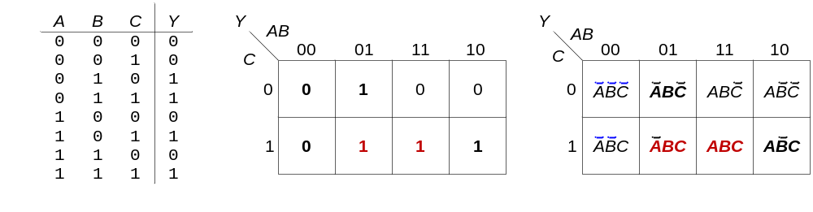
Consensus Theorem in View of K Maps
Consensus Theorem: A’B+AC+BC=A’B+AC

