Slide 1
CSE 140, Lecture 2
Combinational Logic
CK Cheng
CSE Dept.
UC San Diego

Slide 2
Combinational Logic Outlines
Introduction
  Scope
  Boolean Algebra (Review)
    Definition
    Duality
    AND/OR Gates
    Expressions vs Circuits
  Handy Tools
    DeMorgan’s Theorem
    Consensus Theorem
    Shannon’s Expansion
Specification
Synthesis

Slide 3
1.1 Combinational Logic: Scope
Description
  Language: e.g. C Programming, BSV, Verilog, VHDL
  Boolean algebra
  Truth table: Powerful engineering tool
Design
  Schematic Diagram
  Inputs, Gates, Nets, Outputs
Goal
  Validity: correctness, turnaround time
  Performance: power, timing, cost
  Testability: yield, diagnosis, robustness

Slide 4
Scope: Boolean algebra, switching algebra, logic
Boolean Algebra: multiple-valued logic, i.e. each variable have multiple values.
Switching Algebra: binary logic, i.e. each variable can be either 1 or 0.
Boolean Algebra ≠ Switching Algebra
BB
Switching Algebra
Two Level Logic
Boolean Algebra

Slide 5
Scope: Switching Algebra (Binary Values)
Typically consider only two discrete values:
  1’s and 0’s
  1, TRUE, HIGH
  0, FALSE, LOW
1 and 0 can be represented by specific voltage levels, rotating gears, fluid levels, etc.
Digital circuits usually depend on specific voltage levels to represent 1 and 0
Bit: Binary digit
1-<5>

Slide 6
Scope: Levels of Logic
Multiple Level Logic: Many layers of two level logic with some inverters, e.g. (((a+bc)’+ab’)+b’c+c’d)’bc+c’e
(A network of two level logic)
Two Level Logic: Sum of products, or product of sums, e.g. ab + a’c + a’b’, (a’+c )(a+b’)(a+b+c’)
Features of Digital Logic Design
Multiple Outputs
Don’t care sets
BB
Boolean Algebra
Switching Algebra
Two Level Logic

Slide 7
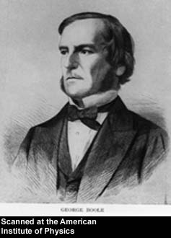
1.2 Boolean Algebra (Review)
George Boole, 1815-1864
Born to working class parents: Son of a shoemaker
Taught himself mathematics and joined the faculty of Queen’s College in Ireland.
Wrote An Investigation of the Laws of Thought (1854): systematize Aristotle’s logic
Introduced binary variables
Introduced the three fundamental logic operations: AND, OR, and NOT.
1-<7>

Slide 8
Review of Boolean Algebra
Let B be a nonempty set with two 2-input operations, a 1-input operation ` (complement), and two distinct elements 0 and 1. Then B is called a Boolean algebra if the following axioms hold.
Associative laws: (a+b)+c=a+(b+c), (a·b) ·c=a·(b·c)
Commutative laws: a+b=b+a, a·b=b·a
Distributive laws: a+(b·c)=(a+b)·(a+c), a·(b+c)=a·b+a·c
Identity laws: a+0=a, a·1=a
Complement laws: a+a’=1, a·a’=0

Slide 9
Review of Boolean Algebra: Duality
Associative laws | (a+b)+c=a+(b+c) | (a·b) ·c=a·(b·c)
Commutative laws | a+b=b+a | a·b=b·a
Distributive laws | a+(b·c)=(a+b)·(a+c) | a·(b+c)=a·b+a·c
Identity laws | a+0=a | a·1=a
Complement laws | a+a’=1 | a·a’=0
Duality: We swap all operators between (+,.) and interchange all elements between (0,1).
For a theorem if the statement can be proven with the laws of Boolean algebra, then the duality of the statement is also true.

Slide 10
1.3 Switching functions: Operators and Digital Logic Gates
id | A | B | Y
0 | 0 | 0 | 0
1 | 0 | 1 | 0
2 | 1 | 0 | 0
3 | 1 | 1 | 1
AND
Y=AB
A | B | Y
0 | 0 | 0
0 | 1 | 1
1 | 0 | 1
1 | 1 | 1
OR
Y=A+B
A | Y
0 | 1
1 | 0
NOT
Y=A’
A
1
A
1
A
1
A
0
A
0
0
A
Input 0 dominates Y
0 blocks the output
1 passes signal A
Input 1 dominates Y
0 passes signal A
1 blocks the output

Slide 11
1.3 Switching functions: Operators and Digital Logic Gates
AND
Y=ABC
OR
Y=A+B+C
id | A | B | C | Y
0 | 0 | 0 | 0 | 0
1 | 0 | 0 | 1 | 0
2 | 0 | 1 | 0 | 0
3 | 0 | 1 | 1 | 0
4 | 1 | 0 | 0 | 0
5 | 1 | 0 | 1 | 0
6 | 1 | 1 | 0 | 0
7 | 1 | 1 | 1 | 1
A | B | C | Y
0 | 0 | 0 | 0
0 | 0 | 1 | 1
0 | 1 | 0 | 1
0 | 1 | 1 | 1
1 | 0 | 0 | 1
1 | 0 | 1 | 1
1 | 1 | 0 | 1
1 | 1 | 1 | 1
0 blocks the output
1 passes signal A
For AND, only one row is true
(minterm)
0 passes signal A
1 blocks the output
For OR, only one row is false
(maxterm)

Slide 12
1.3 Switching functions: Example on AND and OR
AND
OR
id | A | B | C | Y
0 | 0 | 0 | 0
1 | 0 | 0 | 1
2 | 0 | 1 | 0
3 | 0 | 1 | 1
4 | 1 | 0 | 0
5 | 1 | 0 | 1
6 | 1 | 1 | 0
7 | 1 | 1 | 1
A | B | C | Y
0 | 0 | 0
0 | 0 | 1
0 | 1 | 0
0 | 1 | 1
1 | 0 | 0
1 | 0 | 1
1 | 1 | 0
1 | 1 | 1
Y=A’B’C
Y=A’+B’+C

Slide 13
Switching Expressions vs Logic Diagrams
Switching expression is related to logic implementation
Switching Expression: #literals, #operators
Schematic Diagram: #gates, #nets, #pins

Slide 14
Laws and Logic Diagrams
Associativity Laws
(A+B) + C = A + (B+C)
(AB)C = A(BC)
C
A
A
B
B
C
C
A
A
B
B
C

Slide 15
Laws and Logic Diagrams
Identity Laws A ∙ 1 = A A + 1 = 1
A ∙ 0 = 0 A + 0 = A
Complement Laws A + A’ = 1 A ∙ A’ = 0
Distributive Laws
A ∙(B+C) = A ∙ B + A ∙ C
A+B ∙ C = (A+B) ∙(A+C)
A
B
A
B
C
A
C
A
B
A
B
C
A
C

Slide 16
Switching Expression and Logic
a
b
a·b
Cost: #gates, #nets, #pins
a·b + c·d
c
d
y=e·(a·b+c·d)
c·d
e
Schematic Diagram:
5 primary inputs
1 primary output
4 gates (3 ANDs, 1 OR)
9 signal nets
12 pins
Boolean Algebra:
5 variables
1 expression
4 operators (3 ANDs, 1 OR)
5 literals

Slide 17
Switching Expression and Logic
a
b
a·b
Schematic Diagram:
5 primary inputs
4 components (gates)
9 signal nets
12 pins
a·b + c·d
c
d
y=e·(a·b+c·d)
c·d
e
Boolean Algebra:
5 literals
4 operators
#inputs
#gates
#nets
#pins
None
#variables
#operators
#variables + #operators
#literals + 2 #operators - 1

Slide 18
Example: f(a,b,c)= ab+a’c+a’b’

Slide 19
Example: f(a,b,c)= (a’+c)(a+b’)(a+b+c)

Slide 20
1.4 Handy Tools
Boolean Algebra
DeMorgan’s Law: Complements
Consensus Theorem
Switching Logic
Shannon’s Expansion
Truth Table
Karnaugh Map (single output, two level logic)
BB
Boolean Algebra
Switching Algebra
Two Level Logic

Slide 21
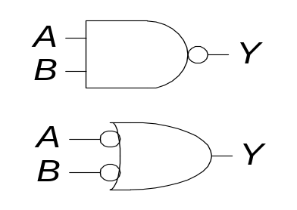
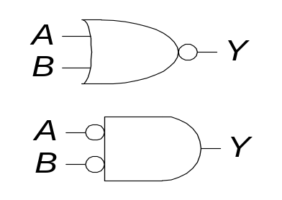
DeMorgan’s Theorem and Digital Logic
T12. DeMorgan’s Theorem (A+B)’ = A’B’ (AB)’ = A’ + B’
Y = (AB)’ = A’ + B’
Y = (A + B)’= A’B’

Slide 22
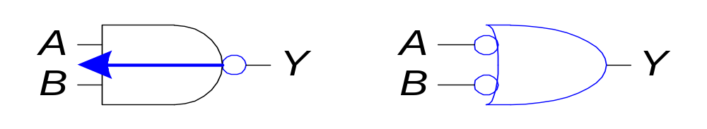
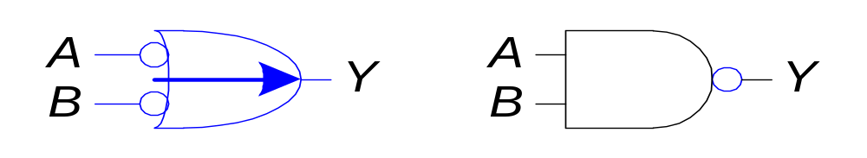
DeMorgan’s Theorem: Bubble Pushing
Pushing bubbles backward (from the output) or forward (from the inputs) changes the body of the gate from AND to OR or vice versa.
Pushing a bubble from the output back to the inputs puts bubbles on all gate inputs.
Pushing bubbles on all gate inputs forward toward the output puts a bubble on the output and changes the gate body.

Slide 23
Consensus Theorem
AB+AC+B’C
=AB+B’C
(A+B)(A+C)(B’+C)
=(A+B)(B’+C)
The consensus of AB, B’C is: ?
Exercise: to prove the reduction using
Venn Diagrams,
Boolean algebra,
Logic simulation and
Shannon’s expansion

Slide 24
Consensus Theorem: Venn Diagrams
AB+AC+B’C : AB+B’C
A
A
B
C
B
C

Slide 25
Consensus Theorem: Boolean Algebra
AB+AC+B’C
=AB+B’C
(A+B)(A+C)(B’+C)
=(A+B)(B’+C)
AB+AC+B’C
=AB+AC1+B’C
=AB+AC(B+B’)+B’C
=AB+ABC+AB’C+B’C
=AB(1+C)+(A+1)B’C
=AB+B’C

Slide 26
Consensus Theorem: Logic Simulation
f(A,B,C)= AB+AC+B’C
g(A,B,C)=AB+B’C
Index | A | B | C | AB | AC | B’C | f | g
0 | 0 | 0 | 0 | 0 | 0 | 0
1 | 0 | 0 | 1 | 0 | 0 | 1
2 | 0 | 1 | 0 | 0 | 0 | 0
3 | 0 | 1 | 1 | 0 | 0 | 0
4 | 1 | 0 | 0 | 0 | 0 | 0
5 | 1 | 0 | 1 | 0 | 1 | 1
6 | 1 | 1 | 0 | 1 | 0 | 0
7 | 1 | 1 | 1 | 1 | 1 | 0

Slide 28
Consensus Theorem (Examples)
iClicker: Which one is not a consensus of the expressions on the right.
A+A’B
A+A’BC
A(B+C)+A’D
ABC+A’D+BCDE
B
BC
(B+C)D
BCD
BCDE

Slide 29
Shannon’s Expansion
Shannon’s expansion assumes a switching algebra system
Divide a switching function into smaller functions
Pick a variable x, partition the switching function into two cases: x=1 and x=0
  f(x,y,z,…)= xf(x=1,y,z,…) + x’f(x=0,y,z,…)
For example
  f(x)=xf(1)+x’f(0)
  f(x,y)=xf(1,y)+x’f(0,y)

Slide 30
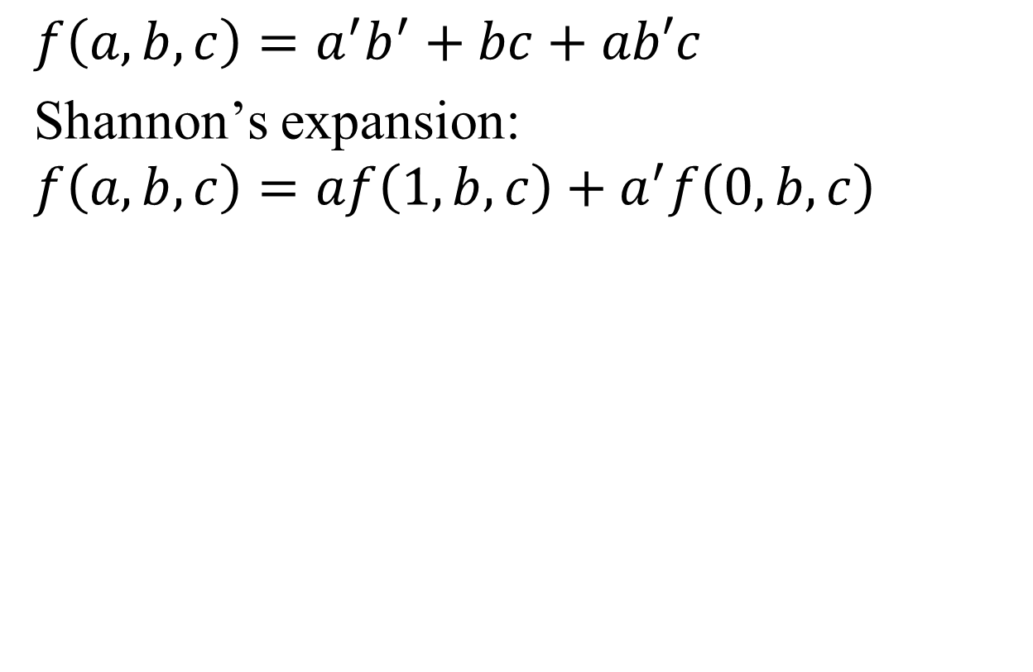
Shannon’s Expansion (Example)
$$f\left(a,b,c\right)=a^{′}b^{′}+bc+ab′c$$
Shannon’s expansion:
$$f\left(a,b,c\right)=af\left(1,b,c\right)+a^{′}f\left(0,b,c\right)$$

Slide 31
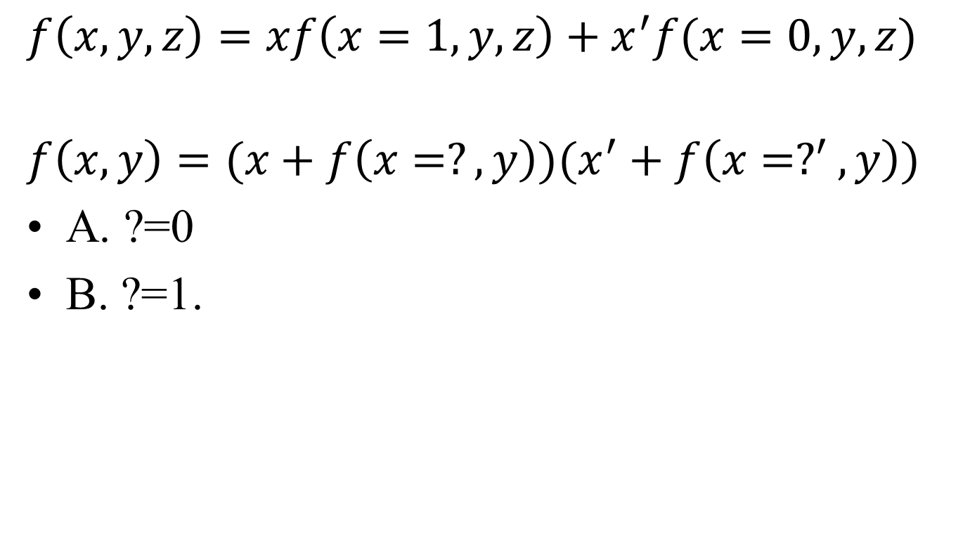
Shannon’s Expansion: Example
  $$f\left(x,y,z\right)=xf\left(x=1,y,z\right)+x^{′}f(x=0,y,z)$$
$$f\left(x,y\right)=(x+f\left(x=?,y\right))(x^{′}+f\left({x=?}^{′},y\right))$$
A. ?=0
B. ?=1.

Slide 32
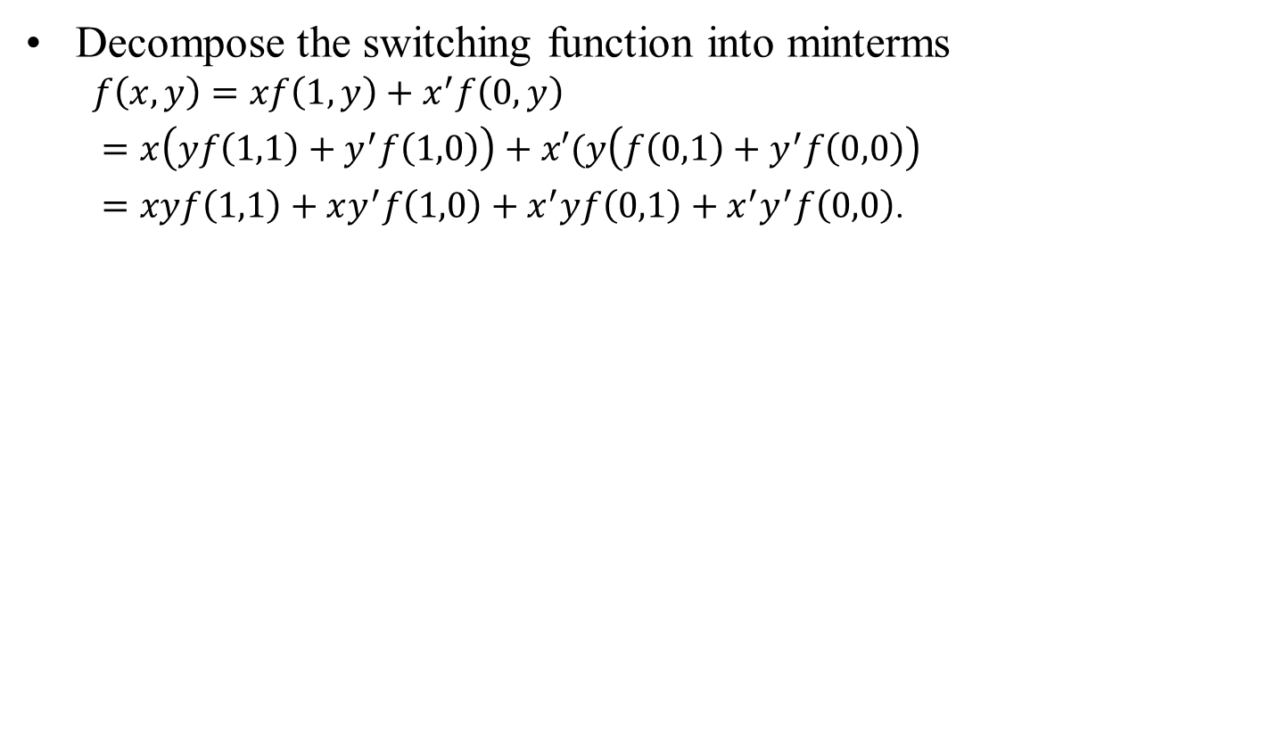
Shannon’s Expansion
Decompose the switching function into minterms
  $$f\left(x,y\right)=xf\left(1,y\right)+x^{′}f\left(0,y\right)$$
  $=x\left(yf\left(1,1\right)+y^{′}f\left(1,0\right)\right)+x′(y\left(f\left(0,1\right)+y^{′}f\left(0,0\right)\right)$
  $=xyf\left(1,1\right)+xy^{′}f\left(1,0\right)+x^{′}yf\left(0,1\right)+x^{′}y^{′}f\left(0,0\right)$.
id | x | y | f(x,y)
0 | 0 | 0 | f(0,0)
1 | 0 | 1 | f(0,1)
2 | 1 | 0 | f(1,0)
3 | 1 | 1 | f(1,1)
Shannon’s expansion can decompose a switching function into a truth table.

Slide 33
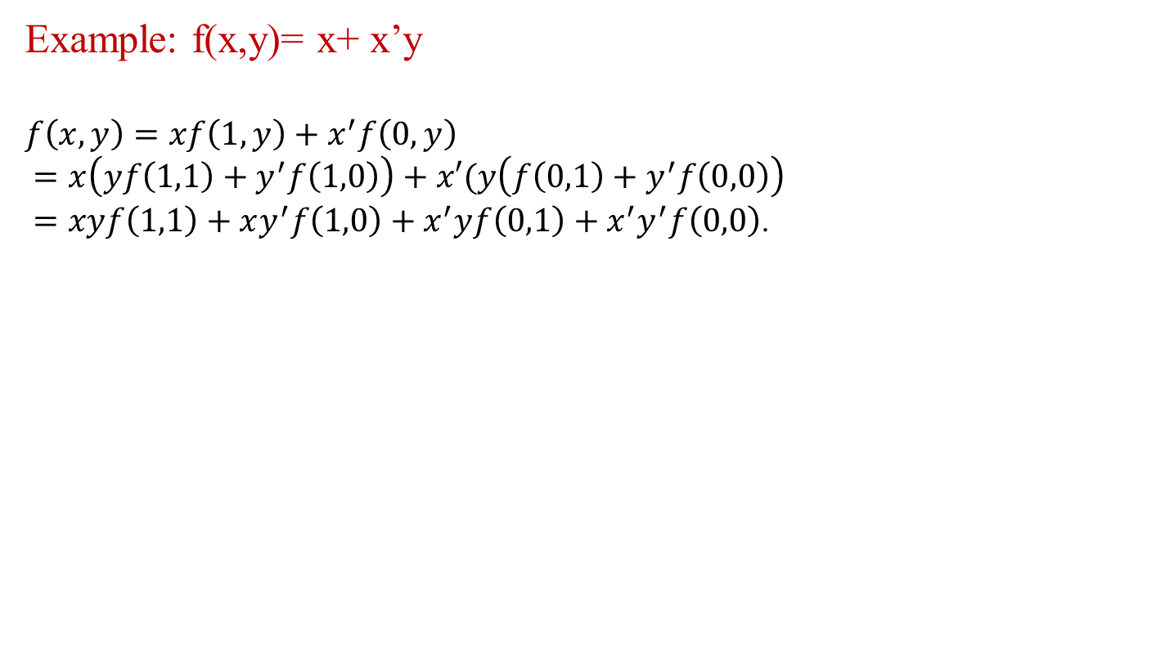
Shannon’s Expansion vs Truth Table
  Example: f(x,y)= x+ x’y
  $$f\left(x,y\right)=xf\left(1,y\right)+x^{′}f\left(0,y\right)$$
  $=x\left(yf\left(1,1\right)+y^{′}f\left(1,0\right)\right)+x′(y\left(f\left(0,1\right)+y^{′}f\left(0,0\right)\right)$
  $=xyf\left(1,1\right)+xy^{′}f\left(1,0\right)+x^{′}yf\left(0,1\right)+x^{′}y^{′}f\left(0,0\right)$.
id | x | y | f(x,y)
0 | 0 | 0 | f(0,0)
1 | 0 | 1 | f(0,1)
2 | 1 | 0 | f(1,0)
3 | 1 | 1 | f(1,1)
Shannon’s expansion can decompose a switching function into a truth table.

Slide 34
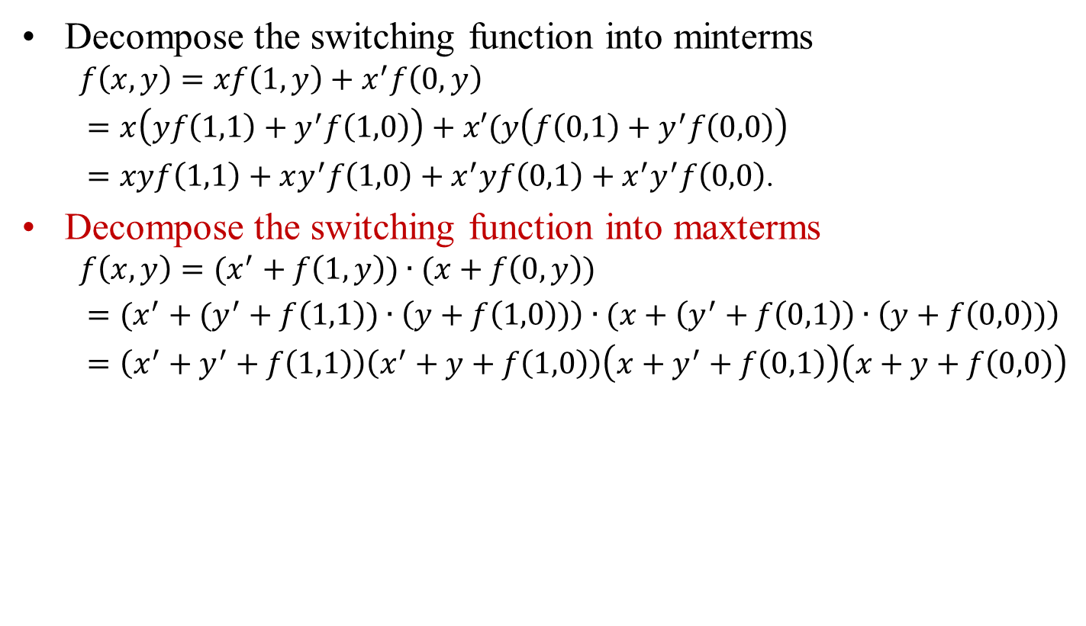
Shannon’s Expansion
Decompose the switching function into minterms
  $$f\left(x,y\right)=xf\left(1,y\right)+x^{′}f\left(0,y\right)$$
  $=x\left(yf\left(1,1\right)+y^{′}f\left(1,0\right)\right)+x′(y\left(f\left(0,1\right)+y^{′}f\left(0,0\right)\right)$
  $=xyf\left(1,1\right)+xy^{′}f\left(1,0\right)+x^{′}yf\left(0,1\right)+x^{′}y^{′}f\left(0,0\right)$.
Decompose the switching function into maxterms
  $$f\left(x,y\right)=(x^{′}+f\left(1,y\right))∙(x+f\left(0,y\right))$$
  $=(x^{′}+(y^{′}+f\left(1,1\right))∙\left(y+f\left(1,0\right))\right)∙(x+\left(y^{′}+f\left(0,1\right)\right)∙\left(y+f\left(0,0\right))\right)$
  $=\left(x^{′}+y^{′}+f\left(1,1\right)\right)\left(x^{′}+y+f\left(1,0\right)\right)\left(x+y^{′}+f\left(0,1\right)\right)\left(x+y+f\left(0,0\right)\right)$

Slide 35
Shannon’s Expansion: Example
Which variable in ab’+ac+bc can be used for expansion?
a
b
c
None of the above

Slide 36
Shannon’s Expansion: Example
F(A,B,C)=AB’+AC+BC

Slide 37
Remark: The choice of the variable for expansion is a nontrivial question.

Slide 38
Review Summary: Switching Algebra and Karnaugh Map
Shannon’s expansion and consensus theorem are used for logic optimization
Shannon’s expansion divides the problem into smaller functions
Consensus theorem finds common terms when we merge small functions
Karnaugh map mimics the above two operations in two dimensional space as a visual aid.

Slide 39
Part I. Combinational Logic
II) Specification
  1. Language
  2. Boolean Algebra
  Canonical Expression: Sum of minterms and
  Product of maxterms
  3. Truth Table: minterms and maxterms
  4. Incompletely Specified Function

Slide 40
Decimal Addition
II. Specification (use addition as an example)
5
+ 7
1 2
Carry Sum
Binary Addition
1 1 1
1 0 1
+ 1 1 1
Carry bits
5
7
12
1 1 0 0
Carryout Sums

Slide 41
Decimal Addition
II. Specification (use addition as an example)
Binary Addition

Slide 42
II. Specification (use addition as an example)
a
a
a
a
A B
A B
A B
A B
C_{out}
C_{in}
C_{out}
C_{in}
C_{out}
C_{in}
C_{out}
C_{in}
S
S
S
S

Slide 43
Binary Addition: Hardware
Half Adder: Two inputs (a,b) and two outputs (carry, sum).
Full Adder: Three inputs (a,b,c_{in}) and two outputs (carry, sum).

Slide 44
Half Adder
Truth Table
id | a | b | carry | sum
0 | 0 | 0 | 0 | 0
1 | 0 | 1 | 0 | 1
2 | 1 | 0 | 0 | 1
3 | 1 | 1 | 1 | 0
a
Sum
b
Carry

Slide 45
Switching Function
Switching Expressions:
Sum (a,b) = a’·b + a·b’
Carry (a, b) = a·b
Ex:
Sum (0,0) = 0’·0 + 0·0’ = 0 + 0 = 0
Sum (0,1) = 0’·1 + 0·1’ = 1 + 0 = 1
Sum (1,1) = 1’·1 + 1·1’ = 0 + 0 = 0
a
a
sum
carry
b
b

Slide 46
BSV notes
function Bit#(2) ha(Bit#(1) a, Bit#(1) b);
Bit#(1) s = (~a & b) | (a & ~b);
Bit#(1) c = a & b;
return {c,s};
endfunction
{c, s} represents bit concatenation

Slide 47
Full Adder
id | a | b | c_{in} | c_{out} | sum
0 | 0 | 0 | 0 | 0 | 0
1 | 0 | 0 | 1 | 0 | 1
2 | 0 | 1 | 0 | 0 | 1
3 | 0 | 1 | 1 | 1 | 0
4 | 1 | 0 | 0 | 0 | 1
5 | 1 | 0 | 1 | 1 | 0
6 | 1 | 1 | 0 | 1 | 0
7 | 1 | 1 | 1 | 1 | 1
cin
a
sum
b
c_{out}
Arithmetic:
2c_{out}+sum=a+b+c_{in}

Slide 48
Minterms
A product of all variables in the function.
A minterm is equal to 1 on exactly one row of the truth table.
id | a | b | c | carry | sum
0 | 0 | 0 | 0 | 0 | 0
1 | 0 | 0 | 1 | 0 | a’b’c
2 | 0 | 1 | 0 | 0 | a’bc’
3 | 0 | 1 | 1 | a’bc | 0
4 | 1 | 0 | 0 | 0 | ab’c’
5 | 1 | 0 | 1 | ab’c | 0
6 | 1 | 1 | 0 | abc’ | 0
7 | 1 | 1 | 1 | abc | abc

Slide 49
Maxterms
A sum of all variables in the function.
A maxterm is equal to 0 on exactly one row of the truth table.
id | a | b | c | carry | sum
0 | 0 | 0 | 0 | a+b+c | a+b+c
1 | 0 | 0 | 1 | a+b+c’ | 1
2 | 0 | 1 | 0 | a+b’+c | 1
3 | 0 | 1 | 1 | 1 | a+b’+c’
4 | 1 | 0 | 0 | a’+b+c | 1
5 | 1 | 0 | 1 | 1 | a’+b+c’
6 | 1 | 1 | 0 | 1 | a’+b’+c
7 | 1 | 1 | 1 | 1 | 1

Slide 50
Minterms and Maxterms
id | a | b | c | minterm | maxterm
0 | 0 | 0 | 0 | m₀=a’b’c’ | M₀=a+b+c
1 | 0 | 0 | 1 | m₁=a’b’c | M₁=a+b+c’
2 | 0 | 1 | 0 | m₂=a’bc’ | M₂=a+b’+c
3 | 0 | 1 | 1 | m₃=a’bc | M₃=a+b’+c’
4 | 1 | 0 | 0 | m₄=ab’c’ | M₄=a’+b+c
5 | 1 | 0 | 1 | m₅=ab’c | M₅=a’+b+c’
6 | 1 | 1 | 0 | m₆=abc’ | M₆=a’+b’+c
7 | 1 | 1 | 1 | m₇=abc | M₇=a’+b’+c’
Minterms cover all the outputs which are true (1).
Maxterms cover all the outputs which are false (0).

Slide 51
Minterms
f1(a,b,c) = a’bc + ab’c + abc’ + abc
a’bc = 1 iff (a,b,c,) = (0,1,1)
ab’c = 1 iff (a,b,c,) = (1,0,1)
abc’ = 1 iff (a,b,c,) = (1,1,0)
abc = 1 iff (a,b,c,) = (1,1,1)
f1(a,b,c) = 1 iff (a,b,c) = (0,1,1), (1,0,1), (1,1,0), or (1,1,1)
Ex: f1(1,0,1) = 1’01 + 10’1 + 101’ + 101 = 1
f1(1,0,0) = 1’00 + 10’0 + 100’ + 100 = 0

Slide 52
Maxterms
f2(a,b,c) = (a+b+c)(a+b+c’)(a+b’+c)(a’+b+c)
a + b + c = 0 iff (a,b,c,) = (0,0,0)
a + b + c’ = 0 iff (a,b,c,) = (0,0,1)
a + b’ + c = 0 iff (a,b,c,) = (0,1,0)
a’ + b + c = 0 iff (a,b,c,) = (1,0,0)
f2(a,b,c) = 0 iff (a,b,c) = (0,0,0), (0,0,1), (0,1,0), (1,0,0)
Ex: f2(1,0,1) = (1+0+1)(1+0+1’)(1+0’+1)(1’+0+1) = 1
f2(0,1,0) = (0+1+0)(0+1+0’)(0+1’+0)(0’+1+0) = 0

Slide 53
f1(a,b,c) = a’bc + ab’c + abc’ + abc
f2(a,b,c) = (a+b+c)(a+b+c’)(a+b’+c)(a’+b+c)
f1(a, b, c) = m₃ + m₅ + m₆ + m₇ = Σm(3,5,6,7)
f2(a, b, c) = M₀M₁M₂M₄ = ΠM(0, 1, 2, 4)
iClicker: Does f1 = f2?
Yes
No.

Slide 54
The coverage of a single minterm. e.g. m₄ = ab’c’
Id a b c_{in} carry minterm ₄ = ab’c’
0 0 0 0 0 0
1 0 0 1 0 0
2 0 1 0 0 0
3 0 1 1 1 0
4 1 0 0 0 1
5 1 0 1 1 0
6 1 1 0 1 0
7 1 1 1 1 0
Only one row has a 1.

Slide 55
The coverage of a single maxterm. E.g. M₄ = a’+b+c
Id a b c_{in} carry maxterm 4 = a+b+c
0 0 0 0 0 1
1 0 0 1 0 1
2 0 1 0 0 1
3 0 1 1 1 1
4 1 0 0 0 0
5 1 0 1 1 1
6 1 1 0 1 1
7 1 1 1 1 1
Only one row has a 0.

Slide 56
Minterms and Maxterms: Summary
f1(a,b,c) = a’bc + ab’c + abc’ + abc
f2(a,b,c) = (a+b+c)(a+b+c’)(a+b’+c)(a’+b+c)
Canonical presentation of logic functions
Conversion between truth tables and switching functions

Slide 57
Incompletely Specified Function
Don’t care set is important because it allows us to
minimize the function
Id a b f (a, b)
0 0 0 1
1 0 1 0
2 1 0 1
3 1 1 -
The input does not happen.
The input happens, but the output is ignored.
Examples:
Decimal number 0… 9 uses 4 bits. (1,1,1,1) does not happen.
Final carry out bit (output is ignored).

Slide 58
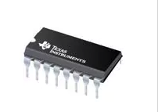
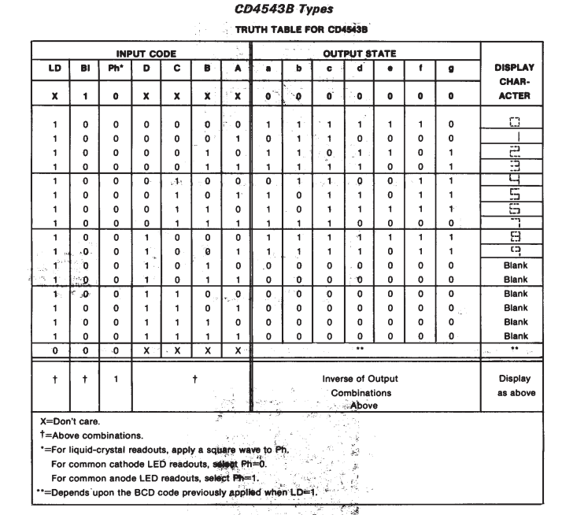
Incomplete Specification - Inputs
Seven Segment Display Driver – CD4543B
D, C, B, A only matter when LD, BI’, PH’
http://www.ti.com/lit/ds/symlink/cd4543b.pdf
http://www.circuitstoday.com/7-segment-display-to-avr-atmega32-using-cd4511b

Slide 59
Incompletely Specified Function
id | a | b | c | g
0 | 0 | 0 | 0 | 0
1 | 0 | 0 | 1 | 1
2 | 0 | 1 | 0 | -
3 | 0 | 1 | 1 | 1
4 | 1 | 0 | 0 | 1
5 | 1 | 0 | 1 | -
6 | 1 | 1 | 0 | 0
7 | 1 | 1 | 1 | 1
g1(a,b,c)=a’b’c+a’bc+ab’c’+abc
=m₁+m₃+m₄+m₇
=∑ m(1,3,4,7)
g₂(a,b,c)=(a+b+c)(a’+b’+c)
=M₀M₆
=∏M(0,6)

Slide 60
Incompletely Specified Function
id | a | b | c | g
0 | 0 | 0 | 0 | 0
1 | 0 | 0 | 1 | 1
2 | 0 | 1 | 0 | -
3 | 0 | 1 | 1 | 1
4 | 1 | 0 | 0 | 1
5 | 1 | 0 | 1 | -
6 | 1 | 1 | 0 | 0
7 | 1 | 1 | 1 | 1
g1(a,b,c)=∑ m(1,3,4,7)
g₂(a,b,c)=∏M(0,6)
iClicker: Does g1(a,b,c) = g2(a,b,c)?
A: Yes
B: No

