Slide 1
Lecture 1:
Introduction to Digital Logic Design
CSE 140: Components and Design Techniques for Digital Systems
Spring 2019
CK Cheng
Dept. of Computer Science and Engineering
University of California, San Diego
Notes:
Digital: 0, 1 or False, True or GND, Vdd
Logic: Reasoning
Design: Theory + Implementation

Slide 2
Outlines
Class Schedule and Enrollment
Staff
  Instructor, TAs, Tutors
Logistics
  Websites, Textbooks, Grading Policy
Motivation
  Moore’s Law, Internet of Things, Quantum Computing
Scope
  Position among courses
  Coverage

Slide 3
Class Schedule and Enrollment
CSE140 A (enrollment 175, waitlist 19)
  Lecture: TR 5-620PM, PCYNH 106
  Discussion: F 11-1150AM, PCYNH 106
  Final: S 1130AM-130PM, 6/8/2019
CSE140 B (enrollment 180, waitlist 9)
  Lecture: TR 2-320PM PCYNH 109
  Discussion: F 8-850PM, PCYNH 109
  Final: S 1130AM-130PM, 6/8/2019
Waitlist: I welcome all students but have no control of the enrollment
No discussion session on Friday 4/5/2019

Slide 4
Information about the Instructor
Instructor: CK Cheng
Education: Ph.D. in EECS UC Berkeley
Industrial Experiences: Engineer of AMD, Mentor Graphics, Bellcore; Consultant for technology companies
Email: ckcheng+140@ucsd.edu
Office: Room 2130 CSE Building
Office hours are posted on the course website
  12-1PM Monday; 10-1050AM Thursday
Websites
  http://cseweb.ucsd.edu/~kuan
  http://cseweb.ucsd.edu/classes/sp19/cse140-a

Slide 5
Information about TAs and Tutors
TAs
Wang, Ariel Xinyuan email:xiw193@ucsd.edu
Hsu, Po-Ya email:p8hsu@ucsd.edu
Assare, Omid email:omid@ucsd.edu
Tutors
Lin, Xiaokang, xil671@ucsd.edu
Liu, Hanshuang hal286@ucsd.edu
Luo, Weisi wel205@ucsd.edu
Nichols, Andrew ainichol@ucsd.edu
Ren, Alissa, alren@ucsd.edu
Zhang, Shirley, shz199@ucsd.edu
Zhu, Zhuowen, zhz402@ucsd.edu
Office hours will be posted on the course website
Notes:
Office hours and paper correction

Slide 6
Logistics: Sites for the Class
Class website
  http://cseweb.ucsd.edu/classes/sp19/cse140-a/index.html
  Index: Staff Contacts and Office Hrs
  Syllabus
    Grading policy
    Class notes
    Assignment: Homework and zyBook Activities
    Exercises: Solutions and Rubrics
Forum (Piazza): Online Discussion *make sure you have access
Score keepers: Gradescope, TritonEd
zyBook: UCSDCSE140ChengSpring2019
Notes:
Joint website

Slide 7
Logistics: Textbooks
Required text:
Online Textbook: Digital Design by F. Vahid
  Sign in or create an account at learn.zybooks.com
  Enter zyBook code UCSDCSE140ChengSpring2019
  Fill email address with domain @ucsd.edu
  Fill section A or B
  Click Subscribe $50
  Reference texts (recommended and reserved in library)
Digital Design, F. Vahid, 2010 (2nd Edition).
Digital Design and Computer Architecture, D.M. Harris and S.L. Harris, Morgan Kaufmann, 2015 (ARM Edition).
Digital Systems and Hardware/Firmware Algorithms, Milos D. Ercegovac and Tomas Lang.

Slide 8
Lecture: iCliker for Peer Instruction
I will pose questions. You will
  Solo vote: Think for yourself and select answer
  Discuss: Analyze problem in teams of three
    Practice analyzing, talking about challenging concepts
    Reach consensus
  Class wide discussion:
    Led by YOU (students) – tell us what you talked about in discussion that everyone should know.
Many questions are open, i.e. no exact solutions.
  Emphasis is on reasoning and team discussion
  No solution will be posted

Slide 9
Logistics: Grading
Grade on style, completeness and correctness
zyBook exercises: 10% (due Tuesday 2:00PM)
iClicker: 0%
Homework: 15% (grade based on a subset of problems)
Midterm 1: 25% (T 4/23/19)
Midterm 2: 25% (T 5/14/19)
Final: 25% (1130AM-130PM, Saturday 6/8/19)
Grading: The best of the following
  The threshold: A- >90% ; B- >80% of 100% score
  The curve: (A+,A,A-) top 33±ε% of class; (B+,B,B-) second 33±ε%
  The bottom: C- above 45% of 100% score.

Slide 10
Logistic: grading components
zyBook: Interactive learning experience
  No excuse for delay (constrained by ZyBooks system)
iClicker:
  Clarification of the concepts and team discussion
  Homework:
    Paper Work
    Group discussion is encouraged. However, we are required to write individually.
  Discount 10% loss of credit for each day after the deadline but no credit after the solution is posted.
  Metric: Posted solutions and rubrics, but not grading results

Slide 11
Logistic: Midterms and Final
Midterms: (Another) Indication of how well we have absorbed the material
  Samples will be posted for more practices.
  Solution and grading policy will be posted after the exam.
  Midterm 2 is not cumulative but requires a good command of the Midterm 1 content.
Final:
  Two hours exam.
  Samples will be posted for more practices.
  Final is not cumulative but requires a good command of the whole class.

Slide 12
Logistic: Class Expectation
Level 1: Definitions (zyBook)
  Basic concepts
  Motivation
Level 2: Concepts and Methods (Lecture and slides)
  Key ideas
Level 3: Hands on Practices (Homeworks)
  Exercises
Level 4: Command of Materials (Samples of exams)
  Review

Slide 13
Course Problems…Cheating
What is cheating?
  Studying together in groups is not cheating but encouraged
  Turned-in work must be completely your own.
  Copying someone else’s solution on a HW or Exam is cheating
  Both “giver” and “receiver” are equally culpable
We will be better off to work on the problem alone during the exam.
We have to address the issue once the cheating is reported by someone (e.g. TA, Tutor, Student, etc.).

Slide 14
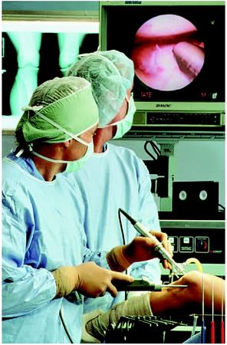

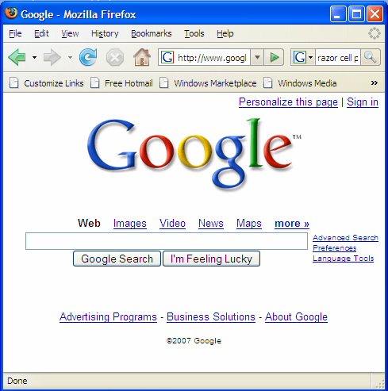
Motivation
Microelectronic technologies have revolutionized our world: cell phones, internet, rapid advances in medicine, etc.
The semiconductor industry has grown from $21 billions in 1985, $335 billions in 2015, to $478 billions in 2018.

Slide 15

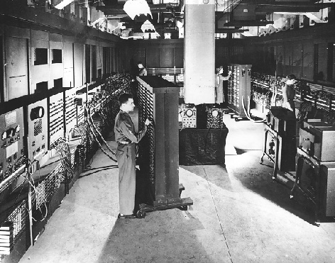
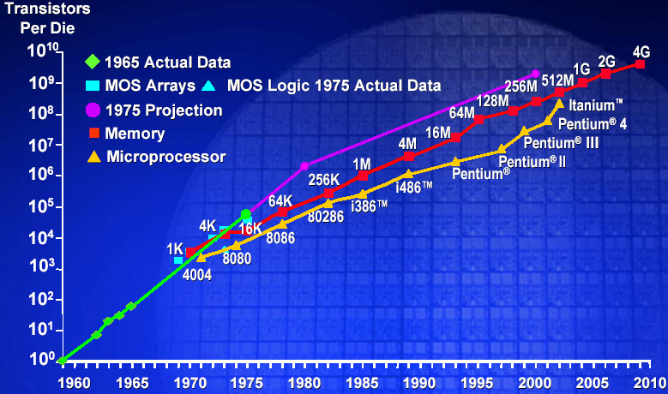
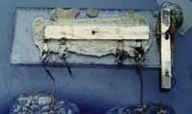
The Digital Revolution
Integrated Circuit: Many digital operations on the same material
Vacuum tubes
Exponential Growth of Computation
(1.6 x 11.1 mm)
ENIAC
Integrated Circuit
Moore’s Law
Stored Program
Model
WWII
1949
1965
Notes:
The stored program model computers and the invention of the transistor and the integrated circuit generated an exponential growth in computing devices and computers – why?
Von neumann architecture – put both data and instructions on the same electronic medium – memory. The whole machine could be constructed from digital logic/circuits.
Digital logic was in turn constructed using electronic circuits – different discrete components vacuum tubes (switches), capacitors, resistors.
But the way digital circuits were constructed underwent a revolution once the transistor came along. The transistor replaced the vacuum tube (both are switches) – given a control signal they either let current pass through them (logic 1) or stop current (logic 0). Discrete circuits were replaced by integrated circuits (everything made from the same silicon material).
The whole computer shrank.

Slide 16
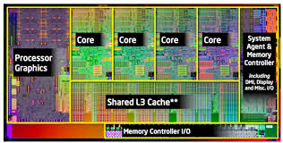
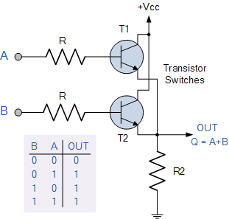
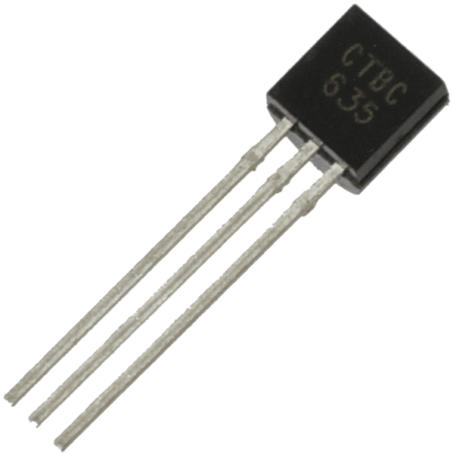
Building complex circuits
Transistor

Slide 17
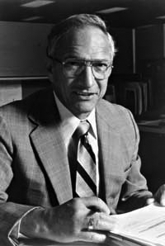
Robert Noyce, 1927 - 1990
Nicknamed “Mayor of Silicon Valley”
Cofounded Fairchild Semiconductor in 1957
Cofounded Intel in 1968
Co-invented the integrated circuit

Slide 18
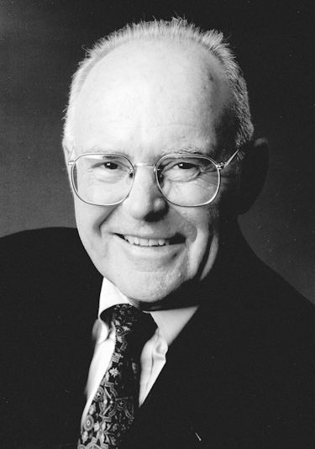
Gordon Moore
Cofounded Intel in 1968 with Robert Noyce.
Moore’s Law: the number of transistors on a computer chip doubles every 1.5 years (observed in 1965)

Slide 19
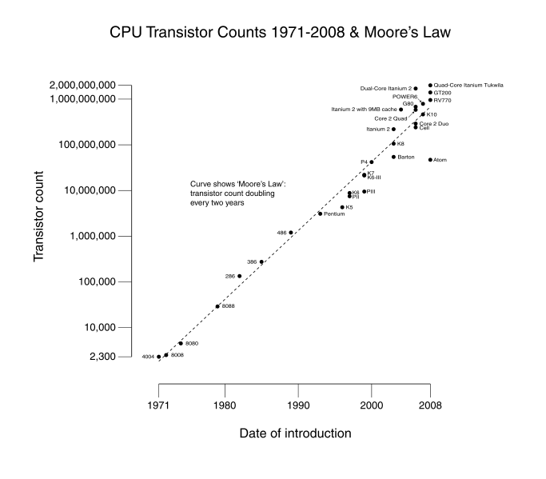
Technology Trends: Moore’s Law
Since 1975, transistor counts have doubled every two years.
Moore’s law: wider applications: larger market: higher revenue: more R&D

Slide 20
New Technologies
New materials and fabrication for devices
  Low power devices
  Three dimensional integrated circuits
  Graphene
New architecture
  Machine learning, deep learning
Quantum computing
Understand the principles to explore the future

Slide 21
Artificial Intelligence
Logic and Reasoning
Boolean Satisfiability
  Product of sum clauses
  Diagnosis
States and Sequences
  Sequential Machines
  Reachability
  Controllability
One example of the applications and opportunities

Slide 22
Scope
The purpose of this course is that we:
Learn the principles of digital design
Learn to systematically debug increasingly complex designs
Design and build digital systems
Learn what’s under the hood of an electronic component
Prepare for the future technology revolution

Slide 23
Position among CSE Courses
Algos: CSE 100, 101
Application (ex: browser)
CSE 131
CSE 120
Operating
Compiler
System
(Mac OSX)
Software
Assembler
Instruction Set
Architecture
Architecture
Processor
Memory
I/O system
CSE 141
Datapath & Control
CSE 140
Digital Design
Circuit Design
Transistors
Big idea: Coordination of many levels of abstraction
Dan Garcia®

Slide 24
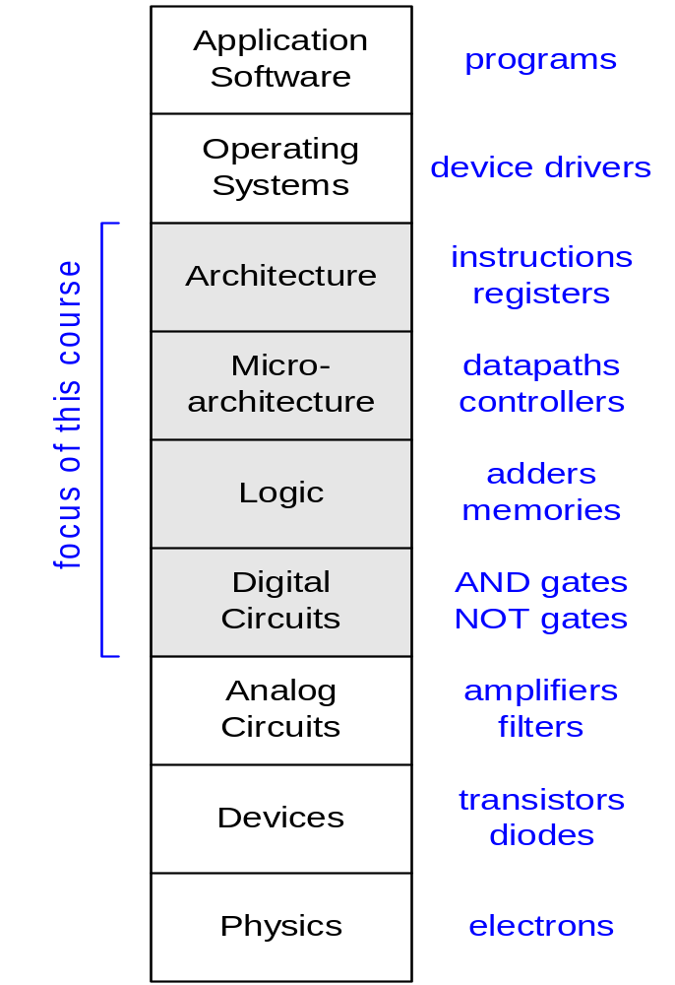
Principle of Abstraction
CSE 30
CSE 141
CSE 140
Abstraction: Hiding details when they are not important

Slide 25
Combinational Logic vs Sequential Network
x₁
.
.
.
x_{n}
x₁
.
.
.
x_{n}
x₁
.
.
.
x_{n}
f_{i}(x)
f_{i}(x,s)
f_{i}(x)
f_{i}(x)
f_{i}(x)
s_{i}
CLK
Sequential Networks
1. Memory
2. Time Steps (Clock)
Combinational logic:
y_{i} = f_{i}(x₁,..,x_{n})
y_{i}^{t} = f_{i} (x₁^{t},…,x_{n}^{t}, s₁^{t}, …,s_{m}^{t})
s_{i}^{t+1} = g_{i}(x₁^{t},…,x_{n}^{t}, s₁^{t},…,s_{m}^{t})

Slide 26
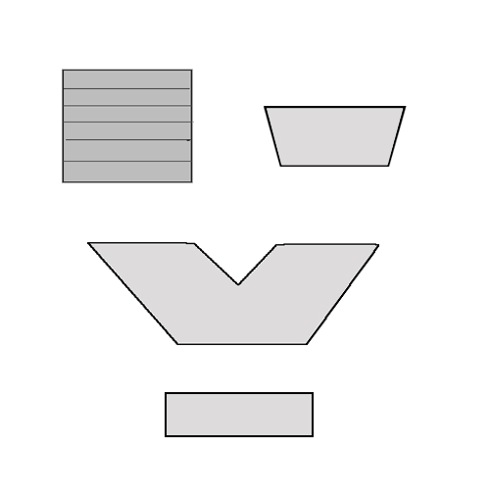
Scope: Overall Picture of CS140
Data Path Subsystem
Input
Control Subsystem
Memory File
Conditions
Pointer
Select
Sequential machine
Mux
ALU
Control
Memory Register
CLK: Synchronizing Clock
Conditions
BSV: Design specification and modular design methodology

Slide 27
Scope
Subjects | Building Blocks | Theory
Combinational Logic | AND, OR, NOT, XOR | Boolean Algebra
Sequential Network | AND, OR, NOT, FF | Finite State Machine
Standard Modules | Operators, Interconnects, Memory | Arithmetics, Universal Logic
System Design | Data Paths, Control Paths | Methodologies
Notes:
Coverage of Midterm 1, Midterm 2, and Final

Slide 28
Combinational Logic
Basics

Slide 29
What is a combinational circuit?
No memory
Realizes one or more functions
Inputs and outputs can only have two discrete values
  Physical domain (usually, voltages) (Ground 0V, Vdd 1V)
  Mathematical domain : Boolean variables (True, False)
Differentiate between different representations:
  physical circuit
  schematic diagram
  mathematical expressions

Slide 30
Binary Digital Logic
Simplest representation is “1” and “0” (base-2).
Choose a physical quantity to represent “1” and “0”
  Usually voltage, but not always (e.g. current, resistance, magnetic polarization, quantum spin, …)
Use a transistor to make the switch (operating as a digital instead of analog device)
  Two states – on / off
  Signals can be high voltage (“1”) or low voltage (“0”)

Slide 31
Basic CMOS
”on” when gate is high
NMOS
PMOS
”on” when gate is low
d
s
g
g
s
d
https://en.wikipedia.org/wiki/CMOS#/media/File:Cmos_impurity_profile.PNG
Complementary Metal Oxide Semiconductor
Invented in the 1960’s, but took over in the 80’s
“on” means low resistance, ”off” means high resistance
Logic “1” and Logic “0” values are arbitrary
  e.g. logic “1” == 1.0 V, logic “0” == 0.0 V
Planar technology
FINFET technology
By Irene Ringworm, CC BY-SA 3.0, https://commons.wikimedia.org/w/index.php?curid=3833512

Slide 32
Transistors as Switches

Slide 33

The most basic CMOS gate - inverter
When “inp” is “1”, then the nmos is on and the pmos is off – output will be ?
When “inp” is “0”, then the nmos is off and the pmos is on – output will be ?
Truth Table
Schematic
Equation
in | out
0 | 1
1 | 0
inp
out
inp
out
out = in’
out =in

Slide 34
Basic Gates – (N)AND gate
AND Y = A & B Y = AB
A | B | Y
0 | 0 | 0
0 | 1 | 0
1 | 0 | 0
1 | 1 | 1
A
B
Y
NAND Y = (A & B)’ Y = (AB)’
What kind of gate is this?
AND
NAND
Inverter
None of the above
A | B | Y
0 | 0 | 1
0 | 1 | 1
1 | 0 | 1
1 | 1 | 0
Bubble means Invert

Slide 35
Basic Gates – (N)OR gate
OR Y = A + B Y = A | B
A | B | Y
0 | 0 | 0
0 | 1 | 1
1 | 0 | 1
1 | 1 | 1
A
NOR Y = (A + B)’ Y = (A | B)’
Y
A | B | Y
0 | 0 | 1
0 | 1 | 0
1 | 0 | 0
1 | 1 | 0
B
A
Bubble means Invert
NOR is universal gate
Y
B

Slide 36
Boolean Algebra
A branch of algebra in which the values of the variables belong to a set B (e.g. {0, 1}), has two operations {+, .} that satisfy the following four sets of laws.
Associative laws: (a+b)+c= a+(b+c), (a·b)·c =a·(b·c)
Commutative laws: a+b=b+a, a·b=b·a
Distributive laws: a+(b·c)=(a+b)·(a+c),
a·(b+c)=a·b+a·c
Identity laws: a+0=a, a·1=a
Complement laws: a+a’=1, a·a’=0
(x’: the complement element of x)

Slide 37
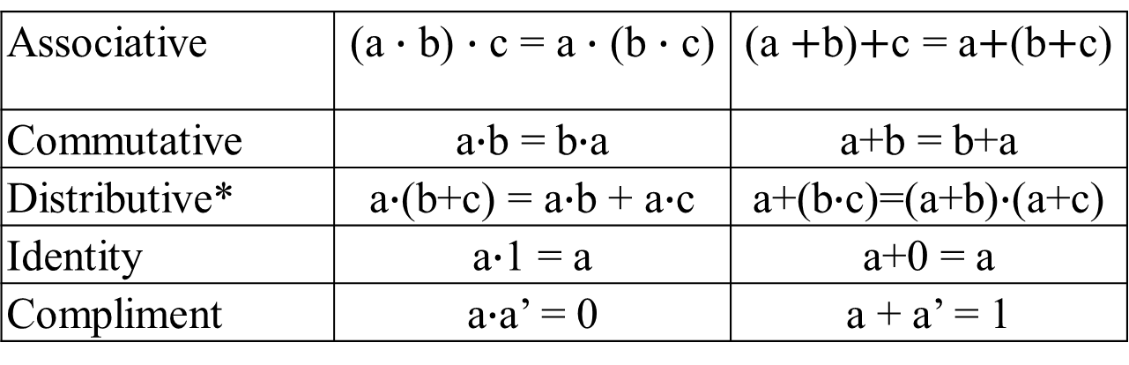
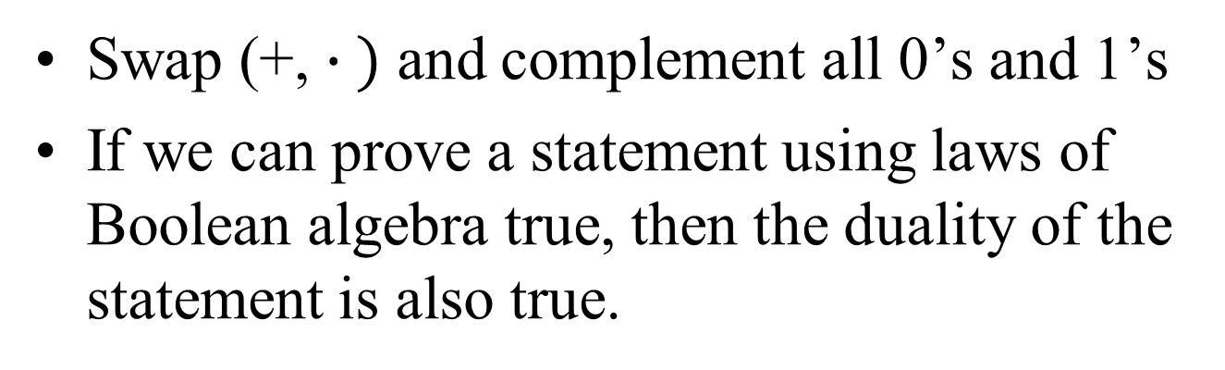
Duality
Swap (+, $∙ )$ and complement all 0’s and 1’s
If we can prove a statement using laws of Boolean algebra true, then the duality of the statement is also true.
Laws and their duals
Associative | (a $∙$ b) $∙$ c = a $∙$ (b $∙$ c) | (a $+$b)$+$c = a$+$(b$+$c)
Commutative | a$∙$b = b$∙$a | a+b = b+a
Distributive* | a$∙$(b+c) = a$∙$b + a$∙$c | a+(b$∙$c)=(a+b)$∙$(a+c)
Identity | a$∙$1 = a | a+0 = a
Compliment | a$∙$a’ = 0 | a + a’ = 1

Slide 38
Representations of combinational circuits:
The Schematic
A
Y
B
What is the simplest combinational circuit that you know?

Slide 39
Representations of combinational circuits
Truth Table: Enumeration of all combinations
Example: AND
id | A | B | Y
0 | 0 | 0 | 0
1 | 0 | 1 | 0
2 | 1 | 0 | 0
3 | 1 | 1 | 1
A
Y=AB
B

Slide 40
Boolean Algebra
Similar to regular algebra but defined on sets with only three basic ‘logic’ operations:
  Intersection: AND (2-input); Operator: ∙ ,&
  Union: OR (2-input); Operator: + ,|
  Complement: NOT ( 1-input); Operator: ‘ ,!
“&, |, !” Symbols in BSV

Slide 41
Some Def’s
Complement : variable with a “BAR” over it or ‘ after it
  A’
Literal : variable or its complement
Implicant: product of literals
  ABC
Implicate: sum of literals
  (A+B+C)
Minterm, maxterm (implicant or implicate that includes all the inputs)
  F(A,B,C,D): ABCD, (A+B+C+D)

Slide 42
Boolean algebra and switching functions
Two-input AND ( ∙ )
Two-input OR (+ )
One-input NOT (Complement, ’ )
AND
OR
A B Y
0 0 0
0 1 0
1 0 0
1 1 1
A B Y
0 0 0
0 1 1
1 0 1
1 1 1
NOT
A Y
0 1
1 0
A
1
A
1
A
1
A
0
A
0
0
A
For an AND gate,
0 at input blocks the other inputs and dominates the output
1 at input passes signal A
For an OR gate,
1 at input blocks the other inputs and dominates the output
0 at input passes signal A

Slide 43
Boolean Algebra
iClicker Q: For two Boolean variables X and Y with X=1, Y=0, what is function F(X,Y)=X+Y?
F(X,Y)=0
F(X,Y)=1
F(X,Y)=2

Slide 44
Boolean Algebra
iClicker Q: For two Boolean variables X and Y with X=1, Y=0, what is function F(X,Y)=X+X+Y?
F(X,Y)=0
F(X,Y)=1
F(X,Y)=2

Slide 45
Boolean Algebra
iClicker Q: For two Boolean variables X and Y with X=1, Y=0, what is function F(X,Y)=X+XY?
F(X,Y)=0
F(X,Y)=1
F(X,Y)=2

Slide 46
Boolean Algebra
iClicker Q: For two Boolean variables X and Y with X=1, Y=0, what is function F(X,Y)=(X+Y)Y?
F(X,Y)=0
F(X,Y)=1
F(X,Y)=2

Slide 47
So, what is the point of representing gates as symbols and Boolean expressions?
Given the Boolean expression, we can draw the circuit it represents by cascading gates (and vice versa)
a
b
ab
ab + cd
c
d
y=e (ab+cd)
cd
e
Logic circuit vs. Boolean Algebra Expression
Simplify the Boolean expression: Reduce the complexity of the circuit

Slide 48
Switching Expression and Logic Diagrams
Switching Expression –
  Equations - # literals, # variables, # operators
    Literal is a variable or its complement (e.g. a, a’)
    Variables (e.g. x)
    Operator (e.g. +, ·)
  Schematic / Logic Diagram - # of gates, # nets (wires), # of pins
    Gate (and, or, etc) – can be more than 2 inputs (e.g. 3 input AND gate)
    Net – wire that connects gates
    Pin - input or output of a gate.

Slide 49
Laws and Logic Diagrams
Associativity Laws
(A+B) + C = A + (B+C)
(AB)C = A(BC)
C
A
A
B
B
C
C
A
A
B
B
C
Notes:
Logic is the same, but timing may be different.
Which one would be choose of (AB)C or A(BC) if A arrives later than B and C signals.

Slide 50
Laws and Logic Diagrams
Distributive Laws
A ∙(B+C) = A ∙ B + A ∙ C
A+B ∙ C = (A+B) ∙(A+C)
A
B
A
B
C
A
C
A
B
A
B
C
A
C
Notes:
Draw / Count
# literals, # operators
# pins.
Show #pins = # literals + #gates * 2– 1.
Each literal has 1 pin, each gate has 1 pin – out connected to 1 pin in (except for primary output) so times 2 pins.
Except output which has only one pin.

Slide 51
Switching Expression and Logic
a
b
a·b
a·b + c·d
c
d
y=e·(a·b+c·d)
c·d
e
Schematic Diagram:
5 primary inputs
1 primary output
4 components (gates)
9 signal nets
12 pins
Boolean Algebra:
5 variables
1 expression
4 operators
5 literals

Slide 52
Switching Expression and Logic
a
b
a·b
Cost: #gates, #nets, #pins
a·b + b’·c
b’
c
y= d’ ·e ·(a·b+b’·c)
b’·c
d’
e
Schematic Diagram:
6 primary inputs
1 primary output
4 gates (3 ANDs, 1 OR)
10 signal nets
11 pins
Nets are wires, Gates ->transistors
Switching Expression:
5 variables
1 expression
4 operators (3 ANDs, 1 OR)
6 literals
Notes:
Show how to count # nets
Show eq for pins
# of literals + 2*# of gates -1 (each gate has an output + one input except for output gate)

Slide 53
Example: f(a, b, c) = ab + a’c + a’b’
# variables
# literals
# gates
Notes:
Draw circuit.
Count # literals = 6
Count # variables = 3
Count # gates = 4 gates
Count # pins = 13 pins
Count # nets = 10
Count # operators (gates) = 4

Slide 54
Which statement is not true in general?
a
b
a·b
Schematic Diagram:
5 primary inputs
4 components (gates)
9 signal nets
12 pins
a·b + c·d
c
d
y=e·(a·b+c·d)
c·d
e
Boolean Algebra: y=e·(a·b+c·d)
5 literals
4 operators
#primary inputs = # literals
#gates = # operators
#nets = #variables + # operators
#pins = # literals + 2 * #operators -1
All of them
Based on CK Cheng – CSE140 Spr18
Notes:
# nets = # variables + # operators - for example, replace e with d’ - reduced # of variables, but # of nets is the same.
# nets = # literals + # operators
Discuss D and why it is true :
Every gate has an output which goes to an input (2 pins) except the last gate
All primary inputs (literals) to to a pin.

Slide 55
Logic Diagram/Schematics
https://commons.wikimedia.org/wiki/File:74181aluschematic.png
Logic circuit vs. Boolean Algebra Expression
Simplify the Boolean expression: Reduce the complexity of the circuit

Slide 56
Next class
Designing Combinational circuits

