Slide 1
CS 140 Lecture 14
Standard Combinational Modules
Professor CK Cheng
CSE Dept.
UC San Diego
Some slides from Harris and Harris

Slide 2
Part III. Standard Modules
Interconnect
Operators. Adders Multiplier
Adders 1. Representation of numbers
  2. Full Adder
  3. Half Adder
  4. Ripple-Carry Adder
  5. Carry Look Ahead Adder
  6. Prefix Adder
  7. Carry Save Adder
  ALU
  Multiplier
  Division

Slide 3
Operators
Specification: Data Representations
Arithmetic: Algorithms
Logic: Synthesis
Layout: Placement and Routing

Slide 4
1. Representation
2’s Complement
-x: 2^{n}-x
1’s Complement
-x: 2^{n}-x-1

Slide 5
1. Representation
Id | 2’s comp. | 1’s comp.
0 | 0 | 15
-1 | 15 | 14
-2 | 14 | 13
-3 | 13 | 12
-4 | 12 | 11
-5 | 11 | 10
-6 | 10 | 9
-7 | 9 | 8
-8 | 8
2’s Complement
-x: 2^{n}-x
e.g. 16-x
1’s Complement
-x: 2^{n}-x-1
e.g. 16-x-1

Slide 6
1. Representation
Id | -Binary | sign mag | 2’s comp | 1’s comp
0 | 0000 | 1000 | 0000 | 1111
-1 | 0001 | 1001 | 1111 | 1110
-2 | 0010 | 1010 | 1110 | 1101
-3 | 0011 | 1011 | 1101 | 1100
-4 | 0100 | 1100 | 1100 | 1011
-5 | 0101 | 1101 | 1011 | 1010
-6 | 0110 | 1110 | 1010 | 1001
-7 | 0111 | 1111 | 1001 | 1000
-8 |  |  | 1000

Slide 7
Representation
1’s Complement
For a negative number, we take the positive number and complement every bit.
2’s Complement
For a negative number, we do 1s complement and plus one.
(b_{n-1}, b_{n-2}, …, b₀): -b_{n-1}2^{n-1}+ sum_{i<n-1} b_{i}2^{i}
(weight in arithmetic)

Slide 8
Representation
2’s Complement
x+y
x-y: x+2^{n}-y= 2^{n}+x-y
-x+y: 2^{n}-x+y
-x-y: 2^{n}-x+2^{n}-y
= 2^{n}+2^{n}-x-y
-(-x)=2^{n}-(2^{n}-x)=x
1’s Complement
x+y
x-y: x+2^{n}-y-1= 2^{n}-1+x-y
-x+y: 2^{n}-x-1+y=2^{n}-1-x+y
-x-y: 2^{n}-x-1+2^{n}-y-1
= 2^{n}-1+2^{n}-x-y-1
-(-x)=2^{n}-(2^{n}-x-1) -1=x

Slide 9
Examples
2 + 3 = 5
0 0 1 0
0 0 1 0
+ 0 0 1 1
0 1 0 1
2 - 3 = -1 (2’s)
0 0 0 0
0 0 1 0
+ 1 1 0 1
1 1 1 1
2 - 3 = -1 (1’s)
0 0 1 0
+ 1 1 0 0
1 1 1 0
Check for overflow (2’s)
-2 - 3 = -5 (2’s)
1 1 0 0
1 1 1 0
+ 1 1 0 1
1 0 1 1
-2 - 3 = -5 (1’s)
1 1 0 0
1 1 0 1
+ 1 1 0 0
1 0 0 1
1
1 0 1 0
3 + 5 = 8
0 1 1 1
0 0 1 1
+ 0 1 0 1
1 0 0 0
C4C3
-3 + -5 = -8
1 1 1 1
1 1 0 1
+ 1 0 1 1
1 0 0 0
C4C3

Slide 10
Addition: 2’s Complement Overflow
In 2’s complement:
overflow = c_{n} xor c_{n-1}
Exercise:
Demonstrate the overflow with more examples.
Prove the condition.

Slide 11
Addition and Subtraction using 2’s Complement
a
b
b’
C4
overflow
MUX
minus
C3
Adder
C_{in}
C_{out}
Sum

Slide 12
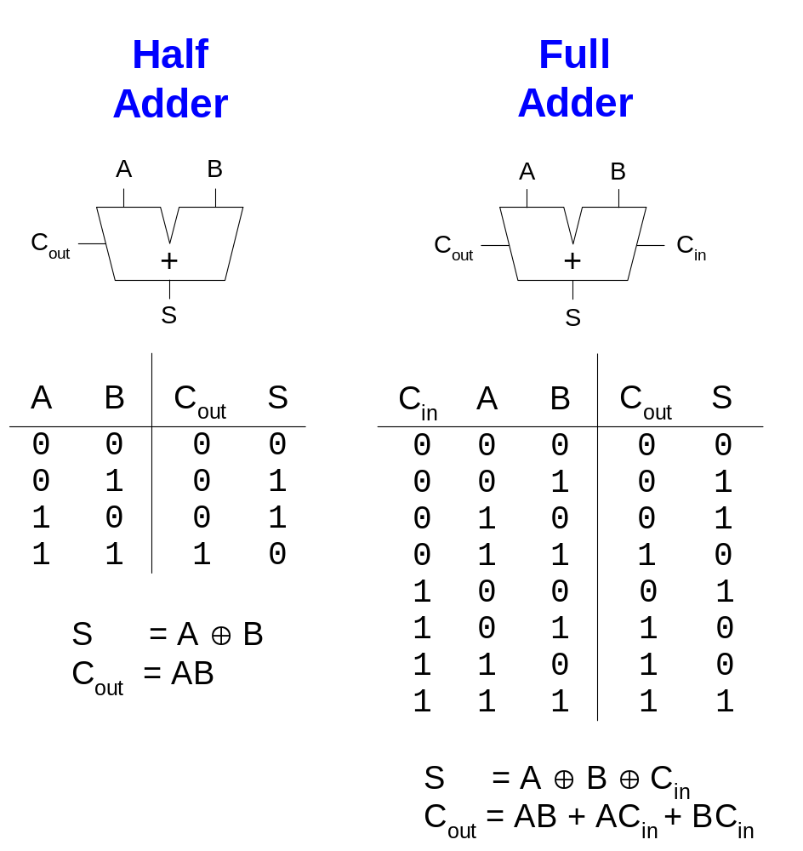
1-Bit Adders

Slide 13
Half Adder
a b
S_{um} = ab’ + a’b = a + b
C_{out} = ab
HA
Cout
S_{um}
a
b
C_{out}
a b C_{out} S_{um}
0 0 0 0
0 1 0 1
1 0 0 1
1 1 1 0
S_{um}

Slide 14
Full Adder Composed of Half Adders
a
HA
x
c_{out}
c_{out}
OR
b
sum
z
y
HA
c_{out}
c_{in}
sum
sum

Slide 15
Full Adder Composed of Half Adders
a
c_{out}
HA
x
c_{out}
b
sum
y
z
c_{out}
c_{in}
HA
sum
sum
Id | a | b | c_{in} | x | y | z | c_{out} | s_{um}
0 | 0 | 0 | 0 | 0 | 0 | 0 | 0 | 0
1 | 0 | 0 | 1 | 0 | 0 | 0 | 0 | 1
2 | 0 | 1 | 0 | 0 | 1 | 0 | 0 | 1
3 | 0 | 1 | 1 | 0 | 1 | 1 | 1 | 0
4 | 1 | 0 | 0 | 0 | 1 | 0 | 0 | 1
5 | 1 | 0 | 1 | 0 | 1 | 1 | 1 | 0
6 | 1 | 1 | 0 | 1 | 0 | 0 | 1 | 0
7 | 1 | 1 | 1 | 1 | 0 | 0 | 1 | 1
Id | x | z | c_{out}
0 | 0 | 0 | 0
1 | 0 | 1 | 1
2 | 1 | 0 | 1
3 | 1 | 1 | -

Slide 16
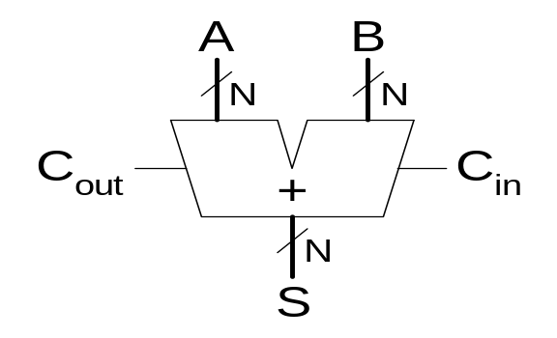
Adder
Several types of carry propagate adders (CPAs) are:
  Ripple-carry adders (slow)
  Carry-lookahead adders (fast)
  Prefix adders (faster)
Carry-lookahead and prefix adders are faster for large adders but require more hardware.
  Symbol

Slide 17
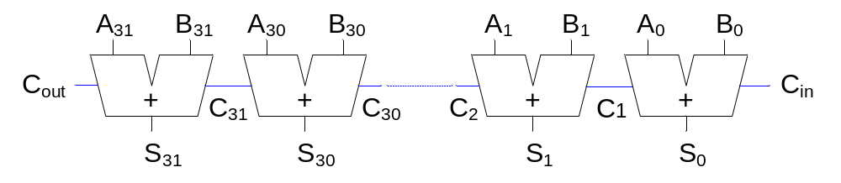
Ripple-Carry Adder
Chain 1-bit adders together
Carry ripples through entire chain
Disadvantage: slow

Slide 18
Ripple-Carry Adder Delay
The delay of an N-bit ripple-carry adder is:
t_{ripple} = Nt_{FA}
where t_{FA} is the delay of a full adder

Slide 19
Carry-Lookahead Adder
Compress the logic levels of C_{out}
Some definitions:
  Generate (G_{i}) and propagate (P_{i}) signals for each column:
    A column will generate a carry out if A_{i} AND B_{i} are both 1.
  G_{i} = A_{i} B_{i}
    A column will propagate a carry in to the carry out if A_{i} OR B_{i} is 1.
  P_{i} = A_{i} + B_{i}
    The carry out of a column (C_{i}) is:
  C_{i+1} = A_{i} B_{i} + (A_{i} + B_{i} )C_{i} = G_{i} + P_{i} C_{i}

Slide 20
Carry Look Ahead Adder
c₁ =a₀b₀ + (a₀+b₀)c₀ = g₀ + p₀c₀
c₂ =a₁b₁ + (a₁+b₁)c₁ = g₁ + p₁c₁ ₌ g₁ + p₁g₀ ₊ p₁p₀c₀
c₃ =a₂b₂ + (a₂+b₂)c₂ = g₂ + p₂c₂ ₌ g₂ + p₂g₁ ₊ p₂p₁g₀ ₊ p₂p₁p₀c₀
c₄ =a₃b₃ + (a₃+b₃)c₃ = g₃ + p₃c₃ ₌ g₃ + p₃g₂ ₊ p₃p₂g₁ ₊ p₃p₂p₁g₀ ₊ p₃p₂p₁p₀c₀
q_{i} = a_{i}b_{i} p_{i} = a_{i} + b_{i}
a₃ b₃
a₂ b₂
a₁ b₁
a₀ b₀
g₃
p₃
g₂
p₂
g₁
p₁
g₀
p₀
c₀
c₄
c₃
c₂
c₁

Slide 21
Carry-Lookahead Addition
Step 1: compute generate (G) and propagate (P) signals for columns (single bits)
Step 2: compute G and P for k-bit blocks
Step 3: C_{in} propagates through each k-bit propagate/generate block

Slide 22
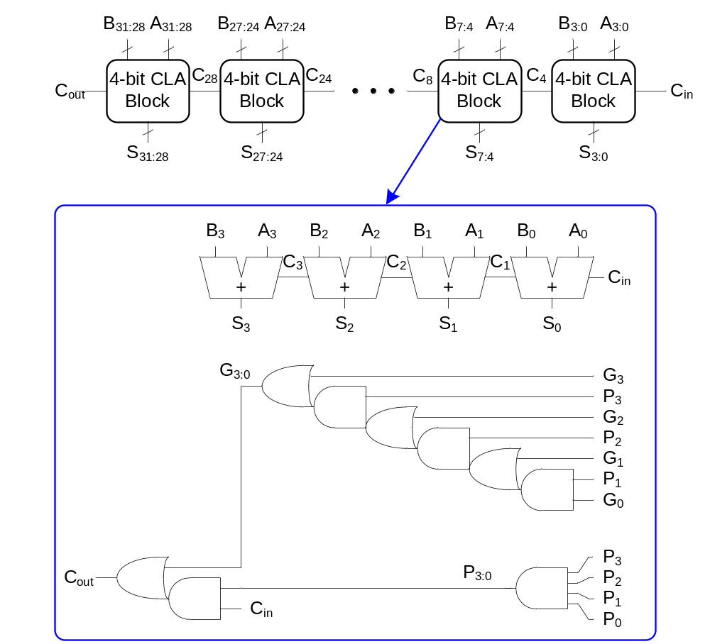
32-bit CLA with 4-bit blocks

Slide 23
Carry-Lookahead Adder Delay
Delay of an N-bit carry-lookahead adder with k-bit blocks:
t_{CLA} = t_{pg} + t_{pg_block} + (N/k – 1)t_{AND_OR} + kt_{FA}
where
  t_{pg} : delay of the column generate and propagate gates
  t_{pg_block} : delay of the block generate and propagate gates
  t_{AND_OR} : delay from C_{in} to C_{out} of the final AND/OR gate in the k-bit CLA block
An N-bit carry-lookahead adder is generally much faster than a ripple-carry adder for N > 16

Slide 24
Prefix Adder
Computes the carry in (C_{i-1}) for each of the columns as fast as possible and then computes the sum:
S_{i} = (A_{i} ⊕ B_{i}) ⊕ C_{i}
Computes G and P for 1-bit, then 2-bit blocks, then 4-bit blocks, then 8-bit blocks, etc. until the carry in (generate signal) is known for each column
Has log₂N stages

Slide 25
Prefix Adder
A carry in is produced by being either generated in a column or propagated from a previous column.
Define column -1 to hold C_{in}, so G₋₁ = C_{in}, P₋₁ = 0
Then, the carry in to col. i = the carry out of col. i-1:
  C_{i-1} = G_{i-1:-1}
G_{i-1:-1} is the generate signal spanning columns i-1 to -1.
There will be a carry out of column i-1 (C_{i-1}) if the block spanning columns i-1 through -1 generates a carry.
Thus, we rewrite the sum equation:S_{i} = (A_{i} ⊕ B_{i}) ⊕ G_{i-1:-1}
Goal: Compute G_{0:-1}, G_{1:-1}, G_{2:-1}, G_{3:-1}, G_{4:-1}, G_{5:-1}, … (These are called the prefixes)

Slide 26
Prefix Adder
The generate and propagate signals for a block spanning bits i:j are:
  G_{i:j} = G_{i:k} + P_{i:k} G_{k-1:j}
  P_{i:j} = P_{i:k}P_{k-1:j}
In words, these prefixes describe that:
  A block will generate a carry if the upper part (i:k) generates a carry or if the upper part propagates a carry generated in the lower part (k-1:j)
  A block will propagate a carry if both the upper and lower parts propagate the carry.

Slide 27
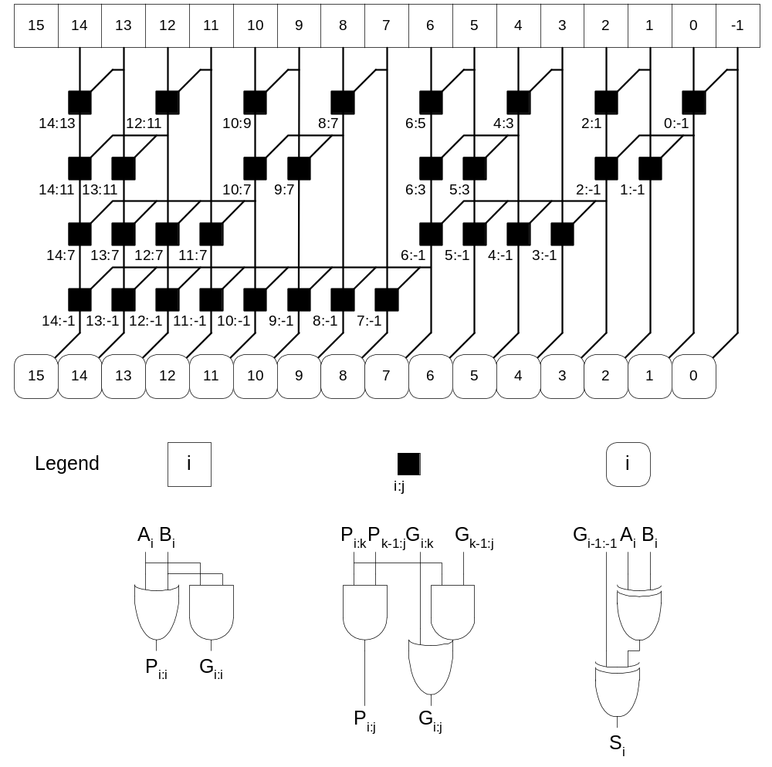
Prefix Adder Schematic

Slide 28
Carry Save Adder
Fast and low power addition for multiple additions
A Redundant Number System
Save the Partial Solution for Multiple Additions
One Bit Propagation for Each Addition

Slide 29
Carry Save Adder: A Redundant Number System
For each digit, we have two bits
  (0,0) (0,1) (1,0) (1,1)
Weight 0 (0,0)
Weight 1 (0,1) (1,0)
Weight 2 (1,1)

Slide 30
Carry Save Adder: A Simple Example
Weight | 32 | 16 | 8 | 4 | 2 | 1
n1 | 0 | 0 | 1 | 0 | 0 | 1
n2 | 0 | 1 | 1 | 1 | 1 | 0
n3 | 0 | 1 | 1 | 1 | 0 | 1
n4 | 0 | 0 | 1 | 0 | 1 | 1

Slide 31
Carry Save Adder: A Simple Example
Weight | 64 | 32 | 16 | 8 | 4 | 2 | 1
n1 | 0 | 0 | 0 | 1 | 1 | 0 | 1
n2 | 0 | 0 | 1 | 1 | 1 | 1 | 0
n3 | 0 | 0 | 1 | 1 | 1 | 0 | 1
n4 | 0 | 0 | 0 | 1 | 1 | 1 | 1
n1 | 00 | 00 | 00 | 10 | 10 | 00 | 10
n2 | 0 | 0 | 1 | 1 | 1 | 1 | 0
A=n1+n2 | 00 | 00 | 11 | 01 | 00 | 10 | 10
n3 | 0 | 0 | 1 | 1 | 1 | 0 | 1
B=A+n3 | 00 | 01 | 11 | 00 | 10 | 11 | 00
n4 | 0 | 0 | 0 | 1 | 1 | 1 | 1
C=B+n4 | 00 | 11 | 00 | 11 | 01 | 10 | 10
Sum | 1 | 0 | 1 | 0 | 1 | 1 | 1

Slide 32
Carry Save Adder: One Digit Logic Diagram
Addend in two bit
Addend in one bit
Full Adder
A
B
Full Adder
Cin
Carry out form digit i-1
Cout
Sum
Carry out to digit i+1
Sum in two bits
For digit i, the addition of addend in two bits and addend in one bit produces the carry out and sum.
The sum and the carry out from digit i-1 become the two bit output at digit i.

Slide 33
Carry Save Adder: Three Digit Logic Diagram
Addend in two bit
Addend in two bit
Addend in two bit
Addend in one bit
Addend in one bit
Addend in one bit
Full Adder
Full Adder
A
B
Full Adder
A
B
A
B
Full Adder
Full Adder
Full Adder
Cin
Cin
Cin
Cout
Cout
Cout
Sum
Sum
Sum
Cout form digit i-2
Cout to digit i+2
Cout to digit i+1
Cout form digit i-1
Sum in two bits
Sum in two bits
Sum in two bits
For digit i, the addition of addend in two bits and addend in one bit produces the carry out and sum.
The sum and the carry out from digit i-1 become the two bit output at digit i.

Slide 34
Carry Save Adder
Procedure of carry save addition system
Convert the first addend to the redundant number system
For intermediate solution, perform carry save addition.
Split the redundant number into two numbers.
Perform the addition on the two numbers to general the solution.

Slide 35
Prefix Adder Delay
The delay of an N-bit prefix adder is:
t_{PA} = t_{pg} + log₂N(t_{pg_prefix} ) + t_{XOR}
where
  t_{pg} is the delay of the column generate and propagate gates (AND or OR gate)
  t_{pg_prefix} is the delay of the black prefix cell (AND-OR gate)

Slide 36
Adder Delay Comparisons
Compare the delay of 32-bit ripple-carry, carry-lookahead, and prefix adders. The carry-lookahead adder has 4-bit blocks. Assume that each two-input gate delay is 100 ps and the full adder delay is 300 ps.

Slide 37
Adder Delay Comparisons
Compare the delay of 32-bit ripple-carry, carry-lookahead, and prefix adders. The carry-lookahead adder has 4-bit blocks. Assume that each two-input gate delay is 100 ps and the full adder delay is 300 ps.
  t_{ripple} = Nt_{FA} = 32(300 ps) = 9.6 ns
t_{CLA} = t_{pg} + t_{pg_block} + (N/k – 1)t_{AND_OR} + kt_{FA}
= [100 + 600 + (7)200 + 4(300)] ps
= 3.3 ns
t_{PA} = t_{pg} + log₂N(t_{pg_prefix} ) + t_{XOR}
= [100 + log₂32(200) + 100] ps
= 1.2 ns

Slide 38
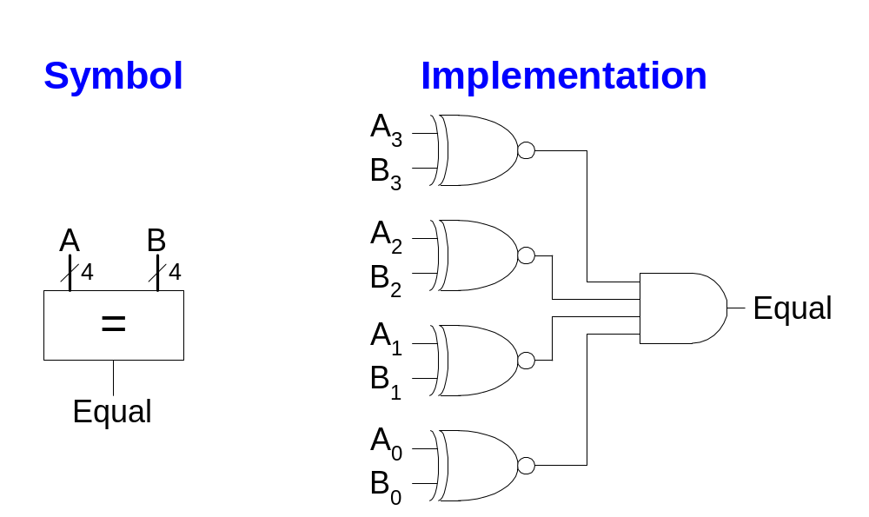
Comparator: Equality

Slide 39
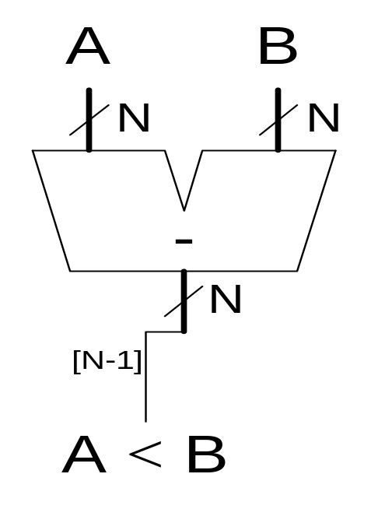
Comparator: Less Than
For unsigned numbers

Slide 40
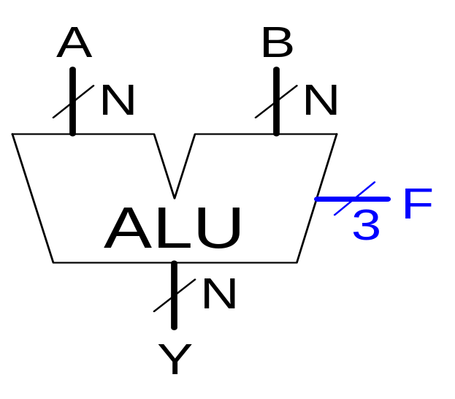
Arithmetic Logic Unit (ALU)
F_{2:0} | Function
000 | A & B
001 | A | B
010 | A + B
011 | not used
100 | A & ~B
101 | A | ~B
110 | A - B
111 | SLT

Slide 41
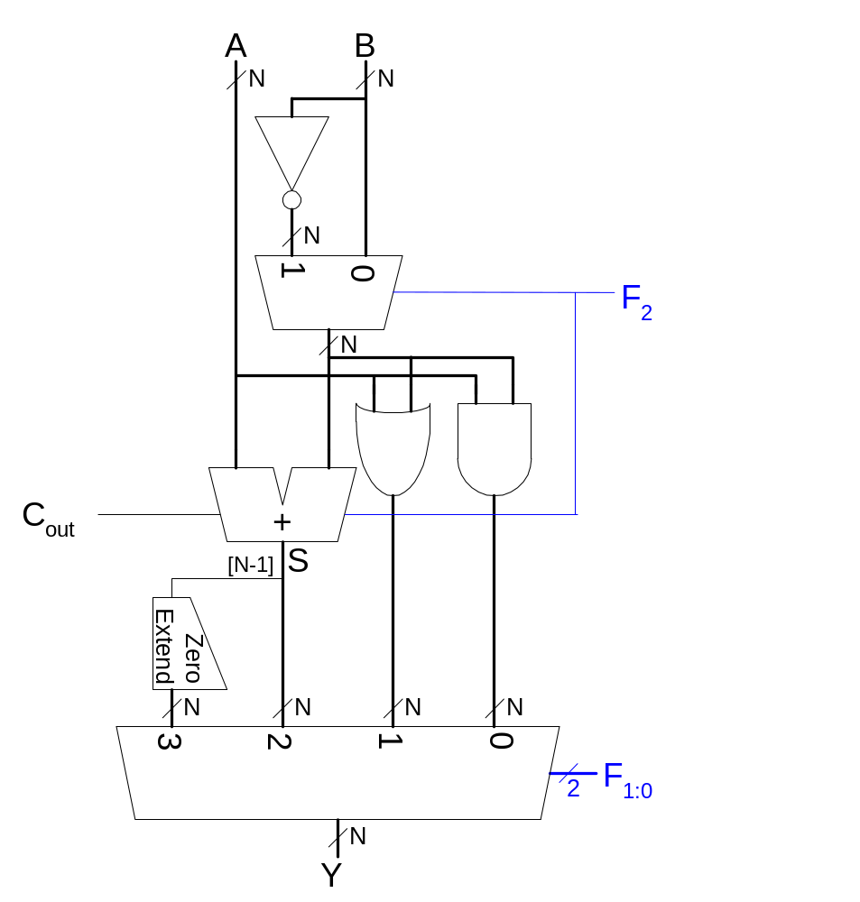
ALU Design
F_{2:0} | Function
000 | A & B
001 | A | B
010 | A + B
011 | not used
100 | A & ~B
101 | A | ~B
110 | A - B
111 | SLT

Slide 42

Set Less Than (SLT) Example
Configure a 32-bit ALU for the set if less than (SLT) operation. Suppose A = 25 and B = 32.

Slide 43
Set Less Than (SLT) Example
Configure a 32-bit ALU for the set if less than (SLT) operation. Suppose A = 25 and B = 32.
  A is less than B, so we expect Y to be the 32-bit representation of 1 (0x00000001).
  For SLT, F_{2:0} = 111.
  F₂ = 1 configures the adder unit as a subtracter. So 25 - 32 = -7.
  The two’s complement representation of -7 has a 1 in the most significant bit, so S₃₁ = 1.
  With F_{1:0} = 11, the final multiplexer selects Y = S₃₁ (zero extended) = 0x00000001.

Slide 44
Shifters
Logical shifter: shifts value to left or right and fills empty spaces with 0’s
  Ex: 11001 >> 2 = 00110
  Ex: 11001 << 2 = 00100
Arithmetic shifter: same as logical shifter, but on right shift, fills empty spaces with the old most significant bit (msb).
  Ex: 11001 >>> 2 = 11110
  Ex: 11001 <<< 2 = 00100
Rotator: rotates bits in a circle, such that bits shifted off one end are shifted into the other end
  Ex: 11001 ROR 2 = 01110
  Ex: 11001 ROL 2 = 00111

Slide 45
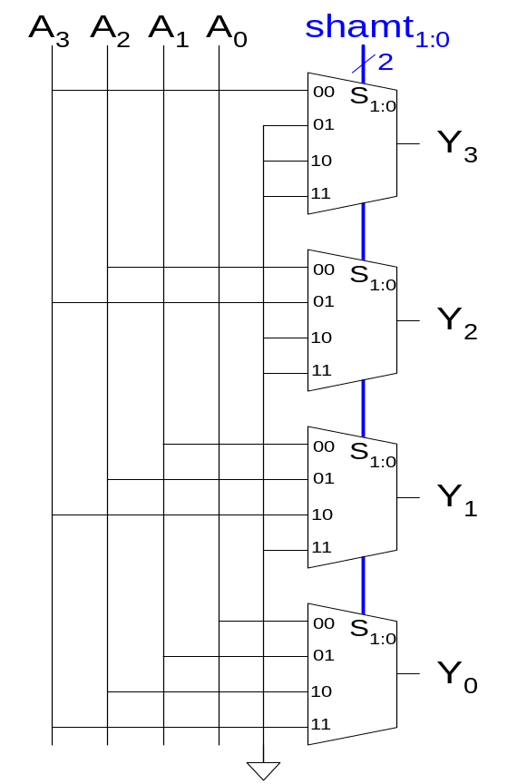
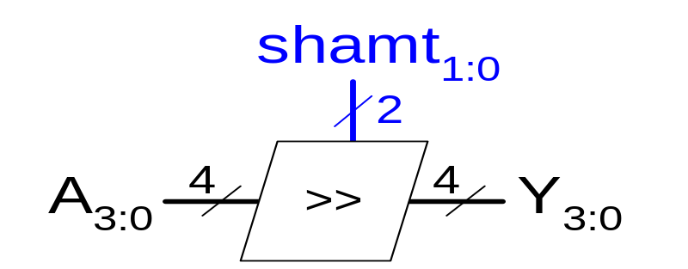
Shifter Design

Slide 46
Shifter
x_{n}
x_{n-1}
x₀
x₋₁
y_{i} = x_{i-1} if En = 1, s = 1, and d = L
= x_{i+1} if En = 1, s = 1, and d = R
= x_{i} if En = 1, s = 0
= 0 if En = 0
s
s / n
En
d
l / r
yn₋₁
y0
x_{i+1}
x_{i}
x_{i-1}
Can be implemented with a mux
s
1
3 2 1 0
d
En
0
yi

Slide 47
Barrel Shifter
shift
x
0 1
0 1
0 1
s₀
O or 1 shift
s₁
O or 2 shift
0 1
0 1
0 1
0 1
0 1
s₂
O or 4 shift
y
0 1
0 1
0 1
0 1
0 1
0 1

Slide 48
Shifters as Multipliers and Dividers
A left shift by N bits multiplies a number by 2^{N}
  Ex: 00001 << 2 = 00100 (1 × 2² = 4)
  Ex: 11101 << 2 = 10100 (-3 × 2² = -12)
The arithmetic right shift by N divides a number by 2^{N}
  Ex: 01000 >>> 2 = 00010 (8 ÷ 2² = 2)
  Ex: 10000 >>> 2 = 11100 (-16 ÷ 2² = -4)

Slide 49
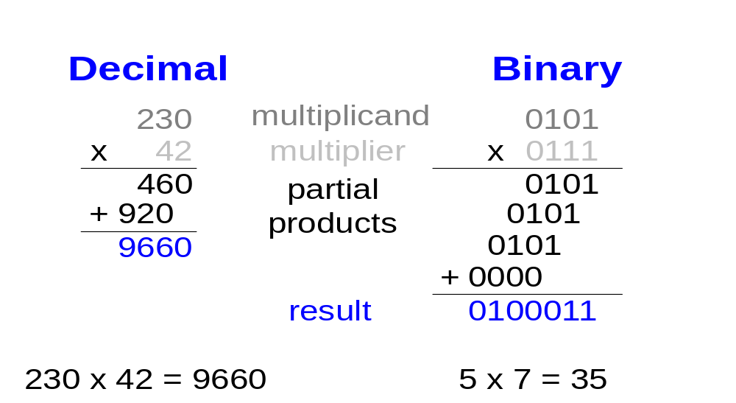
Multipliers
Steps of multiplication for both decimal and binary numbers:
  Partial products are formed by multiplying a single digit of the multiplier with the entire multiplicand
  Shifted partial products are summed to form the result

Slide 50
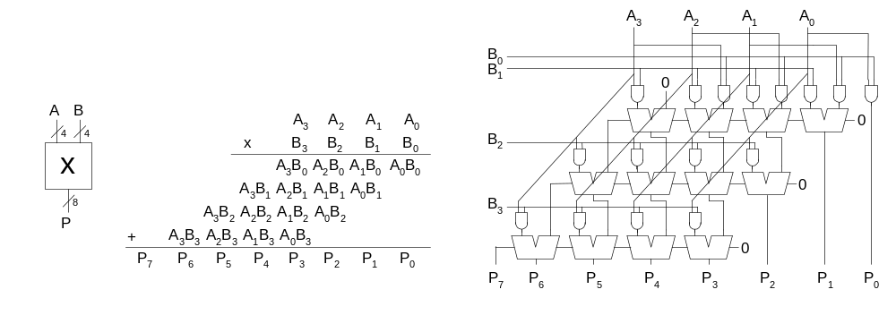
4 x 4 Multiplier

Slide 51
Division Algorithm
Q = A/B
R: remainder
D: difference
R = A
for i = N-1 to 0
D = R - B
if D < 0 then Q_{i} = 0, R’ = R // R < B
else Q_{i} = 1, R’ = D // R ≥ B
R = 2R’

Slide 52
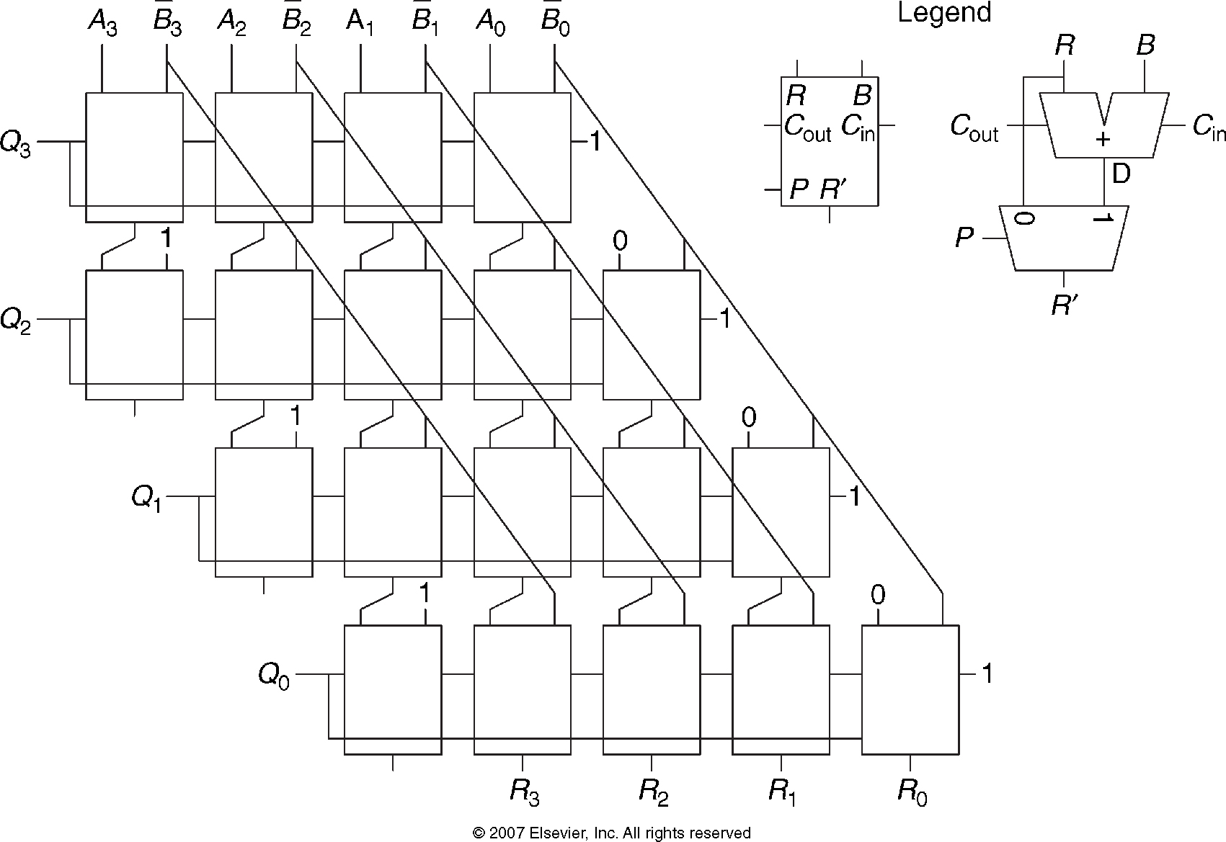
4 x 4 Divider

