Slide 1
CSE140: System Design
Xinyuan Wang
05/31/2019

Slide 2
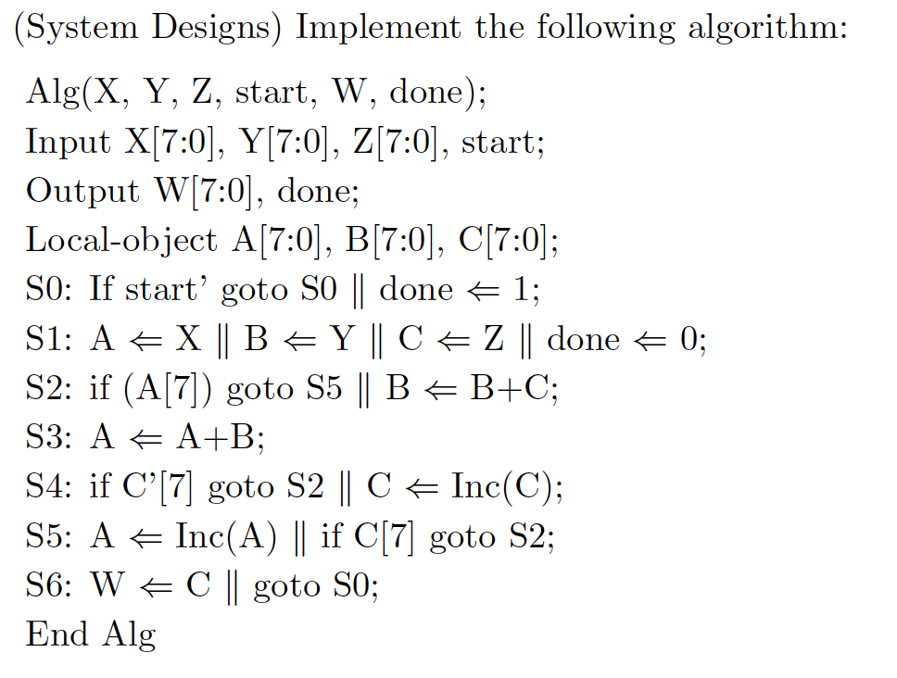
Example: SP18 Final

Slide 3
Framework
n=128
Data
Subsystem
n=64
Data
Inputs
Data
Outputs
Control
Signals
Conditions
Control
Inputs
Control
Subsystem
Control
Outputs
Start/Request
Done/Acknowledgement

Slide 4
Handshaking
Data
Inputs
n=128
n=64
Data
Outputs
Data
Subsystem
Conditions
Control
Signals
Control
Inputs
Control
Outputs
Master that
calls module S
Control
Subsystem
Start/Request
Done/Acknowledgement
X
Y
module S
Z
X
start
Z
done
Y
start
done

Slide 5
Before implementing the data and control subsystems
With the given description of system
Identify Input and Output of data and control subsystems
Identify Condition Bits to Control Subsystem
Identify Data Subsystem Operations
Map Data Operations to Implementable functions
Data
Inputs
n=128
n=64
Data
Outputs
Data
Subsystem
Conditions
Control
Signals
Control
Inputs
Control
Outputs
Control
Subsystem
Start/Request
Done/Acknowledgement

Slide 6
Before implementing the data and control subsystems
With the given description of system
Identify Input and Output of data and control subsystems
8
X
Data
Subsystem
8
8
Y
W
8
Z
A[7],C[7]
?
start
Control
Subsystem
done

Slide 7
Before implementing the data and control subsystems
With the given description of system
Identify Input and Output of data and control subsystems
Identify Condition Bits to Control Subsystem
8
X
Data
Subsystem
8
8
Y
W
8
Z
A[7],C[7]
?
start
Control
Subsystem
done

Slide 8
Before implementing the data and control subsystems
With the given description of system
Identify Input and Output of data and control subsystems
Identify Condition Bits to Control Subsystem
Identify Data Subsystem Operations
8
X
Data
Subsystem
8
8
Y
W
8
Z
A[7],C[7]
?
start
Control
Subsystem
done

Slide 9
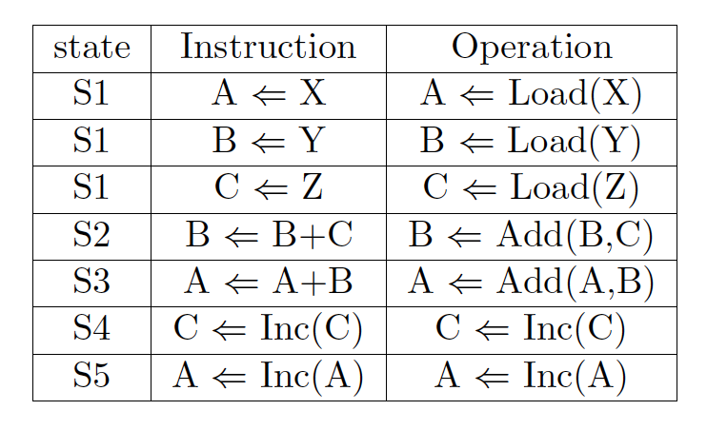
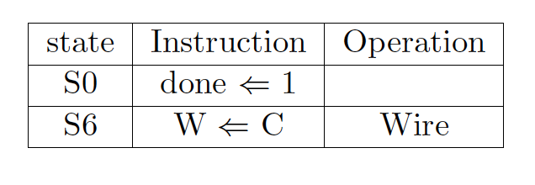
Before implementing the data and control subsystems
With the given description of system
Identify Input and Output of data and control subsystems
Identify Condition Bits to Control Subsystem
Identify Data Subsystem Operations
Map Data Operations to Implementable functions

Slide 10
Implement the data subsystem
  List data operations
  Map operations to functional blocks
  Add interconnect for data transport
  Input control signals and output conditions

Slide 11
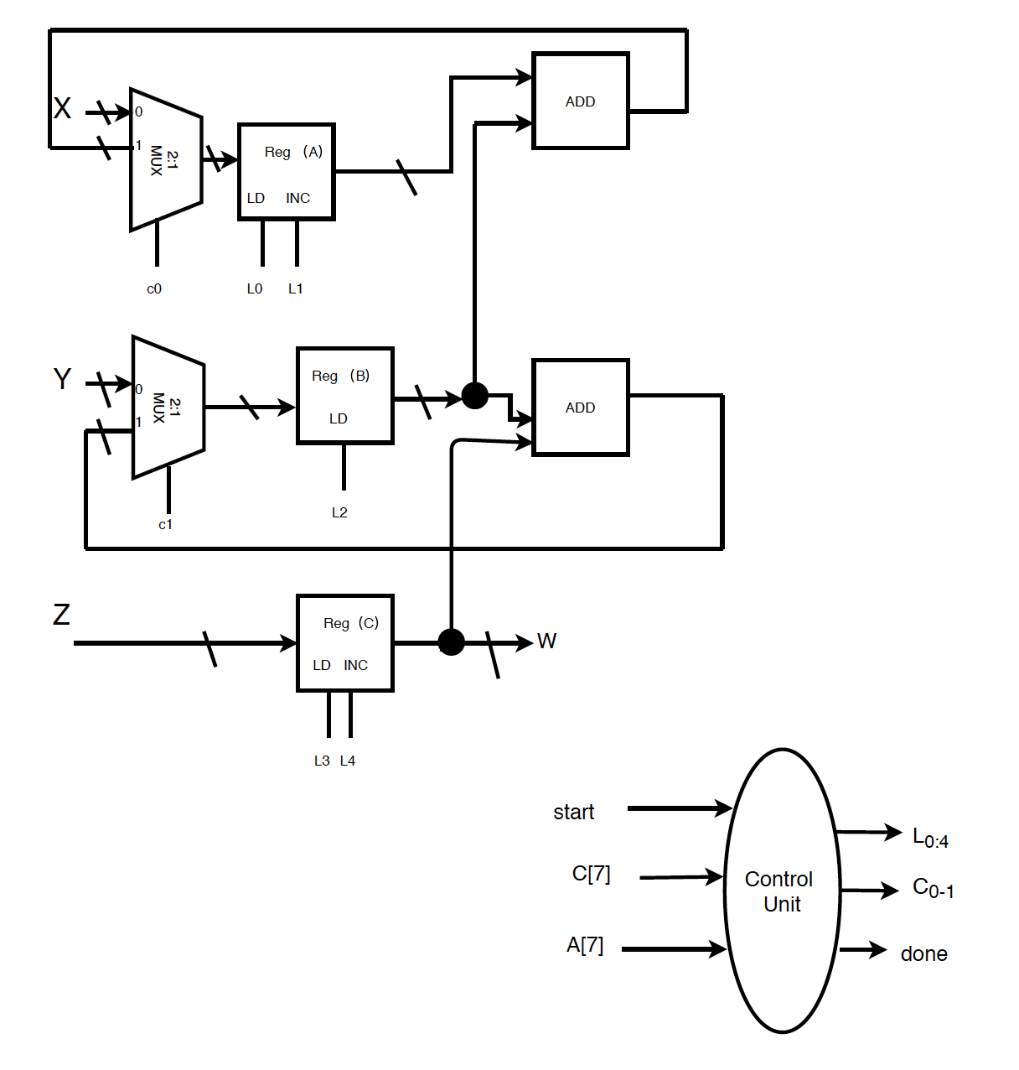
Implement the data subsystem
  List data operations
  Map operations to functional blocks: registers
Registers: If C then R ⬅ D
D
Register A
C
LD
X
A
R
Register B
Register C
Y
B
Z
C

Slide 12
Implement the data subsystem
  List data operations
  Map operations to functional blocks: adders
  Add interconnect for data transport

Slide 13
Implement the data subsystem
  List data operations
  Map operations to functional blocks: mux for multiple sources
  Add interconnect for data transport

Slide 14
Implement the data subsystem
  List data operations
  Map operations to functional blocks
  Add interconnect for data transport
  Input control signals and output conditions

Slide 15
Implement the control subsystem
  Map control signals to operations
  Identify control path components
  Express the control subsystem with FSM
  Implement the control subsystem

Slide 16
Implement the control subsystem
  Map control signals to operations
control
C₀=0, L₀ =1 and L₁ =0
C₁=0 and L₂ =1
L₃ =1 and L₄ =0
C₁=1 and L₂ =1
C₀=1, L₀ =1 and L₁ =0
L₃ =0 and L₄ =1
L₀ =0 and L₁ =1

Slide 17
Implement the control subsystem
  Map control signals to operations
  Identify control path components
8
X
Data
Subsystem
8
8
Y
W
8
Z
A[7],C[7]
C_{0:1 ,} L_{0:4}
start
Control
Subsystem
done
Control
Unit
A[7]
C_{0:1}
C[7]
L_{0:4}
done
start

Slide 18
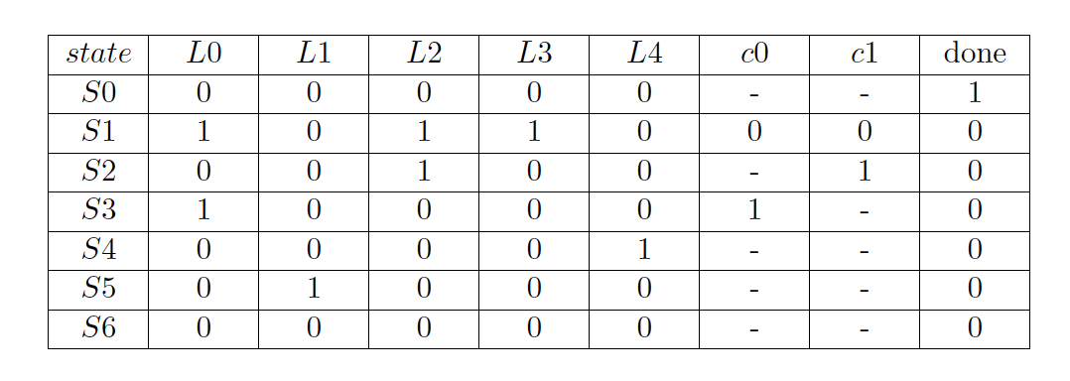
Implement the control subsystem
  Map control signals to operations
  Identify control path components
control
C₀=0, L₀ =1 and L₁ =0
C₁=0 and L₂ =1
L₃ =1 and L₄ =0
C₁=1 and L₂ =1
C₀=1, L₀ =1 and L₁ =0
L₃ =0 and L₄ =1
L₀ =0 and L₁ =1

Slide 19
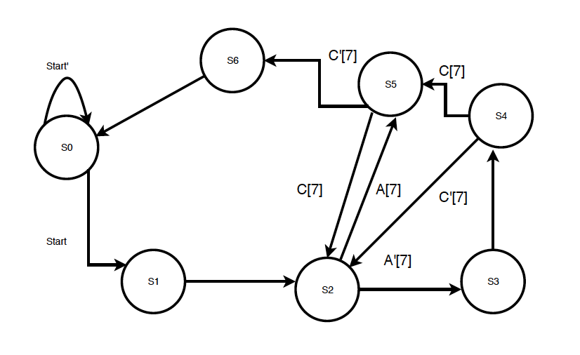
Implement the control subsystem
  Map control signals to operations
  Identify control path components
  Express the control subsystem with FSM
Control
Unit
A[7]
C_{0:1}
C[7]
L_{0:4}
done
start

Slide 20
Implement the control subsystem
  Map control signals to operations
  Identify control path components
  Express the control subsystem with FSM
  Implement the control subsystem
How to implement the state assignment?

Slide 21
State Assignment
Binary | b₂b₁b₀
S0 | 000
S1 | 001
S2 | 010
S3 | 011
S4 | 100
S5 | 101
S6 | 110
S7 | 111
Gray | b₂b₁b₀
S0 | 000
S1 | 001
S2 | 011
S3 | 010
S4 | 110
S5 | 111
S6 | 101
S7 | 100
One Hot | b₇b₆b₅b₄b₃b₂b₁b₀
S0 | 0 0 0 0 0 0 0 1
S1 | 0 0 0 0 0 0 1 0
S2 | 0 0 0 0 0 1 0 0
S3 | 0 0 0 0 1 0 0 0
S4 | 0 0 0 1 0 0 0 0
S5 | 0 0 1 0 0 0 0 0
S6 | 0 1 0 0 0 0 0 0
S7 | 1 0 0 0 0 0 0 0
One Hot Encoding: n bits for n states. Bit i=1 for state i.

Slide 22
Control Subsystem: One-Hot State Machine Design
Input: State Diagram
Use a flip flop to replace each state.
  Set the flip flop which corresponds to the initial state and reset the rest flip flops.
Use an OR gate to collect all inward edges.
Use a Demux to distribute the outward edges.

Slide 23
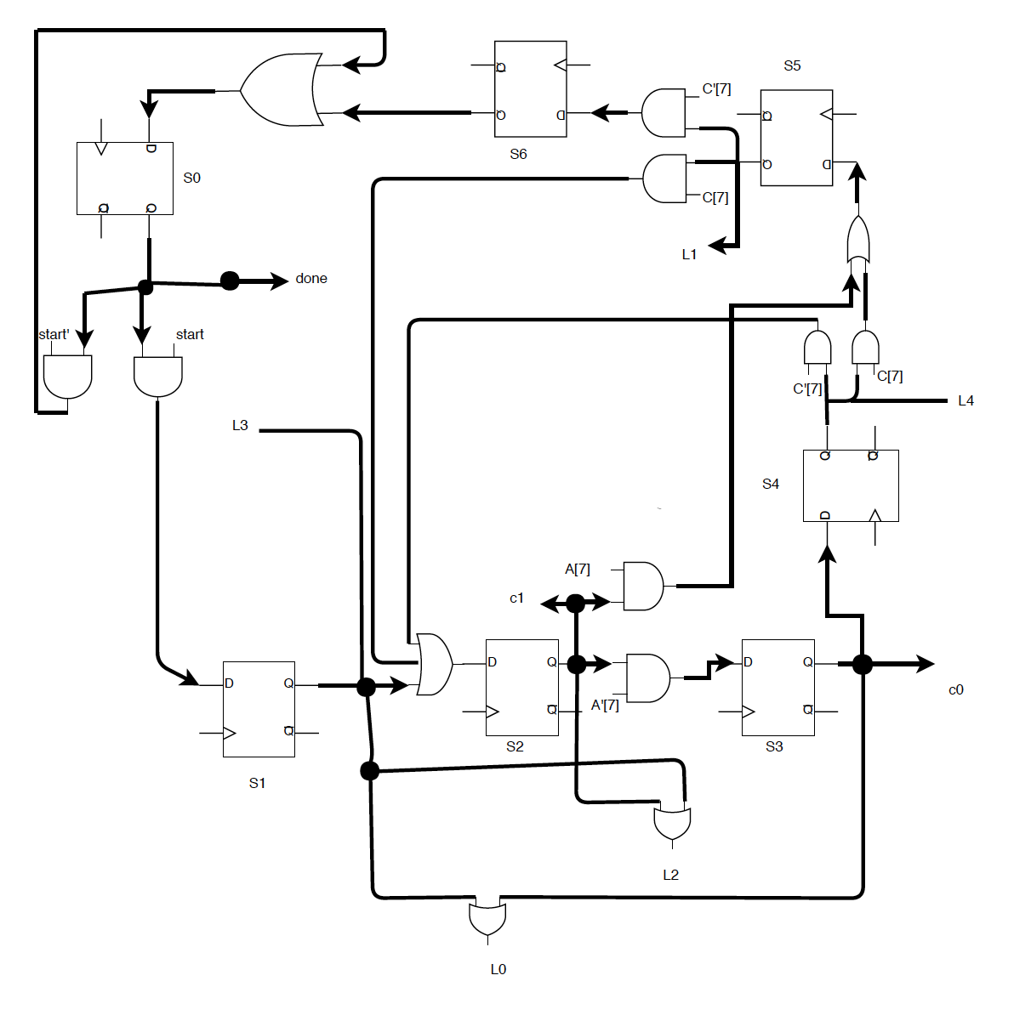
Implement the control subsystem
  Map control signals to operations
  Identify control path components
  Express the control subsystem with FSM
  Implement the control subsystem

