Slide 1
CSE140 Final Review
Xinyuan Wang
06/06/2019

Slide 2
Contents
Serial Adder/Subtractor
Counter
Cascade counter
Floating number

Slide 3
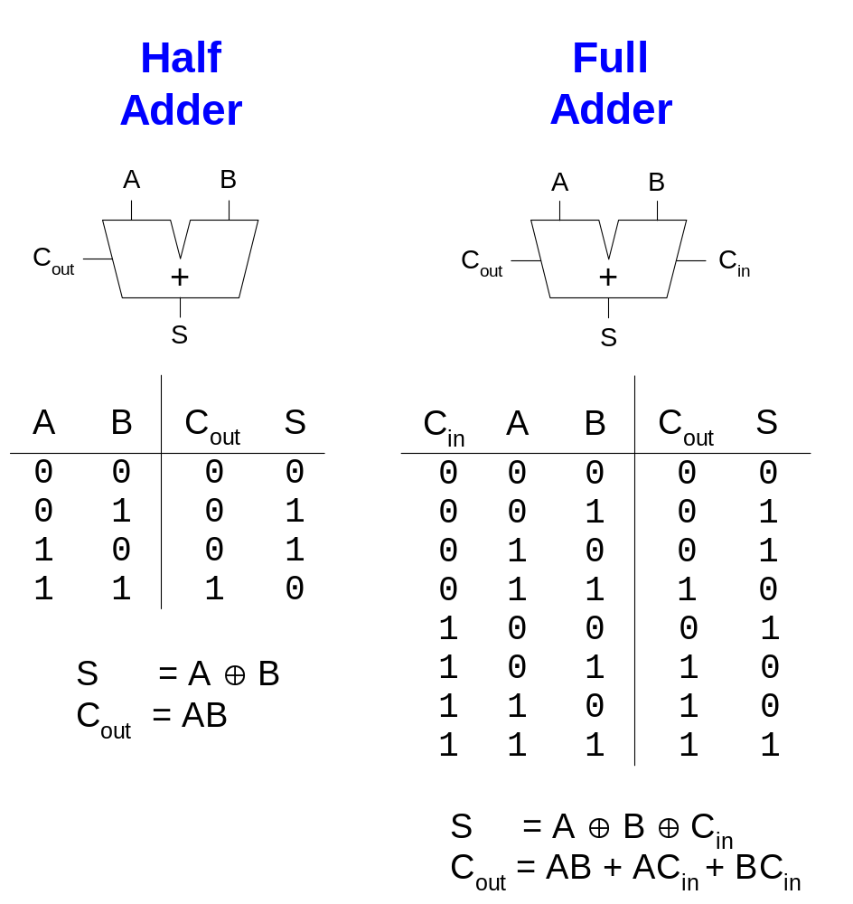














1-Bit Adders/Subtractors
Subtractor
Subtractor
$$B_{out}$$
$$−$$
$$B_{out}$$
$$−$$
$$B_{in}$$
$$D$$
$$D$$
$$B_{out}$$
$$D$$
$$B_{out}$$
$$D$$
$$B_{in}$$
$$B_{out}$$
0
1
0
0
0
1
0
0
1
1
0
1
$$D$$
$$B_{out}=A^{′}B$$
$$D$$
$$B_{in}$$
$$B_{out}=A^{′}B+A^{′}B_{in}+{BB}_{in}$$

Slide 4
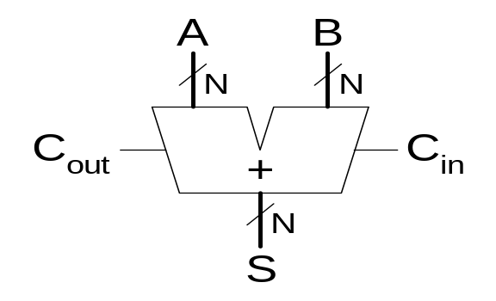
Adder
Several types of carry propagate adders (CPAs) are:
  Ripple-carry adders (slow)
  Carry-lookahead adders (fast)
  Prefix adders (faster)
Carry-lookahead and prefix adders are faster for large adders but require more hardware.
  Symbol

Slide 5
Motivation for Serial Adders and Multipliers
Tradeoff of silicon area and system performance
  Perform process in a series of time
Utilization of FPGA architecture
  Slice operation bitwise
Metrics of Cost, Speed, and Power
Ad: Cheaper hardware, Fit for FPGA architecture, Pipelining for excellent throughput
Dis: Longer latency

Slide 6
Serial Adder: Perform serial bit-addition
At time i, read a_{i} and b_{i}. Produce s_{i} and c_{i+1}
Internal state stores c_{i}. Carry bit c₀ is set as c_{in}
a₃ b₃
a₀ b₀
c_{in}
Serial
Adder
a_{i}
a
b
sum
s_{i}
b_{i}
c_{out}
s₃
s₀

Slide 7
Serial Adder using D F-F
a_{i}
C2
b_{i}
s_{i}
C1
D
Q
Q’
D
Clk
Feed a_{i} and b_{i} and generate s_{i} at time i.
Where is c_{i} and c_{i+1}?

Slide 8
Serial Adder using a D Flip-Flop
id | a_{i} | b_{i} | c_{i} | c_{i+1} | s_{i}
0 | 0 | 0 | 0 | 0 | 0
1 | 0 | 0 | 1 | 0 | 1
2 | 0 | 1 | 0 | 0 | 1
3 | 0 | 1 | 1 | 1 | 0
4 | 1 | 0 | 0 | 0 | 1
5 | 1 | 0 | 1 | 1 | 0
6 | 1 | 1 | 0 | 1 | 0
7 | 1 | 1 | 1 | 1 | 1
D=c_{i+1}
Q=c_{i}

Slide 9
Serial Adder using a D Flip-Flop
Logic Diagram
a_{i}
s_{i}
b_{i}
D
Q
Q’
c_{i}
Clk

Slide 10
Serial Subtractor using a D Flip-Flop
Logic Diagram
id | a_{i} | b_{i} | B_{i} | B_{i+1} | D_{i}
0 | 0 | 0 | 0 | 0 | 0
1 | 0 | 0 | 1 | 1 | 1
2 | 0 | 1 | 0 | 1 | 1
3 | 0 | 1 | 1 | 1 | 0
4 | 1 | 0 | 0 | 0 | 1
5 | 1 | 0 | 1 | 0 | 0
6 | 1 | 1 | 0 | 0 | 0
7 | 1 | 1 | 1 | 1 | 1
a_{i}
D_{i}
b_{i}
D=B_{i+1}
Q=B_{i}
D
Q
Q’
B_{i}
Clk

Slide 11
Counter
Modulo-n Counter
Modulo Counter (m<n)
Counter (a-to-b)
Counter of an Arbitrary Sequence
Cascade Counter

Slide 12
Counter
D
CNT
A modulo-n counter
TC
LD
CLR
Clk
Q
Q (t+1) = (0, 0, .. , 0) if CLR = 1
= D if LD = 1 and CLR = 0
= (Q(t)+1)mod n if LD = 0, CNT = 1 and CLR = 0
= Q (t) if LD = 0, CNT = 0 and CLR = 0
TC = 1 if Q (t) = n-1 and CNT = 1
= 0 otherwise

Slide 13
Counter
A modulo-m counter (m<n)
  Given a mod 16 counter
  Construct a mod-m counter (0 < m < 16) with AND, OR, NOT gates
m=6
Q3 Q2 Q1 Q0
if LD = 0, X = 1 Q(t+1)=(Q(t)+1) mod m
  when Q(t) < m, works as the modulo-n counter
  when Q(t)=m-1, Q(t+1) needs to be reset to 0
3 2 1 0
CLR
CLK
X
CNT
LD
D3 D2 D1 D0
Set LD = 1 when X = 1 and Q(t)= m-1
Q(t+1) = D = 0
Q2
Q0
0 0 0 0

Slide 14
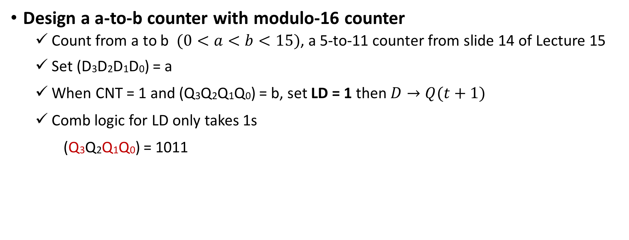
Counter
Design a a-to-b counter with modulo-16 counter
  Count from a to b $(0<a<b<15)$, a 5-to-11 counter from slide 14 of Lecture 15
  Set (D3D2D1D0) = a
  When CNT = 1 and (Q3Q2Q1Q0) = b, set LD = 1 then $D→Q(t+1)$
  Comb logic for LD only takes 1s
  (Q3Q2Q1Q0) = 1011
A 5-to-11 Counter
Q3 Q2 Q1 Q0
CLR
Clk
(Q3Q2Q1Q0) = 1111 cannot be reached in this 5-to-11 counter!
X
CNT
LD
D3 D2 D1 D0
Q3
b
Q1
0 1 0 1 a
Q0

Slide 15
Counter of an Arbitrary Sequence
Given a mod 8 counter, construct
a counter with sequence 0 1 5 6 2 3 7
When Q = 1, load D = 5
When Q = 6, load D = 2
When Q = 3, load D = 7
Q2 Q1 Q0
CLR
Clk
X
CNT
LD
D2 D1 D0
Q2’
Q0
Q2
Q0 Q1 Q0
Q0’

Slide 16
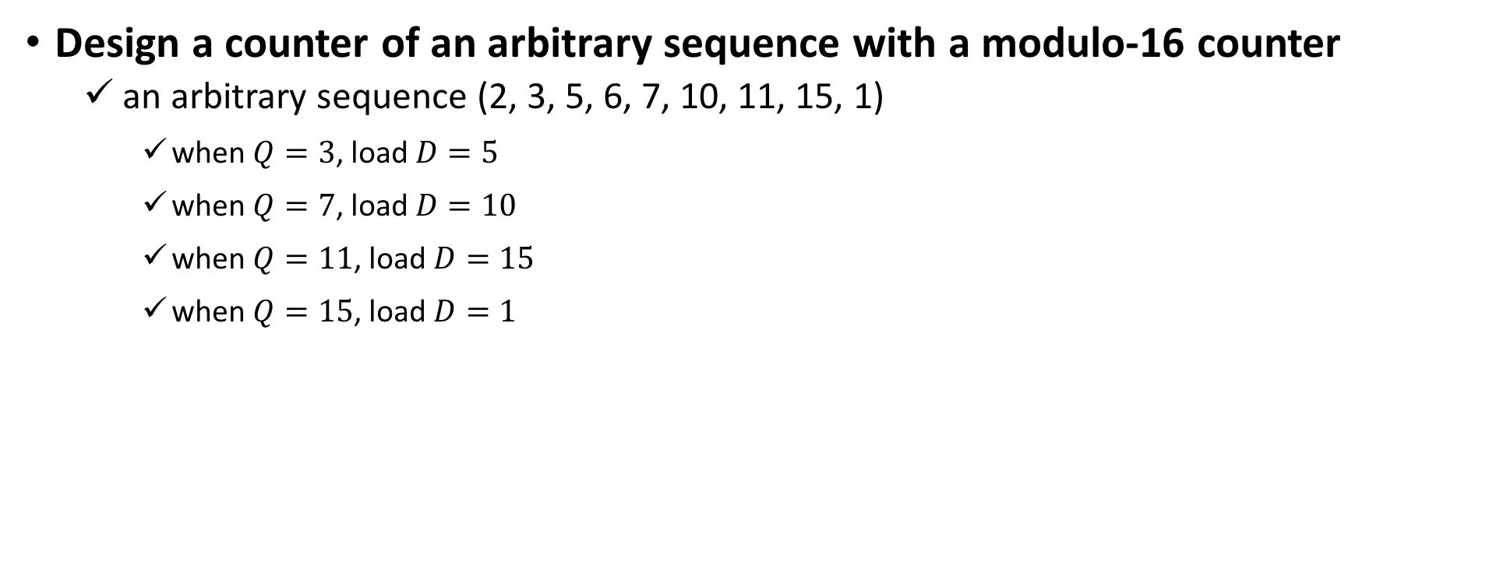
Counter
Design a counter of an arbitrary sequence with a modulo-16 counter
  an arbitrary sequence (2, 3, 5, 6, 7, 10, 11, 15, 1)
    when $Q=3$, load $D=5$
    when $Q=7$, load $D=10$
    when $Q=11$, load $D=15$
    when $Q=15$, load $D=1$
Q3 Q2 Q1 Q0
CLR
Clk
X
CNT
X
s_{i}
C1
Clk
LD
D3 D2 D1 D0
D
D
Q

Slide 17
Counter
Design a counter of an arbitrary sequence with a modulo-16 counter
  an arbitrary sequence (2, 3, 5, 6, 7, 10, 11, 15, 1)
    when $Q=3$, load $D=5$
    when $Q=7$, load $D=10$
    when $Q=11$, load $D=15$
    when $Q=15$, load $D=1$
Q3 Q2 Q1 Q0
CLR
Clk
X
CNT
X
C1
LD
CNT
LD
D3 D2 D1 D0
D
D
Q
CLR
Clk

Slide 18
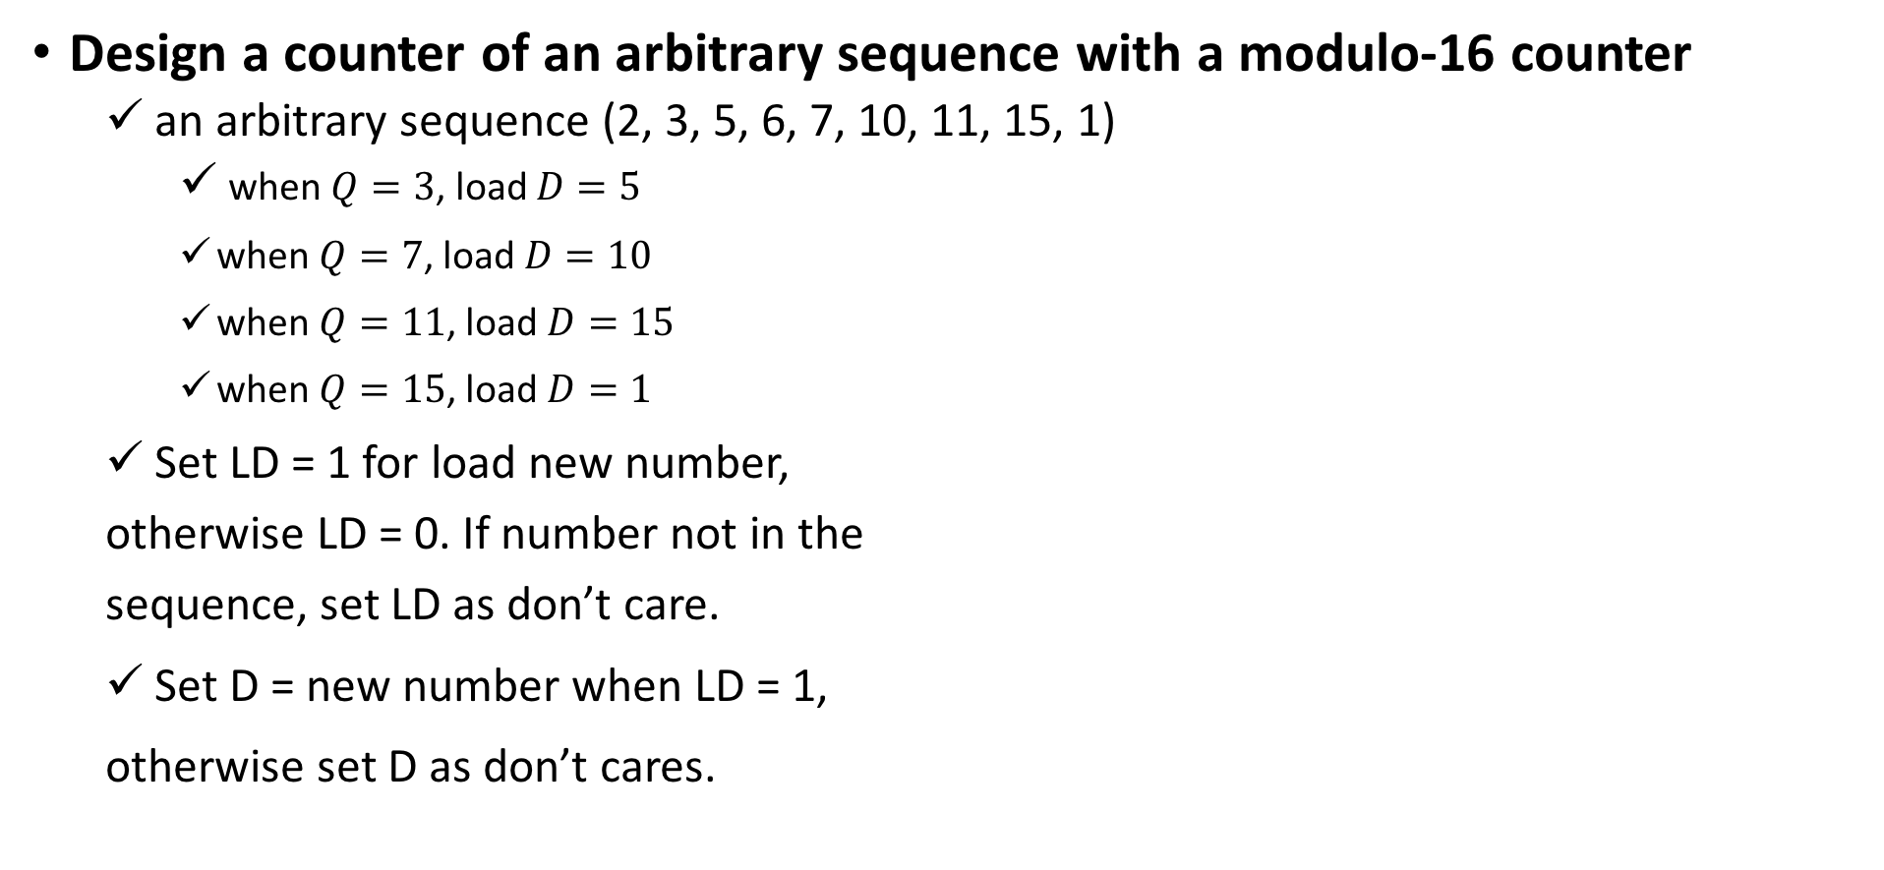
Counter
Design a counter of an arbitrary sequence with a modulo-16 counter
  an arbitrary sequence (2, 3, 5, 6, 7, 10, 11, 15, 1)
    when $Q=3$, load $D=5$
    when $Q=7$, load $D=10$
    when $Q=11$, load $D=15$
    when $Q=15$, load $D=1$
  Set LD = 1 for load new number,
  otherwise LD = 0. If number not in the
  sequence, set LD as don’t care.
  Set D = new number when LD = 1,
  otherwise set D as don’t cares.
Id | Q₃Q₂Q₁Q₀ | LD | D₃ | D₂ | D₁ | D₀
1 | 0001 | 0 | - | - | - | -
2 | 0010 | 0 | - | - | - | -
3 | 0011 | 1 | 0 | 1 | 0 | 1
5 | 0101 | 0 | - | - | - | -
6 | 0110 | 0 | - | - | - | -
7 | 0111 | 1 | 1 | 0 | 1 | 0
10 | 1010 | 0 | - | - | - | -
11 | 1011 | 1 | 1 | 1 | 1 | 1
15 | 1111 | 1 | 0 | 0 | 0 | 1
0, 4, 8, 9, 12, 13, 14 | 0000 … | - | - | - | - | -

Slide 19
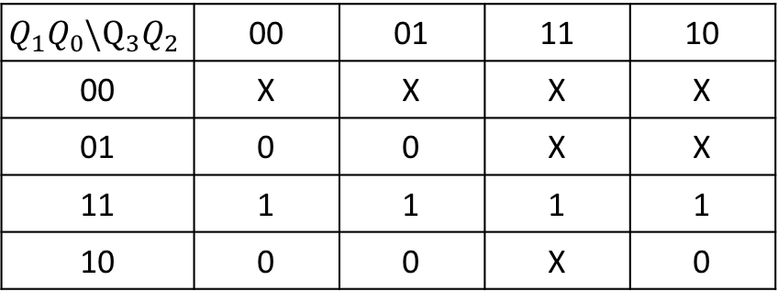
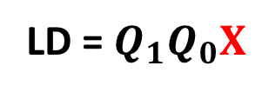
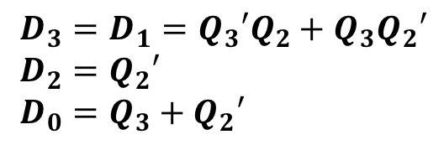
Counter
Design a counter of an arbitrary sequence with a modulo-16 counter
  an arbitrary sequence (2, 3, 5, 6, 7, 10, 11, 15, 1)
  Use K-maps to minimize the logic
Id | Q₃Q₂Q₁Q₀ | LD | D₃ | D₂ | D₁ | D₀
1 | 0001 | 0 | - | - | - | -
2 | 0010 | 0 | - | - | - | -
3 | 0011 | 1 | 0 | 1 | 0 | 1
5 | 0101 | 0 | - | - | - | -
6 | 0110 | 0 | - | - | - | -
7 | 0111 | 1 | 1 | 0 | 1 | 0
10 | 1010 | 0 | - | - | - | -
11 | 1011 | 1 | 1 | 1 | 1 | 1
15 | 1111 | 1 | 0 | 0 | 0 | 1
0, 4, 8, 9, 12, 13, 14 | 0000 … | - | - | - | - | -
LD = $Q_{1}Q_{0}X$
$$Q_{1}Q_{0}\backslash Q_{3}Q_{2}$$ | 00 | 01 | 11 | 10
00 | X | X | X | X
01 | 0 | 0 | X | X
11 | 1 | 1 | 1 | 1
10 | 0 | 0 | X | 0
0 4 12 8
1 5 13 9
3 7 15 11
2 6 14 10
$D_{3}=D_{1}=Q_{3}′Q_{2}+Q_{3}Q_{2}′$
$D_{2}=Q_{2}′$
$D_{0}=Q_{3}+Q_{2}′$

Slide 20
Cascade Counter
A Cascade Modulo 256 Counter constructed with Modulo 16 counter
Q7,Q6,Q5,Q4
Q3,Q2,Q1,Q0
Q3Q2Q1Q0
T_{C0}
Q3Q2Q1Q0
TC
CNT
LD
TC
CNT
LD
X
Clk
Clk
D3D2D1D0
D3D2D1D0
D7,D6,D5,D4
D3,D2,D1,D0

Slide 21
Cascade Counter
The first modulo 16 counter
  Tc0 = 1 when (Q3,Q2,Q1,Q0 )= (1,1,1,1) and X=1
The second modulo 16 counter
  Q7:4(t+1) = Q7:4(t) + 1 mod 16 when T_{C0} = 1
The circuit functions as a modulo 256 counter.
Time |  | 0 | 1 | 2 | 3 | … | 13 | 14 | 15 | 16 | 17 | 18 | 19
Q₇₋₄ |  | 0 | 0 | 0 | 0 | … | 0 | 0 | 0 | 1 | 1 | 1 | 1
T_{C0} |  | 0 | 0 | 0 | 0 | … | 0 | 0 | 1 | 0 | 0 | 0 | 0
Q₃₋₀ |  | 0 | 1 | 2 | 3 | … | 13 | 14 | 15 | 0 | 1 | 2 | 3

Slide 22
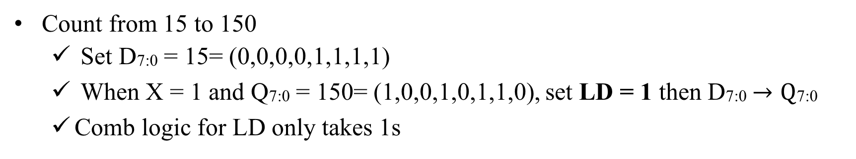
Cascade Counter
Count from 15 to 150
  Set D7:0 = 15= (0,0,0,0,1,1,1,1)
  When X = 1 and Q7:0 = 150= (1,0,0,1,0,1,1,0), set LD = 1 then D7:0$→\text{Q}\text{7:0}$
  Comb logic for LD only takes 1s
Q7,Q6,Q5,Q4
Q3,Q2,Q1,Q0
Q3Q2Q1Q0
T_{C0}
Q3Q2Q1Q0
X
TC
CNT
LD
TC
CNT
LD
Clk
Clk
D3D2D1D0
D3D2D1D0
Q1
Q2
Q4
0,0,0,0
1,1,1,1
Q7

Slide 23
Floating Point Number: Standard
ulp (unit in the last place)
  Difference between two consecutive values of the significand.
  3 Parts→ x = ~s b^{e}:sign, significand, exponent
Sign Bit
23-bit Significand
8-bit exponent

Slide 24
Standard: Normalization
±e₁e₂e₃e₄e₅e₆e₇e₈s₁s₂s₃…s₂₂s₂₃
  1.s₁s₂s₃…s₂₂s₂₃ normalized number
  0.s₁s₂s₃…s₂₂s₂₃ denormalized number
  Id e₁e₂e₃e₄e₅e₆e₇e₈
  0 0 0 0 0 0 0 0 0 x=0.s₁s₂s₃…s₂₂s₂₃ 2⁻¹²⁶
  1 0 0 0 0 0 0 0 1 x=1.s₁s₂s₃…s₂₂s₂₃ 2⁻¹²⁶
  2 0 0 0 0 0 0 1 0 x=1.s₁s₂s₃…s₂₂s₂₃ 2⁻¹²⁵
  .
  126 0 1 1 1 1 1 1 0 x=1.s₁s₂s₃…s₂₂s₂₃ 2⁻¹
  127 0 1 1 1 1 1 1 1 x=1.s₁s₂s₃…s₂₂s₂₃ 2⁰
  128 1 0 0 0 0 0 0 0 x=1.s₁s₂s₃…s₂₂s₂₃ 2¹
  .
  253 1 1 1 1 1 1 0 1 x=1.s₁s₂s₃…s₂₂s₂₃ 2¹²⁶
  254 1 1 1 1 1 1 1 0 x=1.s₁s₂s₃…s₂₂s₂₃ 2¹²⁷
  255 1 1 1 1 1 1 1 1 x= Inf if (s₁ …s₂₃)= 0, else NaN NaN → Not a Number
Tiniest= 1 x 2⁻¹⁴⁹
Normalized minimum N_{min} = 1.0 x 2⁻¹²⁶
Total numbers
# = 2x255 x 2²³-1 (excluding Inf, NaN)
Normalized maximum N_{max} = (2 – 2⁻²³)2¹²⁷

Slide 25
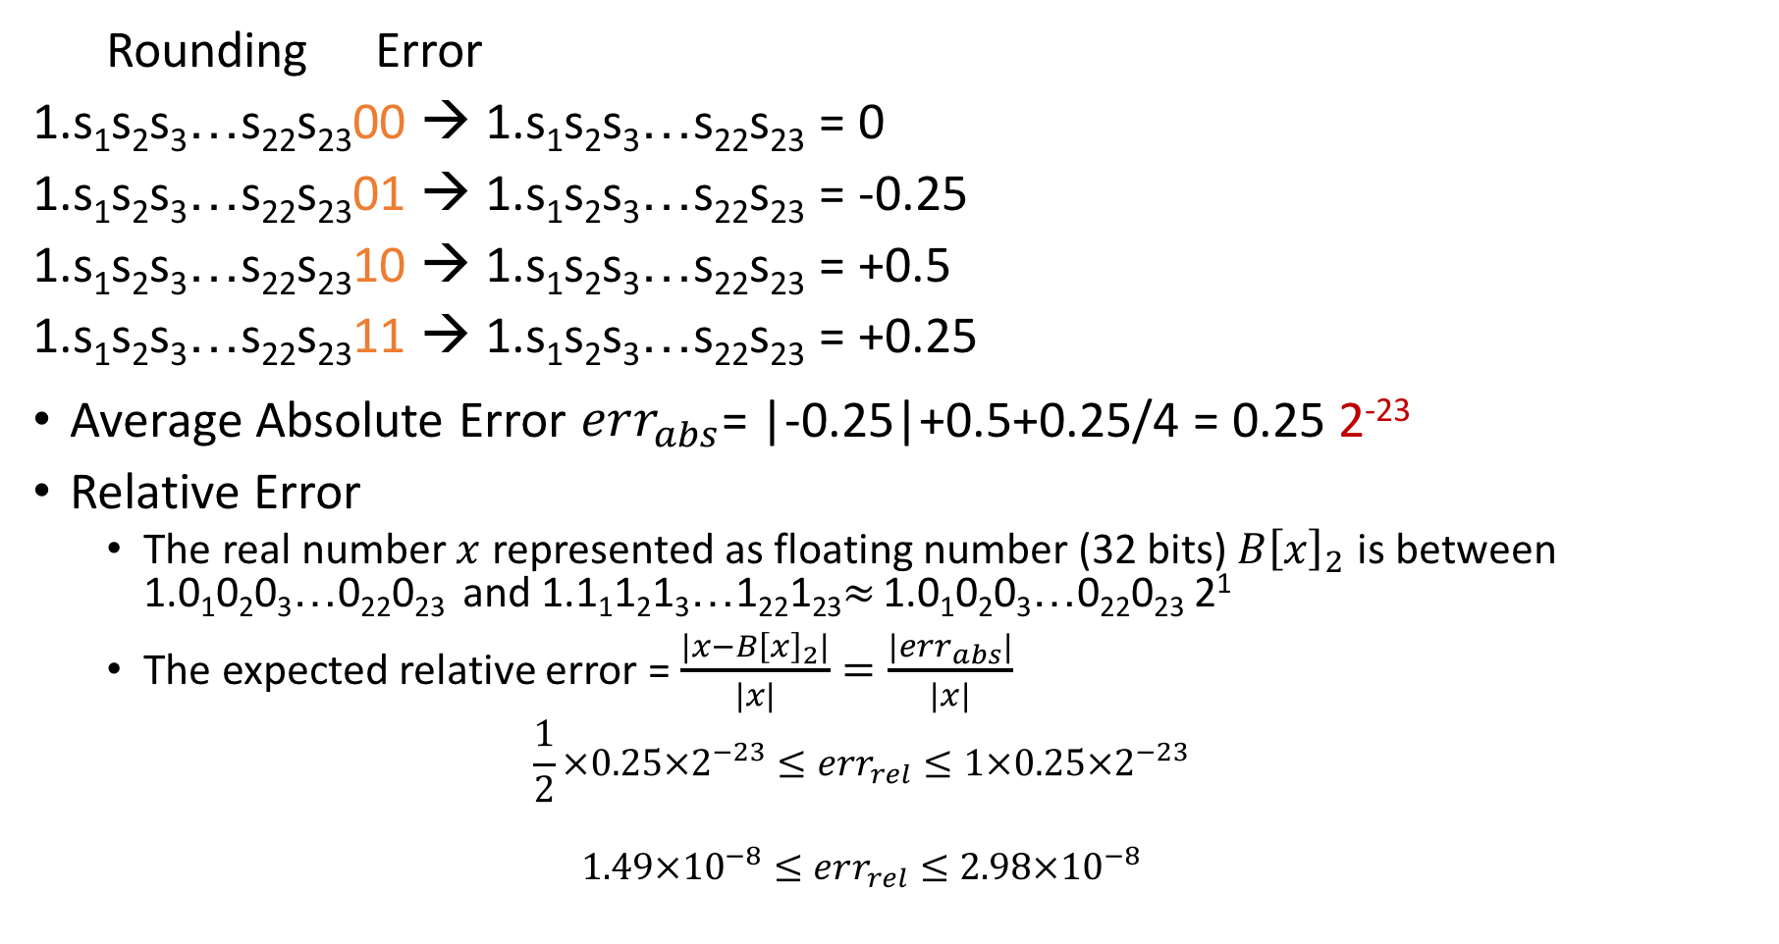
Conventional Rounding Error
Rounding Error
1.s₁s₂s₃…s₂₂s₂₃00 → 1.s₁s₂s₃…s₂₂s₂₃ = 0
1.s₁s₂s₃…s₂₂s₂₃01 → 1.s₁s₂s₃…s₂₂s₂₃ = -0.25
1.s₁s₂s₃…s₂₂s₂₃10 → 1.s₁s₂s₃…s₂₂s₂₃ = +0.5
1.s₁s₂s₃…s₂₂s₂₃11 → 1.s₁s₂s₃…s₂₂s₂₃ = +0.25
  Average Absolute Error $err_{abs}$= |-0.25|+0.5+0.25/4 = 0.25 2⁻²³
Relative Error
  The real number $x$ represented as floating number (32 bits) $B{\left[x\right]}_{2}$ is between 1.0₁0₂0₃…0₂₂0₂₃ and 1.1₁1₂1₃…1₂₂1₂₃$≈$ 1.0₁0₂0₃…0₂₂0₂₃ 2¹
  The expected relative error = $\frac{\left|x−B{\left[x\right]}_{2}\right|}{|x|}=\frac{\left|err_{abs}\right|}{|x|}$
  $$\frac{1}{2}×0.25×2^{−23}≤err_{rel}≤1×0.25×2^{−23}$$
  $$1.49×{10}^{−8}≤err_{rel}≤2.98×{10}^{−8}$$
Average Absolute Error
= |-0.25|+0.5+0.25/4 = 0.25

Slide 26
Rounding: round to even
Round up conditions: 1.bbb…bbbGRXXXX
  Round = 1, Sticky = 1 ➔ > 0.5
  Guard = 1, Round = 1, Sticky = 0 ➔ Round to even
  examples
  Value Fraction GRS Incr? Rounded
  128 1.0000000 000 N 1.000
  15 1.1010000 100 N 1.101
  17 1.0001000 010 N 1.000
  19 1.0011000 110 Y 1.010
  138 1.0001010 011 Y 1.001
  63 1.1111100 111 Y 10.000
Guard bit: LSB of result
Round bit: 1st bit removed
Sticky bit: OR of remaining bits
Round up= R(G+S)

Slide 27
Rounding: Round to even
Guard bit: LSB of result
Round bit: 1st bit removed
Sticky bit: OR of remaining bits
1.bbb…bbbGRS
  Round up = R(G+S)
  GRS Rouding Error
  000 0 0
  001 0 -0.25
  010 0 -0.5
  011 +1 +0.25
  100 0 0
  101 0 -0.25
  110 +1 +0.5
  111 +1 +0.25
Conventional Rounding error
Rounding Error
1.bbbG00 → 1.101 = 0
1.bbbG01 → 1.101 = -0.25
1.bbbG10 → 1.110 = +0.5
1.bbbG11 → 1.110 = +0.25
Average Error = 0.125
Absolute Average Error = 0.25
Average Error = 0
Absolute Average Error = 0.25

Slide 28
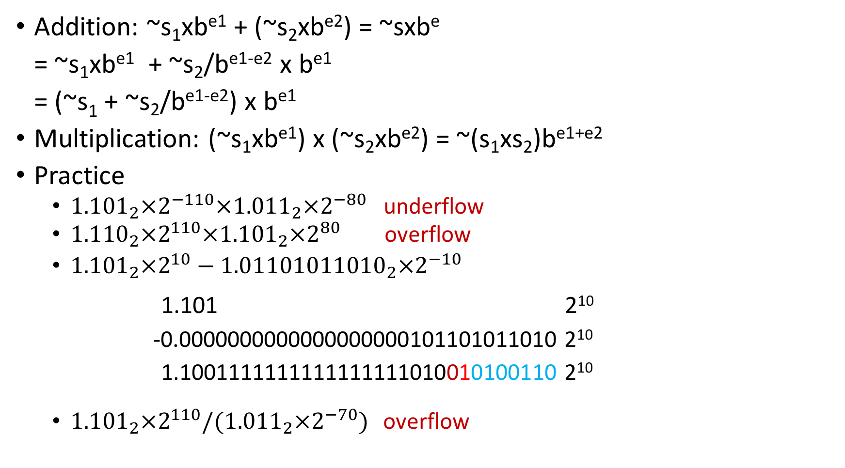
Floating Point Number
Addition: ~s₁xb^{e1} + (~s₂xb^{e2}) = ~sxb^{e}
= ~s₁xb^{e1} + ~s₂/b^{e1-e2} x b^{e1}
= (~s₁ + ~s₂/b^{e1-e2}) x b^{e1}
Multiplication: (~s₁xb^{e1}) x (~s₂xb^{e2}) = ~(s₁xs₂)b^{e1+e2}
Practice
  ${1.101}_{2}×2^{−110}×{1.011}_{2}×2^{−80}$ underflow
  ${1.110}_{2}×2^{110}×{1.101}_{2}×2^{80}$ overflow
  ${1.101}_{2}×2^{10}−{1.01101011010}_{2}×2^{−10}$
1.101 2¹⁰
-0.0000000000000000000101101011010 2¹⁰
1.1001111111111111111010010100110 2¹⁰
  ${1.101}_{2}×2^{110}/({1.011}_{2}×2^{−70})$ overflow
1 10 23
G=0, R=1, S=1
Result =
1.10011111111111111110101₂x2¹⁰
G R S

