Slide 1
CSE140: Adders
Xinyuan Wang
05/24/2019

Slide 2
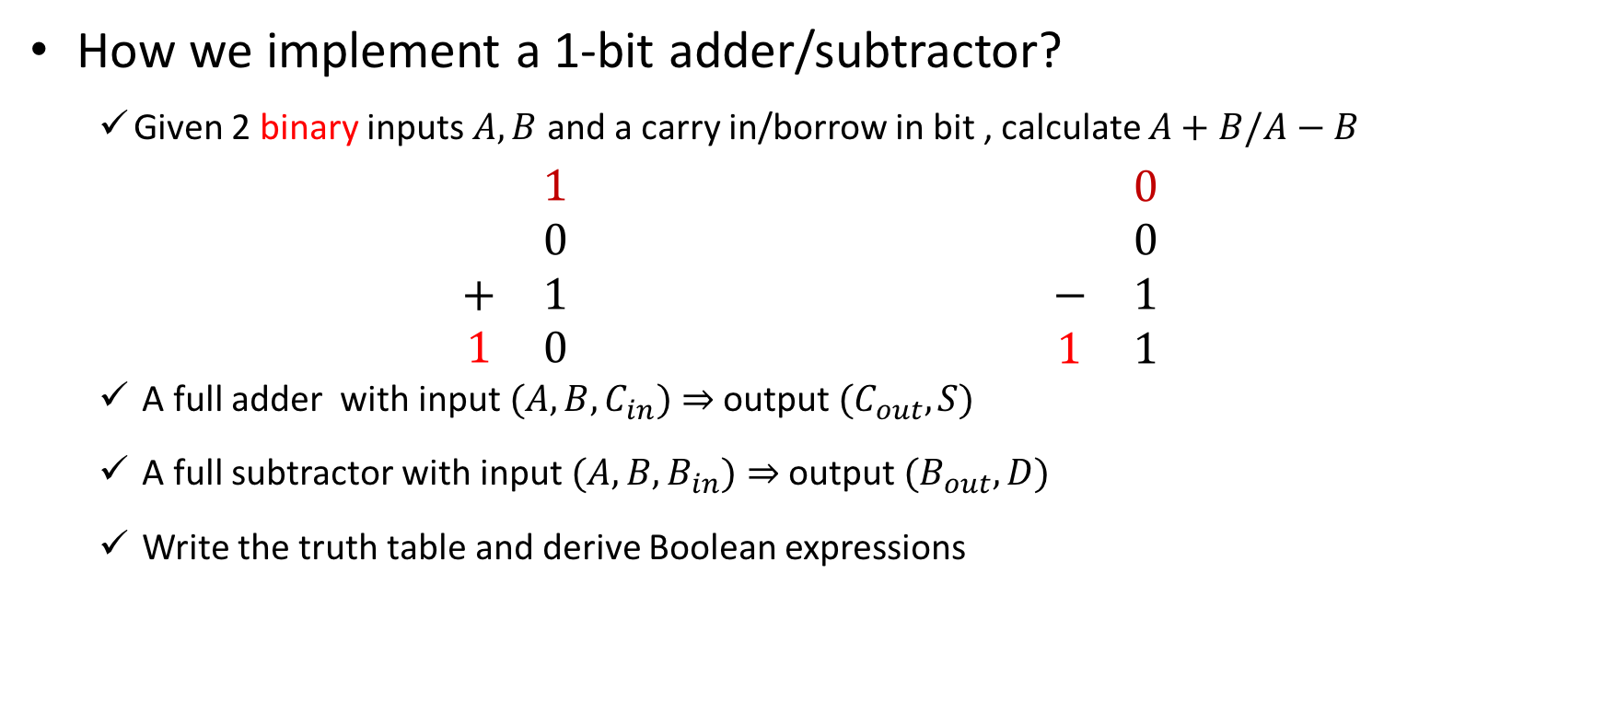


Full Adder/Subtractor
How we implement a 1-bit adder/subtractor?
  Given 2 binary inputs $A,B$ and a carry in/borrow in bit , calculate $A+B/A−B$
$$\begin{matrix} & & 1 & \\ & & 0 & \\ & + & 1 & \\ & 1 & 0 & \end{matrix} \begin{matrix} & & 0 & \\ & & 0 & \\ & − & 1 & \\ & 1 & 1 & \end{matrix}$$
  A full adder with input $(A,B,C_{in})⇒$ output $(C_{out},S)$
  A full subtractor with input $(A,B,B_{in})⇒$ output $(B_{out},D)$
  Write the truth table and derive Boolean expressions
carry in
borrow in
$$A$$
$$A$$
$$B$$
$$B$$
carry out
borrow out

Slide 3
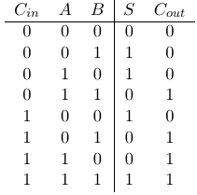
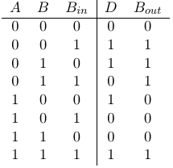
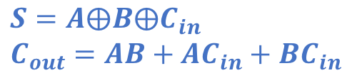
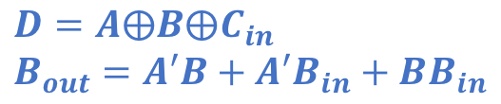
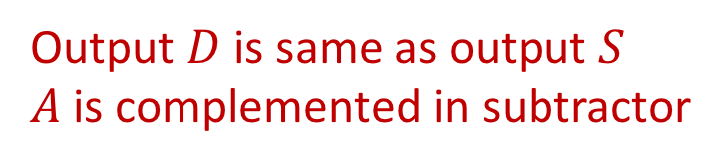
Truth Tables of Full Adder/Subtractor
Derive the Boolean expressions
  What can we observe by comparing the truth tables?
Full Adder
Full Subtractor
Output $D$ is same as output $S$
$A$ is complemented in subtractor
$$S=A⨁B⨁C_{in}$$
$$C_{out}=AB+AC_{in}+BC_{in}$$
$$D=A⨁B⨁C_{in}$$
$$B_{out}=A′B+A′B_{in}+BB_{in}$$

Slide 4
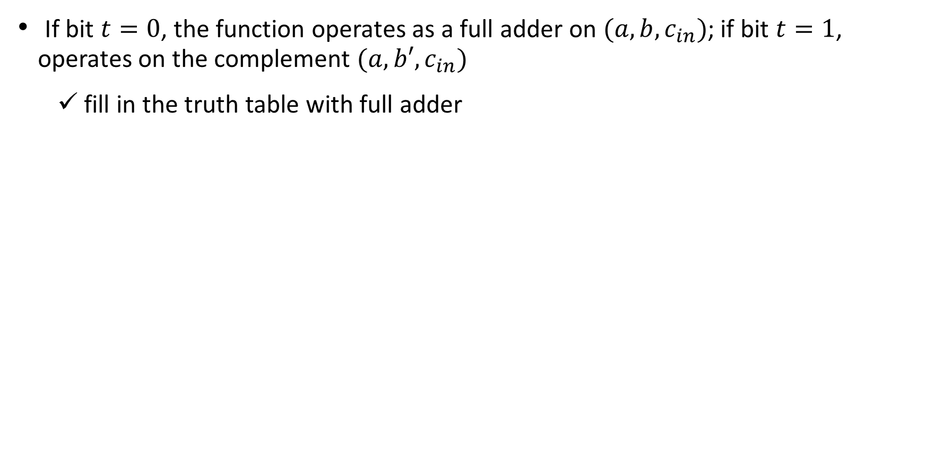
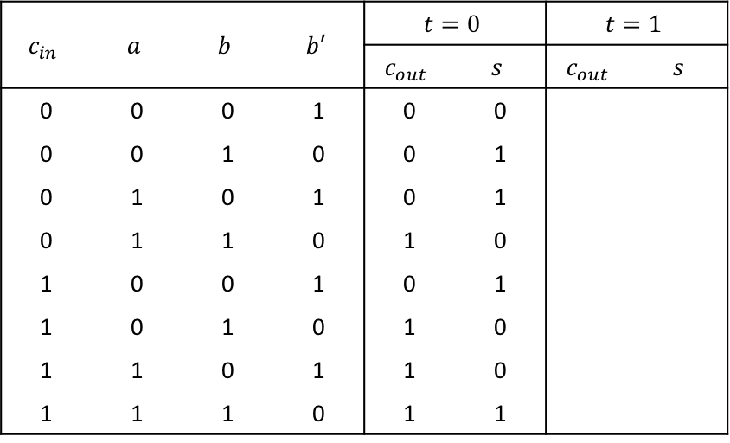


Q1: one’s complement
If bit $t=0$, the function operates as a full adder on $(a,b,c_{in})$; if bit $t=1$, operates on the complement $(a,b′,c_{in})$
  fill in the truth table with full adder
$$(a,b,c_{in})$$
$$(a,b′,c_{in})$$
$$c_{in}$$ | $$a$$ | $$b$$ | $$b′$$ | $$t=0$$ |  | $$t=1$$
 |  |  |  | $$c_{out}$$ | $$s$$ | $$c_{out}$$ | $$s$$
0 | 0 | 0 | 1 | 0 | 0
0 | 0 | 1 | 0 | 0 | 1
0 | 1 | 0 | 1 | 0 | 1
0 | 1 | 1 | 0 | 1 | 0
1 | 0 | 0 | 1 | 0 | 1
1 | 0 | 1 | 0 | 1 | 0
1 | 1 | 0 | 1 | 1 | 0
1 | 1 | 1 | 0 | 1 | 1
Fill in the outputs

Slide 5
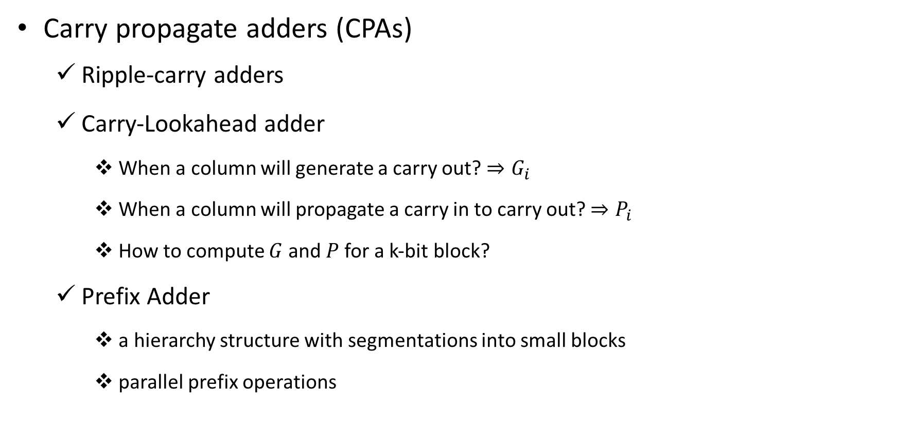
Full Adder/Subtractor
Carry propagate adders (CPAs)
  Ripple-carry adders
  Carry-Lookahead adder
    When a column will generate a carry out? $⇒G_{i}$
    When a column will propagate a carry in to carry out? $⇒P_{i}$
    How to compute $G$ and $P$ for a k-bit block?
  Prefix Adder
    a hierarchy structure with segmentations into small blocks
    parallel prefix operations

Slide 6
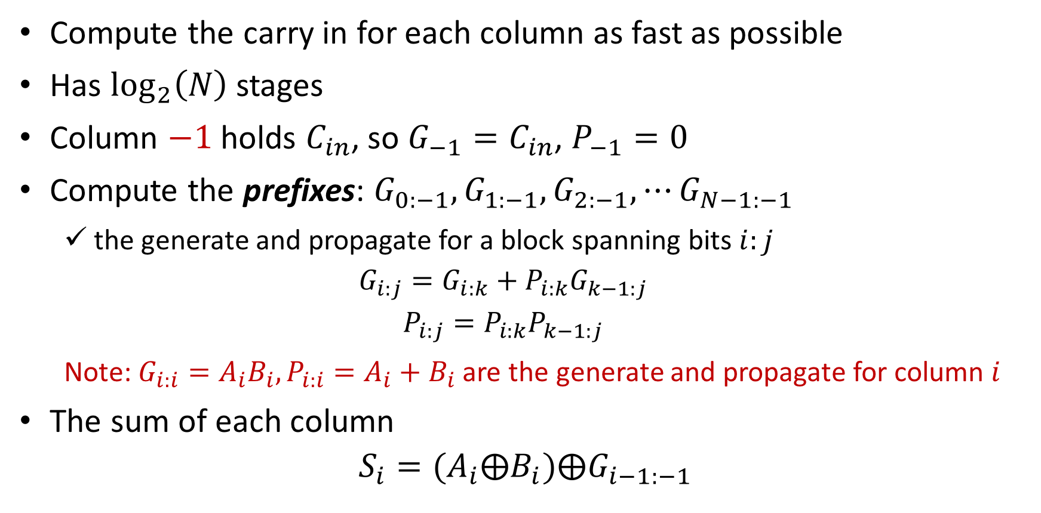
Prefix Adder
Compute the carry in for each column as fast as possible
Has $\log_{2}\left(N\right)$ stages
Column $−1$ holds $C_{in}$, so $G_{−1}=C_{in}$, $P_{−1}=0$
Compute the prefixes: $G_{0:−1},G_{1:−1}, G_{2:−1},⋯G_{N−1:−1}$
  the generate and propagate for a block spanning bits $i:j$
  $$G_{i:j}=G_{i:k}+P_{i:k}G_{k−1:j}$$
  $$P_{i:j}=P_{i:k}P_{k−1:j}$$
  Note: $G_{i:i}=A_{i}B_{i},P_{i:i}=A_{i}+B_{i}$ are the generate and propagate for column $i$
The sum of each column
$$S_{i}=(A_{i}⨁B_{i})⨁G_{i−1:−1}$$

Slide 7
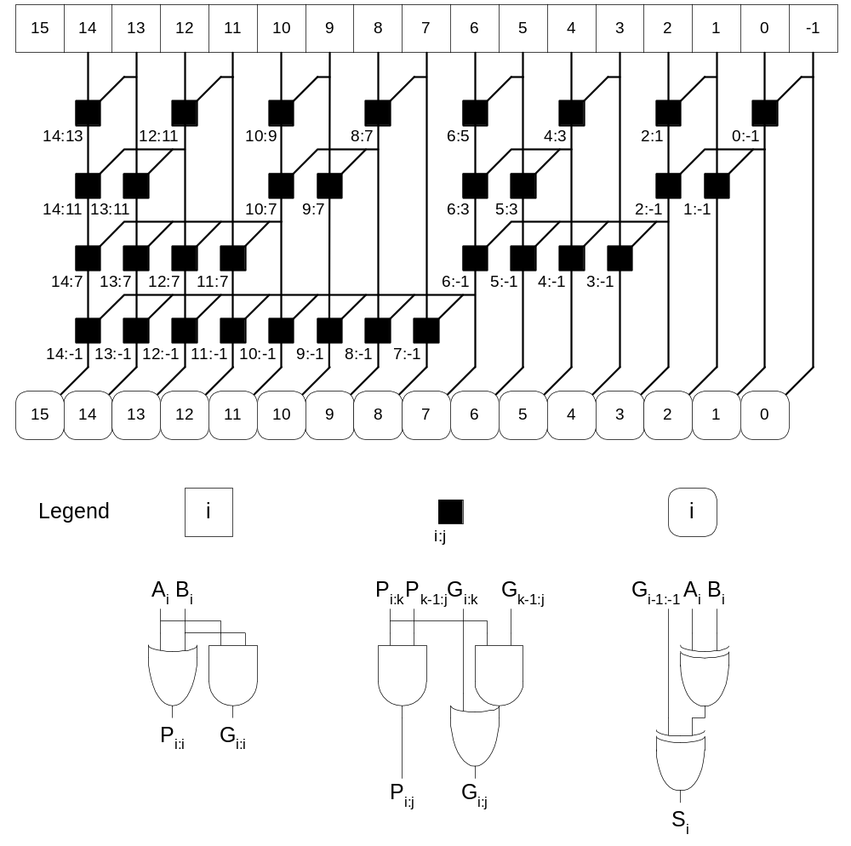
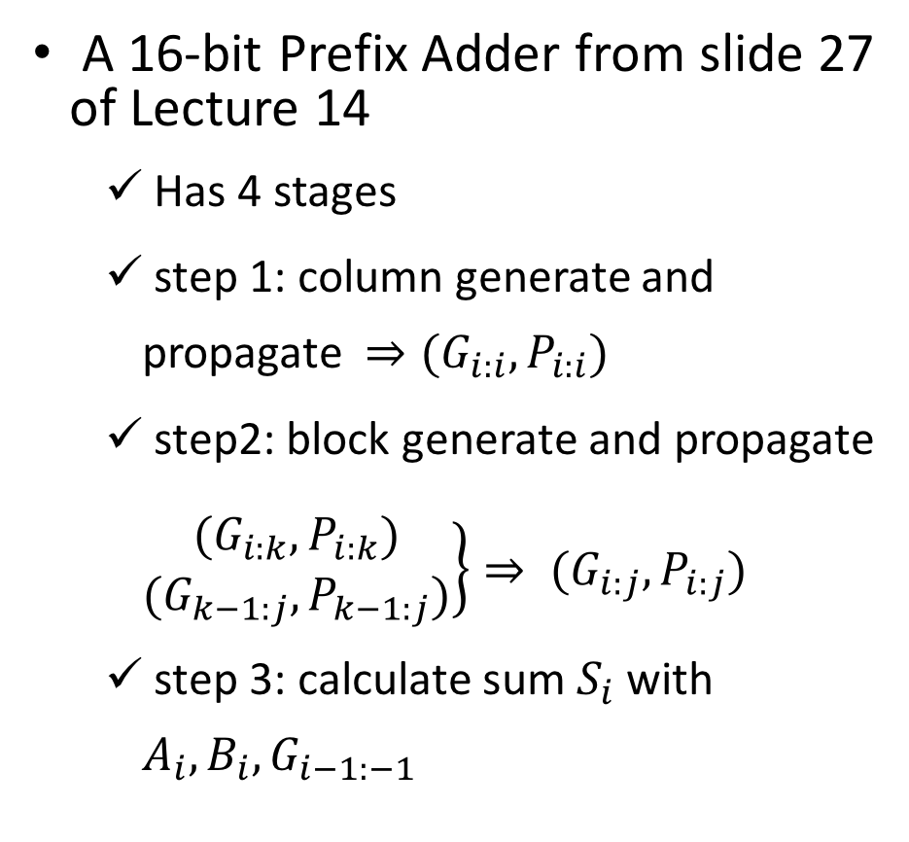
Prefix Adder
A 16-bit Prefix Adder from slide 27 of Lecture 14
  Has 4 stages
  step 1: column generate and propagate $⇒(G_{i:i},P_{i:i})$
  step2: block generate and propagate $\left.\begin{matrix}(G_{i:k},P_{i:k}) \\ (G_{k−1:j},P_{k−1:j})\end{matrix}\right\}⇒ (G_{i:j},P_{i:j})$
  step 3: calculate sum $S_{i}$ with $A_{i},B_{i}, G_{i−1:−1}$
column generate and propagate
block generate and propagate
calculate sum

Slide 8
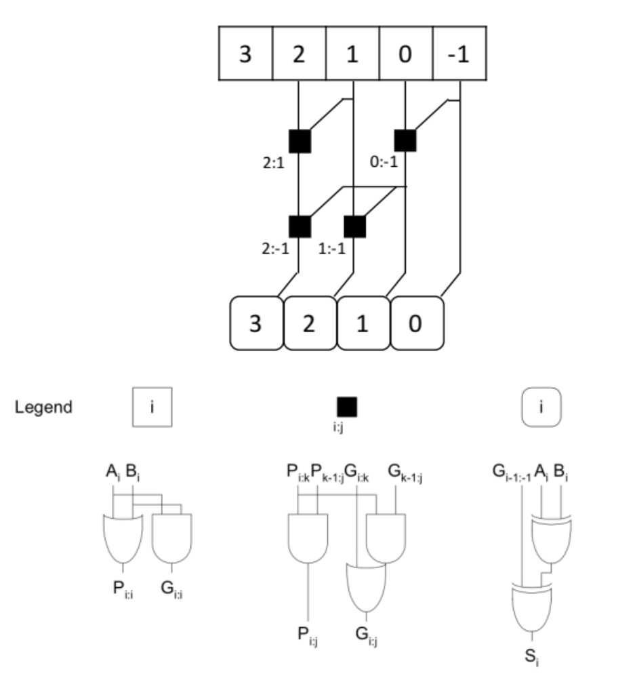
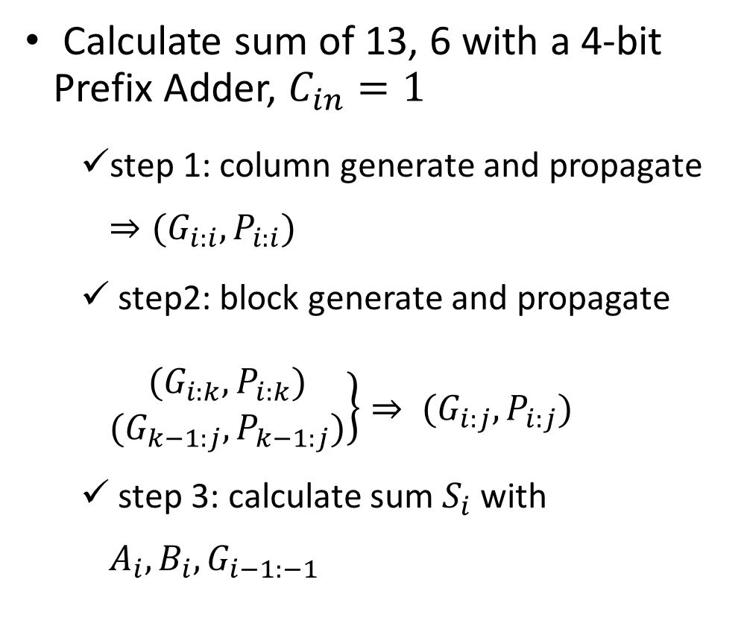
Prefix Adder
Calculate sum of 13, 6 with a 4-bit Prefix Adder, $C_{in}=1$
  step 1: column generate and propagate $⇒(G_{i:i},P_{i:i})$
  step2: block generate and propagate $\left.\begin{matrix}(G_{i:k},P_{i:k}) \\ (G_{k−1:j},P_{k−1:j})\end{matrix}\right\}⇒ (G_{i:j},P_{i:j})$
  step 3: calculate sum $S_{i}$ with $A_{i},B_{i}, G_{i−1:−1}$

Slide 9
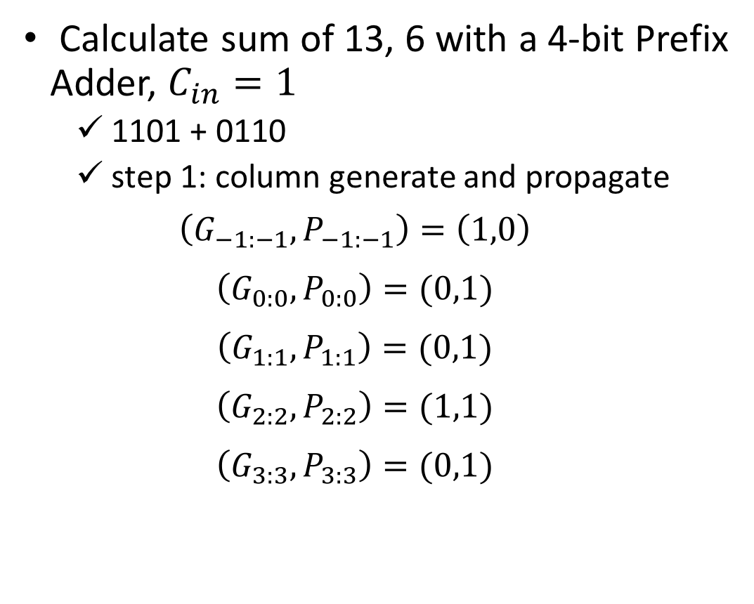
Prefix Adder
Calculate sum of 13, 6 with a 4-bit Prefix Adder, $C_{in}=1$
  1101 + 0110
  step 1: column generate and propagate
  $$\left(G_{−1:−1},P_{−1:−1}\right)=\left(1,0\right)$$
  $$\left(G_{0:0},P_{0:0}\right)=(0,1)$$
  $$\left(G_{1:1},P_{1:1}\right)=(0,1)$$
  $$\left(G_{2:2},P_{2:2}\right)=(1,1)$$
  $$\left(G_{3:3},P_{3:3}\right)=(0,1)$$

Slide 10
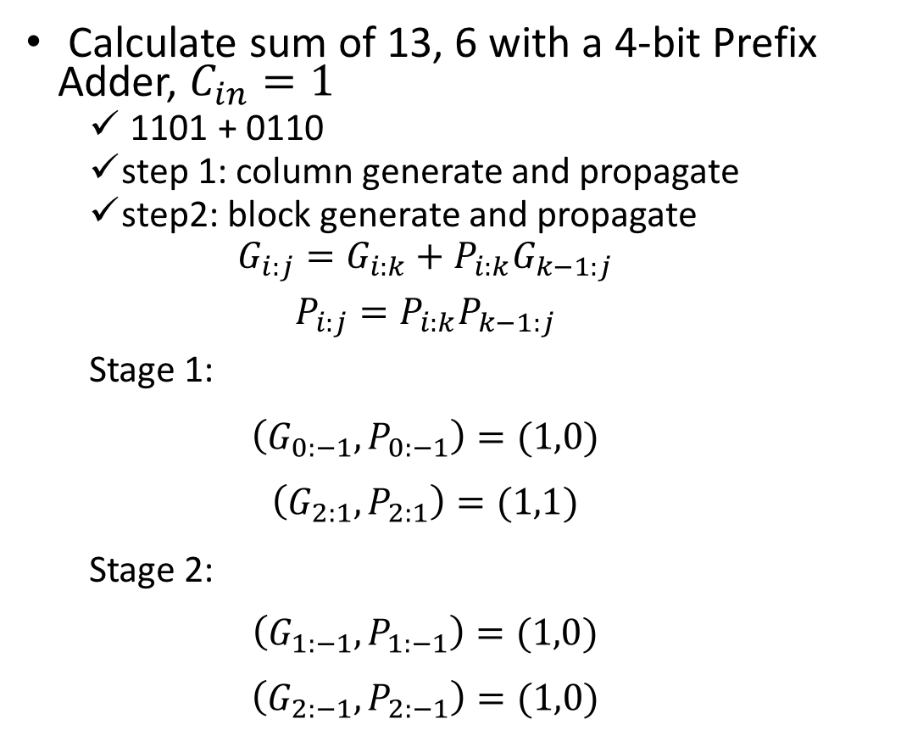



Prefix Adder
  $$(0,1)$$
  $$(1,1)$$
  $$(0,1)$$
  $$(0,1)$$
  $$(1,0)$$
Calculate sum of 13, 6 with a 4-bit Prefix Adder, $C_{in}=1$
  1101 + 0110
  step 1: column generate and propagate
  step2: block generate and propagate
  $$G_{i:j}=G_{i:k}+P_{i:k}G_{k−1:j}$$
  $$P_{i:j}=P_{i:k}P_{k−1:j}$$
  Stage 1:
  $$\left(G_{0:−1},P_{0:−1}\right)=(1,0)$$
  $$\left(G_{2:1},P_{2:1}\right)=(1,1)$$
  Stage 2:
  $$\left(G_{1:−1},P_{1:−1}\right)=(1,0)$$
  $$\left(G_{2:−1},P_{2:−1}\right)=(1,0)$$

Slide 11
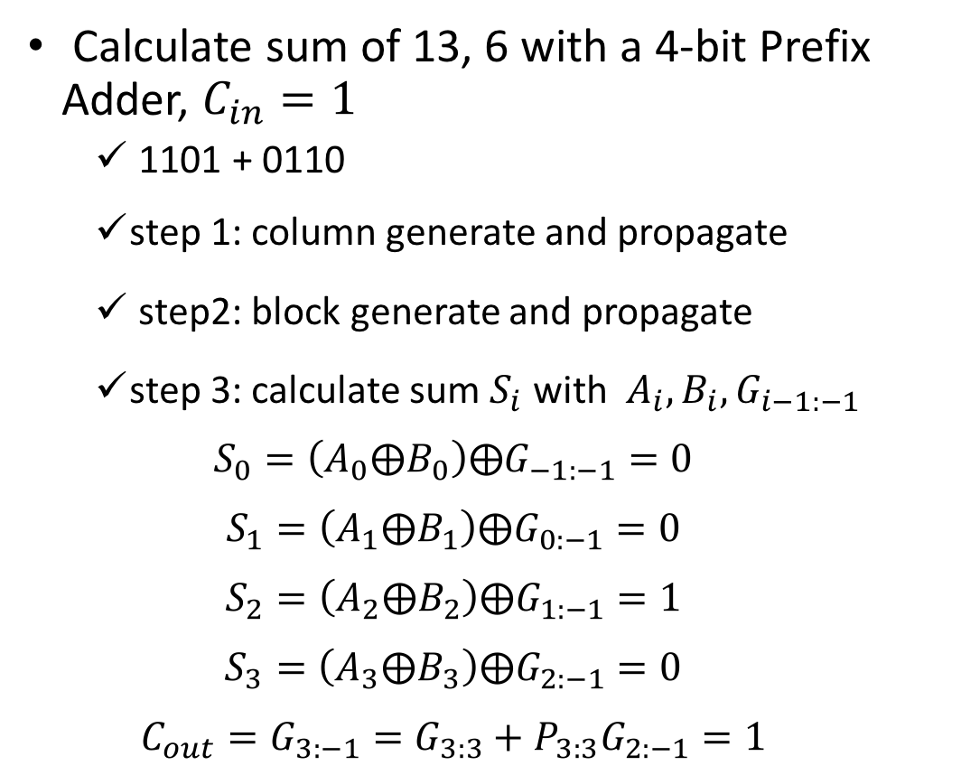



Prefix Adder
  $$(0,1)$$
  $$(1,1)$$
  $$(0,1)$$
  $$(0,1)$$
  $$(1,0)$$
Calculate sum of 13, 6 with a 4-bit Prefix Adder, $C_{in}=1$
  1101 + 0110
  step 1: column generate and propagate
  step2: block generate and propagate
  step 3: calculate sum $S_{i}$ with $A_{i},B_{i}, G_{i−1:−1}$
  $$S_{0}=\left(A_{0}⨁B_{0}\right)⨁G_{−1:−1}=0$$
  $$S_{1}=\left(A_{1}⨁B_{1}\right)⨁G_{0:−1}=0$$
  $$S_{2}=\left(A_{2}⨁B_{2}\right)⨁G_{1:−1}=1$$
  $$S_{3}=\left(A_{3}⨁B_{3}\right)⨁G_{2:−1}=0$$
  $$C_{out}=G_{3:−1}=G_{3:3}+P_{3:3}G_{2:−1}=1$$
  $$(1,1)$$
  $$(1,0)$$
  $$(1,0)$$
  $$(1,0)$$

Slide 12
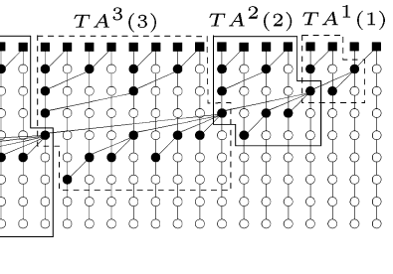
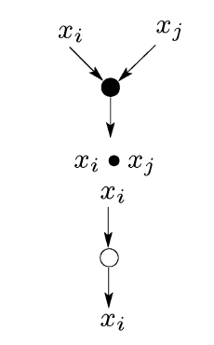
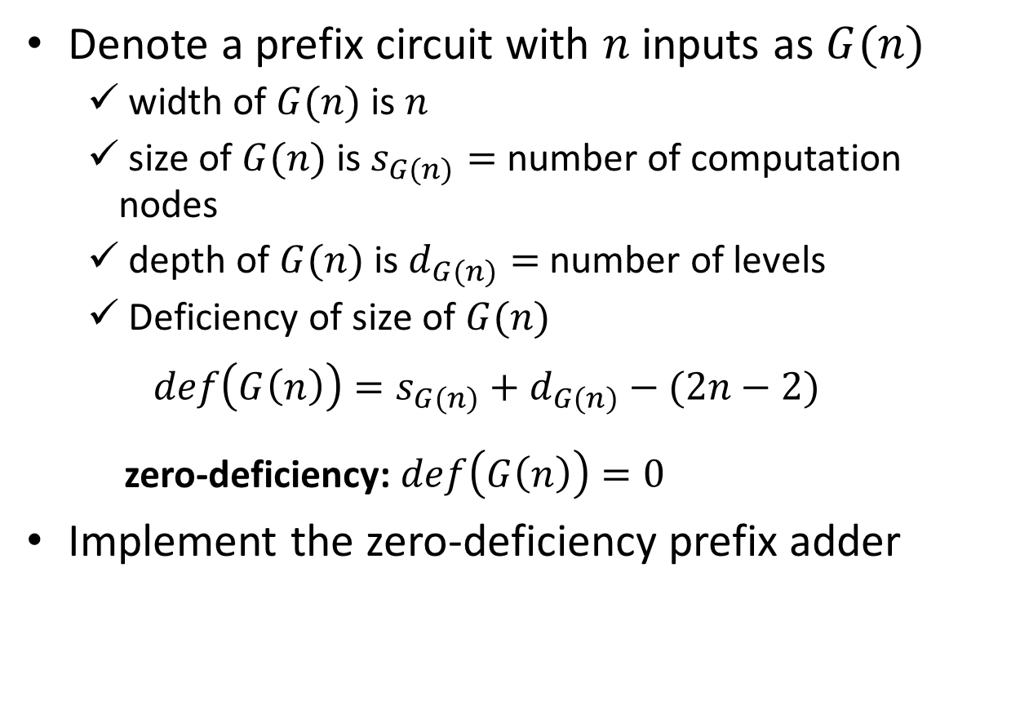
HW: Zero-deficiency prefix circuit
Denote a prefix circuit with $n$ inputs as $G(n)$
  width of $G(n)$ is $n$
  size of $G(n)$ is $s_{G(n)}=$ number of computation nodes
  depth of $G(n)$ is $d_{G(n)}=$ number of levels
  Deficiency of size of $G(n)$
  $$def\left(G\left(n\right)\right)=s_{G(n)}+d_{G(n)}−(2n−2)$$
  zero-deficiency: $def\left(G\left(n\right)\right)=0$
Implement the zero-deficiency prefix adder
legend

Slide 13
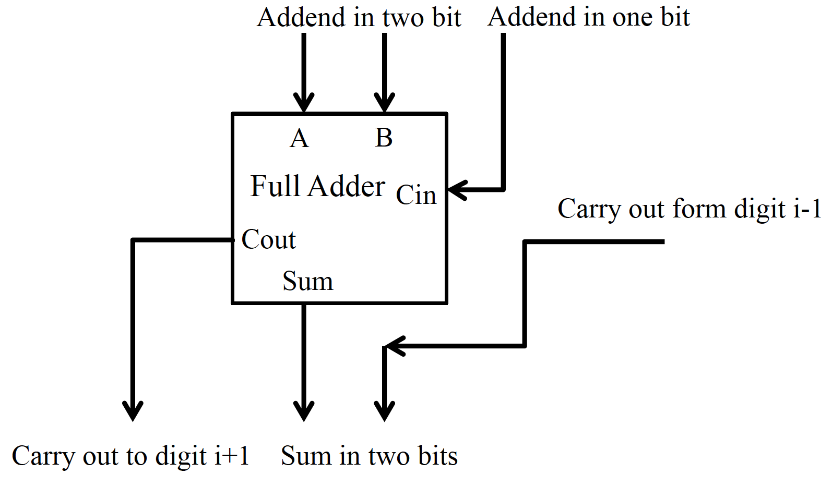



Carry Save Adder
A Redundant Number System
Save the Partial Solution for Multiple Additions
One Bit Propagation for Each Addition
digit $i+1$
digit $i$
digit $i−1$
$$i$$
$$i−1$$
$$i−2$$
$$i+2$$

Slide 14
Carry Save Adder
Example: calculate the sum of 23, 11, 17
Weight | 32 | 16 | 8 | 4 | 2 | 1
n1=23 | 0 | 1 | 0 | 1 | 1 | 1
n2=11 | 0 | 0 | 1 | 0 | 1 | 1
n3=17 | 0 | 1 | 0 | 0 | 0 | 1

Slide 15
Carry Save Adder
Example: calculate the sum of 23, 11, 17
Weight | 64 | 32 | 16 | 8 | 4 | 2 | 1
n1=23 | 0 | 0 | 1 | 0 | 1 | 1 | 1
n2=11 | 0 | 0 | 0 | 1 | 0 | 1 | 1
n3=17 | 0 | 0 | 1 | 0 | 0 | 0 | 1
Addend in one bit
n1 | 00 | 00 | 10 | 00 | 10 | 10 | 10
n2 | 0 | 0 | 0 | 1 | 0 | 1 | 1
A=n1+n2
n3
B=A+n3
Sum
Redundant system

Slide 16
Carry Save Adder
Example: calculate the sum of 23, 11, 17
Weight | 64 | 32 | 16 | 8 | 4 | 2 | 1
n1=23 | 0 | 0 | 1 | 0 | 1 | 1 | 1
n2=11 | 0 | 0 | 0 | 1 | 0 | 1 | 1
n3=17 | 0 | 0 | 1 | 0 | 0 | 0 | 1
n1 | 00 | 00 | 10 | 00 | 10 | 10 | 10
n2 | 0 | 0 | 0 | 1 | 0 | 1 | 1
A=n1+n2 | 00 | 00 | 10 | 10 | 11 | 01 | 00
n3
B=A+n3
Sum
carry
carry
carry
carry
carry
Add three bits with
one bit propagation
sum

Slide 17
Carry Save Adder
Example: calculate the sum of 23, 11, 17
Weight | 64 | 32 | 16 | 8 | 4 | 2 | 1
n1=23 | 0 | 0 | 1 | 0 | 1 | 1 | 1
n2=11 | 0 | 0 | 0 | 1 | 0 | 1 | 1
n3=17 | 0 | 0 | 1 | 0 | 0 | 0 | 1
n1 | 00 | 00 | 10 | 00 | 10 | 10 | 10
n2 | 0 | 0 | 0 | 1 | 0 | 1 | 1
A=n1+n2 | 00 | 00 | 10 | 10 | 11 | 01 | 00
n3 | 0 | 0 | 1 | 0 | 0 | 0 | 1
B=A+n3
Sum
Partial Solution

Slide 18
Carry Save Adder
Example: calculate the sum of 23, 11, 17
Weight | 64 | 32 | 16 | 8 | 4 | 2 | 1
n1=23 | 0 | 0 | 1 | 0 | 1 | 1 | 1
n2=11 | 0 | 0 | 0 | 1 | 0 | 1 | 1
n3=17 | 0 | 0 | 1 | 0 | 0 | 0 | 1
n1 | 00 | 00 | 10 | 00 | 10 | 10 | 10
n2 | 0 | 0 | 0 | 1 | 0 | 1 | 1
A=n1+n2 | 00 | 00 | 10 | 10 | 11 | 01 | 00
n3 | 0 | 0 | 1 | 0 | 0 | 0 | 1
B=A+n3 | 00 | 01 | 00 | 11 | 00 | 10 | 10
Sum
Add three bits with
one bit propagation

Slide 19
Carry Save Adder
Example: calculate the sum of 23, 11, 17
Weight | 64 | 32 | 16 | 8 | 4 | 2 | 1
n1=23 | 0 | 0 | 1 | 0 | 1 | 1 | 1
n2=11 | 0 | 0 | 0 | 1 | 0 | 1 | 1
n3=17 | 0 | 0 | 1 | 0 | 0 | 0 | 1
n1 | 00 | 00 | 10 | 00 | 10 | 10 | 10
n2 | 0 | 0 | 0 | 1 | 0 | 1 | 1
A=n1+n2 | 00 | 00 | 10 | 10 | 11 | 01 | 00
n3 | 0 | 0 | 1 | 0 | 0 | 0 | 1
B=A+n3 | 00 | 01 | 00 | 11 | 00 | 10 | 10
Sum
Partial Solution
An extra addition is needed!

Slide 20
Carry Save Adder
Example: calculate the sum of 23, 11, 17
Weight | 64 | 32 | 16 | 8 | 4 | 2 | 1
n1=23 | 0 | 0 | 1 | 0 | 1 | 1 | 1
n2=11 | 0 | 0 | 0 | 1 | 0 | 1 | 1
n3=17 | 0 | 0 | 1 | 0 | 0 | 0 | 1
n1 | 00 | 00 | 10 | 00 | 10 | 10 | 10
n2 | 0 | 0 | 0 | 1 | 0 | 1 | 1
A=n1+n2 | 00 | 00 | 10 | 10 | 11 | 01 | 00
n3 | 0 | 0 | 1 | 0 | 0 | 0 | 1
B=A+n3 | 00 | 01 | 00 | 11 | 00 | 10 | 10
Two bits of B | 0 | 1 | 0 | 1 | 0 | 0 | 0
 | 0 | 0 | 0 | 1 | 0 | 1 | 1
Sum
Split the redundant number

Slide 21
Carry Save Adder
Example: calculate the sum of 23, 11, 17
Weight | 64 | 32 | 16 | 8 | 4 | 2 | 1
n1=23 | 0 | 0 | 1 | 0 | 1 | 1 | 1
n2=11 | 0 | 0 | 0 | 1 | 0 | 1 | 1
n3=17 | 0 | 0 | 1 | 0 | 0 | 0 | 1
n1 | 00 | 00 | 10 | 00 | 10 | 10 | 10
n2 | 0 | 0 | 0 | 1 | 0 | 1 | 1
A=n1+n2 | 00 | 00 | 10 | 10 | 11 | 01 | 00
n3 | 0 | 0 | 1 | 0 | 0 | 0 | 1
B=A+n3 | 00 | 01 | 00 | 11 | 00 | 10 | 10
Two bits of B | 0 | 1 | 0 | 1 | 0 | 0 | 0
 | 0 | 0 | 0 | 1 | 0 | 1 | 1
Sum | 0 | 1 | 1 | 0 | 0 | 1 | 1

Slide 22




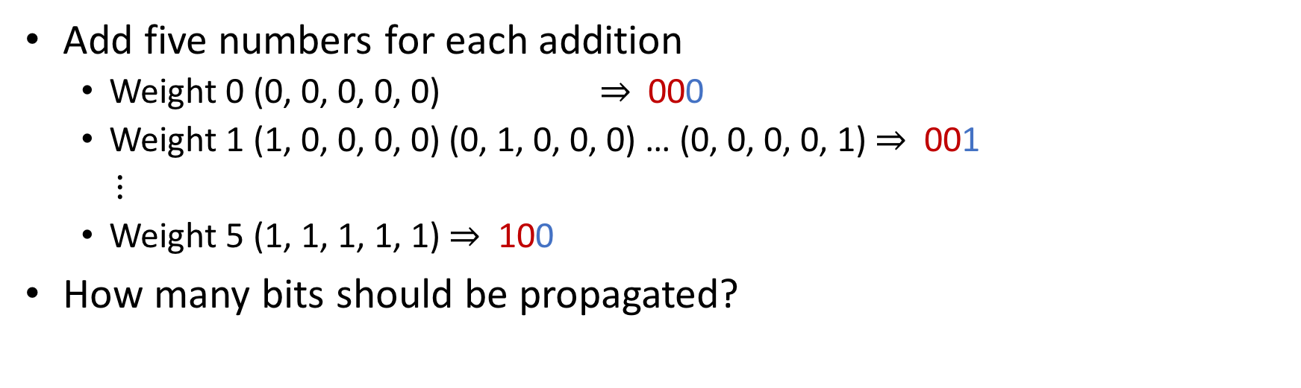







HW: Carry Save Adder
Add five numbers for each addition
  Weight 0 (0, 0, 0, 0, 0) $⇒$ 000
  Weight 1 (1, 0, 0, 0, 0) (0, 1, 0, 0, 0) … (0, 0, 0, 0, 1) $⇒$ 001
  $⋮$
  Weight 5 (1, 1, 1, 1, 1) $⇒$ 100
How many bits should be propagated?
digit $i+1$
digit $i$
digit $i−1$
Addend in 5 bits
$$A_{4:0}\left[i+1\right]$$
Addend in 2 bits
Addend in 5 bits
$$A_{4:0}[i]$$
Addend in 2 bits
Addend in 5 bits
$$A_{4:0}[i−1]$$
Addend in 2 bits
Adder Block
Adder Block
Adder Block
$$S_{2:0}\left[i+1\right]$$
$$S_{2:0}\left[i\right]$$
$$S_{2:0}\left[i−1\right]$$
carry in to digit i-1
carry out from $S_{2}[i−2]$
carry out from $S_{2}[i−3]$
carry out from $S_{1}[i−1]$
sum in 3 bits
sum in 3 bits
sum in 3 bits

