Slide 1
Lecture 1:
Introduction to Digital Logic Design
CSE 140: Components and Design Techniques for Digital Systems
Spring 2018
CK Cheng
Dept. of Computer Science and Engineering
University of California, San Diego
Notes:
Digital: 0, 1 or False, True or GND, Vdd
Logic: Reasoning
Design: Theory + Implementation

Slide 2
Outlines
Class Schedule and Enrollment
Staff
  Instructor, TAs, Tutors
Logistics
  Websites, Textbooks, Grading Policy
Motivation
  Moore’s Law, Internet of Things, Quantum Computing
Scope
  Position among courses
  Coverage

Slide 3
Class Schedule and Enrollment
CSE140 A (enrollment 175, waitlist 48)
  Lecture: TR 5-620PM, SOLIS 107
  Discussion: F 3-350PM, PCYNH 106
  Final: S 3-5PM, 6/9/2018
CSE140 B (enrollment 146, waitlist 16)
  Lecture: TR 2-320PM Center 214
  Discussion: F 4-450PM, PCYNH 106
  Final: S 3-5PM, 6/6/2018
Waitlist: I welcome all students but have no control of the enrollment
No discussion session on Friday 4/6/2018

Slide 4
Information about the Instructor
Instructor: CK Cheng
Education: Ph.D. in EECS UC Berkeley
Industrial Experiences: Engineer of AMD, Mentor Graphics, Bellcore; Consultant for technology companies
Email: ckcheng+140@ucsd.edu
Office: Room 2130 CSE Building
Office hours are posted on the course website
  2-250PM Monday; 10-1050AM Friday
Websites
  http://cseweb.ucsd.edu/~kuan
  http://cseweb.ucsd.edu/classes/sp18/cse140-a

Slide 5
Information about TAs and Tutors
TAs
Wang, Ariel Xinyuan email:xiw193@ucsd.edu
Hsu, Po-Ya email:p8hsu@ucsd.edu
Assare, Omid email:omid@ucsd.edu
Tutors
Yu, Yue 10hrs/week
Deliwala, Ravish Ashish 10hrs/week
Hu, Renxu 5hrs/week
Lu, Anthony 20 hrs/week
Kulshreshtha, Priyanka 10hrs/week
Chen, Zhiran 10hrs/week
Wang, Lan 10hrs/week
Wang, Xinwei 10hrs/week
Kum, Cheuk Him Deacon 10hrs/week
Sim, Joonseop 5hrs/week
Office hours will be posted on the course website
Notes:
Office hours and paper correction

Slide 6
Logistics: Sites for the Class
Class website
  http://cseweb.ucsd.edu/classes/sp18/cse140-a/index.html
  Index: Staff Contacts and Office Hrs
  Syllabus
    Grading policy
    Class notes
    Assignment: Homework and zyBook Activities
    Exercises: Solutions and Rubrics
Forum (Piazza): Online Discussion *make sure you have access
Score keepers: Gradescope, TritonEd
ACMS Labs ieng6: BSV Bluespec System Verilog
zyBook: UCSDCSE140ChengSpring2018
Notes:
Joint website

Slide 7
Logistics: Textbooks
Required text:
Online Textbook: Digital Design by F. Vahid
  Sign in or create an account at learn.zybooks.com
  Enter zyBook code UCSDCSE140ChengSpring2018
  Fill email address with domain @ucsd.edu
  Fill section A or B
  Click Subscribe $54
  Reference texts (recommended and reserved in library)
Digital Design, F. Vahid, 2010 (2nd Edition).
Digital Design and Computer Architecture, D.M. Harris and S.L. Harris, Morgan Kaufmann, 2015 (ARM Edition).
Digital Systems and Hardware/Firmware Algorithms, Milos D. Ercegovac and Tomas Lang.

Slide 8
Lecture: iCliker for Peer Instruction
I will pose questions. You will
  Solo vote: Think for yourself and select answer
  Discuss: Analyze problem in teams of three
    Practice analyzing, talking about challenging concepts
    Reach consensus
  Class wide discussion:
    Led by YOU (students) – tell us what you talked about in discussion that everyone should know.
Many questions are open, i.e. no exact solutions.
  Emphasis is on reasoning and team discussion
  No solution will be posted

Slide 9
Logistics: Grading
Grade on style, completeness and correctness
zyBook exercises: 10% (due Tuesday 2:00PM)
iClicker: 10% (by participation up to 10 classes)
Homework: 15% (grade based on a subset of problems)
Midterm 1: 20% (T 4/24/18)
Midterm 2: 20% (T 5/15/18)
Final: 25% (3-5PM, Saturday 6/9/18)
Grading: The best of the following
  The threshold: A- >90% ; B- >80% of 100% score
  The curve: (A+,A,A-) top 33±ε% of class; (B+,B,B-) second 33±ε%
  The bottom: C- above 45% of 100% score.

Slide 10
Logistic: grading components
zyBook: Interactive learning experience
  No excuse for delay
iClicker:
  Clarification of the concepts and team discussion
  Participation of 10 classes. No excuse for missing
  Homework:
    Paper Work
    Coding: BSV Bluespec System Verilog
    Group discussion is encouraged. However, we are required to write them individually for the best results
  Discount 10% loss of credit for each day after the deadline but no credit after the solution is posted.
  Metric: Posted solutions and rubrics, but not grading results

Slide 11
Logistic: Midterms and Final
Midterms: (Another) Indication of how well we have absorbed the material
  Samples will be posted for more practices.
  Solution and grading policy will be posted after the exam.
  Midterm 2 is not cumulative but requires a good command of the Midterm 1 content.
Final:
  Two hours exam.
  Samples will be posted for more practices.
  Final is not cumulative but requires a good command of the whole class.

Slide 12
Logistic: Class Expectation
Level 1: Introduction (zyBook)
  Basic concepts
  Motivation
Level 2: Essence (Lecture and slides)
  Key ideas
Level 3: Hands on practice (Homework)
  Exercises
Level 4: Samples of exams
  Review

Slide 13
Course Problems…Cheating
What is cheating?
  Studying together in groups is not cheating but encouraged
  Turned-in work must be completely your own.
  Copying someone else’s solution on a HW or Exam is cheating
  Both “giver” and “receiver” are equally culpable
We will be better off to work on the problem alone during the exam.
We have to address the issue once the cheating is reported by TAs or tutors.

Slide 14
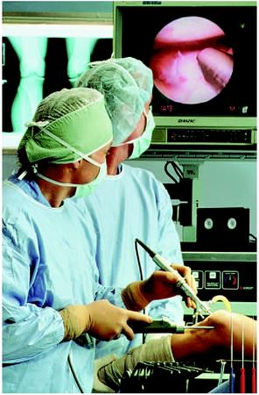


Motivation
Microelectronic technologies have revolutionized our world: cell phones, internet, rapid advances in medicine, etc.
The semiconductor industry has grown from $21 billion in 1985 to $335 billion in 2015.

Slide 15

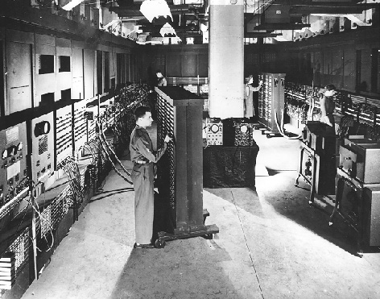
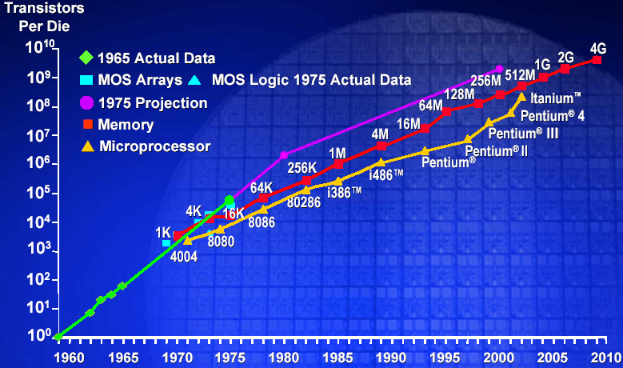
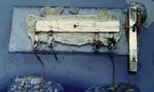
The Digital Revolution
Integrated Circuit: Many digital operations on the same material
Vacuum tubes
Exponential Growth of Computation
(1.6 x 11.1 mm)
ENIAC
Integrated Circuit
Moore’s Law
Stored Program
Model
WWII
1949
1965
Notes:
The stored program model computers and the invention of the transistor and the integrated circuit generated an exponential growth in computing devices and computers – why?
Von neumann architecture – put both data and instructions on the same electronic medium – memory. The whole machine could be constructed from digital logic/circuits.
Digital logic was in turn constructed using electronic circuits – different discrete components vacuum tubes (switches), capacitors, resistors.
But the way digital circuits were constructed underwent a revolution once the transistor came along. The transistor replaced the vacuum tube (both are switches) – given a control signal they either let current pass through them (logic 1) or stop current (logic 0). Discrete circuits were replaced by integrated circuits (everything made from the same silicon material).
The whole computer shrank.

Slide 16
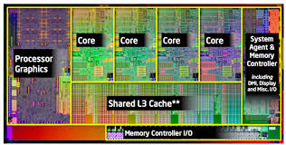
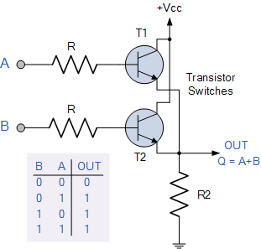
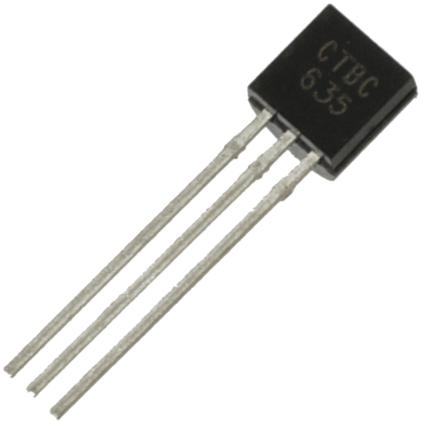
Building complex circuits
Transistor

Slide 17
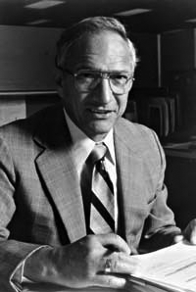
Robert Noyce, 1927 - 1990
Nicknamed “Mayor of Silicon Valley”
Cofounded Fairchild Semiconductor in 1957
Cofounded Intel in 1968
Co-invented the integrated circuit

Slide 18
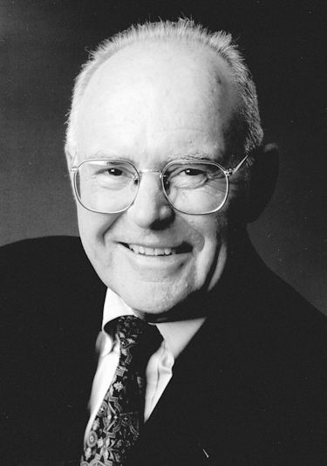
Gordon Moore
Cofounded Intel in 1968 with Robert Noyce.
Moore’s Law: the number of transistors on a computer chip doubles every 1.5 years (observed in 1965)

Slide 19
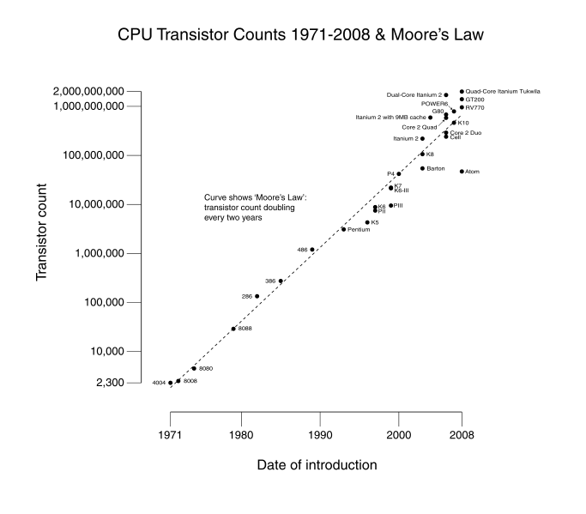
Technology Trends: Moore’s Law
Since 1975, transistor counts have doubled every two years.

Slide 20
New Technologies
New materials and fabrication for devices
  Low power devices
  Three dimensional integrated circuits
  Graphene
New architecture
  Machine learning, deep learning
Quantum computing

Slide 21
Artificial Intelligence
Logic and Reasoning
Boolean Satisfiability
  Product of sum clauses
  Diagnosis
States and Sequences
  Sequential Machines
  Reachability
  Controllability

Slide 22
Scope
The purpose of this course is that we:
Learn the principles of digital design
Learn to systematically debug increasingly complex designs
Design and build digital systems
Learn what’s under the hood of an electronic component
Prepare for the future technology revolution

Slide 23
Position among CSE Courses
Algos: CSE 100, 101
Application (ex: browser)
CSE 131
CSE 120
Operating
Compiler
System
(Mac OSX)
Software
Assembler
Instruction Set
Architecture
Architecture
Processor
Memory
I/O system
CSE 141
Datapath & Control
CSE 140
Digital Design
Circuit Design
Transistors
Big idea: Coordination of many levels of abstraction
Dan Garcia®

Slide 24
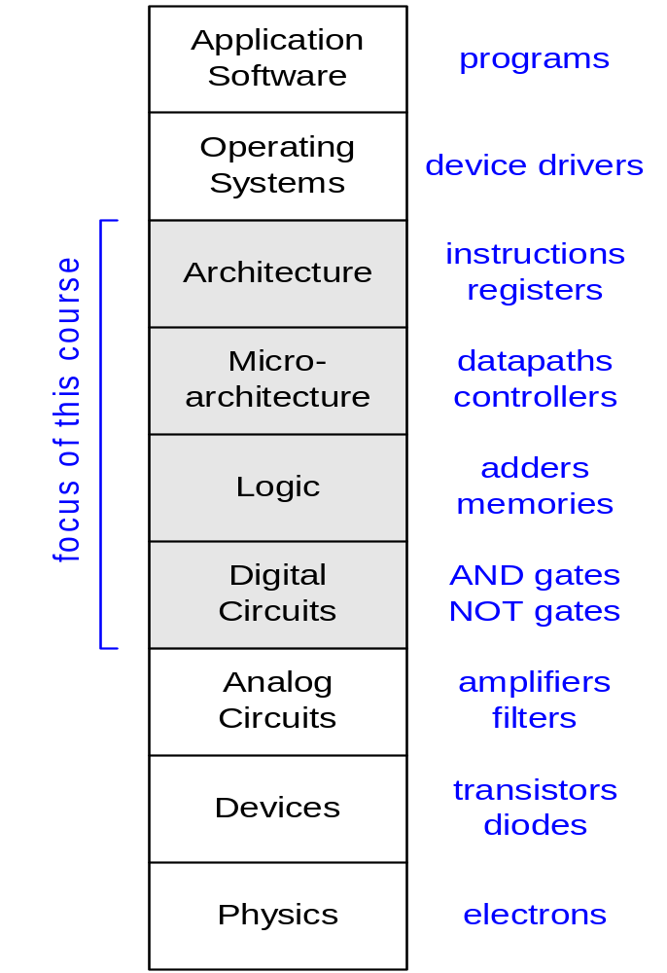
Principle of Abstraction
CSE 30
CSE 141
CSE 140
Abstraction: Hiding details when they are not important

Slide 25
Combinational Logic vs Sequential Network
x₁
.
.
.
x_{n}
x₁
.
.
.
x_{n}
x₁
.
.
.
x_{n}
f_{i}(x)
f_{i}(x,s)
f_{i}(x)
f_{i}(x)
f_{i}(x)
s_{i}
CLK
Sequential Networks
1. Memory
2. Time Steps (Clock)
Combinational logic:
y_{i} = f_{i}(x₁,..,x_{n})
y_{i}^{t} = f_{i} (x₁^{t},…,x_{n}^{t}, s₁^{t}, …,s_{m}^{t})
s_{i}^{t+1} = g_{i}(x₁^{t},…,x_{n}^{t}, s₁^{t},…,s_{m}^{t})

Slide 26
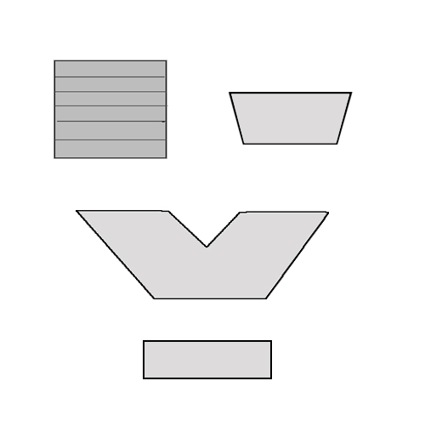
Scope: Overall Picture of CS140
Data Path Subsystem
Input
Control Subsystem
Memory File
Conditions
Pointer
Select
Sequential machine
Mux
ALU
Control
Memory Register
CLK: Synchronizing Clock
Conditions
BSV: Design specification and modular design methodology

Slide 27
Scope
Subjects | Building Blocks | Theory
Combinational Logic | AND, OR, NOT, XOR | Boolean Algebra
Sequential Network | AND, OR, NOT, FF | Finite State Machine
Standard Modules | Operators, Interconnects, Memory | Arithmetics, Universal Logic
System Design | Data Paths, Control Paths | Methodologies
Notes:
Coverage of Midterm 1, Midterm 2, and Final

Slide 28
Combinational Logic
Basics

Slide 29
What is a combinational circuit?
No memory
Realizes one or more functions
Inputs and outputs can only have two discrete values
  Physical domain (usually, voltages) (Ground 0V, Vdd 1V)
  Mathematical domain : Boolean variables (True, False)
Differentiate between different representations:
  physical circuit
  schematic diagram
  mathematical expressions

Slide 30
Boolean Algebra
A branch of algebra in which the values of the variables belong to a set B (e.g. {0, 1}), has two operations {+, .} that satisfy the following four sets of laws.
Associative laws: (a+b)+c= a+(b+c), (a·b)·c =a·(b·c)
Commutative laws: a+b=b+a, a·b=b·a
Distributive laws: a+(b·c)=(a+b)·(a+c),
a·(b+c)=a·b+a·c
Identity laws: a+0=a, a·1=a
Complement laws: a+a’=1, a·a’=0
(x’: the complement element of x)

Slide 31
Representations of combinational circuits:
The Schematic
A
Y
B
What is the simplest combinational circuit that you know?

Slide 32
Representations of combinational circuits
Truth Table: Enumeration of all combinations
Example: AND
id | A | B | Y
0 | 0 | 0 | 0
1 | 0 | 1 | 0
2 | 1 | 0 | 0
3 | 1 | 1 | 1
A
Y=AB
B

Slide 33
Boolean Algebra
Similar to regular algebra but defined on sets with only three basic ‘logic’ operations:
  Intersection: AND (2-input); Operator: ∙ ,&
  Union: OR (2-input); Operator: + ,|
  Complement: NOT ( 1-input); Operator: ‘ ,!
“&, |, !” Symbols in BSV

Slide 34
Boolean algebra and switching functions
Two-input AND ( ∙ )
Two-input OR (+ )
One-input NOT (Complement, ’ )
AND
OR
A B Y
0 0 0
0 1 0
1 0 0
1 1 1
A B Y
0 0 0
0 1 1
1 0 1
1 1 1
NOT
A Y
0 1
1 0
A
1
A
1
A
1
A
0
A
0
0
A
For an AND gate,
0 at input blocks the other inputs and dominates the output
1 at input passes signal A
For an OR gate,
1 at input blocks the other inputs and dominates the output
0 at input passes signal A

Slide 35
Example:
Notes:
Try cases like f(a,b)= (a+b)b, or ab’+a’+b a tautology case

Slide 36
Boolean Algebra
iClicker Q: For two Boolean variables X and Y with X=1, Y=0, what is function F(X,Y)=X+Y?
F(X,Y)=0
F(X,Y)=1
F(X,Y)=2

Slide 37
Boolean Algebra
iClicker Q: For two Boolean variables X and Y with X=1, Y=0, what is function F(X,Y)=X+X+Y?
F(X,Y)=0
F(X,Y)=1
F(X,Y)=2

Slide 38
Boolean Algebra
iClicker Q: For two Boolean variables X and Y with X=1, Y=0, what is function F(X,Y)=X+XY?
F(X,Y)=0
F(X,Y)=1
F(X,Y)=2

Slide 39
Boolean Algebra
iClicker Q: For two Boolean variables X and Y with X=1, Y=0, what is function F(X,Y)=(X+Y)Y?
F(X,Y)=0
F(X,Y)=1
F(X,Y)=2

Slide 40
So, what is the point of representing gates as symbols and Boolean expressions?
Given the Boolean expression, we can draw the circuit it represents by cascading gates (and vice versa)
a
b
ab
ab + cd
c
d
y=e (ab+cd)
cd
e
Logic circuit vs. Boolean Algebra Expression

Slide 41
Next class
Designing Combinational circuits

