Slide 1
CSE 140 Lecture 11
Standard Combinational Modules
CK Cheng
CSE Dept.
UC San Diego

Slide 2
Part III - Standard Combinational Modules
Introduction
Decoder
  Behavior, Logic, Usage
Encoder
Multiplexer (Mux)
  Behavior, Logic, Usage
Demultiplexier (DeMux)

Slide 3
Part III - Standard Combinational Modules
Signal Transport
Decoder: Decode address
Encoder: Encode address
Multiplexer (Mux): Select data by address
Demultiplexier (DeMux): Direct data by address
Shifter: Shift bit location
Data Operator
Adder: Add two binary numbers
Multiplier: Multiply two binary numbers

Slide 4
Interconnect: Decoder, Encoder, Mux, DeMux
Processors
Arbiter
P1
Data 1
Mux
Memory Bank
Address 1
Data
P2
Demux
n-m
Address 2
Mux
Address
n
m
2^{m}
Address k
Decoder
Pk
Data k
Decoder: Decode the address to assert the addressed device
Mux: Select the inputs according to the index addressed by the control signals

Slide 5
1. Decoder
Definition
Logic Diagram
Application (Universal Set)
Tree of Decoders

Slide 6
iClicker: Decoder Definition
A device that decodes
An electronic device that converts signals from one form to another
A machine that converts a coded text into ordinary language
A device or program that translates encoded data into its original format
All of the above

Slide 7
Decoder Definition: A digital module that converts a binary address to the assertion of the addressed device
E (enable)
I₀
0
0
1
2
3
4
5
6
7
y₀
y₁
y₇
I₁
1
.
.
I₂
2
n to 2^{n} decoder function:
n inputs
n= 3
2^{n} outputs
2³= 8
y_{i} = 1 if E= 1 & (I_{2,} I_{1,} I₀ ) = i
y_{i}= 0 otherwise

Slide 8
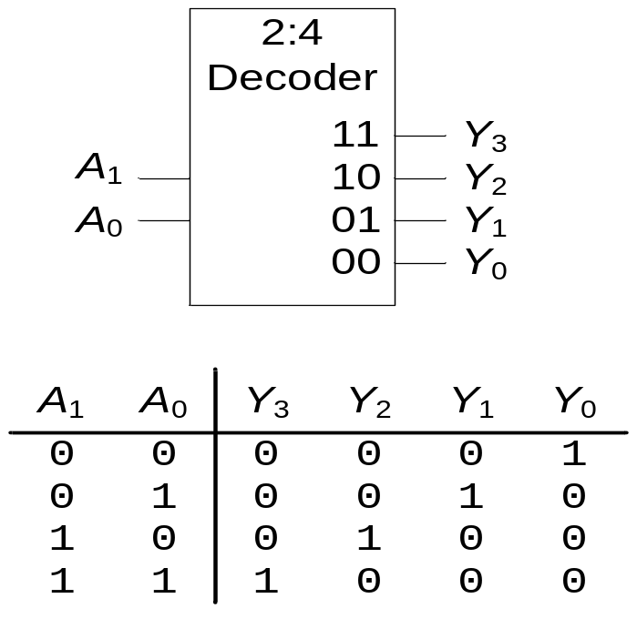
1. Decoder: Definition
N inputs, 2^{N} outputs
One-hot outputs: only one output HIGH at most
E
E= 1

Slide 9
1. Decoder: Definition
iClicker: A 3-input decoder has how many outputs?
2 outputs
4 outputs
8 outputs
10 outputs
E

Slide 10
Decoder Definition
E (enable)
iClicker: For a 3-input decoder, suppose
(E,I₂,I₁,I₀)=(1,0,0,0), then (y₇,y₆, …, y₀) is equal to:
(00000000)
(00000001)
(00000010)
(01000000)
(10000000)
I₀
0
0
1
2
3
4
5
6
7
y₀
y₁
y₇
I₁
1
.
.
I₂
2
3 inputs
8 outputs

Slide 11
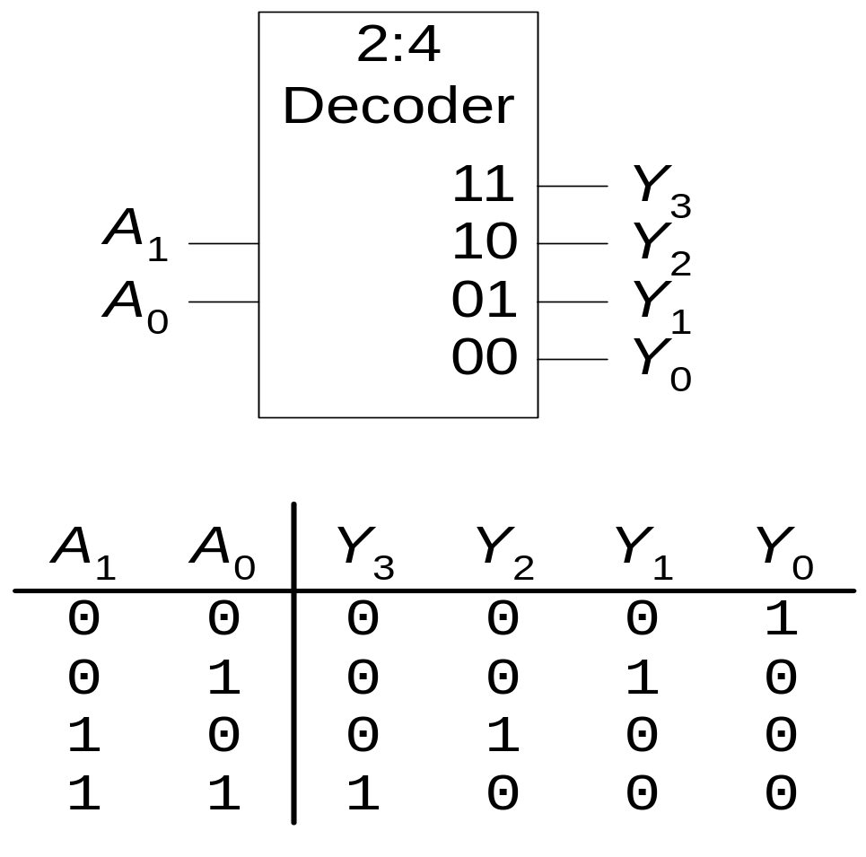
Decoder: Logic Diagram (Inside a decoder)
y₀ = 1 if (A_{1,} A₀ ) = (0,0) & En = 1
En
y_{i} = m_{i} En
A₀’
A₁’
y₀
y₁
.
.
y₃
y₃ = A₁A₀En

Slide 12
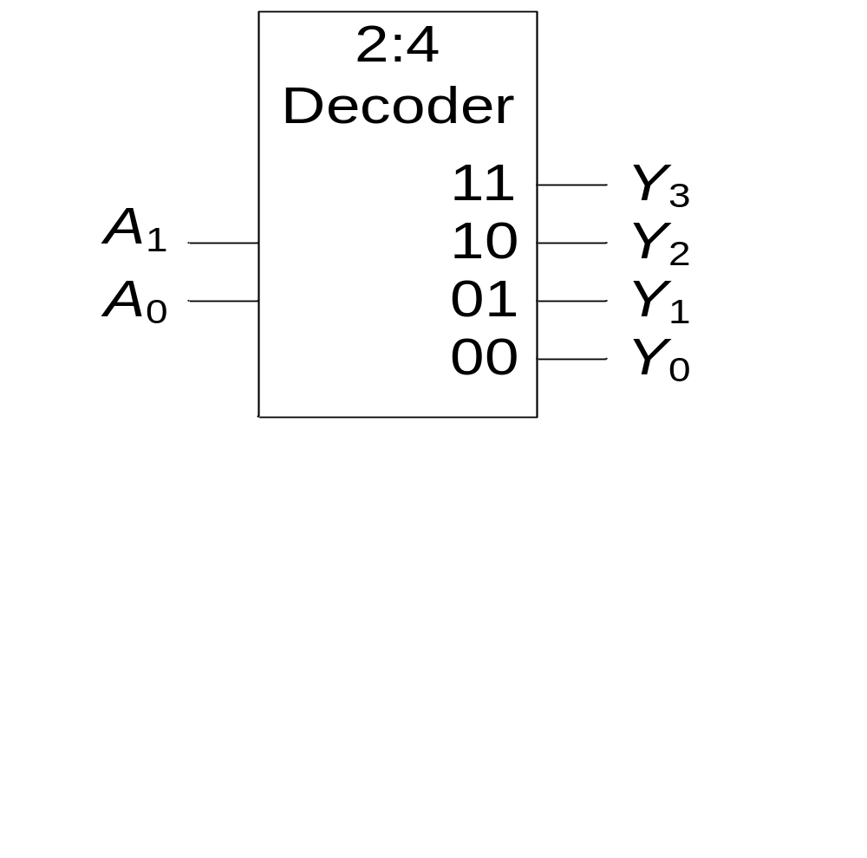
1. Decoder: Definition
PI Q: What is the output Y_{3:0} of the 2:4 decoder for (A₁, A₀) = (1,0)?
(1, 1, 0, 0 )
(1, 0, 1, 1)
(0, 0, 1, 0)
(0, 1, 0, 0)

Slide 13
Decoder Application: universal set {Decoder, OR}
Example:
Implement the following functions with a 3-input decoder and OR gates.
i) f₁(a,b,c) = Σm(1,2,4)
ii) f₂(a,b,c) = Σm(2,3),
iii) f₃(a,b,c) = Σm(0,5,6)

Slide 14
Decoder Application: universal set {Decoder, OR}
Decoder produces minterms when E=1.
We can use an OR gate to collect the minterms to cover the On-set.
For the Don’t Care-Set, we can just ignore the terms.

Slide 15
Decoder Application: universal set {Decoder, OR}
Example:
Implement functions
f₁(a,b,c) = Σm(1,2,4) + Σd(0,5),
f₂(a,b,c) = Σm(2,3) + Σd(1,4),
f₃(a,b,c) = Σm(0,5,6)
y₁
with a 3-input decoder and OR gates.
y₂
y₄
f₁
E=1
y₂
y₃
f₂
y₀
.
.
y₇
c
I₀
0
1
2
3
4
5
6
7
b
I₁
y₀
a
I₂
y₅
y₆
f₃

Slide 16
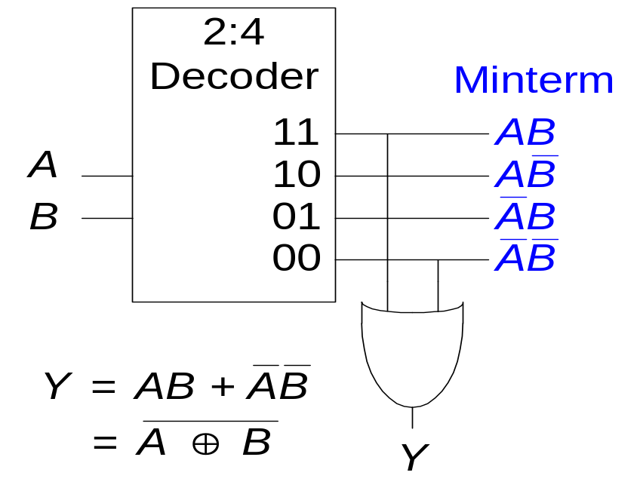
Decoders
OR minterms
E=1

Slide 17
Tree of Decoders: Scale up the size of the decoders using a tree structure
Implement a 4-2⁴ decoder with 3-2³ decoders.
y₀
.
y₇
d
I₀
0
1
2
3
4
5
6
7
c
I₁
b
I₂
y₈
.
y₁₅
I₀
0
1
2
3
4
5
6
7
I₁
I₂
a

Slide 18
Tree of Decoders
Implement a 6-2⁶ decoder with 3-2³ decoders.
E
y₀
E
D0
I_{2,} I_{1,} I₀
y₇
I_{5,} I_{4,} I₃
y₈
D1
I_{2,} I_{1,} I₀
…
y₁₅
…
y₅₆
D7
I_{2,} I_{1,} I₀
y₆₃

Slide 19
PI Q: A four variable switching function f(a,b,c,d) can be implemented using which of the following?
1:2 decoders and OR gates
2:4 decoders and OR gates
3:8 decoders and OR gates
All of the above
None of the above

Slide 20
2. Encoder
Definition
Logic Diagram
Priority Encoder

Slide 21
iClicker: Definition of Encoder
Any program, circuit or algorithm which encodes
In digital audio technology, an encoder is a program that converts an audio WAV file into an MP3 file
A device that convert a message from plain text into code
A circuit that is used to convert between digital video and analog video
All of the above

Slide 22
Encoder Definition: A digital module that converts the assertion of a device to the binary address of the device.
E
I₂^{n}-1…I₀
y_{n-1 …}y₀
A
Encoder Description:
E
At most one I_{i} = 1.
(y_{n-1},.., y₀ ) = i if I_{i} = 1 & Ε = 1
(y_{n-1},.., y₀ ) = 0 otherwise.
A = 1 if E = 1 and one i s.t. I_{i} = 1
A = 0 otherwise.
I₀
0
1
2
3
4
5
6
7
y₀
0
1
2
y₁
y₂
I₇
8 inputs
A
3 outputs

Slide 23
Encoder: Logic Diagram
En
En
y₀
y₁
I₁
I₂
I₃
I₃
I₅
I₆
I₇
I₇
En
En
y₂
I₄
I₅
I₆
I₇
A
I₀
I₁
.
.
I₆
I₇

Slide 24
Priority Encoder:
E
I₀
0
1
2
3
y₀
0
1
y₁
I₃
Eo
Gs

Slide 25
Priority Encoder: Definition
Description: Input (I₂^{n}-1,…, I₀), Output (y_{n-1} ,…,,y₀)
(y_{n-1} ,…,,y₀) = i if I_{i} = 1 & E = 1 & I_{k} = 0
for all k > i (high bit priority) or
for all k< i (low bit priority).
E
E_{o} = 1 if E = 1 & I_{i} = 0 for all i,
G_{s} = 1 if E = 1 & i s.t. I_{i} = 1.
I₀
0
1
2
3
4
5
6
7
y₀
0
1
2
E
y₁
(G_{s} is like A, and E_{o} passes on enable).
y₂
I₇
Eo
Gs

Slide 26
Priority Encoder: Implement a 32-input priority encoder w/ 8 input priority encoders (high bit priority).
E
I₃₁₋₂₄
y_{32,} y_{31,} y₃₀
Eo
Gs
I₂₃₋₁₆
y_{22,} y_{21,} y₂₀
Eo
Gs
I₁₅₋₈
y_{12,} y_{11,} y₁₀
Eo
Gs
I₇₋₀
y_{02,} y_{01,} y₀₀
Eo
Gs

