Slide 1
CSE 140: Components and Design Techniques for Digital Systems
Lecture 10:
Sequential Networks: Timing and Retiming
CK Cheng
Dept. of Computer Science and Engineering
University of California, San Diego

Slide 2
Timing
Motivation
Gate Delay
Flip-Flop Timing Window
Two Timing Constraints: shortest and longest timing paths
Examples

Slide 3
Timing: Motivation
Clock specifies a precise time for the next state
  In general, we allocate one clock period for signal propagation between registers. Goldilocks timing.
Too late: Fail to reach for the setup of the next state.
Too early: Race to disturb the holding of the next state.
Analysis: Verify the timing of the system.
Goal: A robust design.

Slide 4

The Story of Goldilocks and the Three Bears
Once upon a time, there was a little girl named Goldilocks. She went for a walk in the forest. Pretty soon, she came upon a house. She knocked and, when no one answered, she walked right in. At the table in the kitchen, there were three bowls of porridge. Goldilocks was hungry. She tasted the porridge from the first bowl. "This porridge is too hot!" she exclaimed. So, she tasted the porridge from the second bowl.
"This porridge is too cold," she said. So, she tasted the last bowl of porridge. "Ahhh, this porridge is just right," she said happily and
she ate it all up. DLTK's Crafts for Kids

Slide 5
Motivation: So far ….
Combinational
CLK
Logic-level analysis

Slide 6
Motivation: This lecture …
Combinational
CLK
When does our (seemingly logically correct) design go wrong?
How can we design a circuit that works under real constraints?
Popular interview question.

Slide 7
Motivation: Sequential Networks
R1
Combinational
R2
A
B
C
D
CLK1
CLK2
A typical sequential network has combinational circuit between registers (R1 to R2).
The registers are synchronized by clocks (CLK1 to CLK2).
Timing is set between clocks (CLK1 and CLK2).
The beauty of the synchronized design is that we need only to take care of the timing of the regions separated by the registers.

Slide 8
Timing of the System
x(t)
C1
C2
y(t)
CLK
S(t)
For a synchronized digital Moore machine, we need to take care of the timing of the following region(s).
Between every pair of registers.
Between i. input and register, and ii. register and output.

Slide 9
Gate Delay: Combinational Logic Timing
A
Y
B
Min delay of a gate, also called Contamination delay: t_{cd}
  Minimum time from when an input changes until the output starts to change
Max delay of a gate, also called Propagation delay: t_{pd}
  Maximum time from when an input changes until the output is guaranteed to reach its final value (i.e., stop changing)

Slide 10
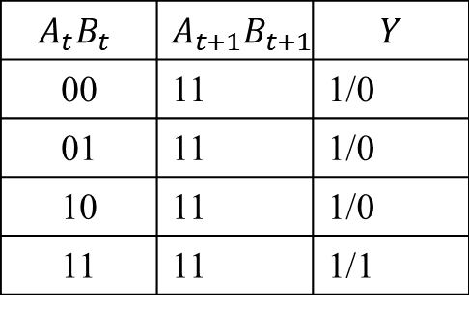
Gate Delay: Combinational Logic Timing
A
$$A_{t}B_{t}$$ | $$A_{t+1}B_{t+1}$$ | $$Y$$
00 | 11 | 1/0
01 | 11 | 1/0
10 | 11 | 1/0
11 | 11 | 1/1
Y
B
Different input transition causes different delay at output

Slide 11
Combinational Logic Delay
A
B
Y
C
D
  Different path causes different output transition delay.

Slide 12
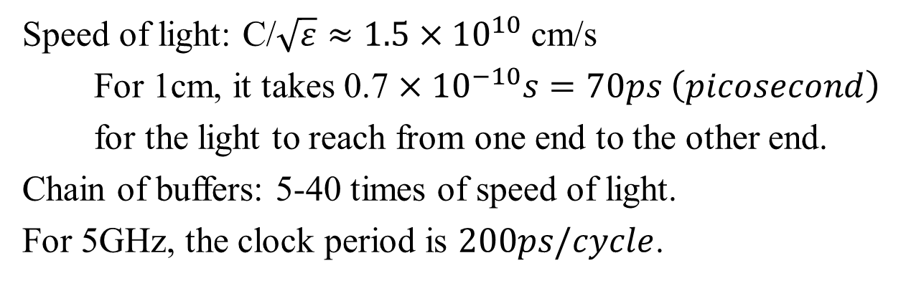
Interconnect Delay
Speed of light: C/$\sqrt{ε}≈1.5×{10}^{10}$ cm/s
For 1cm, it takes 0.7 $×{10}^{−10}s=70ps \left(picosecond\right)$
for the light to reach from one end to the other end.
Chain of buffers: 5-40 times of speed of light.
For 5GHz, the clock period is $200ps/cycle$.

Slide 13
Combinational Logic: Output timing constraints
X₁
Combinational
circuit
Y₁
X₂
Y₂
X₃
Y₃
X₄
Y₄
Contamination delay (shortest): t_{cd}
  Minimum time from when an input changes until any output starts to change
Propagation delay (longest): t_{pd}
  Maximum time from when an input changes until the output or outputs of a combinational circuit are guaranteed to reach their final value (i.e., stop changing)

Slide 14
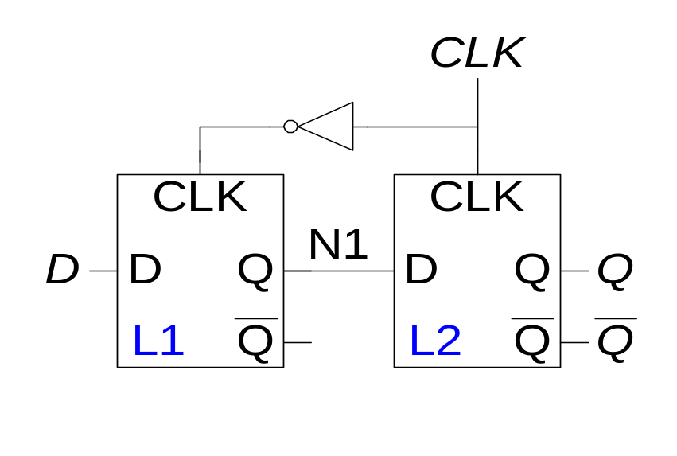
Flip-Flop Timing Window
Timing: Setup Time and Hold Time Constraints
Q
Q’
D
Once a flip flop has been ‘built’ we are stuck with its timing characteristics:
t_{setup}, t_{hold} timing relation between D and CLK
t_{ccq}, t_{pcq} timing relation between CLK and Q
No direct timing relation between input D and output Q

Slide 15
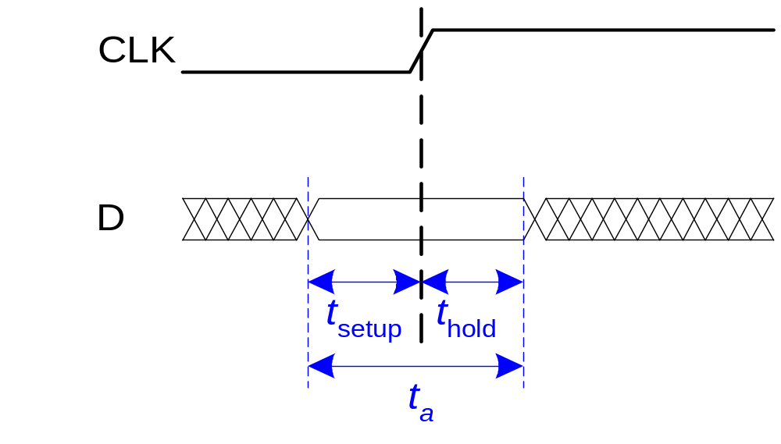
FF Input Constraints: Set up and hold time
Q
Q’
D
Setup time t_{setup} Time before the clock edge that data must be stable (i.e. not change)
Setup time violation This occurs if the input signal D does not settle (set up) to the stable value at least t_{setup} before the clock edge.
Hold time t_{hold} Time after the clock edge that data must be stable
Hold time violation This occurs if the input signal D does not remain unchanged (hold) for at least t_{hold} after the clock edge.

Slide 16
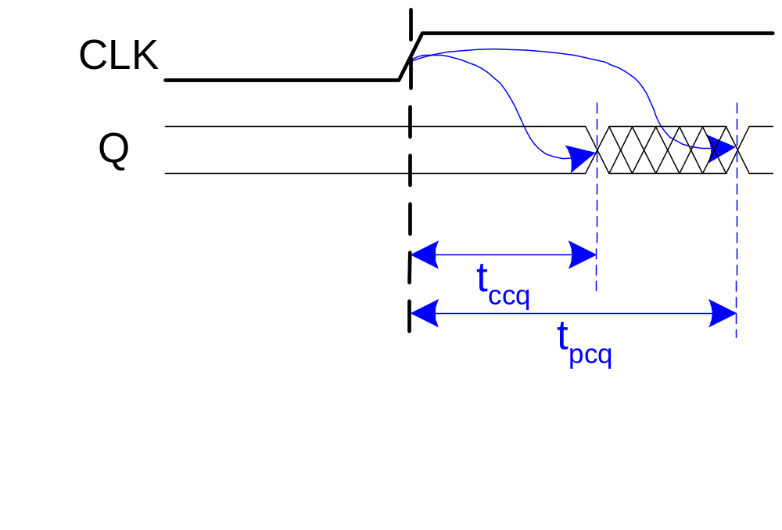
FF Output Timing Constraints
Q
Q’
D
Propagation delay: t_{pcq} = time after clock edge that the output Q is guaranteed to be stable (i.e., to stop changing)
Contamination delay: t_{ccq} = time after clock edge that Q might be unstable (i.e., start changing)

Slide 17
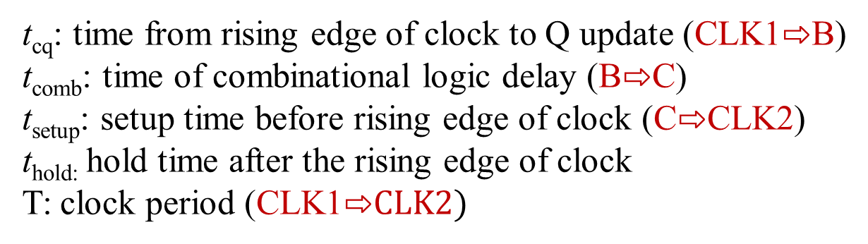
Two Timing Constraints
Combinational
A
B
C
CLK1
CLK2
t_{cq} + t_{comb} + t_{setup} ≤ T
t_{hold} < t_{cq} + t_{comb}

Slide 18
Two Timing Constraints
Combinational
A
B
C
CLK1
CLK2
Setup time constraint
t_{cq} + t_{comb} + t_{setup} ≤ T
Longest delay from CLK1 to CLK2
max(t_{cq} + t_{comb} + t_{setup} )≤ T
Hold time constraint
t_{hold} < t_{cq} + t_{comb}
Shortest delay from CLK1 to CLK2
t_{hold} < min(t_{cq} + t_{comb})

Slide 19
Two Timing Constraints
t_{cq} + t_{comb} + t_{setup} ≤ T
t_{hold} < t_{cq} + t_{comb}
Too long
Just right
Too short
CLK1
CLK2

Slide 20
PIQ: The timing of which of the following signals can cause a setup-time violation?
Q(t)
D(t)
Q
Q’
D
Signal D arrives too early
Signal D arrives too late
Clock CLK arrives too late
Output Q(t) responds too early
None of the above
CLK

Slide 21
PIQ: A hold time violation is likely to occur when
D(t)
Q(t)
Q
Q’
Signal D changes too early
Signal D changes too late
Clock CLK arrives too early
None of the above
D
CLK

Slide 22
PIQ: A hold time violation is likely to occur when
D(t)
Q(t)
Q
Q’
Signal D changes too late
Clock CLK arrives too early
Clock CLK arrives too late
None of the above
D
CLK

Slide 23
An alternate view of the sequential circuit
Combinational
CLK
Combinational
R1
Q1
D2
R2
D1
CLK
CLK

Slide 24
What should happen within a clock cycle for correct functionality?
Combinational
R1
D2
R2
D1
Q1
CLK
CLK

Slide 25
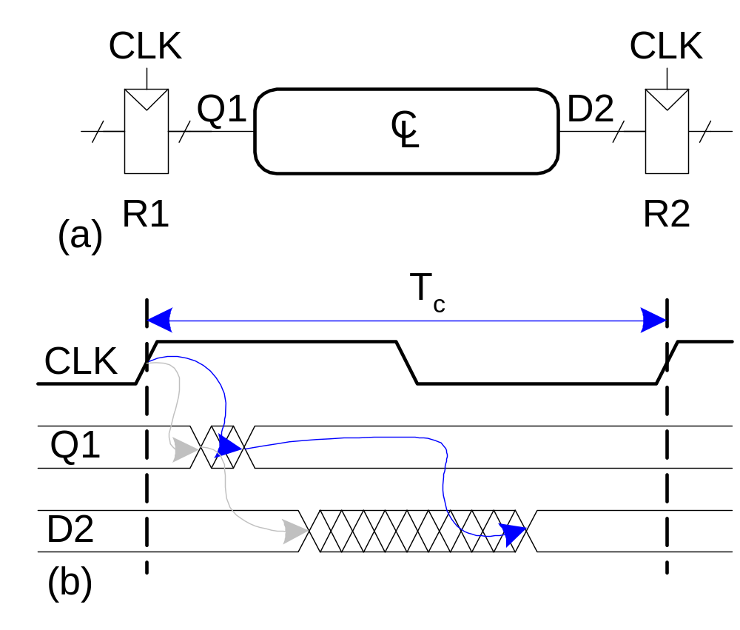
The delay between registers has a minimum and maximum delay, dependent on the delays of the circuit elements

Slide 26
The delay between registers has a minimum and maximum delay, dependent on the delays of the circuit elements
2
3
3

Slide 27
PI Q: Suppose CLK rises at t₁, what is the maximum delay (from t₁) after which D2 reaches a stable value?
Setup time of R1+ Propagation delay of CL + Propagation delay of R2
Hold time of R1+ Propagation delay of CL + setup time of R1
Propagation delay of R1+ Propagation delay of CL + Propagation delay of R2
Propagation delay of R1+ Propagation delay of CL
Propagation delay of CL + Propagation delay of R2

Slide 28
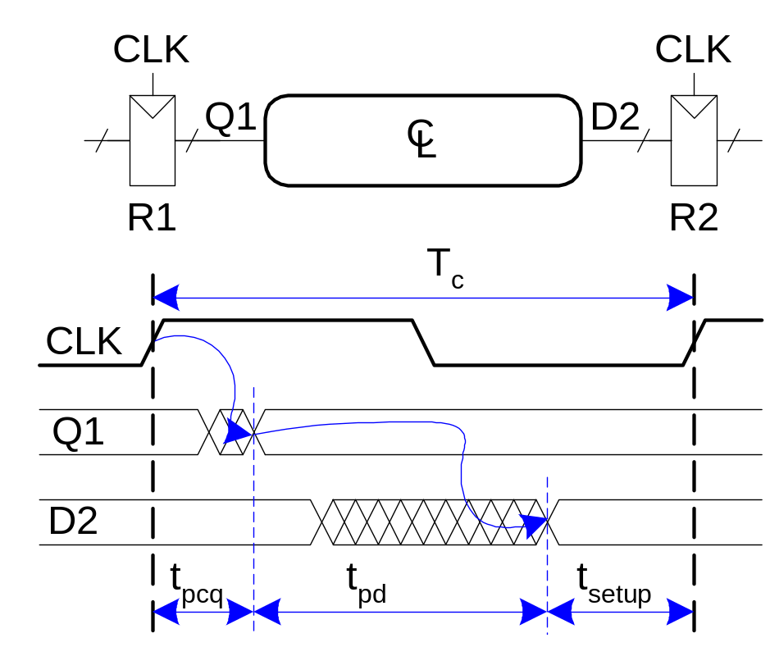
Setup Time Constraint
The setup time constraint depends on the maximum delay from register R1 through the combinational logic.
The input to register R2 must be stable at least t_{setup} before the clock edge.
Maximum delay, t_{max}
=
Setup Time Constraint:

Slide 29
Setup Time Constraint
T_{c} ≥ t_{pcq} + t_{pd} + t_{setup}
PI Q: As a designer, which of the following parameters would you modify to meet the set up time constraint?
The clock period, T_{c}
The prop. delay of R1, t_{pcq}
The prop. delay of CL, t_{pd}
The setup time of R2, t_{setup}
All of the above

Slide 30
Setup Time Constraint
T_{c} ≥ t_{pcq} + t_{pd} + t_{setup}
t_{pd} ≤ T_{c} – (t_{pcq} + t_{setup})
PI Q: As a designer, which of the following parameters would you modify to meet the set up time constraint?
The clock period, T_{c}
The prop. delay of R1, t_{pcq}
The prop. delay of CL, t_{pd}
The setup time of R2, t_{setup}
All of the above

Slide 31
PI Q: Suppose CLK rises at t₁, what is the minimum delay (from t₁) after which D2 starts to change?
Setup time of R1+ propagation delay of CL + propagation of R2
Hold time of R1+ propagation time of CL +setup time of R1
Hold time of R1+ Contamination delay of CL + Propagation time of R2
Contamination delay of R1+ Contamination delay of CL
Contamination delay of CL + Contamination delay of R2

Slide 32
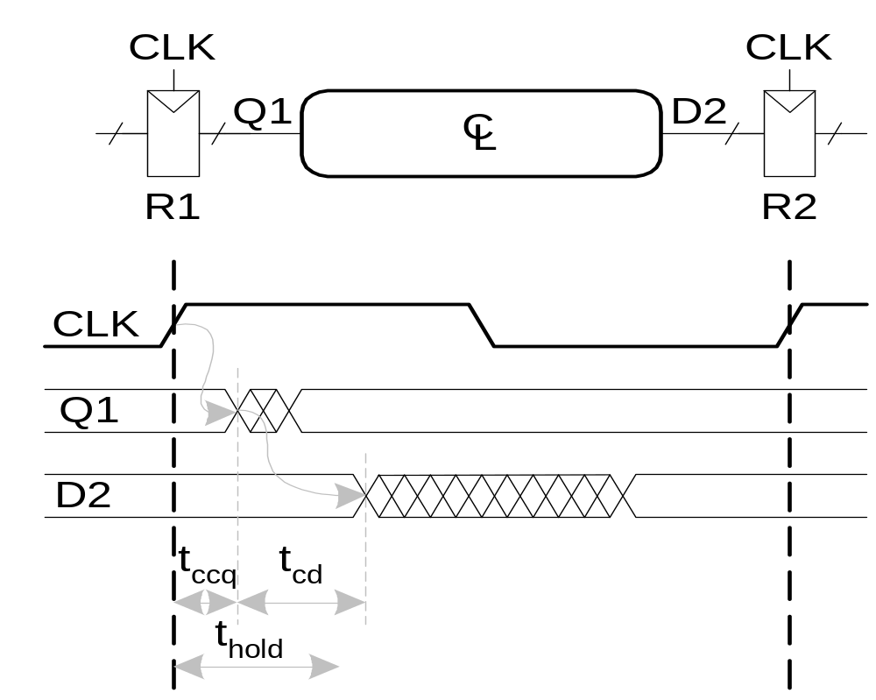
Hold Time Constraint
The hold time constraint depends on the minimum delay from register R1 through the combinational logic.
The input to register R2 must be stable for at least t_{hold} after the clock edge.
Minimum delay, t_{min}
=
Hold Time Constraint:

Slide 33
Hold Time Constraint
t_{hold} < t_{ccq} + t_{cd}
t_{cd} > t_{hold} - t_{ccq}

Slide 34
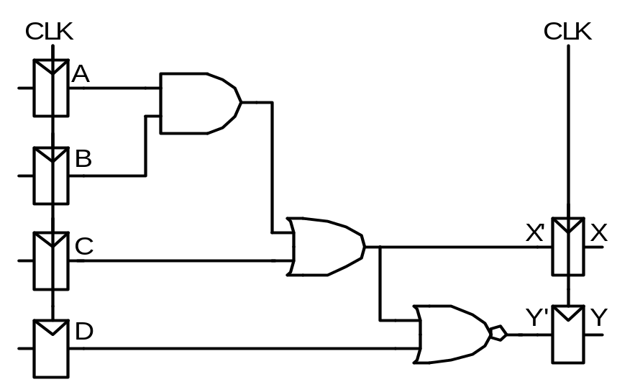
Timing Analysis: Example
Timing Characteristics
FFs t_{ccq} = 30 ps
t_{pcq} = 50 ps
t_{setup} = 60 ps
t_{hold} = 70 ps
Gates t_{pd}(g) = 35 ps
t_{cd}(g)= 25 ps
t_{pd} =
t_{cd} =
Setup time constraint:
T_{c} ≥
f_{c} = 1/T_{c} =
Hold time constraint:
t_{ccq} + t_{pd} > t_{hold} ?

Slide 35
Timing Analysis: Example
FFs t_{ccq} = 30 ps
t_{pcq} = 50 ps
t_{setup} = 60 ps
t_{hold} = 70 ps
Gates t_{pd}(g)= 35 ps
t_{cd}(g)= 25 ps
t_{pd}(com)= 3 x 35 ps = 105 ps
t_{cd}(com)= 25 ps
Setup time constraint:
T ≥ t_{pcq} + t_{pd}(com)+ t_{setup}
=50 + 105 + 60 = 215 ps
f_{c} = 1/T_{c} = 4.65 GHz
Hold time constraint:
t_{ccq} + t_{cd}(com)> t_{hold} ?
(30 + 25) ps > 70 ps ? No!

Slide 36
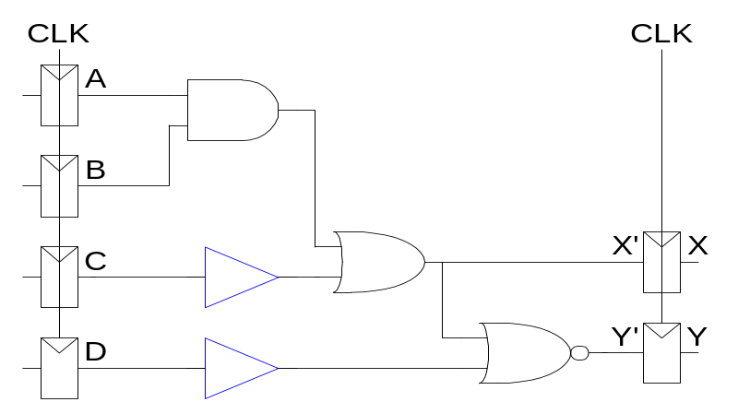
Example: Fix Hold Time Violation
Add buffers to the short paths:
Timing Characteristics
FFs t_{ccq} = 30 ps
t_{pcq} = 50 ps
t_{setup} = 60 ps
t_{hold} = 70 ps
Gates t_{pd}(g)= 35 ps
t_{cd}(g)= 25 ps
t_{pd}(com)=
t_{cd}(com)=
Setup time constraint:
T ≥
f_{c} =
Hold time constraint:
t_{ccq} + t_{pd} > t_{hold} ?

Slide 37
Example: Fix Hold Time Violation
Add buffers to the short paths:
FFs t_{ccq} = 30 ps
t_{pcq} = 50 ps
t_{setup} = 60 ps
t_{hold} = 70 ps
Gates t_{pd}(g)= 35 ps
t_{cd}(g)= 25 ps
t_{pd}(com)= 3 x 35 = 105 ps
t_{cd}(com)= 2 x 25 = 50 ps
Setup time constraint:
T ≥ 50 + 105 + 60 = 215 ps
f_{c} = 1/T_{c} = 4.65 GHz
Hold time constraint:
t_{ccq} + t_{cd}(com)> t_{hold} ?
(30 + 50) ps > 70 ps ? Yes!

Slide 38
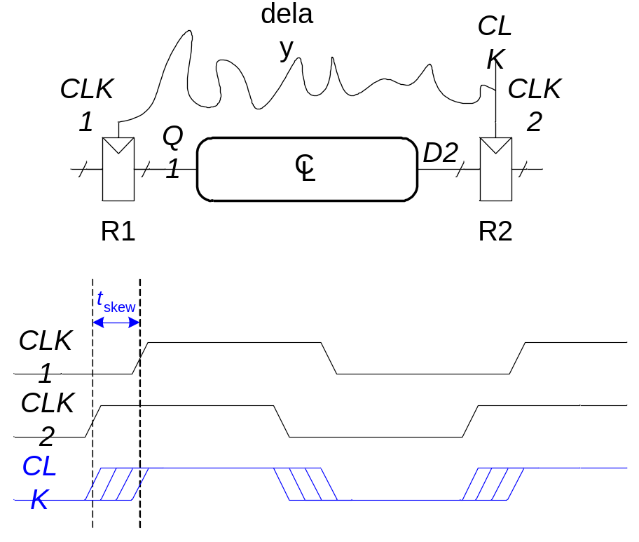
Clock Skew
The clock doesn’t arrive at all registers at the same time. The difference between two clock edges is skew.
Skew as Noise: Caused by process variation, voltage fluctuation, crosstalks (PVC). Examine the worst case to guarantee that the timing is right.
Designated Skew: Make skew by design to improve the performance.

Slide 39
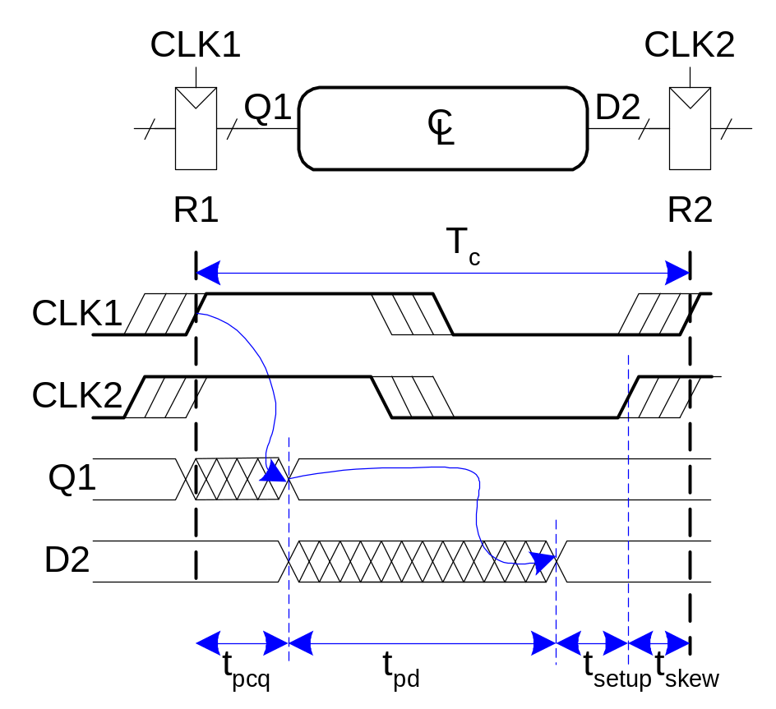
Time Constraint with Clock Skew (Noise)
In the worst case, the CLK2 is:
Earlier than CLK1 for setup time
Later than CLK1 for hold time.
T_{c} ≥ t_{pcq} + t_{pd}(com)+ t_{setup} + t_{skew}
t_{ccq} + t_{cd}(com)> t_{hold} + t_{skew}

Slide 40
Timing Analysis with Clock Skew: Example
Timing Characteristics
t_{ccq} = 30 ps
t_{pcq} = 50 ps
t_{setup} = 60 ps
t_{hold} = 70 ps
t_{pd} = 35 ps
t_{cd} = 25 ps
t_{skew} = 50 ps
t_{pd} = 3 x 35 ps = 105 ps
t_{cd} = 25 ps
Setup time constraint:
T_{c} ≥ 265 ps
f_{c} = 1/T_{c} =3.77 GHz
Without skew we got f_{c} =4.65 GHz

Slide 41
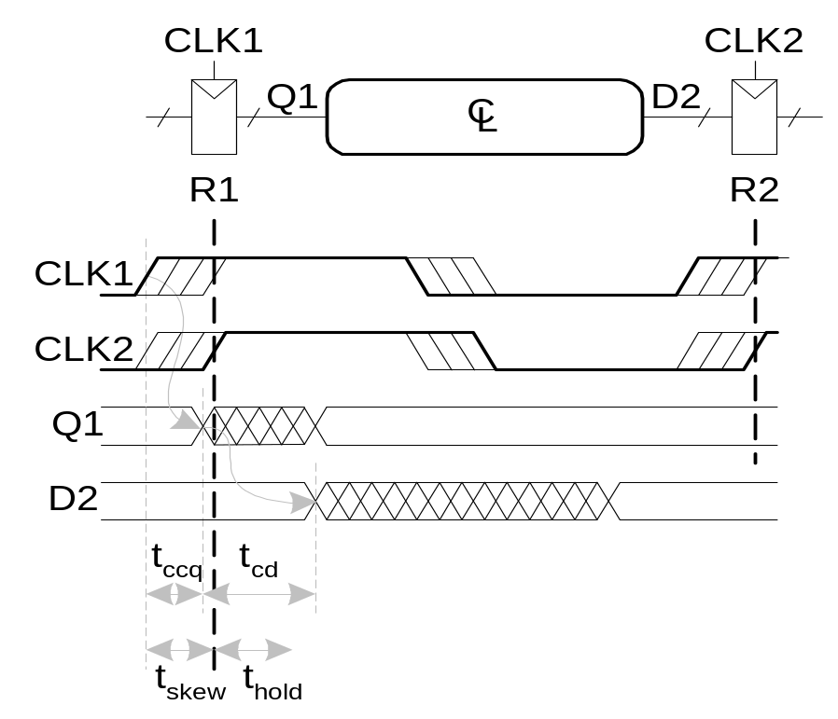
Time Constraint with Clock Skew: Example
In the worst case for setup time, CLK2 is later than CLK1
t_{ccq} + t_{cd}(com)> t_{hold} + t_{skew}

Slide 42
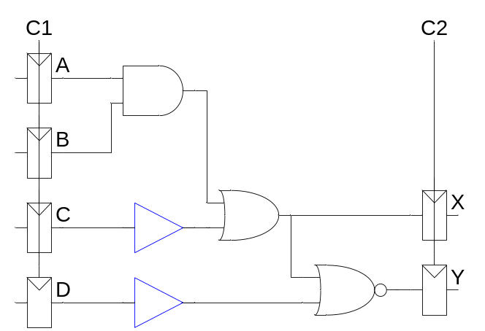
Clock Skew: Example
Add buffers to the short paths:
Timing Characteristics
t_{ccq} = 30 ps
t_{pcq} = 50 ps
t_{setup} = 60 ps
t_{hold} = 70 ps
t_{pd}(g)= 35 ps
t_{cd}(g)= 25 ps
t_{skew} = 50 ps
t_{pd}(com)= 3 x 35 ps = 105 ps
t_{cd}(com)= 2 x 25 ps = 50 ps
Hold time constraint:
t_{ccq} + t_{cd}(com)> t_{hold} + t_{skew}?
(30 + 50) > (70 +50) ps ?

Slide 43
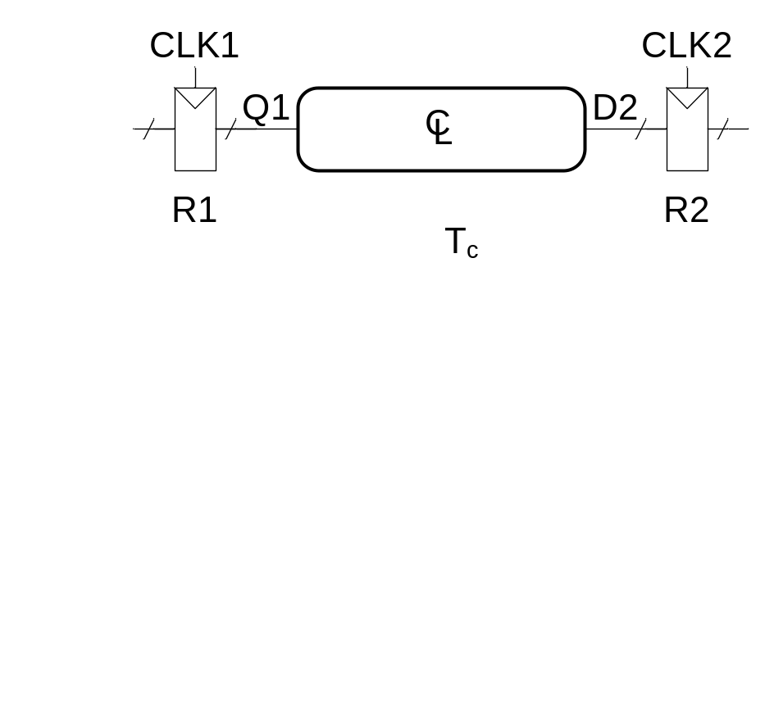
Retiming with Designated Skew
CLK2 is later than CLK1 by t_{skew}
Skew as noise (worst case)
Designated skew
T ≥ t_{pcq} + t_{pd}(com)+ t_{setup} + t_{skew}
T ≥ t_{pcq} + t_{pd}(com)+ t_{setup} - t_{skew}
t_{ccq} + t_{cd}(com)> t_{hold} + t_{skew}
t_{ccq} + t_{cd}(com)> t_{hold} + t_{skew}

Slide 44
Retiming: Example
t_{ccq} = 30 ps
t_{pcq} = 50 ps
t_{setup} = 60 ps
t_{hold} = 70 ps
t_{pd}(g)= 35 ps
t_{cd}(g)= 25 ps
T_{c} ≥ t_{pcq} + t_{pd}(com)+ t_{setup} - t_{skew}
t_{ccq} + t_{cd}(com) ≥ t_{hold} + t_{skew}
T_{c} ≥ 50 + 105 + 60 - t_{skew}
30 + 50 ≥ 70+ t_{skew}
iClicker: The minimum clock period T can be:
195
205
215
None of the above

Slide 45
Timing and Retiming
Retiming: Adjust the clock skew so that the clock period can be reduced.
Add a few more examples on timing and retiming.

Slide 46
Conclusion
Clock to Clock: Range of shortest and longest paths
Design revision and retiming to adjust the constraints
Research: Variation aware designs
Extra materials:
C. Leiserson and J. Saxe, "Retiming Synchronous Circuitry," Algorithmica, pp. 6:5-35, 1991.
L.T. Liu, M. Shih, N.C. Chou, C.K. Cheng, and W. Ku, "Performance-Driven Partitioning Using Retiming and Replication,“ IEEE Int. Conf. on Computer-Aided Design, pp. 296-299, Nov. 1993.

