Slide 1
CSE140 HW2 Preparation
Xinyuan Wang
04/20/2018

Slide 2
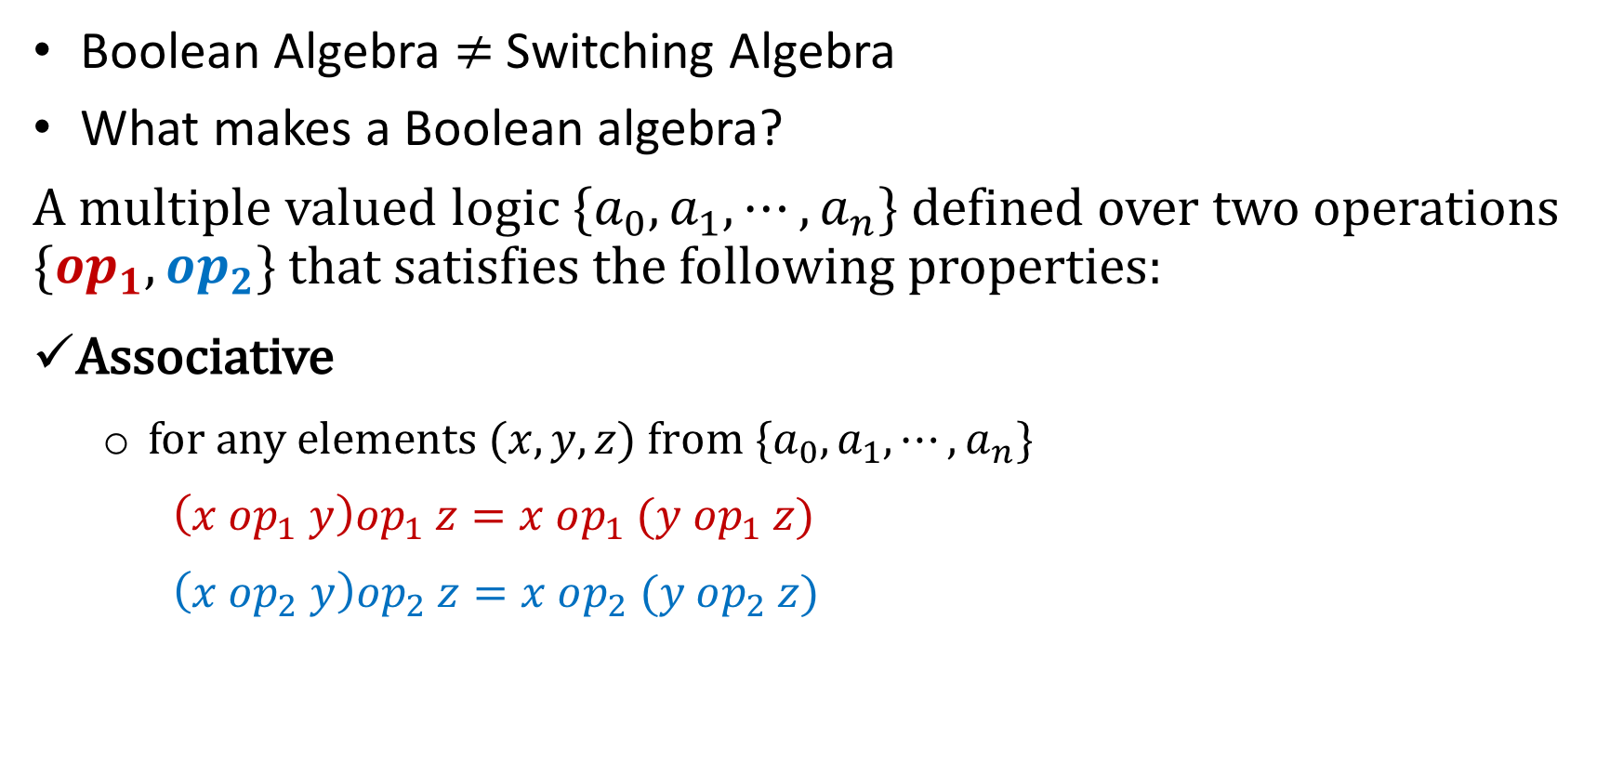
Q1: Boolean Algebra
Boolean Algebra $≠$ Switching Algebra
What makes a Boolean algebra?
A multiple valued logic $\{a_{0},a_{1},⋯,a_{n}\}$ defined over two operations $\{op_{1},op_{2}\}$ that satisfies the following properties:
Associative
  for any elements $(x,y,z)$f$rom \{a_{0},a_{1},⋯,a_{n}\}$
  $\left(x op_{1} y\right)op_{1} z=x op_{1} (y op_{1} z)$
  $\left(x op_{2} y\right)op_{2} z=x op_{2} (y op_{2} z)$

Slide 3
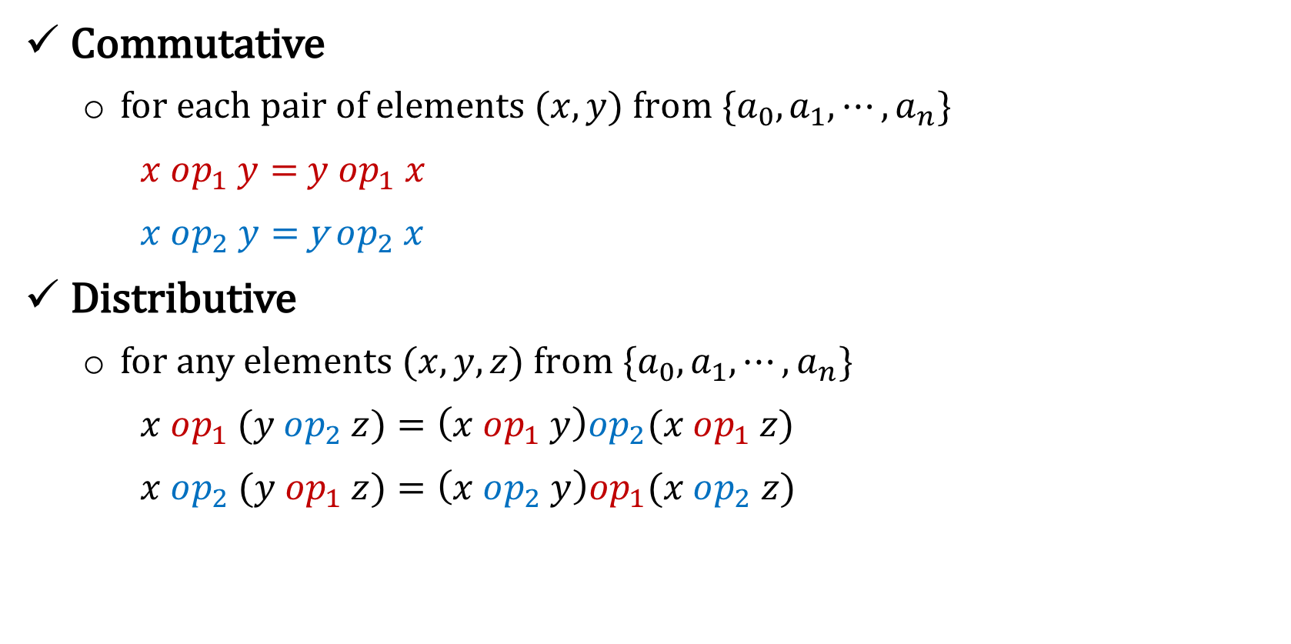
Q1: Boolean Algebra
Commutative
  for each pair of elements $(x,y)$f$rom \{a_{0},a_{1},⋯,a_{n}\}$
  $x op_{1} y=$ $y op_{1} x$
  $x op_{2} y=$ y$op_{2} x$
Distributive
  for any elements $(x,y,z)$f$rom \{a_{0},a_{1},⋯,a_{n}\}$
  $x op_{1} (y op_{2} z)=\left(x op_{1} y\right)op_{2}(x op_{1} z)$
  $x op_{2} (y op_{1} z)=\left(x op_{2} y\right)op_{1}(x op_{2} z)$

Slide 4
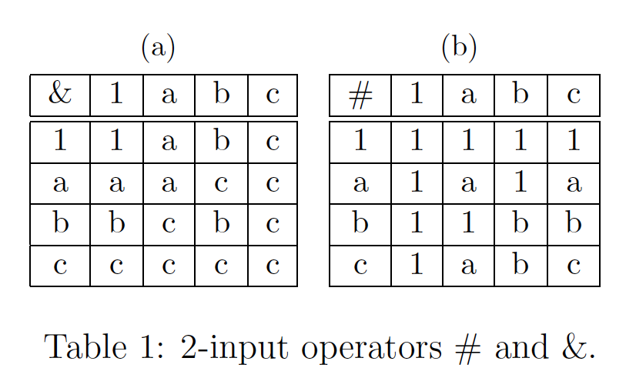
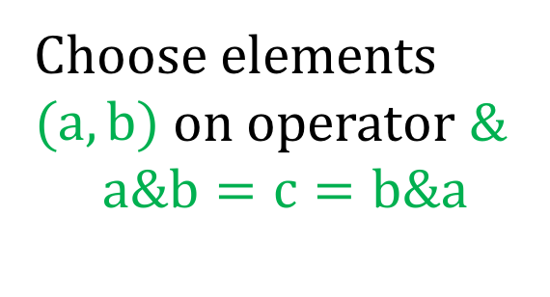
Q1: Boolean Algebra
Example
Commutative
  for each pair of elements $(x,y)$f$rom \{a_{0},a_{1},⋯,a_{n}\}$
  $x op_{1} y=$ $y op_{1} x$
  $x op_{2} y=$ y$op_{2} x$
Distributive
  for any elements $(x,y,z)$f$rom \{a_{0},a_{1},⋯,a_{n}\}$
  $x op_{1} (y op_{2} z)=\left(x op_{1} y\right)op_{2}(x op_{1} z)$
  $x op_{2} (y op_{1} z)=\left(x op_{2} y\right)op_{1}(x op_{2} z)$
Choose elements $(a,b)$ on operator &
$$a\&b=c=b\&a$$

Slide 5
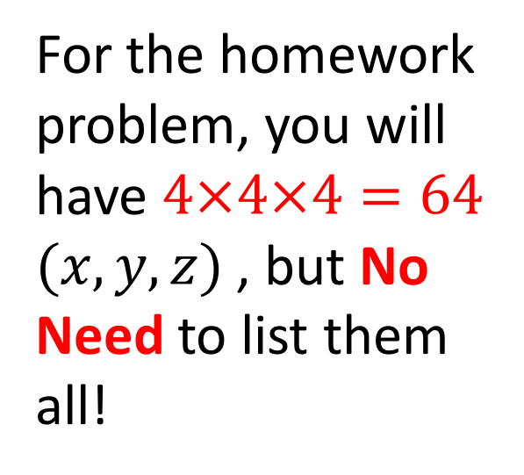
Q1: Boolean Algebra
Commutative
  for each pair of elements $(x,y)$f$rom \{a_{0},a_{1},⋯,a_{n}\}$
  $x op_{1} y=$ $y op_{1} x$
  $x op_{2} y=$ y$op_{2} x$
Distributive
  for any elements $(x,y,z)$f$rom \{a_{0},a_{1},⋯,a_{n}\}$
  $x op_{1} (y op_{2} z)=\left(x op_{1} y\right)op_{2}(x op_{1} z)$
  $x op_{2} (y op_{1} z)=\left(x op_{2} y\right)op_{1}(x op_{2} z)$
For the homework problem, you will have $4×4×4=64$ $(x,y,z)$, but No Need to list them all!

Slide 6
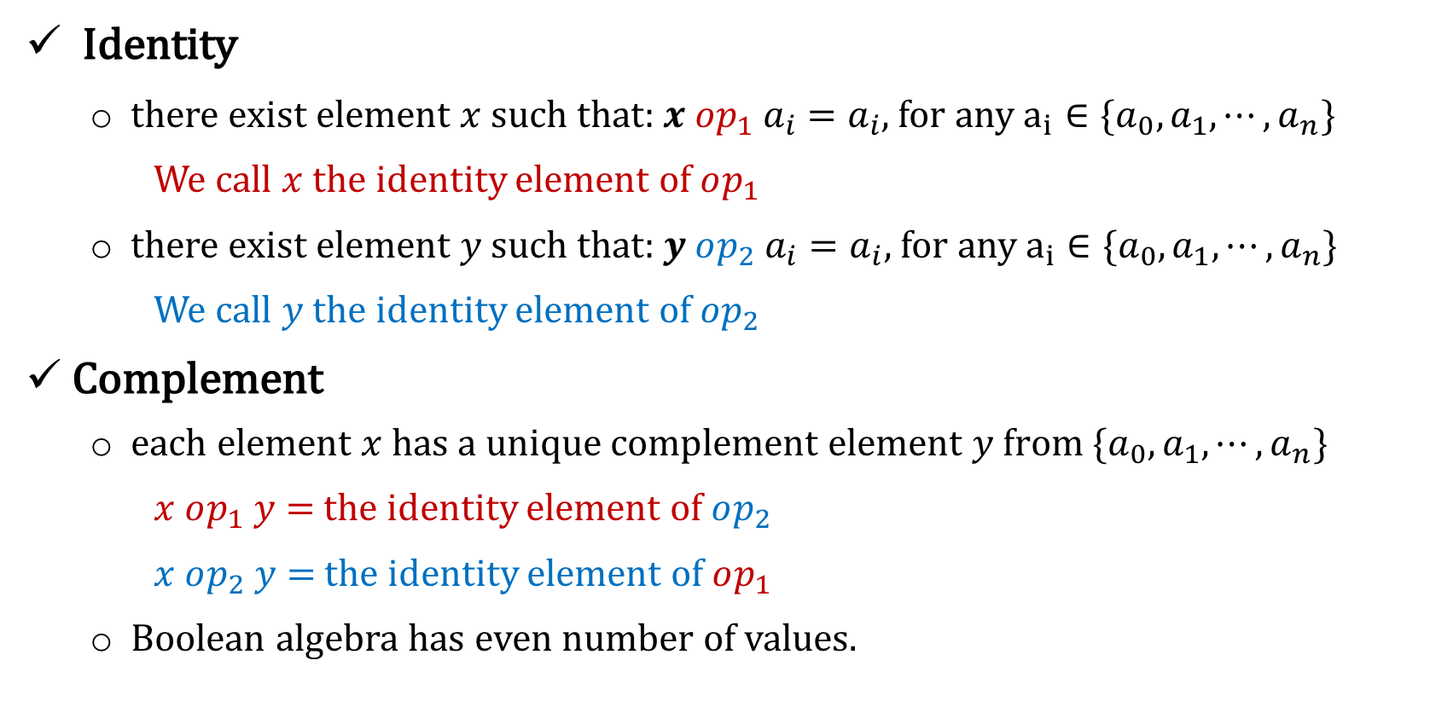
Q1: Boolean Algebra
Identity
  there exist element $x$ such that: $x op_{1} a_{i}=a_{i}$, for any $a_{i}∈\{a_{0},a_{1},⋯,a_{n}\}$
  We call $x$ the identity element of $op_{1}$
  there exist element $y$ such that: $y op_{2} a_{i}=a_{i}$, for any $a_{i}∈\{a_{0},a_{1},⋯,a_{n}\}$
  We call $y$ the identity element of $op_{2}$
Complement
  each element $x$ has a unique complement element $y$f$rom \{a_{0},a_{1},⋯,a_{n}\}$
  $x op_{1} y=$ the identity element of $op_{2}$
  $x op_{2} y=$ the identity element of $op_{1}$
  Boolean algebra has even number of values.

Slide 7

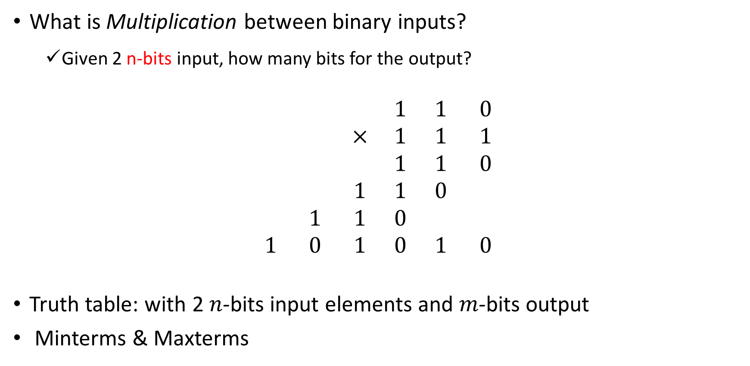
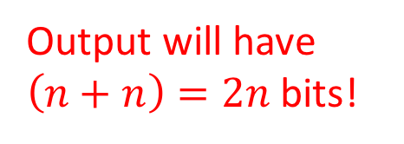
Q2: Multiplication Machine
What is Multiplication between binary inputs?
  Given 2 n-bits input, how many bits for the output?
$$\begin{matrix} & & & 1 & 1 & 0 \\ & & × & 1 & 1 & 1 \\ & & & 1 & 1 & 0 \\ & & 1 & 1 & 0 & \\ & 1 & 1 & 0 & & \\ 1 & 0 & 1 & 0 & 1 & 0\end{matrix}$$
Truth table: with 2 $n$-bits input elements and $m$-bits output
Minterms & Maxterms
Output will have $\left(n+n\right)=2n$ bits!
3-bits
3-bits
6-bits

Slide 8
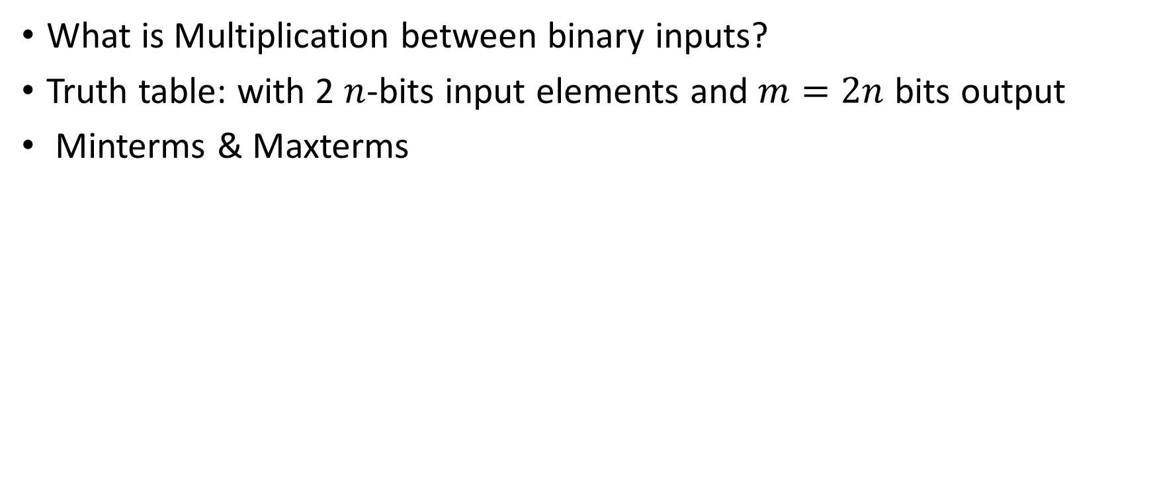
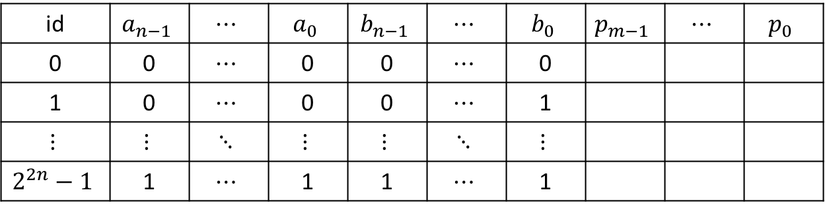
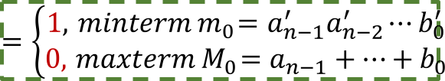
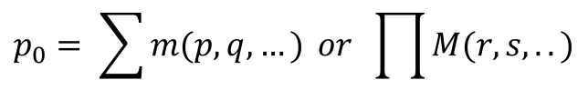
Q2: Multiplication Machine
What is Multiplication between binary inputs?
Truth table: with 2 $n$-bits input elements and $m=2n$ bits output
Minterms & Maxterms
Input 1
Input 2
Output
$$=\left\{\begin{matrix}1, { minterm m}_{0}=a_{n−1}^{′}a_{n−2}^{′}⋯b_{0}^{′} \\ 0, { maxterm M}_{0}=a_{n−1}+⋯+b_{0}\end{matrix}\right.$$
id | $$a_{n−1}$$ | $$⋯$$ | $$a_{0}$$ | $$b_{n−1}$$ | $$⋯$$ | $$b_{0}$$ | $$p_{m−1}$$ | $$⋯$$ | $$p_{0}$$
0 | 0 | $$⋯$$ | 0 | 0 | $$⋯$$ | 0
1 | 0 | $$⋯$$ | 0 | 0 | $$⋯$$ | 1
$$⋮$$ | $$⋮$$ | $$⋱$$ | $$⋮$$ | $$⋮$$ | $$⋱$$ | $$⋮$$
$$2^{2n}−1$$ | 1 | $$⋯$$ | 1 | 1 | $$⋯$$ | 1
$$p_{0}= \sum{m(p,q,…)} or \prod{M(r,s,..)}$$

Slide 9
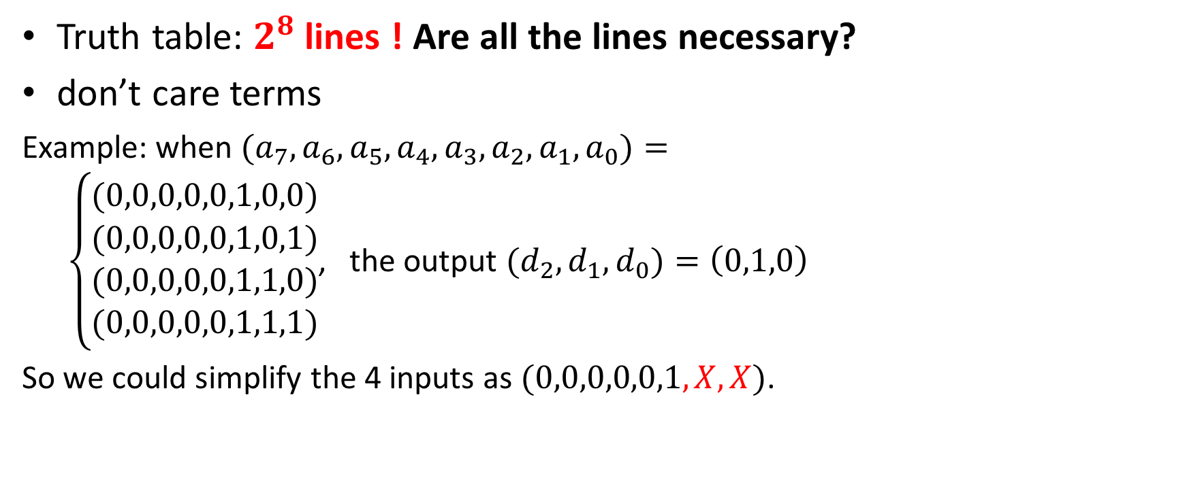
Q3: Priority Encoder
Truth table: $2^{8}$ lines ! Are all the lines necessary?
don’t care terms
Example: when ${(a}_{7},a_{6},a_{5},a_{4},a_{3},a_{2},a_{1},a_{0})=$
$\left\{\begin{matrix}\begin{aligned}(0,0,0,0,0,1,0,0) \\ (0,0,0,0,0,1,0,1) \\ (0,0,0,0,0,1,1,0)\end{aligned} \\ (0,0,0,0,0,1,1,1)\end{matrix}\right.$, the output ${(d}_{2},d_{1},d_{0})=\left(0,1,0\right)$
So we could simplify the 4 inputs as $(0,0,0,0,0,1,X,X)$.

Slide 10
Q4&5: Logic Minimization
Adjacency: two minterms (maxterms) are adjacent, if they differ only in one variable
We can merge each Adjacent pair into one term !
K-maps
  searching for adjacent pairs are the basis of logic minimization.
  present a visual way to efficiently look for this pairs!
  all neighbor cells in a K-maps are adjacent. Don’t forget the edges!!

Slide 11
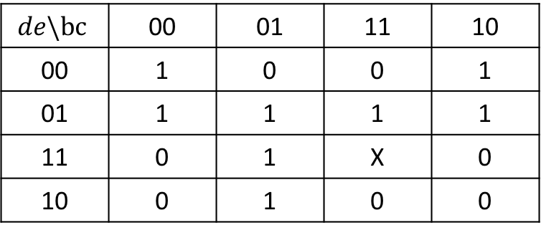
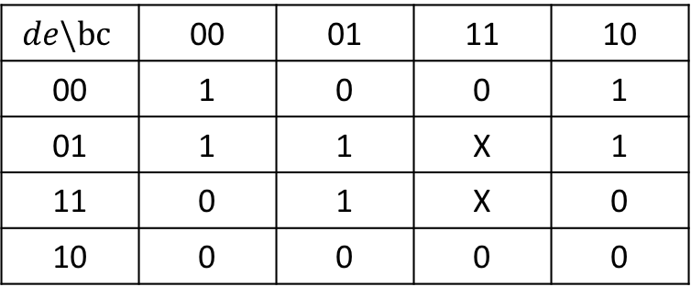


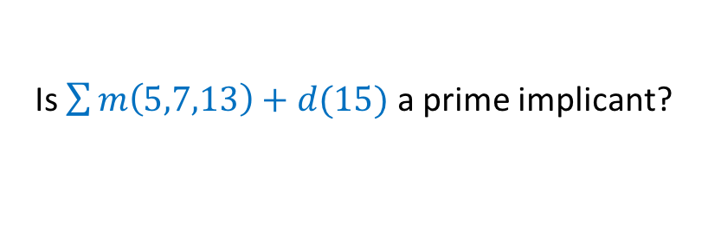
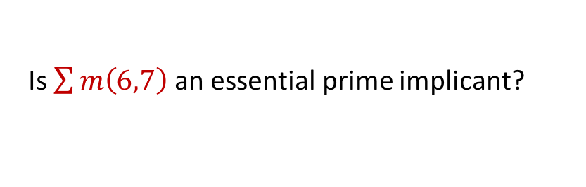
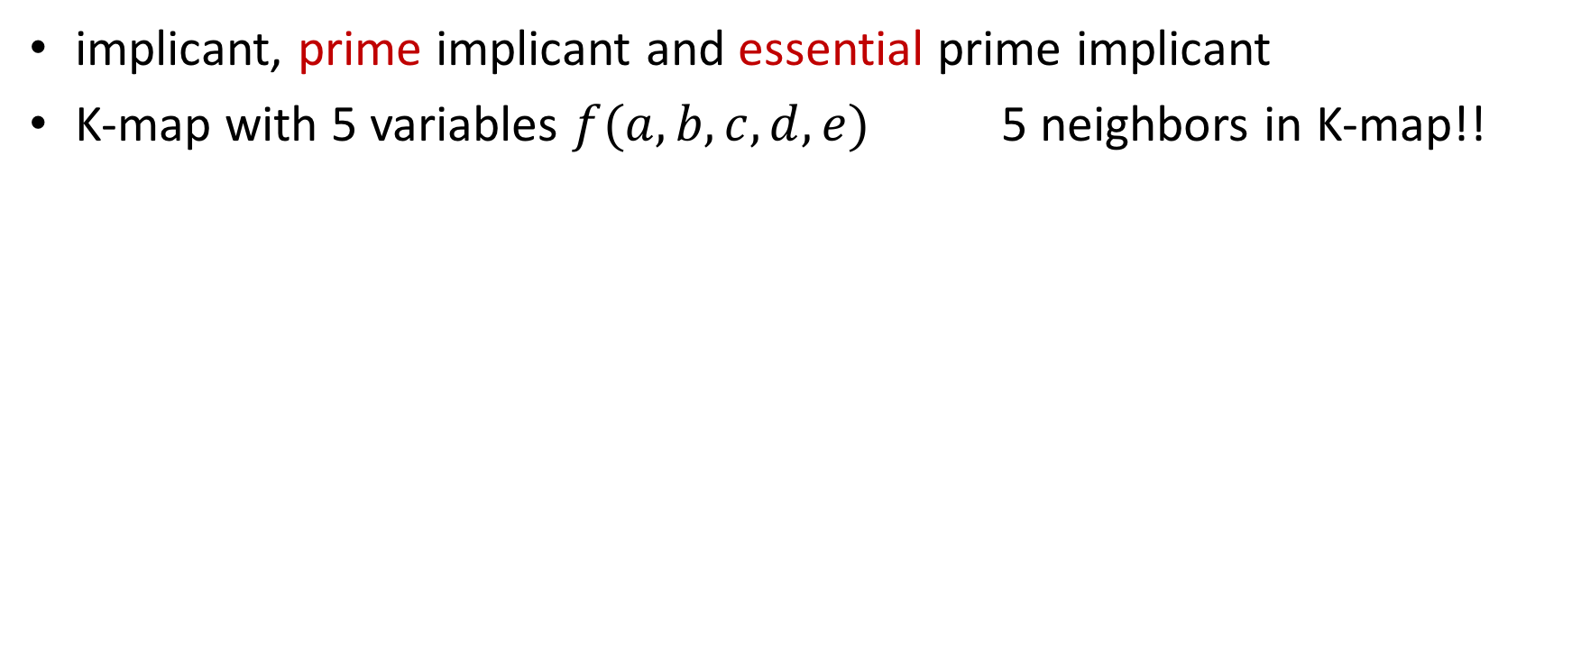
Q4: Minimize SOP
implicant, prime implicant and essential prime implicant
K-map with 5 variables $f(a,b,c,d,e)$ 5 neighbors in K-map!!
$$de\backslash bc$$ | 00 | 01 | 11 | 10
00 | 1 | 0 | 0 | 1
01 | 1 | 1 | 1 | 1
11 | 0 | 1 | X | 0
10 | 0 | 1 | 0 | 0
Is $\sum{m\left(5,7,13\right)+d(15)}$ a prime implicant?
0 4 12 8
$$a=0$$
1 5 13 9
3 7 15 11
2 6 14 10
Is $\sum{m\left(6,7\right)}$ an essential prime implicant?
$$de\backslash bc$$ | 00 | 01 | 11 | 10
00 | 1 | 0 | 0 | 1
01 | 1 | 1 | X | 1
11 | 0 | 1 | X | 0
10 | 0 | 0 | 0 | 0
$$a=1$$
16 20 28 24
17 21 29 25
19 23 31 27
18 22 30 26

Slide 12
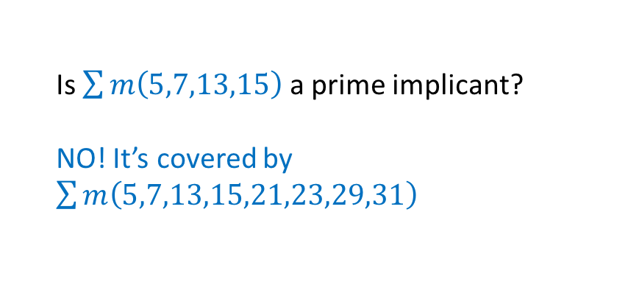
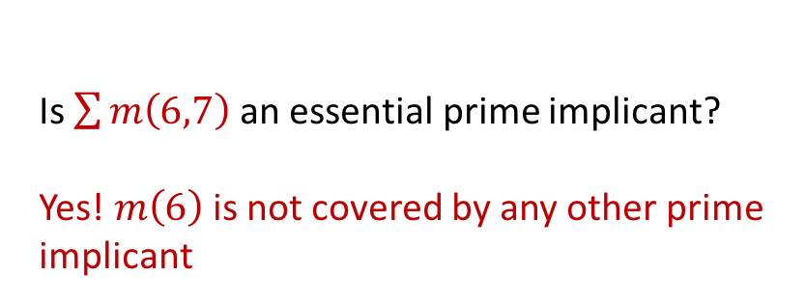
Q4: Minimize SOP
implicant, prime implicant and essential prime implicant
K-map with 5 variables $f(a,b,c,d,e)$ 5 neighbors in K-map!!
$$de\backslash bc$$ | 00 | 01 | 11 | 10
00 | 1 | 0 | 0 | 1
01 | 1 | 1 | 1 | 1
11 | 0 | 1 | X | 0
10 | 0 | 1 | 0 | 0
Is $\sum{m\left(5,7,13,15\right)}$ a prime implicant?
NO! It’s covered by $\sum{m\left(5,7,13,15,21,23,29,31\right)}$
0 4 12 8
$$a=0$$
1 5 13 9
3 7 15 11
2 6 14 10
Is $\sum{m\left(6,7\right)}$ an essential prime implicant?
Yes! $m\left(6\right)$ is not covered by any other prime implicant
$$de\backslash bc$$ | 00 | 01 | 11 | 10
00 | 1 | 0 | 0 | 1
01 | 1 | 1 | X | 1
11 | 0 | 1 | X | 0
10 | 0 | 0 | 0 | 0
$$a=1$$
16 20 28 24
17 21 29 25
19 23 31 27
18 22 30 26

Slide 13
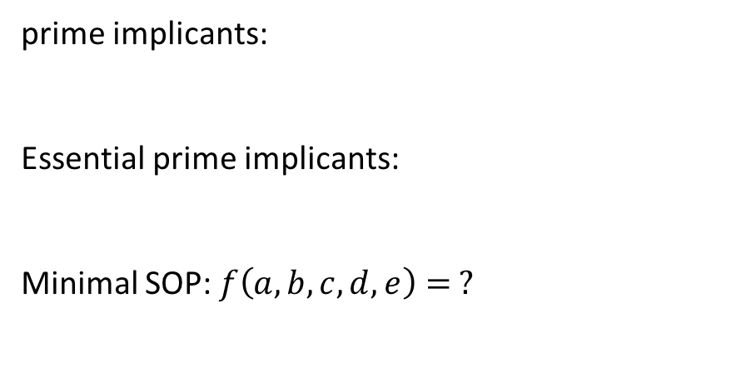
Q4: Minimize SOP
implicant, prime implicant and essential prime implicant
K-map with 5 variables $f(a,b,c,d,e)$ 5 neighbors in K-map!!
$$de\backslash bc$$ | 00 | 01 | 11 | 10
00 | 1 | 0 | 0 | 1
01 | 1 | 1 | 1 | 1
11 | 0 | 1 | X | 0
10 | 0 | 1 | 0 | 0
prime implicants:
Essential prime implicants:
Minimal SOP: $f\left(a,b,c,d,e\right)= ?$
0 4 12 8
$$a=0$$
1 5 13 9
3 7 15 11
2 6 14 10
$$de\backslash bc$$ | 00 | 01 | 11 | 10
00 | 1 | 0 | 0 | 1
01 | 1 | 1 | X | 1
11 | 0 | 1 | X | 0
10 | 0 | 0 | 0 | 0
$$a=1$$
16 20 28 24
17 21 29 25
19 23 31 27
18 22 30 26

Slide 14
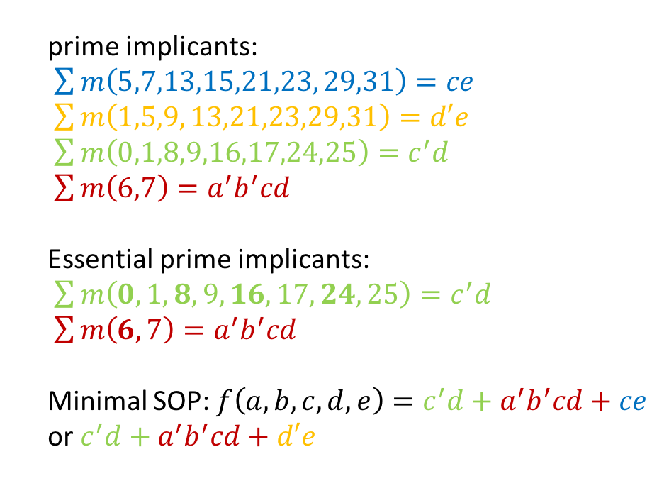
Q4: Minimize SOP
implicant, prime implicant and essential prime implicant
K-map with 5 variables $f(a,b,c,d,e)$ 5 neighbors in K-map!!
$$de\backslash bc$$ | 00 | 01 | 11 | 10
00 | 1 | 0 | 0 | 1
01 | 1 | 1 | 1 | 1
11 | 0 | 1 | X | 0
10 | 0 | 1 | 0 | 0
prime implicants:
$\sum{m\left(5,7,13,15,21,23, 29,31\right)=ce}$
$\sum{m\left(1,5,9, 13,21,23,29,31\right)=d′e}$
$\sum{m\left(0,1,8,9,16,17,24,25\right)=c^{′}d}$
$\sum{m\left(6,7\right)=a^{′}b^{′}cd}$
Essential prime implicants:
$\sum{m\left(0,1,8,9,16,17,24,25\right)=c^{′}d}$
$\sum{m\left(6,7\right)=a^{′}b^{′}cd}$
Minimal SOP: $f\left(a,b,c,d,e\right)=c^{′}d+a^{′}b^{′}cd+ce$ or $c^{′}d+a^{′}b^{′}cd+d′e$
0 4 12 8
$$a=0$$
1 5 13 9
3 7 15 11
2 6 14 10
$$de\backslash bc$$ | 00 | 01 | 11 | 10
00 | 1 | 0 | 0 | 1
01 | 1 | 1 | X | 1
11 | 0 | 1 | X | 0
10 | 0 | 0 | 0 | 0
$$a=1$$
16 20 28 24
17 21 29 25
19 23 31 27
18 22 30 26

Slide 15
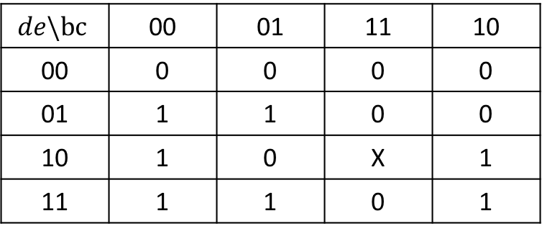
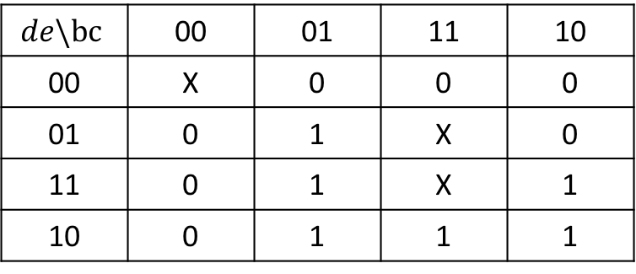

Q5: Minimize POS
implicate, prime implicate and essential prime implicate
K-map with 5 variables $f(a,b,c,d,e)$ 5 neighbors in K-map!!
$$de\backslash bc$$ | 00 | 01 | 11 | 10
00 | 0 | 0 | 0 | 0
01 | 1 | 1 | 0 | 0
10 | 1 | 0 | X | 1
11 | 1 | 1 | 0 | 1
0 4 12 8
$$a=0$$
1 5 13 9
3 7 15 11
2 6 14 10
$$de\backslash bc$$ | 00 | 01 | 11 | 10
00 | X | 0 | 0 | 0
01 | 0 | 1 | X | 0
11 | 0 | 1 | X | 1
10 | 0 | 1 | 1 | 1
$$a=1$$
16 20 28 24
17 21 29 25
19 23 31 27
18 22 30 26

Slide 16
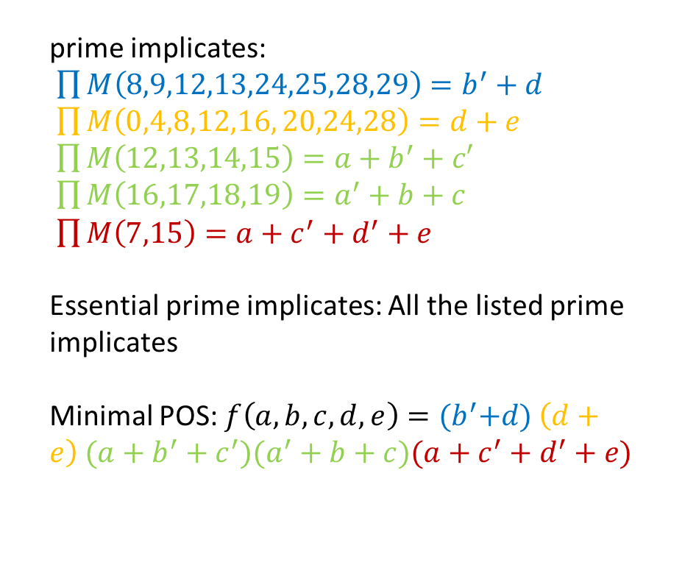
Q5: Minimize POS
implicate, prime implicate and essential prime implicate
K-map with 5 variables $f(a,b,c,d,e)$ 5 neighbors in K-map!!
$$de\backslash bc$$ | 00 | 01 | 11 | 10
00 | 0 | 0 | 0 | 0
01 | 1 | 1 | 0 | 0
10 | 1 | 0 | X | 1
11 | 1 | 1 | 0 | 1
prime implicates:
$\prod{M\left(8,9,12,13,24,25,28,29\right)=b^{′}+d}$
$\prod{M\left(0,4,8,12,16, 20,24,28\right)=d+e}$
$\prod{M\left(12,13,14,15\right)=a+b^{′}+c′}$
$\prod{M\left(16,17,18,19\right)=a^{′}+b+c}$
$\prod{M\left(7,15\right)=a+c^{′}+d^{′}+e}$
Essential prime implicates: All the listed prime implicates
Minimal POS: $f\left(a,b,c,d,e\right)={(b}^{′}+d) \left(d+e\right) (a+b^{′}+c^{′})(a^{′}+b+c)(a+c^{′}+d^{′}+e)$
0 4 12 8
$$a=0$$
1 5 13 9
3 7 15 11
2 6 14 10
$$de\backslash bc$$ | 00 | 01 | 11 | 10
00 | X | 0 | 0 | 0
01 | 0 | 1 | X | 0
11 | 0 | 1 | X | 1
10 | 0 | 1 | 1 | 1
$$a=1$$
16 20 28 24
17 21 29 25
19 23 31 27
18 22 30 26

