Slide 1
CSE140 HW5 Preparation
Xinyuan Wang
06/01/2018

Slide 2
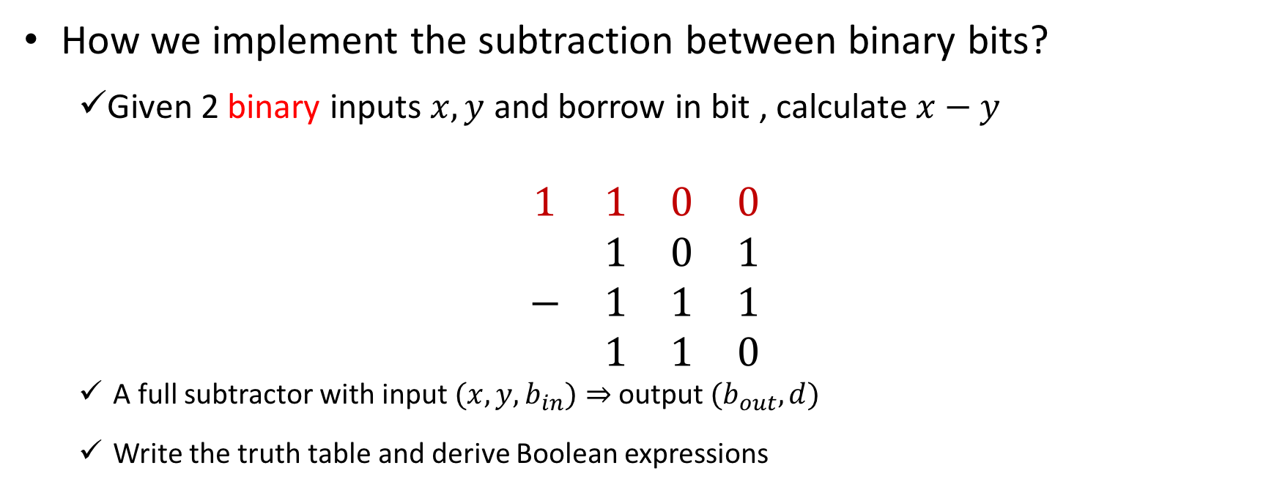


Q1: Subtractor
How we implement the subtraction between binary bits?
  Given 2 binary inputs $x,y$ and borrow in bit , calculate $x−y$
$$\begin{matrix}1 & 1 & 0 & 0 \\ & 1 & 0 & 1 \\ − & 1 & 1 & 1 \\ & 1 & 1 & 0\end{matrix}$$
  A full subtractor with input $(x,y,b_{in})⇒$ output $(b_{out},d)$
  Write the truth table and derive Boolean expressions
borrow out
$$x$$
$$y$$

Slide 3
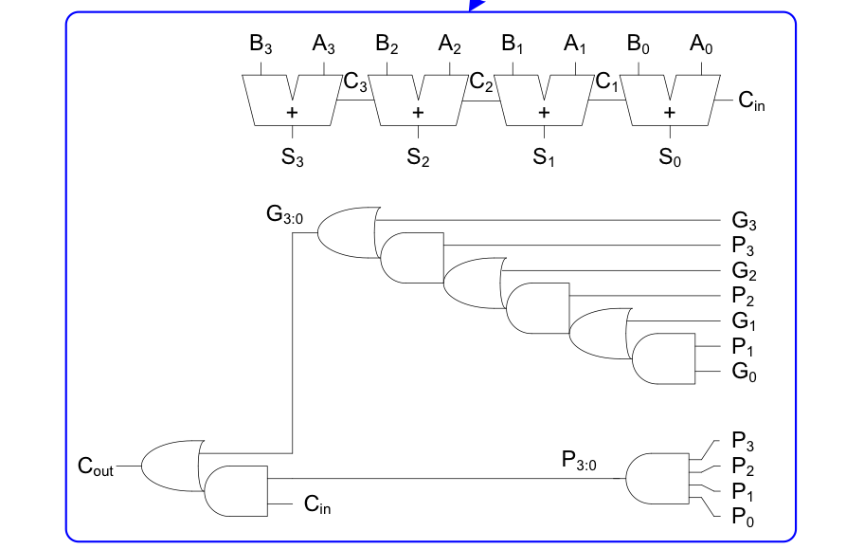
Q1: Subtractor
A four bit borrow look ahead subtractor
  Refer to the carry look ahead adder
A N-bit carry look ahead adder is usually much faster than ripple than a ripple carry adder if N>16
  Delays for carry look ahead and ripple carry adder are defined in slide 18, 23 of lecture 14

Slide 4
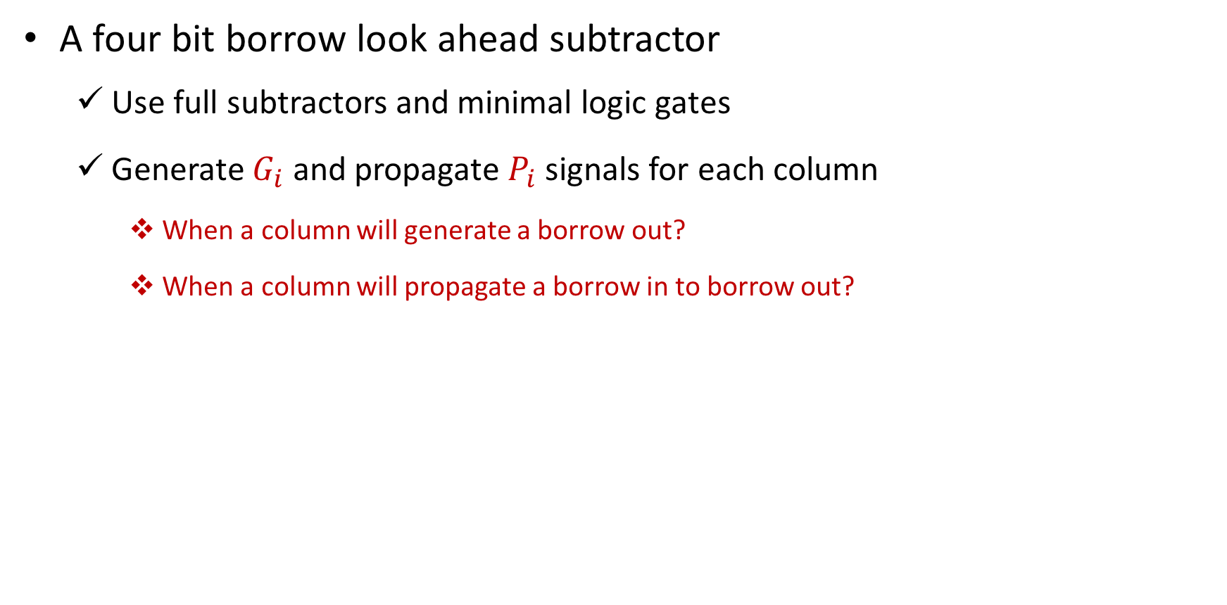
Q1: Subtractor
A four bit borrow look ahead subtractor
  Use full subtractors and minimal logic gates
  Generate $G_{i}$ and propagate $P_{i}$ signals for each column
    When a column will generate a borrow out?
    When a column will propagate a borrow in to borrow out?

Slide 5
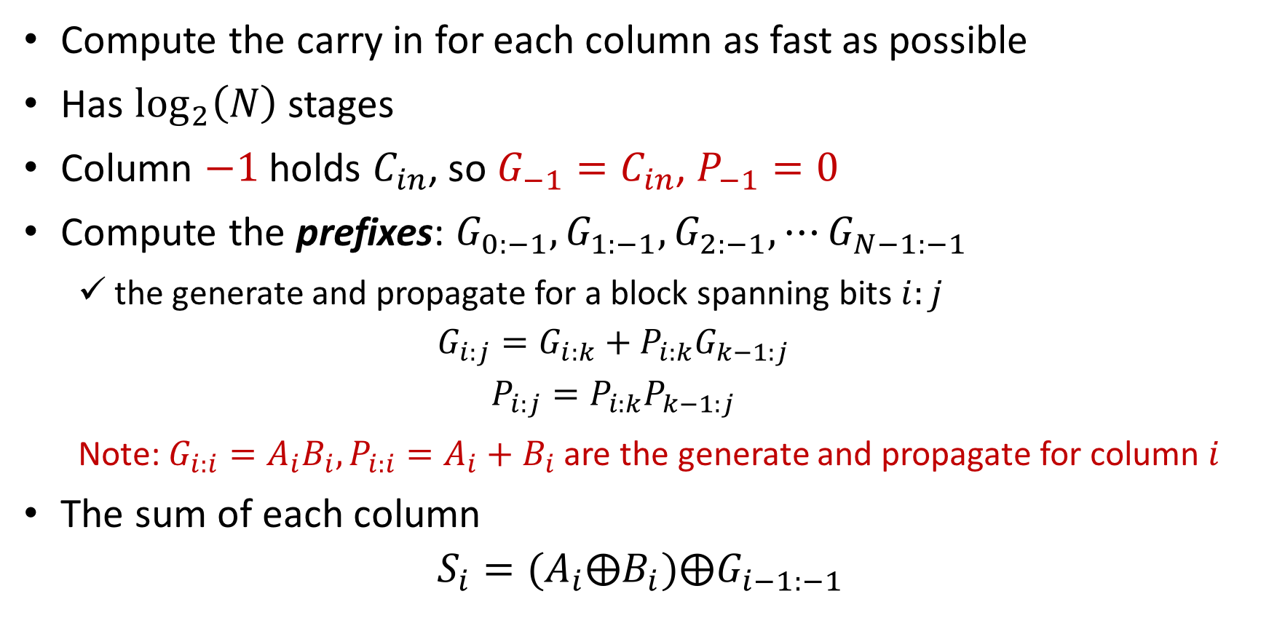
Q2: Prefix Adder
Compute the carry in for each column as fast as possible
Has $\log_{2}\left(N\right)$ stages
Column $−1$ holds $C_{in}$, so $G_{−1}=C_{in}$, $P_{−1}=0$
Compute the prefixes: $G_{0:−1},G_{1:−1}, G_{2:−1},⋯G_{N−1:−1}$
  the generate and propagate for a block spanning bits $i:j$
  $$G_{i:j}=G_{i:k}+P_{i:k}G_{k−1:j}$$
  $$P_{i:j}=P_{i:k}P_{k−1:j}$$
  Note: $G_{i:i}=A_{i}B_{i},P_{i:i}=A_{i}+B_{i}$ are the generate and propagate for column $i$
The sum of each column
$$S_{i}=(A_{i}⨁B_{i})⨁G_{i−1:−1}$$

Slide 6
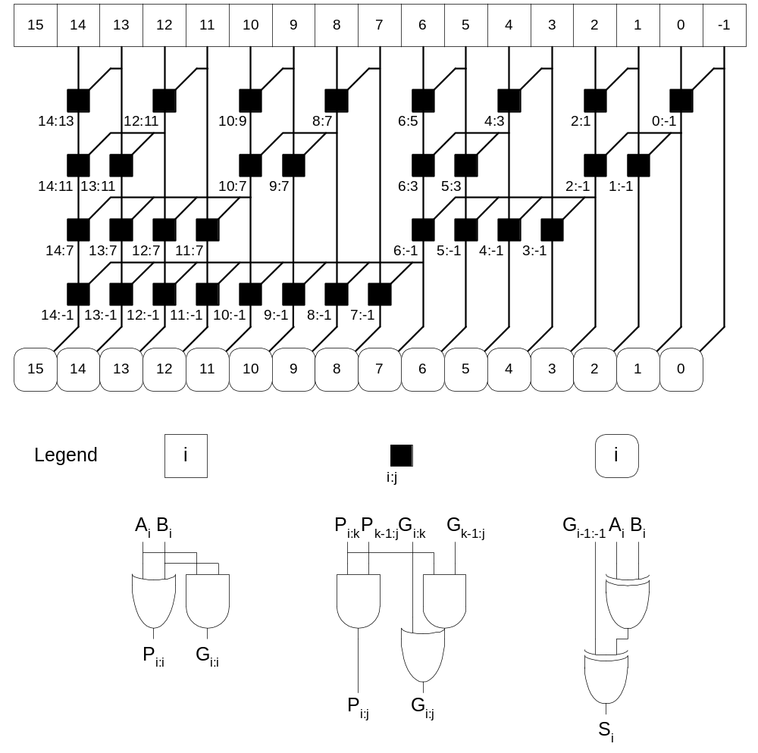
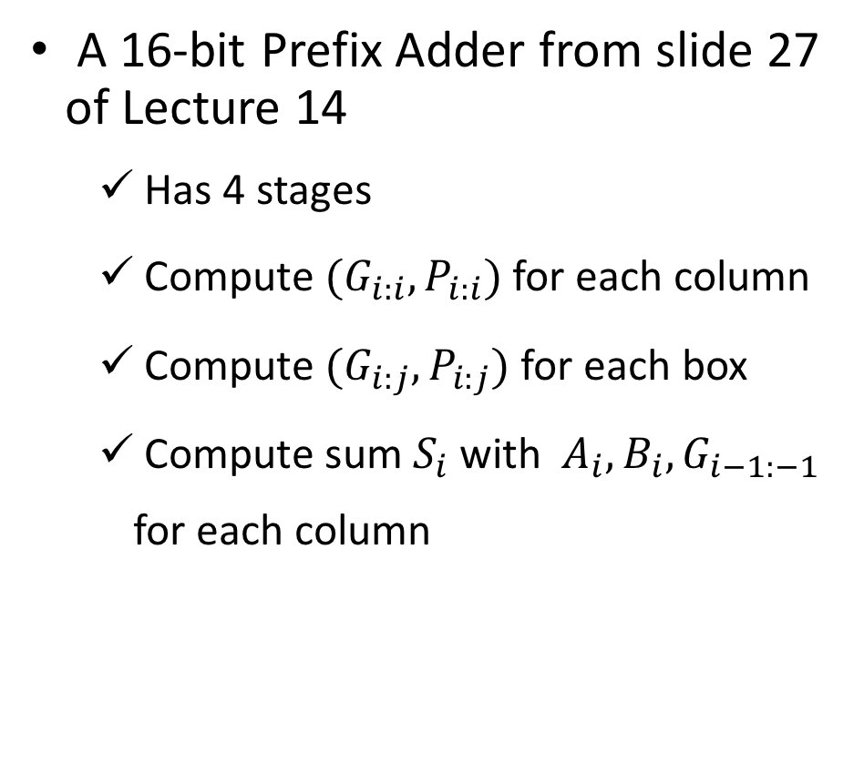
Q2: Prefix Adder
A 16-bit Prefix Adder from slide 27 of Lecture 14
  Has 4 stages
  Compute $(G_{i:i},P_{i:i})$ for each column
  Compute $(G_{i:j},P_{i:j})$ for each box
  Compute sum $S_{i}$ with $A_{i},B_{i}, G_{i−1:−1}$ for each column

Slide 7
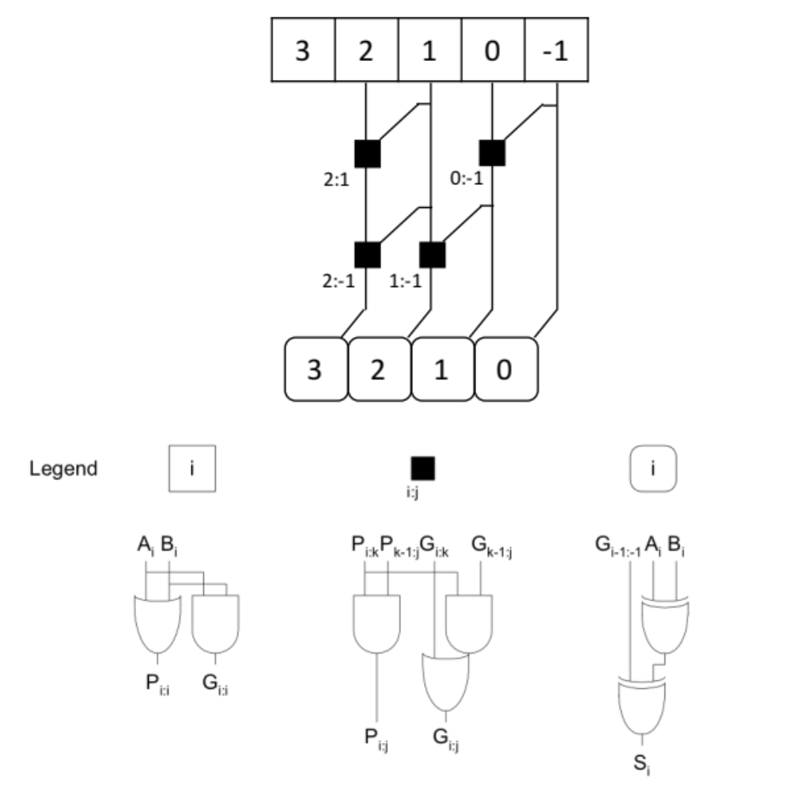
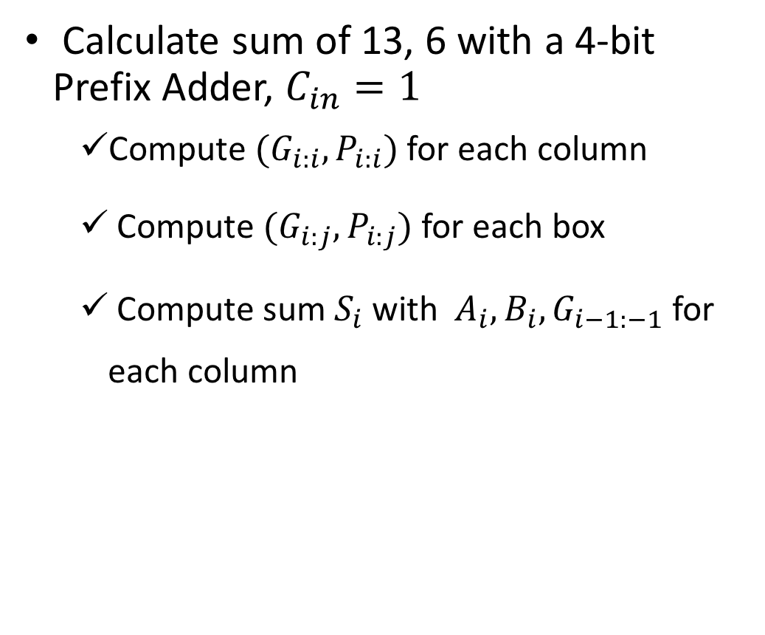
Q2: Prefix Adder
Calculate sum of 13, 6 with a 4-bit Prefix Adder, $C_{in}=1$
  Compute $(G_{i:i},P_{i:i})$ for each column
  Compute $(G_{i:j},P_{i:j})$ for each box
  Compute sum $S_{i}$ with $A_{i},B_{i}, G_{i−1:−1}$ for each column

Slide 8
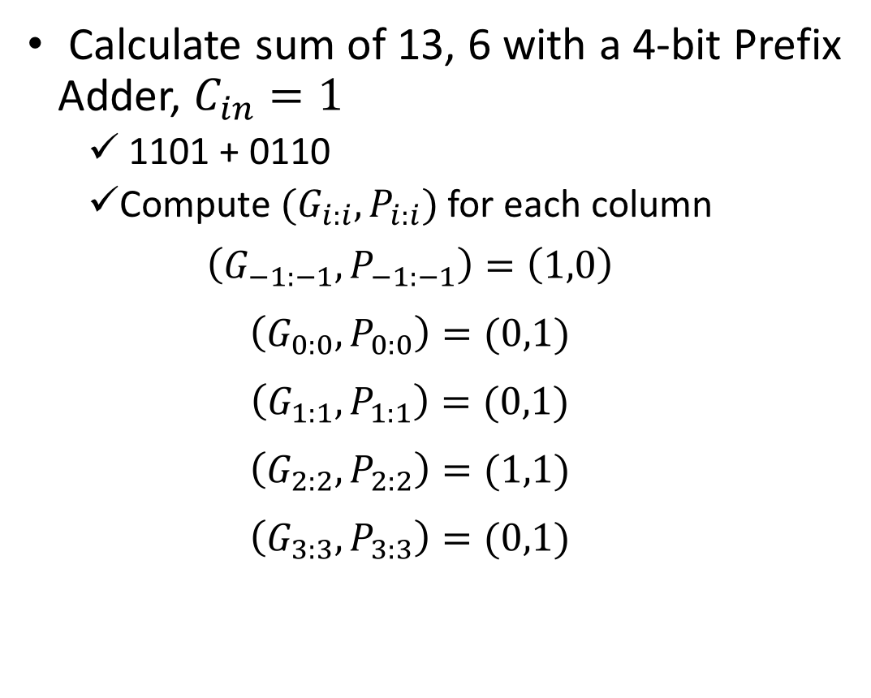
Q2: Prefix Adder
Calculate sum of 13, 6 with a 4-bit Prefix Adder, $C_{in}=1$
  1101 + 0110
  Compute $(G_{i:i},P_{i:i})$ for each column
  $$\left(G_{−1:−1},P_{−1:−1}\right)=\left(1,0\right)$$
  $$\left(G_{0:0},P_{0:0}\right)=(0,1)$$
  $$\left(G_{1:1},P_{1:1}\right)=(0,1)$$
  $$\left(G_{2:2},P_{2:2}\right)=(1,1)$$
  $$\left(G_{3:3},P_{3:3}\right)=(0,1)$$

Slide 9
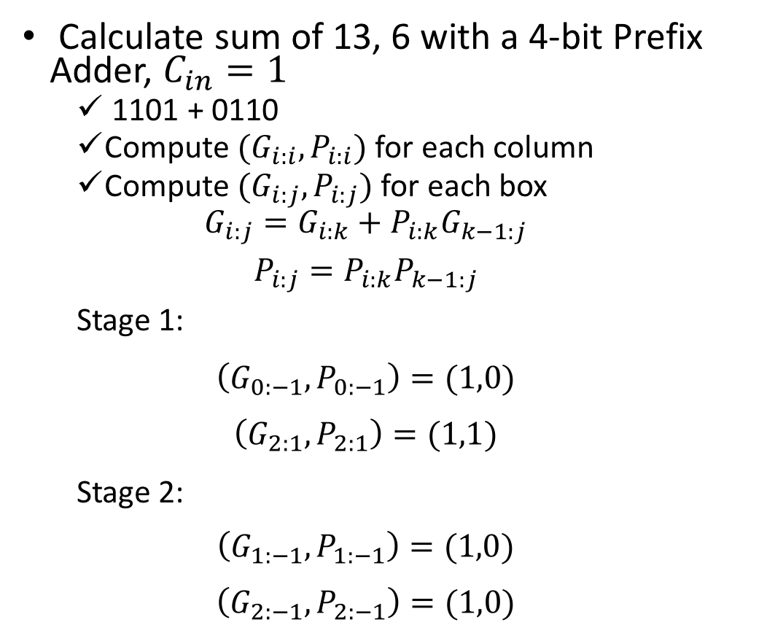



Q2: Prefix Adder
  $$(0,1)$$
  $$(1,1)$$
  $$(0,1)$$
  $$(0,1)$$
  $$(1,0)$$
Calculate sum of 13, 6 with a 4-bit Prefix Adder, $C_{in}=1$
  1101 + 0110
  Compute $(G_{i:i},P_{i:i})$ for each column
  Compute $(G_{i:j},P_{i:j})$ for each box
  $$G_{i:j}=G_{i:k}+P_{i:k}G_{k−1:j}$$
  $$P_{i:j}=P_{i:k}P_{k−1:j}$$
  Stage 1:
  $$\left(G_{0:−1},P_{0:−1}\right)=(1,0)$$
  $$\left(G_{2:1},P_{2:1}\right)=(1,1)$$
  Stage 2:
  $$\left(G_{1:−1},P_{1:−1}\right)=(1,0)$$
  $$\left(G_{2:−1},P_{2:−1}\right)=(1,0)$$

Slide 10
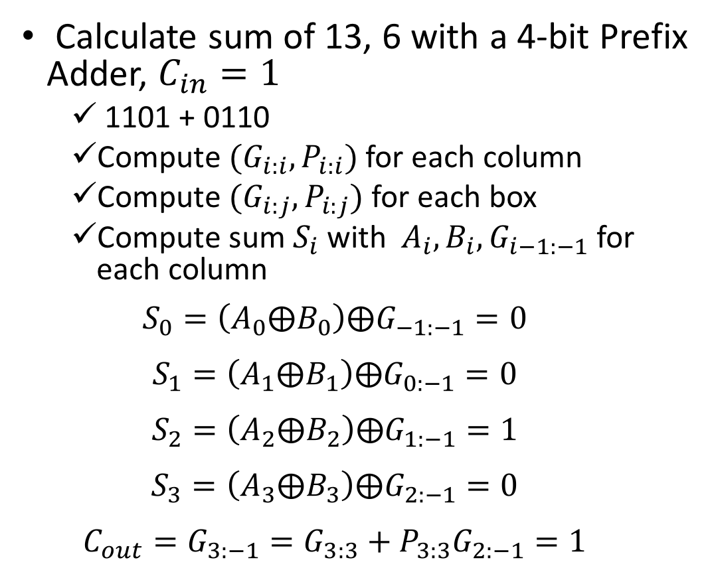



Q2: Prefix Adder
  $$(0,1)$$
  $$(1,1)$$
  $$(0,1)$$
  $$(0,1)$$
  $$(1,0)$$
Calculate sum of 13, 6 with a 4-bit Prefix Adder, $C_{in}=1$
  1101 + 0110
  Compute $(G_{i:i},P_{i:i})$ for each column
  Compute $(G_{i:j},P_{i:j})$ for each box
  Compute sum $S_{i}$ with $A_{i},B_{i}, G_{i−1:−1}$ for each column
  $$S_{0}=\left(A_{0}⨁B_{0}\right)⨁G_{−1:−1}=0$$
  $$S_{1}=\left(A_{1}⨁B_{1}\right)⨁G_{0:−1}=0$$
  $$S_{2}=\left(A_{2}⨁B_{2}\right)⨁G_{1:−1}=1$$
  $$S_{3}=\left(A_{3}⨁B_{3}\right)⨁G_{2:−1}=0$$
  $$C_{out}=G_{3:−1}=G_{3:3}+P_{3:3}G_{2:−1}=1$$
  $$(1,1)$$
  $$(1,0)$$
  $$(1,0)$$
  $$(1,0)$$

Slide 11
Q3: Carry Save Adder
A Redundant Number System
Save the Partial Solution for Multiple Additions
One Bit Propagation for Each Addition

Slide 12
Q3: Carry Save Adder
Example: calculate the sum of 23, 11, 17
Weight | 32 | 16 | 8 | 4 | 2 | 1
n1=23 | 0 | 1 | 0 | 1 | 1 | 1
n2=11 | 0 | 0 | 1 | 0 | 1 | 1
n3=17 | 0 | 1 | 0 | 0 | 0 | 1

Slide 13
Q3: Carry Save Adder
Example: calculate the sum of 23, 11, 17
Weight | 64 | 32 | 16 | 8 | 4 | 2 | 1
n1=23 | 0 | 0 | 1 | 0 | 1 | 1 | 1
n2=11 | 0 | 0 | 0 | 1 | 0 | 1 | 1
n3=17 | 0 | 0 | 1 | 0 | 0 | 0 | 1
n1 | 00 | 00 | 10 | 00 | 10 | 10 | 10
n2 | 0 | 0 | 0 | 1 | 0 | 1 | 1
A=n1+n2
n3
B=A+n3
Sum

Slide 14
Q3: Carry Save Adder
Example: calculate the sum of 23, 11, 17
Weight | 64 | 32 | 16 | 8 | 4 | 2 | 1
n1=23 | 0 | 0 | 1 | 0 | 1 | 1 | 1
n2=11 | 0 | 0 | 0 | 1 | 0 | 1 | 1
n3=17 | 0 | 0 | 1 | 0 | 0 | 0 | 1
n1 | 00 | 00 | 10 | 00 | 10 | 10 | 10
n2 | 0 | 0 | 0 | 1 | 0 | 1 | 1
A=n1+n2 | 00 | 00 | 10 | 10 | 11 | 01 | 00
n3
B=A+n3
Sum

Slide 15
Q3: Carry Save Adder
Example: calculate the sum of 23, 11, 17
Weight | 64 | 32 | 16 | 8 | 4 | 2 | 1
n1=23 | 0 | 0 | 1 | 0 | 1 | 1 | 1
n2=11 | 0 | 0 | 0 | 1 | 0 | 1 | 1
n3=17 | 0 | 0 | 1 | 0 | 0 | 0 | 1
n1 | 00 | 00 | 10 | 00 | 10 | 10 | 10
n2 | 0 | 0 | 0 | 1 | 0 | 1 | 1
A=n1+n2 | 00 | 00 | 10 | 10 | 11 | 01 | 00
n3 | 0 | 0 | 1 | 0 | 0 | 0 | 1
B=A+n3
Sum

Slide 16
Q3: Carry Save Adder
Example: calculate the sum of 23, 11, 17
Weight | 64 | 32 | 16 | 8 | 4 | 2 | 1
n1=23 | 0 | 0 | 1 | 0 | 1 | 1 | 1
n2=11 | 0 | 0 | 0 | 1 | 0 | 1 | 1
n3=17 | 0 | 0 | 1 | 0 | 0 | 0 | 1
n1 | 00 | 00 | 10 | 00 | 10 | 10 | 10
n2 | 0 | 0 | 0 | 1 | 0 | 1 | 1
A=n1+n2 | 00 | 00 | 10 | 10 | 11 | 01 | 00
n3 | 0 | 0 | 1 | 0 | 0 | 0 | 1
B=A+n3 | 00 | 01 | 00 | 11 | 00 | 10 | 10
Sum
An extra non-redundant addition is needed!

Slide 17
Q3: Carry Save Adder
Example: calculate the sum of 23, 11, 17
Weight | 64 | 32 | 16 | 8 | 4 | 2 | 1
n1=23 | 0 | 0 | 1 | 0 | 1 | 1 | 1
n2=11 | 0 | 0 | 0 | 1 | 0 | 1 | 1
n3=17 | 0 | 0 | 1 | 0 | 0 | 0 | 1
n1 | 00 | 00 | 10 | 00 | 10 | 10 | 10
n2 | 0 | 0 | 0 | 1 | 0 | 1 | 1
A=n1+n2 | 00 | 00 | 10 | 10 | 11 | 01 | 00
n3 | 0 | 0 | 1 | 0 | 0 | 0 | 1
B=A+n3 | 00 | 01 | 00 | 11 | 00 | 10 | 10
Two bits of B | 0 | 1 | 0 | 1 | 0 | 0 | 0
 | 0 | 0 | 0 | 1 | 0 | 1 | 1
Sum

Slide 18
Q3: Carry Save Adder
Example: calculate the sum of 23, 11, 17
Weight | 64 | 32 | 16 | 8 | 4 | 2 | 1
n1=23 | 0 | 0 | 1 | 0 | 1 | 1 | 1
n2=11 | 0 | 0 | 0 | 1 | 0 | 1 | 1
n3=17 | 0 | 0 | 1 | 0 | 0 | 0 | 1
n1 | 00 | 00 | 10 | 00 | 10 | 10 | 10
n2 | 0 | 0 | 0 | 1 | 0 | 1 | 1
A=n1+n2 | 00 | 00 | 10 | 10 | 11 | 01 | 00
n3 | 0 | 0 | 1 | 0 | 0 | 0 | 1
B=A+n3 | 00 | 01 | 00 | 11 | 00 | 10 | 10
Two bits of B | 0 | 1 | 0 | 1 | 0 | 0 | 0
 | 0 | 0 | 0 | 1 | 0 | 1 | 1
Sum | 0 | 1 | 1 | 0 | 0 | 1 | 1

Slide 19
Q4: Counter
A modulo-m counter
  Count from 0 to m-1 when CNT = 1 and LD = 0
  Don’t forget the labels
D
CNT
Q (t+1) = (0, 0, .. , 0) if CLR = 1
= D if LD = 1 and CLR = 0
= (Q(t)+1)mod n if LD = 0, CNT = 1 and CLR = 0
= Q (t) if LD = 0, CNT = 0 and CLR = 0
TC
LD
CLR
Clk
TC = 1 if Q (t) = n-1 and CNT = 1
= 0 otherwise
Q

Slide 20
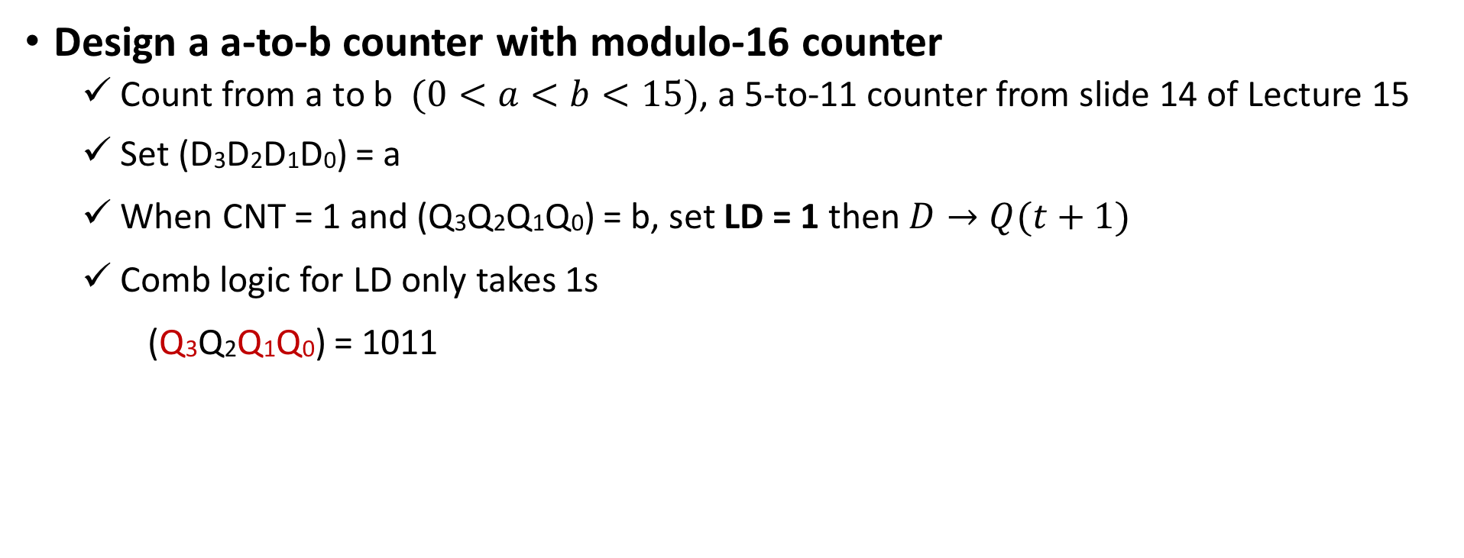
Q4: Counter
Design a a-to-b counter with modulo-16 counter
  Count from a to b $(0<a<b<15)$, a 5-to-11 counter from slide 14 of Lecture 15
  Set (D3D2D1D0) = a
  When CNT = 1 and (Q3Q2Q1Q0) = b, set LD = 1 then $D→Q(t+1)$
  Comb logic for LD only takes 1s
  (Q3Q2Q1Q0) = 1011
A 5-to-11 Counter
Q3 Q2 Q1 Q0
CLR
Clk
(Q3Q2Q1Q0) = 1111 cannot be reached in this 5-to-11 counter!
X
CNT
LD
D3 D2 D1 D0
Q3
(b)
Q1
0 1 0 1 (a)
Q0

Slide 21
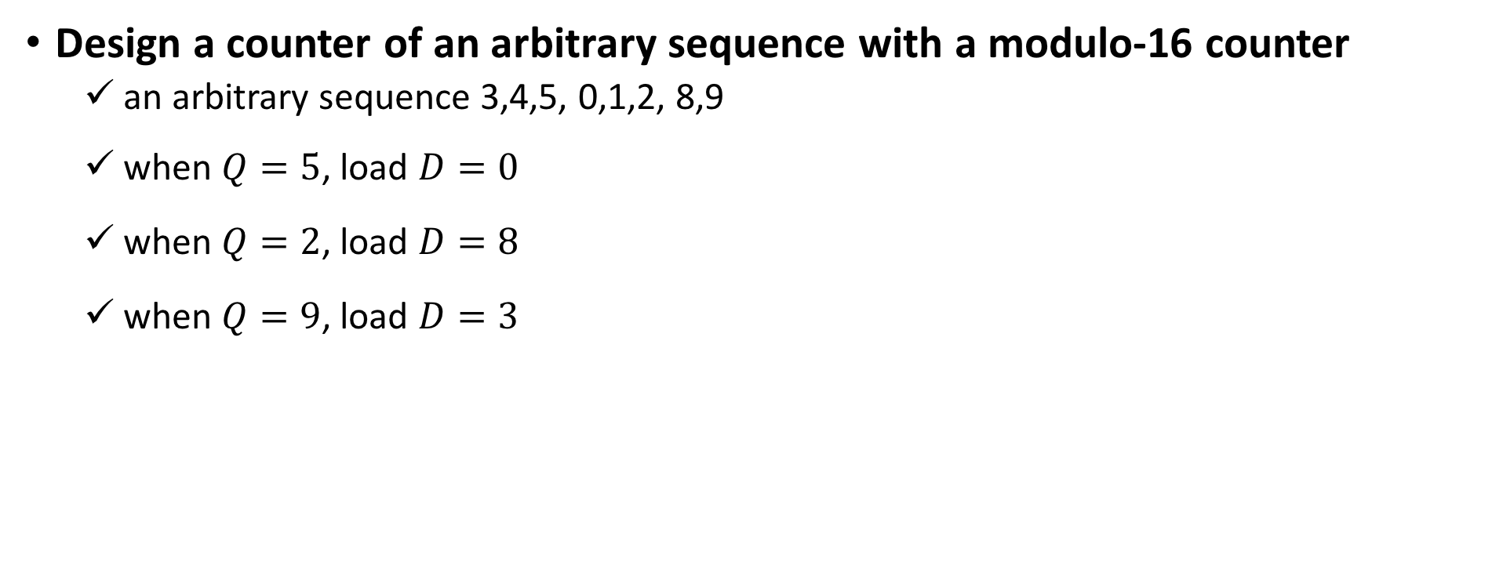
Q4: Counter
Design a counter of an arbitrary sequence with a modulo-16 counter
  an arbitrary sequence 3,4,5, 0,1,2, 8,9
  when $Q=5$, load $D=0$
  when $Q=2$, load $D=8$
  when $Q=9$, load $D=3$
Q3 Q2 Q1 Q0
CLR
Clk
X
CNT
LD
D3 D2 D1 D0

Slide 22
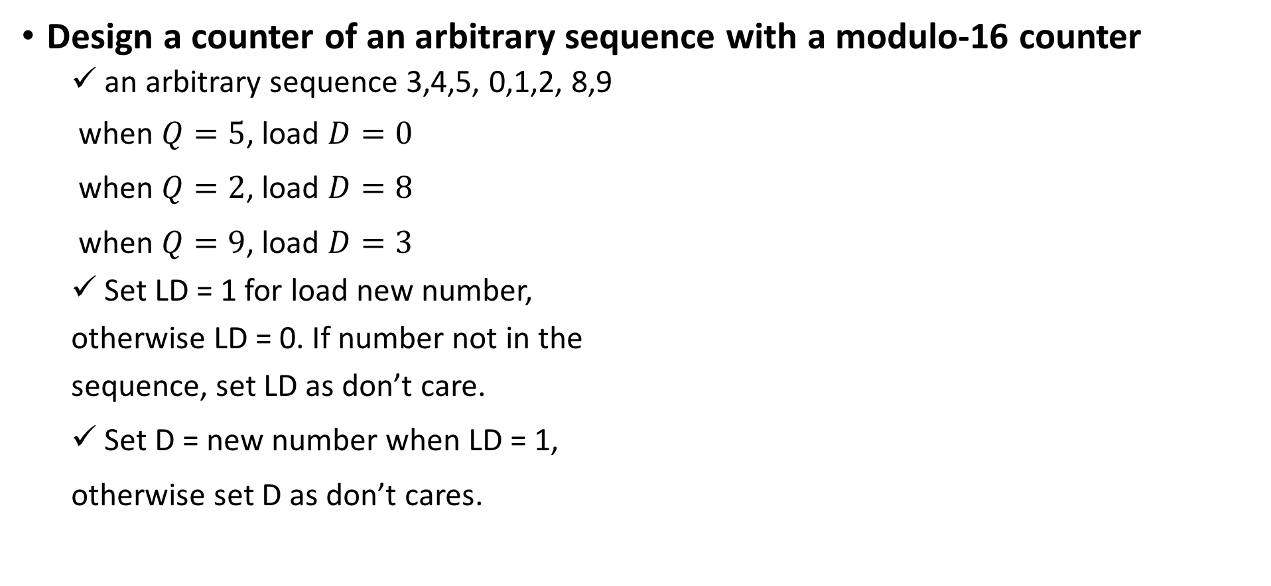
Q4: Counter
Design a counter of an arbitrary sequence with a modulo-16 counter
  an arbitrary sequence 3,4,5, 0,1,2, 8,9
  when $Q=5$, load $D=0$
  when $Q=2$, load $D=8$
  when $Q=9$, load $D=3$
  Set LD = 1 for load new number,
  otherwise LD = 0. If number not in the
  sequence, set LD as don’t care.
  Set D = new number when LD = 1,
  otherwise set D as don’t cares.
Id | Q₃Q₂Q₁Q₀ | LD | D₃ | D₂ | D₁ | D₀
0 | 0000 | 0 | - | - | - | -
1 | 0001 | 0 | - | - | - | -
2 | 0010 | 1 | 1 | 0 | 0 | 0
3 | 0011 | 0 | - | - | - | -
4 | 0100 | 0 | - | - | - | -
5 | 0101 | 1 | 0 | 0 | 0 | 0
8 | 1000 | 0 | - | - | - | -
9 | 1001 | 1 | 0 | 0 | 1 | 1
6,7,10~15 | 0110, 0111, 1010~1111 | - | - | - | - | -

Slide 23
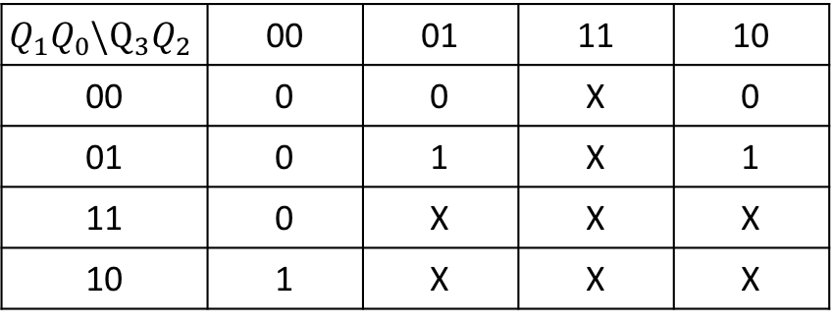

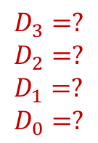
Q4: Counter
Design a counter of an arbitrary sequence with a modulo-16 counter
  an arbitrary sequence 3,4,5, 0,1,2, 8,9
  Use K-maps
Id | Q₃Q₂Q₁Q₀ | LD | D₃ | D₂ | D₁ | D₀
0 | 0000 | 0 | - | - | - | -
1 | 0001 | 0 | - | - | - | -
2 | 0010 | 1 | 1 | 0 | 0 | 0
3 | 0011 | 0 | - | - | - | -
4 | 0100 | 0 | - | - | - | -
5 | 0101 | 1 | 0 | 0 | 0 | 0
8 | 1000 | 0 | - | - | - | -
9 | 1001 | 1 | 0 | 0 | 1 | 1
6,7,10~15 | 0110, 0111, 1010~1111 | - | - | - | - | -
LD = $Q_{1}{Q′}_{0}+Q_{2}Q_{0}+Q_{3}Q_{0}$
$$Q_{1}Q_{0}\backslash Q_{3}Q_{2}$$ | 00 | 01 | 11 | 10
00 | 0 | 0 | X | 0
01 | 0 | 1 | X | 1
11 | 0 | X | X | X
10 | 1 | X | X | X
0 4 12 8
1 5 13 9
3 7 15 11
2 6 14 10
$$D_{3}=?$$
$$D_{2}=?$$
$$D_{1}=?$$
$$D_{0}=?$$

