Slide 1
CSE 140 Discussion

Slide 2
 |  |  | t0 |  | t1 |  | t2 |  | t3
id | S | R | Qt | yt | Qt | yt | Qt | yt | Qt | yt
0 | 0 | 0 | 0 | 0
1 | 0 | 0 | 0 | 1
2 | 0 | 0 | 1 | 0
3 | 0 | 0 | 1 | 1
4 | 0 | 1 | 0 | 0
5 | 0 | 1 | 0 | 1
6 | 0 | 1 | 1 | 0
7 | 0 | 1 | 1 | 1
8 | 1 | 0 | 0 | 0
9 | 1 | 0 | 0 | 1
10 | 1 | 0 | 1 | 0
11 | 1 | 0 | 1 | 1
12 | 1 | 1 | 0 | 0
13 | 1 | 1 | 0 | 1
14 | 1 | 1 | 1 | 0
15 | 1 | 1 | 1 | 1
Truth table of SR latch with incremental steps in time
S
y
y = (S+Q)’
Q
R
Q = (R+y)’
Lecture 7, Slide 17

Slide 3
 |  |  | t0 |  | t1 |  | t2 |  | t3
id | S | R | Qt | yt | Qt | yt | Qt | yt | Qt | yt
0 | 0 | 0 | 0 | 0 | 1 | 1 | 0 | 0 | 1 | 1
1 | 0 | 0 | 0 | 1 | 0 | 1 | 0 | 1 | 0 | 1
2 | 0 | 0 | 1 | 0 | 1 | 0 | 1 | 0 | 1 | 0
3 | 0 | 0 | 1 | 1 | 0 | 0 | 1 | 1 | 0 | 0
4 | 0 | 1 | 0 | 0 | 0 | 1 | 0 | 1 | 0 | 1
5 | 0 | 1 | 0 | 1 | 0 | 1 | 0 | 1 | 0 | 1
6 | 0 | 1 | 1 | 0 | 0 | 0 | 0 | 1 | 0 | 1
7 | 0 | 1 | 1 | 1 | 0 | 0 | 0 | 1 | 0 | 1
8 | 1 | 0 | 0 | 0 | 1 | 0 | 1 | 0 | 1 | 0
9 | 1 | 0 | 0 | 1 | 0 | 0 | 1 | 0 | 1 | 0
10 | 1 | 0 | 1 | 0 | 1 | 0 | 1 | 0 | 1 | 0
11 | 1 | 0 | 1 | 1 | 0 | 0 | 1 | 0 | 1 | 0
12 | 1 | 1 | 0 | 0 | 0 | 0 | 0 | 0 | 0 | 0
13 | 1 | 1 | 0 | 1 | 0 | 0 | 0 | 0 | 0 | 0
14 | 1 | 1 | 1 | 0 | 0 | 0 | 0 | 0 | 0 | 0
15 | 1 | 1 | 1 | 1 | 0 | 0 | 0 | 0 | 0 | 0
“State Table” of SR latch
Qy\SR | 00 | 01 | 10 | 11
00
01
10
11
Lecture 7, Slide 18

Slide 4
State Table and State Diagram
Q y
Q y
State
SR
State
Present
State
Transition
Next
State
State diagram
00
01
10
00
10
State Table
01
10
01
\SR Qy | 00 | 01 | 10 | 11
00 | 11 | 01 | 10 | 00
01 | 01 | 01 | 10 | 00
10 | 10 | 01 | 10 | 00
11 | 00 | 01 | 10 | 00
11
10
01
11
00
11
01
10
00
11
00
11
Lecture 7, Slide 20

Slide 5
SR Latch
\SR Qy | 00 | 01 | 10 | 11
00 | 11 | 01 | 10 | 00
01 | 01 | 01 | 10 | 00
10 | 10 | 01 | 10 | 00
11 | 00 | 01 | 10 | 00
SR=01 (RESET) : (Q,y) = (0,1)
SR=10 (SET) : (Q,y) = (1,0)
SR=00 (NO CHANGE)
So (Q,y) should not become (0,0) or (1,1)
Solutions: Avoid the case that SR = (1,1).
SR=11 (ILLEGAL) : (Q,y) = (0,0)
State table
SR
inputs
00 01 11 10
PS
0 0 0 - 1
1 1 0 - 1
Characteristic Expression
Q(t+1) = S(t)+R’(t)Q(t)
Q(t)
Q(t+1)
NS (next state)
Lecture 7, Slide 26

Slide 6
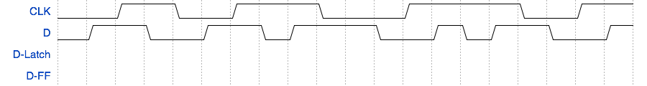
D-Latch vs. D-FF
D-Latch
  Analogy: Door
  CLK = 1 : Q = D
  CLK = 0 : Q = Q_{prev}
D-FF
  Analogy: Camera
  CLK = 0 to 1 : Q = D
  Otherwise : Q = Q_{prev}

Slide 7
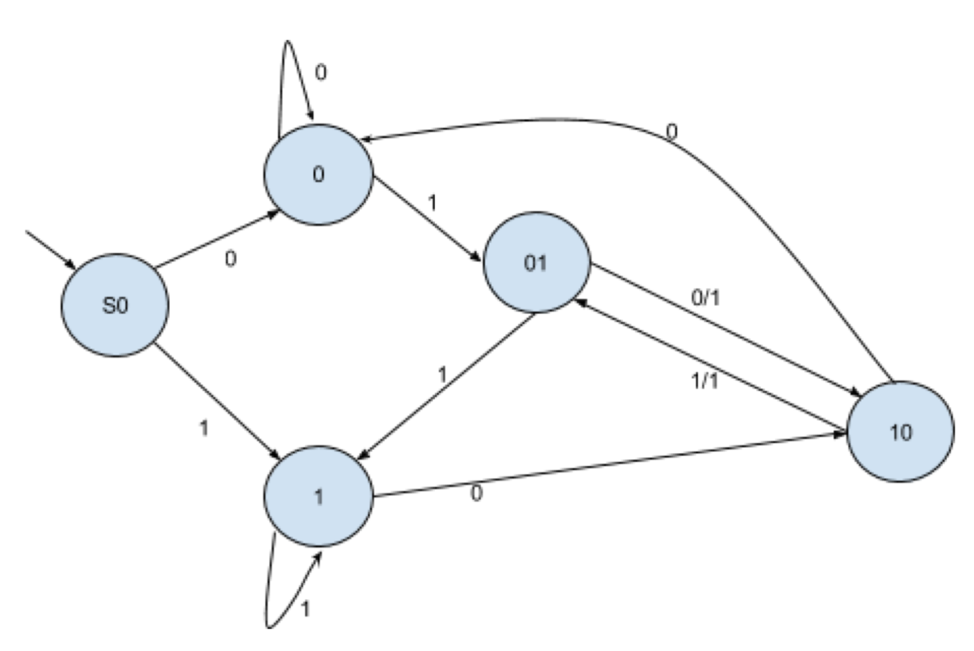
Pattern Recognizer FSM
Example:
  y = 1 if x(t − 2, t) = 101 or 010
  y = 0 otherwise
PS \ Input |  | X = 0 | X = 1
-- | S0 | S1, 0 | S2, 0
0 | S1 | S1, 0 | S3, 0
1 | S2 | S4, 0 | S2, 0
01 | S3 | S4, 1 | S2, 0
10 | S4 | S1, 0 | S3, 1
State Diagram
State Table

Slide 8
HW3 Questions?

Slide 9
Describing Sequential Ckts
State diagrams and next-state tables nor are suitable for describing very large digital designs
  large circuits must be described in a modular fashion -- as a collection of cooperating FSMs
BSV is a modern programming language to describe cooperating FSMs

Slide 10
Modulo-4 counter circuit
inc
inc
Modulo-4
counter
q0
Read the
counter
1
q1
0
q0^{t+1} = ~inc∙q0^{t} + inc∙~q0^{t}
q1^{t+1} = ~inc∙q1^{t} + inc∙~q1^{t}∙q0^{t} + inc∙q1^{t}∙~q0^{t}
“Optimized” logic
q0^{t+1} = inc ⊕ q0^{t}
q1^{t+1} = (inc == 1) ? q0^{t} ⊕ q1^{t} : q1^{t}

Slide 11
Modulo-4 counter circuit
inc
q0^{t+1} = ~inc∙q0^{t} + inc∙~q0^{t}
q1^{t+1} = ~inc∙q1^{t} + inc∙~q1^{t}∙q0^{t} + inc∙q1^{t}∙~q0^{t}
“Optimized” logic
q0^{t+1} =inc ⊕ q0^{t}
q1^{t+1} =(inc == 1) ? q0^{t}⊕q1^{t}:q1^{t}
q0
1
q1
0
PS\input | inc=0 | inc=1
00 | 00 | 01
01 | 01 | 10
10 | 10 | 11
11 | 11 | 00
PS: q1^{t} q0^{t}, NS: q1^{t+1} q0^{t+1}

Slide 12
modulo4 counter in BSV
module moduloCounter(Counter);
Reg#(Bit#(2)) cnt <- mkReg(0);
method Action inc;
cnt <={!cnt[1]&cnt[0] | cnt[1]&!cnt[0], !cnt[0]};
endmethod
method Bit#(2) read;
return cnt;
endmethod
endmodule
inc.en
read
~cnt[1]&…
cnt
Notes:
(Andy) ‘r’ and ‘w’ are ‘_read’ and ‘_write’ in BSV, but ‘r’ and ‘w’ are much easier to write on slides.
(Andy) I changed ‘||’ to ‘|’ in the logic because || is the boolean or and | is the bitwise or.

Slide 13
Interface
Modulo counter has the following interface, i.e., type
An interface can have many different implementations
  For example, the numbers may be represented as Gray code
interface Counter;
method Action inc;
method Bit#(2) read;
endinterface

Slide 14
Modules
A module in BSV is like a class definition in Java or C++
  It has internal state
  The internal state can only be read and manipulated by the (interface) methods
  An action specifies which state elements are to be modified
  Actions are atomic -- either all the specified state elements are modified or none of them are modified (no partially modified state is visible)

Slide 15
FIFO Interface
interface Fifo#(numeric type size, type t);
method Bool notFull;
method Bool notEmpty;
method Action enq(t x);
method Action deq;
method t first;
endinterface
x
en
enq
en
deq
notFull
Fifo
module
!full
- enq should be called only if notFull returns True;
- deq and first should be called only if notEmpty returns True
notEmpty
!emty
first
first

Slide 16
One-Element FIFO Implementation
module mkCFFifo (Fifo#(1, t));
Reg#(t) d <- mkRegU;
Reg#(Bool) v <- mkReg(False);
method Bool notFull;
return !v;
endmethod
method Bool notEmpty;
return v;
endmethod
method Action enq(t x);
v <= True; d <= x;
endmethod
method Action deq;
v <= False;
endmethod
method t first;
return d;
endmethod
endmodule
x
en
enq
en
deq
notFull
Fifo
module
!full
notEmpty
!emty
first
first

Slide 17
FIFO Module: methods with guarded interfaces
n
interface Fifo#(numeric type size,
type t);
method Action enq(t x);
method Action deq;
method t first;
endinterface
enab
enq
not full
rdy
enab
deq
FIFO
not empty
rdy
n
not empty
first
rdy
Every method has a guard (rdy wire); the value returned by a value method is meaningful only if its guard is true
Every action method has an enable signal (en wire); an action method is invoked (en is set to true) only if the guard is true
Guards make it possible to transfer the responsibility of the correct use of a method from the user to the compiler
Guards are extraordinarily convenient for programming and also enhance modularity of the code

Slide 18
One-Element FIFO Implementation with guards
module mkCFFifo (Fifo#(1, t));
Reg#(t) d <- mkRegU;
Reg#(Bool) v <- mkReg(False);
method Action enq(t x)
v <= True; d <= x;
endmethod
method Action deq
v <= False;
endmethod
method t first
return d;
endmethod
endmodule
n
if (!v);
enq
enab
not full
rdy
if (v);
enab
deq
FIFO
not empty
rdy
n
not empty
first
rdy
if (v);

