Slide 1
CSE 140 Discussion 1
Omid Assare

Slide 2
HW1: Introduction
The purpose of this assignment is three-fold:
  Practice the application of Boolean algebra theorems to transform and reduce Boolean expressions.
  Go from the world of Boolean expressions to the world of digital circuits.
  Translate a problem described in words to a Boolean algebraic expression.

Slide 3
Problem 2.1
Prove DeMorgan’s Law using Boolean algebra
  (AB)’ = A’ + B’
  (A + B)’ = A’B’
  Hint: To prove LHS’ = RHS, show RHS is complement of LHS, i.e.,
    LHS.RHS = 0, and
    LHS + RHS = 1.

Slide 4
Problem 2.2
Consensus Theorem
  AB + BC + A’C = AB + A’C
  (A + B)(B + C)(A’ + C) = (A + B)(A’ + C)
  Use Boolean algebra to prove
    Hint: same steps as in proving consensus theorem.

Slide 5
Problem 2.3
Shannon’s Expansion:
  f(a,b,c) = a.f(a=1,b,c) + a’.f(a=0,b,c)
  f(a,b,c) = (a + f(a=0,b,c)).(a’ + f(a=1,b,c))
  Which variable to choose?
    Hint: Consensus theorem

Slide 6
Problem 3
Problem (English) to truth table
Truth table to Boolean algebra
  Sum of products
  Product of sums
Example:
  3-bit input: x1, x2, x3
  Output y = 1 when number of 1’s in input is odd and y = 0 otherwise.

Slide 7
Example
x1 | x2 | x3 | y | minterm | MAXterm
0 | 0 | 0 | 0 | x’1.x’2.x’3 | x1+x2+x3
0 | 0 | 1 | 1 | x’1.x’2.x3 | x1+x2+x’3
0 | 1 | 0 | 1 | x’1.x2.x’3 | x1+x’2+x3
0 | 1 | 1 | 0 | x’1.x2.x3 | x1+x’2+x’3
1 | 0 | 0 | 1 | x1.x’2.x’3 | x’1+x2+x3
1 | 0 | 1 | 0 | x1.x’2.x3 | x’1+x2+x’3
1 | 1 | 0 | 0 | x1.x2.x’3 | x’1+x’2+x3
1 | 1 | 1 | 1 | x1.x2.x3 | x’1+x’2+x’3
SOP: y = x’1.x’2.x3 + x’1.x2.x’3 + x1.x’2.x’3 + x1.x2.x3
POS: y = (x1+x2+x3).(x1+x’2+x’3).(x’1+x2+x’3).(x’1+x’2+x3)

Slide 8
Problem 4
Useful tools for simplification:
a + ab = a (Absorption)
a + a’b
  add consensus: a + a’b + b
  absorption: a + b
ad + bcd + a’c
  add consensus: ad + bcd + a’c + cd
  absorption: ad + a’c + cd
  remove consensus: ad + a’c

Slide 9
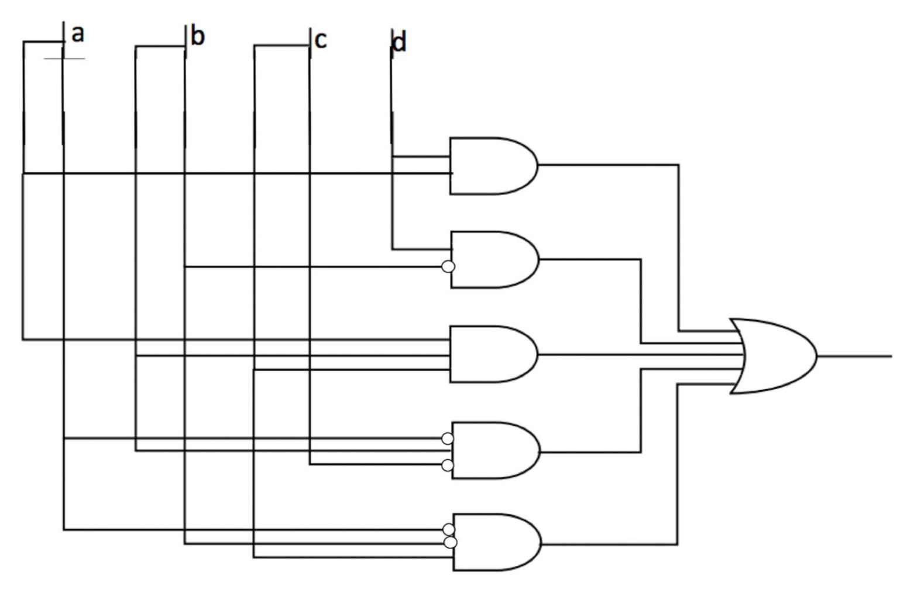
ad + b’d + a’bc’ + a’b’c + abc
#Variables:
  4
#Literals:
  13
#Operators:
  6
#Gates:
  6
#Nets:
  10
#Pins:
  24
#nets: #variables + #operators
#pins: #literals + #gates*2 – 1

Slide 10
BSV Demo
Problem 5
  Test your code
Problem 4
  Test function equivalence

