Slide 1
Week 10 Discussion
Final review
December 14 2023

Slide 2
Logistics
12/14 Thursday 3:00pm - 5:59pm
Location: TBD
Format similar to the midterm:
  True/False, Multiple choice, short answer
Final will cover everything this quarter(focus on the second half)

Slide 3
Topics before
Midterm
Application Security:
Control Flow Vulnerabilities
Mitigation strategies
techniques for evading mitigations
Relationship between each other
Memory Safety
Threat Modelling and Security Properties
System Security :
Principles of secure system design
Isolation (memory isolation, resource isolation in Unix, user/kernel isolation)
VMs
Web Security :
how the web works (Http, DOMs and JS)
Attacker model, Security model
Same-Origin Policy (SOP)
Cross-Site Scripting (XSS)
Cross-Site Request Forgery (CSRF)
SQL Injection (SQLI)

Slide 4
Topics after
Midterm
Network Security :
Layers and Protocols
Attacks
Defenses
Symmetric-key Cryptography :
Encryption
Hash functions
MACs
Public-Key Cryptography :
Key exchange
Encryption
Digital signatures
TLS and secure channels:
Constructing secure channels
Public Key Infrastructures
TLS
Other topics:
Authentication and passwords
Privacy and anonymity
Ethics, law, and policy

Slide 5
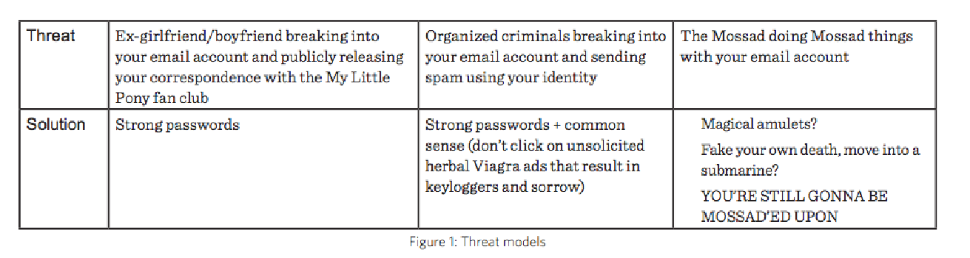
The Security Mindset
Threat Modelling (What are we trying to protect, from whom)
  Security Boundary & Attack Surface
  Risk assessment
  Adversarial Mindset
Security Properties
  Confidentiality: Prevention of unauthorized access to information
  Integrity: Prevention of unauthorized changes
  Authenticity: Identification and assurance of origin
  Availability: Prevention of unauthorized denial of service to others
  Privacy: Protect sensitive information, such as personally identifiable information, etc.

Slide 6
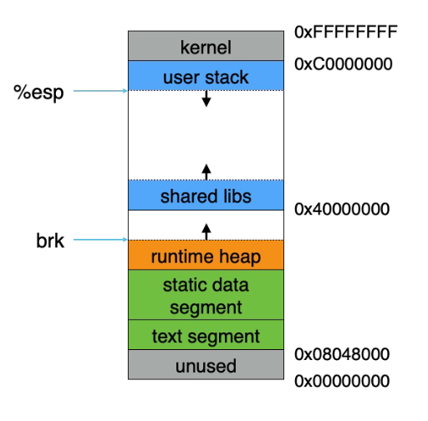
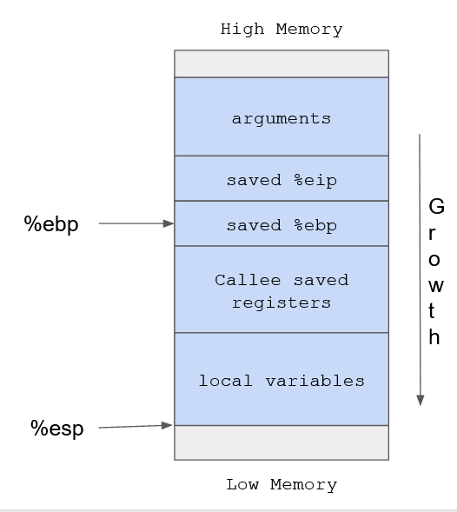
Application Security
Stack layout
  Stack, Heap, Data, Text
Purpose of common registers
  Esp, ebp, eip, etc.
Understand Function calls
Buffer overflows vulnerabilities
  Format String
  Heap
  Integers
  Pointers

Slide 7
Buffer overflow mitigations
Stack Canaries
  Detect overwriting of the return address
Data Execution Prevention (W^X)
  Make all pages either writable or executable
Address Space Layout Randomization (ASLR)
  Randomize memory layout
Understand why they work, what can they protect v.s. What they cannot protect.

Slide 8
Buffer overflow mitigations evasion
Pointer subterfuge
  Non sequential overwrite
Heap spraying
  Spray the heap with shellcode, then jump blindly
Return-to-libc
  Jump to existing code
Return Oriented Programming
  Make shellcode out of existing “gadgets” found in the memory
Which mitigation can these techniques evade?
Why do they work?

Slide 9
System security
Principles of secure system design
Least Privilege
  Faculty can only change grades for classes they teach
Privilege separation
  Multi-user operating system
Complete mediation
  Software fault isolation (SFI)
Failsafe/closed
  System call
Defence-in-depth
Keep-it-simple
  Keeping the Trusted Computing Base (TCB) small and simple

Slide 10
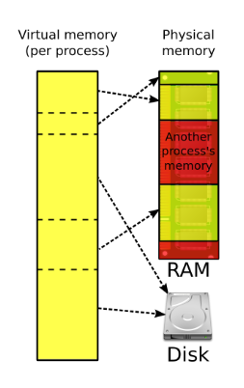
Isolation: Memory Isolation
Process should not be able to access another process’s memory
Each process gets its own virtual address space, managed by the operating system
Memory addresses used by processes are virtual addresses (VAs) not physical addresses (PAs)

Slide 11
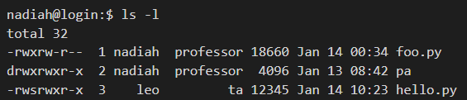
Process Isolation in Unix
Process should only be able to access certain resources
Permissions to access files are granted based on user IDs
Access Operations on file: Read, Write, Execut
Each file has an access control list (ACL)
Role based: user group other
ACL VS Capability based

Slide 12
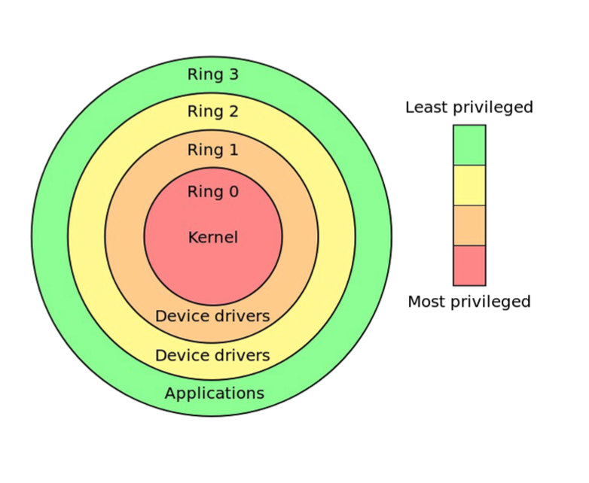
Kernel/User Isolation
Kernel is isolated from user processes
  Page tables
  Processor privilege levels
Interface between userspace and kernel: system calls
  To damage a system, must make system calls
System call interposition
  Monitor app’s system calls and block unauthorized calls

Slide 13
Web Security
Browser
Load and execute content
Basic/Nested execution model
Frame and iFrame
Document Object Model (DOM)
DOM and JS
Same Origin Policy (SOP)
Cookie sending rules
SameSite Cookies
HttpOnly Cookies
HTTP
  Protocol
  Request / Response
  Methods
  Common status code
Web sessions
Cookie
  Purpose
  How to set and use
Nested Execution Model
  iframes
Notes:
Don’t need to focus on things like what are all the HTTP headers.
How does HTTP protocol work
How does it’s browsing session work
HTTP is a stateless protocol
Focus on the security side. Whatever was discussed in the lecture and attacks you did in PA.
Methods
Different methods in different situations
How can you set cookie
Common status code - 200 OK,
Cookies
Why we need it
How can use it in JS
What does SameSite hazard do?

Slide 14
Web Attacks and Defenses
Cross Site Request Forgery (CSRF)
Server-Side Injection
  Command injection
  SQL Injection
    SQL basics
    Mitigations
Client-Side Injection
  Cross Site Scripting (XSS): Injecting malicious scripts into benign and trusted website
  Prevention: Content Security Policy
Understand how the attack works
Notes:
What is Phishing, categories of Phishing
PA attacks :
XSS
It’s on client side
SQL injection
It’s on server side
Able to read basic SQL commands
Mitigations against SQL, XSS and CSRF
You are writing cod

Slide 15
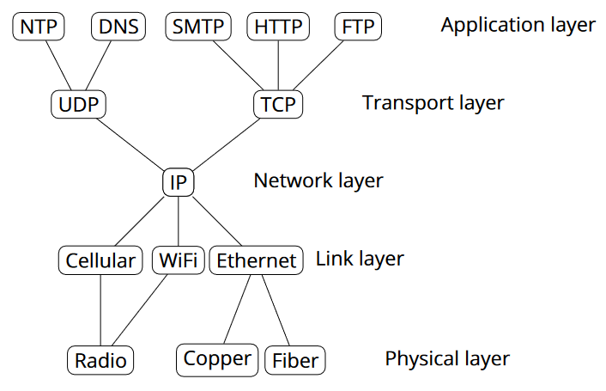
Network Security
Threat modeling
  Attacker capabilities
    Physical access: Attacker has physical access to the network infrastructure.
    In path/Man in the middle: Attacker can see, add, and block packets.
    On path/Man on the side: Attacker can see and add packets, but cannot block packets.
    Passive: Attacker can see victim’s network traffic, but cannot add or modify packets.
    Off path: Attacker cannot see network traffic of the victim.
  Different threats at every network layer and for every protocol
    Application layer
      DNS
      HTTP(S)
    Transport layer
      TCP
      UDP
    Network layer
      IP
      BGP
    Data link layer
      Ethernet
      Wifi
      ARP
    Physical layer
      Physical wires
      Photons
      RF modulation

Slide 16
Network Security
Protocols:
IP: Internet Protocol
  Connectionless delivery model (best effort)
ARP: Address Resolution Protocol
  lets hosts build table mapping IP addresses to MAC addresses.
BGP (Border Gateway Protocol)
  Routing among Autonomous Systems
TCP (Transmission Control Protocol)
  Reliable in-order, connection based delivery
  ACK, SEQ, FIN/RST, and 3-way handshake
DNS (Domain Name Service)
  mapping between host names and IP addresses
Understand them in a security context

Slide 17
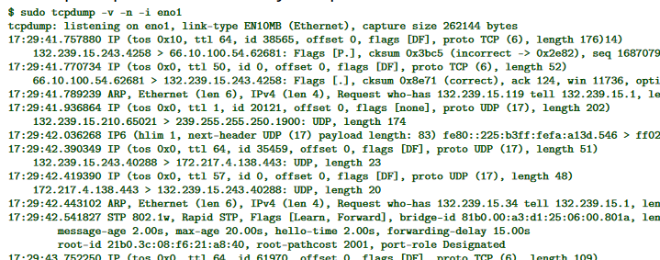
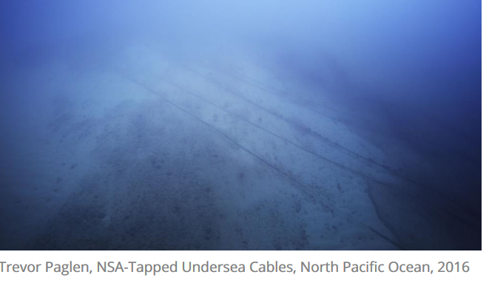
Network Security: attacks
Physical/link layer threats
Eavesdropping
  (routers, switches, etc) see all traffic
  Tapping cables
Injection
  ARP spoofing
    Attacker impersonate host and send response
Jamming
  Disrupting physical signal

Slide 18
Network Security: attacks
Network layer threats
Spoofing
  source address is arbitrary
  DHCP response spoofing
    DHCP request is broadcasted
    Attacker can send out fake response and relay victim’s traffic.
Set arbitrary destination address
  Traffic sender is unauthenticated in Network layer
  Network scanning, DoS
Misdirection
  BGP hijacking
  Nodes are unauthenticated, malicious nodes can cause traffic to redirect.
  Pakistan Youtube black hole

Slide 19
Network Security: attacks
TCP threats
On-path injection
  Connection hijacking, RST injection
  Great Firewall of China: RST injection based on IP/host
Blind spoofing
  off-path attacker convince a victim to open a TCP connection with a spoofed host.
Application layer threats
DNS spoofing
  Poisoning DNS servers

Slide 20
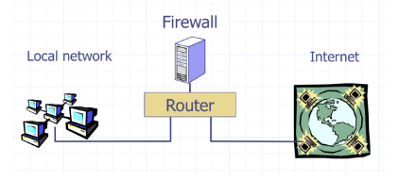
Network Security: defenses
Firewalls: Protecting or isolating one part of the network from other part
  Personal
  Network
  Filter-based
  Proxy-based
Access control policies
  firewall enforces an access control policy
  Distinguish between inbound and outbound connection
Network Address Translation (NAT)
  map between two different address spaces

Slide 21
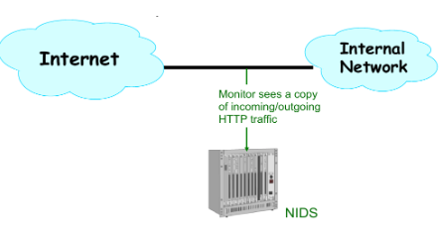
Network Security: defenses
Application proxies
  Control apps by requiring them to pass through proxy
  Is an application-level man-in-the-middle
Network Intrusion Detection Systems (NIDS)
  Passively monitor network traffic for signs of attack
Vulnerability self-scanning
  Probe internal systems with a range of attack
  Fix the attacks that succeed
Honeypots
  sacrificial systems that is designed to lure attackers
  Study attackers and divert them

Slide 22
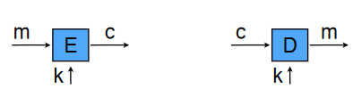
Symmetric-key Cryptography: Encryption
Encryption: (key, plaintext) → ciphertext
  Ek(m) = c
Decryption: (key, ciphertext) → plaintext
  D k(c) = m
Functional property: Where Dk(Ek (m)) = m
One time pad
  c = m ⨁ k
Stream ciphers
  Pseudo random generator
Block ciphers
  Different modes (ECB, CBC)

Slide 23
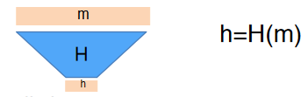
Symmetric-key Cryptography: Hash functions
Hash function maps arbitrary length input into a fixed-size string
Properties
  Hard to find preimage and collision
Examples of hash functions
  MD5
  SHA1,2,3

Slide 24
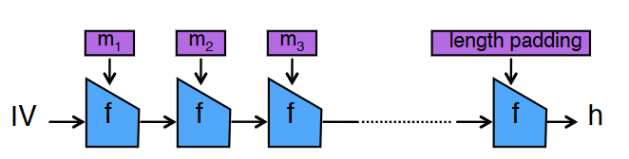
Symmetric-key Cryptography: MAC
We also need integrity
Validate message integrity based on shared secret
a = MACk(m)
MAC constructions
  Is MACk(m) = H(k || m) secure?
    Length extension attack
  HMAC
Combining MAC with encryption
  MAC then Encrypt
  Encrypt and MAC
  Encrypt then MAC
    best

Slide 25
Public-Key Cryptography: key exchange and encryption
Public key: used to encrypt or verify signatures
Private key: used to decrypt and sign
  Enc_pk (m) = c
  Dec_sk (c) = m
Solves key distribution problem
Diffie-Hellman Key Exchange
  Discrete log is not efficient to compute
  Why insecure against man-in-the-mid
RSA Encryption
  Factoring is not efficient to compute
  Textbook RSA is insecure

Slide 26
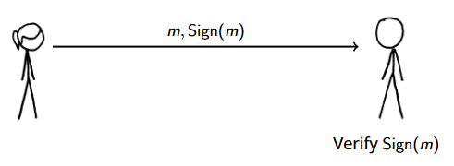
Public-Key Cryptography: Digital Signatures
Signing: (secret key, message) → signature
  Sign_sk (m) = s
Verification: (public key, message, signature) → bool
  Verify_pk (m, s) = true | false
Properties
  Verify_pk (m, Signsk (m)) = true
  Unforgeability
Textbook RSA signatures
  Forgery attack
Using RSA signature with paddings
  Bleichenbacher low exponent signature forgery attack.

Slide 27
TLS and secure channels
Constructing a secure encrypted channel
  Encrypt and MAC data: confidentiality
  Diffie-Hellman key exchange: negotiate shared secret
  Digital Signatures: authenticity
  Random nonces to ensure adversary can’t reuse signature
Public Key Infrastructures
  Ensuring trust in keys
  Certificate Authorities
    Commercial, sign and verify pub key for money
  PGP web of trust
TLS: Transport Layer Security
  encrypted channel for application data
  Used in HTTPS
  Why does TLS achieve its goals?

Slide 28
Other topics
Authentication and passwords
  Techniques for authenticating users
    Something You Know: Passwords
    Something You Have: cards, 2FA, tokens
    Something You Are: biometrics
  Security challenges
    Phishing
    Attacking Passwords
    Biometrics Spoofing
  Mitigations against the challenges
    Protecting Password
      Hashing
      Salting
      Slow hash functions: PBKDF2, bcrypt, scrypt
    Mitigations against biometrics spoofing

Slide 29
Other topics
Privacy and Anonymity
  Definitions of privacy
  Encrypted messaging: PGP
  Anonymous communication: Tor
  Privacy-respecting browsers
Ethics, law, and policy
  Ethical principles
  Laws
    CFAA: Computer Fraud and Abuse Act
    DMCA: Digital Millennium Copyright Act

Slide 30
Good luck on your finals!

