Slide 1
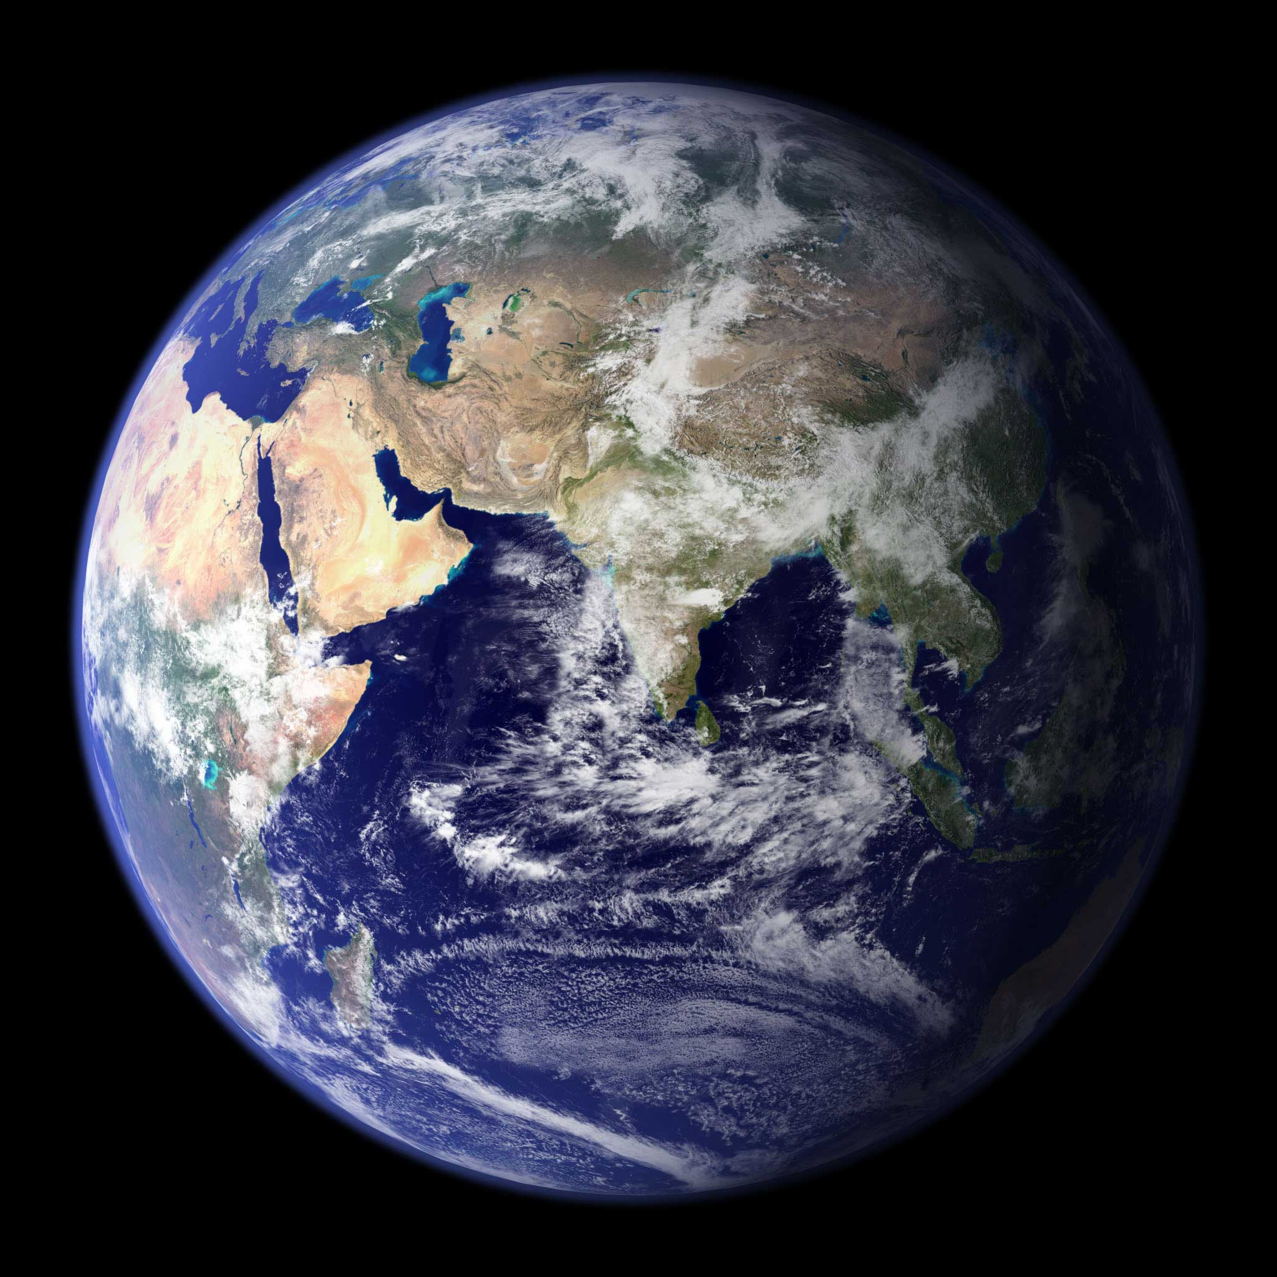


Saving the World through
Ubiquitous Computing
William G. Griswold
Computer Science & Engineering
UC San Diego
Supported by

Slide 2
CSE 91 Goals for Today
Essence: To convince you that Computer Science is not just programming but creatively solving the world’s problems using computers
Careers: To show there are exciting career options that can change the world
UCSD CSE: To show you that UCSD CSE has a number of cool professors doing cool work
Startups: To give you a glimpse of how CSE ideas can convert to business opportunities
Students: To showcase students like you doing this

Slide 3
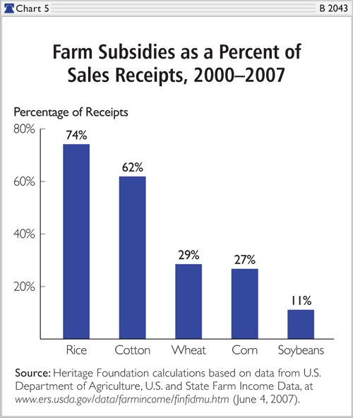
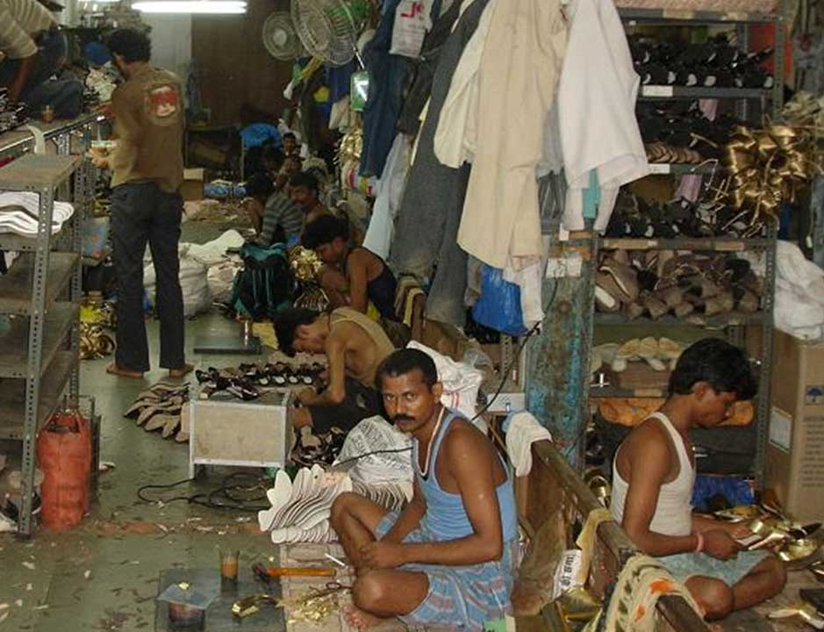
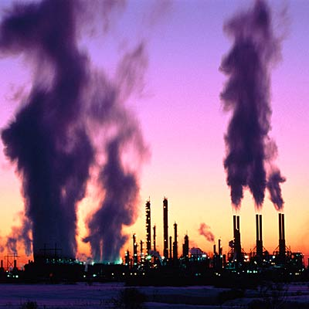
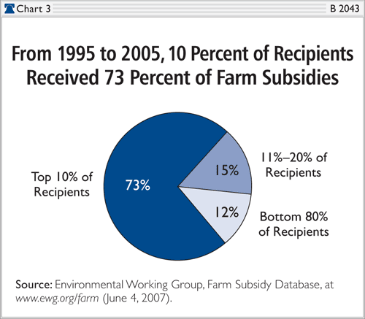
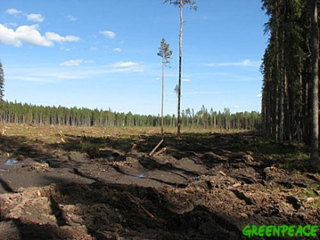
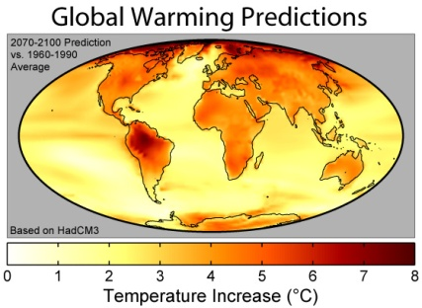
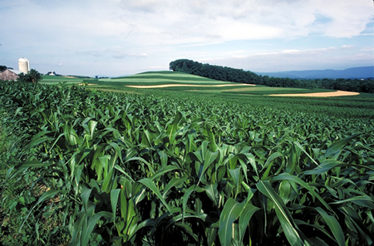
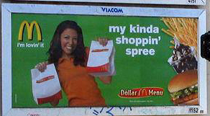
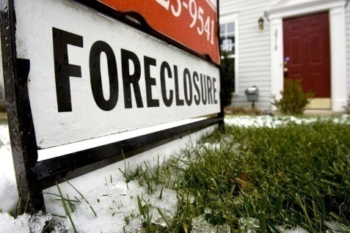
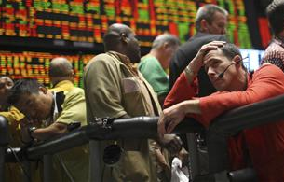
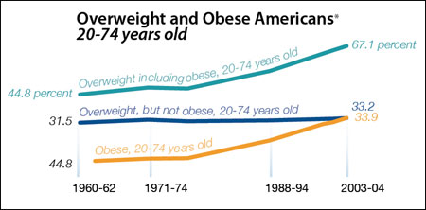
“The Future Doesn’t Need Us”
– Bill Joy (founder of Sun)
Notes:
Draw data from CitiSense?

Slide 4
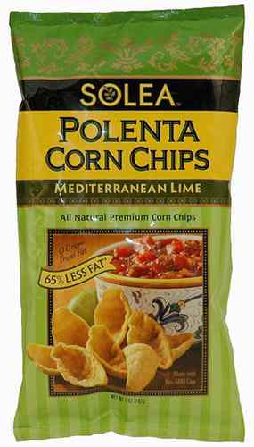
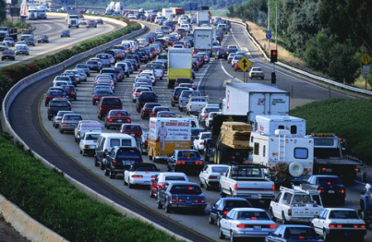
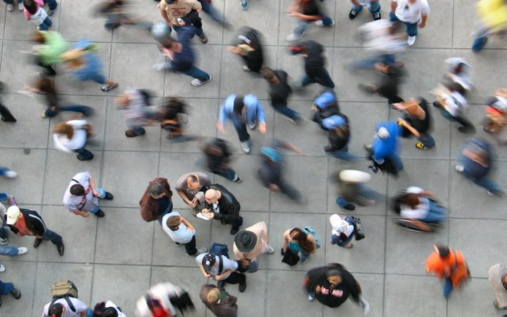
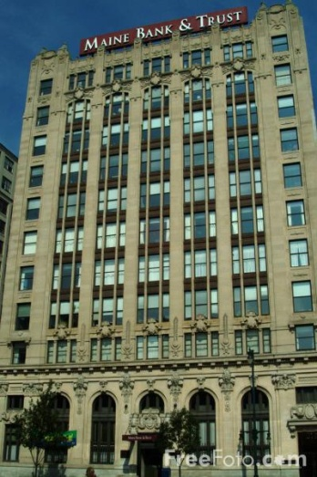
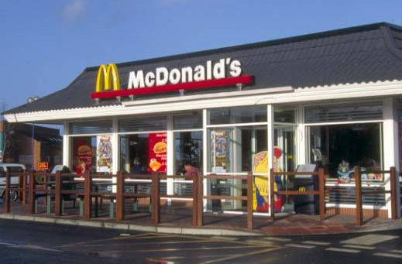
Invisible, Virtual, …Unnoticed
FreeFoto.com
4

Slide 5
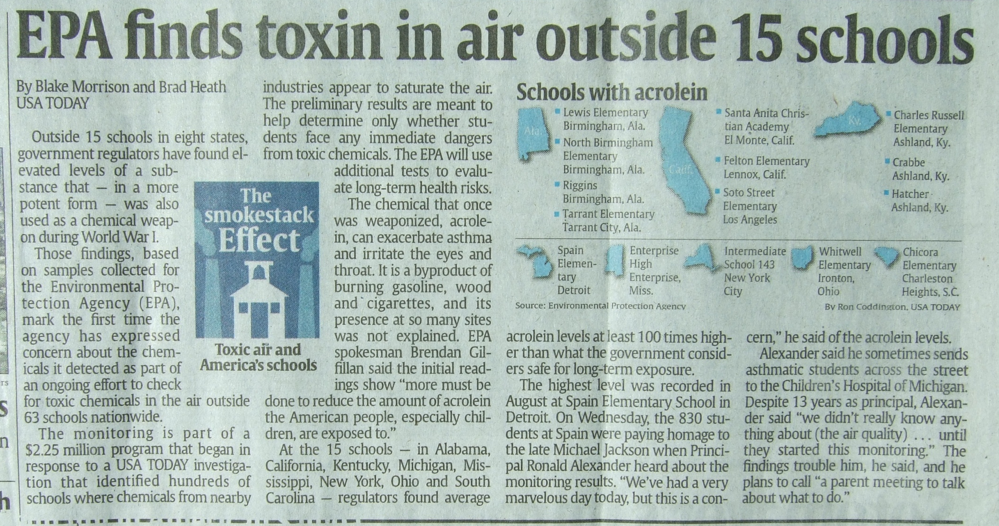
USA Today, 10/1/2009

Slide 6
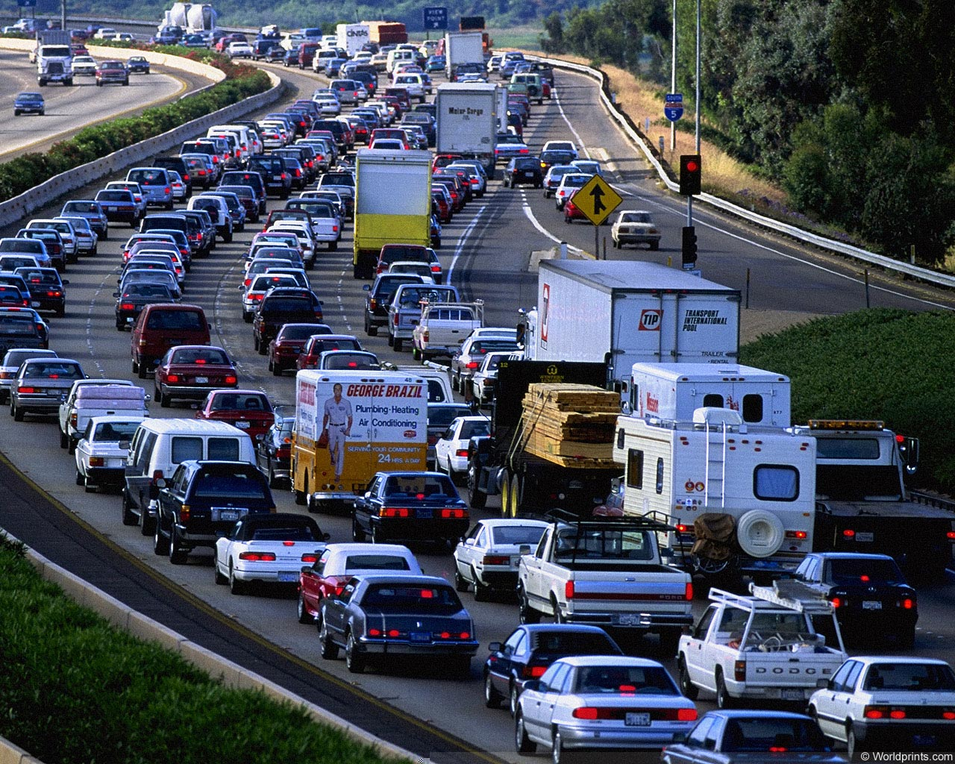
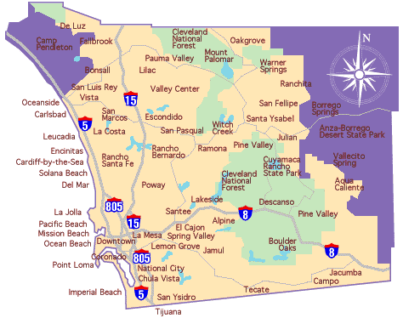
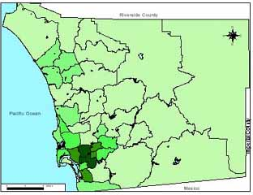
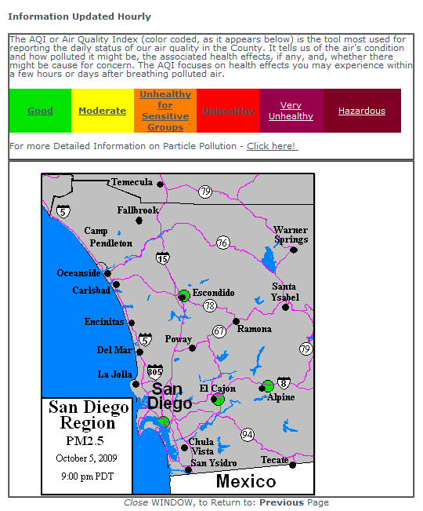
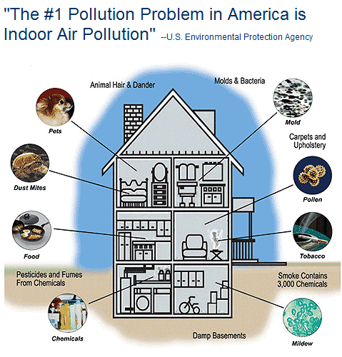
Fact Sheet: Air Pollution
158 million live in counties violating air standards
  cancer in Chula Vista, CA increased 140/million residents
  Primarily diesel trucks & autos
    particulates, benzene, sulfur dioxide, formaldehyde, etc.
30% of schools near highways
  asthma rates 50% higher there
  350,000 – 1,300,000 respiratory events in children annually
Ideas?
4000 sq. mi.
3.1M residents
5 EPA Sensors

Slide 7
Ubiquitous Computing?
[Pervasive Computing
Augmented Reality
Cyber-Physical Systems]
Sensors, networks, and (mobile) computers
linking the physical and virtual worlds,
everywhere, all the time, for everyone

Slide 8
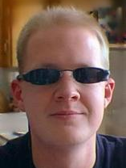
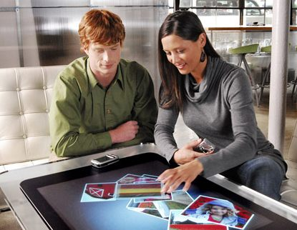
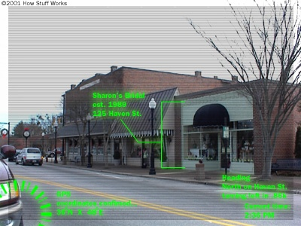
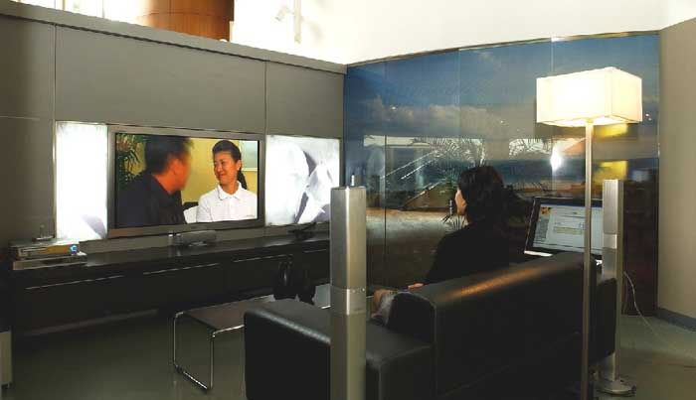
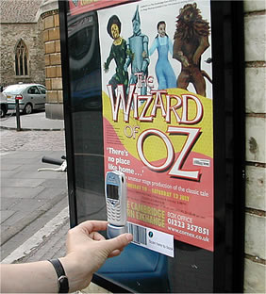
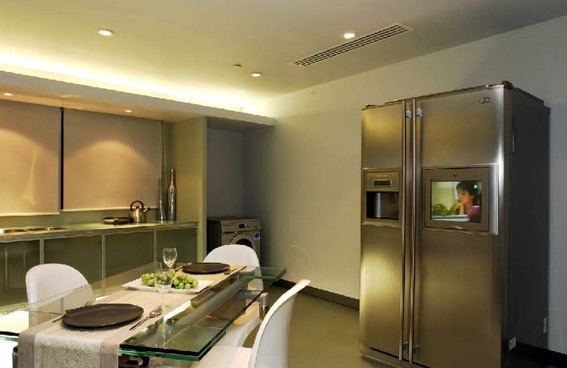

AE Innovations
http://www.hdb.gov.sg/
Bango
Notes:
The alternative vision that I want to advocate today is what is called “ubiquitous computing” – or “embodied virtuality”– linking related parts of the physical and virtual worlds to make the physical world richer and more accessible, rather than abandoning it. Just as reproducing the physical world is hard, so is linking the virtual world to the physical world. But I’d argue that it’s the better thing to do. As humans, we are designed to live and thrive in the physical world, and with ubiquitous computing we don’t have to give any of that up to enjoy the benefits of the virtual world.
The virtual world can be brought into the physical world in many ways:
Among the more fantastic of these visions is “augmented reality”, as suggested by this picture here, supported by heads-up displays and miniature cameras supporting a back-end computer vision system.
This shot here is a demonstration of Microsoft’s new “tabletop computer”, which recognizes devices on the top, as well as sensing the presence of hands and understanding their gestures.
A bit closer to home – literally – is the smart home that I’m sure you’ve all heard about, including fridges, televisions, and lighting systems that seemingly know your every move through activity analysis, say with RFIDs or computer vision technologies.
Most prosaically, today’s mobile phone cameras can resolve a bar code, allowing one to explicitly connect physical objects (like this poster for a musical production) with online services like a booking agency. There are now systems like FotoNave that can achieve the same linkage with a photograph of a known landmark.
As we see with virtual reality and Second Life, a small step in the direction of a far off vision can have profound effects.

Slide 9
(Now, back to saving the world)

Slide 10
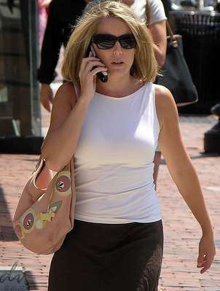
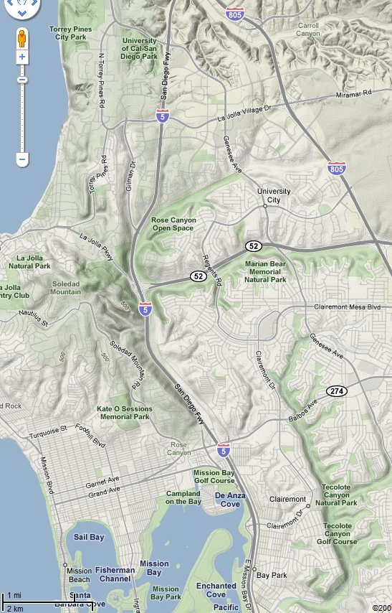
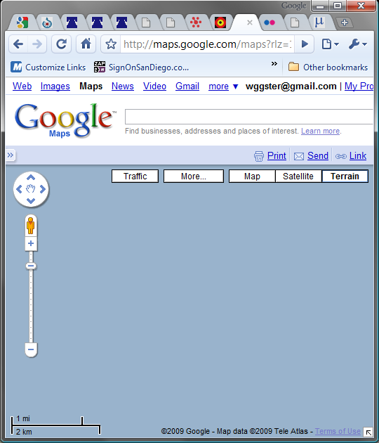
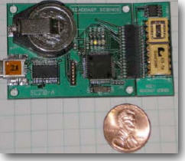

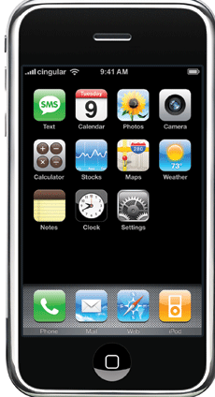
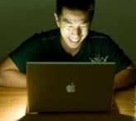

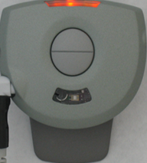
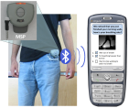
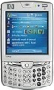




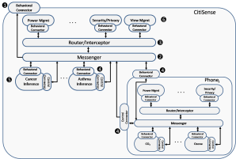


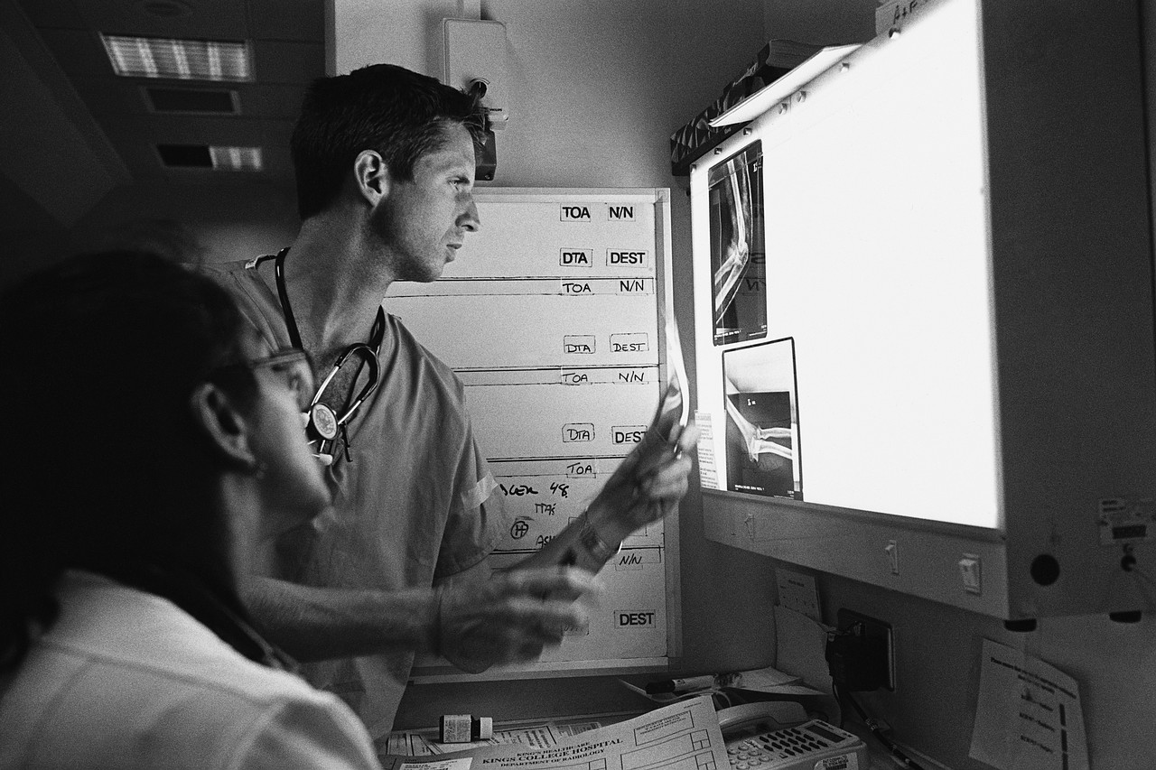
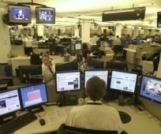

CitiSense – Participatory Sensing
4oz
30 compounds
Seacoast Sci.
Intel MSP
CitiSense
contribute
sense
W
retrieve
L
C/A
S
EPA
discover
“display”
F
distribute
CitiSense Team
Ingolf Krueger
Tajana Simunic Rosing
Sanjoy Dasgupta
Hovav Shacham
Kevin Patrick (Prev. Medicine)

Slide 11
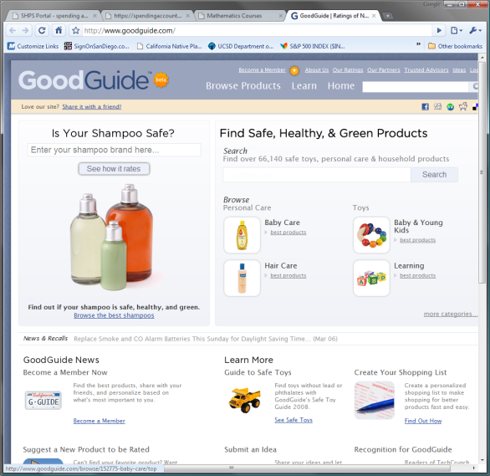

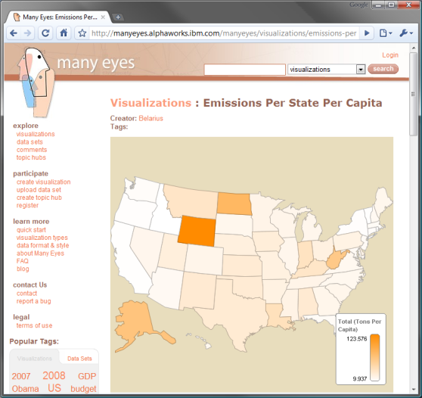
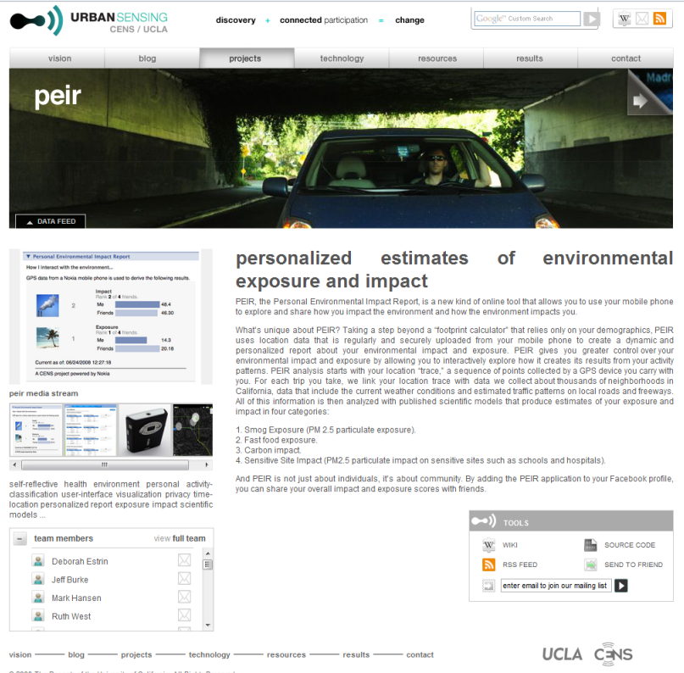
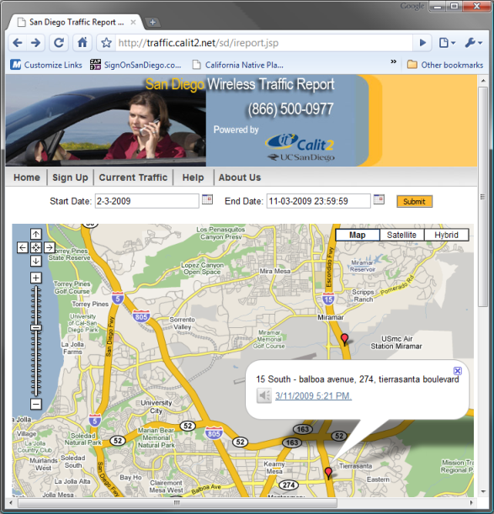
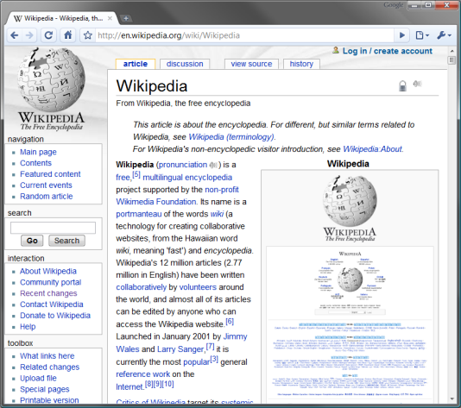
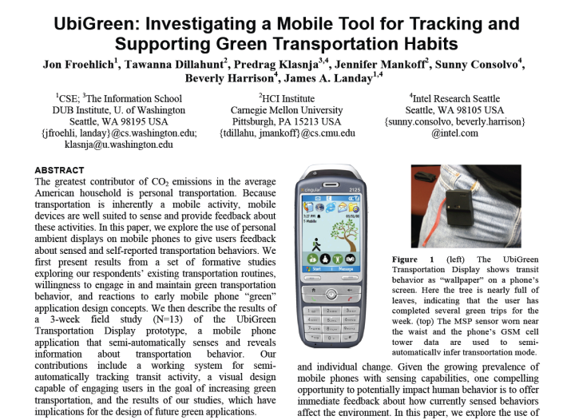
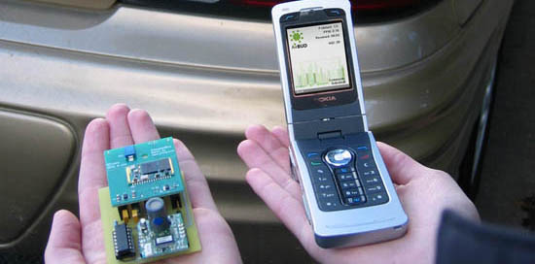

An idea long in coming…
2008
1998
Wattenberg, et al. (IBM) 2007
Estrin et al., 2009
Chockalingam et al., 2007
2001
2009
Spanhake et al., 2007

Slide 12
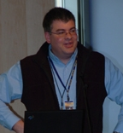

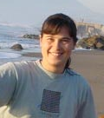


… and a long way to go
Extensible software architecture
  Citizens, policy makers, & researchers should be able to easily add sensors, displays, & apps
Inference with noisy commodity sensors
  Low cost for ubiquity, heterogeneous due to innovation
Mobile power
  Resources will be scarce at the fringes
Security and privacy
  Under multiple authorities, sensors not securable
Use and efficacy
  How will people use, and
  how to design for it?
Ingolf Krueger
Sanjoy Dasgupta
Tajana Rosing
Hovav Shacham
Kevin Patrick
(Preventive Medicine)
Notes:
Need to make earlier point that we’re not used to building systems like this
We’ll need new ways of building systems

Slide 13
Extensible Architecture
Publish-Subscribe, with a Twist
Architecture Inference Power Semantic Web Security & Privacy Attention

Slide 14


Content-Based Publish-Subscribe (CBPS)
Carzaniga, et al.
Advertisements about… Subscriptions for… Publications of… Events
Publishers
Advertise:
Name=“Bob”
& X = ANY
& Y = ANY
Subscribers
Event Brokers
(Content-based routers)
Publish:
Name=“Bob”
& X = -133
& Y = 28
Subscribe:
Name=“Bob”
Asthma/
Cancer
Separation of concerns
Flexibility
Scalability
Subscribe:
Name=“Bob”
& X > -150
& X <= -100
& Y < 45
& Y > 25
Notes:
Quick review of CBPS – see Antonio Carzaniga for details

Slide 15

Publish/Subscribe in CitiSense
Exhaust
Sensor
pub: asthma hazard! (bill)
sub: asthma hazard (bill)
Notifier
(actuator)
sub: exhaust (bill)
pub: {toluene, 84, x, y}
. . .
sub: asthma hazard (bill)
Asthma/
Cancer
pub: asthma hazard! (bill)
PM 2.5, Ozone
Notifier
(actuator)

Slide 16
Semantic Web
Today’s information sources are a largely unstructured collection of HTML web pages and PDF documents
Architecture Inference Power Semantic Web Security & Privacy Attention

Slide 17




Challenge of discovery, sharing
200GB of SEC filings today (15M pages)
SEC reviewed just 16% in 2002
35GB of SEC filings in late 90’s

Slide 18
XBRL Example (Simplified)
<ifrs-gp:OtherOperatingIncomeTotalFinancialInstitutions
decimals="0" unitRef="EUR">
38679000000
</ifrs-gp:OtherOperatingIncomeTotalFinancialInstitutions>
<ifrs-gp:OtherAdministrativeExpenses
decimals="0" unitRef="EUR">
35996000000
</ifrs-gp:OtherAdministrativeExpenses>
<ifrs-gp:OtherOperatingExpenses
decimals="0" unitRef="EUR">
870000000
</ifrs-gp:OtherOperatingExpenses>
...

Slide 19
Security and Privacy
With guidance from
Hovav Shacham
CSE, UC San Diego
Architecture Inference Power Semantic Web Security & Privacy Attention

Slide 20
Very Hard Problems
Cannot secure or tamper-proof sensors
  expensive to “harden”, still must be exposed world
  can attempt to detect suspect data (unusual patterns)
Hard to achieve privacy through anonymization
  k-anonymity asserts that k pieces of personal data needed to uncover identity [Sweeney, 2002]
  k is often lower than calculated due to structure of data sources [Narayanan & Shmatikov, 2008]
How about we encrypt all sensor data?
  problems: selective access, multiple privacy domains, performance

Slide 21
Sketch of Privacy Scheme
  Privatize your data
  S₁ = {bill, CSE 3118, 12:18:20, CO₂ = 27}
  S₂ = {bill, CSE 3118, 12:18:25, CO₂ = 19}
  …
  S₁ = {?, CSE 3118, 12:18:20, CO₂ = 27}
  S₂ = {?, CSE 3118, 12:18:25, CO₂ = 19}
  …
  e(S₁) = {?, 8113 ESC, 02:81:21, CO₂ = 72}
  e(S₂) = {?, 8113 ESC, 52:81:21, CO₂ = 91}
  ...
  Allow others to calculate over encrypted data
  e(S_{1,3}) + e(S_{2,3}) + … + e(S_{n,3}) /n = e(average(S_{i,3})) = 52
  d(52) = 25 (average CO₂ in CSE)
anonymize
encrypt
Release over network
Decrypter “d” does not work on individual data points!

Slide 22
Attention Technologies
Proactive, Rich, Non-disruptive
Architecture Inference Power Semantic Web Security & Privacy Attention

Slide 23
Design Requirements
Proactive – best to know when it’s most relevant (e.g., when you’re being exposed)
Peripheral – shouldn’t divert attention during “critical” tasks
Unobtrusive – shouldn’t cause social problems
  sound will be inappropriate in many cases
Rich – don’t have to get out phone to look at it
Adaptive – changes according to your task, etc.
Redundant – in case you’re busy, miss a notification, or don’t understand it

Slide 24









Multi-Scale Visual Displays
peripheral, persistent, redundant
UbiGreen
8MP CSE display ($15,000 + labor)
Chumby ($200)
2MP display ($4,000 + labor)
Many Eyes
Whereabouts Clock
Delta E-Paper

Slide 25


How about vibrations that feel like sound?
MobiSys’08, Kevin Li et al.
Low learning curve, eyes-free
Need vibrations of varying intensity
  but phone’s $0.50 vibrator only turns on and off
  at a single frequency and amplitude
Pulse-width modulation approach
  how light dimmers work
  for vibrotactile motors, decreases speed
    perceived as lower intensity
    can produce 10 intensities
    amounts to 50Hz dynamic range
  rather than use beat, convey energy in music
    Example: Beethoven’s 5th (requires imagination)
Notes:
50 cent device vibrator only turns on and off

Slide 26
Many challenges I didn’t touch on
Power conservation on mobile
Networking
Databases
“Cloud” computing
Social dynamics
Policy
…

Slide 27

Conclusion
We can no longer delegate our moral and health responsibilities to government agencies
And we no longer need to
  technology is here, and it’s affordable
Advocating an open framework for
participatory sensing, analysis, & presentation
Many exciting problems to solve
  applications
  basic computer science
  social and individual consequences

Slide 28

How does Google Flu Tracker work?
More ways to save the World using computers

Slide 29
Outline
1.0 Why its an important general problem
2.0 The first idea
3.0 Refining the Idea
4.0 Realization and results

Slide 30
Tracking Infectious Disease Early
Motivation: Early tracking → early response → lesser deaths (e.g., H1N1). 1918 pandemic
CDC slow: Center for Disease Control tracking based on doctor visits: 1 – 2 week lag
Question: With the advent of computers can we track flu (other diseases) faster
Prototype: Study flu tracking as a canonical example: flu has caused millions of fatalities

Slide 31
Google and Flu tracking?
Observation: How might you interact with Google if you have the flu?
Application: Could Google take advantage of this observation to track flu early?
  Could we also track by region?

Slide 32
You make the idea work
How to determine the right queries (e.g., “flu symptoms”)?
  Manual? Does not scale, not way search done
  Automated? But how
How to check whether Flu tracker is doing well?
  What is the metric for comparison?
  Can we use to solve “right queries” problem?
How to tell which region a query is coming from?

Slide 33
Queries most correlated to CDC Data
Influenza complication 18.15
Cold/flu remedy 5.05
General influenza symptoms 2.60
Term for influenza 3.74
Specific influenza symptom 2.54
Symptoms of an influenza complication 2.21
Antibiotic medication 6.23
General influenza remedies 0.10
Antiviral medication 0.39
False positive query: “High school basketball”. Why?
Correlation does not imply causality!
(x near y does not mean x causes y)

Slide 34
The details
Solve Problem 2 first using CDC’s Sentinel Provider Surveillance Network (www.cdc.gov/flu
Consider all common query terms and correlate against CDC data (automated). Take top 100 queries, remove false positives, tinker to find best combination (somewhat manual)
Why you need Computer Science
  Models from Computer Science, learning theory: fit model
  Logit (Physician Visit) = c * Logit (Query) + Error; Logit(p) = ln(p/(1-p))
  Need to program query processing using Google programming environment (Map-Reduce)
  Need to build a good user interface
Localize queries using IP geolocation
  Examples: Address from UCSD, address from san.rr.com

Slide 35

CDC (red) versus Google Flu (black)
Explore flu trends across the U.S.

Slide 36

The Race with CDC (red)

Slide 37
Critical thinking
Privacy? What’s the issue?
Bias: how is the data obtained?
Value: Its cool but how useful is it really?

Slide 38
Remember: Computers are good at
Boring work . . .
Large problems . . .
Problems humans cannot solve fast
  Google Flu tracker versus CDC
Transcending human limitations
Creatively solving the world’s problems using computers!

